Slide 1
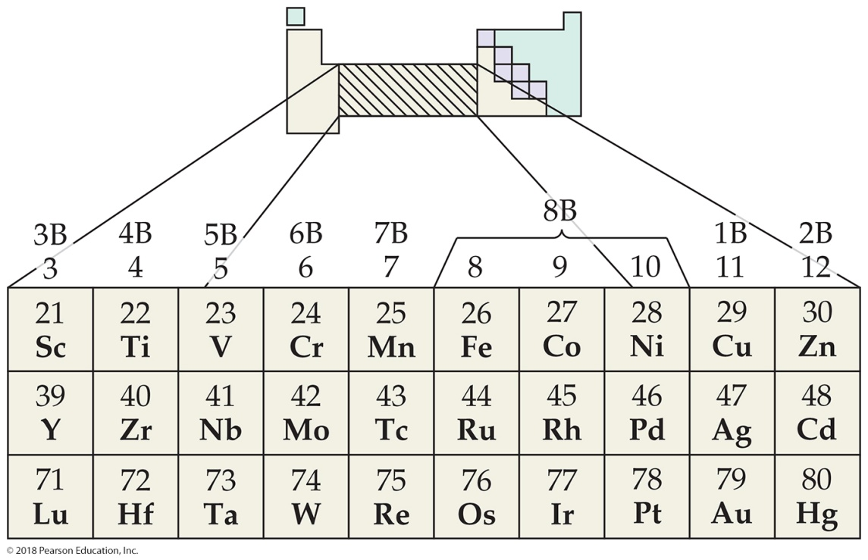
Why Are Transition Metals of Interest?
Color
Catalysts
Magnets
Biological roles
Coordination compounds (metals bonded to molecules and ions)

Slide 2
Transition Metals make Minerals and undergo Metallurgy
Metal | Mineral | Mineral Composition
Chromium | Chromite | F e C r 2 O 4
Cobalt | Cobaltite | C o Ay s S
Copper | Chalcocite | C u 2 S
Blank | Chalcopyrite | C u F e S 2
Blank | Malachite | C u 2 C o 3, O H, sub 2
Iron | Hematite | F e 2 O 3
Blank | Magnetite | F e 3 O 4
METALLURGY
The science and technology of extracting metals from their natural sources and preparing them for practical use
Steps often involved:
Mining
Concentrating the ore
Reducing the ore to free metal
Purifying the metal
Mixing it with other elements to modify its properties (making an alloy—a solid mixture)
Metal | Mineral | Mineral Composition
Manganese | Pyrolusite | MnO₂
Mercury | Cinnabar | HgS
Molybdenum | Molybdenite | MoS₂
Titanium | Rutile | TiO₂
Blank | Ilmenite | FeTiO₃
Zinc | Sphalerite | ZnS

Slide 3
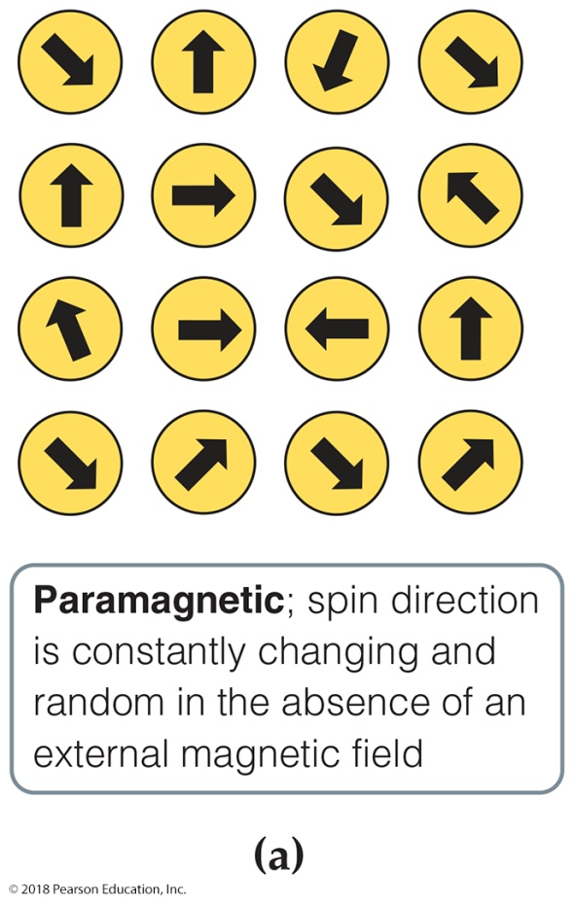
Magnetism
Electrons possess spin, causing a magnetic moment.
When all electrons are spin-paired, the moments cancel each other out: this is a diamagnetic solid.
With unpaired electron(s), the substance is called paramagnetic. In these substances, the adjacent atoms don’t affect each other.
In three other types of magnetism, the atoms affect each other: ferromagnetic, antiferromagnetic, and ferrimagnetic. (These become paramagnetic at higher temperatures.)

Slide 4
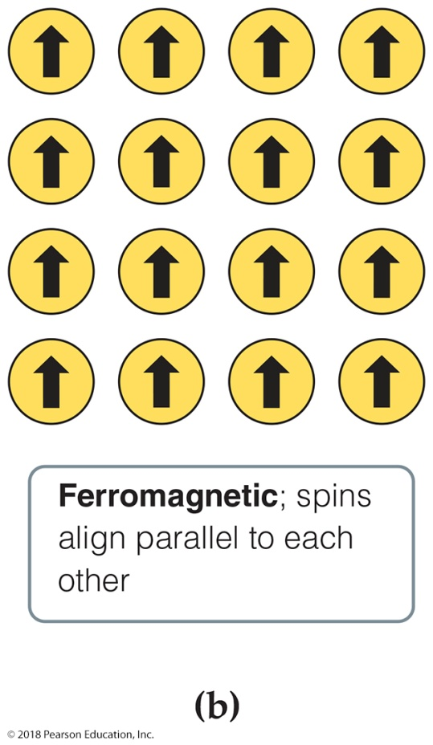
Ferromagnetism
In ferromagnetic substances, the unpaired spins influence each other to align in the same direction, thereby exhibiting strong attractions to an external magnetic field.
Such species are permanent magnets.
Elements: F e, C o, N i; also many
alloys
are most important).

Slide 5
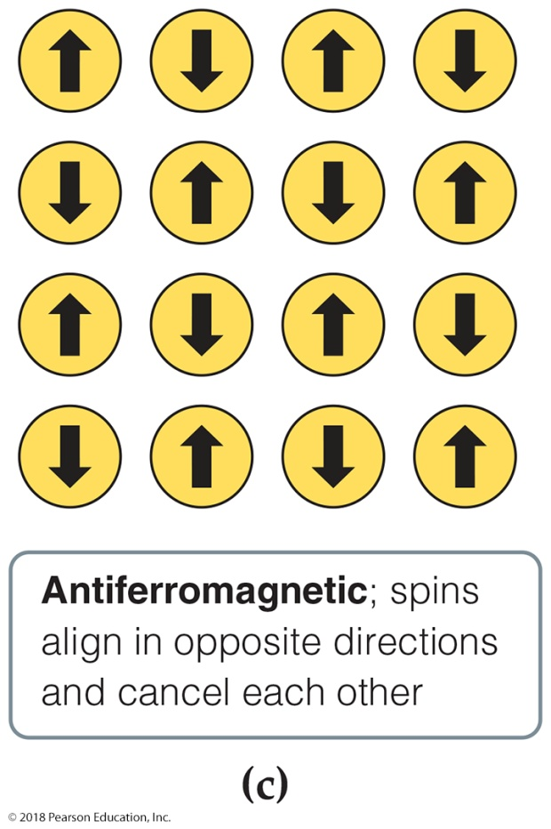
Antiferromagnetism
Antiferromagnetic substances have unpaired spins on adjacent atoms that align in opposing directions.
These magnetic fields tend to cancel each other.
Examples—element: C r; alloys: F e M n; transition metal oxides:

Slide 6
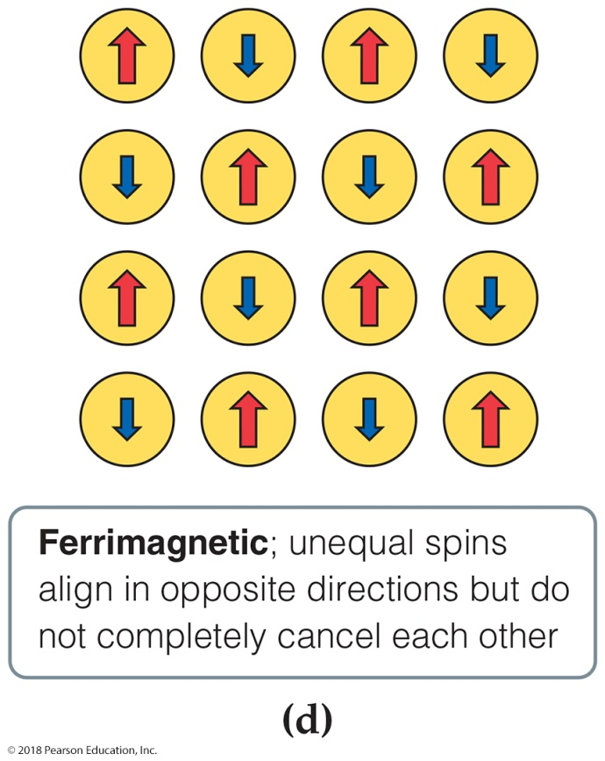
Ferrimagnetism
Ferrimagnetic substances have spins that align opposite each other, but the spins are not equal, so there is a net magnetic field.
This can occur because
magnetic centers have different
numbers of unpaired electrons;
more sites align in one direction than the other;
both of these conditions apply.
Examples are

Slide 7
Electron Configurations
of Transition Metal Atoms & Ions
PROBLEM:
Write condensed electron configurations for the following:
Zr; (b) V³⁺; (c) Mo³⁺.
(Assume that elements in higher periods behave like those in Period 4.)
PLAN:
The general configuration is [noble gas] ns²(n-1)d^{x}. Recall that in ions the ns electrons are lost first.
SOLUTION:
(a) Zr is the second element in the 4d series: [Kr]4d²5s².
(b) V is the third element in the 3d series: [Ar]4s²3d³. In forming V³⁺, three electrons are lost (two 4s and one 3d), so V³⁺ is a d² ion: [Ar]3d².
(c) Mo lies below Cr in Group 6B(6), so we expect the same except in configuration as for Cr. Thus, Mo is [Kr]4d⁵5s¹. In forming the ion, Mo loses the one 5s and two of the 4d electrons to become a 4d³ ion: [Kr]4d³.
1) Cr & Cr ion 2) Pt 3) Mo & Mo²⁺

Slide 8
Electron configuration: transition and inner-transition Elements.
In general we use the Aufbau (or building up) principle to determine electron configuration, but as with most chemistry, there are exceptions to the rule. Look to the right.
Unfortunately, the Aufbau rule cannot predict all electron configuration as it doesn't take into account electron-electron interactions and other quantum mechanical effects. In the end the Aufbau is only a rule of thumb. Electronic levels have to be found using quantum calculations taking into account electron-electron interactions (not to mention spin orbit coupling).
Chromium | [Ar] 3d⁵ 4s¹
Copper | [Ar] 3d¹⁰ 4s¹
Niobium | [Kr] 4d⁴ 5s¹
Molybdenum | [Kr] 4d⁵ 5s¹
Ruthenium | [Kr] 4d⁷ 5s¹
Rhodium | [Kr] 4d⁸ 5s¹
Palladium | [Kr] 4d¹⁰ 5s⁰
Silver | [Kr] 4d¹⁰ 5s¹
Lanthanum | [Xe] 5d¹ 6s²
Cerium | [Xe] 4f¹ 5d¹ 6s²
Gadolinium | [Xe] 4f⁷ 5d¹ 6s²
Platinum | [Xe] 4f¹⁴ 5d⁹ 6s¹
Gold | [Xe] 4f¹⁴ 5d¹⁰ 6s¹
Actinium | [Rn] 6d¹ 7s²
Thorium | [Rn] 6d² 7s²
Protactinium | [Rn] 5f² 6d¹ 7s²
Uranium | [Rn] 5f³ 6d¹ 7s²
Neptunium | [Rn] 5f⁴ 6d¹ 7s²
Curium | [Rn] 5f⁷ 6d¹ 7s²

Slide 9

WORKSHOP TR#1
Transition Metals & Electron Configuration
Write the electron configuration for the following transition metals/ions:
A. Cu
    B. Pt
    C. Tc⁺⁴
    D. Ir⁺
    E. Ru⁺⁴
    F. Ag⁺¹
G. Co⁺³

Slide 10
  Transition Metal Chemistry
One striking characteristic of the representative elements was that their chemistry changes markedly across a given period as the number of valence electrons changes. The chemical similarities occur mainly within the vertical groups. In contrast, the transition metals show great similarities within a given period as well as within a given vertical group. Why?

Slide 11
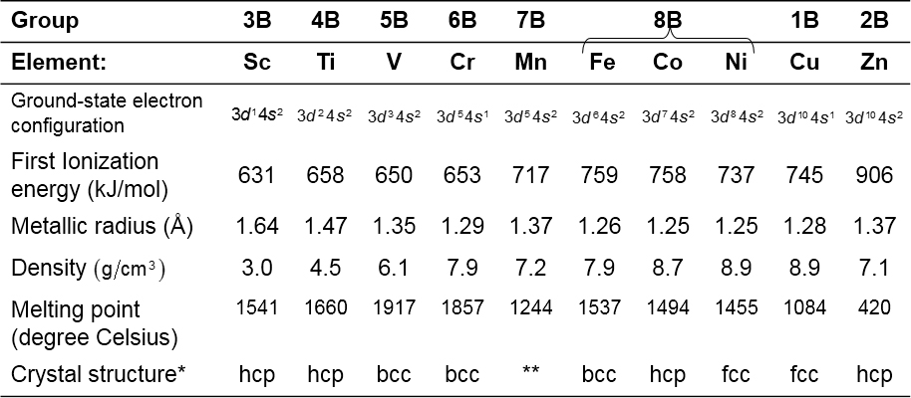
Properties of the First Row Transition Metals
Table: Properties of the Period 4 Transition Metals
*Abbreviations for crystal structures are hcp = hexagonal close packed, fee = face-centered cubic, bcc = body-centered cubic.
**Manganese has a more complex crystal structure.

Slide 12
  Transistion Metals Chemistry & Electron Configuration
This difference occurs because the last electrons added to the transition metal elements are inner electrons: d electrons for the d-block transition metals and f electrons for the lanthanides and actinides. These inner d and f electrons cannot participate in bonding as readily as the valence s and p electrons. Thus, the chemistry of transition elements is not as greatly affected by the gradual change in the number of electrons as is the chemistry of the representative elements. Also note that the transition metals do not extend all the way across the d-block because the Group 12 elements (zinc, cadmium, and mercury) are not normally considered to be transition elements. Because their d-orbitals are full, the Group 12 elements have properties that are more like those of main-group metals than transition metals.

Slide 13
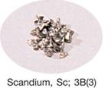
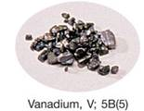
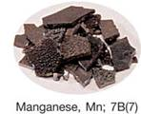
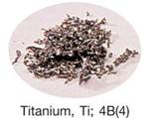
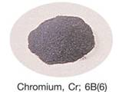
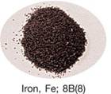
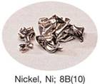
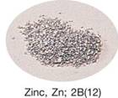
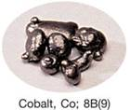
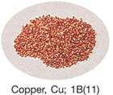
The Period 4 transition metals.

Slide 14
Transition Metal Chemistry
So what characteristics can we expect with transition elements?
(1) Variable oxidation states except for the first & last column. The central group having the most variety.
(2) All the d-block elements are metals. Most of these “d-metals” are good electrical conductors, malleable, ductile, and lustrous. Generally, their melting and boiling points are higher than those of the main-group elements. They are “hard” metals except for Zn.
(3) The low oxidation state ions are generally good reducing agents (they undergo oxidation) and all 3d elements reduce H⁺ except Cu. Recall the activity series.
M → M^{n+} + ne⁻

Slide 15
Transition Metal Chemistry
(4) The atomic radii of the second row of d-metals are typically greater than those in the first row. The atomic radii in the third series (Period 6), however, are about the same as those in the second row and smaller than expected. This effect is due to the lanthanide contraction, which is the decrease in radius along the first row of the f-block. This decrease is due to the increasing nuclear charge along the period coupled with the poor shielding ability of the f-electrons. When the d-block resumes (at lutetium), the atomic radius has fallen from 224 pm for barium to 172 pm for lutetium.
3d < 4d ≈ 5d

Slide 16
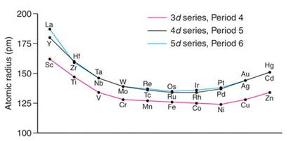
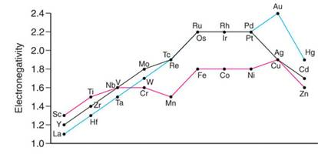
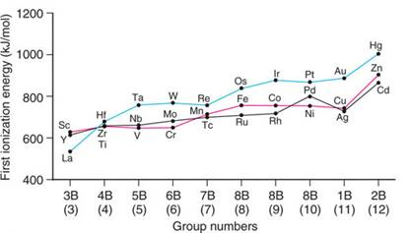
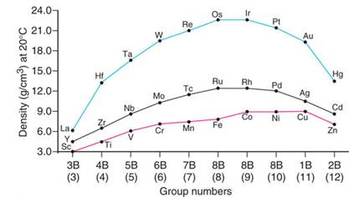
Vertical trends in key properties within the transition elements.

Slide 17
Transition Metal Chemistry
(5) Periodicity
The atomic radius decreases across a period reaching a constant size due to shielding by the other electrons.
Electronegativity generally increases across a period slightly.
Ionization energy gradually increases across a period.
Atomic size and oxidation state has a major effect on the nature of bonding. Ionic bonding is more prevalent for lower oxidation state ions and covalent bonding is preferred for the higher states.

Slide 18
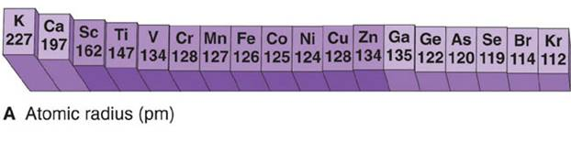
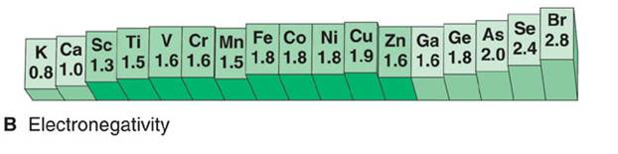
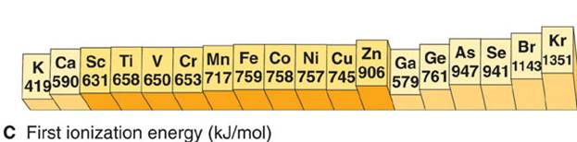
Horizontal trends in key atomic properties of the
Period 4 elements.

Slide 19
General Properties of Transition Metal Ions
Sc – scandium: rare on earth, found in electronic devices Sc³⁺
Ti – titanium: 0.6% by mass on earth, low density, high strength, TiO₂ is an opaque material used as a pigment, Ti(H₂O)₆³⁺ is a purple solution.
V – vanadium: 0.025 by mass, used in alloys & as a catalyst V₂O₅
VO₂⁺ (+5) yellow VO²⁺ (+4) blue V³⁺ (+3) blue-green V²⁺ (+2) violet
Cr – chromium: hard, brittle, lustrous, forms an invisible oxide coating, many colored compounds, most common oxid states +2, +3, & +6
Cr²⁺ - chromous: bright blue, powerful reducing agent
Cr³⁺ - Cr₂O₃ – dark green solid that dissolves in water → Cr(H₂O)₆+²
Cr⁶⁺ - chromic: oxidizing agent, CrO₄²⁻ & Cr₂O₇²⁻
Mn – manganese: 0.1% by mass, used to produce hard steel, Mn(H₂O)₆²⁺ is light pink, and MnO₄⁻ is deep purple (a strong oxidizing agent).
Fe – iron: 4.7% by mass, white lusterous, fairly soft, and highly reactive. Fe(H₂O)₆³⁺ is a yellow solution that is quite acidic.

Slide 20
General Properties of Transition Metal Ions
Co – cobalt: relatively rare, hard, bluish-white metal used to make alloys. Co(H₂O)₆²⁺ is rose colored.
Ni – nickel: abundant, silver-white metal with high electrical & thermal conductivity. It is resistant to corrosion and is used for plating other metals.
Ni(H₂O)₆²⁺ is green colored
Cu – copper: found free in nature, (only Au & Ag), has a stable 0 oxid state. Produces alloys:
brass=Cu, Zn, Sn, Pb, Mn;
bronze=Cu, Sn Zn Pb P;
sterling silver= Ag Cu;
18 carat gold=Au Ag Cu
Cu(H₂O)₆²⁺ is blue; Cu(H₂O)₆⁺ is green
Zn – zinc: colorless solutions, white lustrous, active metal, main ore is sphalerite (ZnFe)S, reducing agent, tarnishes rapidly, 90% is used to galvanize steel, Zn²⁺

Slide 21
Transition Metal Chemistry (in depth)
In forming ionic compounds with nonmetals, the transition metals exhibit several typical characteristics:
    1. Various oxidation states can be found depending on the placement of the transition metals. Elements at the ends of each row occur in only one oxidation state other than zero (exception: mercury). Most other elements have at least two oxidation states other than zero, and elements closer to the center of each row have the widest range of oxidation states. Furthermore, elements in the second and third rows are most likely to reach higher oxidation states than those in the first row.

Slide 22
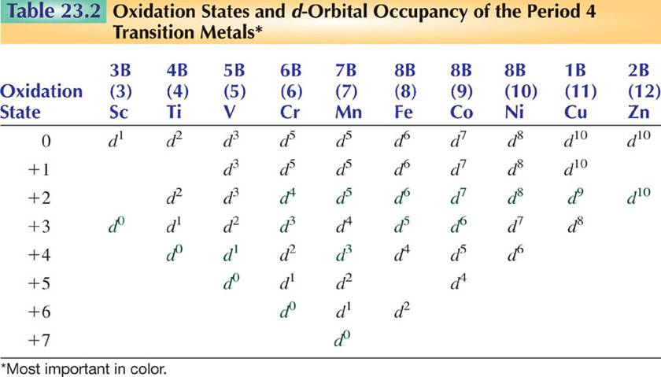


Slide 23
    Transition Metal Chemistry (in depth)
    2. An element with a high oxidation is likely to be a good oxidizing agent. Compounds that contain the transition metal element in a low oxidation state are often good reducing agents.
    3. Cations are often complex ions, species in which the transition metal ion is surrounded by a certain number of ligands (molecules or ions that behave as Lewis bases). These complexes have three major components: a central metal atom, ligands, and counter ions.
    Identify each component in the following complexes:
    K₄[Fe(CN)₆] [Co(NH₃)₆]Br₃
    We will study these in more detail later.

Slide 24
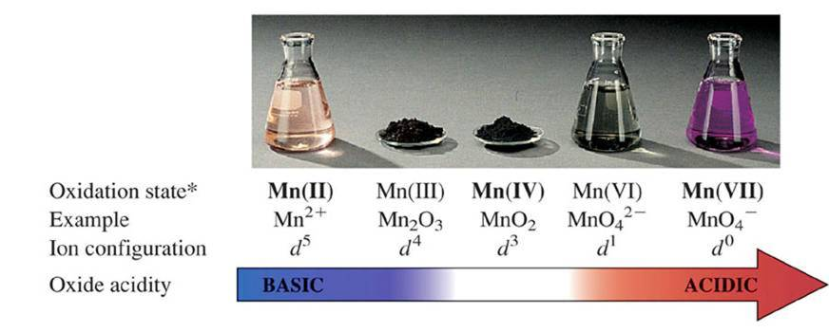
Some Oxidation States of Manganese
Orbital Occupancy
*Most common states in bold face.

Slide 25
4. Most transition metal compounds are colored, because the typical transition metal ion in a complex can absorb visible light of specific wavelengths due to an unpaired d-orbital electron or electrons (exceptions: MnO₄⁻ is purple and CrO₄⁻² is yellow). Complementary colors appear in the color wheel shown below:
We can see from the color wheel that, if for instance, a substance looks blue (as does copper(II) sulfate solution), then it is absorbing orange light (580 to 620 nm). Transitions between d-orbitals or between the ligands and the metal atom in complexes give rise to color.
Moreover, transition metal compounds that do NOT exhibit color either have an empty d-orbital (Sc³⁺ or Ti⁴⁺) or a filled one (Zn²⁺).

Slide 26
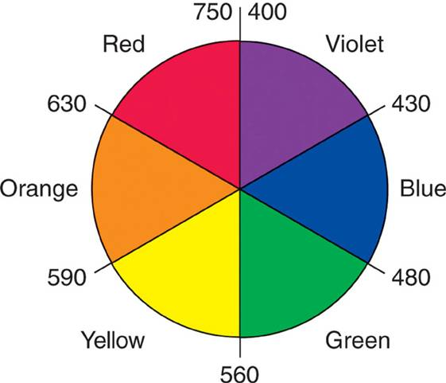
An artist’s wheel.

Slide 27
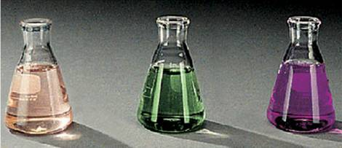
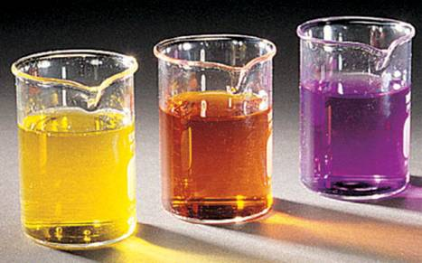
Aqueous oxoanions of transition elements.
One of the most characteristic chemical properties of these elements is the occurrence of multiple oxidation states.
Mn(II)
Mn(VI)
Mn(VII)
Mn(VII)
Cr(VI)
V(V)

Slide 28
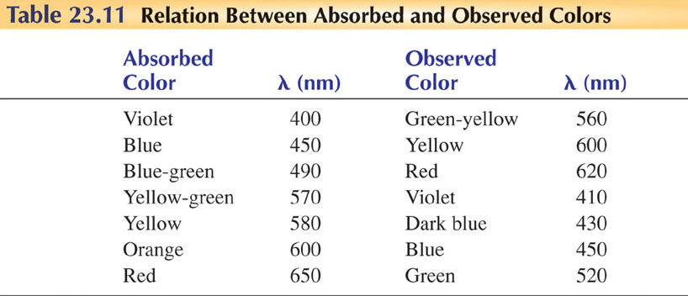

Slide 29
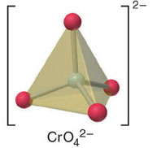
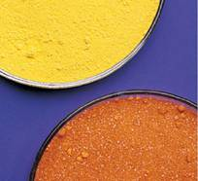
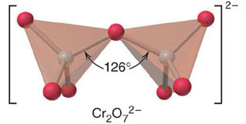
The bright colors of chromium (VI) compounds.

Slide 30
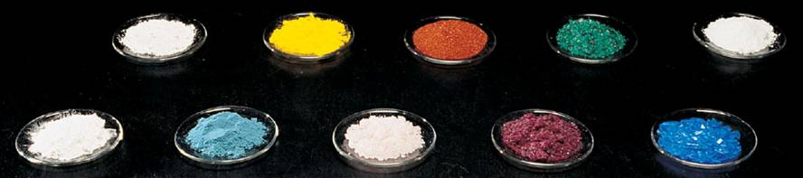
Colors of representative compounds of the Period 4 transition metals.
sodium chromate
nickel(II) nitrate hexahydrate
potassium ferricyanide
zinc sulfate heptahydrate
titanium oxide
scandium oxide
manganese(II) chloride tetrahydrate
copper(II) sulfate pentahydrate
vanadyl sulfate dihydrate
cobalt(II) chloride hexahydrate

Slide 31
  Metal Complexes and Coordination Compounds
Species such as [Co(NH₃)₅Cl]⁺² that are assemblies of a central metal ion bonded to a group of surrounding molecules or ions are called metal complexes or merely complexes. If the complex carries a net charge, it is generally called a complex ion. Compounds that contain complexes are known as coordination compounds.
The molecules or ions that surround the metal ion in a complex are known as ligands. Ligands coordinate (or bond) to a metal atom or ion to form a coordinate covalent bond. Notice that this bond is different than an ordinary covalent bond (where electrons are shared between two joining species). In the coordinate covalent bond, both electrons used to generate the bond are property of the ligand and NOT the metal! A saturated complex fullfills the 18 e- rule.

Slide 32
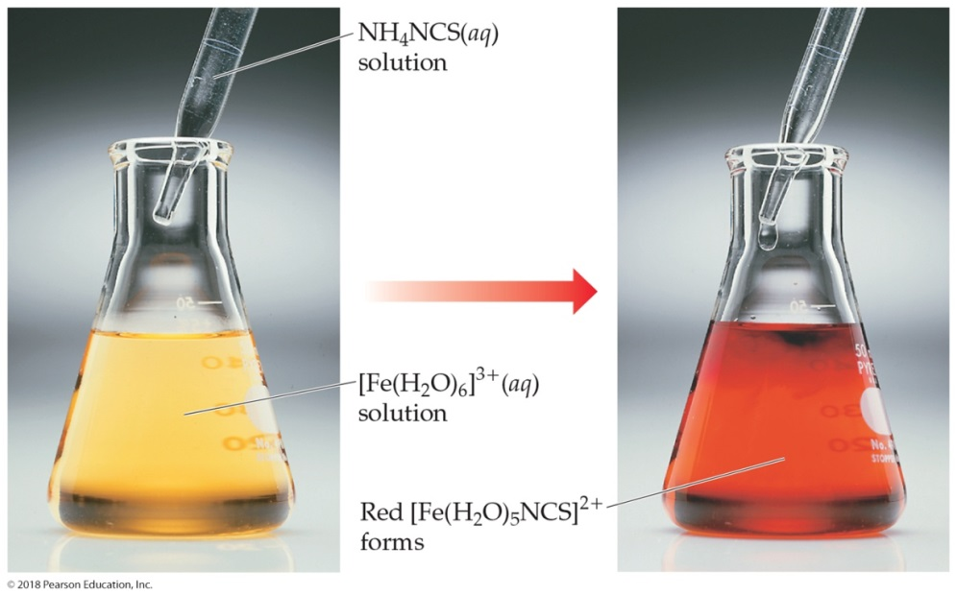
The Metal–Ligand Bond
The reaction between a metal and a ligand is a reaction between a Lewis acid (the metal) and a Lewis base (the ligand).
The new complex has distinct physical and chemical properties (e.g., color, reduction potential).

Slide 33
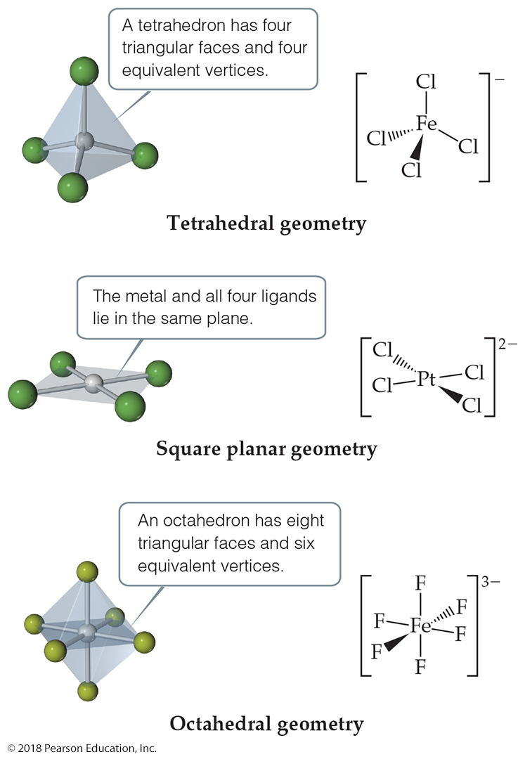
Coordination Numbers
The coordination number of a metal depends upon the size of the metal and the size of the ligands.
Iron(3) can bind to 6 fluorides but only 4 chlorides (larger).
The most common coordination numbers are 4 and 6. They correspond to common geometries: tetrahedral or square planar; octahedral.

Slide 34
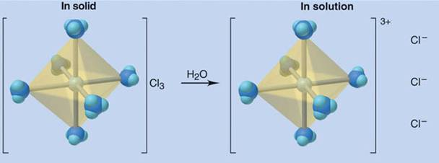
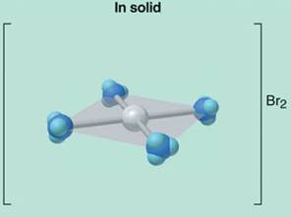
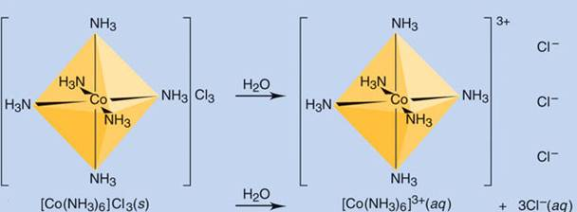
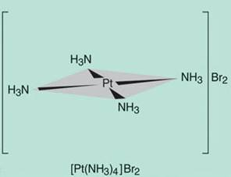
Components of a coordination compound.
models
wedge diagrams
chemical formulas

Slide 35
Ligands are normally either anions or neutral polar molecules. Every ligand has at least one unshared pair of valence electrons to donate. Furthermore, they can broken down into the following categories:
Monodentate ligand examples:
Bidentate ligand examples:

Slide 36
Polydentate ligand examples:
When these ligands are bonded (chelated) to a particular metal, we can define the coordination number as the number of donor atoms to which the metal is bonded.

Slide 37
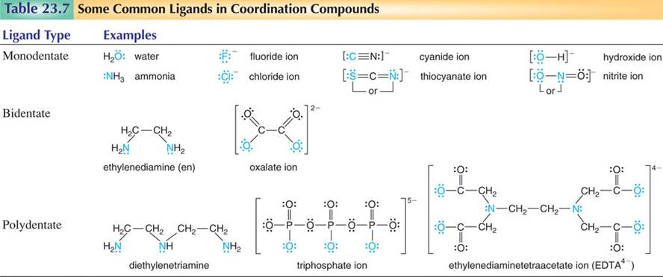
Names of monodentate:
Aqua, ammine, fluoro, chloro, cyano, thiocyano, hydroxo, nitro
Some more Bidentate ligands:
CO₃²⁻ carbanato
NO₃⁻ nitrato
SO₄²⁻ sulfato

Slide 38
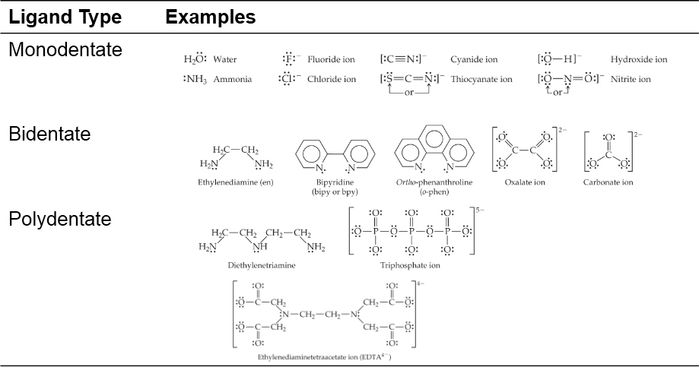
Common Ligands
Table 23.4 Some Common Ligands

Slide 39
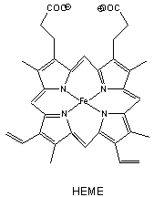
Consider each coordination complex listed below and answer the following questions.
What is the oxidation state of the metal?
What is the total number of valence electrons around the metal?
Determine the coordination number for each complex.
D. Is the complex saturated or unsaturated?
Are any ligands polydentate? If so, identify these ligands.
1. [CoCl₂(en)₂]⁺ 4. [Cr(edta)]⁻
2. [Cr(ox)₃]³⁻ 5. [Ni(CN)₅]³⁻
3. [ZnCl₄]²⁻

Slide 40
Naming Coordination Compounds
1. In naming salts, the name of the cation is given before the name of the anion.
For example, in [Co(NH₃)₅Cl]Cl₂, we name [Co(NH₃)₅Cl]²⁺ before Cl⁻.
2. Within a complex ion or molecule, the ligands are named before the metal. Ligands are listed in alphabetical order, regardless of charge on the ligand. Prefixes (see Rule #4 below) that give the number of ligands are NOT considered part of the ligand name in determining alphabetical order.
Consider once again the [Co(NH₃)₅Cl]²⁺ ion. Name the ammonia ligand first, then the chloride, followed by the metal: pentaamminechlorocobalt(III).

Slide 41
    3. The names of the anionic ligands end in the letter “o”, whereas neutral ones ordinarily bear the name of the molecules. Special names are given for H₂O (aqua), NH₃ (ammine), CO (carbonyl), and NO (nitrosyl).
    For example, [Fe(CN)₂(NH₃)₂(H₂O)₂]⁺ would be named diamminediaquadicyanoiron(III) ion.
    4. Greek prefixes (di, tri, tetra, penta, and hexa) are used to indicate the number of each kind of ligand when more than one is present as shown in the examples above. If the ligand already contains a Greek prefix (as in ethylenediamine) or if it is polydentate (i.e. able to attach at more than one binding site), then the following prefixes are used instead:
2: bis- 3: tris- 4: tetrakis-

Slide 42
5. If the complex is an anion, its name ends in –ate. If the symbol of the metal originates from a Latin name, then the Latin stem is used instead
For example, the compound K₄[Fe(CN)₆] is named potassium hexacyanoferrate(II).
Common Latin stem listings (in parentheses):
Copper (cuprate);
iron (ferrate);
tin (stannate);
lead (plumbate).
6. The oxidation number of the metal is given in parentheses in Roman numerals directly following the name of the metal.

Slide 43
Nomenclature Rules
Table 23.5 Some Common Ligands and Their Names
Ligand | Name in Complexes | Ligand | Name in Complexes
azide, N 3, minus | Azido | oxalate, C 2 O 4, 2 minus | Oxalato
bromide, B r, minus | Bromo | oxide, O, 2 minus | Oxo
chloride, C l, minus | Chloro | ammonia, N H 3 | Ammine
cyanide, C N, minus | Cyano | carbon monoxide, C O | Carbonyl
fluoride, F, minus | Fluoro | ethylenediamine, e n | Ethylenediamine
hydroxide, O H, minus | Hydroxo | pyridine, C 5 H 5 N | Pyridine
carbonate, C O 3, 2 minus | Carbonato | water, H 2 O. Name, aqua | Aqua

Slide 44
Nomenclature Examples

Slide 45
Writing Names and Formulas of Coordination Compounds
PROBLEM:
(a) What is the systematic name of Na₃[AlF₆]?
(b) What is the systematic name of [Co(en)₂Cl₂]NO₃?
(c) What is the formula of tetraaminebromochloroplatinum(IV) chloride?
(d) What is the formula of hexaaminecobalt(III) tetrachloro-ferrate(III)?
SOLUTION:
(a) The complex ion is [AlF₆] ³⁻
Six (hexa-) fluorines (fluoro-) are the ligands - hexafluoro
Aluminum is the central metal atom - aluminate
Aluminum has only the +3 ion so we don’t need Roman numerals.
sodium hexafluoroaluminate

Slide 46
Writing Names and Formulas of Coordination Compounds
(b) There are two ligands, chlorine and ethylenediamine -
dichloro, bis(ethylenediamine)
The complex is the cation and we have to use Roman numerals for the cobalt oxidation state since it has more than one - (III)
The anion, nitrate, is named last.
dichlorobis(ethylenediamine)cobalt(III) nitrate
(c)
4 NH₃
Br⁻
Cl-
Pt⁴⁺
Cl⁻
tetraaminebromochloroplatinum(IV) chloride
[Pt(NH₃)₄BrCl]Cl₂
(d)
6 NH₃
Co³⁺
4 Cl⁻
Fe³⁺
hexaaminecobalt(III) tetrachloro-ferrate(III)
[Co(NH₃)₆][Cl₄Fe]₃

Slide 47
WORKSHOP TR#2
Name/draw each of the following compounds listed below:
A. NH₄[PtCl₃(NH₃)] B. [Co(NH₃)₆][AuCl₄]₂
C. [Cr(OH)₂(NH₃)₄]Br D. [Co(en)₃]³⁺
E. Na₂[PtCl₂(ox)₂] F. [FeOH(H₂O)₅]Cl₂
G. Sodium tetrahydroxoaluminate
H. potassium hexacyanoferrate(II)
I. Dicarbonyldifluorocobalt(III) perchlorate
J. hexapyridinenickel(II) bromide

Slide 48
Coordination Compounds and their Isomers
The geometry (or shape) of a transition metal complex depends on the coordination number and nature of the metal ion. The following table outlines the various typical geometries along with examples of each:
Coordination Number Shape Examples
2 Linear [CuCl₂]⁻, [Ag(NH₃)₂]⁺, [AuCl₂]⁻
4 Square Planar Most d⁸ metal ions (some can be tetrahedral); [Ni(CN)₄]²⁻, [PdCl₄]²⁻ 4 Tetrahedral Most d¹⁰ metal ions; [Cu(CN)₄]³⁻, [CdCl₄]²⁻ 6 Octahedral [Ti(H₂O)₆]³⁺, [Co(en)₃]³⁺
Make sure and note the similarity with the molecular shapes in VSEPR theory.

Slide 49
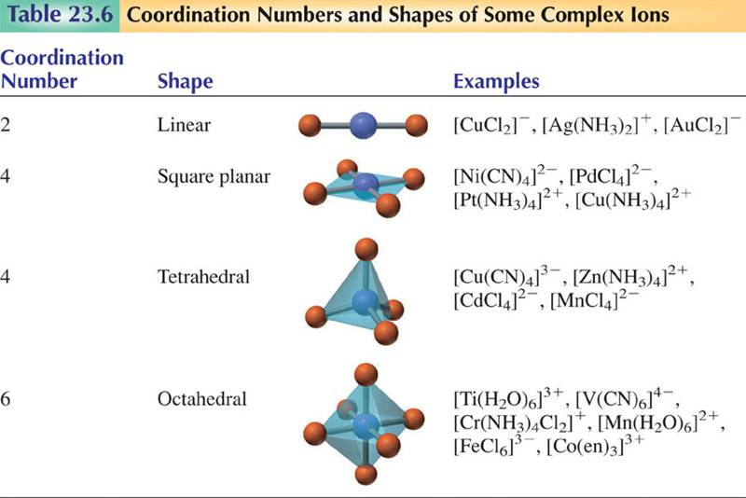

Slide 50
Valence Bond Theory
Recall valence bond theory from last semester, where atomic orbitals mix to form molecular orbitals, and hybrization (or hybrid orbitals) results. (sp linear, sp² trigonal planar, & sp³ tetrahedral). In ordinary covalent compounds the orbitals overlap with one (1) from each atom.
Atomic Orbital Set Hybrid Orbital Set Electronic Geometry
s, p Two sp Linear
s, p, p Three sp² Trigonal Planar
s, p, p, p Four sp³ Tetrahedral
s, p, p, p, d Five sp³d Trigonal Bipyramidal
s, p, p, p, d, d Six sp³d² Octahedral

Slide 51
Valence Bond Theory for Coordination Complexes
The ligands (Lewis Bases) donate electrons to the metal (Lewis Acids) to form the covalent bond in the complex resulting in a mixing of the s, p, & d orbitals of the metal. In coordinate covalent bonds the ligand orbital (containing 2 e-’s) overlaps with the UNOCCUPIED orbital of the metal. The number & type of metal ion hybrid orbital occupied by the ligand’s lone pair of electrons determines the geometry of the complex.

Slide 52
Valence Bond Theory
[Cr(NH₃)₆]³⁺
Hexaamminechromium(III) ion a yellow complex is paramagnetic, use valence bond theory to explain the bonding and magnetic properties of the complex. d³
_ _ _ _{(p)}
_ _{(s)}
Cr³⁺ _ _ _ _ _ _{(d)} and consider 6 :NH₃
therefore need 6 equivalent bonds!
hybridization : _ _ _ : : : : : :
d d d d d s p p p
The 3d metal electrons are unhybridized thus paramagnetic and the ligand electrons fit into the leftover hybridized d²sp³ orbitals of the metal. CN=6 thus octahedral

Slide 53
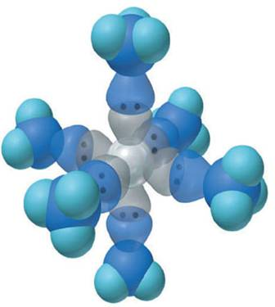
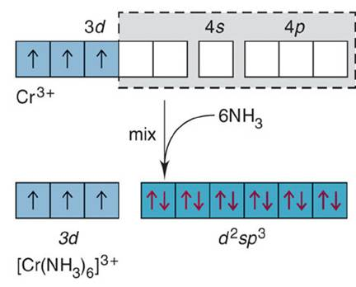
Hybrid orbitals and bonding in the octahedral [Cr(NH₃)₆]³⁺ ion.

Slide 54
Valence Bond Theory
[Ni(CN)₄]²⁻
Use valence bond theory to explain the bonding and magnetic properties of the above complex. d⁸
_ _ _ _{(p)}
_ _{(s)}
Ni²⁺ _ _ _ _ _ _{(d)} and consider 4 :CN
therefore need 4 equivalent bonds!
hybridization : _ _ _ _ : : : : _
d d d d d s p p p
The 3d metal electrons are unhybridized thus diamagnetic and the ligand electrons fit into the leftover hybridized dsp² orbitals of the metal. CN=4 and square planar. Describe [Zn(OH)₄]²⁻

Slide 55
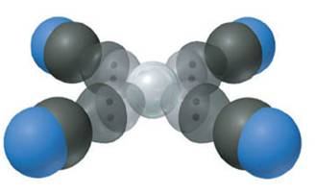
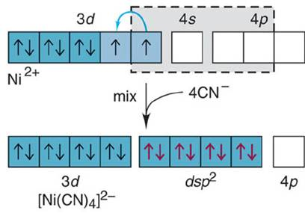
Hybrid orbitals and bonding in the square planar [Ni(CN)₄]²⁻ ion.

Slide 56
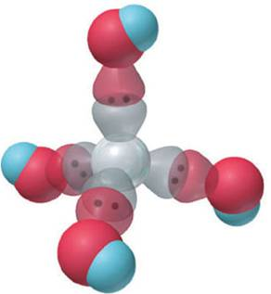
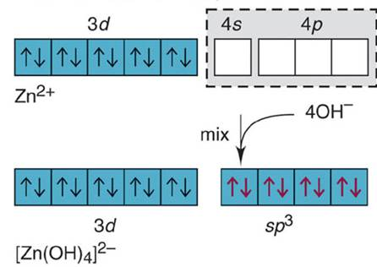
Hybrid orbitals and bonding in the tetrahedral [Zn(OH)₄]²⁻ ion.

Slide 57
Important types of isomerism in coordination compounds.
ISOMERS
Same chemical formula, but different properties
Constitutional (structural) isomers
Stereoisomers
Atoms connected differently
Different spatial arrangement
Coordination isomers
Ligand and counter-ion exchange
Linkage isomers
Different donor atom
Geometric (cis-trans) isomers (diastereomers)
Different arrangement around metal ion
Optical isomers (enantiomers)
Nonsuperimposable mirror images
Coordination isomers: [Pt(NH₃)₄Cl₂](NO₂)₂ & [Pt(NH₃)4(NO₂)₂]Cl₂

Slide 58
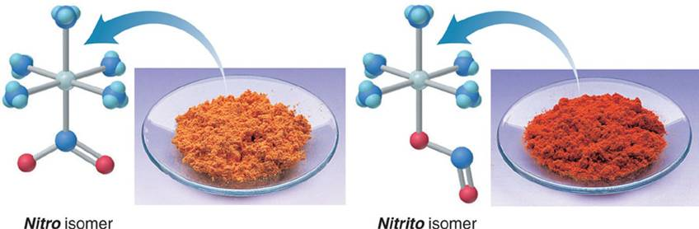
Linkage isomers
Co(NH₃)₅(NO₂)]Cl₂ is an orange solid called pentaamminenitrocobalt(III) chloride
[Co(NH₃)₅(ONO)]Cl₂ is a red compound known as pentaamminenitritocobalt(III) chloride.
NCO: cyanato OCN: isocyanato S=C=N: thiocyanato

Slide 59
Just like in our study of organic chemistry, there exist isomers with transition metal complexes, or compounds with the same chemical formula but different properties. We will focus briefly on geometric isomers (or cis-trans), when atoms or groups of atoms are arranged differently in space relative to the central metal ion. Consider the following example:
cis-[Pt(NH₃)₂Cl₂] versus trans-[Pt(NH₃)₂Cl₂]
The cis- isomer has the identical ligands next to each other; the trans- isomer has the identical ligands across from one another. Please note that this geometrical arrangement can have serious biological effects. For instance, it was discovered that the cis- isomer is a highly effective antitumor agent, while the trans- isomer has no antitumor activity or effect.

Slide 60




Geometric (cis-trans) isomerism.

Slide 61

Optical Isomers
Optical isomers, or enantiomers, are mirror images of one another that don’t superimpose on each other.
They are said to be chiral.
Their properties differ from each other only when in contact with other chiral substances.

Slide 62

Optical Isomers
Enantiomers are distinguished from each other by the way they rotate plane-polarized light.
  Substances that rotate plane-polarized light to the right are dextrorotatory.
  Substances that rotate plane-polarized light to the left are levorotatory.
  A mixture of the two is called a racemic mixture.

Slide 63


Enantiomers
Optical isomerism (nonsuperimposable images) in an octahedral complex ion.
Optical Isomers usually contain chiral centers (asymmetrical centers). Chiral molecules can rotate the plane of light (thus optically active). d=dextrorotatory right l=levoratatory left

Slide 64


Chelates
Bidentate and polydentate ligands are also called chelating agents.
There are many transition metals that are vital to human life.
Several of these are bound to chelating agents.

Slide 65



Chelates in Biological Systems
The porphine molecule is the basis for many important biological metal chelates, becoming a porphyrin ring.
The iron in hemoglobin carries
through the blood.
It contains heme units.
Chlorophylls also have metals bound to porphine units.

Slide 66
Determining the Type of Stereoisomerism
PROBLEM:
Draw all stereoisomers for each of the following and state the type of isomerism:
(a) [Pt(NH₃)₂Br₂]
(b) [Cr(en)₃]³⁺ (en = H₂NCH₂CH₂NH₂)
PLAN:
Determine the geometry around each metal ion and the nature of the ligands. Place the ligands in as many different positions as possible. Look for cis-trans and optical isomers.
SOLUTION:
(a) Pt(II) forms a square planar complex and there are two pair of monodentate ligands - NH₃ and Br.
These are geometric isomers; they are not optical isomers since they are superimposable on their mirror images.
trans
cis

Slide 67
Determining the Type of Stereoisomerism
continued
(b) Ethylenediamine is a bidentate ligand. Cr³⁺ is hexacoordinated and will form an octahedral geometry.
Since all of the ligands are identical, there will be no geometric isomerism possible.
The mirror images are nonsuperimposable and are therefore optical isomers.

Slide 68
WORKSHOP TR#3
Name & draw all the stereoisomers for the following:
cis-[Co(NH₃)₄Cl₂]⁺
trans-[Co(NH₃)₄Cl₂]⁺
[Pd(NH₃)₂(NO₂)₂]
[Fe(C₂O₄)₂(OH₂)₂]

Slide 69
Crystal Field Theory
Recall valence bond theory, where atomic orbitals mix to form molecular orbitals, and hybrization (or hybrid orbitals) results. While important, this theory fails to give insight into the colors of coordination compounds and their magnetic properties. Instead, we turn to crystal field theory, which highlights the effects on the d-orbital energies of the metal ion as a ligand approaches to form a coordinate covalent bond. The model assumes that a complex ion forms as a result of electrostatic attractions between the transition metal cation and the negative charge of the ligands. In the isolated metal ion, the d orbitals have equal energies despite their different orientations.

Slide 70
Crystal Field Theory
However, in an electrostatic field of ligands, the d electrons are repelled unequally because they have different orientations. Because these ligands move along the x, y, and z axes, they approach DIRECTLY toward the lobes of the d_{x}² _{– y}² and d_{z}² orbitals and BETWEEN the lobes of the d_{xy}, d_{yz}, and d_{xz} orbitals. As a result, the electrons in the d_{x}² _{– y}² and d_{z}² orbitals experience stronger repulsions than those in the d_{xy}, d_{yz}, and d_{xz} orbitals and thus lie higher in energy. Therefore, we can illustrate the splitting of the d-orbital energies of an octahedral field of ligands in the following manner:

Slide 71

The five d-orbitals in an octahedral field of ligands.

Slide 72
Crystal Field Theory
The splitting of orbital energies is called the crystal field effect, and the energy difference between the e_{g} and the t_{2g} orbitals is called the crystal field splitting
energy (Δ). The e_{g} level involves d_{z2} & d_{x2-y2} and is along the bond axis. The t_{2g} level involves d_{xy}, d_{xz}, & d_{yz} and bonding lies between the ligand orbitals.

Slide 73

Splitting of d-orbital energies by an octahedral field of ligands.
Δ is the splitting energy

Slide 74
Crystal Field Theory
Different ligands create crystal fields of different strength, thereby causing the d-orbital energies to split differently. A strong-field ligand leads to a larger Δ splitting; a weak-field ligand leads to a smaller Δ splitting. Color in a transition metal complex arises due to two main factors: oxidation state of the metal ion AND type of ligand.

Slide 75

Color
Color depends on the metal AND the ligands.

Slide 76

The effect of ligand on splitting energy.

Slide 77




Orbital occupancy for high- and low-spin complexes
of d⁴ through d⁷ metal ions.
high spin: weak-field ligand
low spin: strong-field ligand
high spin: weak-field ligand
low spin: strong-field ligand

Slide 78



High-spin and low-spin complex ions of Mn²⁺.

Slide 79
Crystal Field Theory
Ligand color arises because a substance absorbs only certain wavelengths of incoming white light. The spectrochemical series is a ranking of ligands in terms of their ability to split d-orbital energies. Consider the following Spectrochemical Series:
I⁻ < Br⁻ < Cl⁻ < F⁻ < OH⁻ < H₂O < SCN⁻ < NH₃ < en < NO₂⁻ < CN⁻ < CO
Weak Field Ligand (smaller Δ) Strong Field Ligand (larger Δ)
Longer wavelength (λ) Shorter wavelength (λ)
High spin Low spin

Slide 80


Crystal-Field Theory
The spectrochemical series ranks ligands in order of their ability to increase the energy gap between d orbitals. (This is a variation known as ligand-field theory.)

Slide 81



Effects of the metal oxidation state and of ligand identity on color.
[V(H₂O)₆]²⁺
[V(H₂O)₆]³⁺
[Cr(NH₃)₆]³⁺
[Cr(NH₃)₅Cl ]²⁺

Slide 82
The spectrochemical series.
For a given ligand, the color depends on the oxidation state of the metal ion.
For a given metal ion, the color depends on the ligand.
I⁻ < Cl⁻ < F⁻ < OH⁻ < H₂O < SCN⁻ < NH₃ < en < NO₂⁻ < CN⁻ < CO
WEAKER FIELD
STRONGER FIELD
SMALLER Δ
LARGER Δ
LONGER λ
SHORTER λ

Slide 83
Identifying Complex Ions as High Spin or Low Spin
PROBLEM:
Iron (II) forms an essential complex in hemoglobin. For each of the two octahedral complex ions [Fe(H₂O)₆]²⁺ and [Fe(CN)₆]⁴⁻, draw an orbital splitting diagram, predict the number of unpaired electrons, and identify the ion as low or high spin.
PLAN:
The electron configuration of Fe²⁺ gives us information that the iron has 6d electrons. The two ligands have field strengths shown in .
Draw the orbital box diagrams, splitting the d orbitals into e_{g} and t_{2g}. Add the electrons noting that a weak-field ligand gives the maximum number of unpaired electrons and a high-spin complex and vice-versa.
[Fe(CN)₆]⁴⁻
SOLUTION:
[Fe(H₂O)₆]²⁺
4 unpaired e⁻⁻ (high spin)
e_{g}
potential energy
e_{g}
no unpaired e⁻⁻ (low spin)
t_{2g}
t_{2g}

Slide 84
The splitting of energy levels influences magnetic properties by affecting the number of unpaired electrons in the metal ion's d orbitals. That is, the relative size of Δ determines the occupancy of the d orbitals, which in turn determines the number of unpaired electrons (if any) present.
Questions:
Predict whether the complex is high or low spin:
a) Mn(OH)₆⁴⁻ b) Mn(CN)₆⁴⁻
2. Fe(CN)₆³⁻ ion has one unpaired electron, does CN⁻ ligand produce a strong or weak field? Explain.
3. Predict the number of unpaired electrons in [Cu(CN)₆]⁴⁻

Slide 85





The color of [Ti(H₂O)₆]³⁺.
Although it is difficult to predict the actual color of a given complex, we can predict whether a complex will absorb longer or shorter wavelengths of light when compared to other complexes. λ = hc/Δ
If the splitting is large (strong field) then Δ is large making λ small (ie. low λ absorbed like blue light) therefore the complementary red is reflected or transmitted.

Slide 86


Crystal-Field Theory
Tetrahedral and square planar complexes differ from octahedral complexes because the ligands do NOT approach directly on the x-, y-, and z-axes as they do in octahedral complexes.

Slide 87


Splitting of d-orbital energies by a tetrahedral field and a square planar field of ligands.
Only low spin is possible
tetrahedral
Only high spin is possible
square planar

Slide 88
Crystal Field Theory for CN = 4
Finally, four ligands around a metal ion can also cause d-orbital splitting, but the magnitude and pattern of the splitting depends on whether the ligands are in a tetrahedral or a square planar arrangement. Consider the following two orbital splitting diagrams on the next slide.
Question:
Qualitative analysis of nickel was based on the reaction of the nickel ion with dimethylglyoxime to form the bidentate chelate: bis(dimethylglyoximato)nickel(II), a reddish-pink colored insoluble compound. If the lone pairs of electrons on nitrogen bond to nickel to form a diamagnetic species, describe the geometry of the complex.
CH₃-C=N-OH dimethylglyoxime
l
CH₃-C=N-OH

Slide 89
Extra Questions on Crystal field Theory
1. Consider the two complexes [Mn(H₂O)₆]²⁺ versus [Mn(CN)₆]⁴⁻. Diagram the expected orbital splitting diagram for each complex, predict the number of unpaired electrons (if any), and identify the ion as low or high spin.
2. Predict the electron configuration of an octahedral d⁴ complex with (a) strong field ligands and (b) weak field ligands, and state the number of unpaired electrons in each case.
3. Predict which of the following complexes absorbs light of the shorter wavelength and explain your reasoning: [Co(H₂O)₆]³⁺ or [Co(en)₃]³⁺.
4. Compare the magnetic properties of [Fe(H₂O)₆]²⁺ and [Fe(CN)₆]⁴⁻.
5. What change in magnetic properties (if any) can be expected when NO₂⁻ ligands in an octahedral complex are replaced by Cl- ligands in a d⁶ complex?
6. Draw the orbital splitting diagram for the following complex and give its electron configuration: tetrahedral CoCl₄²⁻.
7. The complex ion PdCl₄²⁻ is diamagnetic. Propose a structure for PdCl₄²⁻.

Slide 90
8. Explain the following differences in color:
A. [Cr(H₂O)₆]Cl₃ is violet, whereas [Cr(NH₃)₆]Cl₃ is yellow.
B. [Co(H₂O)₆]²⁺ is pink, whereas tetrahedral [CoCl₄]²⁻ is blue.
C. One of the following solids is yellow, and the other is green: Fe(NO₃)₂·6H₂O versus K₄[Fe(CN)₆·3H₂O]. Indicate which is which and explain your reasoning.

Slide 91
Biological Importance of Coordination Complexes
In the Respiratory chain, cytochromes consists of a heme component & a globular protein (see structure). The heme is an octahedral iron complex which binds oxygen, O=O (O₂) [or in some cases, carbon monoxide, C=O (CO) or CN which are both respiratory inhibitors] to Fe (d⁶). In a process called Cooperative Release, the change in Fe⁺² from low spin to high spin determines the capture or release of O₂ to the heme complex. Hemoglobin exists in two forms in our bodies. One form, oxyhemoglobin, has O₂ bound to the iron, the other deooxyhemoglobin, has a water molecule bound instead. Oxyhemoglobin is a low spin complex that give arterial blood its red color, and deoxyhemoglobin is the high spin complex that gives venous blood its blue color.
lose O₂
_ _ → _ _
gain O₂
← _ _ _
_ _ _
Low spin, strong field high spin, weak field
(small radius) (larger radius)
Diamagnetic paramagnetic
Red blue
Fe=O Fe(H₂O)²⁺

Slide 92

Hemoglobin and the octahedral complex in heme.

Slide 93
Putting it all together!
Consider Vitamin B12 shown to the right. This molecule is useful in the treatment of pernicious anemia and other diseases; enzymes derived from vitamin B12 accelerate a large range of important reactions including those involved in producing red blood cells.

Slide 94
A. Label the referenced functional groups in the structure above:
1. ________ 2.________ 3. ________
B. Consider the functional group labeled “3”. Identify the atomic/molecular orbitals involved in the bonding.
C. Are there any aromatic components in vitamin B12? Briefly explain.
D. Will vitamin B12 exhibit optical isomerism? Briefly explain.
Finally, consider the coordination complex component of vitamin B12 for the last two questions. Notice that the metal ion is coordinated by a planar ligand along with two axial ligands.
E. What is the hybridization of the central atom? _____________
F. Assuming a coordinately saturated complex, what is the expected oxidation state of the cobalt atom? Briefly explain.
G. Based on your answer to part G, what is the expected overall charge of the complex (denoted as “x” in the structure on the prior page)? Briefly explain.

