Slide 1
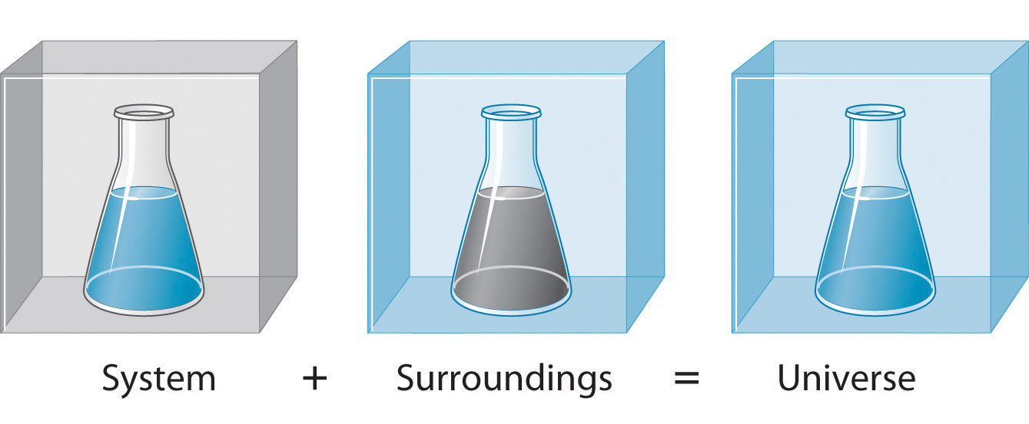
Free Energy and
Thermodynamics
The Laws of Thermodynamics
You can’t win, you can only break even.
You can only break even at T=0.
You cant reach T=0….

Slide 2
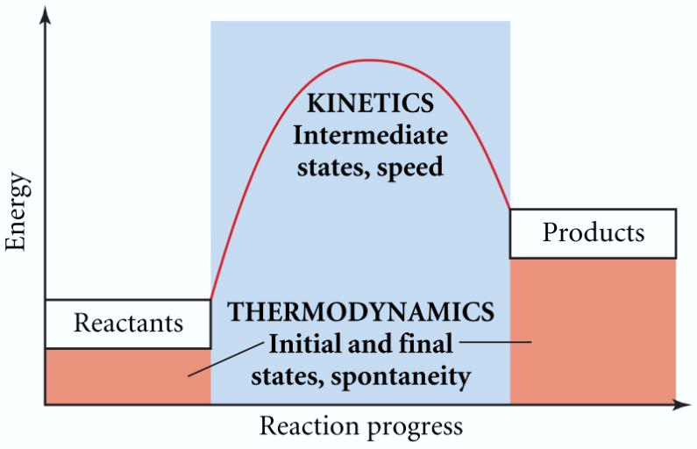
Thermodynamics vs. Kinetics

Slide 3
CHEMICAL THERMODYNAMICS
The first law of thermodynamics:
Energy and matter can be neither created nor destroyed; only transformed from one form to another. The energy and matter of the universe is constant.
The second law of thermodynamics:
In any spontaneous process there is always an increase in the entropy of the universe.
The entropy is increasing.
The third law of thermodynamics:
The entropy of a perfect crystal at 0 K is zero.
There is no molecular motion at absolute 0 K.

Slide 4
A mathematical approach to the laws of thermodynamics

Slide 5
STATE FUNCTIONS
A property of a system which depends only on its present state and not on its pathway.
ΔH = Enthalpy = heat of reaction = q_{p}
A measure of heat (energy) flow of a system relative to its surroundings.
ΔH° standard enthalpy
ΔH_{f}° enthalpy of formation
ΔH° = Σn ΔH_{f}° (products) - Σ m ΔH_{f}° (reactants)
ΔH = ΔE + PΔV
U represents the Internal energy of the particles, both the kinetic and potential energy. ΔE = q + w

Slide 6
HEAT VS WORK
energy transfer as a energy expanded to
result of a temperature move an object against
difference a force
q_{p} w = F x d
endothermic (+q) work on a system
(+w)
exothermic (-q) work by the system
(-w)
q_{c} = -q_{h} w = -PΔV

Slide 7
SPONTANEOUS PROCESSES
A spontaneous process occurs without outside intervention. The rate may be fast or slow.
General Concepts:
  Processes that are spontaneous in one direction are nonspontaneous in the reverse direction.
  Don’t confuse spontaneous with fast. There are fast and slow reactions that are spontaneous.
  Don’t confuse nonspontaneous with impossible. Energy can be used to make some reactions spontaneous that otherwise would not be.

Slide 8
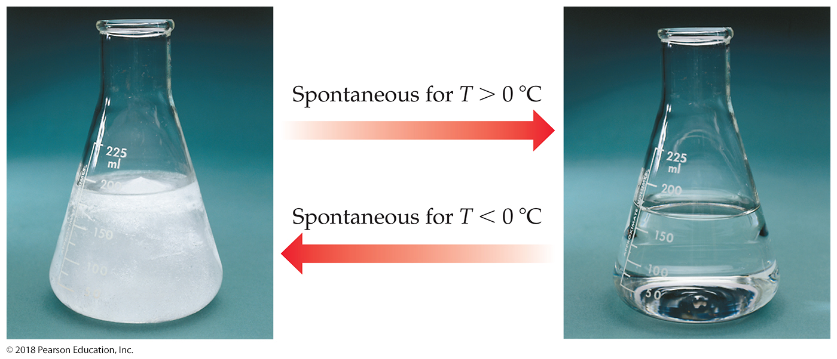
Experimental Factors Affect Spontaneous Processes
Temperature and pressure can affect spontaneity.
An example of how temperature affects spontaneity is ice melting or freezing.

Slide 9
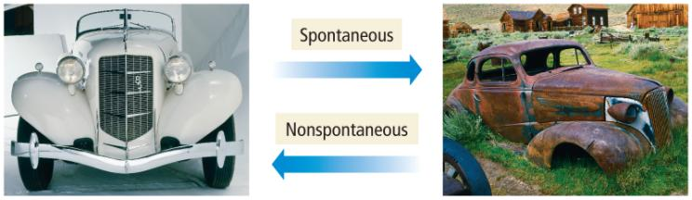
Reversibility of Process
any spontaneous process is irreversible
  it will proceed in only one direction
a reversible process will proceed back and forth between the two end conditions
  equilibrium
  results in no change in free energy
if a process is spontaneous in one direction, it must be nonspontaneous in the opposite direction

Slide 10
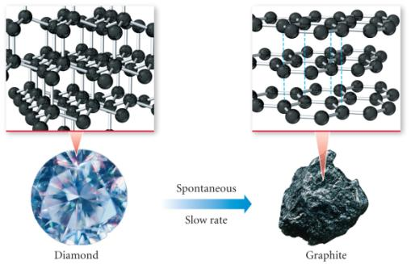
Diamond → Graphite
Graphite is more stable than diamond, so the conversion of diamond into graphite is spontaneous – but don’t worry, it’s so slow that your ring won’t turn into pencil lead in your lifetime (or through many of your generations).

Slide 11
Entropy
A measure of randomness or disorder in a system.
Entropy is a state function with units of J/K and it can be created during a spontaneous process.
ΔS_{univ} = ΔS_{sys} + ΔS_{surr}
The relationship between ΔS_{sys} and ΔS_{surr}
ΔS_{sys} ΔS_{surr} ΔS_{univ} Process spontaneous?
+ + + Yes
- - - No (Rx will occur in
opposite direction)
+ - ? Yes, if ΔS_{sys} > ΔS_{surr}
- + ? Yes, if ΔS_{surr} > ΔS_{sys}

Slide 12
Second Law of Thermodynamics
The entropy of the universe increases in any spontaneous processes.
This results in the following relationships:

Slide 13
Predicting Relative S⁰ Values of a System
1. Temperature changes
S⁰ increases as the temperature rises.
2. Physical states and phase changes
S⁰ increases as a more ordered phase changes to a less ordered phase.
3. Dissolution of a solid or liquid
S⁰ of a dissolved solid or dissolved liquid is usually greater than the S⁰ of the pure solute. However, the extent depends upon the nature of the solute and solvent.
4. Dissolution of a gas
A gas becomes more ordered when it dissolves in a liquid or solid.
5. Atomic size or molecular complexity
In similar substances, increases in mass relate directly to entropy.
In allotropic substances, increases in complexity (e.g. bond flexibility) relate directly to entropy.

Slide 14
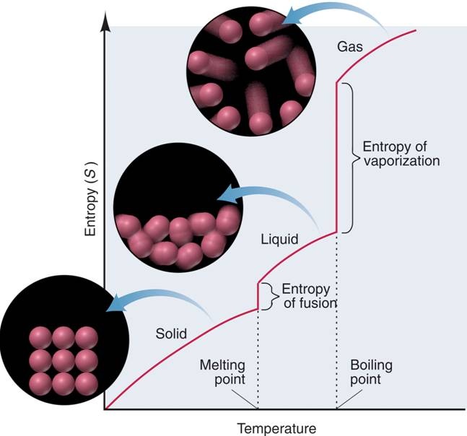
The increase in entropy from solid to liquid to gas.

Slide 15
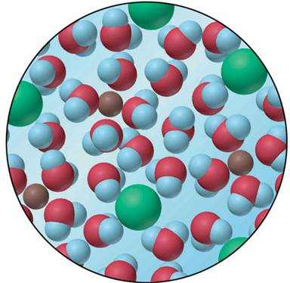
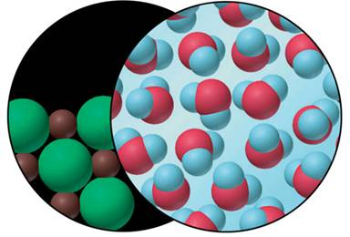
The entropy change accompanying the dissolution of a salt.
pure solid
MIX
pure liquid
solution

Slide 16
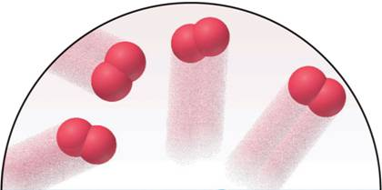
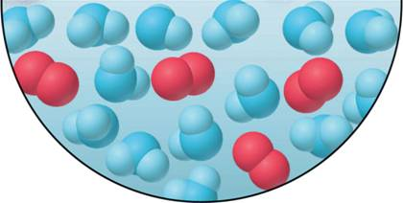
The large decrease in entropy when a gas dissolves in a liquid.
O₂ gas
O₂ gas in H₂O

Slide 17
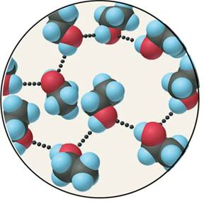
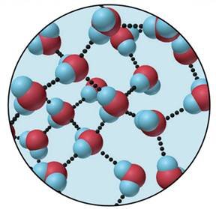
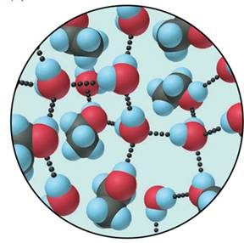
The small increase in entropy when ethanol dissolves in water.
Ethanol
Water
Solution of ethanol and water

Slide 18
Factors Affecting Whether a Reaction Is Spontaneous
The two factors that determine the thermodynamic favorability are the enthalpy and the entropy.
The enthalpy is a comparison of the bond energy of the reactants to the products.
  bond energy = amount needed to break a bond.
  ΔH
The entropy factors relates to the randomness/orderliness of a system
  ΔS
The enthalpy factor is generally more important than the entropy factor

Slide 19
Enthalpy
related to the internal energy
ΔH generally kJ/mol
stronger bonds = more stable molecules
if products more stable than reactants, energy released
  exothermic
  ΔH = negative
if reactants more stable than products, energy absorbed
  endothermic
  ΔH = positive
The enthalpy is favorable for exothermic reactions and unfavorable for endothermic reactions.
Hess’ Law ΔH°_{rxn} = Σ(ΔH°_{prod}) - Σ(ΔH°_{react})

Slide 20
Entropy
Entropy (S) is a thermodynamic function that increases as the number of energetically equivalent ways of arranging the components increases (called microstates, W). S generally has units of J/K mol
S = k ln W
  k = Boltzmann Constant = 1.38 x 10⁻²³ J/K
  W is the number of energetically equivalent ways, unitless
  So entropy is a measure of how many microstates are associated with a particular macroscopic state.
  Since S is a state function, an increase in the number of microstates results in a positive entropy change (more disorder).
Random systems require less energy than ordered systems
It can be found by heat transfer from surroundings at a given temperature:

Slide 21
Entropy Changes in the System
ΔS⁰_{rxn} - the entropy change that occurs when all reactants
and products are in their standard states.
ΔS⁰_{rxn} = ΣΔS⁰_{products} - ΣΔS⁰_{reactants}
The change in entropy of the surroundings is directly
related to an opposite change in the heat of the system
and inversely related to the temperature at which the
heat is transferred.
ΔH_{system}
ΔS_{surroundings} = -
T

Slide 22
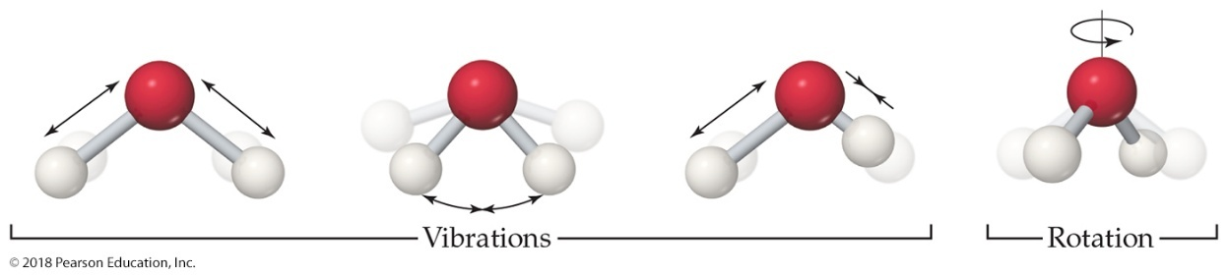
Molecular Motions
Molecules exhibit several types of motion.
Translational: Movement of the entire molecule from one place to another
Vibrational: Periodic motion of atoms within a molecule
Rotational: Rotation of the molecule about an axis
Note: More atoms means more microstates (more possible molecular motions).
The number of microstates and, therefore, the entropy tend to increase with increases in
temperature.
volume.
the number of independently moving molecules

Slide 23
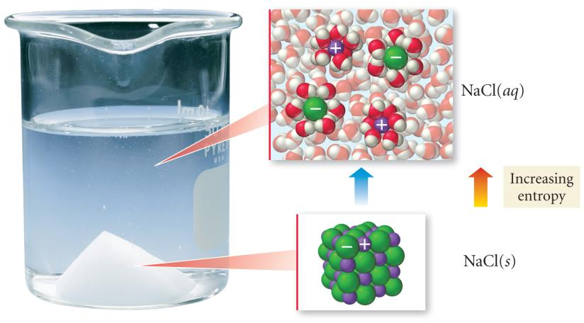
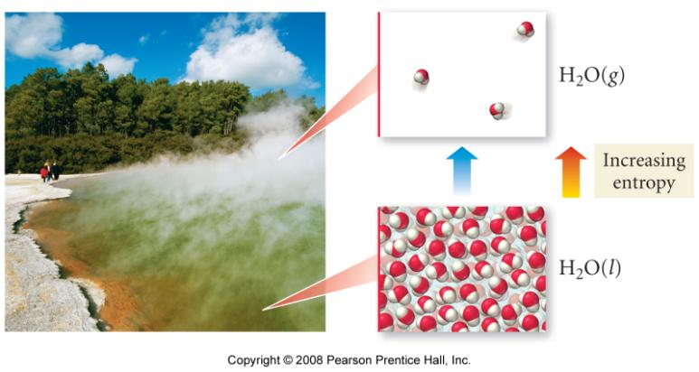
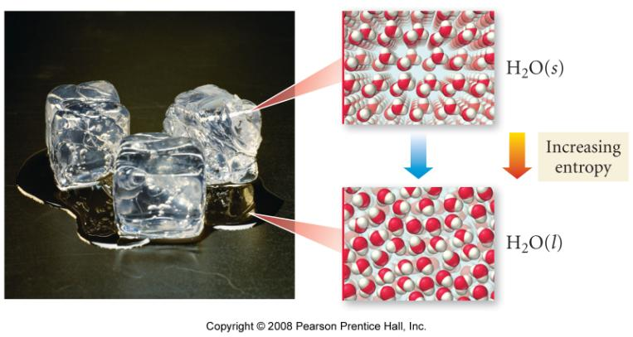
Increases in Entropy

Slide 24
Entropy Changes in Surroundings
Heat that flows into or out of the system changes the entropy of the surroundings.
For an isothermal process (constant T)
At constant pressure,
is simply ΔH° for the
system.

Slide 25
Entropy & Enthalpy Relationship
In general: ΔS > q/T
Rewriting q = ΔH: ΔS ≥ ΔH/T
Rearrange the equation and:
For a reversible (at equilibrium) process
ΔH - TΔS < 0
For a spontaneous reaction at constant T & P
Δ H - TΔS
If the value for Δ H - TΔ S is negative for a reaction then the reaction is spontaneous in the direction of the products.
If the value for Δ H - TΔ S is positive for a reaction then the reaction is spontaneous in the direction of the reactants. (nonspontaneous for products)

Slide 26
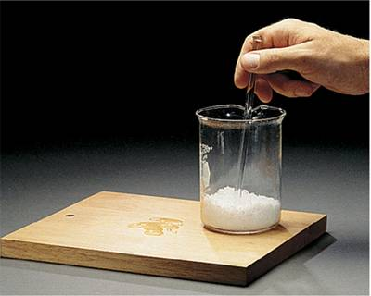
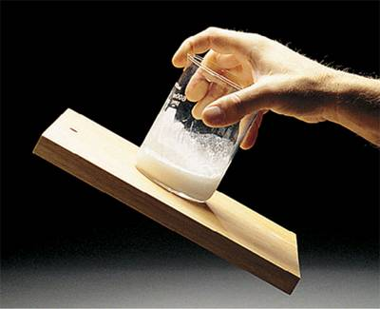
A spontaneous endothermic chemical reaction.
water
.
Ba(OH)₂ 8H₂O(s) + 2NH₄NO₃(s) Ba²⁺(aq) + 2NO₃⁻(aq) + 2NH₃(aq) + 10H₂O(l)
ΔH⁰_{rxn} = +62.3 kJ

Slide 27
APPLICATION OF THE 3RD LAW OF THERMODYNAMICS
S° = standard entropy = absolute entropy
S is usually positive (+) for Substances, S can be negative (-) for Ions because H₃O+ is used as zero
Predicting the sign of ΔS°
The sign is positive if:
1. Molecules are broken during the Rx
2. The number of moles of gas increases
3. solid → liquid liquid → gas solid → gas
an increase in order occurs
1. Ba(OH)₂•8H₂O (s) + 2NH₄NO_{3(s)}→ 2NH_{3(g)} + 10H₂O_{(l)} + Ba(NO₃)_{2(aq)}
2. 2SO_{2(g)} + O_{2(g)} → 2SO_{3(g)}
3. HCl_{(g)} + NH_{3(g)} → NH₄Cl_{(s)}
4. CaCO_{3(s)} → CaO_{(s)} + CO_{2(g)}

Slide 28
Example:
The reaction C₃H_{8(g)} + 5 O_{2(g)} → 3 CO_{2(g)} + 4 H₂O_{(g)} has ΔH_{rxn} = -2044 kJ at 25°C.
Calculate the entropy change of the surroundings.
Given:
Find:
ΔH_{system} = -2044 kJ, T = 298 K
ΔS_{surroundings}, J/K
Concept Plan:
Relationships:
T, ΔH
ΔS
Solution:
Check:
combustion is largely exothermic, so the entropy of the surrounding should increase significantly

Slide 29
Δ S°= Σ n S°(product)-Σ m S°(reactant)
1. Acetone, CH₃COCH₃, is a volatile liquid solvent. The standard enthalpy of formation of the liquid at 25°C is -247.6 kJ/mol; the same quantity for the vapor is -216.6 kJ/mol. What is ΔS_{surr} when 1.00 mol liquid acetone vaporizes at 25ºC?
Calculate ΔS° at 25° for:
2 NaHCO₃ _{(s)} → CO_{2 (g)} + Na₂CO_{3 (s)} + H₂O _{(g)}
Table of S_{f}

Slide 30
S°, S°, S°,
Formula J/(mol•K) Formula J/(mol•K) Formula J/(mol•K)
Nitrogen Sulfur Bromine
N₂(g) 191.5 S₂(g) 228.1 Br⁻(aq) 80.7
NH₃(g) 193 S(rhombic) 31.9 Br₂(l) 152.2
NO(g) 210.6 S(monoclinic) 32.6 Iodine
NO₂(g) 239.9 SO₂(g) 248.1 I⁻(aq) 109.4
HNO₃(aq) 146 H₂S(g) 205.6 I₂(s) 116.1
Oxygen Fluorine Silver
O₂(g) 205.0 F⁻(aq) -9.6 Ag⁺(aq) 73.9
O₃(g) 238.8 F₂(g) 202.7 Ag(s) 42.7
OH⁻(aq) -10.5 HF(g) 173.7 AgF(s) 84
H₂O(g) 188.7 Chlorine AgCl(s) 96.1
H₂O(l) 69.9 Cl⁻(aq) 55.1 AgBr(s) 107.1
Cl₂(g) 223.0 AgI(s) 114
HCl(g) 186.8
Next page
Ex 2

Slide 31
S°, S°, S°,
Formula J/(mol•K) Formula J/(mol•K) Formula J/(mol•K)
Hydrogen Carbon Carbon (continued)
H⁺(aq) 0 C(graphite) 5.7 HCN(l) 112.8
H₂(g) 130.6 C(diamond) 2.4 CCl₄(g) 309.7
Sodium CO(g) 197.5 CCl₄(l) 214.4
Na⁺(aq) 60.2 CO₂(g) 213.7 CH₃CHO(g) 266
Na(s) 51.4 HCO₃⁻(aq) 95.0 C₂H₅OH(l) 161
NaCl(s) 72.1 CH₄(g) 186.1 Silicon
NaHCO₃(s) 102 C₂H₄(g) 219.2 Si(s) 18.0
Na₂CO₃(s) 139 C₂H₆(g) 229.5 SiO₂(s) 41.5
Calcium C₆H₆(l) 172.8 SiF₄(g) 285
Ca²⁺(aq) -55.2 HCHO(g) 219 Lead
Ca(s) 41.6 CH₃OH(l) 127 Pb(s) 64.8
CaO(s) 38.2 CS₂(g) 237.8 PbO(s) 66.3
CaCO₃(s) 92.9 CS₂(l) 151.0 PbS(s) 91.3
HCN(g) 201.7
back

Slide 32
Total Entropy and Spontaneity
Substitute for the entropy of the surroundings:
Multiply by −T:
Rearrange:
We Call

Slide 33
Gibbs Free Energy (G)
ΔG, the change in the free energy of a system, is a measure of the spontaneity of the process and of the useful energy available from it. It is also a State Function just like entropy and enthalpy.
ΔG⁰_{rxn} = Σ mΔG⁰_{products} - Σ nΔG⁰_{reactants}

Slide 34
STANDARD FREE ENERGY OF FORMATION
ΔG°_{f}
The free energy change that occurs when 1 mol of substance is formed from the elements in their standard state.
Calculate ΔG° at 25ºC for:
2 CH₃OH(l) + 3 O₂(g) → 2 CO₂(g) + 4 H₂O(g)
Table of ΔG_{f}

Slide 35
ΔG_{f}° ΔG_{f}° ΔG_{f}°
Formula kJ/mol Formula kJ/mol Formula kJ/mol
Nitrogen Sulfur Bromine
N_{2(g)} 0 S_{2(g)} 80.1 Br⁻_{(aq)} -102.8
NH_{3(g)} -16 S (rhombic) 0 Br_{2(l)} 0
NO_{(g)} 86.60 S (monoclinic) 0.10 Iodine
NO_{2(g)} 51 SO_{2(g)} -300.2 I⁻_{(aq)} -51.7
HNO_{3(aq)} -110.5 H₂S_{(g)} -33 I_{2(s)} 0
Oxygen Fluorine Silver
O_{2(g)} 0 F⁻_{(aq)} -276.5 Ag⁺_{(aq)} 77.1
O_{3(g)} 163 F_{2(g)} 0 Ag_{(s)} 0
OH⁻_{(aq)} -157.3 HF_{(g)} -275 AgF_{(s)} -185
H₂O_{(g)} -228.6 Chlorine AgCl_{(s)} -109.7
H₂O_{(l)} -237.2 Cl⁻_{(aq)} -131.2 AgBr_{(s)} -95.9
Cl_{2(g)} 0 AgI_{(s)} -66.3
HCl_{(g)} -95.3
Next Page
EX 2
EX 3

Slide 36
ΔG_{f}° ΔG_{f}° ΔG_{f}°
Formula kJ/mol Formula kJ/mol Formula kJ/mol
Hydrogen Carbon Carbon (cont.)
H⁺ 0 C (graphite) 0 HCN_{(l)} 121
H_{2(g)} 0 C (diamond) 2.9 CCl_{4(g)} -53.7
Sodium CO_{(g)} -137.2 CCl_{4(l)} -68.6
Na⁺_{(aq)} -261.9 CO_{2(g)} -394.4 CH₃CHO_{(g)} -133.7
Na_{(s)} 0 HCO₃⁻_{(aq)} -587.1 C₂H₅OH_{(l)} -174.8
NaCl_{(s)} -348.0 CH_{4(g)} -50.8 Silicon
NaHCO_{3(s)} -851.9 C₂H_{4(g)} 68.4 Si_{(s)} 0
Na₂CO_{3(s)} -1048.1 C₂H_{6(g)} -32.9 SiO_{2(s)} -856.6
Calcium C₆H_{6(l)} 124.5 SiF_{4(g)} -1506
Ca₂⁺_{(aq)} -553.0 HCHO_{(g)} -110 Lead
Ca_{(s)} 0 CH₃OH_{(l)} -166.2 Pb_{(s)} 0
CaO_{(s)} -603.5 CS_{2(g)} 66.9 PbO_{(s)} -189
CaCO_{3(s)} -1128.8 CS_{2(l)} 63.6 PbS_{(s)} -96.7
HCN_{(g)} 125
BACK

Slide 37

Workshop T#1 on Entropy & Gibbs Free Energy
Carbon tetrachloride is a volatile liquid. What is ΔS_{surr} when 1.00 mol liquid carbon tetrachloride vaporizes at 25ºC?
Calculate ΔS° and ΔG° at 25° for:
a. CaCO₃ _{(s)} → CO_{2 (g)} + CaO _{(s)}
    2 AgBr_{(s)} + I_{2(s)} → Br_{2(l)} + 2 AgI_{(s)}
Table of S_{f}

Slide 38
Gibbs Free Energy (G)
ΔG, the change in the free energy of a system, is a measure of the spontaneity of the process and of the useful energy available from it. There are a multiple number of ways to calculate ΔG.
ΔG⁰_{system} = ΔH⁰_{system} - TΔS⁰_{system}
ΔG < 0 for a spontaneous process
ΔG > 0 for a nonspontaneous process
ΔG = 0 for a process at equilibrium

Slide 39
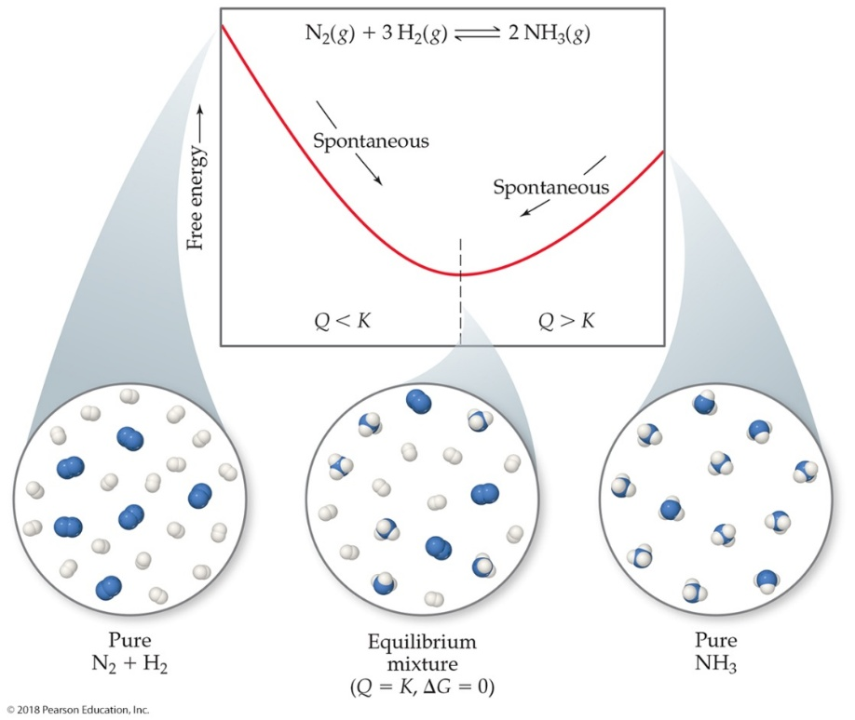
Gibbs Free Energy
If ΔG is negative, the forward reaction is spontaneous.
If ΔG is 0, the system is at equilibrium.
If ΔG is positive, the reaction is nonspontaneous, but spontaneous in the reverse direction.

Slide 40
INTERPRETING ΔG° FOR SPONTANEITY
1. When ΔG° is very small (less than -10 KJ) the reaction is spontaneous as written. Products dominate.
ΔG° < 0 ΣG°(R) > ΣG°(P)
2. When ΔG° is very large (greater than 10 KJ) the reaction is non spontaneous as written. Reactants dominate.
ΔG° > 0 ΣG°(R) < ΣG°(P)
3. When ΔG° is small (+ or -) at equilibrium then both
reactants and products are present.
ΔG° = 0
Ba(OH)•8 H₂O_{(s)} + 2 NH₄NO_{3(s)} → 2 NH_{3(g)}+10 H₂O_{(l)} + Ba(NO₃)_{3(aq)}

Slide 41
GIBBS FREE ENERGY : G
G = H - TS
describes the temperature dependence of spontaneity
Standard conditions (1 atm, if soln=1M & 25°):
ΔG° = ΔH° - TΔS°
A process (at constant P & T) is spontaneous in the direction in which the free energy decreases.

Slide 42
Example– The reaction CCl_{4(g)} → C_{(s, graphite)} + 2 Cl_{2(g)} has
ΔH = +95.7 kJ and ΔS = +142.2 J/K at 25°C.
Calculate ΔG and determine if it is spontaneous.
Given:
Find:
ΔH = +95.7 kJ, ΔS = 142.2 J/K, T = 298 K
ΔG, kJ
Concept Plan:
Relationships:
T, ΔH, ΔS
ΔG
Solution:
Answer:
Since ΔG is +, the reaction is not spontaneous at this temperature. To make it spontaneous, we need to increase the temperature.

Slide 43
Ex. 17.3a – The reaction CCl_{4(g)} → C_{(s, graphite)} + 2 Cl_{2(g)} has
ΔH = +95.7 kJ and ΔS = +142.2 J/K.
Calculate the minimum temperature it will be spontaneous.
Given:
Find:
ΔH = +95.7 kJ, ΔS = 142.2 J/K, ΔG < 0
Τ, Κ
Concept Plan:
Relationships:
ΔG, ΔH, ΔS
T
Solution:
Answer:
The temperature must be higher than 673K for the reaction to be spontaneous

Slide 44
Workshop T#2
2 SO_{2(g)} + O_{2(g)} → 2 SO_{3(g)}
1. At 25°C & 1 atm, calculate ΔH°, ΔS° & ΔG° using the tables found in the appendix.
2. Calculate ΔG at 25°C & 1 atm using ΔG°=ΔH°-TΔS°, compare the value obtained in question 1.
3. Calculate the minimum temperature that the above reaction becomes spontaneous.

Slide 45
ΔG AND EQUILIBRIUM
The equilibrium point occurs at the lowest free energy available to the reaction system.
When a substance undergoes a chemical reaction, the reaction proceeds to give the minimum free energy at equilibrium.
ΔG = ΔG° + RT ln (Q)
but at equilibrium: ΔG = 0
ΔG° = 0 then K = 1
ΔG° < 0 then K > 1
ΔG° > 0 then K < 1
Q: Corrosion of iron by oxygen is
4 Fe_{(s)} + 3 O_{2(g)} ←→ 2 Fe₂O_{3(s)}
calculate K for this Rx at 25°C.
ΔG = ΔG° + RT ln (Q) nonstandard conditions
ΔG° = -RT ln (K) standard conditions

Slide 46
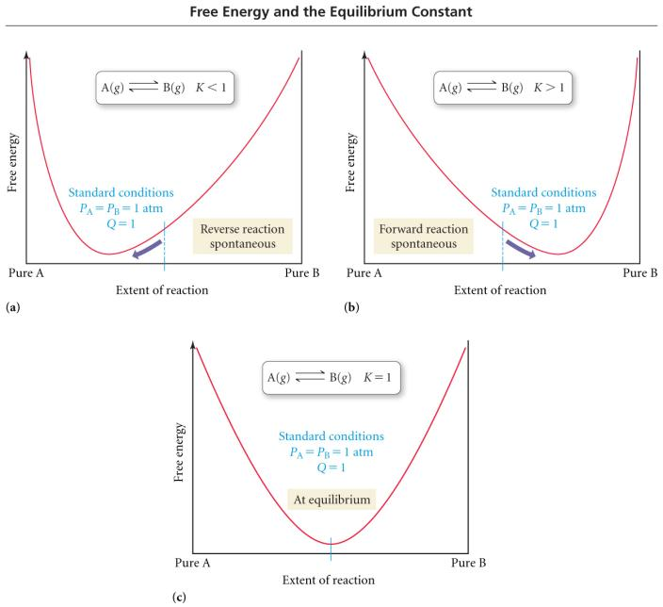

Slide 47
Table 1 The Relationship Between ΔG⁰ and K at 25⁰C
ΔG⁰(kJ)
K
Significance
200
9x10⁻³⁶
Essentially no forward reaction; reverse reaction goes to completion
100
3x10⁻¹⁸
50
2x10⁻⁹
10
2x10⁻²
1
7x10⁻¹
Forward and reverse reactions proceed to same extent
FORWARD REACTION
0
1
REVERSE REACTION
-1
1.5
-10
5x10¹
-50
6x10⁸
-100
3x10¹⁷
Forward reaction goes to completion; essentially no reverse reaction
-200
1x10³⁵

Slide 48
Example - ΔG
Calculate ΔG at 427°C for the reaction below if the P_{N2} = 33.0 atm, P_{H2}= 99.0 atm, and P_{NH3}= 2.0 atm
N₂(g) + 3 H₂(g) → 2 N₃(g)

Slide 49
Free Energy, Equilibrium and Reaction Direction
If Q/K < 1, then ln Q/K < 0; the reaction proceeds to the right (ΔG < 0)
If Q/K > 1, then ln Q/K > 0; the reaction proceeds to the left (ΔG > 0)
If Q/K = 1, then ln Q/K = 0; the reaction is at equilibrium (ΔG = 0)
ΔG = RT ln Q/K = RT lnQ - RT lnK
Under standard conditions (1M concentrations, 1atm for gases), Q = 1 and ln Q = 0 so
ΔG⁰ = - RT lnK

Slide 50
Example - K
Estimate the equilibrium constant and position of equilibrium for the following reaction at 427°C
N₂(g) + 3 H₂(g) ⇔ 2 NH₃(g)

Slide 51
Consider the chemical equation below for the formation of butyric acid : 4C(s) + 4H₂(g) + O₂(g) → C₃H₇COOH(l)
Substance | ΔH_{f}° (kJ/mol) | S° (J/mol K)
C(s) | 0.00 | 5.69
H₂(g) | 0.00 | 130.6
O₂(g) | 0.00 | 205.0
C₃H₇COOH(l) | -533.9 | 226.3
A) Calculate ΔG° for the reaction above.
B) Determine the temperature range at which the reaction is spontaneous.
C) Quantify the work (w) that must be done against the atmosphere for the expansion of the gaseous product at 25 ºC.
D) What is the change in internal energy (∆Eº) of this system?
E) Calculate the equilibrium constant (K_{p}) for the reaction.
F) Determine the value of the equilibrium constant at 35 ºC.
G) Calculate ΔG for the reaction given the following partial pressures: Partial pressure (H₂, g) = 0.63 atm
Partial pressure (O₂, g) = 1.32 atm

Slide 52
Workshop T#3 on ΔGº & K
Calculate ΔGº at 25ºC
AgI _{(s)} ←→ Ag⁺ _{(aq)} + I⁻ _{(aq)}
BaSO_{4 (s)}←→ Ba²⁺_{(aq)} + SO₄²⁻_{(aq)}
What is the value for K_{sp} at 25ºC?
Calculate K at 25ºC for
Zn_{(s)} + 2H⁺_{(aq)}←→ Zn²⁺_{(aq)} + H_{2 (g)}.
Table

Slide 53
Temperature Dependence of K
for an exothermic reaction, increasing the temperature decreases the value of the equilibrium constant
for an endothermic reaction, increasing the temperature increases the value of the equilibrium constant

Slide 54
ΔGº & Spontaneity is dependent on Temperature
ΔHº ΔSº ΔGº
- + - Spontaneous at all T
+ - + Non spontaneous at all T
- - +/- At Low T= Spontaneous
At High T= Nonspontaneous
+ + +/- At low T= Nonspontaneous
At High T= Spontaneous

Slide 55
Lecture Problems on Temperature Relationships
1. At what temperature is the following process spontaneous at 1 atm?
Br₂ (l) → Br₂ (g)
What is the normal boiling point for Br₂ _{(l)}?
2. Calculate ΔGº & K_{p} at 35ºC
N₂O₄ (g) ←→ 2 NO₂ (g)

Slide 56
Workshop T#4 on Temperature Relationships
1. Predict the Spontaneity for H₂O(s) → H₂O(l)
at (a) -10ºC , (b) 0ºC & (c) 10ºC.
2. Carbon tetrachloride is a volatile liquid. What is its normal boiling point?
3. Calculate ΔGº & K_{p} at 375ºC
4CO _{(g)} + 8H₂ _{(g)} ←→ 4CH₄OH _{(g)}
4. Calculate ΔHº, ΔSº & ΔGº at 25ºC and 650ºC.
CS_{2 (g)} + 4H_{2 (g)}←→ CH_{4 (g)} + 2H₂S_{(g)}
Compare the two values and briefly discuss the spontaneity of the R_{x} at both temperature.

