Slide 1
ORGANIC CHEMISTRY
Organic chemistry is the study of carbon chemistry and the compounds of carbon.
Majority of chemical compounds on earth are organic.
The main elements involved in organic chemistry are C, H, O, N,
HC = hydrocarbon
Organic chemistry reminds us of plants and animals but is not
limited to such.
Natural medicines: penicillin, cortisone, streptomycin
Manmade medicines: novocaine, sulfa drugs, aspirin.
Natural textile fibers: nylon, Dacron, latex, rayon
Polymers: saran, Teflon, Styrofoam, plastics, polyethylene, PBC’s

Slide 2
FUNDAMENTAL ASPECTS OF CARBON
CARBON WILL HAVE 4 COVALENT BONDS
NITROGEN WILL HAVE 3 COVALENT BONDS
OXYGEN WILL HAVE 2 COVALENT BONDS
HYDROGEN WILL HAVE 1 COVALENT BOND
IN GENERAL, REMEMBER TO MAKE SURE THESE ATOMS ALWAYS HAVE THE ABOVE # OF BONDS

Slide 3
1-Structure Determines Properties
Organic compounds all contain carbon
CO, CO₂ , carbonates and carbides are inorganic
other common elements are H, O, N, (P, S)
Carbon has versatile bonding patterns
chains, rings, multiple bonds
chain length nearly limitless
Carbon compounds generally covalent
molecular; gases, liquids, or low melting solids; varying solubilities; nonconductive in liquid
C - C bonds unreactive (very stable)

Slide 4
2-The Structural Complexity of Organic Molecules
Reviewing the atomic structure and properties of carbon, we can get
an idea of why organic molecules can be complex.
Contributing factors include:
1. Electron configuration, electronegativity, covalent bonding
2. Bond properties, catenation, and molecular shape.
catenation - two atoms of the same element bound to each other
3. Molecular stability
atomic size and bond strength
available orbitals

Slide 5
3-SHAPE, GEOMETRY, STRUCTURE
Since Organic chemistry is limited to a small number of elements, why are there so many molecules and compounds possible?
Structure, geometry is very important. Remember molecules exist
in 3-D and Chem RX’s occur because the approach is easiest
(requires less energy) - use molecules to show difficulty of approach
(steric hindrance)
Different geometry, shape or structure will give molecules different
physical or chemical properties.
Most common geometry for carbon compounds:
Linear, trigonal planar, tetrahedral, cyclo
Stability can be demonstrated by using models and feeling the amount
of stress needed to make the model.

Slide 6
4-Chemical Diversity
Diversity in structure and behavior is due to interrelated factors:
1. Bonding to heteroatoms
2. Electron density and reactivity
C - C bond
ΔEN = 0; therefore the C-C bond is nonpolar
and in general unreactive.
C - H bond
ΔEN ~ 0; therefore the C-H bond is nearly
nonpolar and fairly unreactive.
C - O bond
ΔEN = 1; therefore the C-O bond is polar
and reactive.
bonds to other heteroatoms are usually large and therefore
weak and reactive.

Slide 7
CLASSIFICATION OF HYDROCARBONS
HYDROCARBONS
ALIPHATIC HYDROCARBONS AROMATIC HYDROCARBONS
(unsaturated hydrocarbons)
SATURATED UNSATURATED
HYDROCARBONS HYDROCARBONS
BENZENE AND FUSED-RING
DERIVATIVES AROMATIC
alkenes alkynes HYDROCARBONS
(C_{n}H_{2n}) (C_{n}H_{2n} ₋ ₂)
Alkanes Cycloalkanes
(C_{n}H_{2n} ₊ ₂) (C_{n}H_{2n})

Slide 8
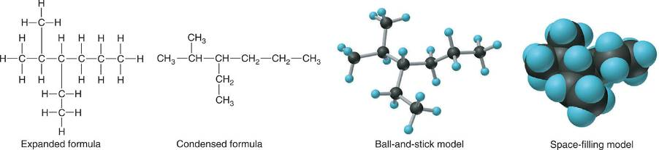
Ways of depicting formulas and models of an alkane

Slide 9
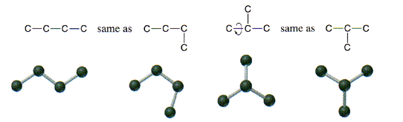
HYDROCARBONS
Carbon Skeletons and Hydrogen Skins
When determining the number of different skeletons, remember that
Each C can form a maximum of four single bonds, OR two single and one double bond, OR one single and triple bond.
The arrangement of C atoms determines the skeleton, so a straight chain and a bent chain represent the same skeleton.
Groups joined by single bonds can rotate, so a branch pointing down is the same as one pointing up.

Slide 10
ring
Some five-carbon skeletons
C
single bonds
double bond
C
C
C
C
C
C
C
C
C
C
C
C
C
C
C
C
C
C
C
C
C
C
C
C
C
C
C
C
C
C
C
C
C
C
C
C
C
C
C
C
C
C
C
C
C
C
C
C
C
C
C
C
C
C
C
C
C
C
C
C
C
C
C
C

Slide 11
Adding the H-atom skin to the C-atom skeleton
A C atom single-bonded to one other atom gets three H atoms.
A C atom single-bonded to two other atoms gets two H atoms.
A C atom single-bonded to three other atoms gets one H atom.
A C atom single-bonded to four other atom is already fully bonded (no H atoms).
A double-bonded C atom is treated as if it were bonded to two other atoms.
A double- and single-bonded C atom or a triple-bonded C atom is treated as if it were bonded to three other atoms.

Slide 12
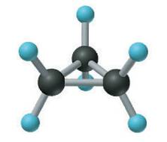
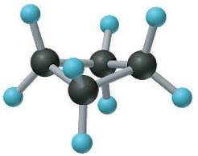
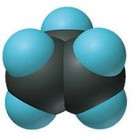
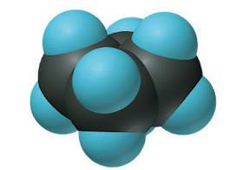
Depicting cycloalkanes
cyclopropane
cyclobutane

Slide 13
The chemical diversity of organic compounds.
4 carbons linked with single bonds, 1 oxygen and needed hydrogens.

Slide 14
The chemical diversity of organic compounds

Slide 15
SAMPLE PROBLEM
Drawing Hydrocarbons
PROBLEM:
Draw structures that have different atom arrangements for hydrocarbons with
(a) Six C atoms, no multiple bonds, and no rings
(b) Four C atoms, one double bond, and no rings
(c) Four C atoms, no multiple bonds, and one ring
PLAN:
Start with the longest chain and then draw shorter chains until you are repeating structures.
SOLUTION:
(a) Six carbons, no rings

Slide 16
SAMPLE PROBLEM
Drawing Hydrocarbons
continued
(a) continued
(b) Four carbons, one double bond
(c) Four carbons, one ring

Slide 17
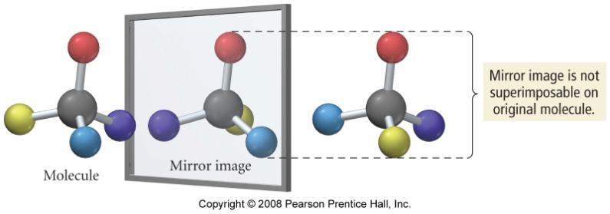
Nonsuperimposable Mirror Images
mirror image cannot be rotated so all its atoms align
with the same atoms of the original molecule

Slide 18
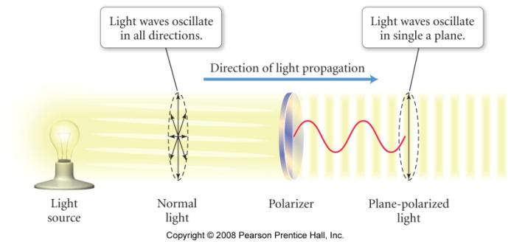
Plane Polarized Light
light that has been filtered so that only those waves traveling in a single plane are allowed through

Slide 19
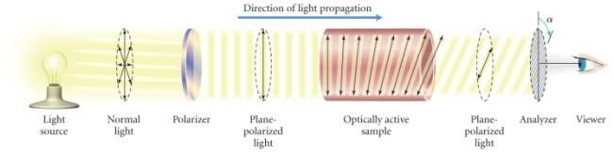
Optical Activity
a pair of enantiomers have all the same physical properties except one – the direction they rotate the plane of plane polarized light
each will rotate the plane the same amount, but in opposite directions
dextrorotatory = rotate to the right
levorotatory = rotate to the left
an equimolar mixture of the pair is called a racemic mixture
rotations cancel, so no net rotation

Slide 20
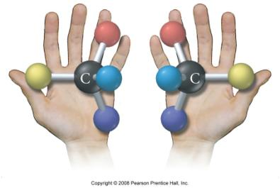
Chirality
any molecule with a nonsuperimposable mirror image is said to be chiral
any carbon with 4 different substituents will be a chiral center
a pair of nonsuperimposable mirror images are called a pair of enantiomers

Slide 21
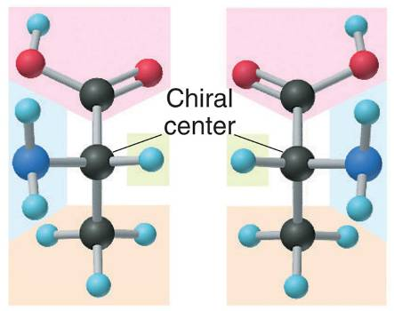
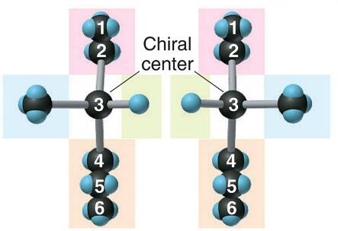
Two chiral molecules.
optical isomers of 3-methylhexane
optical isomers of alanine

Slide 22
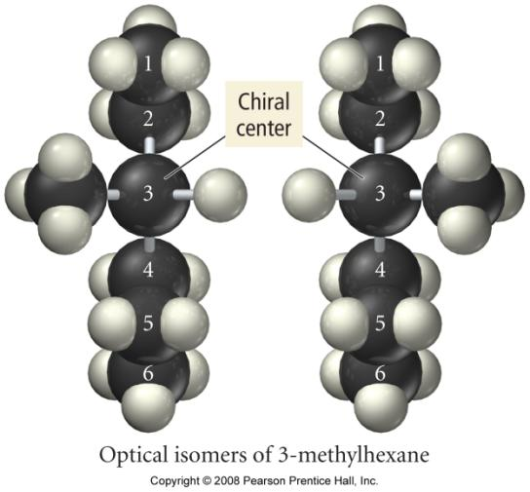
Optical Isomers of 3-methylhexane

Slide 23
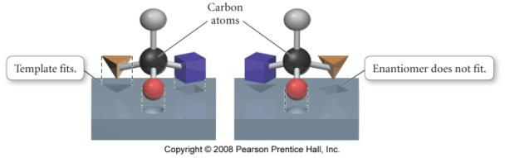
Chemical Behavior of Enantiomers
a pair of enantiomers will have the same chemical reactivity in a non-chiral environment
but in a chiral environment they may exhibit different behaviors
enzyme selection of one enantiomer of a pair

Slide 24
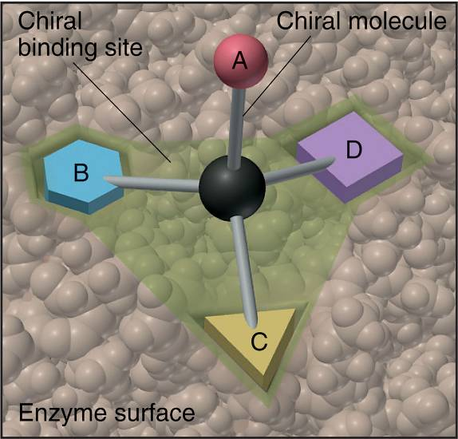
The binding site of an enzyme

Slide 25
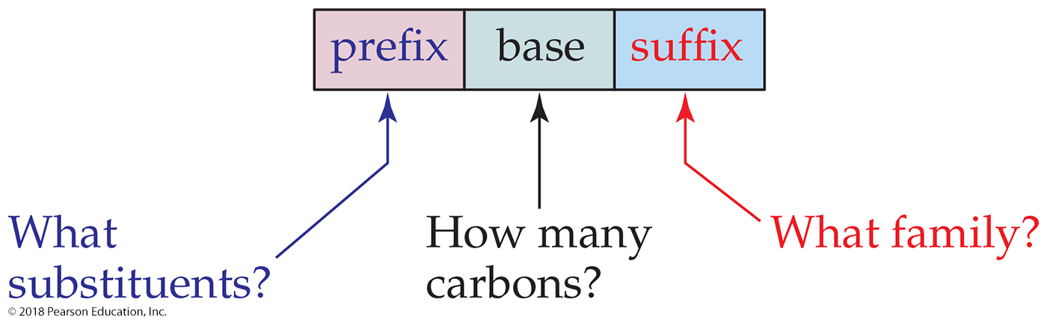
Systematic Nomenclature of Organic Compounds
There are three parts to a compound name:
Base (ROOT): This tells how many carbons are in the longest continuous chain.
Suffix: This tells what type of compound it is.
Prefix: This tells what groups are attached to the chain.

Slide 26
Numerical Roots for Carbon Chains and Branches
PREFIX + ROOT + SUFFIX
Number of C atoms
Roots
meth-
1
eth-
2
prop-
3
but-
4
pent-
5
hex-
6
hept-
7
oct-
8
non-
9
dec-
10

Slide 27

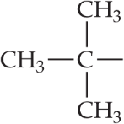
How to Name a Compound
Table 24.4 Condensed Structural Formulas and Common Names for Several Alkyl Groups (BRANCHES)
Group | Name
C H 3 | Methyl
C H 3, C H 2 | Ethyl
C H 3, C H 2, C H 2 | Propyl
C H 3, C H 2, C H 2, C H 2 | Butyl
A C H single bonded above and below to C H 3. | Isopropyl
A C single bonded left, above, and below to C H 3. | tert-Butyl

Slide 28
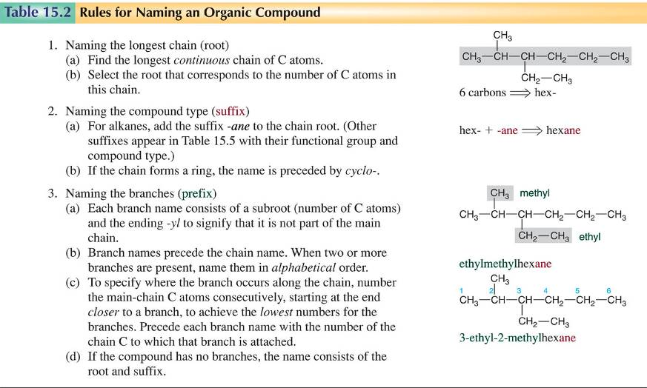
RULES FOR NAMING COMPOUNDS

Slide 29
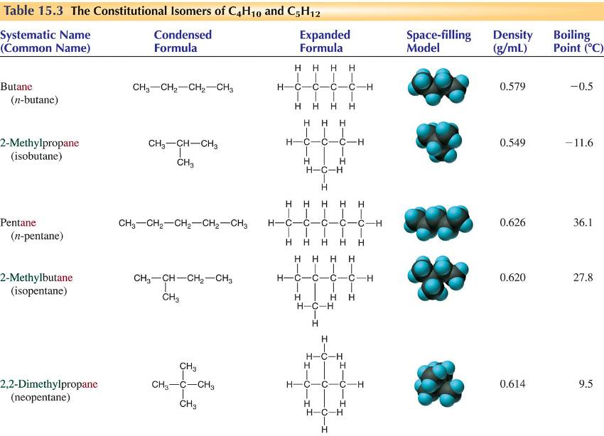
STRUCTURAL ISOMERS OF C₄H₁₀ & C₅H₁₂

Slide 30
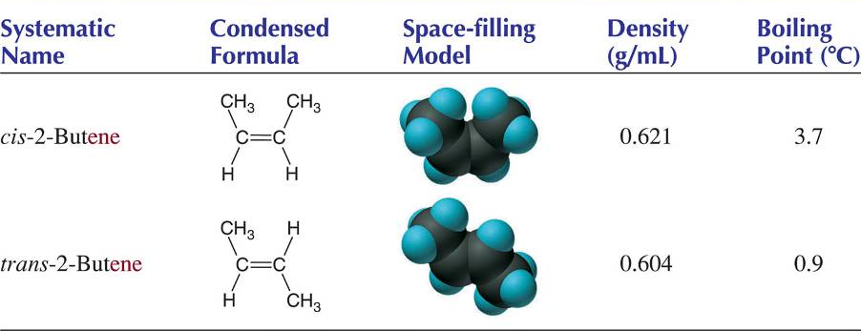
GEOMETRIC ISOMERS

Slide 31
SAMPLE PROBLEM
Naming Alkanes, Alkenes, and Alkynes
PROBLEM:
Give the systematic name for each of the following, indicate the chiral center in part (d), and draw two geometric isomers for part (c).
PLAN:
For (a)-(c), find the longest, continuous chain and give it the base name (root + suffix). Then number the chain so that the branches occur on the lowest numbered carbons and name the branches with the (root + yl). For (d) and (e) the main chain must contain the double bond and the chain must be numbered such that the double bond occurs on the lowest numbered carbon.

Slide 32
Aromatic Hydrocarbons
contain benzene ring structure
even though they are often drawn with C=C, they do not behave like alkenes

Slide 33
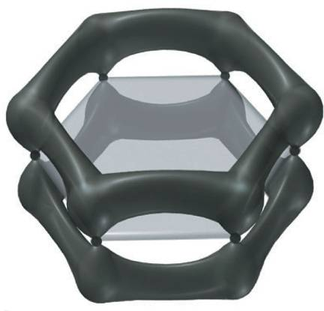
Representations of benzene
or

Slide 34
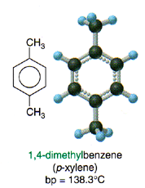
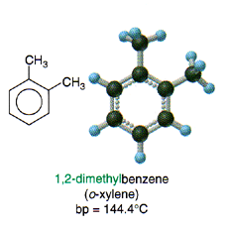
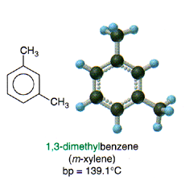
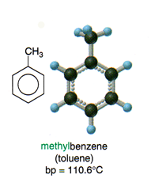
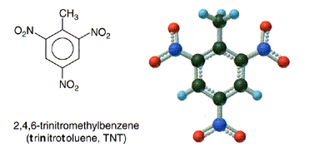

Slide 35
Functional Groups
other organic compounds are hydrocarbons in which functional groups have been substituted for hydrogens
a functional group is a group of atoms that show a characteristic influence on the properties of the molecule
generally, the reactions that a compound will perform are determined by what functional groups it has
since the kind of hydrocarbon chain is irrelevant to the reactions, it may be indicated by the general symbol R
CH₃—OH
R group
functional group

Slide 36
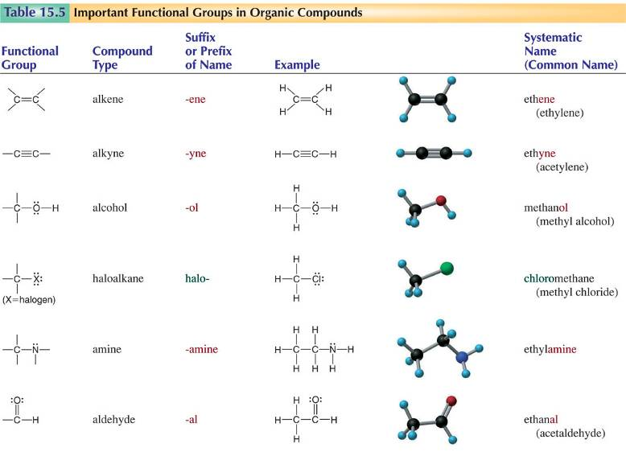
Functional Groups -1

Slide 37

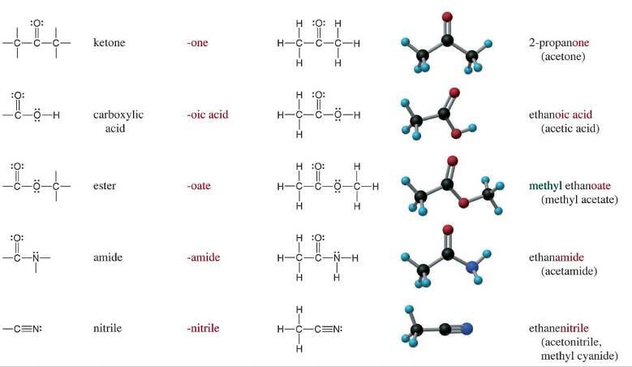
Functional Groups -2

Slide 38
Alcohols
R-OH
ethanol = CH₃CH₂OH
grain alcohol = fermentation of sugars
alcoholic beverages
proof number = 2X percentage of alcohol
gasohol
isopropyl alcohol = (CH₃)₂CHOH
2-propanol
rubbing alcohol
poisonous
methanol = CH₃OH
wood alcohol = thermolysis of wood
paint solvent
poisonous

Slide 39
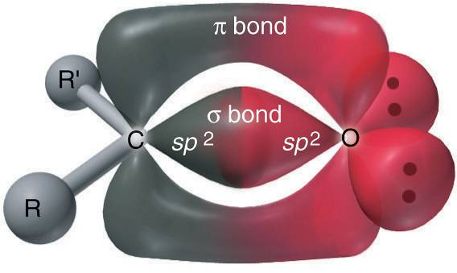
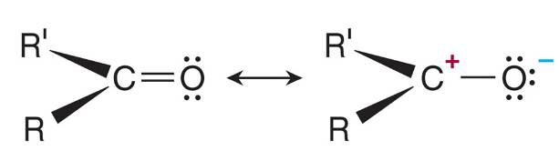
The carbonyl group.

Slide 40
Aldehydes and Ketones
contain the carbonyl group
aldehydes = at least 1 side H
ketones = both sides R groups
many aldehydes and ketones have pleasant tastes and aromas
some are pheromones
formaldehyde = H₂C=O
pungent gas
formalin = a preservative
wood smoke, carcinogenic
acetone = CH₃C(=O)CH₃
nail-polish remover
formaldehyde
acetone

Slide 41

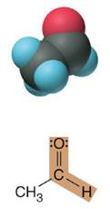
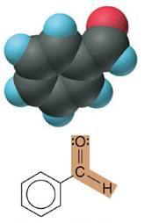
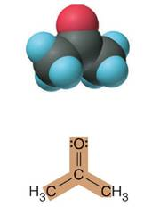
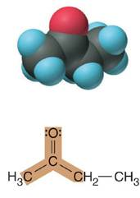
Some common aldehydes and ketones.
methanal (formaldehyde) used to make resins in plywood, dishware, countertops; biological preservative
ethanal (acetaldehyde)
narcotic product of ethanol metabolism; used to make perfume, flavors, plastics, other chemicals
benzaldehyde artificial almond flavoring
2-propanone (acetone) solvent for fat, rubber, plastic, varnish, lacquer; chemical feedstock
2-butanone (methyl ethyl ketone) important solvent

Slide 42
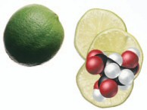
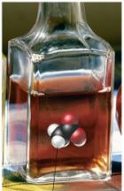
Carboxylic Acids
RCOOH
sour tasting
weak acids
citric acid
found in citrus fruit
ethanoic acid = acetic acid
vinegar
methanoic acid = formic acid
insect bites and stings

Slide 43
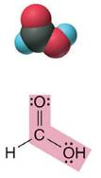
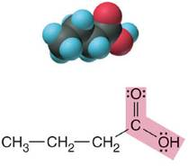
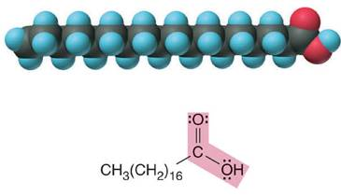
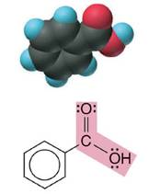
Some molecules with the carboxylic acid functional group.
methanoic acid (formic acid)
an irritating component of ant and bee stings
butanoic acid
(butyric acid)
odor of rancid butter; suspected component of monkey sex attractant
benzoic acid calorimetric standard; used in preserving food, dyeing fabric, curing tobacco
octadecanoic acid
(stearic acid)
found in animal fats; used in making candles and soap

Slide 44
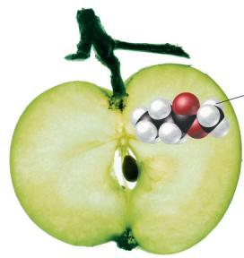
Esters
R–COO–R
sweet odor
made by reacting carboxylic acid with an alcohol
R_{a}COOH + R_{b}OH ⇔ R_{a}COOR_{b} + H₂O
name alkyl group from alcohol, then acid name with oate ending
precedence over carbonyls, but not carboxylic acid
number from end with ester group
methyl butanoate
aspirin

Slide 45
Amines
N containing organic molecules
very bad smelling
form when proteins decompose
organic bases
name alkyl groups attached to the N, then add the word amine to the end
putrescine
ethylamine
ethylmethylamine
cadaverine

Slide 46
Amines
many amines are biologically active
dopamine – a neurotransmitter
epinephrine – an adrenal hormone
pyridoxine – vitamin B₆
alkaloids are plant products that are alkaline and biologically active
toxic
coniine from hemlock
cocaine from coca leaves
nicotine from tobacco leaves
mescaline from peyote cactus
morphine from opium poppies

Slide 47
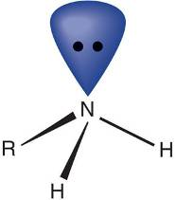
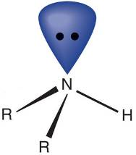
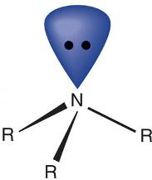
General structures of amines
the amine functional group
primary, 1⁰, amine
secondary, 2⁰, amine
tertiary, 3⁰, amine

Slide 48
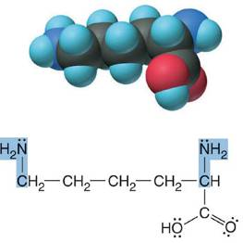
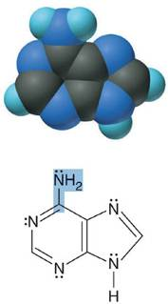
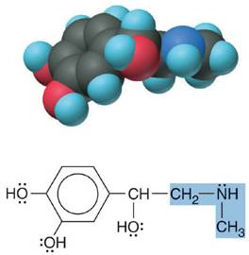
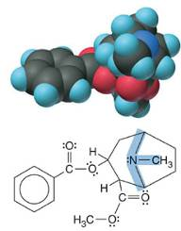
Some biomolecules with the amine functional group.
Lysine (1⁰ amine)
amino acid found in proteins
Adenine (1⁰ amine)
component of nucleic acids
Epinephrine (adrenaline; 2⁰ amine)
neurotransmitter in brain; hormone released during stress
Cocaine (3⁰ amine)
brain stimulant; widely abused drug

Slide 49
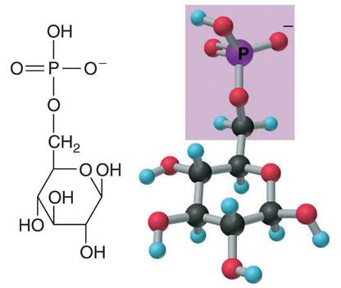
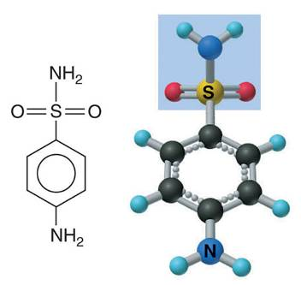
An ester and an amide of other nonmetals.
sulfanilamide
glucose-6-phosphate

Slide 50
SAMPLE PROBLEM
Recognizing Functional Groups
PROBLEM:
Circle and name the functional groups in the following molecules:
SOLUTION:

Slide 51

The Natural α-Amino Acids

Slide 52
Practice – Draw the structural formula of 4-isopropyl-2-methylheptane

Slide 53
Practice – Draw the structural formula of 4-isopropyl-2-methylheptane

Slide 54
Practice – Name the Following

Slide 55
Practice – Name the Following
3
4
5
6
2
1
3,4-dimethyl-3-hexene

Slide 56
Practice – Name the Following

Slide 57
Practice – Name the Following
3
2
1
4
5
3,3-dimethyl-1-pentyne

Slide 58
Practice – Name the Following

Slide 59
Practice – Name the Following
1-chloro-4-fluorobenzene
1,3-dibromobenzene
or meta-dibromobenzene
or m-dibromobenzene

Slide 60
Types of Organic Reactions
An addition reaction occurs when an unsaturated reactant becomes a saturated product:
Elimination reactions are the opposite of addition; they occur when a more saturated reactant becomes a less saturated product:
A substitution reaction occurs when an atom (or group) from an added reagent substitutes for one in the organic reactant:

Slide 61


Addition Reactions of Alkenes and Alkynes

Slide 62
Reactions of Alcohols
Nucleophilic Substitution
CH₃ OH + HCl → CH₃Cl + H₂O
Acid Catalyzed Elimination (Dehydration)
H₂SO₄
CH₃ CH₂OH → CH₂ CH₂ + H₂O
Oxidation
- 2 H
- 2 H
CH₃ CH₂OH → CH₃ CHO → CH₃ COOH
with Reactive Metals
CH₃ OH + Na → CH₃O⁻Na⁺ + ½ H₂

Slide 63



Reactions of aldehydes & ketones
aldehydes and ketones are generally synthesized by the oxidation of alcohols
therefore, reduction of an aldehyde or ketone results in an alcohol

Slide 64

Decomposition of Esters
Heating an ester in the presence of an acid catalyst and water can decompose the ester. (This is the reverse reaction of the preparation of an ester; it is an equilibrium.)
Heating an ester in the presence of a base results in saponification (making soap).

Slide 65
SAMPLE PROBLEM
Recognizing the Type of Organic Reaction
PROBLEM:
State whether each reaction is an addition, elimination, or substitution:
PLAN:
Look for changes in the number of atoms attached to carbon.
More atoms bonded to C is an addition.
Fewer atoms bonded to C is an elimination.
Same number of atoms bonded to C is a substitution.

Slide 66
SAMPLE PROBLEM
Predicting the Reactions of Alcohols, Alkyl
Halides, and Amines
PROBLEM:
Determine the reaction type and predict the product(s) in the following:
PLAN:
Check for functional groups and reagents, then for inorganics added. In (a) the -OH will substitute in the alkyl halide; in (b) the amine and alkyl halide will undergo a substitution of amine for halogen; in (c) the inorganics form a strong oxidizing agent resulting in an elimination.

Slide 67

MONOMERS of POLYMERS

Slide 68




Steps in the free-radical polymerization of ethylene.

Slide 69



The structure of glucose in aqueous solution and the
formation of a disaccharide.

