Slide 1
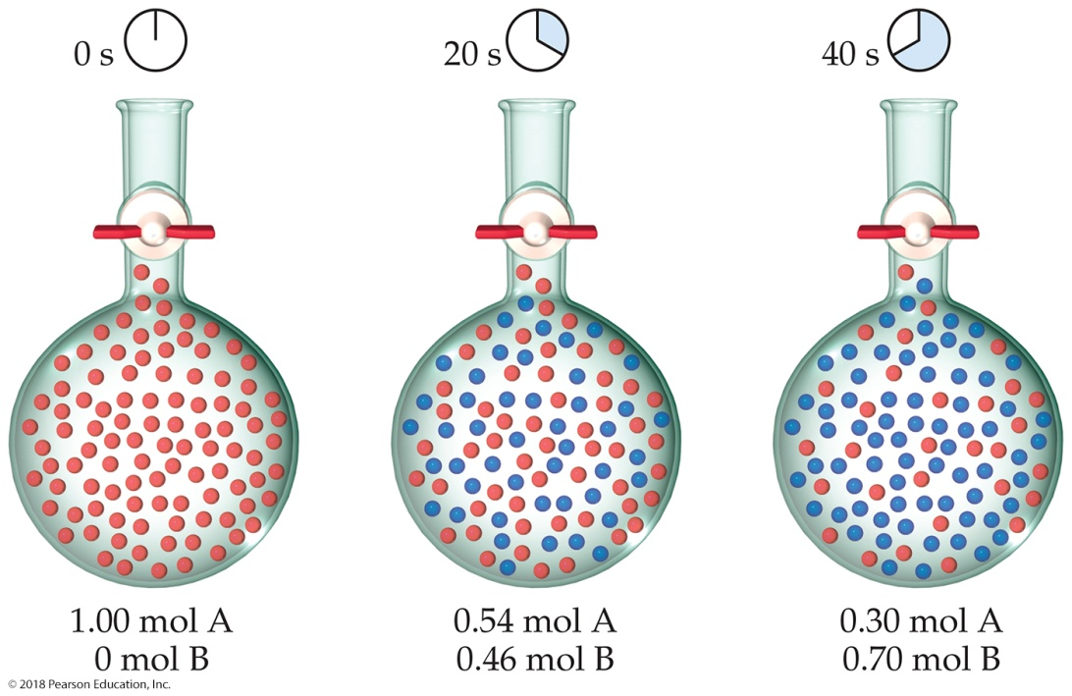
Sample Exercise 14.1 Calculating an Average Rate of Reaction
From the data in Figure 14.2, calculate the average rate at which A disappears over the time interval from 20 s to 40 s.
Solution
Analyze We are given the concentration of A at 20 s (0.54 M) and at 40 s (0.30 M) and asked to calculate the average rate of reaction over this time interval.
Plan The average rate is given by the change in concentration, Δ[A], divided by the change in time, Δt. Because A is a reactant, a minus sign is used in the calculation to make the rate a positive quantity.

Slide 2
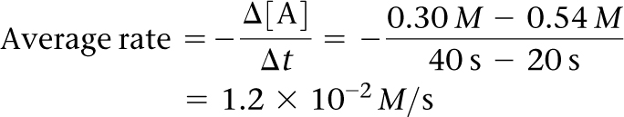
Sample Exercise 14.1 Calculating an Average Rate of Reaction
Continued
Solve
Practice Exercise 1
If the experiment in Figure 14.2 is run for 60 s, 0.16 mol A remain. Which of the following statements is or are true?
(i) After 60 s there are 0.84 mol B in the flask.
(ii) The decrease in the number of moles of A from t₁ = 0 s to t₂ = 20 s is greater than that from t₁ = 40 to t₂ = 60 s.
(iii) The average rate for the reaction from t₁ = 40 s to t₂ = 60 s is 7.0 × 10^{–3} M/s.
(a) Only one of the statements is true.
(b) Statements (i) and (ii) are true.
(c) Statements (i) and (iii) are true.
(d) Statements (ii) and (iii) are true.
(e) All three statements are true.
Practice Exercise 2
Use the data in Figure 14.2 to calculate the average rate of appearance of B over the time interval from 0 s to 40 s.

Slide 3
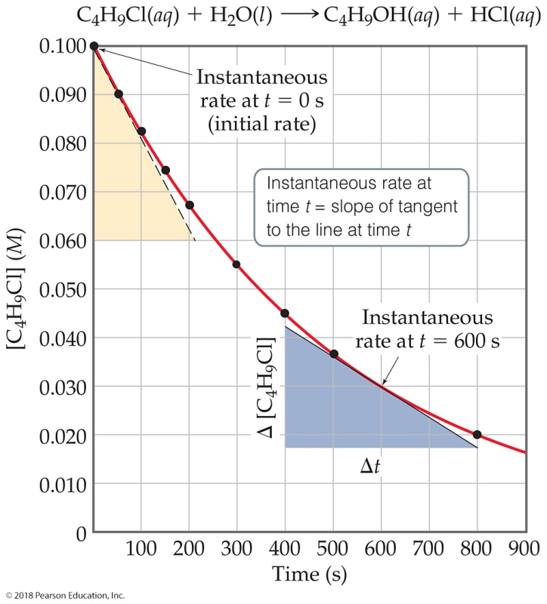
Sample Exercise 14.2 Calculating an Instantaneous Rate of Reaction
Using Figure 14.3, calculate the instantaneous rate of disappearance of C₄H₉Cl at t = 0 s (the initial rate).
Solution
Analyze We are asked to determine an instantaneous rate from a graph of reactant concentration versus time.
Plan To obtain the instantaneous rate at t = 0 s, we must determine the slope of the curve at t = 0. The tangent is drawn on the graph as the hypotenuse of the tan triangle. The slope of this straight line equals the change in the vertical axis divided by the corresponding change in the horizontal axis (which, in the case of this example, is the change in molarity over change in time).

Slide 4
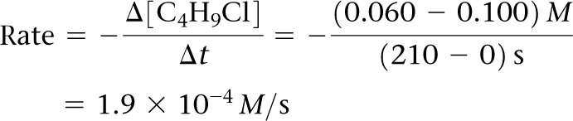
Sample Exercise 14.2 Calculating an Instantaneous Rate of Reaction
Continued
Solve The tangent line falls from [C₄H₉Cl] = 0.100 M to 0.060 M in the time change from 0 s to 210 s. Thus, the initial rate is
Practice Exercise 1
Which of the following could be the instantaneous rate of the reaction in Figure 14.3 at t = 1000 s?
(a) 1.2 × 10^{–4} M/s
(b) 8.8 × 10^{–5} M/s
(c) 6.3 × 10^{–5} M/s
(d) 2.7 × 10^{–5} M/s
(e) More than one of these.
Practice Exercise 2
Using Figure 14.3, determine the instantaneous rate of disappearance of C₄H₉Cl at t = 300 s.

Slide 5
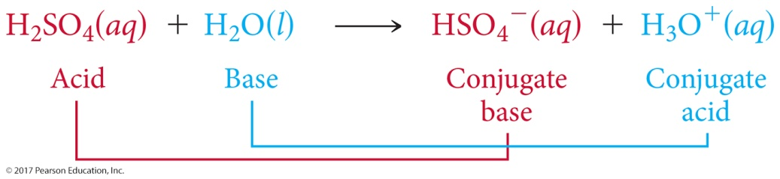

Sample Exercise 14.3 Relating Rates at Which Products Appear and Reactants Disappear
(a) How is the rate at which ozone disappears related to the rate at which oxygen appears in the reaction 2 O₃(g) 3 O₂(g)?
(b) If the rate at which O₂ appears, Δ[O₂]/Δt, is 6.0 × 10^{–5} M/s at a particular instant, at what rate is O₃ disappearing at this same time, –Δ[O₃]/Δt?
Solution
Analyze We are given a balanced chemical equation and asked to relate the rate of appearance of the product to the rate of disappearance of the reactant.
Plan We can use the coefficients in the chemical equation as shown in Equation 14.4 to express the relative rates of reactions.
Solve
(a) Using the coefficients in the balanced equation and the relationship given by Equation 14.4, we have:
(b) Solving the equation from part (a) for the rate at which O₃ disappears, –Δ[O₃]/Δt, we have:

Slide 6
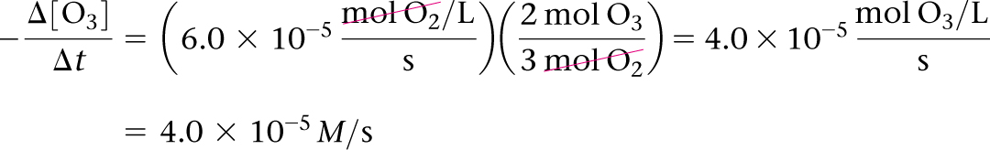
Sample Exercise 14.3 Relating Rates at Which Products Appear and Reactants Disappear
Continued
Check We can apply a stoichiometric factor to convert the O₂ formation rate to the O₃ disappearance rate:
Practice Exercise 1
At a certain time in a reaction, substance A is disappearing at a rate of 4.0 × 10^{–2} M/s, substance B is appearing at a rate of 2.0 × 10^{–2} M/s, and substance C is appearing at a rate of 6.0 × 10^{–2} M/s. Which of the following could be the stoichiometry for the reaction being studied?
(a) 2 A + B 3 C (b) A 2 B + 3 C
(c) 2 A B + 3 C (d) 4 A 2 B + 3 C
(e) A + 2 B 3 C
Practice Exercise 2
If the rate of decomposition of N₂O₅ in the reaction 2 N₂O₅(g) 4 NO₂(g) + O₂(g) at a particular instant is
4.2 × 10^{–7}M/s, what is the rate of appearance of (a) NO₂ and (b) O₂ at that instant?

Slide 7
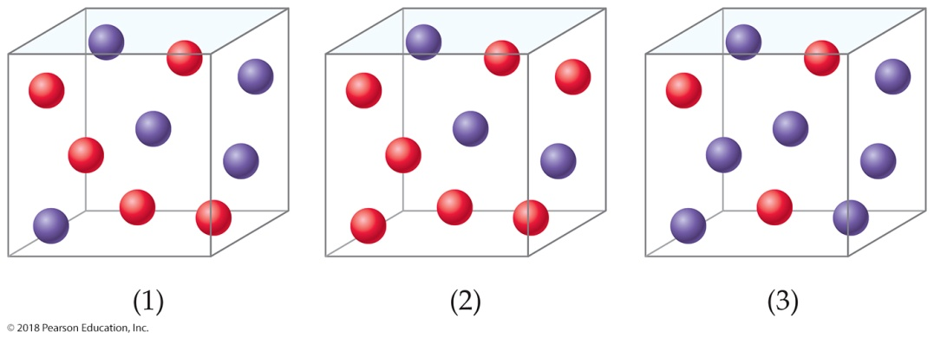
Sample Exercise 14.4 Relating a Rate Law to the Effect of Concentration on Rate
Consider a reaction A + B C for which rate = k[A][B]². Each of the following boxes represents a reaction mixture in which A is shown as red spheres and B as purple ones. Rank these mixtures in order of increasing rate of reaction.
Solution
Analyze We are given three boxes containing different numbers of spheres representing mixtures containing different reactant concentrations. We are asked to use the given rate law and the compositions of the boxes to rank the mixtures in order of increasing reaction rates.
Plan Because all three boxes have the same volume, we can put the number of spheres of each kind into the rate law and calculate the rate for each box.
Solve Box 1 contains 5 red spheres and 5 purple spheres, giving the following rate:
Box 1: Rate = k(5)(5)² = 125k
Box 2 contains 7 red spheres and 3 purple spheres:
Box 2: Rate = k(7)(3)² = 63k

Slide 8
Sample Exercise 14.4 Relating a Rate Law to the Effect of Concentration on Rate
Continued
Box 3 contains 3 red spheres and 7 purple spheres:
Box 3: Rate = k(3)(7)² = 147k
The slowest rate is 63k (Box 2), and the highest is 147k (Box 3). Thus, the rates vary in the order 2 < 1 < 3.
Check Each box contains 10 spheres. The rate law indicates that in this case [B] has a greater influence on rate than [A] because B has a larger reaction order. Hence, the mixture with the highest concentration of B (most purple spheres) should react fastest. This analysis confirms the order 2 < 1 < 3.
Practice Exercise 1
Suppose the rate law for the reaction in this Sample Exercise were rate = k[A]²[B]. What would be the ordering of the rates for the three mixtures shown above, from slowest to fastest?
(a) 1 < 2 < 3 (b) 1 < 3 < 2 (c) 3 < 2 < 1 (d) 2 < 1 < 3 (e) 3 < 1 < 2
Practice Exercise 2
Assuming that rate = k[A][B], rank the mixtures represented in this Sample Exercise in order of increasing rate.

Slide 9
Sample Exercise 14.5 Determining Reaction Orders and Units for Rate Constants
(a) What are the overall reaction orders for the reactions described in Equations 14.9 and 14.11?
(b) What are the units of the rate constant for the rate law in Equation 14.9?
Solution
Analyze We are given two rate laws and asked to express (a) the overall reaction order for each and (b) the units for the rate constant for the first reaction.
Plan The overall reaction order is the sum of the exponents in the rate law. The units for the rate constant, k, are found
by using the normal units for rate (M/s) and concentration (M) in the rate law and applying algebra to solve for k.
Solve
(a) The rate of the reaction in Equation 14.9 is first order in N₂O₅ and first order overall. The reaction in Equation 14.11 is first order in CHCl₃ and one-half order in Cl₂. The overall reaction order is three halves.
(b) For the rate law for Equation 14.9, we have
Units of rate = (units of rate constant)(units of concentration)
so
Note that if the reaction order changes, the units of the rate constant change.

Slide 10
Sample Exercise 14.5 Determining Reaction Orders and Units for Rate Constants
Continued
Practice Exercise 1
Which of the following are the units of the rate constant for Equation 14.11?
(a) M^{–1/2} s^{–1} (b) M^{–1/2} s^{–1/2} (c) M ^{1/2} s^{–1} (d) M^{–3/2} s^{–1} (e) M^{–3/2}s^{–1/2}
Practice Exercise 2
(a) What is the reaction order of the reactant H₂ in Equation 14.10? (b) What are the units of the rate constant for Equation 14.10?

Slide 11
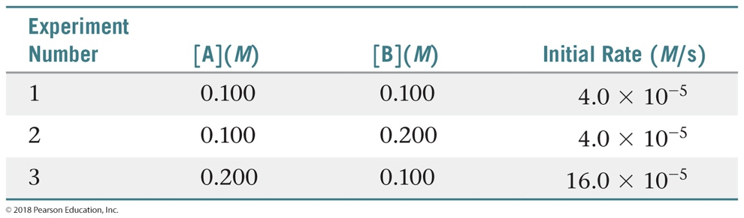
Sample Exercise 14.6 Determining a Rate Law from Initial Rate Data
The initial rate of a reaction A + B C was measured for three different starting concentrations of A and B, and the results are as follows:
Using these data, determine (a) the rate law for the reaction, (b) the rate constant, (c) the rate of the reaction when
[A] = 0.050 M and [B] = 0.100 M.
Solution
Analyze We are given a table of data that relates concentrations of reactants with initial rates of reaction and asked to determine (a) the rate law, (b) the rate constant, and (c) the rate of reaction for a set of concentrations not listed in the table.
Plan (a) We assume that the rate law has the following form: Rate = k[A]^{m}[B]^{n}. We will use the given data to deduce the reaction orders m and n by determining how changes in the concentration change the rate. (b) Once we know m and n, we can use the rate law and one of the sets of data to determine the rate constant k. (c) Upon determining both the rate constant and the reaction orders, we can use the rate law with the given concentrations to calculate rate.

Slide 12

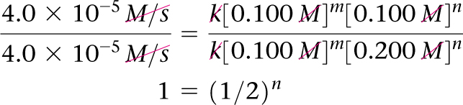

Sample Exercise 14.6 Determining a Rate Law from Initial Rate Data
Continued
Solve
(a) If we compare experiments 1 and 2, we see that [A] is held constant and [B] is doubled. Thus, this pair of experiments shows how [B] affects the rate, allowing us to deduce the order of the rate law with respect to B.
Inserting values of rate and concentration from the experiments gives:
The only way this equation can be true is if n = 0. Therefore, the rate law is zero order in B, which means that the rate is independent of [B].
In experiments 1 and 3, [B] is held constant, so these data allow us to determine the order of the rate law with respect to [A].

Slide 13
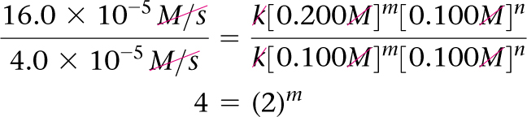

Sample Exercise 14.6 Determining a Rate Law from Initial Rate Data
Continued
  Inserting values of rate and concentration from the experiments gives:
Because the rate increases by a factor of four when [A] is doubled, we can conclude that m = 2 and the rate law is second order in B.
Combining these results, we arrive at the rate law: Rate = k[A]²[B]⁰ = k[A]²
(b) Using the rate law and the data from experiment 1, we have:
(c) Using the rate law from part (a) and the rate constant from part (b), we have:
Rate = k[A]²
= (4.0 × 10^{–3} M^{–1}s^{–1})(0.050 M)²
= 1.0 × 10^{–5} M/s
Because [B] is not part of the rate law, it is irrelevant to the rate if there is at least some B present to react with A.

Slide 14
Sample Exercise 14.6 Determining a Rate Law from Initial Rate Data
Continued
  Check A good way to check our rate law is to use the concentrations in experiment 2 or 3 and see if we can correctly calculate the rate. Using data from experiment 3, we have
  Rate = k[A]² = (4.0 × 10^{–3} M^{–1} s^{–1})(0.200 M)²
  = 1.6 × 10^{–4} M/s
  Thus, the rate law correctly reproduces the data, giving both the correct number and the correct units for the rate.
Practice Exercise 1
  Consider the reaction examined above in the Sample Exercise, A + B C. If the concentration of B is doubled, the rate of disappearance of B ________, whereas if the concentration of A is doubled, the rate of disappearance of B ________.
  (a) does not change; does not change
  (b) increases by a factor of two; increases by a factor of two
  (c) increases by a factor of four; increases by a factor of two
  (d) does not change; increases by a factor of four
  (e) increases by a factor of four; does not change

Slide 15
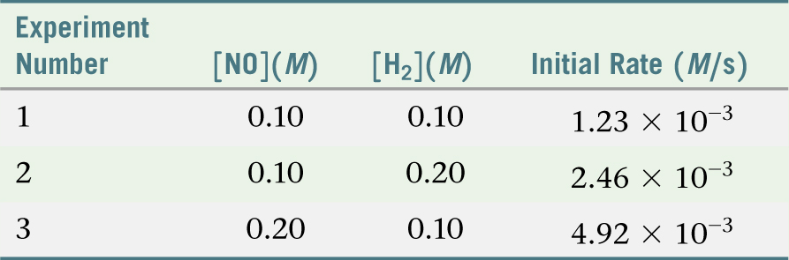
Sample Exercise 14.6 Determining a Rate Law from Initial Rate Data
Continued
Practice Exercise 2
  The following data were measured for the reaction of nitric oxide with hydrogen:
  2 NO(g) + 2 H₂(g) N₂(g) + 2 H₂O(g)
  (a) Determine the rate law for this reaction.
  (b) Calculate the rate constant.
  (c) Calculate the rate when [NO] = 0.050 M and [H₂] = 0.150 M.

Slide 16
Sample Exercise 14.7 Using the Integrated First-Order Rate Law
The decomposition of a certain insecticide in water at 12 °C follows first-order kinetics with a rate constant of
1.45 yr^{–1}. A quantity of this insecticide is washed into a lake on June 1, leading to a concentration of 5.0 × 10^{–7} g/cm³. Assume that the temperature of the lake is constant (so that there are no effects of temperature variation on the rate). (a) What is the concentration of the insecticide on June 1 of the following year? (b) How long will it take for the insecticide concentration to decrease to 3.0 × 10^{–7} g/cm³?
Solution
Analyze We are given the rate constant for a reaction that obeys first-order kinetics, as well as information about concentrations and times, and asked to calculate how much reactant (insecticide) remains after 1 yr. We must also determine the time interval needed to reach a particular insecticide concentration.
Plan In part (a) we are given the rate constant, a period of time, and the initial concentration of the reactant, so we can use Equation 14.13 to determine the concentration of the reactant after 1 year has passed. In part (b) we are given the initial and final concentrations and the rate constant. In this case we can use Equation 14.13 to calculate the time that must pass to reach the desired concentration.
Solve
(a) Substituting the known quantities into Equation 14.13, we have:
ln[insecticide]_{t = 1 yr} = –(1.45 yr^{–1})(1.00 yr) + ln(5.0 × 10^{–7})
We use the ln function on a calculator to evaluate the second term on the right [that is, ln(5.0 × 10^{–7})], giving:
ln[insecticide]_{t = 1 yr} = –1.45 + (–14.51) = –15.96

Slide 17
Sample Exercise 14.7 Using the Integrated First-Order Rate Law
Continued
To obtain [insecticide]_{t = 1 yr}, we use the inverse natural logarithm, or e^{x}, function on the calculator:
[insecticide]_{t = 1 yr} = e^{–15.96} = 1.2 × 10^{–7}g/cm³
Note that the concentration units for [A]_{t} and [A]₀ must be the same.
(b) Again substituting into Equation 14.13, with [insecticide]_{t} = 3.0 × 10^{–7} g/cm³, gives:
ln(3.0 × 10^{–7}) = –(1.45 yr^{–1})(t) + ln(5.0 × 10^{–7})
Solving for t gives:
t = –[ln(3.0 × 10^{–7}) – ln(5.0 × 10^{–7})]/1.45 yr^{–1}
= –(–15.02 + 14.51)/1.45 yr^{–1} = 0.35 yr
Check In part (a) the concentration remaining after 1.00 yr (that is, 1.2 × 10^{–7} g/cm³) is less than the original concentration (5.0 × 10^{–7} g/cm³), as it should be. In (b) the given concentration (3.0 × 10^{–7} g/cm³) is greater than that remaining after 1.00 yr, indicating that the time must be less than a year. Thus, t = 0.35 yr is a reasonable answer.

Slide 18
Sample Exercise 14.7 Using the Integrated First-Order Rate Law
Continued
Practice Exercise 1
At 25 °C, the decomposition of dinitrogen pentoxide, N₂O₅(g), into NO₂(g) and O₂(g) follows first-order kinetics with k = 3.4 × 10^{–5} s^{–1}. A sample of N₂O₅with an initial pressure of 760 torr decomposes at 25 °C until its partial pressure is 650 torr. How much time (in seconds) has elapsed?
(a) 5.3 × 10^{–6} (b) 2000 (c) 4600 (d) 34,000 (e) 190,000
Practice Exercise 2
The decomposition of dimethyl ether, (CH₃)₂O, at 510 °C is a first-order process with a rate constant of
6.8 × 10^{–4} s^{–1}:
(CH₃)₂O(g) CH₄(g) + H₂(g) + CO(g)
If the initial pressure of (CH₃)₂O is 135 torr, what is its pressure after 1420 s?

Slide 19
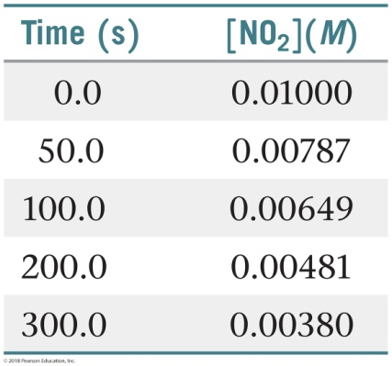
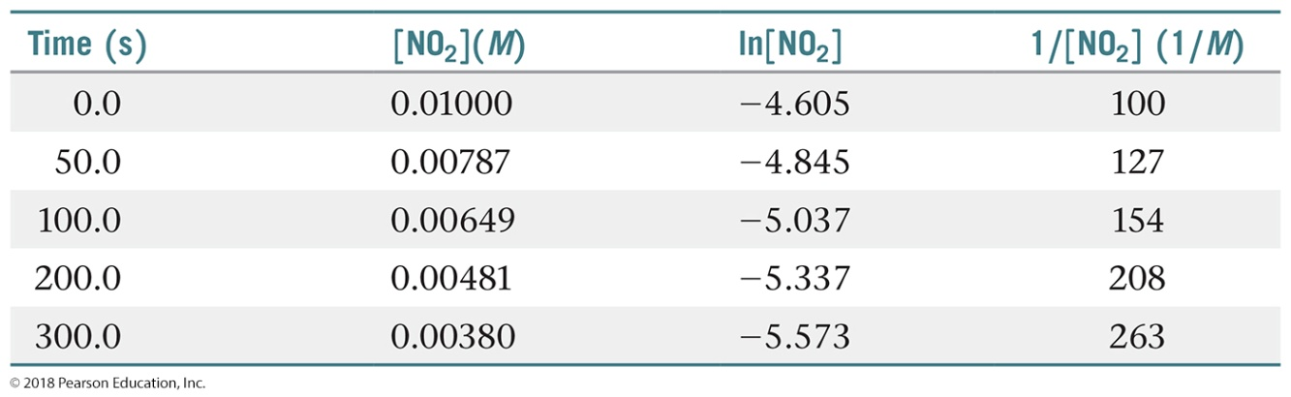
Sample Exercise 14.8 Determining Reaction Order from the Integrated Rate Law
The following data were obtained for the gas-phase decomposition of nitrogen dioxide at 300 °C, NO₂(g) NO(g) + O₂(g). Is the reaction first or second order in NO₂?
Solution
Analyze We are given the concentrations of a reactant at various times during a reaction and asked to determine whether the reaction is first or second order.
Plan We can plot ln[NO₂] and 1/[NO₂] against time. If one plot or the other is linear, we will know the reaction is either first or second order.
Solve
To graph ln[NO₂] and 1/[NO₂]
against time, we first make the
following calculations from the
data given:

Slide 20
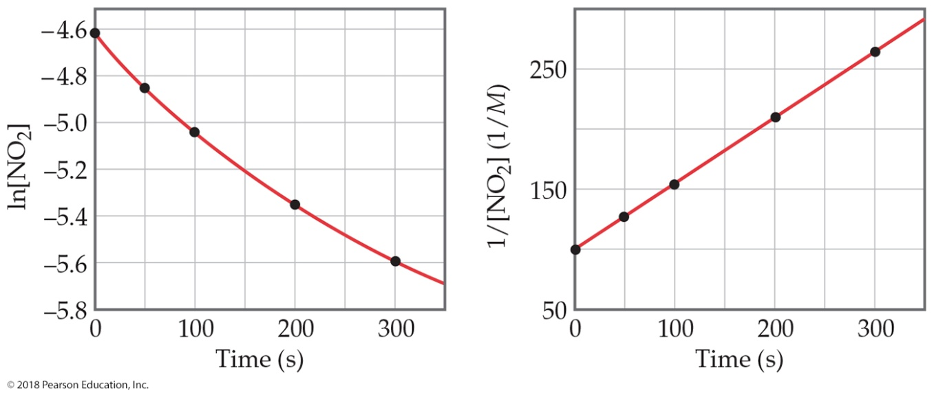
Sample Exercise 14.8 Determining Reaction Order from the Integrated Rate Law
Continued
As Figure 14.8 shows, only the plot of 1/[NO₂] versus time is linear. Thus, the reaction obeys a second-order rate law: Rate = k[NO₂]². From the slope of this straight-line graph, we determine that k = 0.543 M^{–1} s^{–1} for the disappearance of NO₂.

Slide 21
Sample Exercise 14.8 Determining Reaction Order from the Integrated Rate Law
Continued
Practice Exercise 1
For a certain reaction A products, a plot of ln[A] versus time produces a straight line with a slope of
–3.0 × 10^{–2} s^{–1}. Which of the following statements is or are true?
(i) The reaction follows first-order kinetics.
(ii) The rate constant for the reaction is 3.0 × 10^{–2} s^{–1}.
(iii) The initial concentration of [A] was 1.0 M.
(a) Only one of the statements is true.
(b) Statements (i) and (ii) are true.
(c) Statements (i) and (iii) are true.
(d) Statements (ii) and (iii) are true.
(e) All three statements are true.
Practice Exercise 2
The decomposition of NO₂ discussed in the Sample Exercise is second order in NO₂ with k = 0.543 M^{–1} s^{–1}. If the initial concentration of NO₂ in a closed vessel is 0.0500 M, what is the concentration of this reactant after 0.500 h?

Slide 22

Sample Exercise 14.9 Determining the Half-Life of a First-Order Reaction
The reaction of C₄H₉Cl with water is a first-order reaction. (a) Use Figure 14.3 to estimate the half-life for this reaction. (b) Use the half-life from (a) to calculate the rate constant.
Solution
Analyze We are asked to estimate the half-life of a reaction from a graph of concentration versus time and then to use the half-life to calculate the rate constant for the reaction.
Plan
(a) To estimate a half-life, we can select a concentration and then determine the time required for the concentration to decrease to half of that value.
(b) Equation 14.17 is used to calculate the rate constant from the half-life.

Slide 23

Sample Exercise 14.9 Determining the Half-Life of a First-Order Reaction
Continued
Solve
(a) From the graph, we see that the initial value of [C₄H₉Cl] is 0.100 M. The half-life for this first-order reaction is the time required for [C₄H₉Cl] to decrease to 0.050 M, which we can read off the graph. This point occurs at approximately 340 s.
(b) Solving Equation 14.17 for k, we have
Check At the end of the second half-life, which should occur at 680 s, the concentration should have decreased by yet another factor of 2, to 0.025 M. Inspection of the graph shows that this is indeed the case.

Slide 24
Sample Exercise 14.9 Determining the Half-Life of a First-Order Reaction
Continued
Practice Exercise 1
We noted in an earlier Practice Exercise that at 25 °C the decomposition of N₂O₅(g) into NO₂(g) and O₂(g) follows first-order kinetics with k = 3.4 × 10^{–5} s^{–1}. How long will it take for a sample originally containing 2.0 atm of N₂O₅ to reach a partial pressure of 380 torr?
(a) 5.7 h (b) 8.2 h (c) 11 h (d) 16 h (e) 32 h
Practice Exercise 2
(a) Using Equation 14.17, calculate t_{1/2} for the decomposition of the insecticide described in Sample Exercise 14.7.
(b) How long does it take for the concentration of the insecticide to reach one-quarter of the initial value?

Slide 25
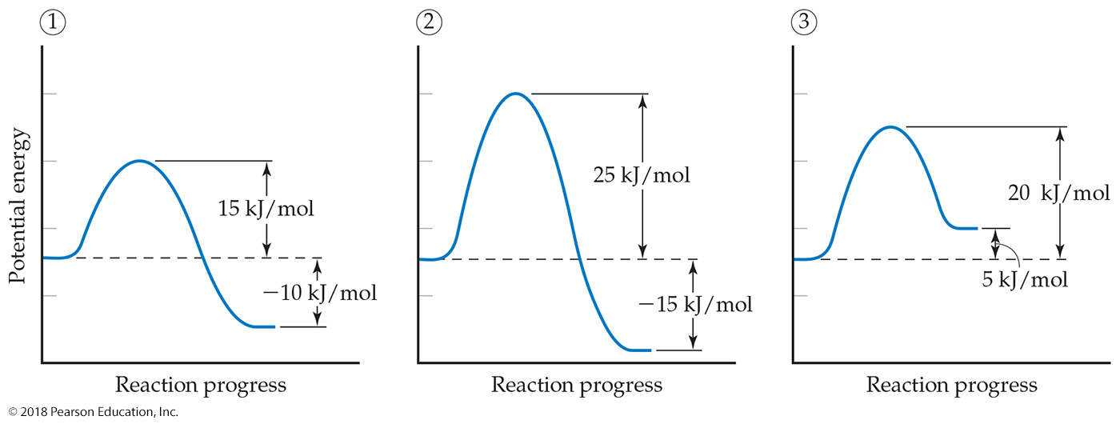
Sample Exercise 14.10 Activation Energies and Speeds of Reaction
Consider a series of reactions having these energy profiles:
Rank the forward rate constants from smallest to largest assuming all three reactions have nearly the same value for the frequency factor A.
Solution
The lower the activation energy, the larger the rate constant and the faster the reaction. The value of ΔE does not affect the value of the rate constant. Hence, the order of the rate constants is 2 < 3 < 1.

Slide 26
Sample Exercise 14.10 Activation Energies and Speeds of Reaction
Continued
Practice Exercise 1
Which of the following changes always leads to an increase in the rate constant for a reaction:
(i) Decreasing the temperature
(ii) Decreasing the activation energy
(iii) Making the value of ΔE more negative
(a) Only one—(i), or (ii), or (iii)—increases the reaction rate.
(b) (i) and (ii)
(c) (i) and (iii)
(d) (ii) and (iii)
(e) All three—(i), (ii), and (iii)—increase the reaction rate.
Practice Exercise 2
Rank the rate constants of the reverse reactions from slowest to fastest.

Slide 27
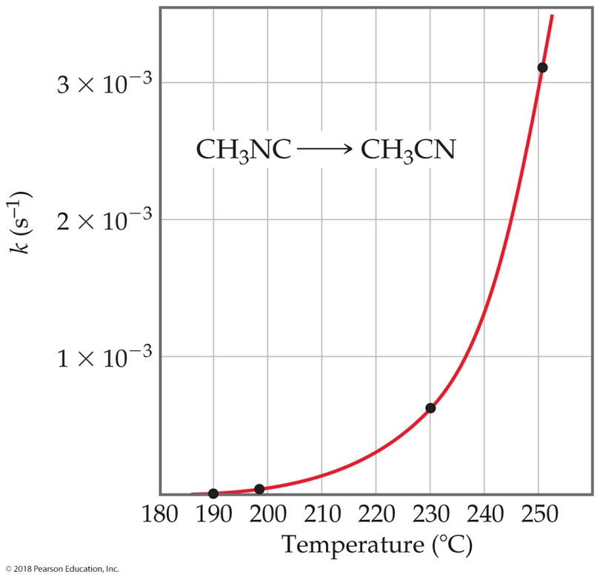
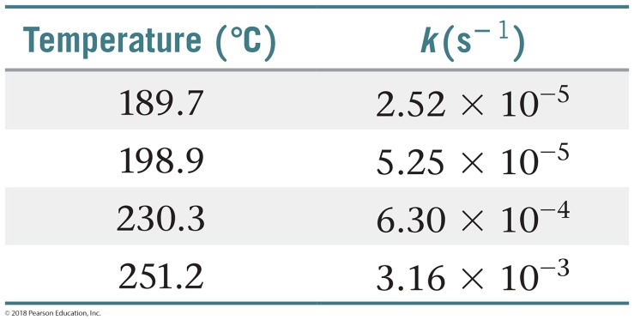
Sample Exercise 14.11 Determining the Activation Energy
The table at right shows the rate constants for the rearrangement of methyl isonitrile at various temperatures (these are the data points in Figure 14.13):
(a) From these data, calculate the activation energy for the reaction.
(b) What is the value of the rate constant at 430.0 K?
Solution
Analyze We are given rate constants, k, measured at several temperatures and asked to determine the activation energy, E_{a}, and the rate constant, k, at a particular temperature.
Plan We can obtain E_{a} from the slope of a graph of ln k versus 1/T. Once we know E_{a}, we can use Equation 14.23 together with the given rate data to calculate the rate constant at 430.0 K.

Slide 28
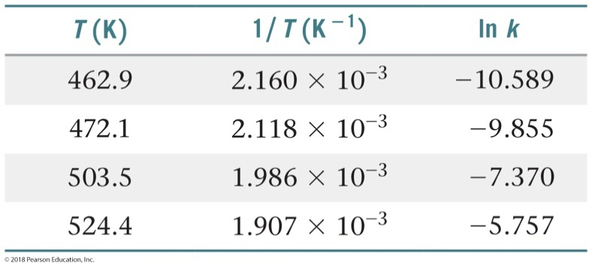
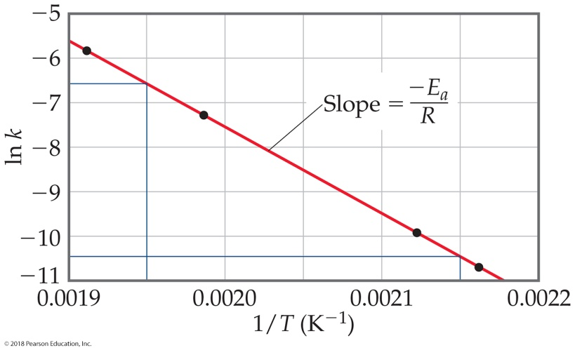
Sample Exercise 14.11 Determining the Activation Energy
Continued
Solve
(a) We must first convert the temperatures from degrees Celsius to kelvins. We then take the inverse of each temperature, 1/T, and the natural log of each rate constant, ln k. This gives us the table shown below:
A graph of ln k versus 1/T is a straight line (Figure 14.18).

Slide 29

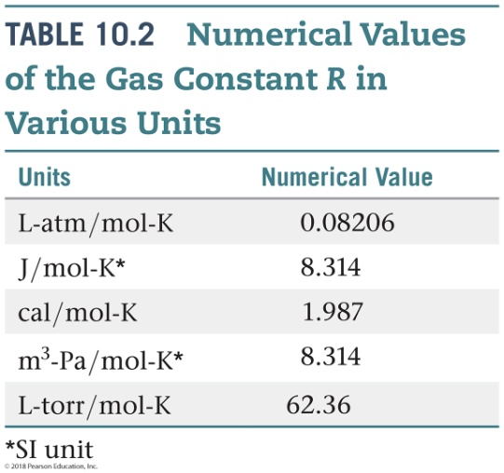
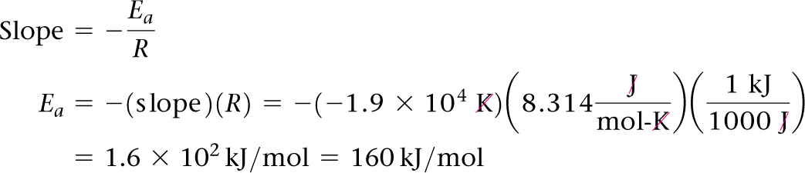
Sample Exercise 14.11 Determining the Activation Energy
Continued
The slope of the line is obtained by choosing any two well-separated points and using the coordinates of each:
Because logarithms have no units, the numerator in this equation is dimensionless. The denominator has the units of 1/T, namely, K^{–1}. Thus, the overall units for the slope are K. The slope equals –E_{a}/R. We use the value for the gas constant R in units of J/mol-K (Table 10.2).
We thus obtain

Slide 30
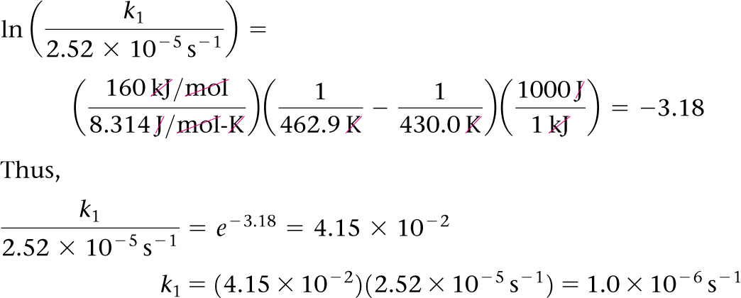
Sample Exercise 14.11 Determining the Activation Energy
Continued
We report the activation energy to only two significant figures because we are limited by the precision with which we can read the graph in Figure 14.18.
(b) To determine the rate constant, k₁, at T₁ = 430.0 K, we can use Equation 14.23 with E_{a} = 160 kJ/mol and one of the rate constants and temperatures from the given data, such as k₂ = 2.52 × 10^{–5} s^{–1} and T₂ = 462.9 K:
Note that the units of k₁ are the same as those of k₂ and the rate constant at 430.0 K is smaller than it is at 462.9 K, as it should be.

Slide 31
Sample Exercise 14.11 Determining the Activation Energy
Continued
Practice Exercise 1
Using the data in Sample Exercise 14.11, which of the following is the rate constant for the rearrangement of methyl isonitrile at 320 °C?
(a) 8.1 × 10^{–15} s^{–1}
(b) 2.2 × 10^{–13} s^{–1}
(c) 2.7 × 10^{–9} s^{–1}
(d) 2.3 × 10^{–1} s^{–1}
(e) 9.2 × 10³ s^{–1}
Practice Exercise 2
To one significant figure, what is the value for the frequency factor A for the data presented in Sample Exercise 14.11.

Slide 32
Sample Exercise 14.12 Determining Molecularity and Identifying Intermediates
It has been proposed that the conversion of ozone into O₂ proceeds by a two-step mechanism:
O₃(g) O₂(g) + O(g)
O₃(g) + O(g) 2 O₂(g)
(a) Describe the molecularity of each elementary reaction in this mechanism.
(b) Write the equation for the overall reaction.
(c) Identify the intermediate(s).
Solution
Analyze We are given a two-step mechanism and asked for (a) the molecularities of each of the two elementary reactions, (b) the equation for the overall process, and (c) the intermediate.
Plan The molecularity of each elementary reaction depends on the number of reactant molecules in the equation for that reaction. The overall equation is the sum of the equations for the elementary reactions. The intermediate is a substance formed in one step of the mechanism and used in another and therefore not part of the equation for the overall reaction.
Solve
(a) The first elementary reaction involves a single reactant and is consequently unimolecular. The second reaction, which involves two reactant molecules, is bimolecular.
(b) Adding the two elementary reactions gives
2 O₃(g) + O(g) 3 O₂(g) + O(g)

Slide 33
Sample Exercise 14.12 Determining Molecularity and Identifying Intermediates
Continued
Because O(g) appears in equal amounts on both sides of the equation, it can be eliminated to give the net equation for the chemical process:
2 O₃(g) 3 O₂(g)
(c) The intermediate is O(g). It is neither an original reactant nor a final product but is formed in the first step of the mechanism and consumed in the second.
Practice Exercise 1
Consider the following two-step reaction mechanism:
A(g) + B(g) X(g) + Y(g)
X(g) + C(g) Y(g) + Z(g)
Which of the following statements about this mechanism is or are true?
(i) Both of the steps in this mechanism are bimolecular.
(ii) The overall reaction is A(g) + B(g) + C(g) Y(g) + Z(g).
(iii) The substance X(g) is an intermediate in this mechanism.
(a) Only one of the statements is true.
(b) Statements (i) and (ii) are true.
(c) Statements (i) and (iii) are true.
(d) Statements (ii) and (iii) are true.
(e) All three statements are true.

Slide 34
Sample Exercise 14.12 Determining Molecularity and Identifying Intermediates
Continued
Practice Exercise 2
For the reaction
Mo(CO)₆ + P(CH₃)₃ Mo(CO)₅P(CH₃)₃ + CO
the proposed mechanism is
Mo(CO)₆ Mo(CO)₅ + CO
Mo(CO)₅ + P(CH₃)₃ Mo(CO)₅P(CH₃)₃
(a) Is the proposed mechanism consistent with the equation for the overall reaction? (b) What is the molecularity of each step of the mechanism? (c) Identify the intermediate(s).

Slide 35
Sample Exercise 14.13 Predicting the Rate Law for an Elementary Reaction
If the following reaction occurs in a single elementary reaction, predict its rate law:
H₂(g) + Br₂(g) 2 HBr(g)
Solution
Analyze We are given the equation and asked for its rate law, assuming that it is an elementary process.
Plan Because we are assuming that the reaction occurs as a single elementary reaction, we are able to write the rate law using the coefficients for the reactants in the equation as the reaction orders.
Solve The reaction is bimolecular, involving one molecule of H₂ and one molecule of Br₂. Thus, the rate law is first order in each reactant and second order overall:
Rate = k[H₂][Br₂]
Comment Experimental studies of this reaction show that the reaction
actually has a very different rate law:
Rate = k[H₂][Br₂]^{1/2}
Because the experimental rate law differs from the one obtained by assuming a single elementary reaction, we can conclude that the mechanism cannot occur by a single elementary step. It must, therefore, involve two or more elementary steps.

Slide 36
Sample Exercise 14.13 Predicting the Rate Law for an Elementary Reaction
Continued
Practice Exercise 1
Consider the following reaction: 2 A + B X + 2 Y. You are told that the first step in the mechanism of this reaction has the following rate law: Rate = k[A][B]. Which of the following could be the first step in the reaction mechanism (note that substance Z is an intermediate)?
(a) A + A Y + Z
(b) A X + Z
(c) A + A + B X + Y + Y
(d) B X + Y
(e) A + B X + Z
Practice Exercise 2
Consider the following reaction: 2 NO(g) + Br₂(g) 2 NOBr(g).
(a) Write the rate law for the reaction, assuming it involves a single elementary reaction. (b) Is a single-step mechanism likely for this reaction?

Slide 37
Sample Exercise 14.14 Determining the Rate Law for a Multistep Mechanism
The decomposition of nitrous oxide, N₂O, is believed to occur by a two-step mechanism:
N₂O(g) N₂(g) + O(g) (slow)
N₂O(g) + O(g) N₂(g) + O₂(g) (fast)
(a) Write the equation for the overall reaction. (b) Write the rate law for the overall reaction.
Solution
Analyze Given a multistep mechanism with the relative speeds of the steps, we are asked to write the overall reaction and the rate law for that overall reaction.
Plan (a) Find the overall reaction by adding the elementary steps and eliminating the intermediates. (b) The rate law for the overall reaction will be that of the slow, rate-determining step.
Solve
(a) Adding the two elementary reactions gives
2 N₂O(g) + O(g) 2 N₂(g) + O₂(g) + O(g)
Omitting the intermediate, O(g), which occurs on both sides of the equation, gives the overall reaction:
2 N₂O(g) 2 N₂(g) + O₂(g)

Slide 38
Sample Exercise 14.14 Determining the Rate Law for a Multistep Mechanism
Continued
(b) The rate law for the overall reaction is just the rate law for the slow, rate-determining elementary reaction. Because that slow step is a unimolecular elementary reaction, the rate law is first order:
Rate = k[N₂O]
Practice Exercise 1
An alternative two-step reaction mechanism has been proposed for the reaction
NO₂(g) + CO(g) NO(g) + CO₂(g), which was discussed on page 597:
Step 1:
NO₂(g) + NO₂(g) N₂O₄(g) (slow)
Step 2:
N₂O₄(g) + CO(g) NO(g) + CO₂(g) + NO₂(g) (fast)
Which experiment would allow you to distinguish between the two proposed mechanisms?
(a) Run trials with different initial concentrations of NO₂(g) and measure the initial reaction rates. (b) Run trials with different initial concentrations of CO(g) and measure the initial reaction rates. (c) Conduct experiments to identify the reaction intermediate(s). (d) It is not possible to distinguish between the two proposed reaction mechanisms.

Slide 39
Sample Exercise 14.14 Determining the Rate Law for a Multistep Mechanism
Continued
Practice Exercise 2
Ozone reacts with nitrogen dioxide to produce dinitrogen pentoxide and oxygen:
O₃(g) + 2 NO₂(g) N₂O₅(g) + O₂(g)
The reaction is believed to occur in two steps:
O₃(g) + NO₂(g) NO₃(g) + O₂(g)
NO₃(g) + NO₂(g) N₂O₅(g)
The experimental rate law is rate = k[O₃][NO₂]. What can you say about the relative rates of the two steps of the mechanism?

Slide 40
Sample Exercise 14.15 Deriving the Rate Law for a Mechanism with a Fast Initial Step
Show that the following mechanism for Equation 14.26 also produces a rate law consistent with the experimentally observed one:
Step 1: NO(g) + NO(g) N₂O₂(g) (fast, equilibrium)
Step 2: N₂O₂(g) + Br₂(g) 2 NOBr(g) (slow)
k₁
k_{–1}
k₂
Solution
Analyze We are given a mechanism with a fast initial step and asked to write the rate law for the overall reaction.
Plan The rate law of the slow elementary step in a mechanism determines the rate law for the overall reaction. Thus, we first write the rate law based on the molecularity of the slow step. In this case, the slow step involves the intermediate N₂O₂ as a reactant. Experimental rate laws, however, do not contain the concentrations of intermediates; instead they are expressed in terms of the concentrations of reactants, and in some cases products. Thus, we must relate the concentration of N₂O₂ to the concentration of NO by assuming that an equilibrium is established in the first step.
Solve The second step is rate determining, so the overall rate is
Rate = k₂[N₂O₂][Br₂]

Slide 41


Sample Exercise 14.15 Deriving the Rate Law for a Mechanism with a Fast Initial Step
Continued
We solve for the concentration of the intermediate N₂O₂ by assuming that an equilibrium is established in step 1; thus, the rates of the forward and reverse reactions in step 1 are equal:
k₁[NO]² = k_{–1}[N₂O₂]
Solving for the concentration of the intermediate, N₂O₂, gives
Substituting this expression into the rate expression gives
Thus, this mechanism also yields a rate law consistent with the experimental one. Remember: There may be more than one mechanism that leads to an observed experimental rate law!

Slide 42
Sample Exercise 14.15 Deriving the Rate Law for a Mechanism with a Fast Initial Step
Continued
Practice Exercise 1
Consider the following hypothetical reaction:
2 P + Q 2 R + S. The following mechanism is proposed for this reaction:
P + P T (fast)
Q + T R + U (slow)
U R + S (fast)
Substances T and U are unstable intermediates. What rate law is predicted by this mechanism?
(a) Rate = k[P]² (b) Rate = k[P][Q] (c) Rate = k[P]²[Q]
(d) Rate = k[P][Q]² (e) Rate = k[U]
Practice Exercise 2
The first step of a mechanism involving the reaction of bromine is
Br₂(g) 2 Br(g) (fast, equilibrium)
What is the expression relating the concentration of Br(g) to that of Br₂(g)?
k₁
k_{–1}

Slide 43
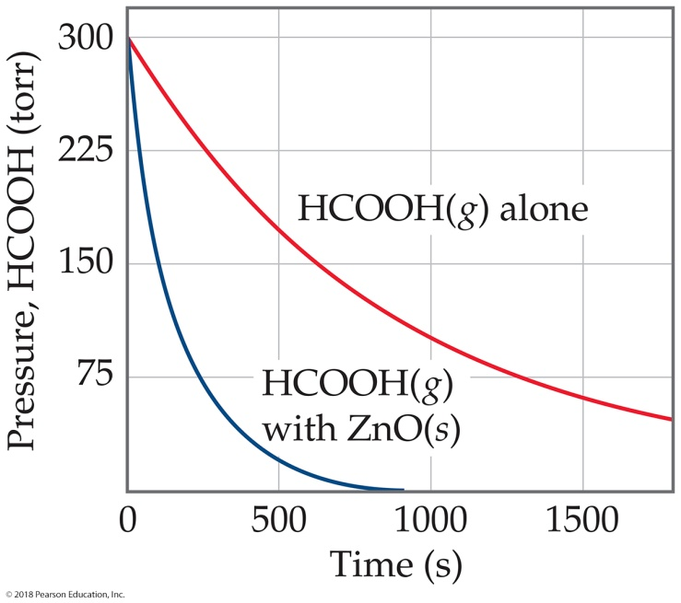

Sample Integrative Exercise Putting Concepts Together
Formic acid (HCOOH) decomposes in the gas phase at elevated temperatures as follows:
HCOOH(g) CO₂(g) + H₂(g)
The uncatalyzed decomposition reaction is determined to be first order. A graph of the partial pressure of HCOOH versus time for decomposition at 838 K is shown as the red curve in Figure 14.30. When a small amount of solid ZnO is added to the reaction chamber, the partial pressure of acid versus time varies as shown by the blue curve in Figure 14.30.
(a) Estimate the half-life and first-order rate constant for formic acid decomposition.
(b) What can you conclude from the effect of added ZnO on the decomposition of formic acid?
(c) The progress of the reaction was followed by measuring the partial pressure of formic acid vapor at selected times. Suppose that, instead, we had plotted the concentration of formic acid in units of mol/L. What effect would this have had on the calculated value of k?
Figure 14.30 Variation in pressure of HCOOH(g) as a function of time at 838 K.
(d) The pressure of formic acid vapor at the start of the reaction is 3.00 × 10² torr. Assuming constant temperature and ideal-gas behavior, what is the pressure in the system at the end of the reaction? If the volume of the reaction chamber is 436 cm³, how many moles of gas occupy the reaction chamber at the end of the reaction?
(e) The standard heat of formation of formic acid vapor is = –378.6 kJ/mol. Calculate ΔH° for the overall reaction. If the activation energy (E_{a}) for the reaction is 184 kJ/mol, sketch an approximate energy profile for the reaction, and label E_{a}, ΔH°, and the transition state.

Slide 44
Sample Integrative Exercise Putting Concepts Together
Continued
Solution
(a) The initial pressure of HCOOH is 3.00 × 10² torr. On the graph we move to the level at which the partial pressure of HCOOH is 1.50 × 10² torr, half the initial value. This corresponds to a time of about 6.60 × 10² s, which is therefore the half-life. The first-order rate constant is given by Equation 14.17:
k = 0.693/t_{1/2} = 0.693/660 s = 1.05 × 10^{–3} s^{–1}.
(b) The reaction proceeds much more rapidly in the presence of solid ZnO, so the surface of the oxide must be acting as a catalyst for the decomposition of the acid. This is an example of heterogeneous catalysis.
(c) If we had graphed the concentration of formic acid in units of moles per liter, we would still have determined that the half-life for decomposition is 660 s, and we would have computed the same value for k. Because the units for k are s^{–1}, the value for k is independent of the units used for concentration.
(d) According to the stoichiometry of the reaction, two moles of product are formed for each mole of reactant. When reaction is completed, therefore, the pressure will be 600 torr, just twice the initial pressure, assuming ideal-gas behavior. (Because we are working at quite high temperature and fairly low gas pressure, assuming ideal-gas behavior is reasonable.) The number of moles of gas present can be calculated using the ideal-gas equation (Section 10.4):

Slide 45
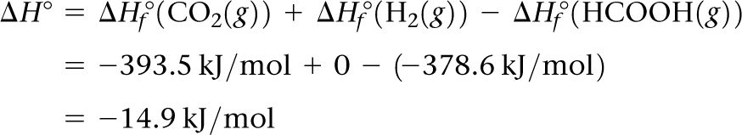
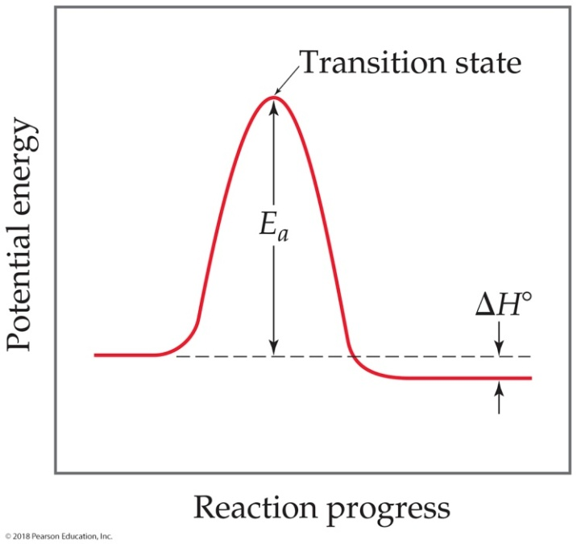
Sample Integrative Exercise Putting Concepts Together
Continued
(e) We first calculate the overall change in energy, H (Section 5.7 and Appendix C), as in
From this and the given value for E_{a}, we can draw an approximate energy profile for the reaction, in analogy to Figure 14.16.

