Slide 1
RATES OF REACTION GOALS
CHEMICAL KINETICS:
1 - STUDY REACTION RATES
2 - HOW THESE RATES CHANGE DEPEND ON
CONDITIONS
3 - DESCRIBES MOLECULAR EVENTS THAT
OCCUR DURING THE REACTION.
FACTORS AFFECTING REACTION RATES:
Physical state of the reactants (SURFACE AREA)
Reactant concentrations
Reaction temperature
Presence of a catalyst
Notes:
1

Slide 2
Physical State of the Reactants
The more readily the reactants collide, the more rapidly they react.
Homogeneous reactions (all gases or liquids) are often faster.
Heterogeneous reactions that involve solids are slower; the faster of these reactions occurs if the surface area is increased; that is, a fine powder reacts faster than a pellet or tablet.

Slide 3
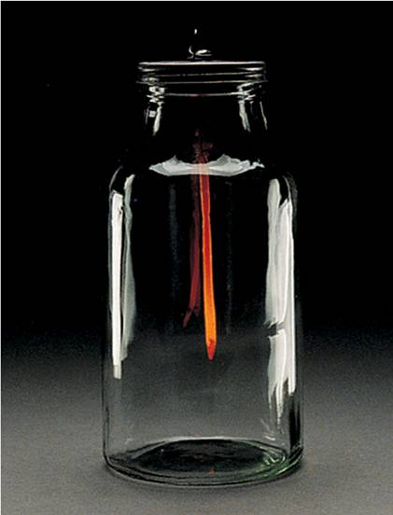
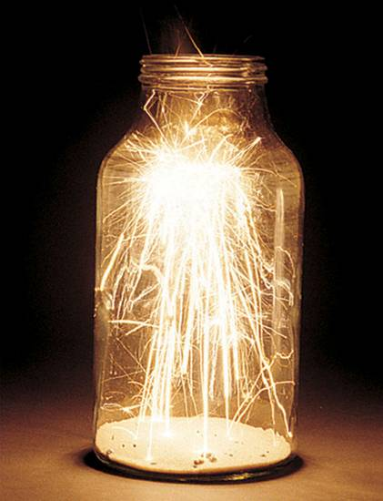
The effect of surface area on reaction rate.

Slide 4
Temperature
Reaction rate generally increases with increased temperature.
Kinetic energy of molecules is related to temperature.
At higher temperatures, molecules move more quickly, increasing numbers of collisions and the energy the molecules possess during the collisions.

Slide 5
Presence of a Catalyst
Catalysts affect rate without being in the overall balanced equation.
Catalysts affect the kinds of collisions, changing the mechanism (individual reactions that are part of the pathway from reactants to products).
Catalysts are critical in many biological reactions.
_{MnO2}
2H₂O₂ → 2H₂O + O₂
Many times the [catalyst] has little effect on rate

Slide 6

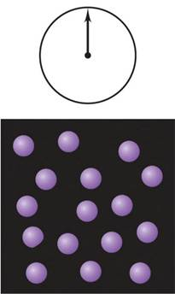
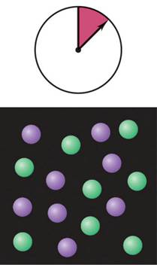
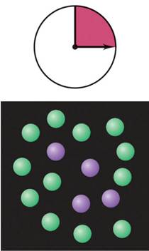
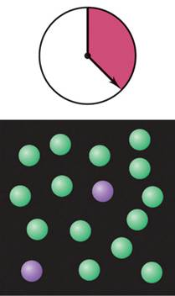
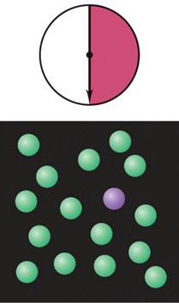
Reaction rate: the central focus of chemical kinetics
Notes:
6

Slide 7
Reaction Rate
Rate is a change in concentration over a time period: Δ[ ]/Δt.
Δ means “change in.” {final-inital}
[ ] means molar concentration.
t represents time.
Types of rate measured:
average rate
instantaneous rate
initial rate

Slide 8
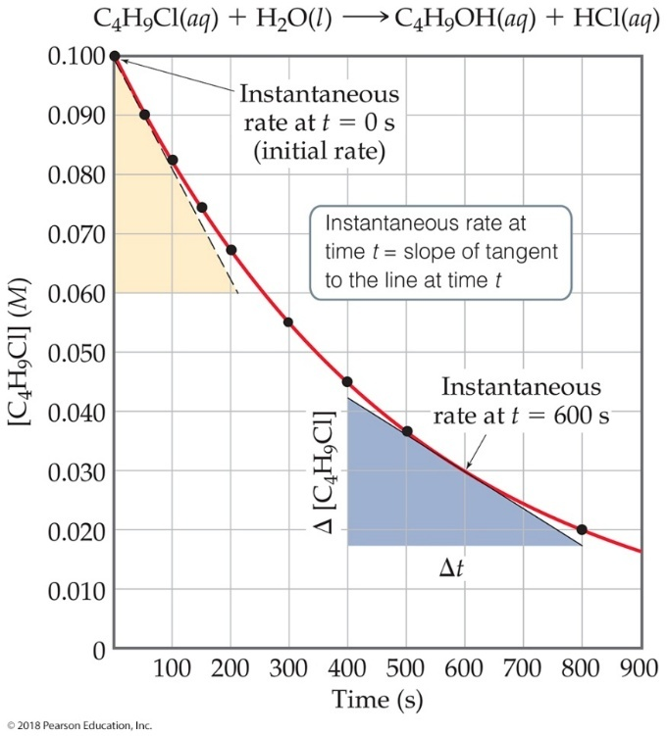
Plotting Rate Data
A plot of the data gives more information about rate.
The slope of the curve at one point in time gives the instantaneous rate.
The instantaneous rate at time zero is called the initial rate; this is often the rate of interest to chemists.
This figure shows instantaneous and initial rate of the earlier example.
Note: Reactions typically slow down over time!

Slide 9
RATES OF REACTION: A linear approach
1. DESCRIBES THE INCREASE IN MOLAR P (PRODUCTS) OF A REACTION PER UNIT TIME
2. DESCRIBES THE DECREASE IN MOLAR R (REACTANTS) PER UNIT TIME
R = Δ[P] R = - Δ[R]
Δ t Δt
* RATE OF REACTION can be considered either as the INSTANTANEOUS or AVERAGE RATE depending on the sampling increments.
Notes:
9

Slide 10
Reaction Rate and Stoichiometry
in most reactions, the coefficients of the balanced equation are not all the same
H_{2 (g)} + I_{2 (g)} → 2 HI_{(g)}
for these reactions, the change in the number of molecules of one substance is a multiple of the change in the number of molecules of another
for the above reaction, for every 1 mole of H₂ used, 1 mole of I₂ will also be used and 2 moles of HI made
therefore the rate of change will be different
in order to be consistent, the change in the concentration of each substance is multiplied by 1/coefficient
Notes:
10

Slide 11
In general, for the linear approach, for the reaction:
aA + bB cC + dD
1
Δ[A]
1
Δ[B]
1
Δ[C]
1
Δ[D]
rate =
-
= -
= +
= +
a
Δt
b
Δt
c
Δt
d
Δt
The numerical value of the rate depends upon the substance that
serves as the reference. The rest is relative to the balanced
chemical equation.
Q. 2H₂O₂ ⇔ 2H₂O + O₂ R = ?
Notes:
11

Slide 12
CHEMICAL KINETICS: A Linear Approach
The study of reaction rates is the study of reactant
(and/or product) concentrations as a function of time.
For example: Given 2 NH₃ + 2 O₂ → N₂O + 3 H₂O the rate of disappearance of oxygen is related how to the rate of formation of water? Give the linear rate law.
The linear rate law is dependent on stoichiometry.
For example: If the rate of appearance of N₂O is
Δ[N₂O] = 7.0 x 10⁻³ M/s at a particular instant,
Δ t what is the value of the rate of
disappearance of NH₃ at the same time?

Slide 13
Lecture Questions about the linear approach
1. How is the rate of disappearance of ozone related
to the rate of appearance of oxygen in the following
equation: 2O_{3(g)} → 3O_{2(g)}
2. If the rate of appearance of O₂; Δ[O₂] = 6 x 10⁻⁵ M/s
Δt
at a particular instant, what is the value of the rate of disappearance of O₃;
- Δ[O₃] at the same time?
Δt
Notes:
13

Slide 14

Workshop # 1
The decomposition of N₂O₅, proceeds
2N₂O₅ _{(g)} → 4NO_{2(g)} + O_{2(g)}
If the rate of decomposition of N₂O₅ at a particular instant in a reaction vessel is 4.2 x 10⁻⁷ M/s, what is the rate of appearance of NO₂?
What is the rate of appearance of O₂?
Notes:
14

Slide 15
Average Rate: A closer look
the average rate is the change in measured concentrations in any particular time period
linear approximation of a curve
the larger the time interval, the more the average rate deviates from the instantaneous rate
Notes:
15

Slide 16

H₂
I₂
HI
 |  |  | Avg. Rate, M/s | Avg. Rate, M/s
Time (s) | [H₂], M | [HI], M | -Δ[H₂]/Δt | 1/2 Δ[HI]/Δt
0.000 | 1.000 | 0.000
10.000 | 0.819 | 0.362 | 0.0181 | 0.0181
20.000 | 0.670 | 0.660 | 0.0149 | 0.0149
30.000 | 0.549 | 0.902 | 0.0121 | 0.0121
40.000 | 0.449 | 1.102 | 0.0100 | 0.0100
50.000 | 0.368 | 1.264 | 0.0081 | 0.0081
60.000 | 0.301 | 1.398 | 0.0067 | 0.0067
70.000 | 0.247 | 1.506 | 0.0054 | 0.0054
80.000 | 0.202 | 1.596 | 0.0045 | 0.0045
90.000 | 0.165 | 1.670 | 0.0037 | 0.0037
100.000 | 0.135 | 1.730 | 0.0030 | 0.0030
 |  |  | Avg. Rate, M/s
Time (s) | [H₂], M | [HI], M | -Δ[H₂]/Δt
0.000 | 1.000 | 0.000
10.000 | 0.819 | 0.362 | 0.0181
20.000 | 0.670 | 0.660 | 0.0149
30.000 | 0.549 | 0.902 | 0.0121
40.000 | 0.449 | 1.102 | 0.0100
50.000 | 0.368 | 1.264 | 0.0081
60.000 | 0.301 | 1.398 | 0.0067
70.000 | 0.247 | 1.506 | 0.0054
80.000 | 0.202 | 1.596 | 0.0045
90.000 | 0.165 | 1.670 | 0.0037
100.000 | 0.135 | 1.730 | 0.0030
 |  |  | Avg. Rate, M/s | Avg. Rate, M/s
Time (s) | [H₂], M | [HI], M | -Δ[H₂]/Δt | 1/2 Δ[HI]/Δt
0.000 | 1.000
10.000 | 0.819
20.000 | 0.670
30.000 | 0.549
40.000 | 0.449
50.000 | 0.368
60.000 | 0.301
70.000 | 0.247
80.000 | 0.202
90.000 | 0.165
100.000 | 0.135
 |  |  | Avg. Rate, M/s | Avg. Rate, M/s
Time (s) | [H₂], M | [HI], M | -Δ[H₂]/Δt | 1/2 Δ[HI]/Δt
0.000 | 1.000 | 0.000
10.000 | 0.819 | 0.362
20.000 | 0.670 | 0.660
30.000 | 0.549 | 0.902
40.000 | 0.449 | 1.102
50.000 | 0.368 | 1.264
60.000 | 0.301 | 1.398
70.000 | 0.247 | 1.506
80.000 | 0.202 | 1.596
90.000 | 0.165 | 1.670
100.000 | 0.135 | 1.730
Stoichiometry tells us that for every 1 mole/L of H₂ used,
2 moles/L of HI are made.
The average rate is the change in the concentration in a given time period.
Assuming a 1 L container, at 10 s, we used 0.181 moles of H₂. Therefore the amount of HI made is 2(0.181 moles) = 0.362 moles
In the first 10 s, the Δ[H₂] is -0.181 M, so the rate is
At 60 s, we used 0.699 moles of H₂. Therefore the amount of HI made is 2(0.699 moles) = 1.398 moles
16
Notes:
16

Slide 17
average rate in a given time period = − slope of the line connecting the [H₂] points; and ½ +slope of the line for [HI]
the average rate for the first 40 s is 0.0150 M/s
the average rate for the first 10 s is 0.0181 M/s
the average rate for the first 80 s is 0.0108 M/s
Notes:
17

Slide 18
Instantaneous Rate: A closer look
the instantaneous rate is the change in concentration at any one particular time
slope at one point of a curve
determined by taking the slope of a line tangent to the curve at that particular point
first derivative of the function
for you calculus fans
Notes:
18

Slide 19
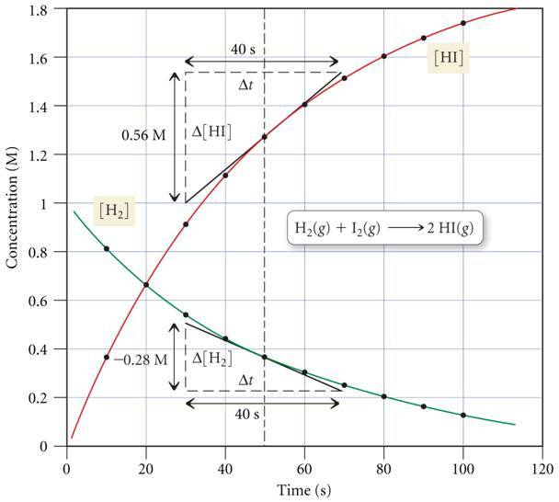
H_{2 (g)} + I_{2 (g)} → 2 HI _{(g)}
Using [H₂], the instantaneous rate at 50 s is:
Using [HI], the instantaneous rate at 50 s is:
19
Notes:
19

Slide 20
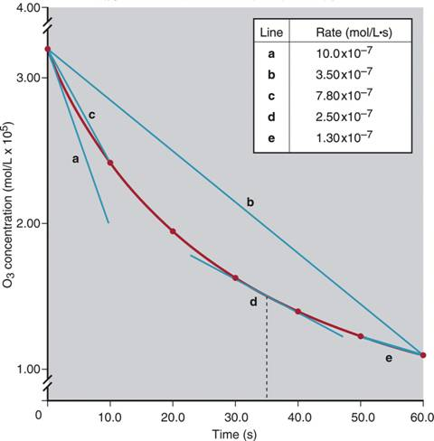
The concentrations of O₃ vs. time during its reaction with C₂H₄
Δ [C₂H₄]
rate =
-
Δt
=
Δ [O₃]
-
Δt
=
Δ [O₂]
+
Δt
Notes:
20

Slide 21
EXPERIMENTAL DETERMINATION OF THE RATE
(Techniques we use to determine the rate)
1. Calculate [P] as Rx proceeds (slow Rx)
2. If a Gas, use ΔP (manometer)
3. Colorimetry uses Beer’s law:
A= -Log 1/T (100%) & A=εcl
Notes:
21

Slide 22
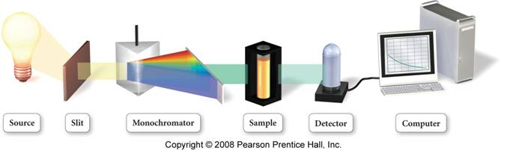
Continuous Monitoring Method
polarimetry – measuring the change in the degree of rotation of plane-polarized light caused by one of the components over time
spectrophotometry – measuring the amount of light of a particular wavelength absorbed by one component over time
the component absorbs its complimentary color
total pressure – the total pressure of a gas mixture is stoichiometrically related to partial pressures of the gases in the reaction
Notes:
22

Slide 23
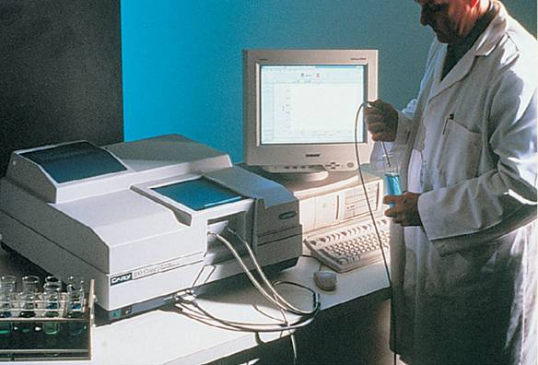
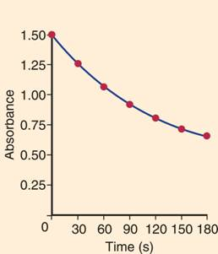
Tools of the Laboratory
Spectrophotometric monitoring of a reaction.
Notes:
23

Slide 24
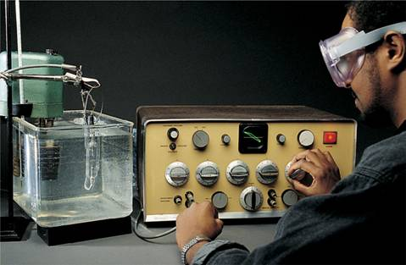
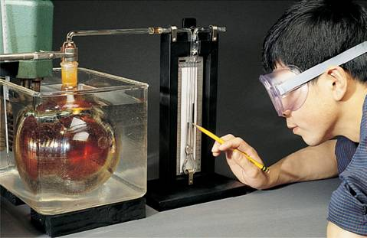
Tools of the Laboratory
Conductometric monitoring of a reaction
Manometric monitoring of a reaction
Notes:
24

Slide 25
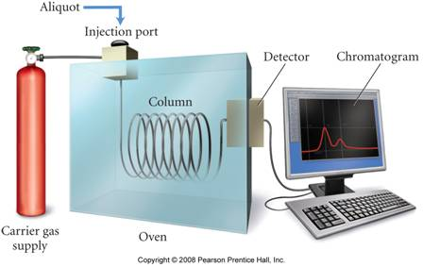
Sampling Method
gas chromatography can measure the concentrations of various components in a mixture
for samples that have volatile components
separates mixture by adherence to a surface
drawing off periodic aliquots from the mixture and doing quantitative analysis
titration for one of the components
gravimetric analysis
Notes:
25

Slide 26
RATES OF REACTION: A nonlinear approach
HOW CAN YOU PREDICT RATES AT ANY TIME – OVER A LONG PERIOD OF TIME?
RATE LAW
DEPENDENCE OF RATE ON CONCENTRATION
An equation that relates the Reaction to the [reactants] or to a [catalyst] raised to a power
Rate = k [H₂]^{n} [I₂]^{m}
Notes:
26

Slide 27
RATE LAW (RATE EQUATION)
R = k [A]^{m} [B]^{n}….
For aA + bB + …. = cC + dD +….
k = rate constant (at constant temperature;
the rate constant does not change as the
reaction proceeds.)
m, n = reaction orders (describes how the rate is affected by reactant concentration)
note: a & b are not related to m & n
note: R, k, & m/n are all found experimentally
Notes:
27

Slide 28
Units of the Rate Constant k for Several Overall
Reaction Orders
Overall Reaction Order
Units of k (t in seconds)
0
mol/L*s (or mol L⁻¹ s⁻¹)
1
1/s (or s⁻¹)
2
L/mol*s (or L mol ⁻¹ s⁻¹)
3
L² / mol² *s (or L² mol⁻² s⁻¹)
Notes:
28

Slide 29
REACTION ORDER
1. What are the overall reaction orders for:
A. 2N₂O_{5(g)} → 4NO_{2(g)} + O _{2 (g)}
B. CHCl_{3(g)} + Cl_{2(g)} → CCl_{4(g)} + HCl_{(g)}
The overall reaction order is the sum of the powers to which
all the [reactants] are used in the rate law.
2. What are the usual units of the rate constant for the rate
law for a? Units of rate = (units of k) (units of [ ])
Q: what is the reaction order of H₂ & units for k?
H_{2(g)} + I_{2(g)} → 2HI_{(g)} R=k [H₂][I₂]
R = k[N₂O₅]
R=k[CHCl₃] [Cl₂] ^{1/2}
Notes:
29

Slide 30
Determining the Rate Law
can only be determined experimentally
initial rate method
by comparing effect on the rate of changing the initial concentration of reactants one at a time
graphically
Notes:
30

Slide 31
Example 1. A particular reaction was found to depend on the concentration of the hydrogen ion, [H+]. The initial rates varied as a function of [H+] as follows:
[H+] R
0.0500 6.4 x 10⁻⁷
0.1000 3.2 x 10⁻⁷
0.2000 1.6 x 10⁻⁷
a. What is the order of the reaction in [H+]
b. Determine the magnitude of the rate constant.
c. Predict the initial reaction rate when [H+] = 0.400M
Notes:
31

Slide 32
INITIAL RATE METHOD
2. The initial rate of a reaction A+ B →C was measured for several different starting concentrations of A & B
trial [A] [B] R(m/s)
1 0.100 0.100 4 x 10⁻⁵
2 0.100 0.200 4 x 10⁻⁵
3 0.200 0.100 16 x 10⁻⁵
a. Determine the rate law for the reaction
b. Determine the rate of the reaction when [A] = 0.030M & [B] = 0.100M
Notes:
32

Slide 33
Workshop # 2
Problem #1: Rate data were obtained for following reaction: A + 2B ---> C + 2D
What is the rate law expression for this reaction?
Exp. | Initial A (mol/L) | Initial B (mol/L) | Init. Rate of Formation of C (M min⁻¹)
1 | 0.10 | 0.10 | 3.0 x 10⁻⁴
2 | 0.30 | 0.30 | 9.0 x 10⁻⁴
3 | 0.10 | 0.30 | 3.0 x 10⁻⁴
4 | 0.20 | 0.40 | 6.0 x 10⁻⁴
Problem #2: The following data were obtained for the chemical reaction: A + B ---> products
(a) Determine the rate law for this reaction. (b) Find the rate constant. (c) What is the initial rate of reaction when [A]_{o} = 0.12 M and [B]_{o} = 0.015
Exp. | Initial A (mol/L) | Initial B (mol/L) | Init. Rate of Formation of products (M s⁻¹)
1 | 0.040 | 0.040 | 9.6 x 10⁻⁶
2 | 0.080 | 0.040 | 1.92 x 10⁻⁵
3 | 0.080 | 0.020 | 9.6 x 10⁻⁶

Slide 34
Determining the Rate Law
can only be determined experimentally
initial rate method
by comparing effect on the rate of changing the initial concentration of reactants one at a time
graphically
rate = slope of curve [A] vs. time
if graph [A] vs time is straight line, then exponent on A in rate law is 0, rate constant = -slope
if graph ln[A] vs time is straight line, then exponent on A in rate law is 1, rate constant = -slope
if graph 1/[A] vs time is straight line, exponent on A in rate law is 2, rate constant = slope
Notes:
34

Slide 35
HOW DOES CONCENTRATION CHANGE WITH TIME?
A → B + C
R = k [A] is the rate law
so the rate of decomposition of A can be written as:
-d [A] = k [A]
dt
Notes:
35

Slide 36
INTEGRATED RATE LAWS
First-order reaction: A → B R = k[A]
ln [A]_{t} = -kt
[A]_{o}
Second-order reaction: R = k[A]²
1 - 1 = +kt
[A]_{t} [A]_{o}
Zero-order reaction: R = k
[A]_{t} - [A]_{o} = -kt
Notes:
36

Slide 37
Zero Order Reactions
Rate = k[A]⁰ = k
constant rate reactions
[A] = -kt + [A]₀
graph of [A] vs. time is straight line with slope = -k and y-intercept = [A]₀
t _{½} = [A₀]/2k
when Rate = M/sec, k = M/sec
[A]₀
slope = - k
[A]
time
Notes:
37

Slide 38
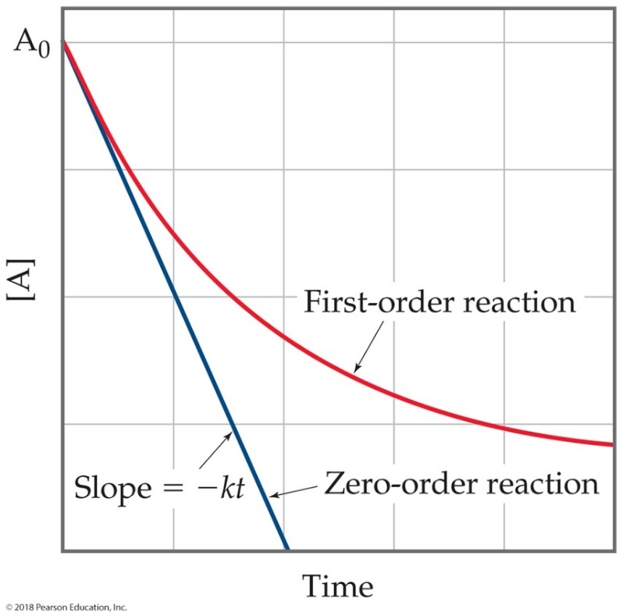
Zero-Order Reactions
Occasionally, rate is independent of the concentration of the reactant:
These are zero-order reactions.
These reactions are linear in concentration.

Slide 39
First Order Reactions
Rate = k[A]
ln[A] = -kt + ln[A]₀
graph ln[A] vs. time gives straight line with slope = -k and y-intercept = ln[A]₀
used to determine the rate constant
t_{½} = 0.693/k
the half-life of a first order reaction is constant
the when Rate = M/sec, k = sec⁻¹
Notes:
39

Slide 40
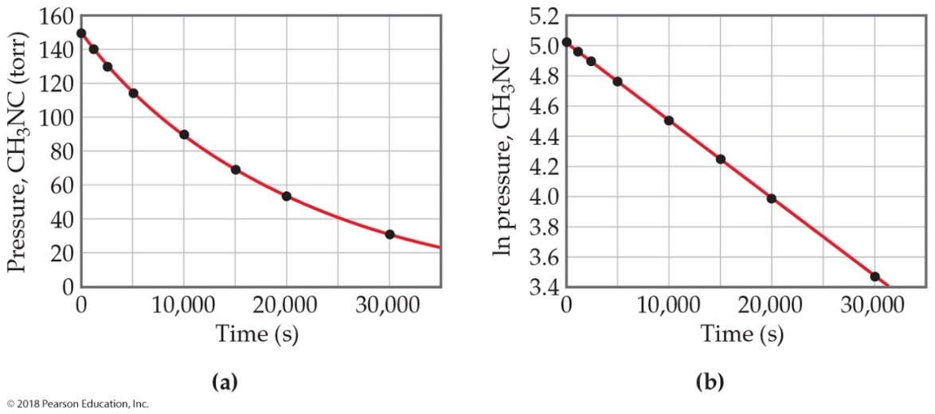
Evidence That Conversion of Methyl Isonitrile to Acetonitrile
The equation for the reaction:
It is first order. The plot of
vs. time is linear.

Slide 41
Second Order Reactions
Rate = k[A]²
1/[A] = kt + 1/[A]₀
graph 1/[A] vs. time gives straight line with slope = k and y-intercept = 1/[A]₀
used to determine the rate constant
t_{½} = 1/(k[A₀])
when Rate = M/sec, k = M⁻¹∙sec⁻¹
Notes:
41

Slide 42
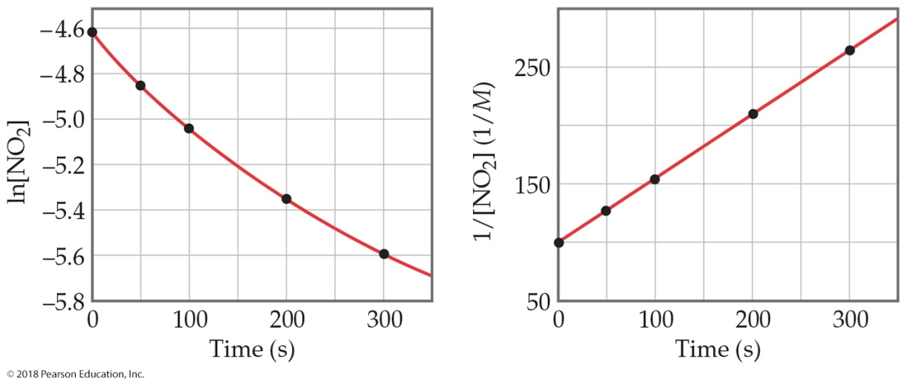
An Example of a Second-Order Reaction: Decomposition of N O₂
A plot following NO₂
decomposition shows that it must be second order because it is
linear for
not linear for
Equation:

Slide 43
Integrated Rate Laws REVIEW
Δ[A]
rate = -
= k [A]
first order rate equation
Δt
[A]_{t}
ln
= - kt
ln [A]_{t} = -kt + ln [A]_{o}
[A]_{o}
Δ[A]
rate = -
= k [A]²
second order rate equation
Δt
1
1
1
1
-
= kt
= kt
+
[A]_{t}
[A]₀
[A]_{t}
[A]₀
Δ[A]
rate = -
= k [A]⁰
zero order rate equation
Δt
[A]_{t} - [A]₀ = - kt
Notes:
43

Slide 44
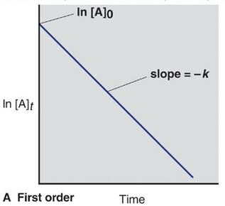
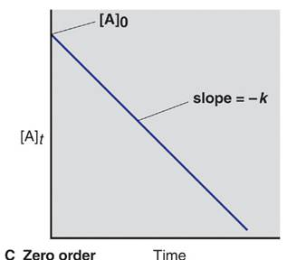

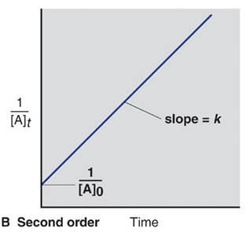


Integrated rate laws and reaction order
1/[A]_{t} = kt + 1/[A]₀
[A]_{t} = -kt + [A]₀
ln[A]_{t} = -kt + ln[A]₀
Notes:
44

Slide 45
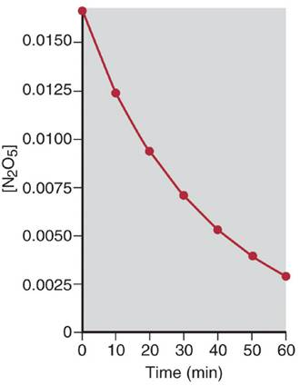
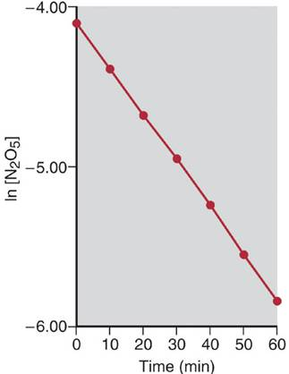
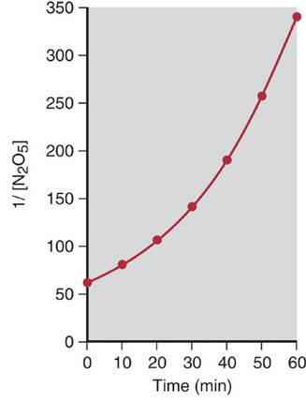
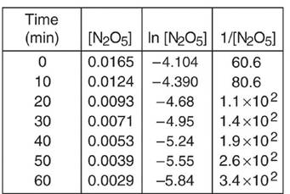
Graphical determination of the reaction order for the
decomposition of N₂O₅.
Notes:
45

Slide 46
Δ CONCENTRATION WITH TIME
1. The first-order rate constant for the decomposition of certain insecticide in water at 12°C is 1.45 year⁻¹ . A quantity of this insecticide is washed into a lake in June, leading to a concentration of 5.0 x 10⁻⁷ g/cm³ of water. Assume that the effective temperature of the lake is 12°C.
A. What is the concentration of the insecticide in June of the following year?
B. How long will it take for the [Insecticides] to drop to 3.0 x 10⁻⁷ g/cm³?
Notes:
46

Slide 47

Workshop # 3
Cyclopropane is used as an anesthetic. The isomerization of cyclopropane (Δ) to propene is first order with a rate constant of 9.2 s⁻¹ @ 1000°C.
A. If an initial sample of Δ has a concentration if 6.00 M, what will the concentration be after 1 second?
B. What will the concentration be after 1 second if the reaction was second order.
Notes:
47

Slide 48
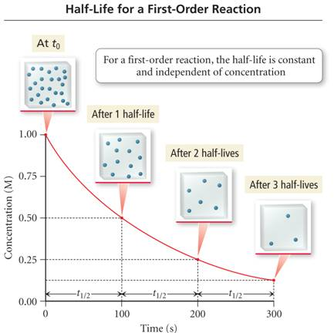
Half-Life
the half-life, t_{1/2}, of a reaction is the length of time it takes for the concentration of the reactants to fall to ½ its initial value
the half-life of the reaction depends on the order of the reaction
Notes:
48

Slide 49
HALF- LIFE
- The time it takes for the reactant concentration to decrease to half it’s initial value.
1st order 2nd order
t¹/₂ = 0.693 t¹/₂ = 1
k k[A].
Q1. The thermal decomposition of N₂O₅ to form NO₂ & O₂ is 1st order with a rate constant of 5.1 x 10⁻⁴s⁻¹ at 313k. What is the half-life of this process?
Q2. At 70°C the rate constant is 6.82 x 10⁻³s⁻¹ suppose we start with 0.300mol of N₂O₅, how many moles of N₂O₅ will remain after 1.5 min.?
Q3. What is the t¹/₂ of N₂O₅ at 70 °C?
Notes:
49

Slide 50
An Overview of Zero-Order, First-Order, and
Simple Second-Order Reactions
Zero Order
First Order
Second Order
Rate law
rate = k
rate = k [A]
rate = k [A]²
Units for k
mol/L*s
1/s
L/mol*s
Integrated rate law in straight-line form
[A]_{t} =
k t + [A]₀
ln[A]_{t} =
-k t + ln[A]₀
1/[A]_{t} =
k t + 1/[A]₀
Plot for straight line
[A]_{t} vs. t
ln[A]_{t} vs. t
1/[A]_{t} = t
Slope, y-intercept
-k, [A]₀
-k, ln[A]₀
k, 1/[A]₀
Half-life
[A]₀/2k
ln 2/k
1/k [A]₀
Notes:
50

Slide 51
RATE AND TEMPERATURE
Arrhenius Equation
k= Ae^{-Ea/RT}
R = 8.31 J/K mol
E_{a} = activation energy
T = absolute temperature
A = frequency factor
If two temperatures are compared:
In k₁ = E_{a} ( 1 - 1 )
k₂ R T₂ T₁
Notes:
51

Slide 52
The Arrhenius Equation: The Exponential Factor
the exponential factor in the Arrhenius equation is a number between 0 and 1
it represents the fraction of reactant molecules with sufficient energy so they can make it over the energy barrier
the higher the energy barrier (larger activation energy), the fewer molecules that have sufficient energy to overcome it
that extra energy comes from converting the kinetic energy of motion to potential energy in the molecule when the molecules collide
increasing the temperature increases the average kinetic energy of the molecules
therefore, increasing the temperature will increase the number of molecules with sufficient energy to overcome the energy barrier
therefore increasing the temperature will increase the reaction rate
Notes:
52

Slide 53
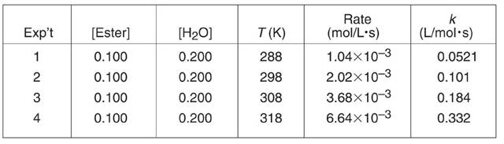
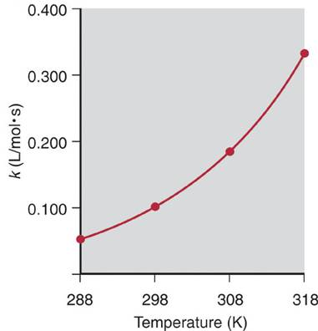
Dependence of the rate constant on temperature
Notes:
53

Slide 54
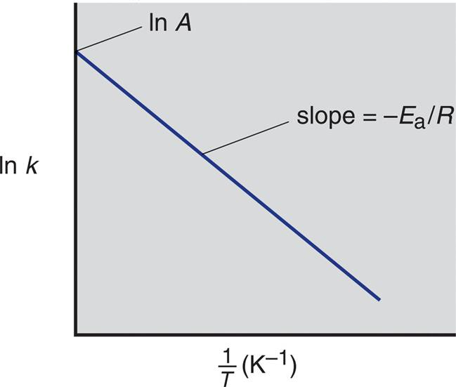
Graphical determination of the activation energy
ln k = -E_{a}/R (1/T) + ln A
Notes:
54

Slide 55
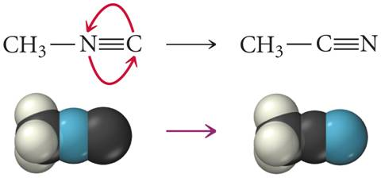
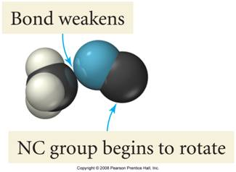
Isomerization of Methyl Isonitrile
methyl isonitrile rearranges to acetonitrile
in order for the reaction to occur, the H₃C-N bond must break; and a new H₃C-C bond form
Notes:
55

Slide 56
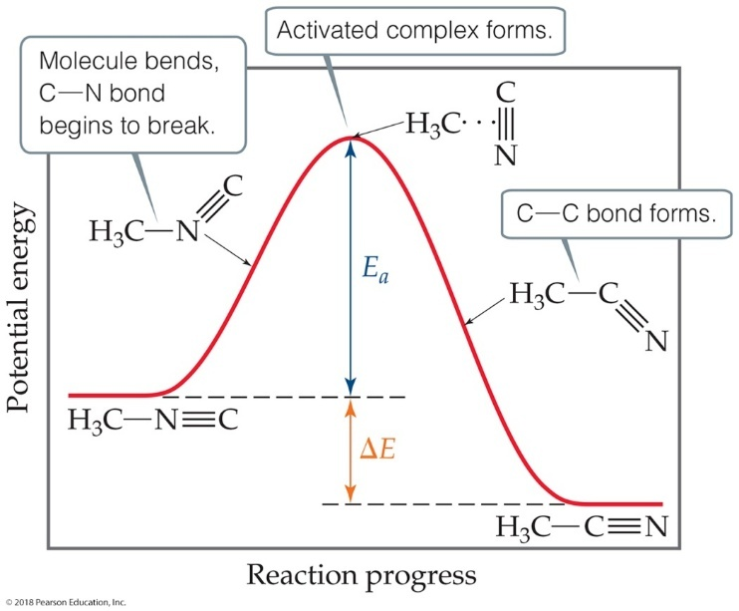
Reaction Progress
Plots are made to show the energy possessed by the particles as the reaction proceeds.
At the highest energy state, the transition state is formed.
Reactions can be endothermic or exothermic after this.
Rate constant depends on the magnitude of Ea

Slide 57
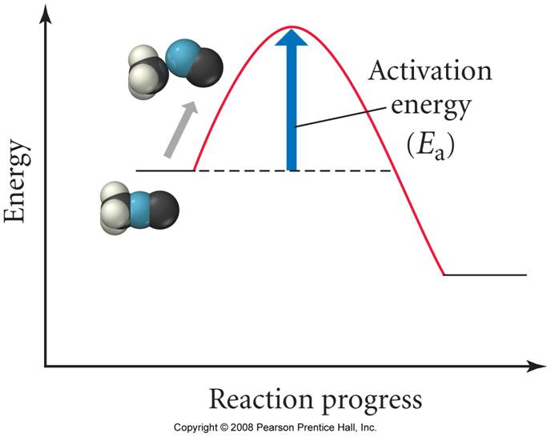
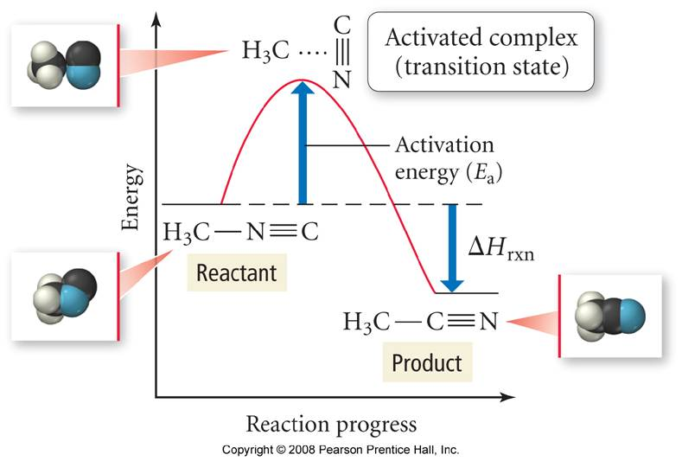
Energy Profile for the Isomerization of Methyl Isonitrile
As the reaction begins, the C-N bond weakens enough for the C≡N group to start to rotate
the activation energy is the difference in energy between the reactants and the activated complex
the collision frequency is the number of molecules that approach the peak in a given period of time
the activated complex is a chemical species with partial bonds
57
Notes:
57

Slide 58

Workshop # 4
H₃C-N ΞC: → H₃C -CΞN:
methyl isonitrile acelonitrile
Q 1. For the conversion of methyl isonitrile to acetonitrile, the table below shows the relationship between temperature and the rate constant.
T k
298.9°C 5.25 x 10⁻⁵
330.3°C 6.30 x 10⁻⁴
351.2°C 3.16 x 10⁻³
1. Graphically determine Ea then compare to calculated values.
2. What is k at 530.3 K?
Notes:
58

Slide 59
Why do rates vary? Let’s look at the theory behind the trends. Factors That Affect Reaction Rate
Temperature
Frequency of collisions
Orientation of molecules
Energy needed for the reaction to take place (activation energy)

Slide 60
(1) COLLISION THEORY
A theory that assumes that Reactant particles must collide with an energy greater than some minimum value and with proper orientation.
E_{a} - Activation Energy
Minimum energy of collision required for 2 particles to react
k ≈ zfp
z = collision frequency
f = fraction of collisions w/e > Ea
p = fraction of collisions w/proper orientation
Notes:
60

Slide 61
Collision Theory and the Arrhenius Equation
A is the factor called the frequency factor and is the number of molecules that can approach overcoming the energy barrier
there are two factors that make up the frequency factor – the orientation factor (p) and the collision frequency factor (z)
Notes:
61

Slide 62
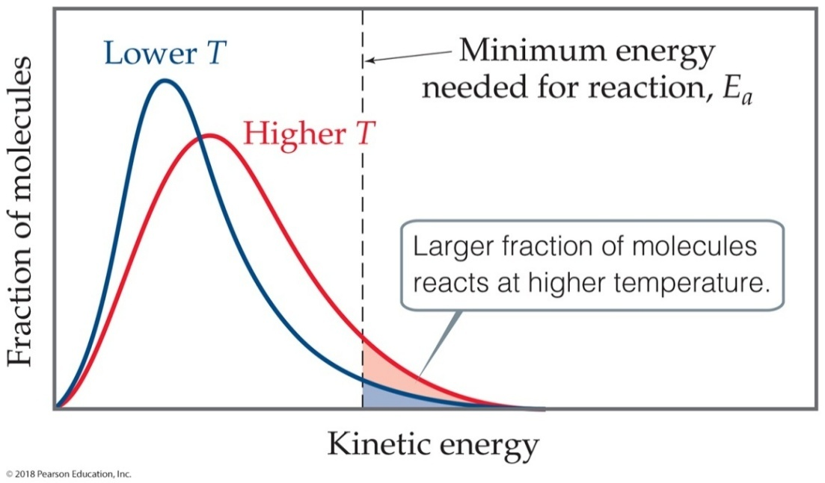
Distribution of the Energy of Molecules
Gases have an average temperature, but each individual molecule has its own energy.
At higher energies, more molecules possess the energy needed for the reaction to occur.

Slide 63
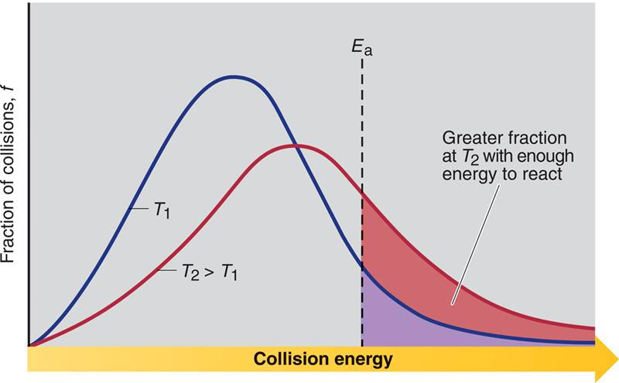
The effect of temperature on the distribution of collision energies
Notes:
63

Slide 64
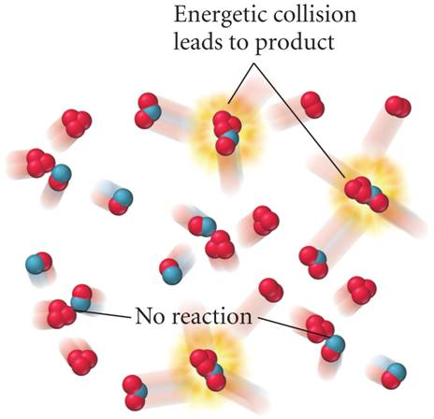
Effective Collisions Kinetic Energy Factor
for a collision to lead to overcoming the energy barrier, the reacting molecules must have sufficient kinetic energy so that when they collide it can form the activated complex
Notes:
64

Slide 65
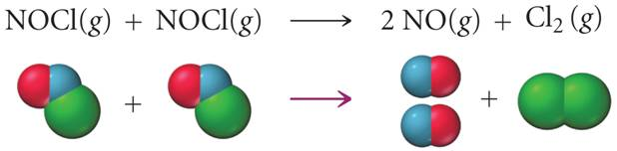
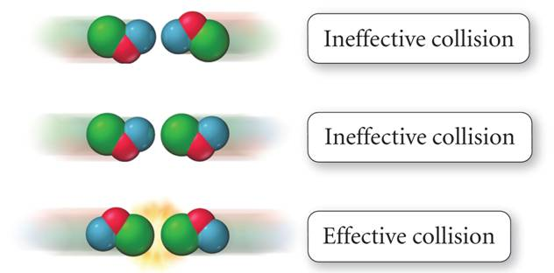
Effective Collisions Orientation Effect
Notes:
65

Slide 66
NO_{(g)} + Cl₂^{(g)} → NOCl_{(g)} + Cl-_{(g)}
Experimentally observed rate constants
k_{25°C} = 4.9 x 10⁻⁶ L/mols
k_{35°C} = 1.5 x 10⁻⁵ L/mols
* Generally a 10°C ↑ will double or triple the rate. There
exists a strong dependence on temperature.
The collision frequency (z) is proportional to √3RT/MM
(rms) temperature dependent.
2. The fraction of collisions greater than E_{a} (f) x e^{-Ea/RT}
temperature dependent
Notes:
66

Slide 67
TRANSITION STATE THEORY
Explains the reaction resulting from the collision of 2
particles in terms of an activated complex.
Activated Complex
- an unstable group of atoms which break up
to form the products of a chemical reaction.
O = N + Cl - Cl → [O = N….Cl….Cl] ≠ → O = N - Cl + Cl
The energy transferred from the collision (KE) is localized in the bonds (….) of the activated complex as vibrational motion. At some point the energy in the (….) bond becomes so great resulting in the (….) bond breaking.
Notes:
67

Slide 68
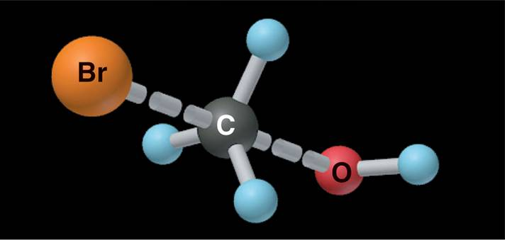
Nature of the transition state in the reaction between CH₃Br and OH⁻.
CH₃Br + OH⁻ CH₃OH + Br ⁻
transition state or activated complex
Notes:
68

Slide 69
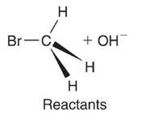
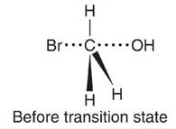
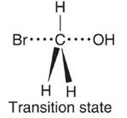
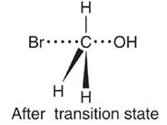
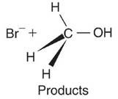
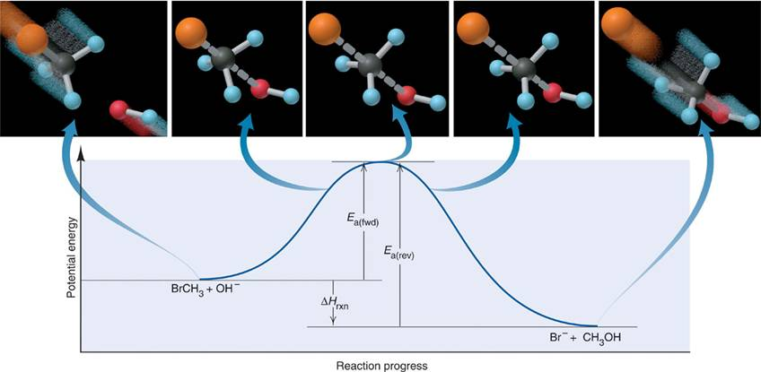
Reaction energy diagram for the reaction of CH₃Br and OH⁻.
Notes:
69

Slide 70
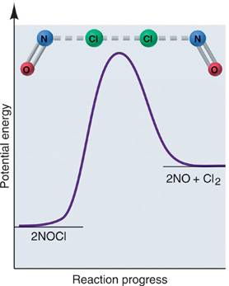
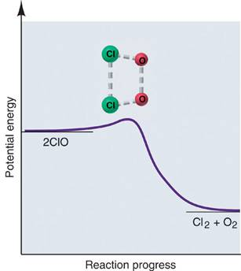
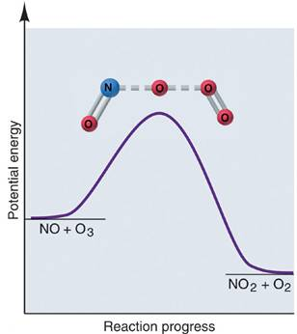
Reaction energy diagrams and possible transition states.
Notes:
70

Slide 71
Sample Problem
Drawing Reaction Energy Diagrams and
Transition States
PROBLEM:
A key reaction in the upper atmosphere is
O₃(g) + O(g) 2O₂(g)
The E_{a(fwd)} is 19 kJ, and the ΔH_{rxn} for the reaction is -392 kJ. Draw a reaction energy diagram for this reaction, postulate a transition state, and calculate E_{a(rev)}.
PLAN:
Consider the relationships among the reactants, products and transition state. The reactants are at a higher energy level than the products and the transition state is slightly higher than the reactants.
SOLUTION:
Notes:
71

Slide 72

Reaction energy diagram for the two-step reaction of NO₂ and F₂.
Notes:
72

Slide 73
REACTION MECHANISM
- A set of elementary reactions whose overall effect is given by the Net Chemical equation.
ELEMENTARY REACTIONS
- Describes a single molecular event such as a collision of molecules resulting in a reaction.
REACTION INTERMEDIATE
- A species produced during a reaction that does not
appear in the Net equation. The species reacts in a
subsequent step in the mechanism.
Notes:
73

Slide 74
An Example of a Reaction Mechanism
Overall reaction:
H_{2(g)} + 2 ICl_{(g)} → 2 HCl_{(g)} + I_{2(g)}
Mechanism:
H_{2(g)} + ICl_{(g)} → HCl_{(g)} + HI_{(g)}
HI_{(g)} + ICl_{(g)} → HCl_{(g)} + I_{2(g)}
the steps in this mechanism are elementary steps, meaning that they cannot be broken down into simpler steps and that the molecules actually interact directly in this manner without any other steps
Notes:
74

Slide 75
Rate Laws for Elementary Steps
each step in the mechanism is like its own little reaction – with its own activation energy and own rate law
the rate law for an overall reaction must be determined experimentally
but the rate law of an elementary step can be deduced from the equation of the step
H₂(g) + 2 ICl(g) → 2 HCl(g) + I₂(g)
H₂(g) + ICl(g) → HCl(g) + HI(g) Rate = k₁[H₂][ICl]
HI(g) + ICl(g) → HCl(g) + I₂(g) Rate = k₂[HI][ICl]
Notes:
75

Slide 76
MOLECULARITY
The number of molecules on the reaction side of an elementary reaction.
Unimolecular: 1 reactant molecule
A → P
Bimolecular: 2 reactant molecules
A + B → P
Termolecular: 3 reactant molecules
2A + B → P
1. Br + Br + Ar → Br₂ + Ar*
2. O₃* → O₂ + O
3. NO₂ + NO₂ → NO₃ + NO
Notes:
76

Slide 77
1. C Cl₂ F₂ decomposes in the stratosphere from irradiation with short UV light present at that altitude. The decomposition yields chlorine atoms. This atom catalyzes the decomposition of O₃ in the presence of O-atoms.
Classify the following:
I. l. C Cl₂ F₂ → CF₂Cl • + Cl•
2. Cl• _{(g)} + O_{3(g)} → ClO•_{(g)} + O₂^{(g)}
ClO• _{(g)} + O_{(g)} → Cl•_{(g)} + O_{2(g)}
O_{3(g)} + O_{(g)} → 2O_{2(g)}
II. H₂O_{2(l)} + FeCl_{3(aq)} → H₂O_{(l)} + FeO⁺
FeO⁺ + H₂O₂ → H₂O + O₂ + Fe³⁺
2H₂O₂ → 2H₂O + O₂
Notes:
77

Slide 78
REACTION MECHANISM
1. The elementary steps must add up to the overall
equation.
2. The elementary steps must be physically possible.
Termolecular is rare
3. The mechanism must correlate with the rate law.
Rate-determining step:
This is the elementary step that is slowest and
therefore limits the rate for the overall reaction.
The rate law for the rate determining step is
the rate law for the overall reaction.
Notes:
78

Slide 79

Another Reaction Mechanism
NO_{2(g)} + CO_{(g)} → NO_{(g)} + CO_{2(g)} Rate_{obs} = k[NO₂]²
NO_{2(g)} + NO_{2(g)} → NO_{3(g)} + NO_{(g)} Rate = k₁[NO₂]² slow
NO_{3(g)} + CO_{(g)} → NO_{2(g)} + CO_{2(g)} Rate = k₂[NO₃][CO] fast
The first step is slower than the second step because its activation energy is larger.
The first step in this mechanism is the rate determining step.
The rate law of the first step is the same as the rate law of the overall reaction.
Notes:
79

Slide 80
An Example
k₁
2 NO_{(g)} ⇔ N₂O_{2(g)} Fast
H_{2(g)} + N₂O_{2(g)} → H₂O_{(g)} + N₂O_{(g)} Slow Rate = k₂[H₂][N₂O₂]
H_{2(g)} + N₂O_{(g)} → H₂O_{(g)} + N_{2(g)} Fast
k₋₁
2 H_{2(g)} + 2 NO_{(g)} → 2 H₂O_{(g)} + N_{2(g)} Rate_{obs} = k [H₂][NO]²
for Step 1 Rate_{forward} = Rate_{reverse}
Notes:
80

Slide 81
THE RELATIONSHIP BETWEEN THE RATE LAW
AND MECHANISM
The actual mechanism can not be observed directly. It
must be devised from experimental evidence and
scientific method.
Q1. 2O_{3(g)} → 3O_{2(g)} overall Rx
proposed mechanism:
O₃ k₁ O₂ + O fast
k⁻¹
_{k2}
O₃ + O → 2O₂ slow
what is the rate law?
Notes:
81

Slide 82
Workshop # 5
Q1a. Proposed Mechanism:
H₂O₂ + I⁻ ←→ H₂O + IO⁻
IO⁻ + H₂O₂ → H₂O + O₂ + I⁻
What is the rate law if the first step is the slower step?
Q1b. Qa is the mechanism at 25°C but at 1000°C the first equation is faster than the second. Now what is the rate law?

Slide 83
Workshop # 6
Q1. overall reaction:
Mo(CO)₆ + P(CH₃)₃ → Mo(CO)₅P(CH₃)₃ + CO
Proposed mechanism:
Mo(CO)₆ ←→ Mo(CO)₅ + CO
Mo(CO)₅ + P(CH₃)₃ → Mo(CO)₅P(CH₃)₃ slow
1. Is the proposed mechanism consistent with the equation for the overall reaction?
2. Identify the intermediates?
3. Determine the rate law.
Q2. A) Write the rate law for the following reaction assuming it involves a single elementary step.
2NO_{(g)} + Br_{2(g)} → 2 NOBr_{(g)}
B) Is a single step mechanism likely for this reaction?
Notes:
83

Slide 84
CATALYSIS
A Catalyst speeds up the reaction without being consumed.
- biological catalyst ≡ Enzymes
How does a catalyst work?
- A catalyst is an active participant to a reaction. It either affects the frequency factor, A (collisions) or, more commonly, a Catalyst works by providing an alternative reaction pathway for the breaking and remaking of bonds. The activation energy (E_{a}) for this new pathway is often less than the activation energy of the normal pathway.
Homogeneous catalyst:
- The catalyst is in the same phase as the reactant.
Heterogeneous catalyst:
- The catalyst is in a different phase from the reactants.
Physical Absorption:
- Weak intermolecular forces
Chemisorption:
- Binding of species to surface by Intramolecular forces
Notes:
84

Slide 85

Homogeneous Catalysts
The reactants and catalyst are in the same phase.
Many times, reactants and catalyst are dissolved in the same solvent, as seen below.

Slide 86

Heterogeneous Catalysts
The catalyst is in a different phase than the reactants.
Often, gases are passed over a solid catalyst.
The adsorption of the reactants is often the rate-determining step.

Slide 87

Reaction energy diagram of a catalyzed and an uncatalyzed process.
Notes:
87

Slide 88
Mechanism for the catalyzed hydrolysis of an organic ester.
Notes:
88

Slide 89

Enzymes
Enzymes are biological catalysts.
They have a region where the reactants attach. That region is called the active site. The reactants are referred to as substrates.

Slide 90
Enzymes
because many of the molecules are large and complex, most biological reactions require a catalyst to proceed at a reasonable rate
protein molecules that catalyze biological reactions are called enzymes
enzymes work by adsorbing the substrate reactant onto an active site that orients it for reaction
Notes:
90

Slide 91

Enzyme-Substrate Binding Lock and Key Mechanism
Notes:
91

Slide 92


Enzymatic Hydrolysis of Sucrose
Notes:
92

