Slide 1
Sample Exercise 17.1 Calculating the pH When a Common Ion Is Involved
What is the pH of a solution made by adding 0.30 mol of acetic acid and 0.30 mol of sodium acetate to enough water to make 1.0 L of solution?
Solution
Analyze We are asked to determine the pH of a solution of a weak electrolyte (CH₃COOH) and a strong electrolyte (CH₃COONa) that share a common ion, CH₃COO–.
Plan In any problem in which we must determine the pH of a solution containing a mixture of solutes, it is helpful to proceed by a series of logical steps:
(1) Consider which solutes are strong electrolytes and which are weak electrolytes, and identify the major species in solution.
(2) Identify the important equilibrium reaction that is the source of H⁺ and therefore determines pH.
(3) Tabulate the concentrations of ions involved in the equilibrium.
(4) Use the equilibrium-constant expression to calculate [H⁺] and then pH.
Solve
First, because CH₃COOH is a weak electrolyte and CH₃COONa is a strong electrolyte, the major species in the solution are CH₃COOH (a weak acid), Na⁺ (which is neither acidic nor basic and is therefore a spectator in the acid–base chemistry), and CH₃COO– (which is the conjugate base of CH₃COOH).

Slide 2
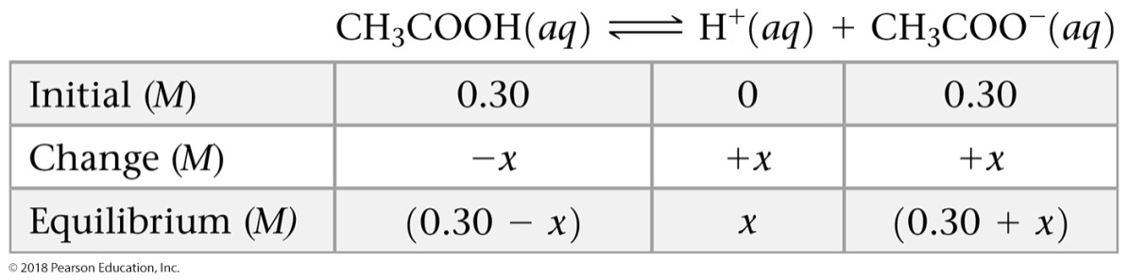
Sample Exercise 17.1 Calculating the pH When a Common Ion Is Involved
Continued
Second, [H⁺] and, therefore, the pH are controlled by the dissociation equilibrium of CH₃COOH:
CH₃COOH(aq) H⁺(aq) + CH₃COO–(aq)
(We have written the equilibrium using H⁺(aq) rather than H₃O⁺(aq), but both representations of the hydrated hydrogen ion are equally valid.)
Third, we tabulate the initial and equilibrium concentrations as we did in solving other equilibrium problems in Chapters 15 and 16:
The equilibrium concentration of CH₃COO– (the common ion) is the initial concentration that is due to CH₃COONa (0.30 M) plus the change in concentration (x) that is due to the ionization of CH₃COOH.

Slide 3

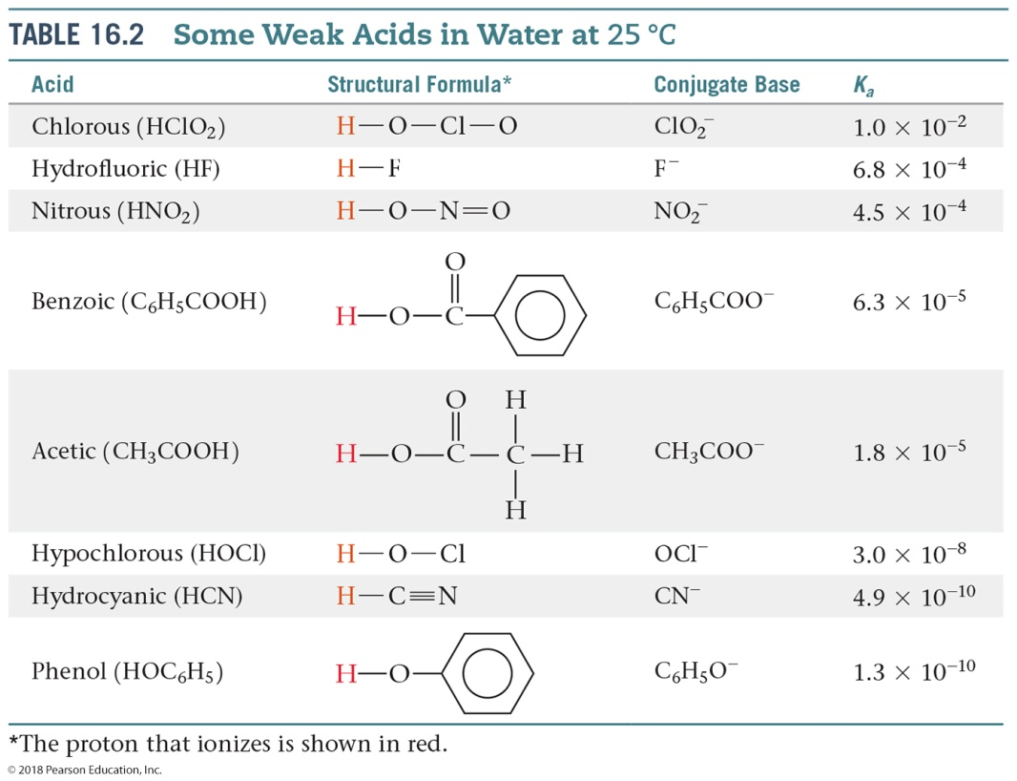

Sample Exercise 17.1 Calculating the pH When a Common Ion Is Involved
Continued
Now we can use the equilibrium-constant expression:
The dissociation constant for CH₃COOH at 25 °C is from Table 16.2, or Appendix D; addition of CH₃COONa does not change the value of this constant. Substituting the equilibrium-constant concentrations from our table into the equilibrium expression gives:

Slide 4

Sample Exercise 17.1 Calculating the pH When a Common Ion Is Involved
Continued
Because K_{a} is small, we assume that x is small compared to the original concentrations of CH₃COOH and CH₃COO– (0.30 M each). Thus, we can ignore the very small x relative to 0.30 M, giving:
The resulting value of x is indeed small relative to 0.30, justifying the approximation made in simplifying the problem.
x = 1.8 × 10^{–5} M = [H⁺]
Finally, we calculate the pH from the equilibrium concentration of H⁺(aq):
pH = –log(1.8 × 10^{–5}) = 4.74
Comment In Section 16.6, we calculated that a 0.30 M solution of CH₃COOH has a pH of 2.64, corresponding to [H⁺] = 2.3 × 10^{–3} M. Thus, the addition of CH₃COONa has substantially decreased [H⁺], as we expect from Le Châtelier’s principle.

Slide 5
Sample Exercise 17.1 Calculating the pH When a Common Ion Is Involved
Continued
Practice Exercise 1
For the generic equilibrium HA(aq) H⁺ (aq) + A–(aq), which of these statements is true?
(a) The equilibrium constant for this reaction changes as the pH changes.
(b) If you add the soluble salt KA to a solution of HA that is at equilibrium, the concentration of HA would decrease.
(c) If you add the soluble salt KA to a solution of HA that is at equilibrium, the concentration of A– would decrease.
(d) If you add the soluble salt KA to a solution of HA that is at equilibrium, the pH would increase.
Practice Exercise 2
Calculate the pH of a solution containing 0.085 M nitrous acid (HNO₂, K_{a} = 4.5 × 10^{–4}) and 0.10 M potassium nitrite (KNO₂).

Slide 6
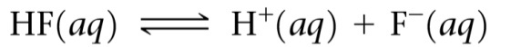

Sample Exercise 17.2 Calculating Ion Concentrations When a Common Ion Is Involved
Calculate the fluoride ion concentration and pH of a solution that is 0.20 M in HF and 0.10 M in HCl.
Solution
Analyze We are asked to determine the concentration of F– and the pH in a solution containing the weak acid HF and the strong acid HCl. In this case the common ion is H⁺.
Plan We can again use the four steps outlined in Sample Exercise 17.1.
Solve
Because HF is a weak acid and HCl is a strong acid, the major species in solution are HF, H⁺, and Cl–. The Cl–, which is the conjugate base of a strong acid, is merely a spectator ion in any acid–base chemistry. The problem asks for [F–], which is formed by ionization of HF. Thus, this is the important equilibrium:
The common ion in this problem is the hydrogen (or hydronium) ion. Now we can tabulate the initial and equilibrium concentrations of each species involved in this equilibrium:

Slide 7

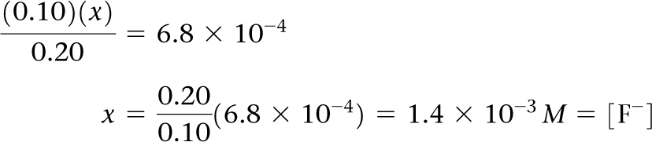
Sample Exercise 17.2 Calculating Ion Concentrations When a Common Ion Is Involved
Continued
The equilibrium constant for the ionization of HF, from Appendix D, is 6.8 × 10^{–4}. Substituting the equilibrium-constant concentrations into the equilibrium expression gives:
If we assume that x is small relative to 0.10 or 0.20 M, this expression simplifies to:
This F– concentration is substantially smaller than it would be in a 0.20 M solution of HF with no added HCl. The common ion, H⁺, suppresses the ionization of HF. The concentration of H⁺(aq) is:
[H⁺] = (0.10 + x) M 0.10 M
Thus, pH = 1.00

Slide 8
Sample Exercise 17.2 Calculating Ion Concentrations When a Common Ion Is Involved
Continued
Comment Notice that for all practical purposes, the hydrogen ion concentration is due entirely to the HCl; the HF makes a negligible contribution by comparison.
Practice Exercise 1
Calculate the concentration of the lactate ion in a solution that is 0.100 M in lactic acid (CH₃CH(OH)COOH,
pK_{a} = 3.86) and 0.080 M in HCl.
(a) 4.83 M (b) 0.0800 M
(c) 7.3 × 10^{–3} M (d) 3.65 × 10^{–3} M
(e) 1.73 × 10^{–4} M
Practice Exercise 2
Calculate the formate ion concentration and pH of a solution that is 0.050 M in formic acid (HCOOH, K_{a} = 1.8 × 10^{–4}) and 0.10 M in HNO₃.

Slide 9
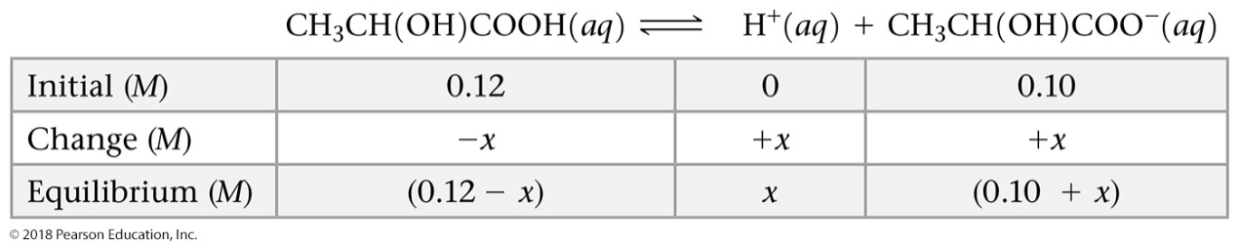

Sample Exercise 17.3 Calculating the pH of a Buffer
What is the pH of a buffer that is 0.12 M in lactic acid [CH₃CH(OH)COOH, or HC₃H₅O₃] and 0.10 M in sodium lactate [CH₃CH(OH)COONa or NaC₃H₅O₃]? For lactic acid, K_{a} = 1.4 × 10^{–4}.
Solution
Analyze We are asked to calculate the pH of a buffer containing lactic acid (HC₃H₅O₃) and its conjugate base, the lactate ion (C₃H₅O₃–).
Plan We will first determine the pH using the method described in Section 17.1. Because HC₃H₅O₃ is a weak electrolyte and NaC₃H₅O₃ is a strong electrolyte, the major species in solution are HC₃H₅O₃, Na⁺, and C₃H₅O₃–. The Na⁺ ion is a spectator ion. The HC₃H₅O₃/C₃H₅O₃– conjugate acid–base pair determines [H⁺] and, thus, pH; [H⁺] can be determined using the acid-dissociation equilibrium of lactic acid.
Solve
The initial and equilibrium concentrations of the species involved in this equilibrium are:
The equilibrium concentrations are governed by the equilibrium expression:

Slide 10
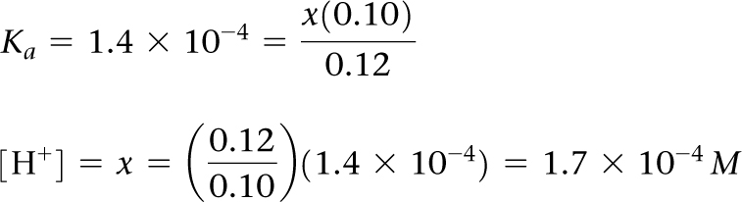
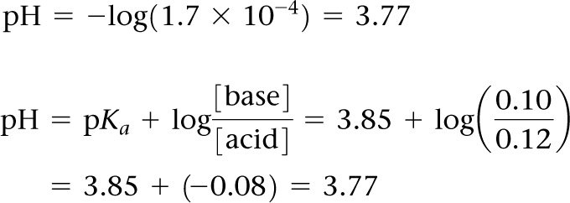
Sample Exercise 17.3 Calculating the pH of a Buffer
Continued
Because K_{a} is small and a common ion is present, we expect x to be small relative to either 0.12 or 0.10 M. Thus, our equation can be simplified to give:
Solving for x gives a value that justifies our approximation:
Then, we can solve for pH:
Alternatively, we can use the Henderson–Hasselbalch equation with the initial concentrations of acid and base to calculate pH directly:

Slide 11
Sample Exercise 17.3 Calculating the pH of a Buffer
Continued
Practice Exercise 1
If the pH of a buffer solution is equal to the pK_{a} of the acid in the buffer, what does this tell you about the relative concentrations of the acid and conjugate base forms of the buffer components?
(a) The acid concentration must be zero. (b) The base concentration must be zero. (c) The acid and base concentrations must be equal. (d) The acid and base concentrations must be equal to the K_{a}. (e) The base concentration must be 2.3 times as large as the acid concentration.
Practice Exercise 2
Calculate the pH of a buffer composed of 0.12 M benzoic acid and 0.20 M sodium benzoate. (Refer to Appendix D.)

Slide 12

Sample Exercise 17.4 Calculating pH When the Henderson– Hasselbalch Equation May Not Be Accurate
Calculate the pH of a buffer that initially contains 1.00 × 10^{–3} M CH₃COOH and 1.00 × 10^{–4} M CH₃COONa in the following two ways: (i) using the Henderson–Hasselbalch equation and (ii) making no assumptions about quantities (which means you will need to use the quadratic equation). The K_{a} of CH₃COOH is 1.80 × 10^{–5}.
Solution
Analyze We are asked to calculate the pH of a buffer two different ways. We know the initial concentrations of the weak acid and its conjugate base, and the K_{a} of the weak acid.
Plan We will first use the Henderson–Hasselbalch equation, which relates pK_{a} and ratio of acid–base concentrations to the pH. This will be straightforward. Then, we will redo the calculation making no assumptions about any quantities, which means we will need to write out the initial/change/equilibrium concentrations, as we have done before. In addition, we will need to solve for quantities using the quadratic equation (since we cannot make assumptions about unknowns being small).
Solve
(i) The Henderson–Hasselbalch equation is
We know the K_{a} of the acid (1.8 × 10^{–5}), so we know pK_{a} (pK_{a} = –log K_{a} = 4.74).
We know the initial concentrations of the base, sodium acetate, and the acid, acetic acid, which we will assume are the same as the equilibrium concentrations.

Slide 13
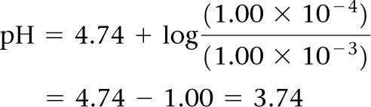
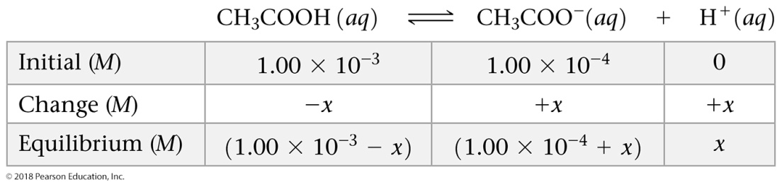
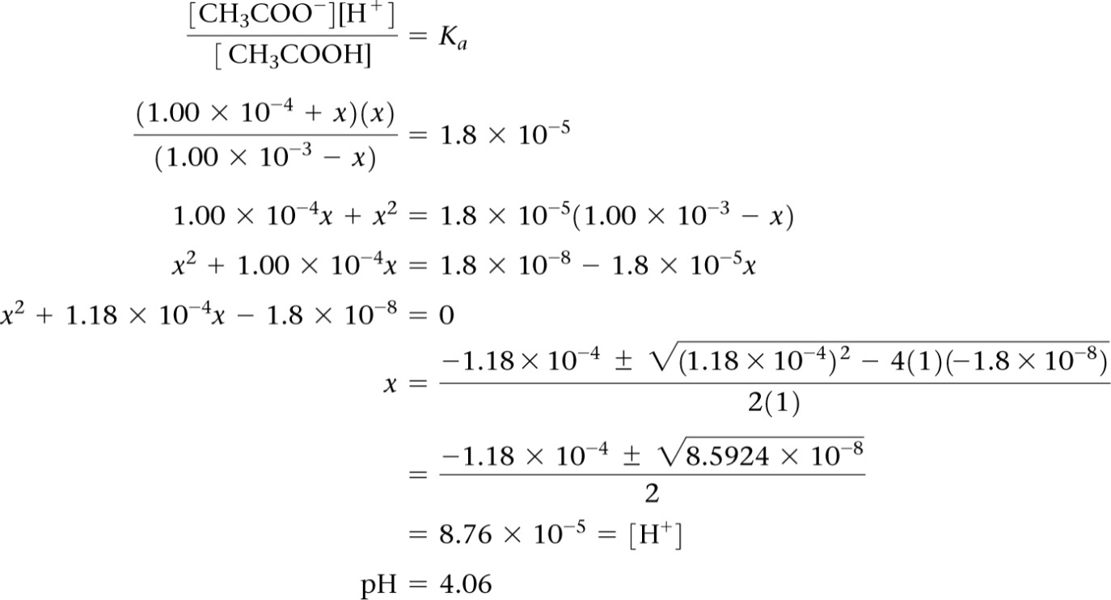
Sample Exercise 17.4 Calculating pH When the Henderson– Hasselbalch Equation May Not Be Accurate
Continued
Therefore, we have:
(ii) Now we will redo the calculation, without making any assumptions at all. We will solve for x, which represents the H⁺ concentration at equilibrium, in order to calculate pH.

Slide 14
Sample Exercise 17.4 Calculating pH When the Henderson– Hasselbalch Equation May Not Be Accurate
Continued
Comment In Sample Exercise 17.3, the calculated pH is the same whether we solve exactly using the quadratic equation or make the simplifying assumption that the equilibrium concentrations of acid and base are equal to their initial concentrations. The simplifying assumption works because the concentrations of the acid–base conjugate pair are both a thousand times larger than K_{a}. In this Sample Exercise, the acid–base conjugate pair concentrations are only 10–100 as large as K_{a}. Therefore, we cannot assume that x is small compared to the initial concentrations (that is, that the initial concentrations are essentially equal to the equilibrium concentrations). The best answer to this Sample Exercise is pH = 4.06, obtained without assuming x is small. Therefore, we see that the assumptions behind the Henderson–Hasselbalch equation are not valid when the initial concentration of the weak acid (or base) is small compared to its K_{a} (or K_{b}).
Practice Exercise 1
A buffer is made with sodium acetate (CH₃COONa) and acetic acid (CH₃COOH); the K_{a} for acetic acid is 1.80 × 10^{–5}. The pH of the buffer is 3.98. What is the ratio of the equilibrium concentration of sodium acetate to that of acetic acid?
(a) –0.760 (b) 0.174 (c) 0.840 (d) 5.75 (e) Not enough information is given to answer this question.
Practice Exercise 2
Calculate the final, equilibrium pH of a buffer that initially contains 6.50 × 10^{–4} M HOCl and 7.50 × 10^{–4} M NaOCl. The K_{a} of HOCl is 3.0 × 10^{–5}.

Slide 15
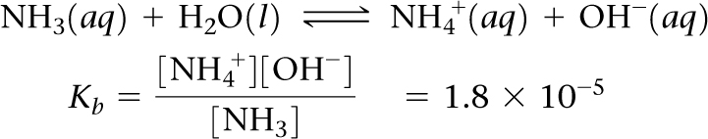
Sample Exercise 17.5 Preparing a Buffer
How many moles of NH₄Cl must be added to 2.0 L of 0.10 M NH₃ to form a buffer whose pH is 9.00? (Assume that the addition of NH₄Cl does not change the volume of the solution.)
Solution
Analyze We are asked to determine the amount of NH₄⁺ ion required to prepare a buffer of a specific pH.
Plan The major species in the solution will be NH₄⁺, Cl–, and NH₃. Of these, the Cl– ion is a spectator (it is the conjugate base of a strong acid). Thus, the NH₄⁺/NH₃ conjugate acid–base pair will determine the pH of the buffer. The equilibrium relationship between NH₄⁺ and NH₃ is given by the base-dissociation reaction for NH₃:
The key to this exercise is to use this K_{b} expression to calculate [NH₄⁺].
Solve
We obtain [OH–] from the given pH: pOH = 14.00 – pH = 14.00 – 9.00 = 5.00
and so: [OH–] = 1.0 × 10^{–5} M

Slide 16
Sample Exercise 17.5 Preparing a Buffer
Continued
Because K_{b} is small and the common ion [NH₄⁺] is present, the equilibrium concentration of NH₃ essentially equals its initial concentration:
[NH₃] = 0.10 M
We now use the expression for K_{b} to calculate [NH₄⁺]:
Thus, for the solution to have pH = 9.00, [NH₄⁺] must equal 0.18 M. The number of moles of NH₄Cl needed to produce this concentration is given by the product of the volume of the solution and its molarity:
Comment Because NH₄⁺ and NH₃ are a conjugate acid–base pair, we could use the Henderson–Hasselbalch equation (Equation 17.9) to solve this problem. To do so requires first using Equation 16.41 to calculate pK_{a} for NH₄⁺ from the value of pK_{b} for NH₃. We suggest you try this approach to convince yourself that you can use the Henderson–Hasselbalch equation for buffers for which you are given K_{b} for the conjugate base rather than K_{a} for the conjugate acid.

Slide 17
Sample Exercise 17.5 Preparing a Buffer
Continued
Practice Exercise 1
Calculate the number of grams of ammonium chloride that must be added to 2.00 L of a 0.500 M ammonia solution to obtain a buffer of pH = 9.20. Assume the volume of the solution does not change as the solid is added. K_{b} for ammonia is 1.80 × 10^{–5}.
(a) 60.7 g (b) 30.4 g (c) 1.52 g (d) 0.568 g (e) 1.59 × 10^{–5} g
Practice Exercise 2
Calculate the concentration of sodium benzoate that must be present in a 0.20 M solution of benzoic acid (C₆H₅COOH) to produce a pH of 4.00. Refer to Appendix D.

Slide 18
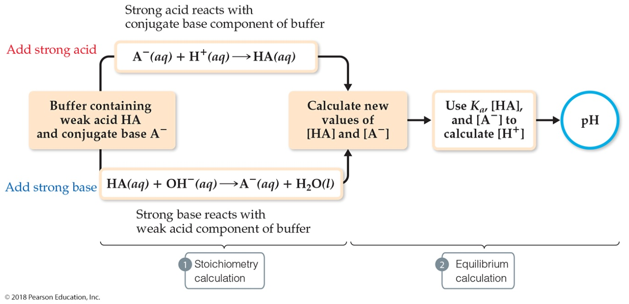
Sample Exercise 17.6 Calculating pH Changes in Buffers
A buffer is made by adding 0.300 mol CH₃COOH and 0.300 mol CH₃COONa to enough water to make 1.000 L of solution. The pH of the buffer is 4.74 (Sample Exercise 17.1). (a) Calculate the pH of this solution after 5.0 mL of 4.0 M NaOH(aq) solution is added. (b) For comparison, calculate the pH of a solution made by adding 5.0 mL of 4.0 M NaOH(aq) solution to 1.000 L of pure water.
Solution
Analyze We are asked to determine the pH of a buffer after addition of a small amount of strong base and to compare the pH change with the pH that would result if we were to add the same amount of strong base to pure water.
Plan Solving this problem involves the two steps outlined in Figure 17.3. First we do a stoichiometry calculation to determine how the added OH– affects the buffer composition. Then we use the resulting buffer composition and either the Henderson–Hasselbalch equation or the equilibrium-constant expression for the buffer to determine the pH.

Slide 19
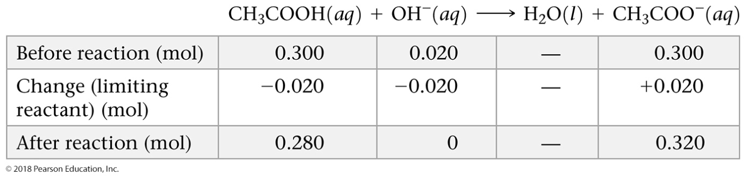
Sample Exercise 17.6 Calculating pH Changes in Buffers
Continued
Solve
(a) Stoichiometry Calculation: The OH– provided by NaOH reacts with CH₃COOH, the weak acid component of the buffer. Since volumes are changing, it is prudent to figure out how many moles of reactants and products would be produced, then divide by the final volume later to obtain concentrations. Prior to this neutralization reaction, there are 0.300 mol each of CH₃COOH and CH₃COO–. The amount of base added is 0.0050 L × 4.0 mol/L = 0.020 mol. Neutralizing the 0.020 mol OH– requires 0.020 mol of CH₃COOH. Consequently, the amount of CH₃COOH decreases by 0.020 mol, and the amount of the product of the neutralization, CH₃COO–, increases by 0.020 mol. We can create a table to see how the composition of the buffer changes as a result of its reaction with OH–:
Equilibrium Calculation: We now turn our attention to the equilibrium for the ionization of acetic acid, the relationship that determines the buffer pH:
CH₃COOH(aq) H⁺(aq) + CH₃COO–(aq)

Slide 20

Sample Exercise 17.6 Calculating pH Changes in Buffers
Continued
Using the quantities of CH₃COOH and CH₃COO– remaining in the buffer after the reaction with strong base, we determine the pH using the Henderson–Hasselbalch equation. The volume of the solution is now 1.000 L + 0.0050 L = 1.005 L due to addition of the NaOH solution:
(b) To determine the pH of a solution made by adding 0.020 mol of NaOH to 1.000 L of pure water, we first determine the concentration of OH– ions in solution:
[OH–] = 0.020 mol/1.005 L = 0.020 M
We use this value in Equation 16.18 to calculate pOH and then use our calculated pOH value to obtain pH:
pOH = –log[OH–] = –log(0.020) = +1.70
pH = 14 – (+1.70) = 12.30

Slide 21
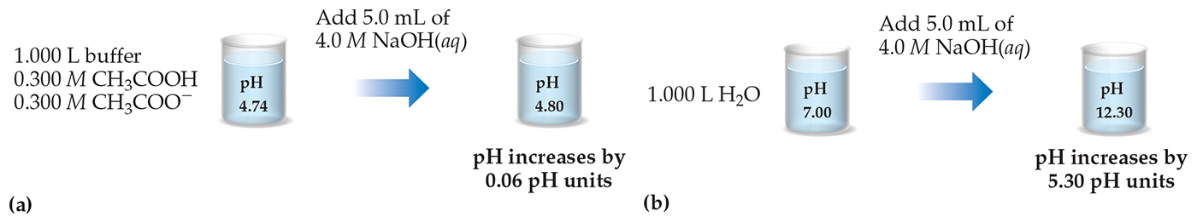
Sample Exercise 17.6 Calculating pH Changes in Buffers
Continued
Comment Note that the small amount of added NaOH changes the pH of water significantly. In contrast, the pH of the buffer changes very little when the NaOH is added, as summarized in Figure 17.4.
Practice Exercise 1
Which of these statements is true? (a) If you add strong acid or base to a buffer, the pH will never change. (b) In order
to do calculations in which strong acid or base is added to a buffer, you only need to use the Henderson–Hasselbalch
equation. (c) Strong bases react with strong acids, but not weak acids. (d) If you add a strong acid or base to a buffer, the buffer’s pK_{a} or pK_{b} will change. (e) In order to do calculations in which a strong acid or base is added to a buffer, you need to calculate the amounts of substances from the neutralization reaction and then equilibrate.
Practice Exercise 2
Determine (a) the pH of the original buffer described in Sample Exercise 17.6 after the addition of 0.020 mol HCl and
(b) the pH of the solution that would result from the addition of 0.020 mol HCl to 1.000 L of pure water.

Slide 22
Sample Exercise 17.7 Calculations for a Strong Acid–Strong Base Titration
Calculate the pH when (a) 49.0 mL and (b) 51.0 mL of 0.100 M NaOH solution have been added to 50.0 mL of 0.100 M HCl solution.
Solution
Analyze We are asked to calculate the pH at two points in the titration of a strong acid with a strong base. The first point is just before the equivalence point, so we expect the pH to be determined by the small amount of strong acid that has not yet been neutralized. The second point is just after the equivalence point, so we expect this pH to be determined by the small amount of excess strong base.
Plan (a) As the NaOH solution is added to the HCl solution, H⁺(aq) reacts with OH–(aq) to form H₂O. Both Na⁺ and Cl– are spectator ions, having negligible effect on the pH. To determine the pH of the solution, we must first determine how many moles of H⁺ were originally present and how many moles of OH– were added. We can then calculate how many moles of each ion remain after the neutralization reaction. To calculate [H⁺], and hence pH, we must also remember that the volume of the solution increases as we add titrant, thus diluting the concentration of all solutes present. Therefore, it is best to deal with moles first, and then convert to molarities using total solution volumes (volume of acid plus volume of base). (b) We proceed in the same way as in part (a) except we are now past the equivalence point and have more OH– the solution than H⁺.
Solve
(a) The number of moles of H+ in the original HCl solution is given by the product of the volume of the solution and its molarity:

Slide 23
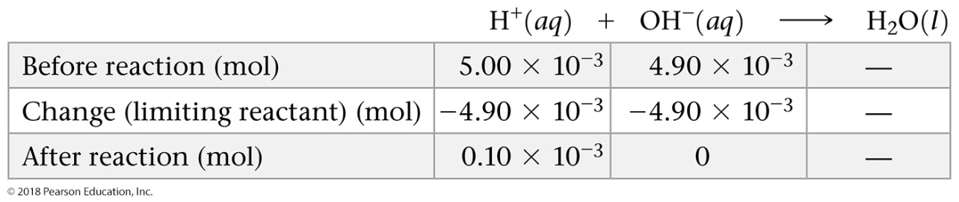
Sample Exercise 17.7 Calculations for a Strong Acid–Strong Base Titration
Continued
Likewise, the number of moles of OH– in 49.0 mL of 0.100 M NaOH is:
Because we have not reached the equivalence point, there are more moles of H+ present than OH–. Therefore, OH– is the limiting reactant. Each mole of OH– reacts with 1 mol of H⁺. Using the convention introduced in Sample Exercise 17.6, we have:
The volume of the reaction mixture increases as the NaOH solution is added to the HCl solution. Thus, at this point in the titration, the volume in the titration flask is:
50.0 mL + 49.0 mL = 99.0 mL = 0.0990 L
Thus, the concentration of H⁺(aq) in the flask is:

Slide 24
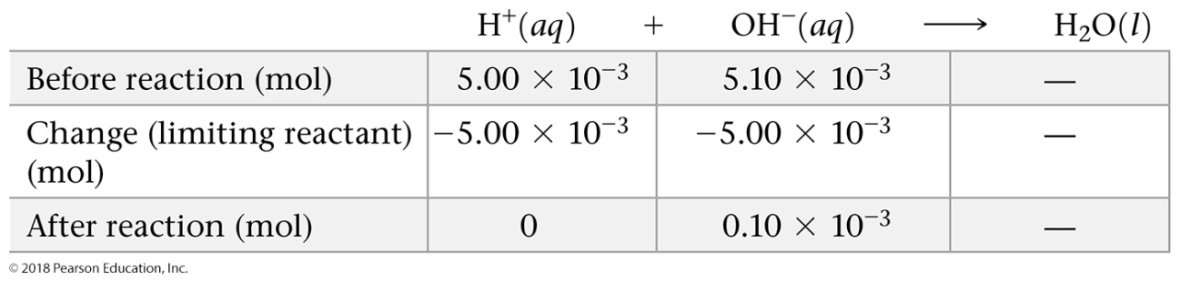
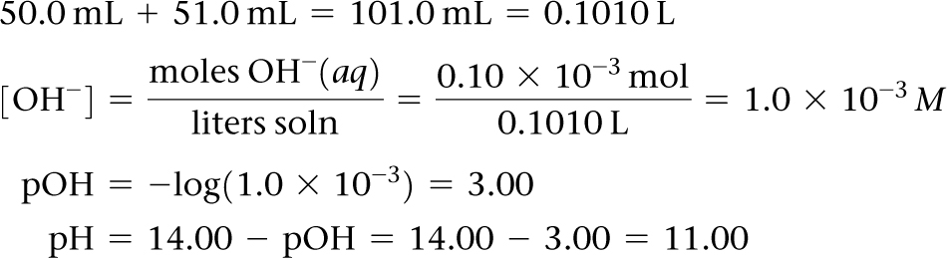
Sample Exercise 17.7 Calculations for a Strong Acid–Strong Base Titration
Continued
The corresponding pH is:
–log(1.0 × 10^{–3}) = 3.00
(b) As before, the initial number of moles of each reactant is determined from their volumes and concentrations. The reactant present in smaller stoichiometric amount (the limiting reactant) is consumed completely, leaving an excess of hydroxide ion.
In this case, the volume in the titration flask is:
Hence, the concentration of OH–(aq) in the flask is:
and we have:

Slide 25
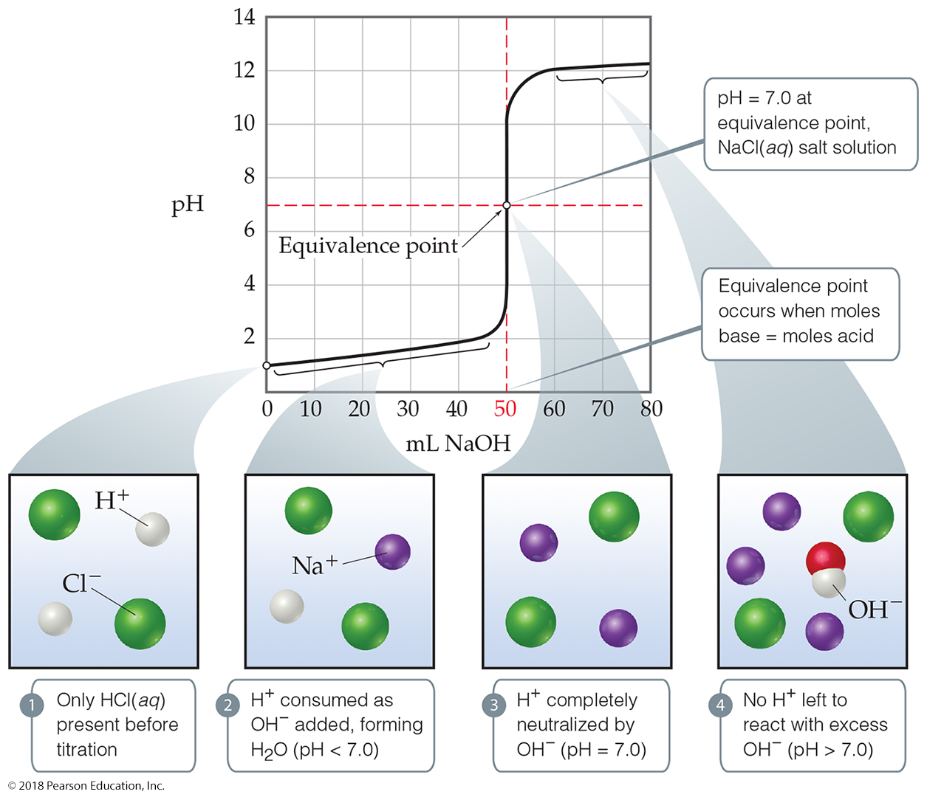
Sample Exercise 17.7 Calculations for a Strong Acid–Strong Base Titration
Continued
Comment Note that the pH increased by only two pH units, from 1.00 (Figure 17.7) to 3.00, after the first 49.0 mL of NaOH solution was added, but jumped by eight pH units, from 3.00 to 11.00, as 2.0 mL of base solution was added near the equivalence point. Such a rapid rise in pH near the equivalence point is a characteristic of titrations involving strong acids and strong bases.

Slide 26
Sample Exercise 17.7 Calculations for a Strong Acid–Strong Base Titration
Continued
Practice Exercise 1
An acid–base titration is performed: 250.0 mL of an unknown concentration of HCl (aq) is titrated to the equivalence point with 36.7 mL of a 0.1000 M aqueous solution of NaOH. Which of the following statements is not true of this titration? (a) The HCl solution is less concentrated than the NaOH solution. (b) The pH is less than 7 after adding 25 mL of NaOH solution. (c) The pH at the equivalence point is 7.00. (d) If an additional 1.00 mL of NaOH solution is added beyond the equivalence point, the pH of the solution is more than 7.00. (e) At the equivalence point, the OH– concentration in the solution is 3.67 × 10^{–3} M.
Practice Exercise 2
Calculate the pH when (a) 24.9 mL and (b) 25.1 mL of 0.100 M HNO₃ have been added to 25.0 mL of 0.100 M KOH solution.

Slide 27
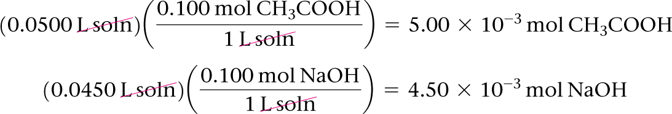
Sample Exercise 17.8 Calculations for a Weak Acid–Strong Base Titration
Calculate the pH of the solution formed when 45.0 mL of 0.100 M NaOH is added to 50.0 mL of 0.100 M CH₃COOH (K_{a} = 1.8 × 10^{–5}).
Solution
Analyze We are asked to calculate the pH before the equivalence point of the titration of a weak acid with a strong base.
Plan We first must determine the number of moles of CH₃COOH and CH₃COO– present after the neutralization reaction (the stoichiometry calculation). We then calculate pH using K_{a}, [CH₃COOH], and [CH₃COO–] (the equilibrium calculation).
Solve
Stoichiometry Calculation: The product of the volume and concentration of each solution gives the number of moles of each reactant present before the neutralization:

Slide 28
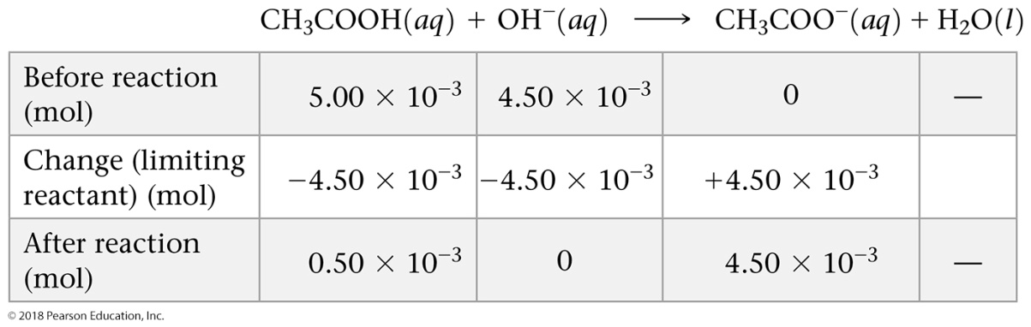
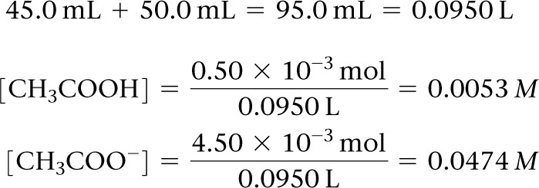
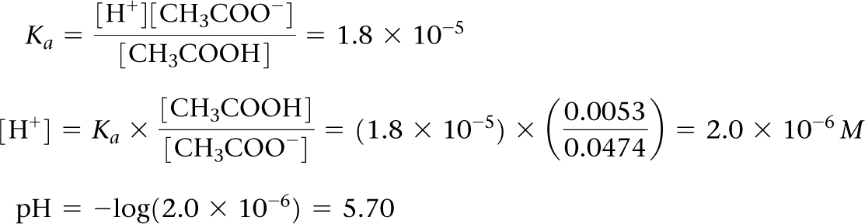
Sample Exercise 17.8 Calculations for a Weak Acid–Strong Base Titration
Continued
The 4.50 × 10^{–3} mol of NaOH consumes 4.50 × 10^{–3} mol of CH₃COOH:
The total volume of the solution is:
The resulting molarities of CH₃COOH and CH₃COO– after the reaction are therefore:
Equilibrium Calculation: The equilibrium between CH₃COOH and CH₃COO– must obey the equilibrium-constant expression for CH₃COOH:

Slide 29
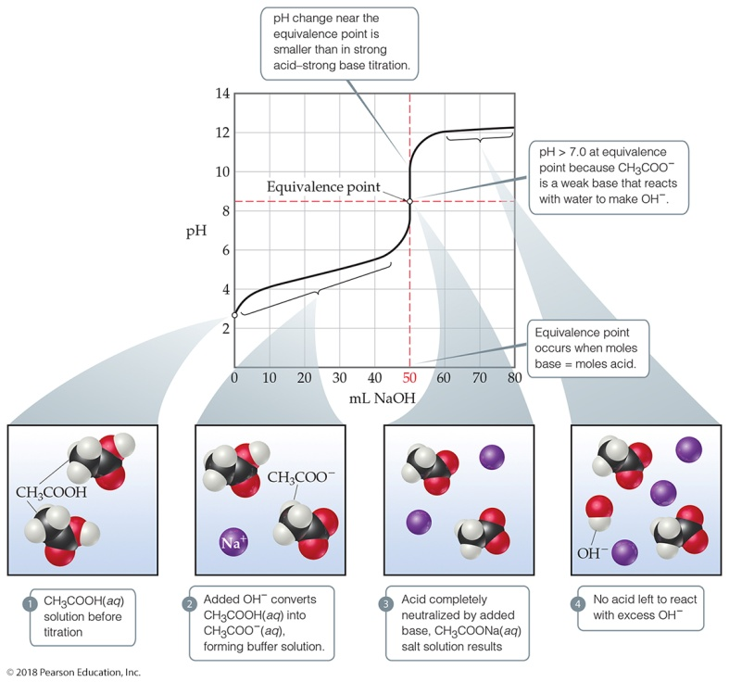
Sample Exercise 17.8 Calculations for a Weak Acid–Strong Base Titration
Continued
Solving for [H⁺] gives:
Comment We could have solved for pH equally well using the Henderson–Hasselbalch equation in the last step.
Practice Exercise 1
If you think carefully about what happens during the course of a weak acid–strong base titration, you can learn some very interesting things. For example, let’s look back at Figure 17.9 and pretend you did not know that acetic acid was the acid being titrated. You can figure out the pK_{a} of a weak acid just by thinking about the definition of K_{a} and looking at the right place on the titration curve! Which of the following choices is the best way to do this?
(a) At the equivalence point, pH = pK_{a}. (b) Halfway to the equivalence point, pH = pK_{a}. (c) Before any base is added, pH = pK_{a}. (d) At the top of the graph with excess base added, pH = pK_{a}.

Slide 30
Sample Exercise 17.8 Calculations for a Weak Acid–Strong Base Titration
Continued
Practice Exercise 2
(a) Calculate the pH in the solution formed by adding 10.0 mL of 0.050 M NaOH to 40.0 mL of 0.0250 M benzoic
acid (C₆H₅COOH, K_{a} = 6.3 × 10^{–5}). (b) Calculate the pH in the solution formed by adding 10.0 mL of 0.100 M HCl to 20.0 mL of 0.100 M NH₃.

Slide 31


Sample Exercise 17.9 Calculating the pH at the Equivalence Point
Calculate the pH at the equivalence point in the titration of 50.0 mL of 0.100 M CH₃COOH with 0.100 M NaOH.
Solution
Analyze We are asked to determine the pH at the equivalence point of the titration of a weak acid with a strong base. Because the neutralization of a weak acid produces its anion, a conjugate base that can react with water, we expect the pH at the equivalence point to be greater than 7.
Plan The initial number of moles of acetic acid equals the number of moles of acetate ion at the equivalence point. We use the volume of the solution at the equivalence point to calculate the concentration of acetate ion. Because the acetate ion is a weak base, we can calculate the pH using K_{b} and [CH₃COO–].
Solve
The number of moles of acetic acid in the initial solution is obtained from the volume and molarity of the solution:
Hence, 5.00 × 10^{–3} mol of CH₃COO– is formed. It will take 50.0 mL of NaOH to reach the equivalence point (Figure 17.9). The volume of this salt solution at the equivalence point is the sum of the volumes of the acid and base, 50.0 mL + 50.0 mL = 100.0 mL = 0.1000 L. Thus, the concentration of CH₃COO– is:

Slide 32
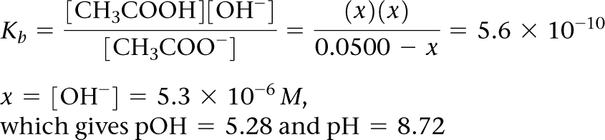
Sample Exercise 17.9 Calculating the pH at the Equivalence Point
Continued
The CH₃COO– ion is a weak base:
CH₃COO–(aq) + H₂O(l) CH₃COOH(aq) + OH–(aq)
The K_{b} for CH₃COO– can be calculated from the K_{a} value of its conjugate acid, K_{b} = K_{w}/K_{a} = (1.0 × 10^{–14})/
(1.8 × 10^{–5}) = 5.6 × 10^{–10}. Using the K_{b} expression, we have:
Making the approximation that 0.0500 – x 0.0500, and then solving for x, we have:
Check The pH is above 7, as expected for the salt of a weak acid and strong base.

Slide 33
Sample Exercise 17.9 Calculating the pH at the Equivalence Point
Continued
Practice Exercise 1
Why is pH at the equivalence point larger than 7 when you titrate a weak acid with a strong base? (a) There is excess strong base at the equivalence point. (b) There is excess weak acid at the equivalence point. (c) The conjugate base that is formed at the equivalence point is a strong base. (d) The conjugate base that is formed at the equivalence point reacts with water. (e) This statement is false: the pH is always 7 at an equivalence point in a pH titration.
Practice Exercise 2
Calculate the pH at the equivalence point when (a) 40.0 mL of 0.025 M benzoic acid (C₆H₅COOH, K_{a} = 6.3 × 10^{–5}) is titrated with 0.050 M NaOH and (b) 40.0 mL of 0.100 M NH₃ is titrated with 0.100 M HCl.

Slide 34
Sample Exercise 17.10 Writing Solubility-Product (K_{sp}) Expressions
Write the expression for the solubility-product constant for CaF₂, and look up the corresponding K_{sp} value in Appendix D.
Solution
Analyze We are asked to write an equilibrium-constant expression for the process by which CaF₂ dissolves in water.
Plan We apply the general rules for writing an equilibrium-constant expression, excluding the solid reactant from the expression. We assume that the compound dissociates completely into its component ions:
CaF₂(s) Ca²⁺ (aq) + 2 F–(aq)
Solve The expression for K_{sp} is
K_{sp} = [Ca²⁺][F–]²
Appendix D gives 3.9 × 10^{–11} for this K_{sp}.

Slide 35
Sample Exercise 17.10 Writing Solubility-Product (K_{sp}) Expressions
Continued
Practice Exercise 1
Which of these expressions correctly expresses the solubility-product constant for Ag₃PO₄ in water?
(a) [Ag][PO₄] (b) [Ag⁺][PO₄^{3–}] (c) [Ag⁺]³[PO₄^{3–}] (d) [Ag⁺][PO₄^{3–}]³ (e) [Ag⁺]³[PO₄^{3–}]³
Practice Exercise 2
Give the solubility-product-constant expressions and K_{sp} values (from Appendix D) for (a) barium carbonate and (b) silver sulfate.

Slide 36
Sample Exercise 17.11 Calculating K_{sp} from Solubility
Solid silver chromate is added to pure water at 25 °C, and some of the solid remains undissolved. The mixture is stirred for several days to ensure that equilibrium is achieved between the undissolved Ag₂CrO₄(s) and the solution. Analysis of the equilibrated solution shows that its silver ion concentration is 1.3 × 10^{–4} M. Assuming that the Ag₂CrO₄ solution is saturated and that there are no other important equilibria involving Ag⁺ or CrO₄^{2–} ions in the solution, calculate K_{sp} for this compound.
Solution
Analyze We are given the equilibrium concentration of Ag⁺ in a saturated solution of Ag₂CrO₄ and asked to determine the value of K_{sp} for Ag₂CrO₄.
Plan The equilibrium equation and the expression for K_{sp} are
Ag₂CrO₄(s) 2 Ag⁺(aq) + CrO₄^{2–}(aq)
K_{sp} = [Ag⁺]²[CrO₄^{2–}]
To calculate K_{sp}, we need the equilibrium concentrations of Ag⁺ and CrO₄^{2–}. We know that at equilibrium [Ag⁺] = 1.3 × 10^{–4} M. All the Ag⁺ and CrO₄^{2–} ions in the solution come from the Ag₂CrO₄ that dissolves. Thus, we can use [Ag⁺] to calculate [CrO₄^{2–}].
Solve From the chemical formula of silver chromate, we know that there must be two Ag⁺ ions in solution for each CrO₄^{2–} ion in solution. Consequently, the concentration of CrO₄^{2–} is half the concentration of Ag⁺:

Slide 37
Sample Exercise 17.11 Calculating K_{sp} from Solubility
Continued
and K_{sp} is
K_{sp} = [Ag⁺]²[CrO₄^{2–}] = (1.3 × 10^{–4})²(6.5 × 10^{–5}) = 1.1 × 10^{–12}
Check We obtain a small value, as expected for a slightly soluble salt. Furthermore, the calculated value agrees well with the one given in Appendix D, 1.2 × 10^{–12}.
Practice Exercise 1
You add 10.0 grams of solid copper(II) phosphate, Cu₃(PO₄)₂, to a beaker and then add 100.0 mL of water to the beaker at T = 298 K. The solid does not appear to dissolve. You wait a long time, with occasional stirring and eventually measure the equilibrium concentration of Cu²⁺ (aq) in the water to be 5.01 × 10^{–8} M. What is the K_{sp} of copper(II) phosphate?
(a) 5.01 × 10^{–8} (b) 2.50 × 10^{–15} (c) 4.20 × 10^{–15}
(d) 3.16 × 10^{–37} (e) 1.40 × 10^{–37}
Practice Exercise 2
A saturated solution of Mg(OH)₂ in contact with undissolved Mg(OH)₂(s) is prepared at 25 °C. The pH of the solution is found to be 10.17. Assuming that there are no other simultaneous equilibria involving the Mg²⁺ or OH– ions, calculate K_{sp} for this compound.

Slide 38
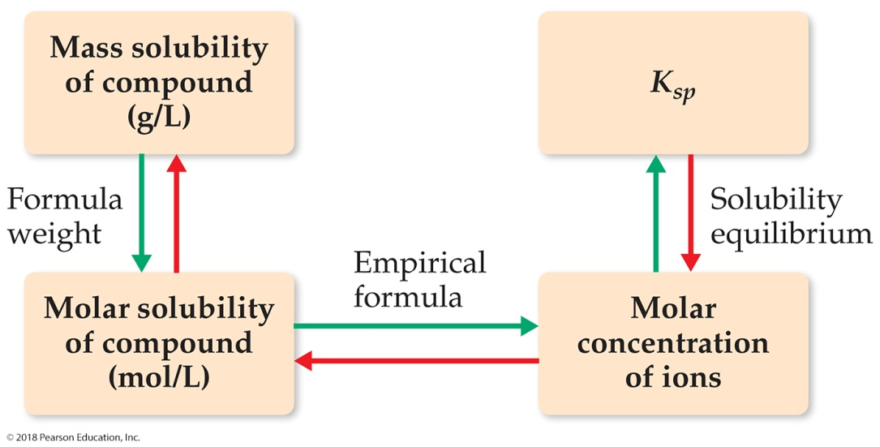
Sample Exercise 17.12 Calculating Solubility from K_{sp}
The K_{sp} for CaF₂ is 3.9 × 10^{–11} at 25 °C. Assuming equilibrium is established between solid and dissolved CaF₂, and that there are no other important equilibria affecting its solubility, calculate the solubility of CaF₂ in grams per liter.
Solution
Analyze We are given K_{sp} for CaF₂ and asked to determine solubility. Recall that the solubility of a substance is the quantity that can dissolve in solvent, whereas the solubility-product constant, K_{sp}, is an equilibrium constant.
Plan To go from K_{sp} to solubility, we follow the steps indicated by the red arrows in Figure 17.16. We first write the chemical equation for the dissolution and set up a table of initial and equilibrium concentrations. We then use the equilibrium-constant expression. In this case we know K_{sp}, and so we solve for the concentrations of the ions in solution. Once we know these concentrations, we use the formula weight to determine solubility in g/L.

Slide 39
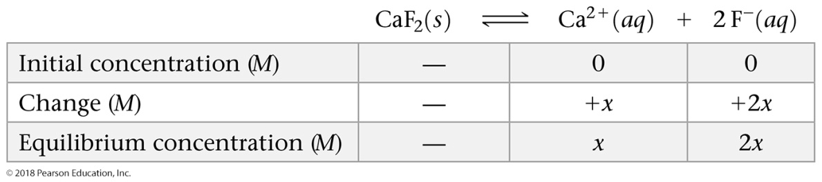


Sample Exercise 17.12 Calculating Solubility from K_{sp}
Continued
Solve
Assume that initially no salt has dissolved, and then allow x mol/L of CaF₂ to dissociate completely when equilibrium is achieved:
The stoichiometry of the equilibrium dictates that 2x mol/L of F– are produced for each x mol/L of CaF₂ that dissolve. We now use the expression for K_{sp} and substitute the equilibrium concentrations to solve for the value of x:
K_{sp} = [Ca²⁺][F–]² = (x)(2x)² = 4x³ = 3.9 × 10^{–11}
(Remember that .) Thus, the molar solubility of CaF₂ is 2.1 × 10^{–4} mol/L.
The mass of CaF₂ that dissolves in water to form 1 L of solution is:

Slide 40
Sample Exercise 17.12 Calculating Solubility from K_{sp}
Continued
Check We expect a small number for the solubility of a slightly soluble salt. If we reverse the calculation, we should be able to recalculate the solubility product: K_{sp} = (2.1 × 10^{–4})(4.2 × 10^{–4})² = 3.7 × 10^{–11}, close to the value given in the problem statement, 3.9 × 10^{–11}.
Comment Because F– is the anion of a weak acid, you might expect hydrolysis of the ion to affect the solubility of CaF₂. The basicity of F– is so small (K_{b} = 1.5 × 10^{–11}), however, that the hydrolysis occurs to only a slight extent and does not significantly influence the solubility. The reported solubility is 0.017 g/L at 25 °C, in good agreement with our calculation.
Practice Exercise 1
Of the five salts listed below, which has the highest concentration of its cation in water? Assume that all salt solutions are saturated and that the ions do not undergo any additional reactions in water.
(a) lead(II) chromate, K_{sp} = 2.8 × 10^{–13}
(b) cobalt(II) hydroxide, K_{sp} = 1.3 × 10^{–15}
(c) cobalt(II) sulfide, K_{sp} = 5 × 10^{–22}
(d) chromium(III) hydroxide, K_{sp} = 1.6 × 10^{–30}
(e) silver sulfide, K_{sp} = 6 × 10^{–51}
Practice Exercise 2
The K_{sp} for LaF₃ is 2 × 10^{–19}. What is the solubility of LaF₃ in water in moles per liter?

Slide 41
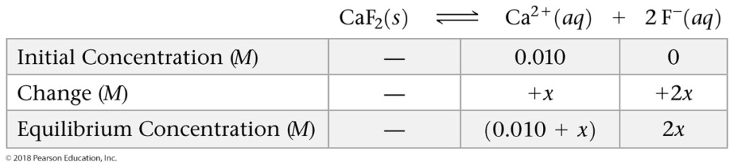
Sample Exercise 17.13 Calculating the Effect of a Common Ion on Solubility
Calculate the molar solubility of CaF₂ at 25 °C in a solution that is (a) 0.010 M in Ca(NO₃)₂ and (b) 0.010 M in NaF.
Solution
Analyze We are asked to determine the solubility of CaF₂ in the presence of two strong electrolytes, each containing an ion common to CaF₂. In (a) the common ion is Ca²⁺, and NO₃– is a spectator ion. In (b) the common ion is F–, and Na⁺ is a spectator ion.
Plan Because the slightly soluble compound is CaF₂, we need to use K_{sp} for this compound, which Appendix D gives as 3.9 × 10^{–11}. The value of K_{sp} is unchanged by the presence of additional solutes. Because of the common-ion effect, however, the solubility of the salt decreases in the presence of common ions. We use our standard equilibrium techniques of starting with the equation for CaF₂ dissolution, setting up a table of initial and equilibrium concentrations, and using the K_{sp} expression to determine the concentration of the ion that comes only from CaF₂.
Solve
(a) The initial concentration of Ca²⁺ is 0.010 M because of the dissolved Ca(NO₃)₂:
Substituting into the solubility-product expression gives: K_{sp} = 3.9 × 10^{–11} = [Ca²⁺][F–]² = (0.010 + x)(2x)²

Slide 42
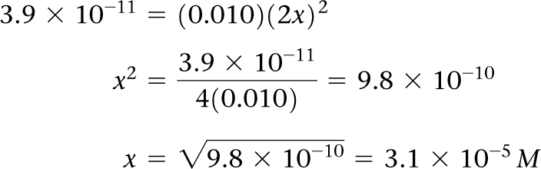
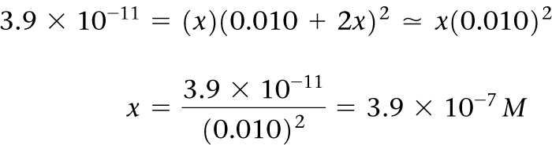
Sample Exercise 17.13 Calculating the Effect of a Common Ion on Solubility
Continued
If we assume that x is small compared to 0.010, we have:
This very small value for x validates the simplifying assumption we made. Our calculation indicates that 3.1 × 10^{–5} mol of solid CaF₂ dissolves per liter of 0.010 M Ca(NO₃)₂ solution.
(b) The common ion is F–, and at equilibrium we have:
[Ca²⁺] = x and [F–] = 0.010 + 2x
Assuming that 2x is much smaller than 0.010 M
(that is, 0.010 + 2x 0.010), we have:
Thus, 3.9 × 10^{–7} mol of solid CaF₂ should
dissolve per liter of 0.010 M NaF solution.

Slide 43
Sample Exercise 17.13 Calculating the Effect of a Common Ion on Solubility
Continued
Comment The molar solubility of CaF₂ in water is 2.1 × 10^{–4} M (Sample Exercise 17.12). By comparison, our calculations here give a CaF₂ solubility of 3.1 × 10^{–5} M in the presence of 0.010 M Ca²⁺ and 3.9 × 10^{–7} M in the presence of 0.010 M F– ion. Thus, the addition of either Ca²⁺ or F– to a solution of CaF₂ decreases the solubility. However, the effect of F– on the solubility is more pronounced than that of Ca²⁺ because [F–] appears to the second power in the K_{sp} expression for CaF₂, whereas [Ca²⁺] appears to the first power.
Practice Exercise 1
Consider a saturated solution of the salt MA₃, in which M is a metal cation with a 3+ charge and A is an anion with a 1– charge, in water at 298 K. Which of the following will affect the K_{sp} of MA₃ in water?
(a) The addition of more M³⁺ to the solution. (b) The addition of more A– to the solution. (c) Diluting the solution. (d) Raising the temperature of the solution. (e) More than one of the above factors.
Practice Exercise 2
For manganese(II) hydroxide, Mn(OH)₂, K_{sp} = 1.6 × 10^{–13}. Calculate the molar solubility of Mn(OH)₂ in a solution that contains 0.020 M NaOH.

Slide 44
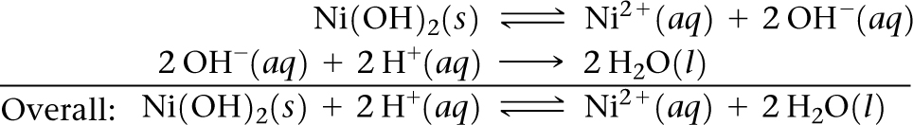
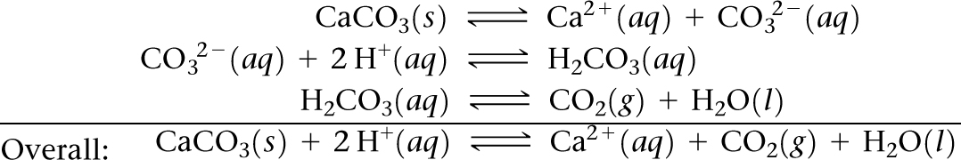
Sample Exercise 17.14 Predicting the Effect of Acid on Solubility
Which of these substances are more soluble in acidic solution than in basic solution:
(a) Ni(OH)₂(s), (b) CaCO₃(s), (c) BaF₂(s), (d) AgCl(s)?
Solution
Analyze The problem lists four sparingly soluble salts, and we are asked to determine which are more soluble at low pH than at high pH.
Plan We will identify ionic compounds that dissociate to produce a basic anion, as these are especially soluble in acid solution.
Solve
(a) Ni(OH)₂(s) is more soluble in acidic solution because of the basicity of OH–; the H⁺ reacts with the OH– ion, forming water:
(b) Similarly, CaCO₃(s) dissolves in acid solutions because CO₃^{2–} is a basic anion:

Slide 45
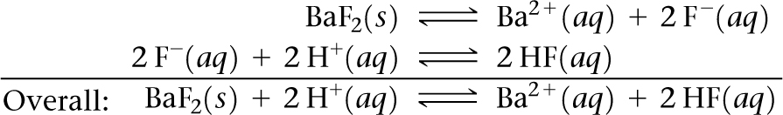
Sample Exercise 17.14 Predicting the Effect of Acid on Solubility
Continued
The reaction between CO₃^{2–} and H⁺ occurs in steps, with HCO₃– forming first and H₂CO₃ forming in appreciable amounts only when [H⁺] is sufficiently high.
(c) The solubility of BaF₂ is enhanced by lowering the pH because F– is a basic anion:
(d) The solubility of AgCl is unaffected by changes in pH because Cl– is the anion of a strong acid and therefore has negligible basicity.
Practice Exercise 1
Which of the following actions will increase the solubility of AgBr in water? (a) increasing the pH (b) decreasing the pH (c) adding NaBr (d) adding NaNO₃ (e) none of the above
Practice Exercise 2
Write the net ionic equation for the reaction between a strong acid and (a) CuS, (b) Cu(N₃)₂.

Slide 46
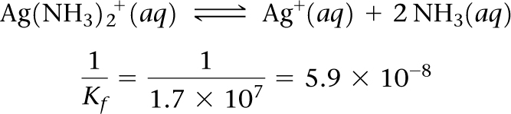
Sample Exercise 17.15 Evaluating an Equilibrium Involving a Complex Ion
Calculate the concentration of Ag⁺ present in solution at equilibrium when concentrated ammonia is added to a 0.010 M solution of AgNO₃ to give an equilibrium concentration of [NH₃] = 0.20 M. Neglect the small volume change that occurs when NH₃ is added.
Solution
Analyze Addition of NH₃(aq) to Ag⁺(aq) forms Ag(NH₃)₂⁺(aq), as shown in Equation 17.22. We are asked to determine what concentration of Ag⁺(aq) remains uncombined when the NH₃ concentration is brought to 0.20 M in a solution originally 0.010 M in AgNO₃.
Plan We assume that the AgNO₃ is completely dissociated, giving 0.010 M Ag⁺. Because K_{f} for the formation of Ag(NH₃)₂⁺ is quite large, we assume that essentially all the Ag⁺ is converted to Ag(NH₃)₂⁺ and approach the problem as though we are concerned with the dissociation of Ag(NH₃)₂⁺ rather than its formation. To facilitate this approach, we need to reverse Equation 17.22 and make the corresponding change to the equilibrium constant:

Slide 47
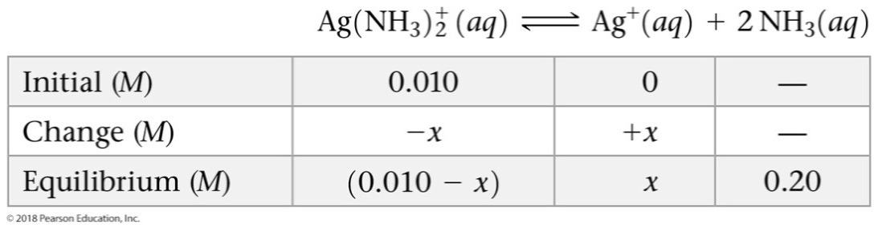

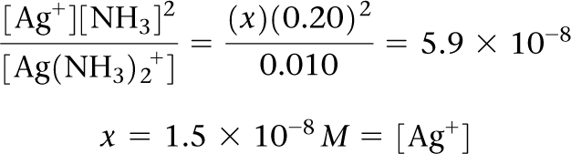
Sample Exercise 17.15 Evaluating an Equilibrium Involving a Complex Ion
Continued
Solve If [Ag⁺] is 0.010 M initially, [Ag(NH₃) ] will be 0.010 M following addition of the NH₃. We construct a table to solve this equilibrium problem. Note that the NH₃ concentration given in the problem is an equilibrium concentration rather than an initial concentration.
Because [Ag⁺] is very small, we can assume x is small compared to 0.010. Substituting these values into the equilibrium-constant expression for the dissociation of Ag(NH₃)₂⁺, we obtain
Formation of the Ag(NH₃)₂⁺ complex drastically reduces the concentration of free Ag⁺ ion in solution.

Slide 48
Sample Exercise 17.15 Evaluating an Equilibrium Involving a Complex Ion
Continued
Practice Exercise 1
You have an aqueous solution of chromium(III) nitrate that you titrate with an aqueous solution of sodium hydroxide. After a certain amount of titrant has been added, you observe a precipitate forming. You add more sodium hydroxide solution and the precipitate dissolves, leaving a solution again. What has happened? (a) The precipitate was sodium hydroxide, which redissolved in the larger volume. (b) The precipitate was chromium hydroxide, which dissolved once more solution was added, forming Cr³⁺(aq). (c) The precipitate was chromium hydroxide, which then reacted with more hydroxide to produce a soluble complex ion, Cr(OH)₄–(aq). (d) The precipitate was sodium nitrate, which reacted with more nitrate to produce the soluble complex ion Na(NO₃)₃^{2–}(aq).
Practice Exercise 2
Calculate [Cr³⁺] in equilibrium with Cr(OH)₄–(aq) when 0.010 mol of Cr(NO₃)₃ is dissolved in 1 L of solution buffered at pH 10.0.

Slide 49


Sample Exercise 17.16 Predicting Whether a Precipitate Forms
Does a precipitate form when 0.10 L of 8.0 × 10^{–3} M Pb(NO₃)₂ is added to 0.40 L of 5.0 × 10^{–3} M Na₂O₄?
Solution
Analyze The problem asks us to determine whether a precipitate forms when two salt solutions are combined.
Plan We should determine the concentrations of all ions just after the solutions are mixed and compare the value of Q with K_{sp} for any potentially insoluble product. The possible metathesis products are PbSO₄ and NaNO₃. Like all sodium salts NaNO₃ is soluble, but PbSO₄ has a K_{sp} of 6.3 × 10^{–7} (Appendix D) and will precipitate if the Pb²⁺ and SO₄^{2–} concentrations are high enough for Q to exceed K_{sp}.
Solve
When the two solutions are mixed, the volume is 0.10 L + 0.40 L = 0.50 L. The number of moles of Pb²⁺ in 0.10 L of 8.0 × 10^{–3} M Pb(NO₃)₂ is:
The concentration of Pb²⁺ in the 0.50-L mixture is therefore:

Slide 50

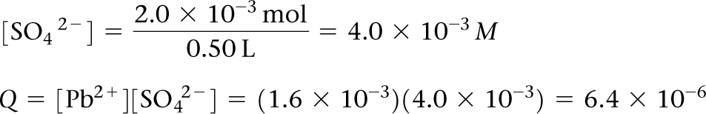
Sample Exercise 17.16 Predicting Whether a Precipitate Forms
Continued
The number of moles of SO₄^{2–} in 0.40 L of 5.0 × 10^{–3} M Na₂SO₄ is:
Therefore:
and:
Because Q > K_{sp}, PbSO₄ precipitates.
Practice Exercise 1
An insoluble salt MA has a K_{sp} of 1.0 × 10^{–16}. Two solutions, MNO₃ and NaA are mixed, to yield a final solution that is 1.0 × 10^{–8} M in M⁺(aq) and 1.00 × 10^{–7} M in A–(aq). Will a precipitate form?
(a) Yes (b) No
Practice Exercise 2
Does a precipitate form when 0.050 L of 2.0 × 10^{–2} M NaF is mixed with 0.010 L of 1.0 × 10^{–2} M Ca(NO₃)₂?

Slide 51
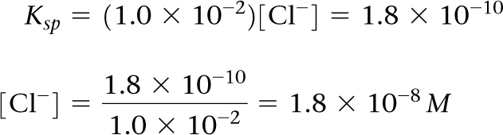
Sample Exercise 17.17 Selective Precipitation
A solution contains 1.0 × 10^{–2} M Ag⁺(aq) and 2.0 × 10^{–2} M Pb²⁺(aq). When Cl–(aq) is added, both AgCl
(K_{sp} = 1.8 × 10^{–10}) and PbCl₂ (K_{sp} = 1.7 × 10^{–5}) can precipitate. What concentration of Cl–(aq) is necessary to begin the precipitation of each salt? Which salt precipitates first?
Solution
Analyze We are asked to determine the concentration of Cl–(aq) necessary to begin the precipitation from a solution containing Ag⁺(aq) and Pb²⁺(aq) ions, and to predict which metal chloride will begin to precipitate first.
Plan We are given K_{sp} values for the two precipitates. Using these and the metal ion concentrations, we can calculate what Cl–(aq) concentration is necessary to precipitate each salt. The salt requiring the lower Cl–(aq) ion concentration precipitates first.
Solve For AgCl we have K_{sp} = [Ag⁺][Cl–] = 1.8 × 10^{–10}.
Because [Ag⁺] = 1.0 × 10^{–2} M, the greatest concentration of Cl–(aq) that can be present without causing precipitation of AgCl can be calculated from the K_{sp} expression:

Slide 52
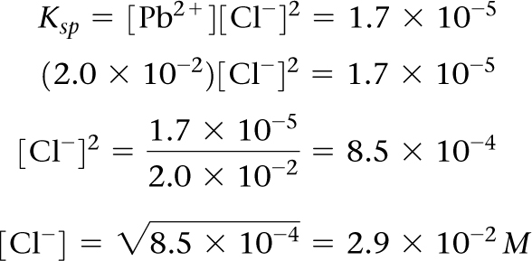
Sample Exercise 17.17 Selective Precipitation
Continued
Any Cl–(aq) in excess of this very small concentration will cause AgCl to precipitate from solution. Proceeding similarly for PbCl₂, we have
Thus, a concentration of Cl–(aq) in excess of 2.9 × 10^{–2} M causes PbCl₂ to precipitate.
Comparing the Cl–(aq) concentration required to precipitate each salt, we see that as Cl–(aq) is added, AgCl precipitates first because it requires a much smaller concentration of Cl–. Thus, Ag⁺(aq) can be separated from Pb²⁺(aq) by slowly adding Cl–(aq) so that the chloride ion concentration remains between 1.8 × 10^{–8} M and 2.9 × 10^{–2} M.
Comment Precipitation of AgCl will keep the Cl–(aq) concentration low until the number of moles of Cl–(aq) added exceeds the number of moles of Ag⁺(aq) in the solution. Once past this point, [Cl–] rises sharply and PbCl₂ will soon begin to precipitate.

Slide 53
Sample Exercise 17.17 Selective Precipitation
Continued
Practice Exercise 1
Under what conditions does an ionic compound precipitate from a solution of the constituent ions?
(a) always (b) when Q = K_{sp} (c) when Q exceeds K_{sp} (d) when Q is less than K_{sp} (e) never, if it is very soluble
Practice Exercise 2
A solution consists of 0.050 M Mg²⁺(aq) and Cu²⁺(aq). Which ion precipitates first as OH–(aq) is added? What concentration of OH–(aq) is necessary to begin the precipitation of each cation? [K_{sp} = 1.8 × 10^{–11} for Mg(OH)₂, and K_{sp} = 4.8 × 10^{–20} for Cu(OH)₂.]

Slide 54
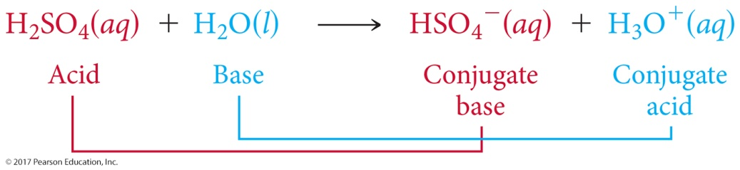
Sample Integrative Exercise Putting Concepts Together
A sample of 1.25 L of HCl gas at 21 °C and 0.950 atm is bubbled through 0.500 L of 0.150 M NH₃ solution. Calculate the pH of the resulting solution assuming that all the HCl dissolves and that the volume of the solution remains 0.500 L.
Solution
The number of moles of HCl gas is calculated from the ideal-gas law:
The number of moles of NH₃ in the solution is given by the product of the volume of the solution and its concentration:
The acid HCl and base NH₃ react, transferring a proton from HCl to NH₃, producing NH₄⁺ and Cl– ions:
HCl(g) + NH₃(aq) NH₄⁺ (aq) + Cl–(aq)

Slide 55
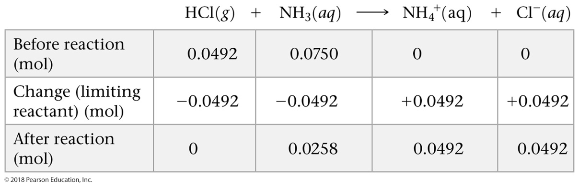
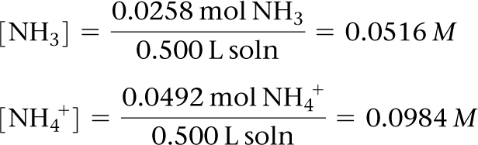
Sample Integrative Exercise Putting Concepts Together
Continued
To determine the pH of the solution, we first calculate the amount of each reactant and each product present at the completion of the reaction. Because you can assume this neutralization reaction proceeds as far toward the product side as possible, this is a limiting reactant problem.
Thus, the reaction produces a solution containing a mixture of NH₃, NH₄⁺, and Cl–. The NH₃ is a weak base (K_{b} = 1.8 × 10^{–5}), NH₄⁺ is its conjugate acid, and Cl– is neither acidic nor basic. Consequently, the pH depends on [NH₃] and [NH₄⁺]:

Slide 56
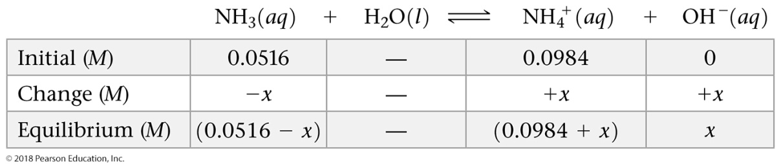
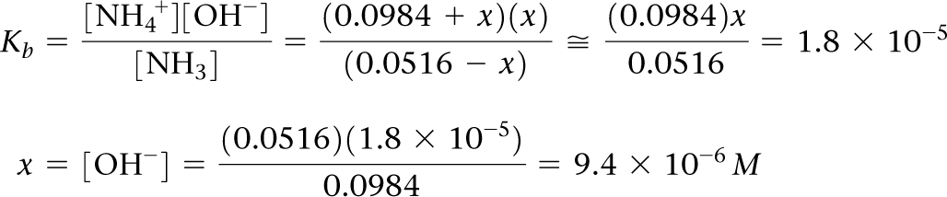
Sample Integrative Exercise Putting Concepts Together
Continued
We can calculate the pH using either K_{b} for NH₃ or K_{a} for NH₄⁺. Using the K_{b} expression, we have:
Hence, pOH = –log(9.4 × 10^{–6}) = 5.03
and pH = 14.00 – pOH = 14.00 – 5.03 = 8.97.

