Slide 1

Sample Exercise 15.1 Writing Equilibrium-Constant Expressions
Write the equilibrium expression for K_{c} for the following reactions:
(a) 2 O₃(g) 3 O₂(g)
(b) 2 NO(g) + Cl₂(g) 2 NOCl(g)
(c) Ag⁺(aq) + 2 NH₃(aq) Ag(NH₃)₂⁺(aq)
Solution
Analyze We are given three equations and are asked to write an equilibrium-constant expression for each.
Plan Using the law of mass action, we write each expression as a quotient having the product concentration terms in the numerator and the reactant concentration terms in the denominator. Each concentration term is raised to the power of its coefficient in the balanced chemical equation.
Solve
(a)
(b)
(c)

Slide 2
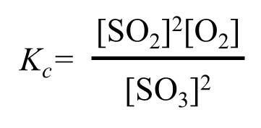
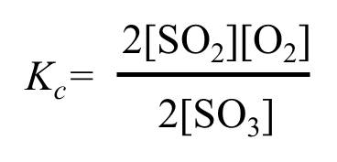
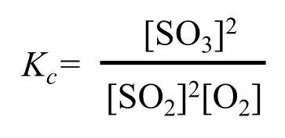
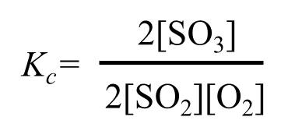
Sample Exercise 15.1 Writing Equilibrium-Constant Expressions
Continued
Practice Exercise 1
For the reaction 2 SO₂(g) + O₂(g) 2 SO₃(g), which of the following is the correct equilibrium-constant expression?
\ (b)
(c) (d)
Practice Exercise 2
Write the equilibrium-constant expression K_{c} for
(a) H₂(g) + I₂(g) 2 HI(g),
(b) Cd²⁺(aq) + 4 Br–(aq) CdBr₄^{2–}(aq).

Slide 3
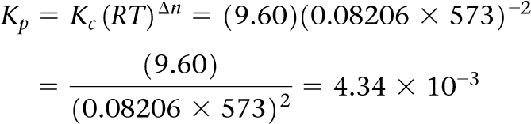
Sample Exercise 15.2 Converting between K_{c} and K_{p}
For the Haber process,
N₂(g) + 3 H₂(g) 2 NH₃(g)
K_{c} = 9.60 at 300 °C. Calculate K_{p} for this reaction at this temperature.
Solution
Analyze We are given K_{c} for a reaction and asked to calculate K_{p}.
Plan The relationship between K_{c} and K_{p} is given by Equation 15.15. To apply that equation, we must determine Δn by comparing the number of moles of product with the number of moles of reactants (Equation 15.16).
Solve With 2 mol of gaseous products (2 NH₃) and 4 mol of gaseous reactants (1 N₂ + 3 H₂), Δn = 2 – 4 = –2. (Remember that Δ functions are always based on products minus reactants.) The temperature is 273 + 300 = 573 K. The value for the ideal-gas constant, R, is 0.08206 L-atm/mol-K. Using K_{c} = 9.60, we therefore have

Slide 4
Sample Exercise 15.2 Converting between K_{c} and K_{p}
Continued
Practice Exercise 1
For which of the following reactions is the ratio K_{p}/K_{c} largest at 300 K?
(a) N₂(g) + O₂(g) 2 NO(g)
(b) CaCO₃(s) CaO(s) + CO₂(g)
(c) Ni(CO)₄(g) Ni(s) + 4 CO(g)
(d) C(s) + 2 H₂(g) CH₄(g)
Practice Exercise 2
For the equilibrium 2 SO₃(g) 2 SO₂(g) + O₂(g), K_{c} is 4.08 × 10^{–3} at 1000 K. Calculate the value for K_{p}.

Slide 5
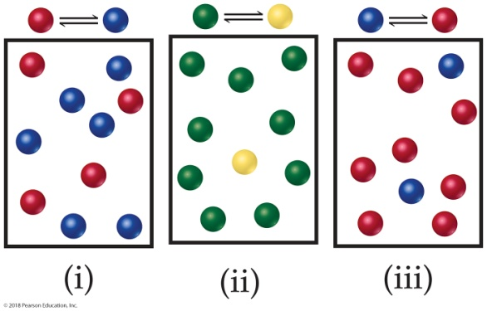
Sample Exercise 15.3 Interpreting the Magnitude of an Equilibrium Constant
The following diagrams represent three systems at equilibrium, all in the same-size containers. (a) Without doing any calculations, rank the systems in order of increasing K_{c}. (b) If the volume of the containers is 1.0 L and each sphere represents 0.10 mol, calculate K_{c} for each system.
Solution
Analyze We are asked to judge the relative magnitudes of three equilibrium constants and then to calculate them.
Plan (a) The more product present at equilibrium, relative to reactant, the larger the equilibrium constant. (b) The equilibrium constant is given by Equation 15.8.
Solve
(a) Each box contains 10 spheres. The amount of product in each varies as follows: (i) 6, (ii) 1, (iii) 8. Therefore, the equilibrium constant varies in the order (ii) < (i) < (iii), from smallest (most reactants) to largest (most products).
(b) In (i), we have 0.60 mol/L product and 0.40 mol/L reactant, giving K_{c} = 0.60/0.40 = 1.5. (You will get the same result by merely dividing the number of spheres of each kind: 6 spheres/4 spheres = 1.5.) In (ii), we have
0.10 mol/L product and 0.90 mol/L reactant, giving K_{c} = 0.10/0.90 = 0.11 (or 1 sphere/9 spheres = 0.11). In (iii), we have 0.80 mol/L product and 0.20 mol/L reactant, giving K_{c} = 0.80/0.20 = 4.0 (or 8 spheres/2 spheres = 4.0). These calculations verify the order in (a).

Slide 6
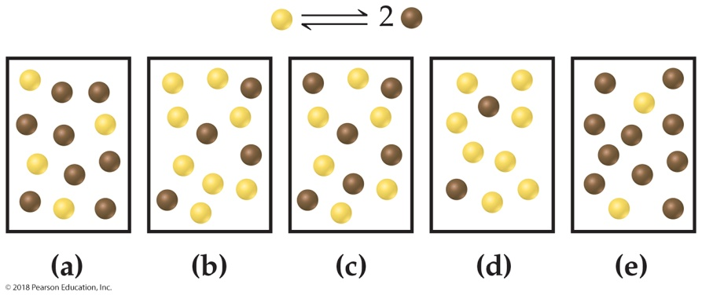
Sample Exercise 15.3 Interpreting the Magnitude of an Equilibrium Constant
Continued
Comment Imagine a drawing that represents a reaction with a very small or very large value of K_{c}. For example, what would the drawing look like if K_{c} = 1 × 10^{–5}? In that case, there would need to be 100,000 reactant molecules for only 1 product molecule. But then, that would be impractical to draw.
Practice Exercise 1
The equilibrium constant for the reaction N₂O₄(g) 2 NO₂(g) at 2 °C is K_{c} = 2.0. If each yellow sphere represents 1 mol of N₂O₄ and each brown sphere 1 mol of NO₂ which of the following 1.0 L containers represents the equilibrium mixture at 2 °C?
Practice Exercise 2
For the reaction H₂(g) + I₂(g) 2 HI(g), K_{p} = 794 at 298 K and K_{p} = 55 at 700 K. Is the formation of HI favored more at the higher or lower temperature?

Slide 7

Sample Exercise 15.4 Combining Equilibrium Expressions
Given the reactions
HF(aq) H⁺(aq) + F–(aq) K_{c} = 6.8 × 10^{–4}
H₂C₂O₄(aq) 2 H⁺(aq) + C₂O₄^{2–}(aq) K_{c} = 3.8 × 10^{–6}
determine the value of K_{c} for the reaction
2 HF(aq) + C₂O₄^{2–}(aq) 2 F–(aq) + H₂C₂O₄(aq)
Solution
Analyze We are given two equilibrium equations and the corresponding equilibrium constants and are asked to determine the equilibrium constant for a third equation, which is related to the first two.
Plan We cannot simply add the first two equations to get the third. Instead, we need to determine how to manipulate these equations to come up with equations that we can add to give us the desired equation.
Solve
If we multiply the first equation by 2 and make the corresponding change to its equilibrium constant (raising to the power 2), we get
2 HF(aq) 2 H⁺(aq) + 2 F–(aq) K_{c} = (6.8 × 10^{–4})² = 4.6 × 10^{–7}
Reversing the second equation and again making the corresponding change to its equilibrium constant (taking
the reciprocal) gives
2 H⁺(aq) + C₂O₄^{2–}(aq) H₂C₂O₄(aq)

Slide 8
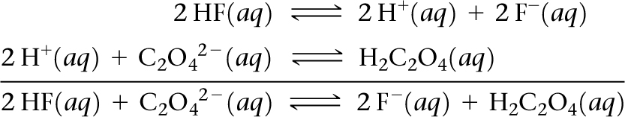
Sample Exercise 15.4 Combining Equilibrium Expressions
Continued
Now, we have two equations that sum to give the net equation, and we can multiply the individual K_{c} values to get the desired equilibrium constant.
    K_{c} = 4.6 × 10^{–7}
    K_{c} = 2.5 × 10⁵
    K_{c} = (4.6 × 10^{–7})(2.6 × 10⁵) = 0.12
Practice Exercise 1
    Given the equilibrium constants for the following two reactions in aqueous solution at 25 °C,
    HNO₂(aq) H⁺(aq) + NO₂–(aq) K_{c} = 4.5 × 10^{–4}
    H₂SO₃(aq) 2 H⁺(aq) + SO₃–(aq) K_{c} = 1.1 × 10^{–9}
    what is the value of K_{c} for the reaction?
    2 HNO₂(aq) + SO₃^{2–}(aq) H₂SO₃(aq) + 2 NO₂–(aq)
    (a) 4.9 × 10^{–13} (b) 4.1 × 10⁵ (c) 8.2 × 10⁵ (d) 1.8 × 10² (e) 5.4 × 10^{–3}
Practice Exercise 2
    Given that, at 700 K, K_{p} = 54.0 for the reaction H₂(g) + I₂(g) 2 HI(g) and K_{p} = 1.04 × 10^{–4} for the reaction
    N₂(g) + 3 H₂(g) 2 NH₃(g), determine the value of K_{p} for the reaction 2 NH₃(g) + 3 I₂(g) 6 HI(g) + N₂(g) at 700 K.

Slide 9


Sample Exercise 15.5 Writing Equilibrium-Constant Expressions for Heterogeneous Reactions
Write the equilibrium-constant expression K_{c} for
(a) CO₂(g) + H₂(g) CO(g) + H₂O(l)
(b) SnO₂(s) + 2 CO(g) Sn(s) + 2 CO₂(g)
Solution
Analyze We are given two chemical equations, both for heterogeneous equilibria, and asked to write the corresponding equilibrium-constant expressions.
Plan We use the law of mass action, remembering to omit any pure solids and pure liquids from the expressions.
Solve
(a) The equilibrium-constant expression is
Because H₂O appears in the reaction as a liquid, its concentration does not appear in the equilibrium-constant expression.
(b) The equilibrium-constant expression is

Slide 10
Sample Exercise 15.5 Writing Equilibrium-Constant Expressions for Heterogeneous Reactions
Continued
Because SnO₂ and Sn are pure solids, their concentrations do not appear in the equilibrium-constant expression.
Practice Exercise 1
Consider the equilibrium that is established in a saturated solution of silver chloride, Ag⁺(aq) + Cl–(aq) AgCl(s). If solid AgCl is added to this solution, what will happen to the concentration of Ag⁺ and Cl– ions in solution?
(a) [Ag⁺] and [Cl–] will both increase (b) [Ag⁺] and [Cl–] will both decrease (c) [Ag⁺] will increase and [Cl–] will decrease (d) [Ag⁺] will decrease and [Cl–] will increase (e) neither [Ag⁺] nor [Cl–] will change
Practice Exercise 2
Write the following equilibrium-constant expressions:
(a) K_{c} for Cr(s) + 3 Ag⁺(aq) Cr³⁺(aq) + 3 Ag(s),
(b) K_{p} for 3 Fe(s) + 4 H₂O(g) Fe₃O₄(s) + 4 H₂(g).

Slide 11
Sample Exercise 15.6 Analyzing a Heterogeneous Equilibrium
Each of these mixtures was placed in a closed container and allowed to stand:
(a) CaCO₃(s)
(b) CaO(s) and CO₂(g) at a pressure greater than the value of K_{p}
(c) CaCO₃(s) and CO₂(g) at a pressure greater than the value of K_{p}
(d) CaCO₃(s) and CaO(s)
Determine whether or not each mixture can attain the equilibrium
CaCO₃(s) CaO(s) + CO₂(g)
Solution
Analyze We are asked which of several combinations of species can establish an equilibrium between calcium carbonate and its decomposition products, calcium oxide and carbon dioxide.
Plan For equilibrium to be achieved, it must be possible for both the forward process and the reverse process to occur. For the forward process to occur, some calcium carbonate must be present. For the reverse process to occur, both calcium oxide and carbon dioxide must be present. In both cases, either the necessary compounds may be present initially or they may be formed by reaction of the other species.

Slide 12
Sample Exercise 15.6 Analyzing a Heterogeneous Equilibrium
Continued
Solve Equilibrium can be reached in all cases except (c) as long as sufficient quantities of solids are present.
(a) CaCO₃ simply decomposes, forming CaO(s) and CO₂(g) until the equilibrium pressure of CO₂ is attained. There must be enough CaCO₃, however, to allow the CO₂ pressure to reach equilibrium. (b) CO₂ continues to combine with CaO until the partial pressure of the CO₂ decreases to the equilibrium value. (c) Because there is no CaO present, equilibrium cannot be attained; there is no way the CO₂ pressure can decrease to its equilibrium value (which would require some CO₂ to react with CaO). (d) The situation is essentially the same as in (a): CaCO₃ decomposes until equilibrium is attained. The presence of CaO initially makes no difference.
Practice Exercise 1
If 8.0 g of NH₄HS(s) is placed in a sealed vessel with a volume of 1.0 L and heated to 200 °C the reaction NH₄HS(s) NH₃(g) + H₂S(g) will occur. When the system comes to equilibrium, some NH₄HS(s) is still present. Which of the following changes will lead to a reduction in the amount of NH₄HS(s) that is present, assuming in all cases that equilibrium is re-established following the change?
(a) Adding more NH₃(g) to the vessel (b) Adding more H₂S(g) to the vessel (c) Adding more NH₄HS(s) to the vessel (d) Increasing the volume of the vessel (e) Decreasing the volume of the vessel
Practice Exercise 2
When added to Fe₃O₄(s) in a closed container, which one of the following substances—H₂(g), H₂O(g), O₂(g)—
allows equilibrium to be established in the reaction 3 Fe(s) + 4 H₂O(g) Fe₃O₄(s) + 4 H₂(g)?

Slide 13
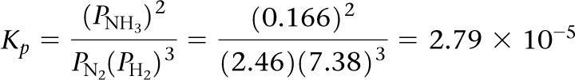
Sample Exercise 15.7 Calculating K When All Equilibrium Concentrations Are Known
After a mixture of hydrogen and nitrogen gases in a reaction vessel is allowed to attain equilibrium at 472 °C, it is found to contain 7.38 atm H₂, 2.46 atm N₂, and 0.166 atm NH₃. From these data, calculate the equilibrium constant K_{p} for the reaction
N₂(g) + 3 H₂(g) 2 NH₃(g)
Solution
Analyze We are given a balanced equation and equilibrium partial pressures and are asked to calculate the value of the equilibrium constant.
Plan Using the balanced equation, we write the equilibrium constant expression. We then substitute the equilibrium partial pressures into the expression and solve for K_{p}.
Solve

Slide 14
Sample Exercise 15.7 Calculating K When All Equilibrium Concentrations Are Known
Continued
Practice Exercise 1
A mixture of gaseous sulfur dioxide and oxygen are added to a reaction vessel and heated to 1000 K where they react to form SO₃(g). If the vessel contains 0.669 atm SO₂(g), 0.395 atm O₂(g), and 0.0851 atm SO₃(g) after the system has reached equilibrium, what is the equilibrium constant K_{p} for the reaction 2 SO₂(g) + O₂(g) 2 SO₃(g)?
(a) 0.0410 (b) 0.322 (c) 24.4 (d) 3.36 (e) 3.11
Practice Exercise 2
An aqueous solution of acetic acid is found to have the following equilibrium concentrations at 25 °C:
[CH₃COOH] = 1.65 × 10^{–2} M; [H⁺] = 5.44 × 10^{–4} M; and [CH₃COO–] = 5.44 × 10^{–4} M. Calculate the equilibrium constant K_{c} for the ionization of acetic acid at 25 °C. The reaction is
CH₃COOH(aq) H⁺(aq) + CH₃COO–(aq)

Slide 15
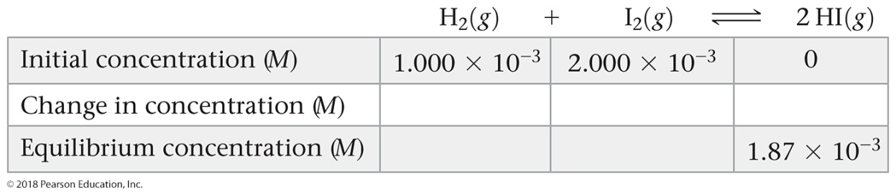
Sample Exercise 15.8 Calculating K from Initial and Equilibrium Concentrations
A reaction vessel containing 1.000 × 10^{–3} M H₂ gas and 2.000 × 10^{–3} M I₂ gas is heated to 448 °C where the following reaction takes place
H₂(g) + I₂(g) 2 HI(g)
What is the value of the equilibrium constant K_{c} if once the system comes to equilibrium at 448 °C the concentration of HI is 1.87 × 10^{–3} M?
Solution
Analyze We are given the initial concentrations of H₂ and I₂ and the equilibrium concentration of HI. We are asked to calculate the equilibrium constant K_{c} for H₂(g) + I₂(g) 2 HI(g).
Plan We construct a table to find equilibrium concentrations of all species and then use the equilibrium concentrations to calculate the equilibrium constant.
Solve
(1) We tabulate the initial and equilibrium concentrations of as many species as we can. We also provide space in our table for listing the changes in concentrations. As shown, it is convenient to use the chemical equation as the heading for the table.

Slide 16
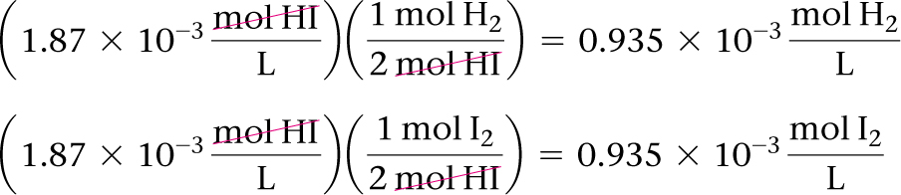
Sample Exercise 15.8 Calculating K from Initial and Equilibrium Concentrations
Continued
(2) We calculate the change in HI concentration, which is the difference between the equilibrium and initial values:
Change in [HI] = 1.87 × 10^{–3} M – 0 = 1.87 × 10^{–3} M
(3) We use the coefficients in the balanced equation to relate the change in [HI] to the changes in [H₂] and [I₂]:
(4) We calculate the equilibrium concentrations of H₂ and I₂, using initial concentrations and changes in concentration. The equilibrium concentration equals the initial concentration minus that consumed:
[H₂] = (1.000 × 10^{–3} M) – (0.935 × 10^{–3} M) = 0.065 × 10^{–3} M
[I₂] = (2.000 × 10^{–3} M) – (0.935 × 10^{–3} M) = 1.065 × 10^{–3} M

Slide 17
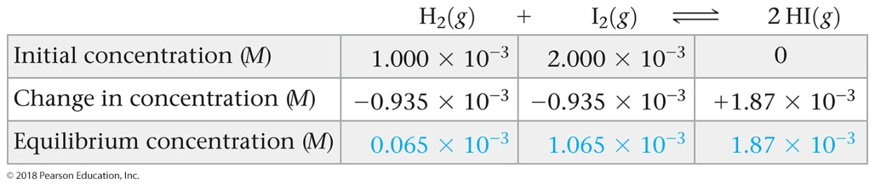

Sample Exercise 15.8 Calculating K from Initial and Equilibrium Concentrations
Continued
(5) Our table now is complete (with equilibrium concentrations in blue for emphasis):
Notice that the entries for the changes are negative when a reactant is consumed and positive when a product is formed.
Finally, we use the equilibrium-constant expression to calculate the equilibrium constant:
Comment The same method can be applied to gaseous equilibrium problems to calculate K_{p}, in which case partial pressures are used as table entries in place of molar concentrations. Your instructor may refer to this kind of table as an ICE chart, where ICE stands for Initial – Change – Equilibrium.

Slide 18
Sample Exercise 15.8 Calculating K from Initial and Equilibrium Concentrations
Continued
Practice Exercise 1
In Section 15.1, we discussed the equilibrium between N₂O₄(g) and NO₂(g). Let’s return to that equation in a quantitative example. When 9.2 g of frozen N₂O₄ is added to a 0.50 L reaction vessel that is heated to 400 K and allowed to come to equilibrium, the concentration of N₂O₄ is determined to be 0.057 M. Given this information, what is the value of K_{c} for the reaction N₂O₄(g) 2 NO₂(g) at 400 K? (a) 0.23 (b) 0.36 (c) 0.13 (d) 1.4 (e) 2.5
Practice Exercise 2
The gaseous compound BrCl decomposes at high temperature in a sealed container: 2 BrCl(g) Br₂(g) + Cl₂(g). Initially, the vessel is charged at 500 K with BrCl(g) at a partial pressure of 0.500 atm. At equilibrium, the BrCl(g) partial pressure is 0.040 atm. Calculate the value of K_{p} at 500 K.

Slide 19
Sample Exercise 15.9 Predicting the Direction of Approach to Equilibrium
At 448 °C, the equilibrium constant K_{c} for the reaction
H₂(g) + I₂(g) 2 HI(g)
is 50.5. Predict in which direction the reaction proceeds to reach equilibrium if we start with 2.0 × 10^{–2} mol of HI,
1.0 × 10^{–2} mol of H₂, and 3.0 × 10^{–2} mol of I₂ in a 2.00-L container.
Solution
Analyze We are given a volume and initial molar amounts of the species in a reaction and asked to determine in which direction the reaction must proceed to achieve equilibrium.
Plan We can determine the starting concentration of each species in the reaction mixture. We can then substitute the starting concentrations into the equilibrium-constant expression to calculate the reaction quotient, Q_{c}. Comparing the magnitudes of the equilibrium constant, which is given, and the reaction quotient will tell us in which direction the reaction will proceed.
Solve
The initial concentrations are
[HI] = 2.0 × 10^{–2} mol/2.00 L = 1.0 × 10^{–2} M
[H₂] = 1.0 × 10^{–2} mol/2.00 L = 5.0 × 10^{–3} M
[I₂] = 3.0 × 10^{–2} mol/2.00 L = 1.5 × 10^{–2} M

Slide 20

Sample Exercise 15.9 Predicting the Direction of Approach to Equilibrium
Continued
The reaction quotient is therefore
Because Q_{c} < K_{c}, the concentration of HI must increase and the concentrations of H₂ and I₂ must decrease to reach equilibrium; the reaction as written proceeds left to right to attain equilibrium.
Practice Exercise 1
Which of the following statements accurately describes what would happen to the direction of the reaction described in the sample exercise above, if the size of the container were different from 2.00 L? (a) The reaction would proceed in the opposite direction (from right to left) if the container volume were reduced sufficiently. (b) The reaction would proceed in the opposite direction if the container volume were expanded sufficiently. (c) The direction of this reaction does not depend on the volume of the container.
Practice Exercise 2
At 1000 K, the value of K_{p} for the reaction 2 SO₃(g) 2 SO₂(g) + O₂(g) is 0.338. Calculate the value for Q_{p}, and predict the direction in which the reaction proceeds toward equilibrium if the initial partial pressures are
P_{SO3} = 0.16 atm; P_{SO2} = 0.41 atm; P_{O2} = 2.5 atm.

Slide 21
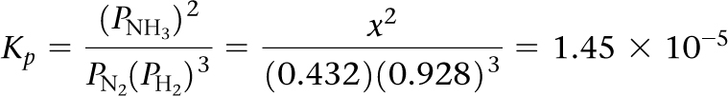
Sample Exercise 15.10 Calculating Equilibrium Concentrations
For the Haber process, N₂(g) + 3 H₂(g) 2 NH₃(g), K_{p} = 1.45 × 10^{–5}, at 500 °C. In an equilibrium mixture of the three gases at 500 °C, the partial pressure of H₂ is 0.928 atm and that of N₂ is 0.432 atm. What is the partial pressure of NH₃ in this equilibrium mixture?
Solution
Analyze We are given an equilibrium constant, K_{p}, and the equilibrium partial pressures of two of the three substances in the equation (N₂ and H₂), and we are asked to calculate the equilibrium partial pressure for the third substance (NH₃).
Plan We can set K_{p} equal to the equilibrium-constant expression and substitute in the partial pressures that we know. Then we can solve for the only unknown in the equation.
Solve
We tabulate the equilibrium pressures:
N₂(g) + 3 H₂(g) 2 NH₃(g)
Equilibrium pressure (atm) 0.432 0.928 x
Because we do not know the equilibrium pressure of NH₃, we represent it with x. At equilibrium, the pressures must satisfy the equilibrium-constant expression:

Slide 22
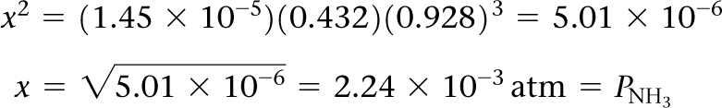

Sample Exercise 15.10 Calculating Equilibrium Concentrations
Continued
We now rearrange the equation to solve for x:
Check We can always check our answer by using it to recalculate the value of the equilibrium constant:
Practice Exercise 1
At 500 K, the reaction 2 NO(g) + Cl₂(g) 2 NOCl(g) has K_{p} = 51. In an equilibrium mixture at 500 K, the partial pressure of NO is 0.125 atm and Cl₂ is 0.165 atm. What is the partial pressure of NOCl in the equilibrium mixture? (a) 0.13 atm (b) 0.36 atm (c) 1.0 atm (d) 5.1 × 10^{–5} atm (e) 0.125 atm
Practice Exercise 2
At 500 K, the reaction PCl₅(g) PCl₃(g) + Cl₂(g) has K_{p} = 0.497. In an equilibrium mixture at 500 K, the partial pressure of PCl₅ is 0.860 atm and that of PCl₃ is 0.350 atm. What is the partial pressure of Cl₂ in the equilibrium mixture?

Slide 23
Sample Exercise 15.11 Calculating Equilibrium Concentrations from Initial Concentrations
A 1.000-L flask is filled with 1.000 mol of H₂(g) and 2.000 mol of I₂(g) at 448 °C. The value of the equilibrium constant K_{c} for the reaction
H₂(g) + I₂(g) 2 HI(g)
at 448 °C is 50.5. What are the equilibrium concentrations of H₂, I₂, and HI in moles per liter?
Solution
Analyze We are given the volume of a container, an equilibrium constant, and starting amounts of reactants in the container and are asked to calculate the equilibrium concentrations of all species.
Plan In this case, we are not given any of the equilibrium concentrations. We must develop some relationships that relate the initial concentrations to those at equilibrium. The procedure is similar in many regards to that outlined in Sample Exercise 15.8, where we calculated an equilibrium constant using initial concentrations.
Solve
(1) We note the initial concentrations of H₂ and I₂:
[H₂] = 1.000 M and [I₂] = 2.000 M

Slide 24
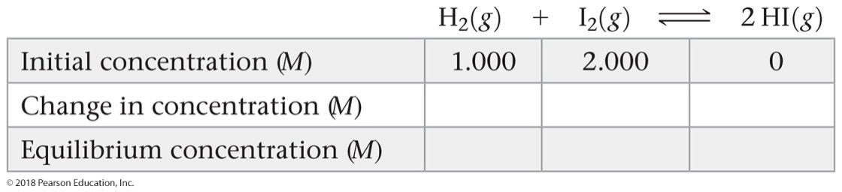
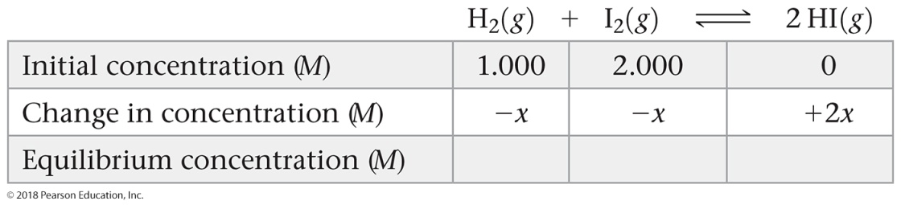
Sample Exercise 15.11 Calculating Equilibrium Concentrations from Initial Concentrations
Continued
(2) We construct a table in which we tabulate the initial concentrations:
(3) We use the stoichiometry of the reaction to determine the changes in concentration that occur as the reaction proceeds to equilibrium. The H₂ and I₂ concentrations will decrease as equilibrium is established and that of HI will increase. Let’s represent the change in concentration of H₂ by x. The balanced chemical equation tells us that for each x mol of H₂ that reacts, x mol of I₂ are consumed and 2x mol of HI are produced:

Slide 25
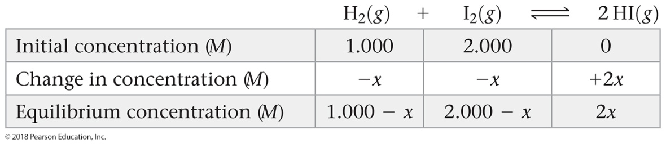

Sample Exercise 15.11 Calculating Equilibrium Concentrations from Initial Concentrations
Continued
(4) We use initial concentrations and changes in concentrations, as dictated by stoichiometry, to express the equilibrium concentrations. With all our entries, our table now looks like this:
(5) We substitute the equilibrium concentrations into the equilibrium-constant expression and solve for x:
If you have an equation-solving calculator, you can solve this equation directly for x. If not, expand this expression to obtain a quadratic equation in x:
4x² = 50.5(x² – 3.000x + 2.000)
46.5x² – 151.5x + 101.0 = 0
Solving the quadratic equation (Appendix A.3) leads to two solutions for x:

Slide 26
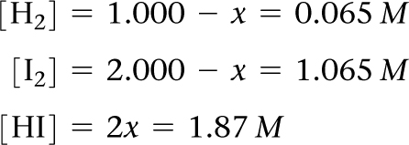

Sample Exercise 15.11 Calculating Equilibrium Concentrations from Initial Concentrations
Continued
When we substitute x = 2.323 into the expressions for the equilibrium concentrations, we find negative concentrations of H₂ and I₂. Because a negative concentration is not chemically meaningful, we reject this solution. We then use
x = 0.935 to find the equilibrium concentrations:
Check We can check our solution by putting these numbers into the equilibrium-constant expression to assure that we correctly calculate the equilibrium constant:
Comment Whenever you use a quadratic equation to solve an equilibrium problem, one of the solutions to the equation will give you a value that leads to negative concentrations and thus is not chemically meaningful. Reject this solution to the quadratic equation.

Slide 27
Sample Exercise 15.11 Calculating Equilibrium Concentrations from Initial Concentrations
Continued
Practice Exercise 1
For the equilibrium Br₂(g) + Cl₂(g) 2 BrCl(g), the equilibrium constant K_{p} is 7.0 at 400 K. If a cylinder is charged with BrCl(g) at an initial pressure of 1.00 atm and the system is allowed to come to equilibrium what is the final (equilibrium) pressure of BrCl? (a) 0.57 atm (b) 0.22 atm (c) 0.45 atm (d) 0.15 atm (e) 0.31 atm
Practice Exercise 2
For the equilibrium PCl₅(g) PCl₃(g) + Cl₂(g), the equilibrium constant K_{p} is 0.497 at 500 K. A gas cylinder at 500 K is charged with PCl₅(g) at an initial pressure of 1.66 atm. What are the equilibrium pressures of PCl₅, PCl₃, and Cl₂ at this temperature?

Slide 28
Sample Exercise 15.12 Using Le Châtelier’s Principle to Predict Shifts in Equilibrium
Consider the equilibrium
N₂O₄(g) 2 NO₂(g) ΔH° = 58.0 kJ
In which direction will the equilibrium shift when (a) N₂O₄ is added, (b) NO₂ is removed, (c) the pressure is increased by addition of N₂(g), (d) the volume is increased, (e) the temperature is decreased?
Solution
Analyze We are given a series of changes to be made to a system at equilibrium and are asked to predict what effect each change will have on the position of the equilibrium.
Plan Le Châtelier’s principle can be used to determine the effects of each of these changes.
Solve
(a) The system will adjust to decrease the concentration of the added N₂O₄, so the equilibrium shifts to the right, in the direction of the product.
(b) The system will adjust to the removal of NO₂ by shifting to the side that produces more NO₂; thus, the equilibrium shifts to the right.
(c) Adding N₂ will increase the total pressure of the system, but N₂ is not involved in the reaction. The partial pressures of NO₂ and N₂O₄ are therefore unchanged, and there is no shift in the position of the equilibrium.
(d) If the volume is increased, the system will shift in the direction that occupies a larger volume (more gas molecules); thus, the equilibrium shifts to the right.

Slide 29
Sample Exercise 15.12 Using Le Châtelier’s Principle to Predict Shifts in Equilibrium
Continued
(e) The reaction is endothermic, so we can imagine heat as a reagent on the reactant side of the equation. Decreasing the temperature will shift the equilibrium in the direction that produces heat, so the equilibrium shifts to the left, toward the formation of more N₂O₄. Note that only this last change also affects the value of the equilibrium constant, K.
Practice Exercise 1
For the reaction
4 NH₃(g) + 5 O₂(g) 4 NO(g) + 6 H₂O(g) ΔH° = –904 kJ
which of the following changes will shift the equilibrium to the right, toward the formation of more products?
(a) Adding more water vapor (b) Increasing the temperature (c) Increasing the volume of the reaction vessel
(d) Removing O₂(g) (e) Adding 1 atm of Ne(g) to the reaction vessel.
Practice Exercise 2
For the reaction
PCl₅(g) PCl₃(g) + Cl₂(g) ΔH° = 87.9 kJ
in which direction will the equilibrium shift when (a) Cl₂(g) is removed, (b) the temperature is decreased, (c) the volume of the reaction system is increased, (d) PCl₃(g) is added?

Slide 30
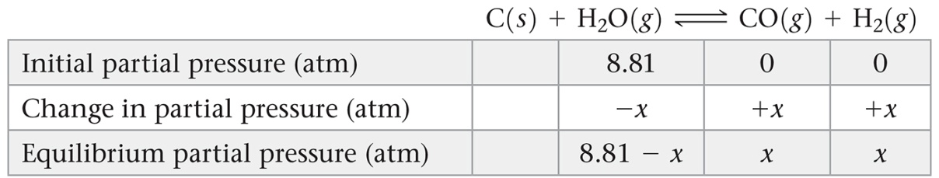
Sample Integrative Exercise Putting Concepts Together
At temperatures near 800 °C, steam passed over hot coke (a form of carbon obtained from coal) reacts to form CO and H₂:
C(s) + H₂O(g) CO(g) + H₂(g)
The mixture of gases that results is an important industrial fuel called water gas. (a) At 800 °C the equilibrium constant for this reaction is K_{p} = 14.1. What are the equilibrium partial pressures of H₂O, CO, and H₂ in the equilibrium mixture at this temperature if we start with solid carbon and 0.100 mol of H₂O in a 1.00-L vessel?
(b) What is the minimum amount of carbon required to achieve equilibrium under these conditions? (c) What is the total pressure in the vessel at equilibrium? (d) At 25 °C the value of K_{p} for this reaction is 1.7 × 10^{–21}. Is the reaction exothermic or endothermic? (e) To produce the maximum amount of CO and H₂ at equilibrium, should the pressure of the system be increased or decreased?
Solution
(a) To determine the equilibrium partial pressures, we use the ideal-gas equation, first determining the starting partial pressure of water.
We then construct a table of initial partial pressures and their changes as equilibrium is achieved:

Slide 31

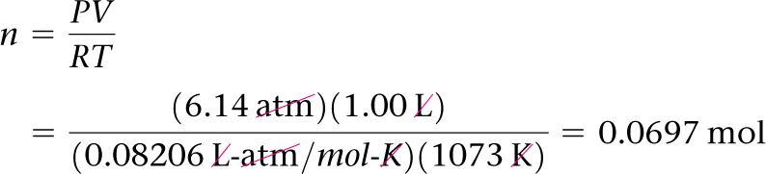
Sample Integrative Exercise Putting Concepts Together
Continued
There are no entries in the table under C(s) because the reactant, being a solid, does not appear in the equilibrium-constant expression. Substituting the equilibrium partial pressures of the other species into the equilibrium-constant expression for the reaction gives:
Multiplying through by the denominator gives a quadratic equation in x: x² = (14.1)(8.81 – x)
Solving this equation for x using the quadratic formula yields x = 6.14 atm. x² + 14.1x – 124.22 = 0
Hence, the equilibrium partial pressures are P_{CO} = x = 6.14 atm,
P_{H2} = x = 6.14 atm, and P_{H2O} = (8.81 – x) = 2.67 atm.
(b) Part (a) shows that x = 6.14 atm of H₂O must react for the system to achieve equilibrium. We can use the ideal-gas equation to convert this partial pressure into a mole amount.
Thus, 0.0697 mol of H₂O and the same amount of C must react to achieve equilibrium. As a result, there must be at least 0.0697 mol of C (0.836 g C) present among the reactants at the start of the reaction.

Slide 32

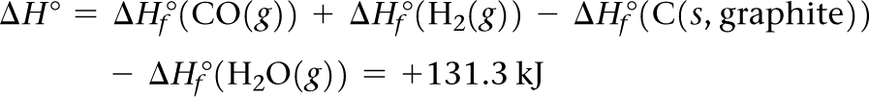
Sample Integrative Exercise Putting Concepts Together
Continued
(c) The total pressure in the vessel at equilibrium is simply the sum of the equilibrium partial pressures:
(d) In discussing Le Châtelier’s principle, we saw that endothermic reactions exhibit an increase in K_{p} with increasing temperature. Because the equilibrium constant for this reaction increases as temperature increases, the reaction must be endothermic. From the enthalpies of formation given in Appendix C, we can verify our prediction by calculating the enthalpy change for the reaction:
The positive sign for ΔH° indicates that the reaction is endothermic.
(e) According to Le Châtelier’s principle, a decrease in the pressure causes a gaseous equilibrium to shift toward the side of the equation with the greater number of moles of gas. In this case, there are 2 mol of gas on the product side and only one on the reactant side. Therefore, the pressure should be decreased to maximize the yield of the CO and H₂.

