Slide 1
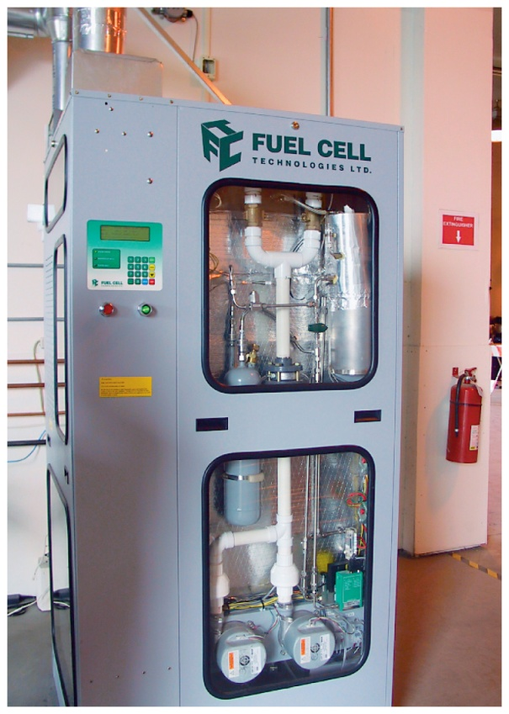
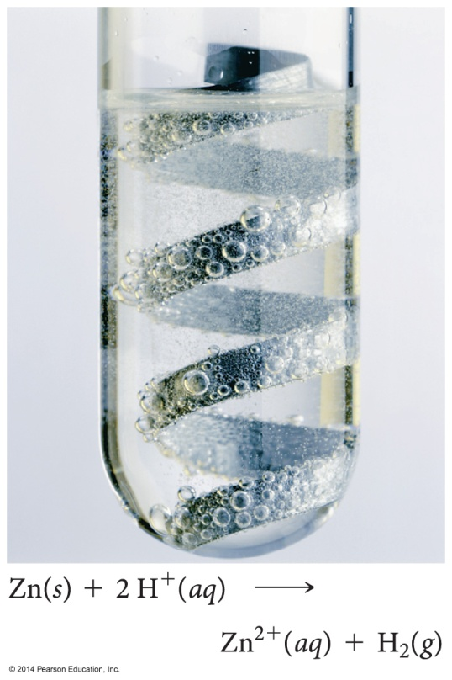
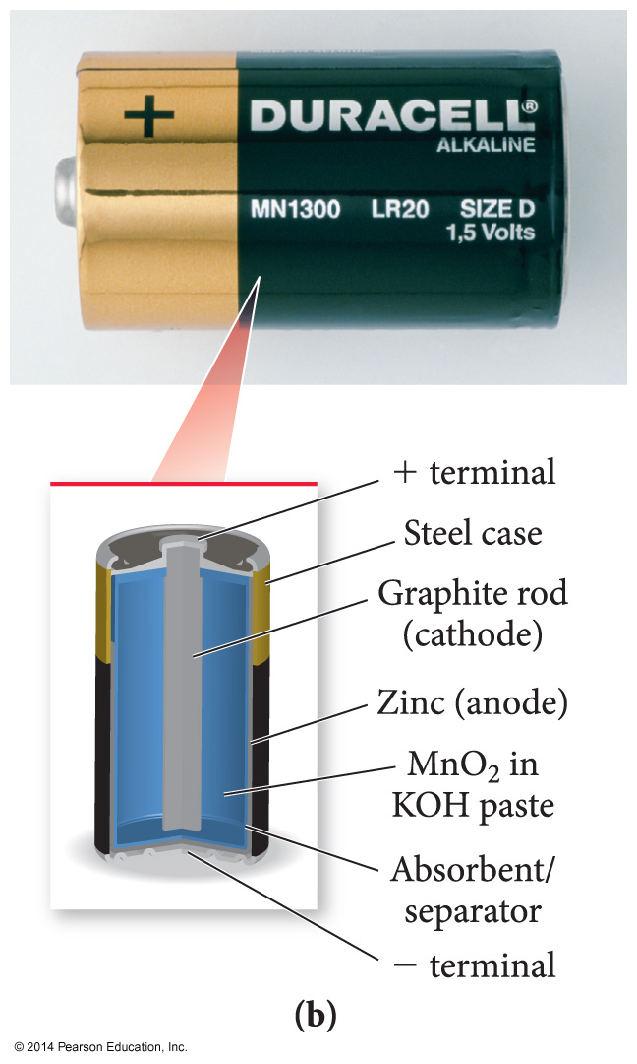
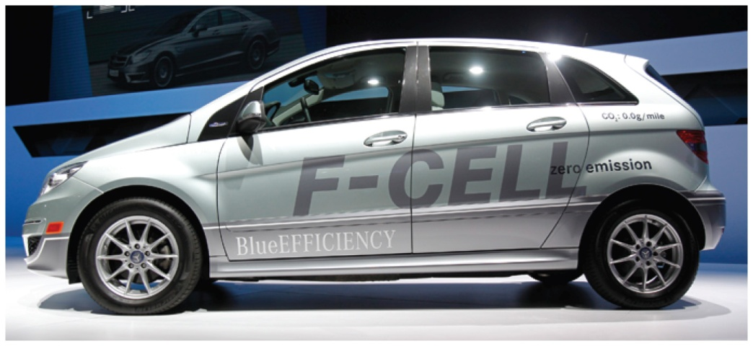
Electrochemistry

Slide 2
ELECTRON TRANSFER
Reduction-Oxidation RX (redox)
INTRODUCTORY CHEMISTRY APPROACH
A reaction in which electrons are transferred from one species to another.
Combustion reactions are redox reactions
- oxidation means the loss of electrons
- reduction means the gain of electrons
- electrolyte is a substance dissolved in water which
produces an electrically conducting solution
- nonelectrolyte is a substance dissolved in water
which does not conduct electricity.
Rusting is a redox reaction:
4Fe(s) + 30₂(g) → 2Fe₂O₃(s)
Electrochemistry involves redox reactions:
Cu(s) + 2AgNO₃(aq) → 2Ag(s) + Cu(NO₃)₂(aq)
Notes:
2

Slide 3
IDENTIFING REDOX RX
INTRODUCTORY CHEMISTRY APPROACH
Element + compound → New element + New compound
A + BC → B + AC
Element + Element → Compound
A + B → AB
Check oxidation state (charges) of species
A change in oxidation # means redox reaction
Identify the Redox Rx:
Cu + AgNO₃ → Cu(NO₃)₂ + Ag
NO + O₂ → NO₂
K₂SO₄ + CaCl₂ →KCl + CaSO₄
C₂H₄O₂ + O₂ → CO₂ + H₂O
Notes:
3

Slide 4
LABELING COMPONENTS OF REDOX REACTIONS
GENERAL CHEMISTRY APPROACH
The REDUCING AGENT is the species which undergoes OXIDATION.
The OXIDIZING AGENT is the species which undergoes REDUCTION.
CuO + H₂ → Cu + H₂O
Notes:
4

Slide 5

Workshop EC #1
Determine the oxidation state of each component in the following substances.
Identify the Oxidizing and Reducing Agents in Each of the Following
3 H₂S + 2 NO₃– + 2 H⁺ → 3 S + 2 NO + 4 H₂O
MnO₂ + 4 HBr → MnBr₂ + Br₂ + 2 H₂O
5
Notes:
5

Slide 6

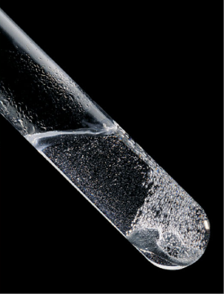

A summary of redox terminology.
Zn(s) + 2H⁺(aq) Zn²⁺(aq) + H₂(g)
OXIDATION
One reactant loses electrons.
Zn loses electrons.
Reducing agent is oxidized.
Zn is the reducing agent and becomes oxidized.
Oxidation number increases.
The oxidation number of Zn increases from 0 to +2.
REDUCTION
Other reactant gains electrons.
Hydrogen ion gains electrons.
Oxidizing agent is reduced.
Hydrogen ion is the oxidizing agent and becomes reduced.
Oxidation number decreases.
The oxidation number of H decreases from +1 to 0.
Notes:
6

Slide 7
Key Points About Redox Reactions
Oxidation (electron loss) always accompanies reduction (electron gain).
The oxidizing agent is reduced, and the reducing agent is oxidized.
The number of electrons gained by the oxidizing agent always equals the number lost by the reducing agent.
Notes:
7

Slide 8
ACTIVITY SERIES OF SOME SELECTED METALS
A brief activity series of selected metals, hydrogen and halogens are shown
below. The series are listed in descending order of chemical reactivity, with the most active metals and halogens at the top (the elements most likely to undergo oxidation). Any metal on the list will replace the ions of those metals (to undergo reduction) that appear anywhere underneath it on the list.
METALS HALOGENS
K (most oxidized, strong reducing agent) F₂ (relatively stronger oxidizing agent)
Ca Cl₂
Na Br₂
Mg l₂ (relatively weaker oxidizing agent)
Al
Zn
Fe
Ni
Sn
Pb
H
Cu
Ag
Hg
Au(least oxidized)
Oxidation refers to the loss of
electrons and reduction refers to the
gain of electrons
Notes:
8

Slide 9
Oxidizing/Reducing Agents
Strongest
oxidizing
agent
Most positive values of E° red
Increasing
strength of
reducing
agent
F₂(g) + 2e⁻ → 2F⁻(aq)
• •
2H⁺(aq) + 2e⁻ → H₂(g)
• •
Li⁺(aq) + e⁻ → Li(s)
Increasing
strength of
oxidizing
agent
Strongest
reducing
agent
Most negative values of E° red
Notes:
9

Slide 10
Standard Reduction Potentials in Water at 25°C
Standard Potential (V) Reduction Half Reaction
2.87 F₂(g) + 2e⁻ → 2F⁻(aq)
1.51 MnO₄⁻(aq) + 8H⁺(aq) + 5e⁻ → Mn²⁺(aq) + 4H₂O(l)
1.36 Cl₂(g) + 2e⁻ → 2Cl⁻(aq)
1.33 Cr₂O₇²⁻(aq) + 14H⁺(aq) + 6e⁻ → 2Cr³⁺(aq) + H₂O(l)
1.23 O₂(g) + 4H⁺(aq) + 4e⁻ → 2H₂O(l)
1.06 Br₂(l) + 2e⁻ → 2Br⁻(aq)
0.96 NO₃⁻(aq) + 4H⁺(aq) + 3e⁻ → NO(g) + H₂O(l)
0.80 Ag⁺(aq) + e⁻ → Ag(s)
0.77 Fe³⁺(aq) + e⁻ → Fe²⁺(aq)
0.68 O₂(g) + 2H⁺(aq) + 2e⁻ → H₂O₂(aq)
0.59 MnO₄⁻(aq) + 2H₂O(l) + 3e⁻ → MnO₂(s) + 4OH⁻(aq)
0.54 I₂(s) + 2e⁻ → 2I⁻(aq)
0.40 O₂(g) + 2H₂O(l) + 4e⁻ → 4OH⁻(aq)
0.34 Cu²⁺(aq) + 2e⁻ → Cu(s)
0 2H⁺(aq) + 2e⁻ → H₂(g)
-0.28 Ni²⁺(aq) + 2e⁻ → Ni(s)
-0.44 Fe²⁺(aq) + 2e⁻ → Fe(s)
-0.76 Zn²⁺(aq) + 2e⁻ → Zn(s)
-0.83 2H₂O(l) + 2e⁻ → H₂(g) + 2OH⁻(aq)
-1.66 Al³⁺(aq) + 3e⁻ → Al(s)
-2.71 Na⁺(aq) + e⁻ → Na(s)
-3.05 Li⁺(aq) + e⁻ → Li(s)
Notes:
10

Slide 11
Workshop EC#2 on REDOX AGENTS
1) For the following reactions, identify the oxidizing and reducing agents and then determine if they are strong or weak agents.
MnO₄⁻ + C₂O₄²⁻ → MnO₂ + CO₂
As + ClO₃- → H₃AsO₃ + HClO
2) Which of the following species is the strongest oxidizing agent: NO₃⁻(aq), Ag+(aq), or Cr₂O₇²⁻(aq)?
Notes:
11

Slide 12

Half-Reaction Method for Balancing Redox Reactions
Summary: This method divides the overall redox reaction into oxidation and reduction half-reactions.
Each reaction is balanced for mass (atoms) and charge.
One or both are multiplied by some integer to make the number of electrons gained and lost equal.
The half-reactions are then recombined to give the balanced redox equation.
Advantages:
The separation of half-reactions reflects actual physical separations in electrochemical cells.
The half-reactions are easier to balance especially if they involve acid or base.
It is usually not necessary to assign oxidation numbers to those species not undergoing change.
Notes:
12

Slide 13
The guidelines for balancing via the half-reaction method are found below:
    1. Write the corresponding half reactions.
    2. Balance all atoms except O and H.
    3. Balance O; add H₂O as needed.
    4. Balance H as acidic (H⁺).
    5. Add electrons to both half reactions and balance.
    6. Add the half reactions; cross out “like” terms.
7. If basic or alkaline, add the equivalent number of hydroxides (OH⁻) to counterbalance the H⁺ (remember to add to both sides of the equation). Recall that
H⁺ + OH⁻ → H₂O.
Notes:
13

Slide 14
ELECTROCHEMISTRY
Balancing Redox Reactions:
acidic: Cr₂O₇²⁻ + Fe²⁺ → Cr³⁺ + Fe³⁺
Basic: Co²⁺ + H₂O₂ → Co(OH)₃ + H₂O
Balance the following in both acidic and basic environments:
H₂O₂ + Cr₂O₇²⁻ → O₂ + Cr³⁺
Notes:
14

Slide 15
Workshop EC#3 on REDOX REACTIONS
Balance the following reactions.
MnO₄⁻ + C₂O₄²⁻ → MnO₂ + CO₂
As + ClO₃- → H₃AsO₃ + HClO
Notes:
15

Slide 16
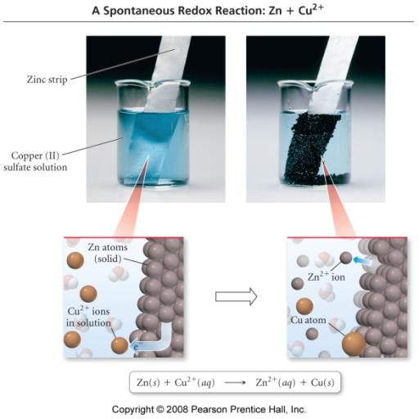
Electric Current Flowing
Directly Between Atoms
Notes:
16

Slide 17
ELECTROCHEMICAL CELLS
CHEMICALS AND EQUIPMENT NEEDED TO BUILD A SIMPLE CELL:
The Cell:
Voltmeter Two alligator clips
Two beakers or glass jars
The Electrodes:
Metal electrode Metal salt solution
The Salt Bridge:
Glass or Plastic u-tube Na or K salt solution
Notes:
17

Slide 18
ELECTROCHEMISTRY
A system consisting of electrodes that dip into an electrolyte and in which a chemical reaction uses or generates an electric current.
Two Basic Types of Electrochemical cells:
Galvanic (Voltaic) Cell:
A spontaneous reaction generates an electric current. Chemical energy is converted into electrical energy
Electrolytic Cell:
An electric current drives a nonspontaneous reaction. Electrical energy is converted into chemical energy.
Notes:
18

Slide 19
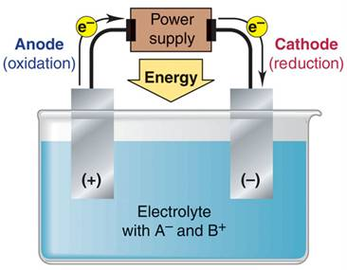
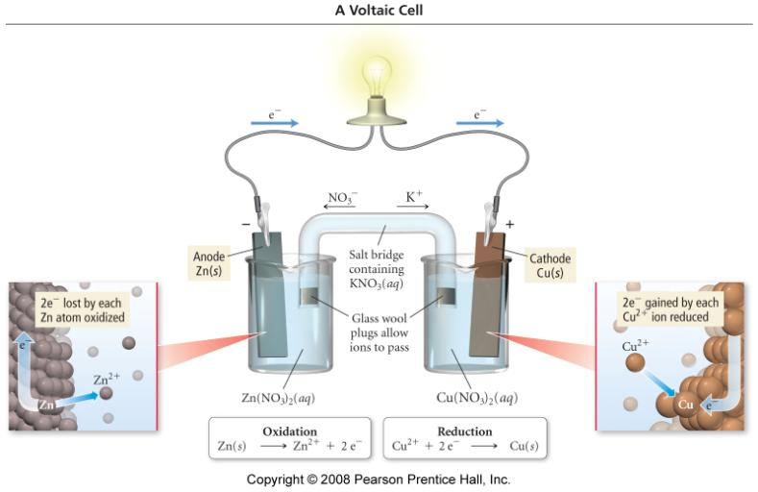
General characteristics of voltaic and electrolytic cells.
VOLTAIC CELL
ELECTROLYTIC CELL
System does work on its surroundings
Energy is released from spontaneous redox reaction
Energy is absorbed to drive a nonspontaneous redox reaction
Surroundings(power supply)
do work on system(cell)
Oxidation half-reaction
X X⁺ + e⁻
Oxidation half-reaction
A⁻ A + e⁻
Reduction half-reaction
Y⁺+ e⁻ Y
Reduction half-reaction
B⁺+ e⁻ B
Overall (cell) reaction
X + Y⁺ X⁺ + Y; ΔG < 0
Overall (cell) reaction
A⁻ + B⁺ A + B; ΔG > 0
Notes:
19

Slide 20
Electric Current Flowing
Indirectly Between Atoms
Notes:
20

Slide 21
Voltaic Cell
the salt bridge is required to complete the circuit and maintain charge balance
Notes:
21

Slide 22
ELECTROCHEMICAL CELLS
A CHEMICAL CHANGE PRODUCES ELECTRICITY
Theory:
If a metal strip is placed in a solution of it’s metal ions, one
of the following reactions may occur
M^{n+} + ne⁻ → M
M → M^{n+} + ne⁻
These reactions are called half-reactions or half cell reactions
If different metal electrodes in their respective solutions were connected by a wire, and if the solutions were electrically connected by a porous membrane or a bridge that minimizes mixing of the solutions, a flow of electrons will move from one electrode, where the reaction is
M₁ → M₁^{n+} + ne⁻
To the other electrode, where the reaction is
M₂^{n+} + ne⁻ → M₂
The overall reaction would be
M₁ + M₂^{n+} → M₂ + M₁^{n+}
Notes:
22

Slide 23
    Electrochemical Cells
An electrochemical cell is a device in which an electric current (i.e. a flow of electrons through a circuit) is either produced by a spontaneous chemical reaction or used to bring about a nonspontaneous reaction. Moreover, a galvanic (or voltaic) cell is an electrochemical cell in which a spontaneous chemical reaction is used to generate an electric current.
Consider the generic example of a galvanic cell shown below:
Notes:
23

Slide 24
The cell consists of two electrodes, or metallic conductors, that make electrical contact with the contents of the cell, and an electrolyte, an ionically conducting medium, inside the cell. Oxidation takes place at one electrode as the species being oxidized releases electrons from the electrode. We can think of the overall chemical reaction as pushing electrons on to one electrode and pulling them off the other electrode. The electrode at which oxidation occurs is called the anode. The electrode at which reduction occurs is called the cathode. Finally, a salt bridge is a bridge-shaped tube containing a concentrated salt in a gel that acts as an electrolyte and provides a conducting path between the two compartments in the electrochemical circuit.
Notes:
24

Slide 25
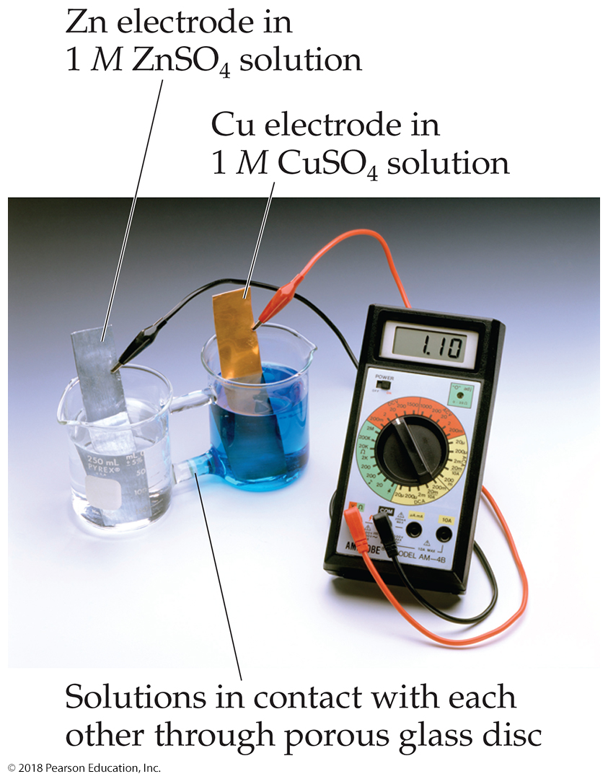
Voltaic Cells (1 of 3)
In spontaneous redox reactions, electrons are transferred and energy is released.
That energy can do work if the electrons flow through an external device.
This is a voltaic cell.

Slide 26
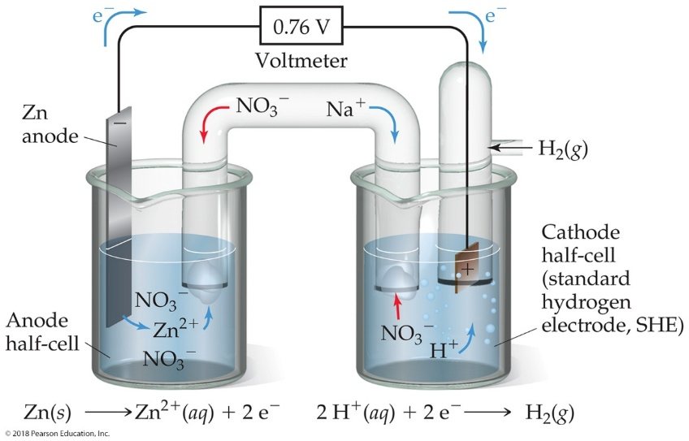
Voltaic Cells (2 of 3)
The oxidation occurs at the anode.
The reduction occurs at the cathode.
When electrons flow, charges aren’t balanced. So, a salt bridge, usually a U-shaped tube that contains a salt/agar solution, is used to keep the charges balanced.

Slide 27
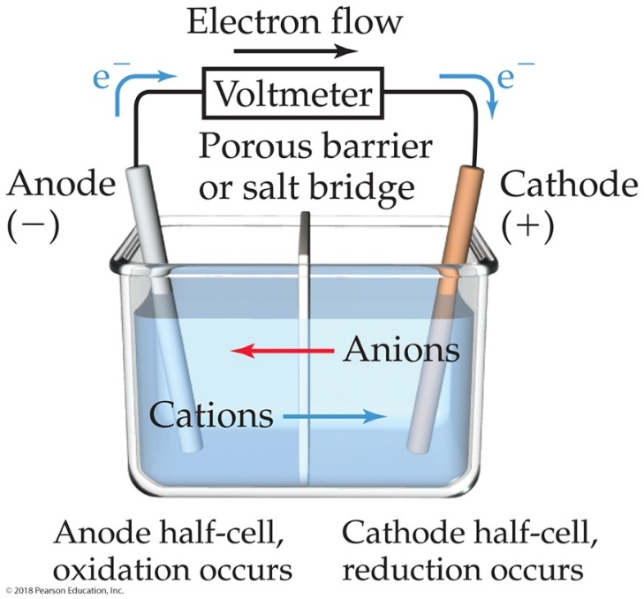
Voltaic Cells (3 of 3)
In the cell, electrons leave the anode and flow through the wire to the cathode.
Cations are formed in the anode compartment.
As the electrons reach the cathode, cations in solution are attracted to the now negative cathode.
The cations gain electrons and are deposited as metal on the cathode.

Slide 28
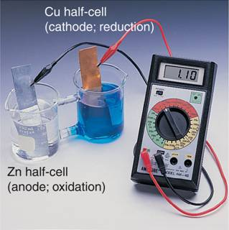
Why Does a Voltaic Cell Work?
The spontaneous reaction occurs as a result of the different abilities of materials (such as metals) to give up their electrons and the ability of the electrons to flow through the circuit.
E_{cell} > 0 for a spontaneous reaction
1 Volt (V) = 1 Joule (J)/ Coulomb (C)
Notes:
28

Slide 29
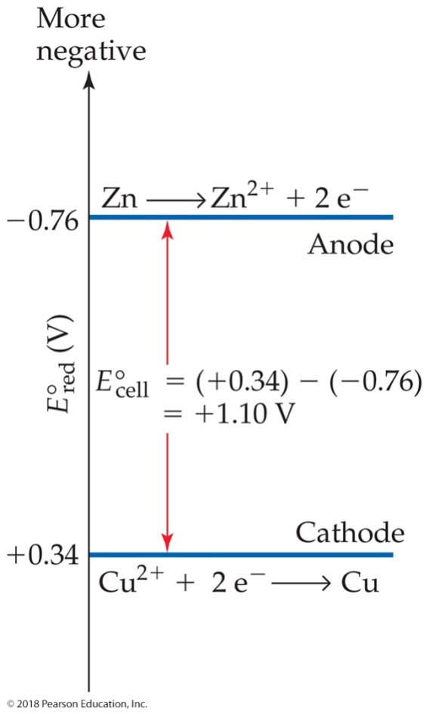
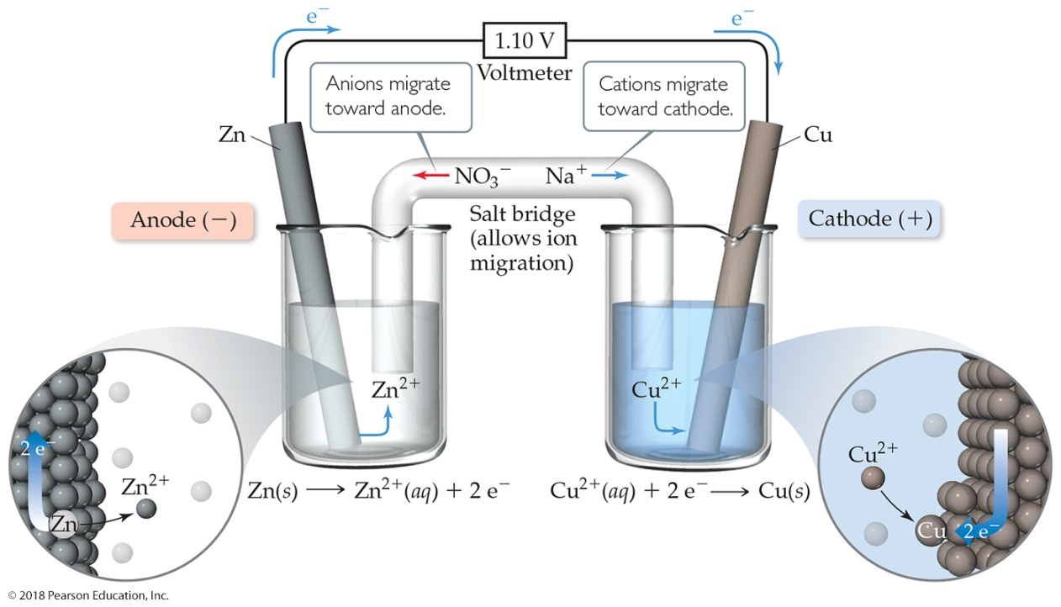
Cell Potentials

Slide 30
More Positive
Cathode(reduction)
Eº _{Red} (cathode)
Eº cell
Eº_{red} (anode)
Anode(oxidation)
More Negative
Eº_{Red}
(V)
A cell will always run spontaneous in the direction that produces a positive Eº_{cell}
Notes:
30

Slide 31
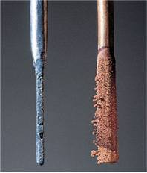
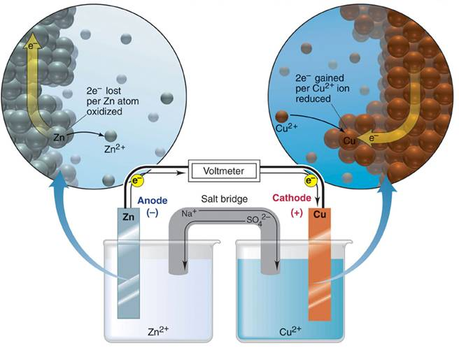
A voltaic cell based on the zinc-copper reaction.
Oxidation half-reaction
Zn(s) Zn²⁺(aq) + 2e⁻
Reduction half-reaction
Cu²⁺(aq) + 2e⁻ Cu(s)
Overall (cell) reaction
Zn(s) + Cu²⁺(aq) Zn²⁺(aq) + Cu(s)
Notes:
31

Slide 32
Notation for a Voltaic Cell
components of anode compartment
(oxidation half-cell)
components of cathode compartment
(reduction half-cell)
phase of lower oxidation state
phase of higher oxidation state
phase of higher oxidation state
phase of lower oxidation state
phase boundary between half-cells
Examples:
Zn(s) | Zn²⁺(aq) || Cu²⁺(aq) | Cu (s)
Zn(s) Zn²⁺(aq) + 2e⁻
Cu²⁺(aq) + 2e⁻ Cu(s)
graphite | I⁻(aq) | I₂(s) || H⁺(aq), MnO₄⁻(aq) | Mn²⁺(aq) | graphite
inert electrode
Notes:
32

Slide 33
NOTATION FOR VOLTAIC CELLS
Zn + Cu²⁺ → Zn²⁺ + Cu
Zn(s)/Zn²⁺(aq) // Cu²⁺(aq)/Cu(s)
Anode Cathode
oxidation reduction
salt bridge
write the net ionic equation for:
Al(s)/Al³⁺⁽aq)//Cu²⁺(aq)/Cu(s)
Notes:
33

Slide 34
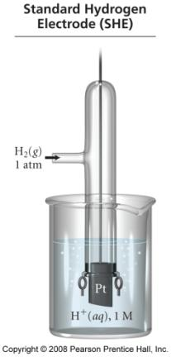
Standard Reduction Potential
a half-reaction with a strong tendency to occur has a large + half-cell potential
when two half-cells are connected, the electrons will flow so that the half-reaction with the stronger tendency will occur
we cannot measure the absolute tendency of a half-reaction, we can only measure it relative to another half-reaction
we select as a standard half-reaction the reduction of H⁺ to H₂ under standard conditions, which we assign a potential difference = 0 v
  standard hydrogen electrode, SHE
34
Notes:
34

Slide 35
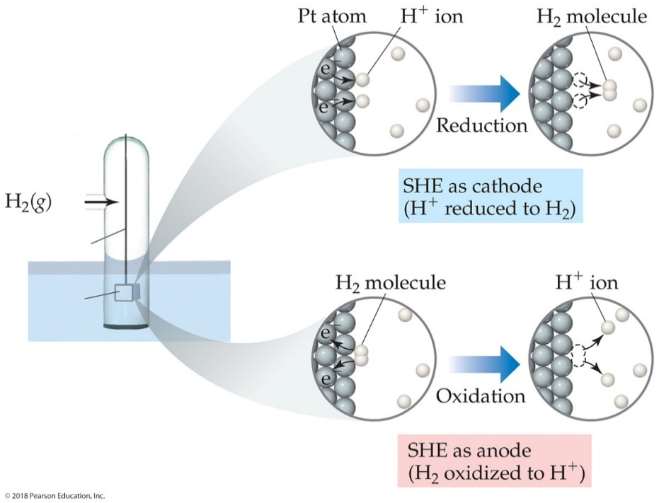
Standard Hydrogen Electrode
Their reference is called the standard hydrogen electrode (SHE).
By definition as the standard, the reduction potential for hydrogen is 0 V:

Slide 36
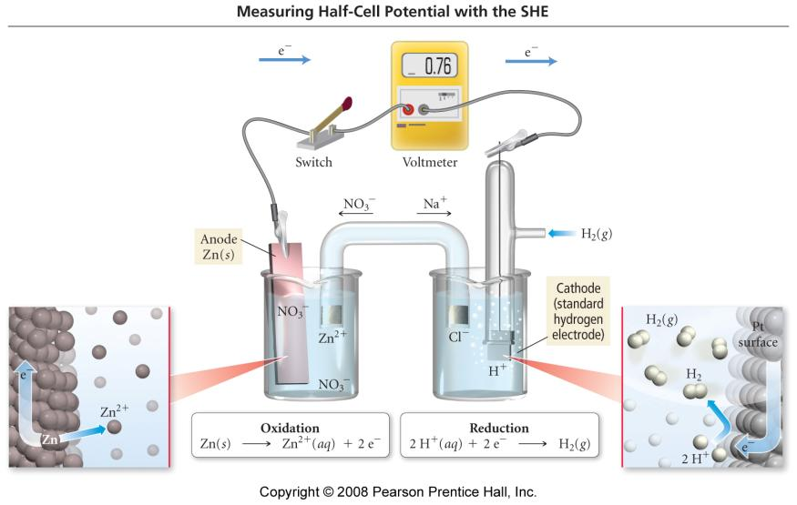
Notes:
36

Slide 37
If given: Al(s)→Al³⁺(aq)+3e- and 2H⁺(aq)+2e-→H₂(g) write the notation.
The Hydrogen Electrode (Inactive Electrodes):
At the hydrogen electrode, the half reaction involves a gas.
2 H⁺(aq) + 2e⁻ ←→ H₂(g)
so an inert material must serve as the reaction site (Pt). Another inactive electode is C_{(graphite).}
H⁺(aq)/H₂(g)/Pt cathode
Pt/H₂(g)/H⁺(aq) anode
Therefore:
Al(s)/Al³⁺(aq)//H⁺(aq)/H₂(g)/Pt
Notes:
37

Slide 38
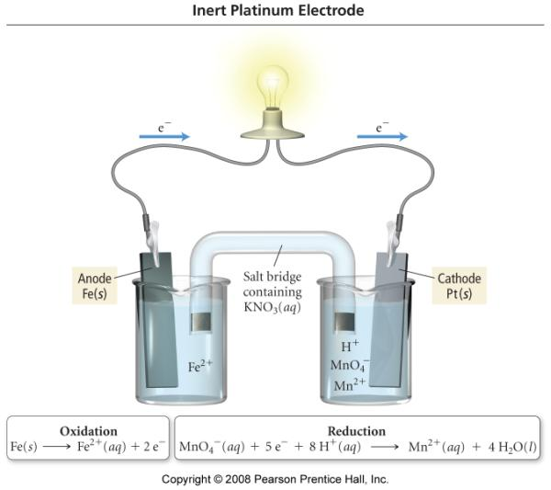
What is the notation for this cell?
Fe(s) | Fe²⁺(aq) || MnO₄⁻(aq), H⁺(aq) | Mn²⁺(aq), | Pt(s)
38
Notes:
38

Slide 39
Sample Problem:
Diagramming Voltaic Cells
PROBLEM:
Diagram, show balanced equations, and write the notation for a voltaic cell that consists of one half-cell with a Cr bar in a Cr(NO₃)₃ solution, another half-cell with an Ag bar in an AgNO₃ solution, and a KNO₃ salt bridge. Measurement indicates that the Cr electrode is negative relative to the Ag electrode.
PLAN:
Identify the oxidation and reduction reactions and write each half-reaction. Associate the (-)(Cr) pole with the anode (oxidation) and the (+) pole with the cathode (reduction).
SOLUTION:
e⁻
Voltmeter
Oxidation half-reaction
Cr(s) Cr³⁺(aq) + 3e⁻
salt bridge
Cr
Ag
K⁺
Reduction half-reaction
Ag⁺(aq) + e⁻ Ag(s)
NO₃⁻
Cr³⁺
Ag⁺
Overall (cell) reaction
Cr(s) + Ag⁺(aq) Cr³⁺(aq) + Ag(s)
Cr(s) | Cr³⁺(aq) || Ag⁺(aq) | Ag(s)
Notes:
39

Slide 40
Workshop EC#4 on NOTATION for VOLTAIC CELLS
1) Write the net ionic equation.
a) Tl(s)/Tl⁺(aq)//Sn²⁺(aq)/Sn(s)
b) Zn(s)/Zn²⁺(aq)//Fe³⁺(aq),Fe²⁺(aq)/Pt
c) Pt/H₂(g)/H⁺(aq) // Zn²⁺(aq)/Zn(s)
2) Diagram the above electrochemical cells.
Notes:
40

Slide 41
STANDARD REDUCTION POTENTIALS
Individual potentials can not be measured so standard conditions: 1M H⁺ at 1 atm is arbitrarily measured as 0 V (Volts).
E_{cell} = Eº_{H+→H2} + Eº_{Zn→Zn2+}
0.76 V = (0 V) - (-0.76 V)
cathode anode
E_{cell} = Eº_{cath} – Eº_{anode}
The standard reduction potential is the Eº value for the reduction half reaction (cathode) and are found in tables.
Q: Will an electrochemical cell composed of Zn as the cathode and Fe as the anode be spontaneous?
Notes:
41

Slide 42
Standard Reduction Potentials in Water at 25°C
Standard Potential (V) Reduction Half Reaction
2.87 F₂(g) + 2e⁻ → 2F⁻(aq)
1.51 MnO₄⁻(aq) + 8H⁺(aq) + 5e⁻ → Mn²⁺(aq) + 4H₂O(l)
1.36 Cl₂(g) + 2e⁻ → 2Cl⁻(aq)
1.33 Cr₂O₇²⁻(aq) + 14H⁺(aq) + 6e⁻ → 2Cr³⁺(aq) + H₂O(l)
1.23 O₂(g) + 4H⁺(aq) + 4e⁻ → 2H₂O(l)
1.06 Br₂(l) + 2e⁻ → 2Br⁻(aq)
0.96 NO₃⁻(aq) + 4H⁺(aq) + 3e⁻ → NO(g) + H₂O(l)
0.80 Ag⁺(aq) + e⁻ → Ag(s)
0.77 Fe³⁺(aq) + e⁻ → Fe²⁺(aq)
0.68 O₂(g) + 2H⁺(aq) + 2e⁻ → H₂O₂(aq)
0.59 MnO₄⁻(aq) + 2H₂O(l) + 3e⁻ → MnO₂(s) + 4OH⁻(aq)
0.54 I₂(s) + 2e⁻ → 2I⁻(aq)
0.40 O₂(g) + 2H₂O(l) + 4e⁻ → 4OH⁻(aq)
0.34 Cu²⁺(aq) + 2e⁻ → Cu(s)
0 2H⁺(aq) + 2e⁻ → H₂(g)
-0.28 Ni²⁺(aq) + 2e⁻ → Ni(s)
-0.44 Fe²⁺(aq) + 2e⁻ → Fe(s)
-0.76 Zn²⁺(aq) + 2e⁻ → Zn(s)
-0.83 2H₂O(l) + 2e⁻ → H₂(g) + 2OH⁻(aq)
-1.66 Al³⁺(aq) + 3e⁻ → Al(s)
-2.71 Na⁺(aq) + e⁻ → Na(s)
-3.05 Li⁺(aq) + e⁻ → Li(s)
Notes:
42

Slide 43
The table of electrode potentials can be used to predict the direction of spontaneity.
A spontaneous reaction has the strongest oxidizing agent as the reactant.
Q1. Will dichromate ion oxidize Mn²⁺ to MnO₄⁻ in an acidic solution?
Q2. Describe the spontaneous galvanic cell based on
Ag⁺ + e⁻ → Ag Eº = 0.80 V
Fe³⁺ + e⁻ → Fe²⁺ Eº = 0.77V
Notes:
43

Slide 44
STANDARD REDUCTION POTENTIALS
Intensive property
1. If the 1/2 reaction is reversed then the sign is reversed.
2. Electrons must balance so half-reactions may be multiplied by a factor. The E° is unchanged.
Q. Consider: Al³⁺(aq) + Mg(s) → Al(s) + Mg²⁺(aq) (unbalanced)
  Give the balance cell reaction
  Calculate E° for the cell.
  Calculate E° for the rx of Al(s) with Mg²⁺(aq)
Notes:
44

Slide 45
Electromotive Force
The difference in electric potential between two points is called the POTENTIAL DIFFERENCE. Cell potential (E_{cell}) = electromotive force (emf).
Electrical work = charge x potential difference
J = C x V
Joules = coulomb x Voltage
The Faraday constant, F, describes the magnitude of charge of one mole of electrons. F = 9.65 x 10⁴ C
w = -F x Potential Difference
w_{max} = -nFE_{cell}
Example: The emf of a particular cell is 0.500 V. Calculate the maxiumum electrical work of this cell for 1 g of aluminum.
Al(s)/ Al³⁺(aq) // Cu²⁺(aq) / Cu(s)
Notes:
45

Slide 46
Galvanic cells differ in their abilities to generate an electrical current. The cell potential (ε) is a measure of the ability of a cell reaction to force electrons through a circuit. A reaction with a lot of pushing-and-pulling power generates a high cell potential (and hence, a high voltage). This voltage can be read by a voltmeter. When taking both half reactions into account, for a reaction to be spontaneous, the overall cell potential (or emf, electromotive force) MUST BE POSITIVE. That is, Δε° is (+). Please note that the emf is generally measured when all the species taking part are in their standard states (i.e. pressure is 1 atm; all ions are at 1 M, and all liquids/solids are pure). Cell emf and reaction free energy (ΔG°) can be related via the following relationship:
ΔG° = -n F ΔE°,
where n=mol e⁻ and F=Faraday’s Constant (96,500 C/mol e⁻)
Notes:
46

Slide 47
For a Voltaic Cell, the work done is electrical: ΔGº = w_{max} = -nFEº_{cell}
Q. Calculate the standard free energy change for the net reaction in a hydrogen-oxygen fuel cell.
2 H₂ (g) + O₂ (g) → 2 H₂O (l)
What is the emf for the cell? How does this compare to ΔG_{f}º (H₂O)_{l}?
Notes:
47

Slide 48
EXAMPLE 1: Consider the following unbalanced chemical equations:
MnO₄⁻ + 5e⁻ + 8H⁺ → Mn²⁺ + 4H₂O
Fe²⁺(aq) + 2e⁻(aq) → Fe(s)
Use your table of standard reduction potentials in order to determine the following:
A. Diagram the galvanic cell, indicating the direction of flow of electrons in the external circuit and the motion of the ions in the salt bridge.
B. Write balanced chemical equations for the half-reactions at the anode, the cathode, and for the overall cell reaction.
C. Calculate the standard cell potential for this galvanic cell.
D. Calculate the standard free energy for this galvanic cell.
E. Write the abbreviated notation to describe this cell.
Notes:
48

Slide 49
EXAMPLE 2: Consider the following unbalanced chemical equation:
Cr₂O₇²⁻(aq) + I⁻(aq) → Cr⁺³(aq) + I₂(s)
Use your table of standard reduction potentials in order to determine the following:
A. Diagram the galvanic cell, indicating the direction of flow of electrons in the external circuit and the motion of the ions in the salt bridge.
B. Write balanced chemical equations for the half-reactions at the anode, the cathode, and for the overall cell reaction.
C. Calculate the standard cell potential for this galvanic cell.
D. Calculate the standard free energy for this galvanic cell.
E. Write the abbreviated notation to describe this cell.
Notes:
49

Slide 50
Workshop EC#5
Q1. MnO₄⁻ + 5e⁻ + 8H⁺ → Mn²⁺ + 4H₂O
ClO₄⁻ + 2H⁺ + 2e⁻ → ClO₃⁻ + H₂O
Give the balance cell reactions for the reduction of permanganate then calculate the E° cell.
Q2. A voltaic cell consists of Fe dipped in 1.0 M FeCl₂ and the other cell is Ag dipped in 1.0 M AgNO₃. Obtain the standard free energy change for this cell using ΔG_{f}º. What is the emf for this cell?
Notes:
50

Slide 51
Workshop EC#6
Q1: A galvanic cell consists of a iron electrode immersed in a 1.0 M ferrous chloride solution and a silver electrode immersed in a 1.0 M silver nitrate solution. A salt bridge comprised of potassium nitrate connects the two half-cells.
Use your table of standard reduction potentials in order to determine the following:
A. Diagram the galvanic cell, indicating the direction of flow of electrons in the external circuit and the motion of the ions in the salt bridge.
B. Write balanced chemical equations for the half-reactions at the anode, the cathode, and for the overall cell reaction.
C. Calculate the standard cell potential for this galvanic cell.
D. Calculate the standard free energy for this galvanic cell.
E. Write the abbreviated notation to describe this cell.
Notes:
51

Slide 52
Summary of Voltaic/Galvanic Cells
1. The cell potential should always be positive.
2. the electron flow is in the direction of a positive Eº_{cell}
designate the anode (oxidation) & the cathode (reduction) RC & OA
4. be able to describe the nature of the electrodes (active vs. inactive)
Notes:
52

Slide 53
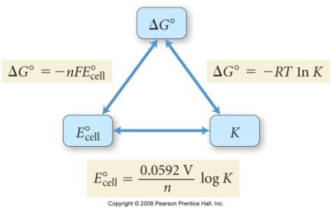
E°_{cell,} ΔG° and K
for a spontaneous reaction
  one the proceeds in the forward direction with the chemicals in their standard states
  ΔG° < 1 (negative)
  E° > 1 (positive)
  K > 1
ΔG° = −RTlnK = −nFE°_{cell}
  n is the number of electrons
  F = Faraday’s Constant = 96,485 C/mol e⁻
53
Notes:
53

Slide 54
Cell Potential & Equilibrium
One of the most useful applications of standard cell potentials is the calculation of equilibrium constants from electrochemical data. Recall,
ΔG° = -nFΔEº and ΔG° = -RT ln K_{c}
So: Eº_{cell} = RT/nF (ln K) = 2.303RT/nF (log K)
The equilibrium constant of a reaction can be calculated from standard cell potentials by combining the equations for the half-reactions to give the cell reaction of interest and determining the standard cell potential of the corresponding cell. That is:
Eº_{cell} = (0.0592/n) log (K) at 25ºC
Notes:
54

Slide 55
Cell Potential & Equilibrium
Calculate the cell potential, free energy, and equilibrium constant using the standard emf values for:
1. Pb²⁺(aq) + Fe(s) → Pb(s) + Fe²⁺(aq)
Notes:
55

Slide 56
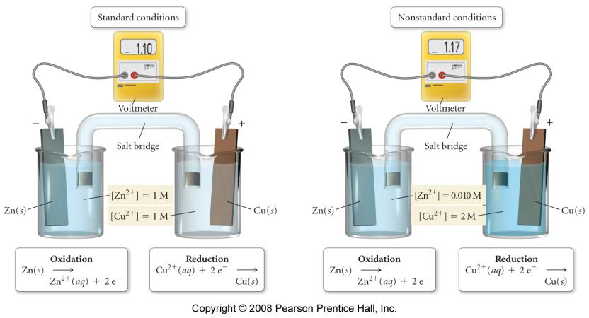
E° at Nonstandard Conditions
Notes:
56

Slide 57
CONCENTRATION EFFECTS
Finally, consider a galvanic cell where the concentrations of the solutions are NOT 1 M. As a reaction proceeds towards equilibrium, the concentrations of its reactants and products change, and ΔG_{rxn} approaches 0. Therefore, as reactants are consumed in an electrochemical cell, the cell potential decreases until finally it reaches 0. To understand this behavior quantitatively, we need to find how the cell emf varies with the concentrations of species in the cell.
Recall: ΔG = ΔG° + RT ln Q
Because ΔG = -nFE & ΔG°= -nFEº
ஃ -nFE = -nFEº + RT ln Q
Notes:
57

Slide 58
CONCENTRATION EFFECTS
When we divide through by -nF, we derive the
Nernst Equation: ε = ε° - (RT/nF) ln Q
That is, the dependence of emf on composition is expressed via the Nernst equation, where Q is the reaction quotient for the cell reaction.
E_{cell} = Eº_{cell} – (2.303RT/nF) log (Q)
Notes:
58

Slide 59
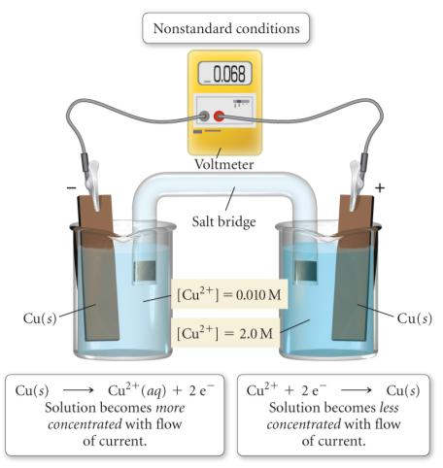
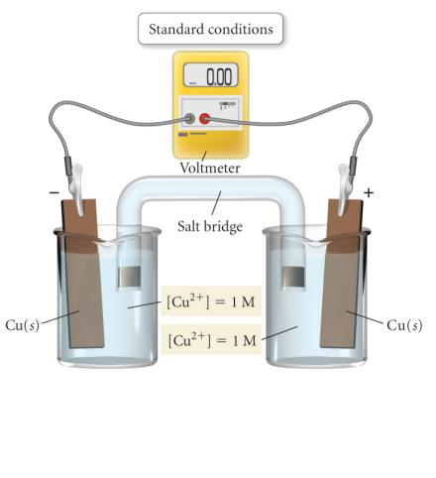
Concentration Cell
when the cell concentrations are equal there is no difference in energy between the half-cells and no electrons flow
when the cell concentrations are different, electrons flow from the side with the less concentrated solution (anode) to the side with the more concentrated solution (cathode)
Cu(s)⏐ Cu²⁺_{(aq)} (0.010 M) ⏐⏐ Cu²⁺_{(aq)} (2.0 M)⏐ Cu(s)
59
Notes:
59

Slide 60
CONCENTRATION EFFECTS
E_{cell} = Eº_{cell} – (2.303RT/nF) log (Q)
2Al + 3Mn²⁺ → 2Al³⁺ + 3Mn Eº_{cell} =0.48V
Predict whether the cell potential is larger or smaller than the standard cell potential if:
    [Al³⁺] = 2.0 M & [Mn²⁺] = 1.0 M
    [Al³⁺] = 1.0M & [Mn²⁺] = 3.0M
Notes:
60

Slide 61
Concentration Cells
it is possible to get a spontaneous reaction when the oxidation and reduction reactions are the same, as long as the electrolyte concentrations are different
the difference in energy is due to the entropic difference in the solutions
  the more concentrated solution has lower entropy than the less concentrated
electrons will flow from the electrode in the less concentrated solution to the electrode in the more concentrated solution
  oxidation of the electrode in the less concentrated solution will increase the ion concentration in the solution – the less concentrated solution has the anode
  reduction of the solution ions at the electrode in the more concentrated solution reduces the ion concentration – the more concentrated solution has the cathode
61
Notes:
61

Slide 62
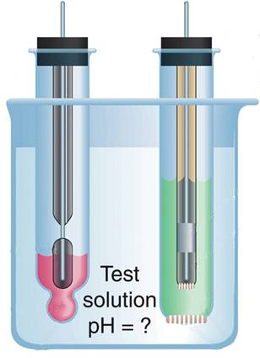
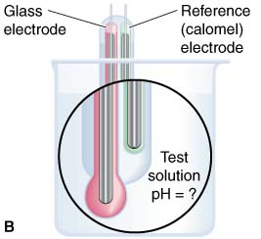
The laboratory measurement of pH.
Pt
Reference (calomel) electrode
Glass electrode
Hg
Paste of Hg₂Cl₂ in Hg
AgCl on Ag on Pt
KCl solution
1M HCl
Thin glass membrane
Porous ceramic plugs
Notes:
62

Slide 63
Nernst Equation & pH
A pH meter is constructed using hydrogen gas bubbling over an inert platinum electrode at a pressure of 1.2 atm. The other electrode is aluminum metal immersed in a 0.20M Al³⁺ solution. What is the cell emf when the hydrogen electrode is immersed in a sample of acid rain with pH of 4.0 at 25ºC? If the electrode is placed in a sample of shampoo and the emf is 1.17 V, what is the pH of the shampoo?
Notes:
63

Slide 64
Workshop EC#7 on EQUILIBRIUM & CONCENTRATION EFFECTS
1. Calculate the cell potential, free energy, and equilibrium constant using the standard emf values for:
S₄O₆²⁻ + Cr²⁺ → Cr³⁺ + S₂O₃²⁻
2. Describe the cell based on:
VO₂⁺ + 2H⁺ + e- → VO²⁺ + H₂O Eº_{cell} = 1.0V
Zn²⁺ + 2e- → Zn Eº_{cell} = -0.76
Where [VO₂⁺]=2.0M, [H⁺]=0.5M, [VO²⁺]=0.01M & [Zn²⁺]=0.1M
3: Calculate ε_{cell} for the following:
Pt(s) | H₂(g, 1 atm) | H⁺(aq, pH = 4.0) || H⁺(aq, pH = 3.0) | H₂(g, 1 atm) | Pt(s)
Notes:
64

Slide 65
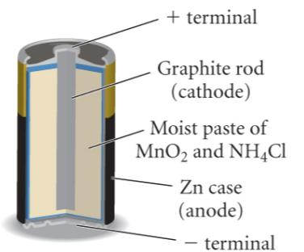
LeClanche’ Acidic Dry Cell
electrolyte in paste form
  ZnCl₂ + NH₄Cl
    or MgBr₂
anode = Zn (or Mg)
  Zn(s) → Zn²⁺(aq) + 2 e⁻
cathode = graphite rod
MnO₂ is reduced
2 MnO₂(s) + 2 NH₄⁺(aq) + 2 H₂O(l) + 2 e⁻
→ 2 NH₄OH(aq) + 2 Mn(O)OH(s)
cell voltage = 1.5 v
expensive, nonrechargeable, heavy, easily corroded
65
Notes:
65

Slide 66
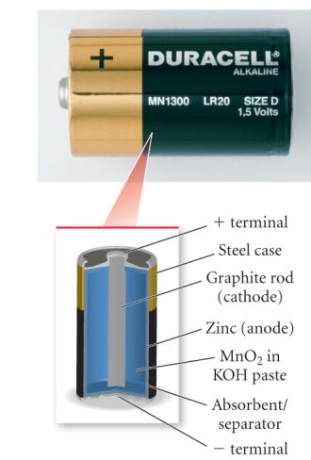
Alkaline Dry Cell
same basic cell as acidic dry cell, except electrolyte is alkaline KOH paste
anode = Zn (or Mg)
  Zn(s) → Zn²⁺(aq) + 2 e⁻
cathode = brass rod
MnO₂ is reduced
2 MnO₂(s) + 2 NH₄⁺(aq) + 2 H₂O(l) + 2 e⁻
→ 2 NH₄OH(aq) + 2 Mn(O)OH(s)
cell voltage = 1.54 v
longer shelf life than acidic dry cells and rechargeable, little corrosion of zinc
66
Notes:
66

Slide 67
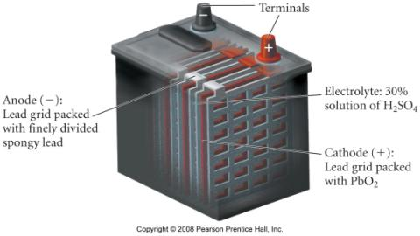
Lead Storage Battery
6 cells in series
electrolyte = 30% H₂SO₄
anode = Pb
Pb(s) + SO₄²⁻(aq) → PbSO₄(s) + 2 e⁻
cathode = Pb coated with PbO₂
PbO₂ is reduced
PbO₂(s) + 4 H⁺(aq) + SO₄²⁻(aq) + 2 e⁻
→ PbSO₄(s) + 2 H₂O(l)
cell voltage = 2.09 v
rechargeable, heavy
67
Notes:
67

Slide 68
NiCad Battery
electrolyte is concentrated KOH solution
anode = Cd
Cd(s) + 2 OH⁻¹(aq) → Cd(OH)₂(s) + 2 e⁻¹ E⁰ = 0.81 v
cathode = Ni coated with NiO₂
NiO₂ is reduced
NiO₂(s) + 2 H₂O(l) + 2 e⁻¹ → Ni(OH)₂(s) + 2OH⁻¹ E⁰ = 0.49 v
cell voltage = 1.30 v
rechargeable, long life, light – however recharging incorrectly can lead to battery breakdown
68
Notes:
68

Slide 69
Ni-MH Battery
electrolyte is concentrated KOH solution
anode = metal alloy with dissolved hydrogen
  oxidation of H from H⁰ to H⁺¹
M∙H(s) + OH⁻¹(aq) → M(s) + H₂O(l) + e⁻¹ E° = 0.89 v
cathode = Ni coated with NiO₂
NiO₂ is reduced
NiO₂(s) + 2 H₂O(l) + 2 e⁻¹ → Ni(OH)₂(s) + 2OH⁻¹ E⁰ = 0.49 v
cell voltage = 1.30 v
rechargeable, long life, light, more environmentally friendly than NiCad, greater energy density than NiCad
69
Notes:
69

Slide 70
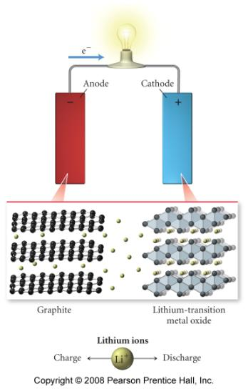
Lithium Ion Battery
electrolyte is concentrated KOH solution
anode = graphite impregnated with Li ions
cathode = Li - transition metal oxide
  reduction of transition metal
work on Li ion migration from anode to cathode causing a corresponding migration of electrons from anode to cathode
rechargeable, long life, very light, more environmentally friendly, greater energy density
70
Notes:
70

Slide 71
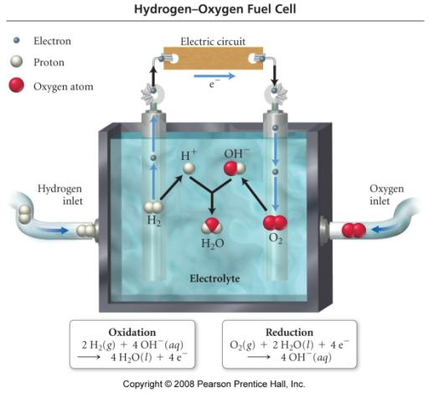
Fuel Cells
like batteries in which reactants are constantly being added
  so it never runs down!
Anode and Cathode both Pt coated metal
Electrolyte is OH– solution
Anode Reaction:
2 H₂ + 4 OH–
→ 4 H₂O(l) + 4 e⁻
Cathode Reaction:
O₂ + 4 H₂O + 4 e⁻
→ 4 OH–
71
Notes:
71

Slide 72
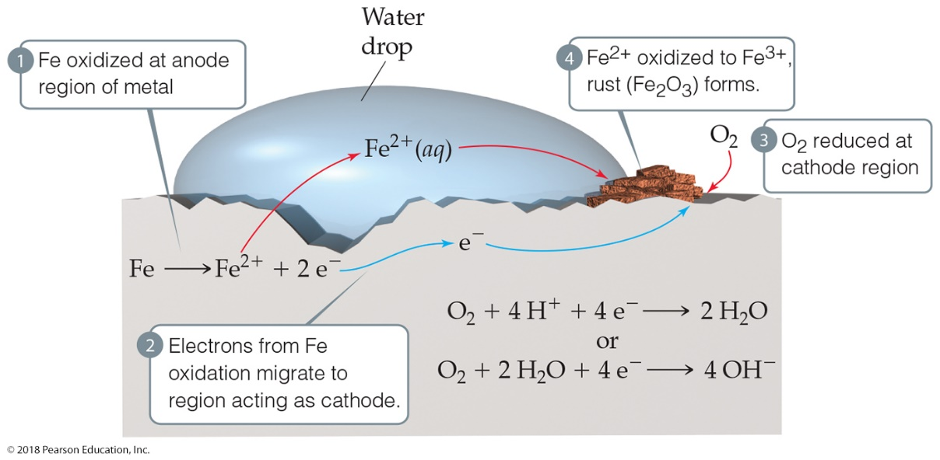
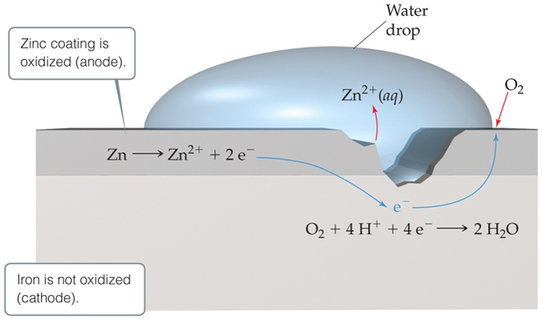
Cathodic protection occurs because zinc is more easily oxidized, so that metal is sacrificed to keep the iron from rusting. Another method to prevent corrosion is used for underground pipes. A sacrificial anode is attached to the pipe. The anode is oxidized before the pipe.
Corrosion is oxidation.
Its common name is rusting.

Slide 73
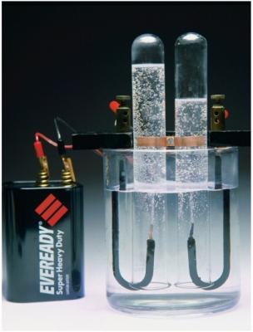
Electrolysis
electrolysis is the process of using electricity to break a compound apart
electrolysis is done in an electrolytic cell
electrolytic cells can be used to separate elements from their compounds
  generate H₂ from water for fuel cells
  recover metals from their ores
73
Notes:
73

Slide 74
    Electrolysis
An electrolytic cell is an electrochemical cell in which electrolysis takes place. The arrangement of components in electrolytic cells is different from that in galvanic cells. Specifically, the two electrodes usually share the same compartment, there is usually only one electrolyte, and concentrations and pressures are usually far from standard. In an electrolytic cell, current supplied by an external source is used to drive the nonspontaneous reaction.
As in a galvanic cell, oxidation occurs at the anode and reduction occurs at the cathode, and electrons travel through the external wire from anode to cathode. But unlike the spontaneous current in a galvanic cell, a current MUST be supplied by an external electrical power source. The result is to force oxidation at one electrode and reduction at the other.
Notes:
74

Slide 75
Electrodes
Anode
  electrode where oxidation occurs
  anions attracted to it
  connected to positive end of battery in electrolytic cell
  loses weight in electrolytic cell
Cathode
  electrode where reduction occurs
  cations attracted to it
  connected to negative end of battery in electrolytic cell
  gains weight in electrolytic cell
    electrode where plating takes place in electroplating
75
Notes:
75

Slide 76
Furthermore, another contrast lies in the labeling of the electrodes. The anode of an electrolytic cell is labeled (+), and the cathode is labeled (-), opposite of a galvanic cell.
Many electrolytic applications involve isolating a metal or nonmetal from a molten salt. Predicting the product at each electrode is simple if the salt is pure because the cation will be reduced and the anion oxidized. For example, consider the following:
Example: The electrolysis of molten CuCl₂ produces Cu(s) and Cl₂(g). What is the minimum external emf needed to drive this electrolysis under standard conditions?
Notes:
76

Slide 77
Mixtures of Ions
when more than one cation is present, the cation that is easiest to reduce will be reduced first at the cathode
  least negative or most positive E°_{red}
when more than one anion is present, the anion that is easiest to oxidize will be oxidized first at the anode
  least negative or most positive E°_{ox}
77
Notes:
77

Slide 78
The situation becomes a bit more complex when attempting to electrolyze an aqueous solution of a salt. Aqueous salt solutions are mixtures of ions & water, so we have to compare the various electrode potentials to predict the electrode products. The table of standard reduction potentials becomes a crucial resource for predicting products in these types of equations and predicting which element will plate out at a particular electrode when various solutions are combined.
The presence of water does increase the number of possible reactions that can take place in an electrolytic cell. Consider the following:
Reduction:
M^{n+} + ne⁻ → M(s) VS. 2H₂O + 2e⁻ → H₂ + 2OH⁻
***As an example, Cu²⁺, Ag⁺, and Ni²⁺ are easier to reduce than water.
***Water is easier to reduce than Na⁺, Mg²⁺, and Al³⁺.
Notes:
78

Slide 79
Oxidation:
2X⁻ → X₂ + 2e⁻ vs. H₂O → ½O₂ + 2H⁺ + 2e⁻
For example, I⁻ and Br⁻ are easier to oxidize than water.
Water is easier to oxidize than F⁻ and SO₄²⁻.
However, the products predicted from this type of comparison of electrode potentials are NOT ALWAYS THE ACTUAL PRODUCTS! For gases such as H₂(g) and O₂(g) to be produced at metal electrodes, an additional voltage is required. This increment over the expected voltage is called the overpotential, and it is 0.4 to 0.6 V for these gases. The overpotential results from kinetic factors such as the large activation energy required for gases to form at the electrode.
Notes:
79

Slide 80
To summarize electrolysis, consider the following points:
    1. Cations of less active metals are reduced to the metal; cations of more active metals are NOT reduced. That is, most transition metal cations are more readily reduced than water; water is more readily reduced than main group metals.
    2. Anions that are oxidized because of overvoltage of O₂ formation include the halides (except F⁻).
3. Anions that are NOT oxidized include F⁻ and common oxoanions such as SO₄²⁻, CO₃²⁻, NO₃⁻, and PO₄³⁻ because the central nonmetal in the oxoanions is already in its highest oxidation state.
Notes:
80

Slide 81
Electrolysis of Aqueous Solutions
Complicated by more than one possible oxidation and reduction
possible cathode reactions
  reduction of cation to metal
  reduction of water to H₂
    2 H₂O + 2 e⁻¹ ® H₂ + 2 OH⁻¹ E° = -0.83 v @ stand. cond.
    E° = -0.41 v @ pH 7
possible anode reactions
  oxidation of anion to element
  oxidation of H₂O to O₂
    2 H₂O ® O₂ + 4e⁻¹ + 4H⁺¹ E° = -1.23 v @ stand. cond.
    E° = -0.82 v @ pH 7
  oxidation of electrode
    particularly Cu
    graphite doesn’t oxidize
half-reactions that lead to least negative E_{tot} will occur
  unless overvoltage changes the conditions
81
Notes:
81

Slide 82
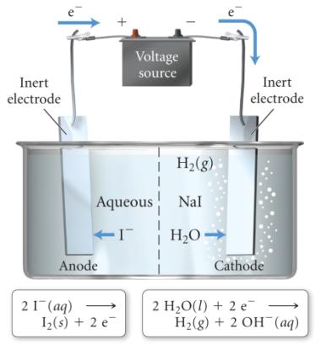
Electrolysis of NaI_{(aq)}
with Inert Electrodes
possible oxidations
2 I⁻¹ → I₂ + 2 e⁻¹ E° = −0.54 v
2 H₂O → O₂ + 4e⁻¹ + 4H⁺¹ E° = −0.82 v
possible oxidations
2 I⁻¹ → I₂ + 2 e⁻¹ E° = −0.54 v
2 H₂O → O₂ + 4e⁻¹ + 4H⁺¹ E° = −0.82 v
possible reductions
Na⁺¹ + 1e⁻¹ → Na⁰ E° = −2.71 v
2 H₂O + 2 e⁻¹ → H₂ + 2 OH⁻¹ E° = −0.41 v
possible reductions
Na⁺¹ + 1e⁻¹ → Na⁰ E° = −2.71 v
2 H₂O + 2 e⁻¹ → H₂ + 2 OH⁻¹ E° = −0.41 v
overall reaction
2 I⁻_{(aq)} + 2 H₂O_{(l)} → I_{2(aq)} + H_{2(g)} + 2 OH⁻¹_{(aq)}
82
Notes:
82

Slide 83
Practice Problems on the Electrolysis of Mixtures
A sample of AlBr₃ was contaminated with KF then made molten and electrolyzed. Determine the products and write the overall cell reaction.
2. Suppose aqueous solutions of Cu²⁺, Ag⁺, & Zn²⁺ were all in one container. If the voltage was initially low and then gradually turned up, in which order will the metals plate out onto the cathode?
Ag⁺ + e⁻ → Ag
Cu²⁺ + 2e⁻ → Cu
Zn²⁺ + 2e⁻ → Zn
Notes:
83

Slide 84
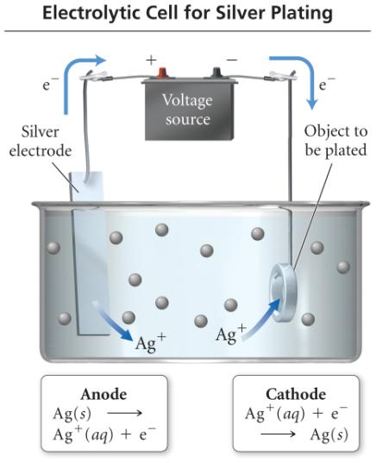
electroplating
In electroplating, the work piece is the cathode.
  Cations are reduced at cathode and plate to the surface of the work piece.
  The anode is made of the plate metal. The anode oxidizes and replaces the metal cations in the solution
84
Notes:
84

Slide 85
Finally, we consider the stoichiometric relationship that exists between charge and product in an electrolytic cell. This relationship was first determined experimentally by Michael Faraday and is referred to as Faraday’s law of electrolysis: The amount of substance produced at each electrode is directly proportional to the quantity of charge flowing through the cell. Recall that Faraday’s constant F = 96,500 C/mol e⁻. We turn to classical physics in order to relate charge per unit time, known as current and measured in terms of the ampere (A). Therefore, we define 1 ampere as 1 coulomb flowing through a conductor in 1 second. That is:
1 A = 1C/s
Current
(Amperes)
& time
Quantity
of Charge
(Coulombs)
Moles
of electrons
(Faraday)
Moles
of substance
(oxid or red)
Grams
of
substance
Notes:
85

Slide 86
Electrolysis and “Stoichiometry”
1 coulomb = 1 ampere × 1 second
Q = I t = n F
Q = charge (C)
I = current (A)
t = time (s)
n = moles of electrons that travel through the wire in the given time
F = Faraday’s constant
Note: n is different than that for the Nernst equation!

Slide 87
Lecture Problems on Electroplating of metals
EXAMPLE 1: Consider the electrolysis of molten MgCl₂. Calculate the mass of magnesium formed upon passage of a current of 60.0 A for a period of 4.00 x 10³ s.
EXAMPLE 2. How long must a current of 5.00 A be applied to a solution of silver ions to produce 10.5 g of silver?
Notes:
87

Slide 88
Workshop EC#8 on Electroysis & Stoichiometry
1. Calculate the mass of aluminum produced in 1.00 hr by the electrolysis of molten AlCl₃ if the electrical current is 10.0 A.
2. In an electrolytic cell, a current of 0.250 ampere is passed through a solution of a chloride of iron, producing Fe(s) and Cl₂(g). When the cell operates for 2.00 hours, 0.521 g of iron is deposited at one electrode.
A. Determine the formula of the chloride of iron in the original solution.
B. Calculate the current that would produce chlorine gas from the solution at a rate of 3.00 g/hr.
3. Determine the time (in hours) required to obtain 7.00 g of magnesium metal from molten magnesium chloride using a current of 7.30 A.
Notes:
88

