Slide 1
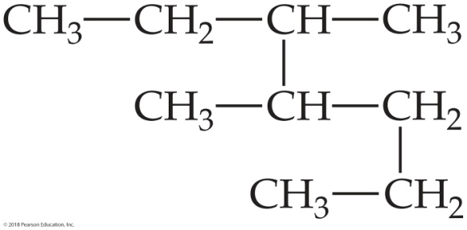
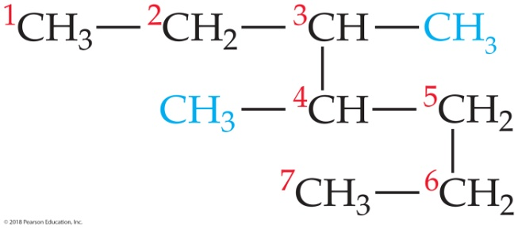
Sample Exercise 24.1 Naming Alkanes
Give the systematic name for the following alkane:
Solution
Analyze We are given the condensed structural formula of an alkane and asked to give its name.
Plan Because the hydrocarbon is an alkane, its name ends in -ane. The name of the parent hydrocarbon is based on the longest continuous chain of carbon atoms. Branches are alkyl groups, named after the number of C atoms in the branch and located by counting C atoms along the longest continuous chain.
Solve The longest continuous chain of C atoms extends from the upper left CH₃ group to the lower left CH₃ group and is seven C atoms long:

Slide 2
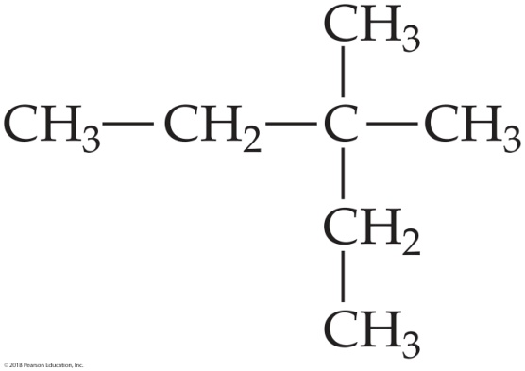
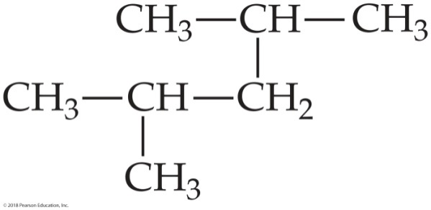
Sample Exercise 24.1 Naming Alkanes
Continued
The parent compound is thus heptane. There are two methyl groups branching off the main chain. Hence, this compound is a dimethylheptane. To specify the location of the two methyl groups, we must number the C atoms from the end that gives the lower two numbers to the carbons bearing side chains. This means that we should start numbering at the upper left carbon. There is a methyl group on C3 and one on C4. The compound is thus 3,4-dimethylheptane.
Practice Exercise 1
What is the systematic name of this compound?
(a) 3-ethyl-3-methylbutane
(b) 2-ethyl-2-methylbutane
(c) 3,3-dimethylpentane
(d) isoheptane
(e) 1,2-dimethylneopentane
Practice Exercise 2
Name the following alkane:

Slide 3
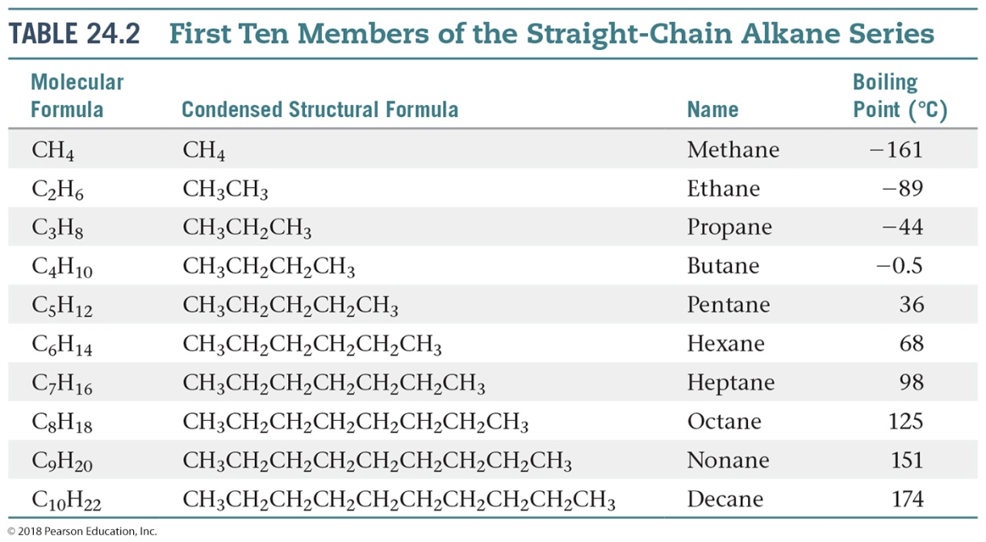
Sample Exercise 24.2 Writing Condensed Structural Formulas
Write the condensed structural formula for 3-ethyl-2-methylpentane.
Solution
Analyze We are given the systematic name for a hydrocarbon and asked to write its condensed structural formula.
Plan Because the name ends in -ane, the compound is an alkane, meaning that all the carbon–carbon bonds are single bonds. The parent hydrocarbon is pentane, indicating five C atoms (Table 24.2). There are two alkyl groups specified, an ethyl group (two carbon atoms, C₂H₅) and a methyl group (one carbon atom, CH₃). Counting from left to right along the five-carbon chain, the name tells us that the ethyl group is attached to C3 and the methyl group is attached to C2.

Slide 4

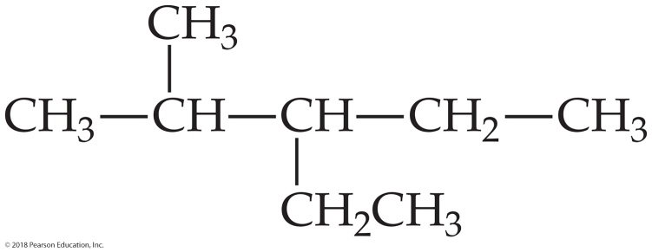
Sample Exercise 24.2 Writing Condensed Structural Formulas
Continued
Solve We begin by writing five C atoms attached by single bonds. These represent the backbone of the parent pentane chain:
C C C C C
We next place a methyl group on the second C and an ethyl group on the third C of the chain. We then add hydrogens to all the other C atoms to make four bonds to each carbon:
The formula can be written more concisely as
CH₃CH(CH₃)CH(C₂H₅)CH₂CH₃
where the branching alkyl groups are indicated in parentheses.

Slide 5
Sample Exercise 24.2 Writing Condensed Structural Formulas
Continued
Practice Exercise 1
How many hydrogen atoms are in 2,2-dimethylhexane?
(a) 6
(b) 8
(c) 16
(d) 18
(e) 20
Practice Exercise 2
Write the condensed structural formula for 2,3-dimethylhexane.

Slide 6
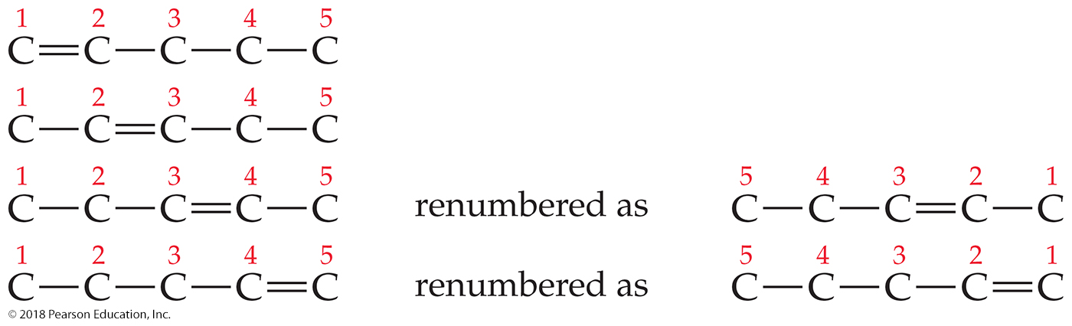
Sample Exercise 24.3 Drawing Isomers
Draw all the structural and geometric isomers of pentene, C₅H₁₀, that have an unbranched hydrocarbon chain.
Solution
Analyze We are asked to draw all the isomers (both structural and geometric) for an alkene with a five-carbon chain.
Plan Because the compound is named pentene and not pentadiene or pentatriene, we know that the five-carbon chain contains only one carbon–carbon double bond. Thus, we begin by placing the double bond in various locations along the chain, remembering that the chain can be numbered from either end. After finding the different unique locations for the double bond, we consider whether the molecule can have cis and trans isomers.
Solve
There can be a double bond after either the first carbon (1-pentene) or second carbon (2-pentene). These are the only two possibilities because the chain can be numbered from either end. Thus, what we might erroneously call 3-pentene is actually 2-pentene, as seen by numbering the carbon chain from the other end:

Slide 7
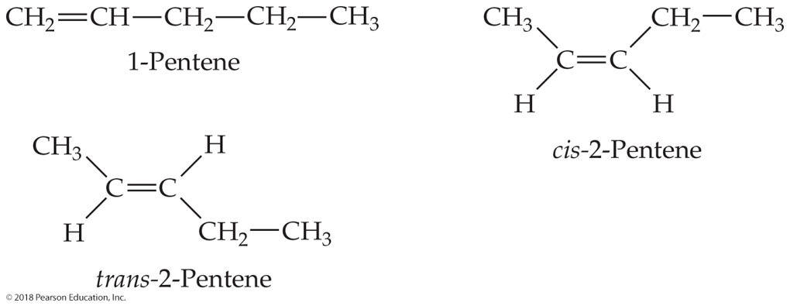
Sample Exercise 24.3 Drawing Isomers
Continued
Because the first C atom in 1-pentene is bonded to two H atoms, there are no cis– trans isomers. There are cis and trans isomers for 2-pentene, however. Thus, the three isomers for pentene are:
(You should convince yourself that cis-3-pentene is identical to cis-2-pentene and that trans-3-pentene is identical to trans-2-pentene. However, cis-2-pentene and trans-2-pentene are the correct names because they have smaller numbered prefixes.)
Practice Exercise 1
Which compound does not exist?
(a) 1,2,3,4,5,6,7-octaheptaene (b) cis-2-butane (c) trans-3-hexene (d) 1-propene (e) cis-4-decene
Practice Exercise 2
How many straight-chain isomers are there of hexene, C₆H₁₂?

Slide 8
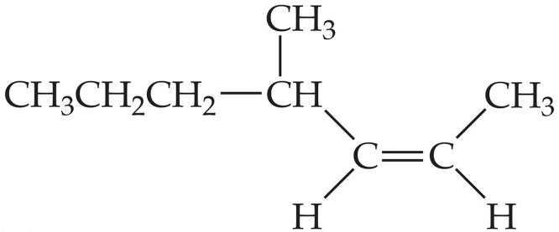
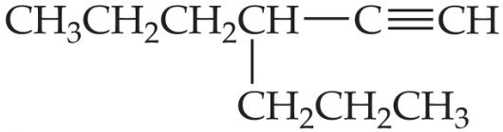
Sample Exercise 24.4 Naming Unsaturated Hydrocarbons
Name the following compounds:
(a) (b)
Solution
Analyze We are given the condensed structural formulas for an alkene and an alkyne and asked to name the compounds.
Plan In each case, the name is based on the number of carbon atoms in the longest continuous carbon chain that contains the multiple bond. In the alkene, care must be taken to indicate whether cis–trans isomerism is possible and, if so, which isomer is given.
Solve
(a) The longest continuous chain of carbons that contains the double bond is seven carbons long, so the parent hydrocarbon is heptene. Because the double bond begins at carbon 2 (numbering from the end closer to the double bond), we have 2-heptene. With a methyl group at carbon atom 4, we have 4-methyl-2-heptene. The geometrical configuration at the double bond is cis (that is, the alkyl groups are bonded to the double bond on the same side). Thus, the full name is 4-methyl-cis-2-heptene.

Slide 9
Sample Exercise 24.4 Naming Unsaturated Hydrocarbons
Continued
(b) The longest continuous chain containing the triple bond has six carbons, so this compound is a derivative of hexyne. The triple bond comes after the first carbon (numbering from the right), making it 1-hexyne. The branch from the hexyne chain contains three carbon atoms, making it a propyl group. Because this substituent is located on C3 of the hexyne chain, the molecule is 3-propyl-1-hexyne.
Practice Exercise 1
If a compound has two carbon–carbon triple bonds and one carbon–carbon double bond, what class of compound is it?
(a) an eneyne (b) a dieneyne (c) a trieneyne (d) an enediyne (e) an enetriyne
Practice Exercise 2
Draw the condensed structural formula for 4-methyl-2-pentyne.

Slide 10
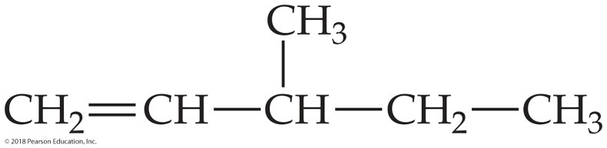
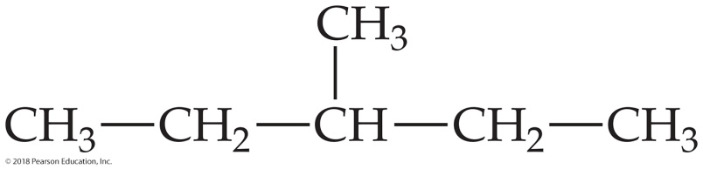
Sample Exercise 24.5 Predicting the Product of an Addition Reaction
Write the condensed structural formula for the product of the hydrogenation of 3-methyl-1-pentene.
Solution
Analyze We are asked to predict the compound formed when a particular alkene undergoes hydrogenation (reaction with H₂) and to write the condensed structural formula of the product.
Plan To determine the condensed structural formula of the product, we must first write the condensed structural formula or Lewis structure of the reactant. In the hydrogenation of the alkene, H₂ adds to the double bond, producing an alkane.
Solve The name of the starting compound tells us that we have a chain of five C atoms with a double bond at one end (position 1) and a methyl group on C3:
Hydrogenation—the addition of two H atoms to the carbons of the double bond—leads to the following alkane:

Slide 11
Sample Exercise 24.5 Predicting the Product of an Addition Reaction
Continued
Comment The longest chain in this alkane has five carbon atoms; the product is therefore 3-methylpentane.
Practice Exercise 1
What product is formed from the hydrogenation of 2-methylpropene? (a) propane, (b) butane, (c) 2-methylbutane, (d) 2-methylpropane, (e) 2-methylpropyne.
Practice Exercise 2
Addition of HCl to an alkene forms 2-chloropropane. What is the alkene?

Slide 12
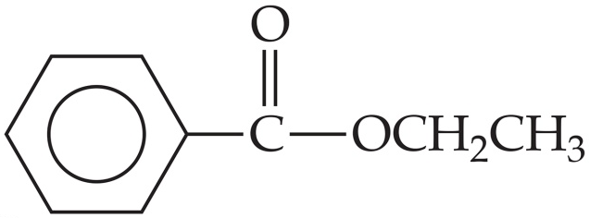
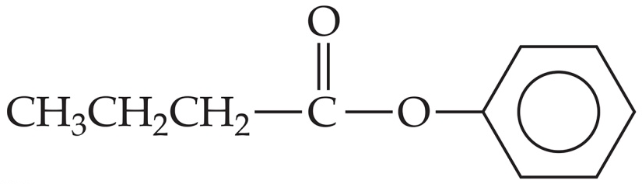
Sample Exercise 24.6 Naming Esters and Predicting Hydrolysis Products
In a basic aqueous solution, esters react with hydroxide ion to form the salt of the carboxylic acid and the alcohol from which the ester is constituted. Name each of the following esters, and indicate the products of their reaction with aqueous base.
(a) (b)
Solution
Analyze We are given two esters and asked to name them and to predict the products formed when they undergo hydrolysis (split into an alcohol and carboxylate ion) in basic solution.
Plan Esters are formed by the condensation reaction between an alcohol and a carboxylic acid. To name an ester, we must analyze its structure and determine the identities of the alcohol and acid from which it is formed. We can identify the alcohol by adding an OH to the alkyl group attached to the O atom of the carboxyl (COO) group. We can identify the acid by adding an H to the O atom of the carboxyl group. We have learned that the first part of an ester name indicates the alcohol portion and the second indicates the acid portion. The name conforms to how the ester undergoes hydrolysis in base, reacting with base to form an alcohol and a carboxylate anion.

Slide 13
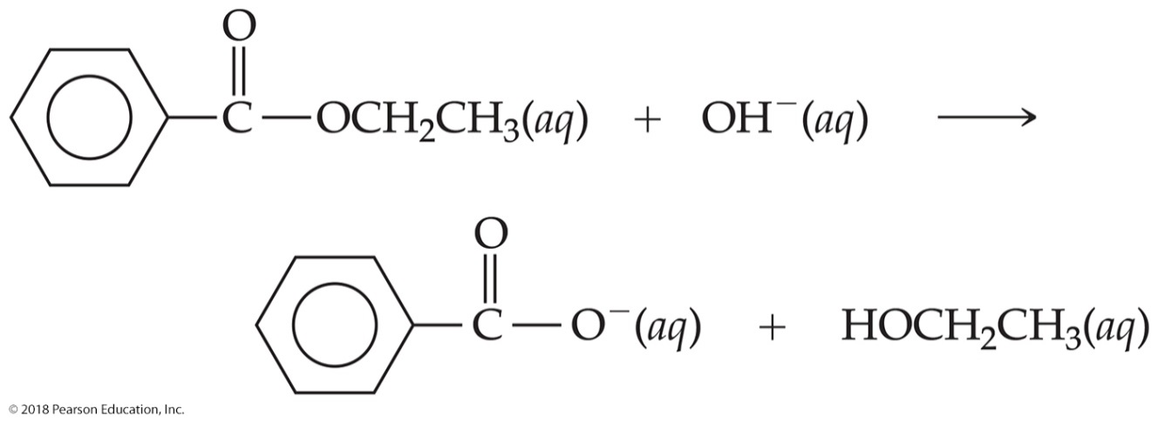
Sample Exercise 24.6 Naming Esters and Predicting Hydrolysis Products
Continued
Solve
(a) This ester is derived from ethanol (CH₃CH₂OH) and benzoic acid (C₆H₅COOH). Its name is therefore ethyl benzoate. The net ionic equation for reaction of ethyl benzoate with hydroxide ion is
The products are benzoate ion and ethanol.

Slide 14
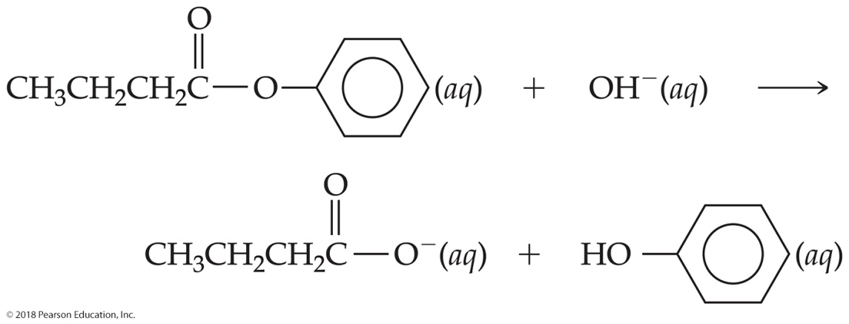
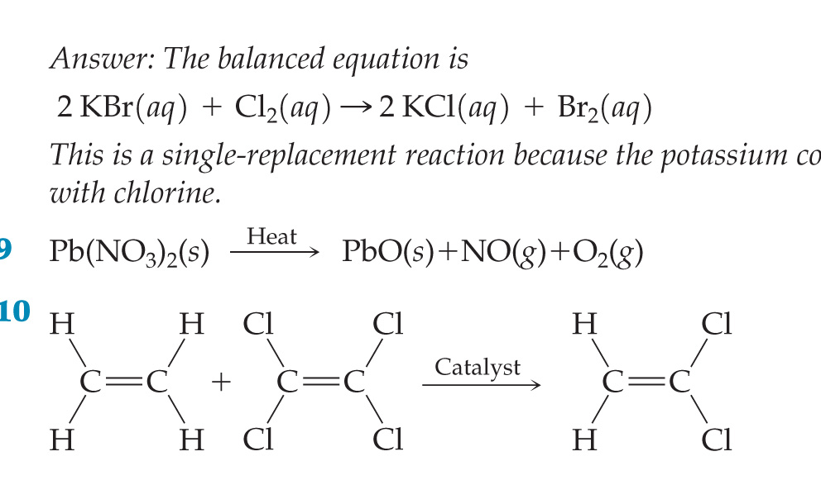
Sample Exercise 24.6 Naming Esters and Predicting Hydrolysis Products
Continued
(b) This ester is derived from phenol (C₆H₅OH) and butanoic acid (commonly called butyric acid) (CH₃CH₂CH₂COOH). The residue from the phenol is called the phenyl group. The ester is therefore named phenyl butyrate or phenyl butanoate. The net ionic equation for the reaction of phenyl butyrate with hydroxide ion is
The products are butyrate ion and phenol.
Practice Exercise 1
For the generic ester RC(O)OR´, which bond will hydrolyze under basic conditions?
(a) the R C bond (b) the C O bond (c) the C O bond (d) the O R´ bond (e) more than one of the above
Practice Exercise 2
Write the condensed structural formula for the ester formed from propyl alcohol and propionic acid.

Slide 15
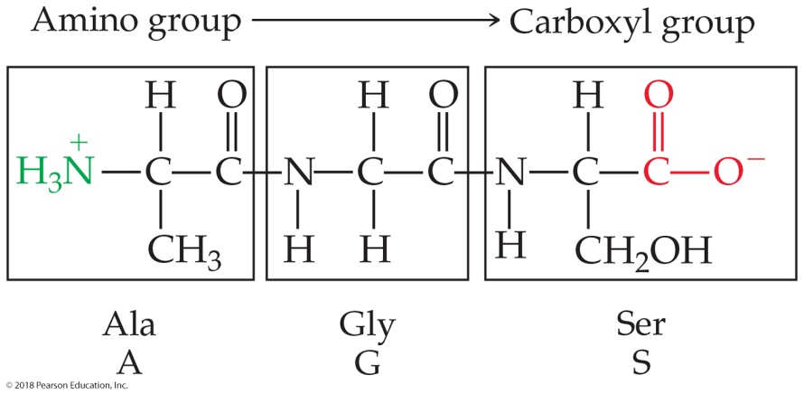
Sample Exercise 24.7 Drawing the Structural Formula of a Tripeptide
Draw the structural formula for alanylglycylserine.
Solution
Analyze We are given the name of a substance with peptide bonds and asked to write its structural formula.
Plan The name of this substance suggests that three amino acids—alanine, glycine, and serine—have been linked together, forming a tripeptide. Note that the ending -yl has been added to each amino acid except for the last one, serine. By convention, the sequence of amino acids in peptides and proteins is written from the nitrogen end to the carbon end: The first-named amino acid (alanine, in this case) has a free amino group and the last-named one (serine) has a free carboxyl group.
Solve We first combine the carboxyl group of alanine with the amino group of glycine to form a peptide bond and then the carboxyl group of glycine with the amino group of serine to form another peptide bond:
We can abbreviate this tripeptide as either Ala-Gly-Ser or AGS.

Slide 16
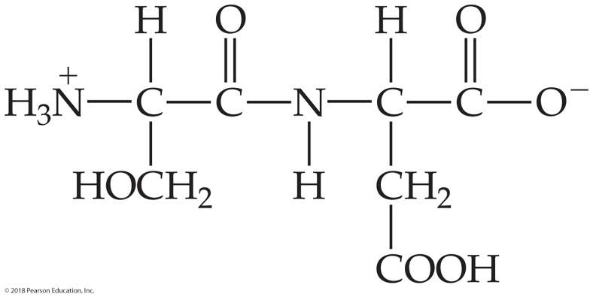
Sample Exercise 24.7 Drawing the Structural Formula of a Tripeptide
Continued
Practice Exercise 1
How many nitrogen atoms are in the tripeptide Arg-Asp-Gly?
(a) 3 (b) 4 (c) 5 (d) 6 (e) 7
Practice Exercise 2
Name the dipeptide and give the two ways of writing its abbreviation.

Slide 17
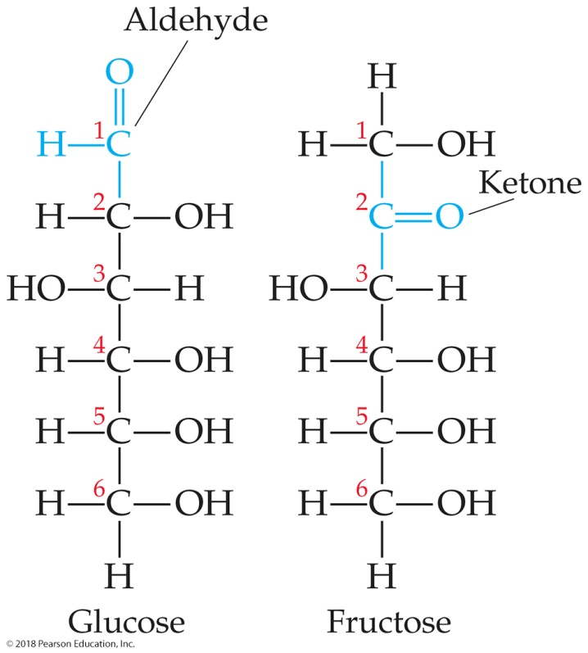
Sample Exercise 24.8 Identifying Functional Groups and Chiral Centers in Carbohydrates
How many chiral carbon atoms are there in the open-chain form of glucose (Figure 24.19)?
Solution
Analyze We are given the structure of glucose and asked to determine the number of chiral carbons in the molecule.
Plan A chiral carbon has four different groups attached (Section 24.5). We need to identify those carbon atoms in glucose.

Slide 18
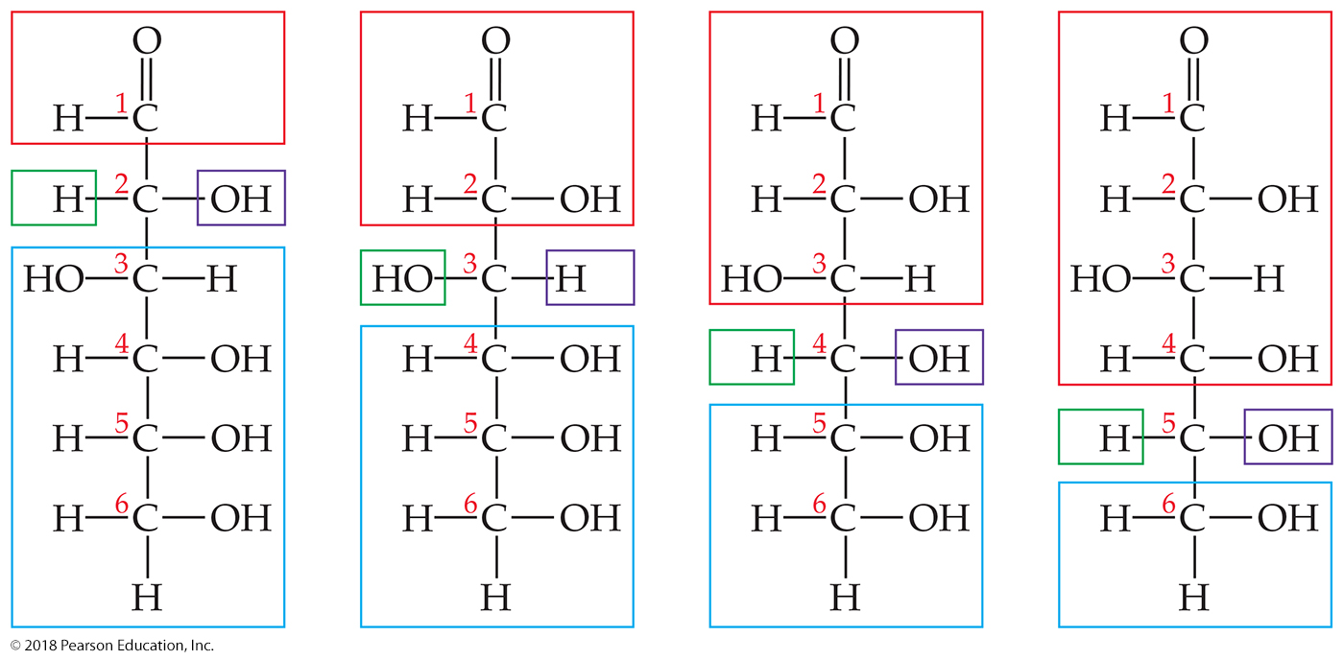
Sample Exercise 24.8 Identifying Functional Groups and Chiral Centers in Carbohydrates
Continued
Solve Carbons 2, 3, 4, and 5 each have four different groups attached to them:
Thus, there are four chiral carbon atoms in the glucose molecule.

Slide 19
Sample Exercise 24.8 Identifying Functional Groups and Chiral Centers in Carbohydrates
Continued
Practice Exercise 1
How many chiral carbon atoms are there in the open-chain form of fructose (Figure 24.19)?
(a) 0
(b) 1
(c) 2
(d) 3
(e) 4
Practice Exercise 2
Name the functional groups present in the beta form of glucose.

Slide 20
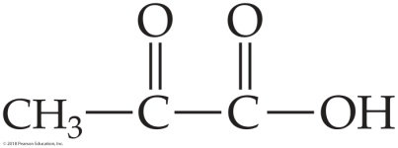
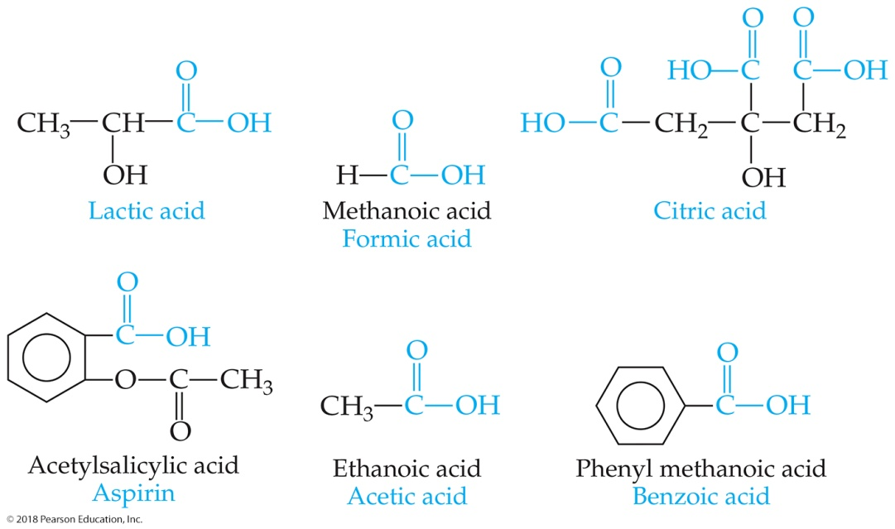
Sample Integrative Exercise Putting Concepts Together
Pyruvic acid,
is formed in the body from carbohydrate metabolism. In muscles, it is reduced to lactic acid in the course of exertion. The acid-dissociation constant for pyruvic acid is 3.2 × 10^{–3}. (a) Why does pyruvic acid have a larger acid-dissociation constant than acetic acid? (b) Would you expect pyruvic acid to exist primarily as the neutral acid or as dissociated ions in muscle tissue, assuming a pH of 7.4 and an initial acid concentration of 2 × 10^{–4} M? (c) What would you predict for the solubility properties of pyruvic acid? Explain. (d) What is the hybridization of each carbon atom in pyruvic acid? (e) Assuming H atoms as the reducing agent, write a balanced chemical equation for the reduction of pyruvic acid to lactic acid (Figure 24.13). (Although H atoms do not exist as such in biochemical systems, biochemical reducing agents deliver hydrogen for such reductions.)

Slide 21
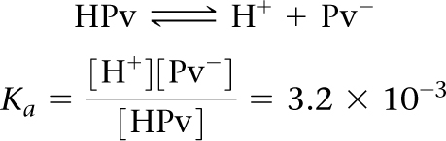

Sample Integrative Exercise Putting Concepts Together
Continued
Solution
(a) The acid-dissociation constant for pyruvic acid should be somewhat greater than that of acetic acid because the carbonyl function on the α-carbon atom of pyruvic acid exerts an electron-withdrawing effect on the carboxylic acid group. In the C O H bond system, the electrons are shifted from H, facilitating loss of the H as a proton. (Section 16.10)
(b) To determine the extent of ionization, we first set up the ionization equilibrium and equilibrium-constant expression. Using HPv as the symbol for the acid, we have
Let [Pv–] = x. Then the concentration of undissociated acid is 2 × 10^{–4} – x. The concentration of [H⁺] is fixed at 4.0 × 10^{–8} M (the antilog of the pH value). Substituting, we obtain

Slide 22
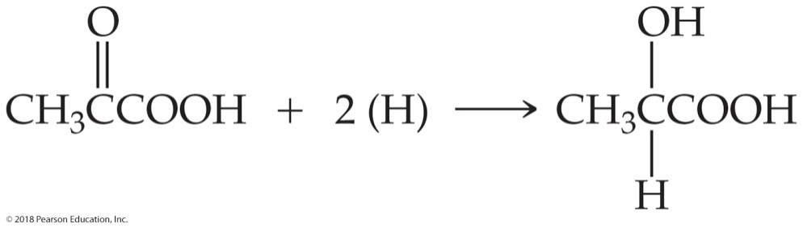
Sample Integrative Exercise Putting Concepts Together
Continued
Solving for x, we obtain
x = [Pv–] = 2 × 10^{–4} M
This is the initial concentration of acid, which means that essentially all the acid has dissociated. We might have expected this result because the acid is quite dilute and the acid-dissociation constant is fairly high.
(c) Pyruvic acid should be quite soluble in water because it has polar functional groups and a small hydrocarbon component. We would predict it would be soluble in polar organic solvents, especially ones that contain oxygen. In fact, pyruvic acid dissolves in water, ethanol, and diethyl ether.
(d) The methyl group carbon has sp³ hybridization. The carbon of the carbonyl group has sp² hybridization because of the double bond to oxygen. Similarly, the carboxylic acid carbon is sp² hybridized.
(e) The balanced chemical equation for this reaction is
Essentially, the ketonic functional group has been reduced to an alcohol.

