Slide 1
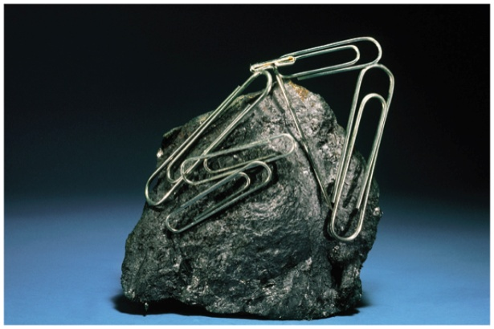
Sample Exercise 23.1 Identifying the Coordination Sphere of Complex
Palladium(II) tends to form complexes with coordination number 4. A compound has the composition PdCl₂ • 3 NH₃. (a) Write the formula for this compound that best shows the coordination structure. (b) When an aqueous solution of the compound is treated with excess AgNO₃(aq), how many moles of AgCl(s) are formed per mole of PdCl₂ • 3 NH₃?
Solution
Analyze We are given the coordination number of Pd(II) and a chemical formula indicating that the complex contains NH₃ and Cl⁻. We are asked to determine (a) which ligands are attached to Pd(II) in the compound and (b) how the compound behaves toward AgNO₃ in aqueous solution.
Plan (a) Because of their charge, the Cl⁻ ions can be either in the coordination sphere, where they are bonded directly to the metal, or outside the coordination sphere, where they are bonded ionically to the complex. The electrically neutral NH₃ ligands must be in the coordination sphere, and we will assume that four ligands are bonded to the Pd(II) ion. (b) Any chlorides in the coordination sphere do not precipitate as AgCl.
Solve
(a) By analogy to the ammonia complexes of cobalt(III) shown in Figure 23.7, we
predict that the three NH₃ are ligands attached to the Pd(II) ion. The fourth ligand
around Pd(II) is one chloride ion. The second chloride ion is not a ligand; it serves
only as a counterion (a noncoordinating ion that balances charge) in the compound.
We conclude that the formula showing the structure best is [Pd(NH₃)₃Cl]Cl.

Slide 2
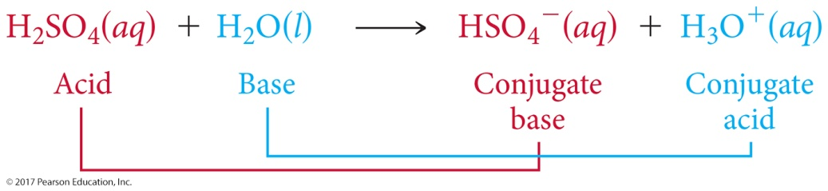
Sample Exercise 23.1 Identifying the Coordination Sphere of Complex
Continued
(b) Because only the non-ligand Cl⁻ can react, we expect to produce 1 mol of AgCl(s) per mole of complex. The balanced equation is
[Pd(NH₃)₃Cl]Cl(aq) + AgNO₃(aq) [Pd(NH₃)₃Cl]NO₃(aq) + AgCl(s)
This is a metathesis reaction (Section 4.2) in which one of the cations is the [Pd(NH₃)₃Cl]⁺ complex ion.
Practice Exercise 1
When the compound RhCl₃ • 4 NH₃ is dissolved in water and treated with excess AgNO₃(aq) one mole of AgCl(s) is formed for every mole of RhCl₃ • 4 NH₃. What is the correct way to write the formula of this compound?
(a) [Rh(NH₃)₄Cl₃] (b) [Rh(NH₃)₄Cl₂]Cl (c) [Rh(NH₃)₄Cl]Cl₂ (d) [Rh(NH₃)₄]Cl₃ (e) [RhCl₃](NH₃)₄
Practice Exercise 2
Predict the number of ions produced per formula unit when the compound CoCl₂ • 6 H₂O dissolves in water to form an aqueous solution.

Slide 3
Sample Exercise 23.2 Determining the Oxidation Number of a Metal in a Complex
What is the oxidation number of the metal in [Rh(NH₃)₅Cl](NO₃)₂?
Solution
Analyze We are given the chemical formula of a coordination compound and asked to determine the oxidation number of its metal atom.
Plan To determine the oxidation number of Rh, we need to figure out what charges are contributed by the other groups. The overall charge is zero, so the oxidation number of the metal must balance the charge due to the rest of the compound.
Solve The NO₃ group is the nitrate anion, which has a 1– charge. The NH₃ ligands carry zero charge, and the Cl is a coordinated chloride ion, which has a 1– charge. The sum of all the charges must be zero:
x + 5(0) + (−1) + 2(−1) = 0
[Rh(NH₃)₅Cl](NO₃)₂
The oxidation number of rhodium, x, must therefore be +3.

Slide 4
Sample Exercise 23.2 Determining the Oxidation Number of a Metal in a Complex
Continued
Practice Exercise 1
In which of the following compounds does the transition-metal have the highest oxidation number?
(a) [Co(NH₃)₄Cl₂] (b) K₂[PtCl₆] (c) Rb₃[MoO₃F₃] (d) Na[Ag(CN)₂] (e) K₄[Mn(CN)₆]
Practice Exercise 2
What is the charge of the complex formed by a platinum(II) metal ion surrounded by two ammonia molecules and two bromide ions?

Slide 5
Sample Exercise 23.3 Naming Coordination Compounds
Name the compounds (a) [Cr(H₂O)₄Cl₂]Cl, (b) K₄[Ni(CN)4].
Solution
Analyze We are given the chemical formulas for two coordination compounds and assigned the task of naming them.
Plan To name the complexes, we need to determine the ligands in the complexes, the names of the ligands, and the oxidation of the metal ion. We then put the information together following the rules listed in the text.
Solve
(a) The ligands are four water molecules—tetraaqua—and two chloride ions—dichloro. By assigning all the oxidation numbers we know for this molecule, we see that the oxidation number of Cr is +3:
+3 + 4(0) + 2(−1) + (−1) = 0
[Cr(H₂O)₄Cl₂]Cl
Thus, we have chromium(III). Finally, the anion is chloride. The name of the compound is tetraaquadichlorochromium(III) chloride.

Slide 6
Sample Exercise 23.3 Naming Coordination Compounds
Continued
(b) The complex has four cyanide ion ligands, CN⁻, which means tetracyano, and the oxidation state of the nickel
is zero:
4(+1) + 0 + 4(−1) = 0
K₄[Ni(CN)₄]
Because the complex is an anion, the metal is indicated as nickelate(0). Putting these parts together and naming the
cation first, we have potassium tetracyanonickelate(0).
Practice Exercise 1
What is the name of the compound [Rh(NH₃)₄Cl₂]Cl?
(a) Rhodium(III) tetraamminedichloro chloride (b) Tetraammoniadichlororhodium(III) chloride
(c) Tetraamminedichlororhodium(III) chloride (d) Tetraamminetrichlororhodium(III)
(e) Tetraamminedichlororhodium(II) chloride
Practice Exercise 2
Name the compounds (a) [Mo(NH₃)₃Br₃]NO₃, (b) (NH₄)₂[CuBr₄]. (c) Write the formula for sodium diaquabis(oxalato)ruthenate(III).

Slide 7
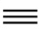
Sample Exercise 23.4 Determining the Number of Geometric Isomers
The Lewis structure :C O: indicates that the CO molecule has two lone pairs of electrons. When CO binds to a transition-metal atom, it nearly always does so by using the C lone pair. How many geometric isomers are there for tetracarbonyldichloroiron(II)?
Solution
Analyze We are given the name of a complex containing only monodentate ligands, and we must determine the number of isomers the complex can form.
Plan We can count the number of ligands to determine the coordination number of the Fe and then use the coordination number to predict the geometry. We can then either make a series of drawings with ligands in different positions to determine the number of isomers or deduce the number of isomers by analogy to cases we have discussed.
Solve The name indicates that the complex has four carbonyl (CO) ligands and two chloro (Cl⁻) ligands, so its formula is Fe(CO)₄Cl₂. The complex therefore has a coordination number of 6, and we can assume an octahedral geometry. Like [Co(NH₃)₄Cl₂]⁺ (Figure 23.8), it has four ligands of one type and two of another. Consequently, there are two isomers possible: one with the Cl⁻ ligands across the metal from each other, trans-[Fe(CO)₄Cl₂], and one with the Cl⁻ ligands adjacent to each other, cis-[Fe(CO)₄Cl₂].

Slide 8
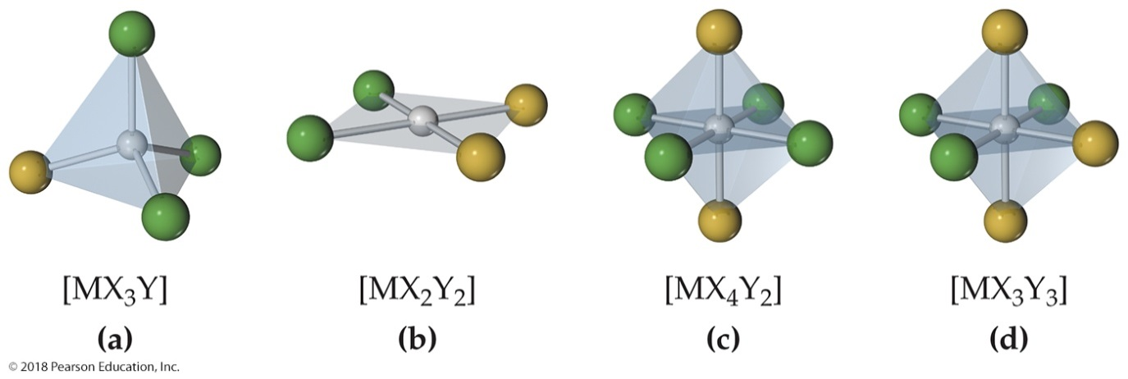
Sample Exercise 23.4 Determining the Number of Geometric Isomers
Continued
Comment It is easy to overestimate the number of geometric isomers. Sometimes different orientations of a single isomer are incorrectly thought to be different isomers. If two structures can be rotated so that they are equivalent, they are not isomers of each other. The problem of identifying isomers is compounded by the difficulty we often have in visualizing three-dimensional molecules from their two-dimensional representations. It is sometimes easier to determine the number of isomers if we use three-dimensional models.
Practice Exercise 1
Which of the following molecules does not have a geometric isomer?
Practice Exercise 2
How many isomers exist for the square-planar molecule [Pt(NH₃)₂ClBr]?

Slide 9
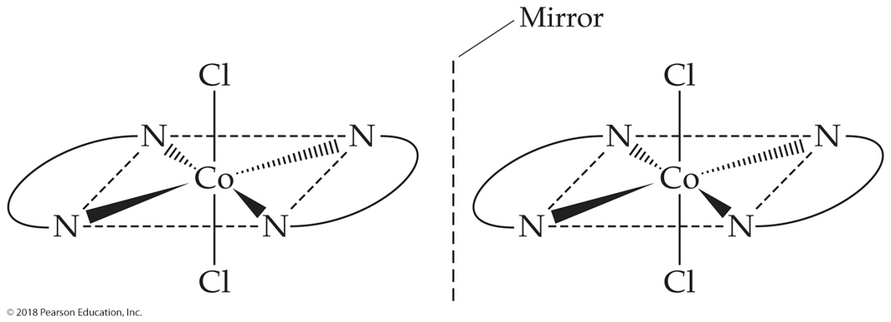
Sample Exercise 23.5 Predicting Whether a Complex Has Optical Isomers
Does either cis-[Co(en)₂Cl₂]⁺ or trans-[Co(en)₂Cl₂]⁻ have optical isomers?
Solution
Analyze We are given the chemical formula for two geometric isomers and asked to determine whether either one has optical isomers. Because en is a bidentate ligand, we know that both complexes are octahedral and both have coordination number 6.
Plan We need to sketch the structures of the cis and trans isomers and their mirror images. We can draw the en ligand as two N atoms connected by an arc. If the mirror image cannot be superimposed on the original structure, the complex and its mirror image are optical isomers.
Solve The trans isomer of [Co(en)₂Cl₂]⁺ and its
mirror image are shown here. Notice that the
mirror image of the isomer is identical to the
original. Consequently trans-[Co(en)₂Cl₂]⁺ does
not exhibit optical isomerism.].

Slide 10
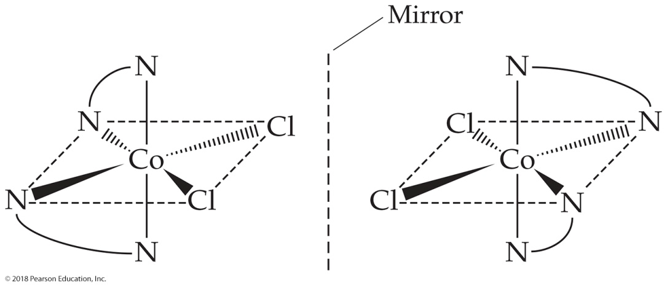
Sample Exercise 23.5 Predicting Whether a Complex Has Optical Isomers
Continued
The cis isomer of [Co(en)₂Cl₂]⁺ and its mirror image
are shown here. In this case the two cannot be superimposed
on each other. Thus, the two cis structures are optical isomers
(enantiomers). We say that cis-[Co(en)₂Cl₂]⁺ is a chiral
complex.
Practice Exercise 1
Which of the following complexes has an optical isomer?
(a) Tetrahedral [CdBr₂Cl₂]²⁻ (b) Octahedral [CoCl₄(en)]^{2–} (c) Octahedral [Co(NH₃)₄Cl₂]²⁺
(d) Tetrahedral [Co(NH₃)BrClI]⁻
Practice Exercise 2
Does the square-planar complex ion [Pt(NH₃)(N₃)ClBr]⁻ have optical isomers? Explain your answer.

Slide 11
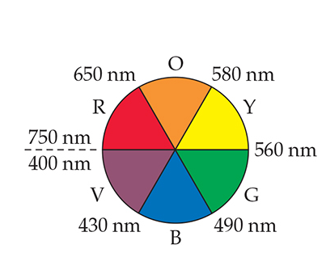
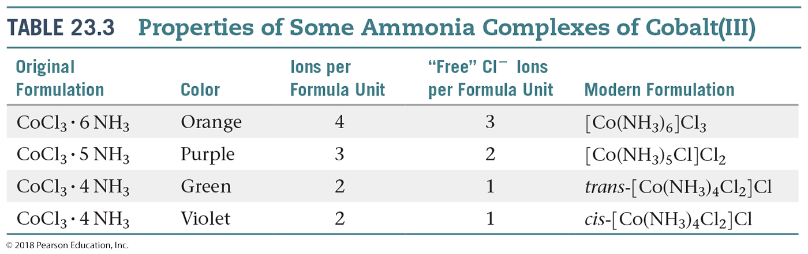
Sample Exercise 23.6 Relating Color Absorbed to Color Observed
The complex ion trans-[Co(NH₃)₄Cl₂]⁺ absorbs light primarily in the red region of the visible spectrum (the most intense absorption is at 680 nm). What is the color of the complex ion?
Solution
Analyze We need to relate the color absorbed by a complex (red) to the color observed for the complex.
Plan For an object that absorbs only one color from the visible spectrum, the
color we see is complementary to the color absorbed. We can use the color
wheel of Figure 23.25 to determine the complementary color.
Solve From Figure 23.25, we see that green is complementary to red, so the
complex appears green.
Comment As noted in Section 23.2,
this green complex was one of those
that helped Werner establish his
theory of coordination (Table 23.3).
The other geometric isomer of this
complex, cis-[Co(NH₃)₄Cl₂]⁺, absorbs
yellow light and therefore appears
violet.

Slide 12
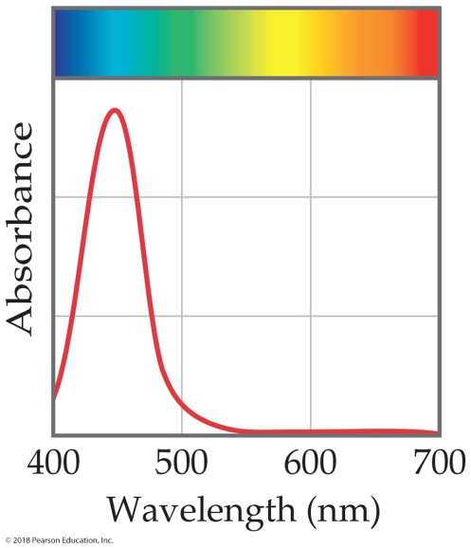
Sample Exercise 23.6 Relating Color Absorbed to Color Observed
Continued
Practice Exercise 1
A solution containing a certain transition-metal complex ion has the absorption spectrum shown here.
What color would you expect a solution containing this ion to be? (a) violet (b) blue (c) green (d) orange (e) red
Practice Exercise 2
A certain transition-metal complex ion absorbs at 695 nm. Which color is this ion most likely to be—blue, yellow, green, or red?

Slide 13
Sample Exercise 23.7 The Spectrochemical Series, Crystal-Field Splitting, Color, and Magnetism
The compound hexaamminecobalt(III) chloride is diamagnetic and orange in color with a single absorption peak in its visible absorption spectrum. (a) What is the electron configuration of the cobalt(III) ion? (b) Is [Co(NH₃)₆]³⁺ a high-spin complex or a low-spin complex? (c) Estimate the wavelength where you expect the absorption of light to reach a maximum? (d) What color and magnetic behavior would you predict for the complex ion [Co(en)₃]³⁺?
Solution
Analyze We are given the color and magnetic behavior of an octahedral complex containing Co with a +3 oxidation number. We need to use this information to determine its electron configuration, its spin state (low-spin or high-spin), and the color of light it absorbs. In part (d), we must use the spectrochemical series to predict how its properties will change if NH₃ is replaced by ethylenediamine (en).
Plan (a) From the oxidation number and the periodic table we can determine the number of valence electrons for Co(III), and from that we can determine the electron configuration. (b) The magnetic behavior can be used to determine whether this compound is a low-spin or high-spin complex. (c) Since there is a single peak in the visible absorption spectrum, the color of the compound should be complementary to the color of light that is absorbed most strongly. (d) Ethylenediamine is a stronger field ligand than NH₃, so we expect a larger Δ for [Co(en)₃]³⁺ than for [Co(NH₃)₆]³⁺.

Slide 14
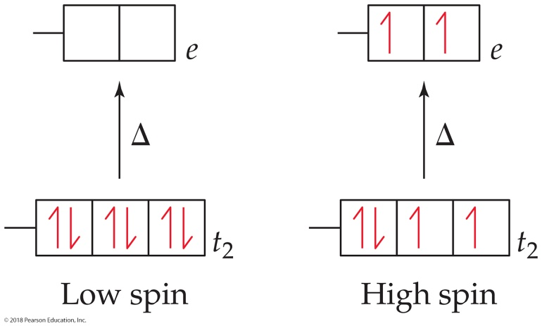
Sample Exercise 23.7 The Spectrochemical Series, Crystal-Field Splitting, Color, and Magnetism
Continued
Solve
(a) Co has an electron configuration of [Ar]4s²3d⁷, and Co³⁺ has three fewer electrons than Co. Because transition-metal ions always lose their valence shell s electrons, the electron configuration of Co³⁺ is [Ar]3d⁶.
(b) There are six valence electrons in the d orbitals. The filling of the t₂ and e orbitals for both high-spin and low-spin complexes is shown below. Because the compound is diamagnetic, we know all of the electrons must be paired up, which allows us to determine that [Co(NH₃)₆]³⁺ is a low-spin complex.

Slide 15
Sample Exercise 23.7 The Spectrochemical Series, Crystal-Field Splitting, Color, and Magnetism
Continued
(c) We are told that the compound is orange and has a single absorption peak in the visible region of the spectrum. The compound must therefore absorb the complementary color of orange, which is blue. The blue region of the spectrum ranges from approximately 430 nm to 490 nm. As an estimate we assume that the complex ion absorbs somewhere in the middle of the blue region, near 460 nm.
(d) Ethylenediammine is higher in the spectrochemical series than ammonia. Therefore, we expect a larger ∆ for
[Co(en)₃]³⁺. Because ∆ was already greater than the spinpairing energy for [Co(NH₃)₆]³⁺, we expect [Co(en)₃]³⁺ to be a low-spin complex as well, with a d⁶ configuration, so it will also be diamagnetic. The wavelength at which the complex absorbs light will shift to higher energy. If we assume a shift in the absorption maximum from blue to violet, the color of the complex will become yellow.
Comment The compound [Co(en)₃]Cl₃, which contains the [Co(en)₃]³⁺ ion, was made and studied by Alfred Werner. This compound forms diamagnetic, golden-yellow crystals.

Slide 16

Sample Exercise 23.7 The Spectrochemical Series, Crystal-Field Splitting, Color, and Magnetism
Continued
Practice Exercise 1
Which of the following octahedral complex ions will have the fewest number of unpaired electrons?
(a) [Cr(H₂O)₆]³⁺ (b) [V(H₂O)₆]³⁺ (c) [FeF₆]³⁻ (d) [RhCl₆]³⁻ (e) [Ni(NH₃)₆]²⁺
Practice Exercise 2
Consider the colors of the ammonia complexes of Co³⁺ given in Table 23.3. Based on the change in color would you expect [Co(NH₃)₅Cl]²⁺ to have a larger or smaller value of ∆ than [Co(NH₃)₆]³⁺? Is this prediction consistent with the spectrochemical series?

Slide 17
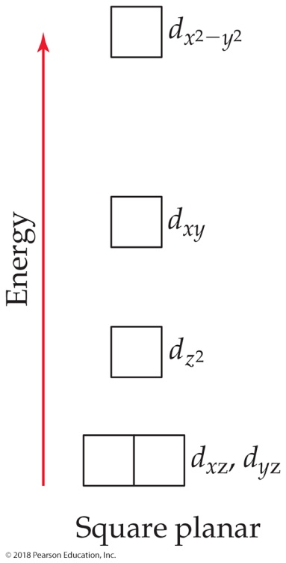
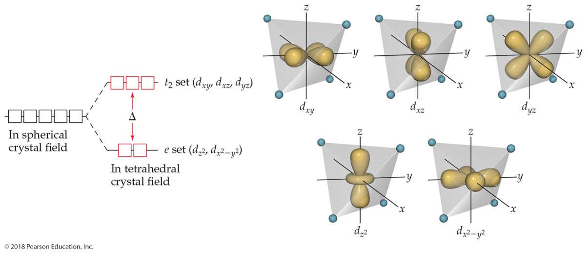
Sample Exercise 23.8 Populating d Orbitals in Tetrahedral and Square-Planar Complexes
Nickel(II) complexes in which the metal coordination number is 4 can have either square-planar or tetrahedral geometry. [NiCl₄]²⁻ is paramagnetic, and [Ni(CN)₄]²⁻ is diamagnetic. One of these complexes is square planar, and the other is tetrahedral. Use the relevant crystal-field splitting diagrams in the text to determine which complex has which geometry.
Solution
Analyze We are given two complexes containing Ni²⁺ and their magnetic properties. We are given two molecular geometry choices and asked to use crystal-field splitting diagrams from the text to determine which complex has which geometry.
Plan We need to determine the number of d electrons in Ni²⁺ and then use Figure 23.33 for the tetrahedral complex and Figure 23.34 for the square-planar complex.

Slide 18
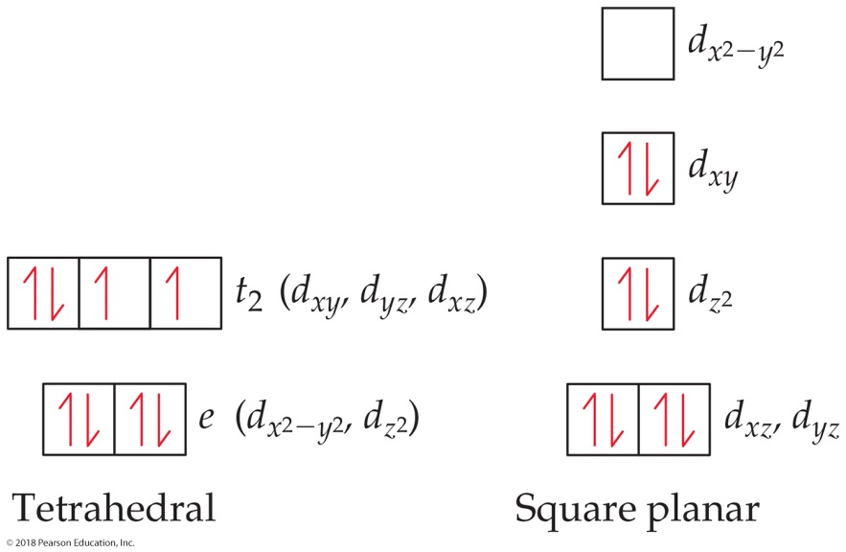
Sample Exercise 23.8 Populating d Orbitals in Tetrahedral and Square-Planar Complexes
Continued
Solve Nickel(II) has the electron configuration [Ar]3d⁸. With very few exceptions tetrahedral complexes are high spin and square-planar complexes are low spin. Therefore, the population of the d orbitals in the two geometries is
The tetrahedral complex has two unpaired electrons, and the square-planar complex has none. We know from Section 23.1 that the tetrahedral complex must be paramagnetic and the square planar must be diamagnetic. Therefore, [NiCl₄]²⁻ is tetrahedral, and [Ni(CN)₄]²⁻ is square planar.

Slide 19
Sample Exercise 23.8 Populating d Orbitals in Tetrahedral and Square-Planar Complexes
Continued
Comment Nickel(II) forms octahedral complexes more frequently than square-planar ones, whereas d⁸ metals from periods 5 and 6 tend to favor square-planar coordination.
Practice Exercise 1
How many unpaired electrons do you predict for the tetrahedral [MnCl₄]²⁻ ion?
(a) 1, (b) 2, (c) 3, (d) 4, (e) 5.
Practice Exercise 2
Are there any diamagnetic tetrahedral complexes containing transition metal ions with partially filled d orbitals? If so what electron count(s) leads to diamagnetism?

Slide 20
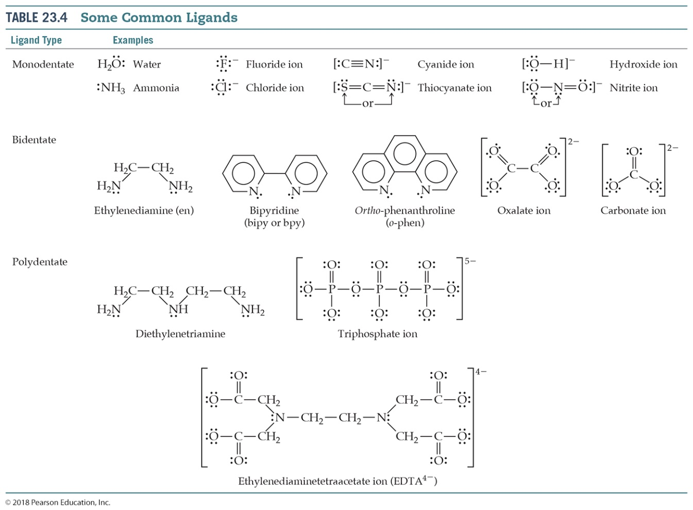
Sample Integrative Exercise Putting Concepts Together
The oxalate ion has the Lewis structure shown in Table 23.4. (a) Show the geometry of the complex formed when this ion complexes with cobalt(II) to form [Co(C₂O₄)(H₂O)₄]. (b) Write the formula for the salt formed when three oxalate ions complex with Co(II), assuming that the charge-balancing cation is Na⁺. (c) Sketch all the possible geometric isomers for the cobalt complex formed in part (b). Are any of these isomers chiral? Explain. (d) The equilibrium constant for the formation
of the cobalt(II) complex produced by
coordination of three oxalate anions,
as in part (b), is 5.0 ✕ 10⁹, and the
equilibrium constant for formation of
the cobalt(II) complex with three
molecules of ortho-phenanthroline
(Table 23.4) is 9 ✕ 10¹⁹. From these
results, what conclusions can you
draw regarding the relative Lewis base
properties of the two ligands toward
cobalt(II)? (e) Using the approach
described in Sample Exercise 17.14,
calculate the concentration of free
aqueous Co(II) ion in a solution initially
containing 0.040 M oxalate (aq) and
0.0010 M Co²⁺(aq).

Slide 21

Sample Integrative Exercise Putting Concepts Together
Continued
Solution
(a) The complex formed by coordination of one oxalate ion is octahedral:
(b) Because the oxalate ion has a charge of 2−, the net charge of a complex with three oxalate anions and one Co²⁺ ion is 4−. Therefore, the coordination compound has the formula:
Na₄[Co(C₂O₄)₃]

Slide 22
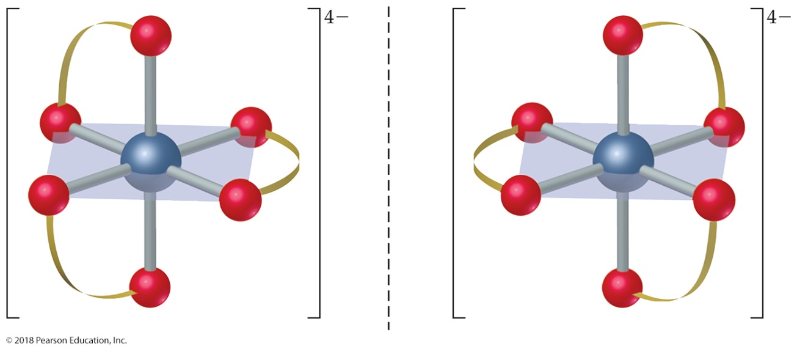

Sample Integrative Exercise Putting Concepts Together
Continued
(c) There is only one geometric isomer. The complex is chiral, however, in the same way the [Co(en)₃]³⁺ complex is chiral (Figure 23.22). The two mirror images are not superimposable, so there are two enantiomers:

Slide 23
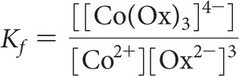
Sample Integrative Exercise Putting Concepts Together
Continued
(d) The ortho-phenanthroline ligand is bidentate, like the oxalate ligand, so they both exhibit the chelate effect. Thus, we conclude that ortho-phenanthroline is a stronger Lewis base toward Co²⁺ than oxalate. This conclusion is consistent with what we learned about bases in Section 16.7, that nitrogen bases are generally stronger than oxygen bases. (Recall, for example, that NH₃ is a stronger base than H₂O.)
(e) The equilibrium we must consider involves 3 mol of oxalate ion (represented as Ox²⁻).
Co²⁺(aq) + 3 Ox²⁻(aq) [Co(Ox)₃]⁴⁻(aq)
The formation-constant expression is:
Because K_{f} is so large, we can assume that essentially all the Co²⁺ is converted to the oxalato complex. Under
that assumption, the final concentration of [Co(Ox)₃]⁴⁻ is 0.0010 M and that of oxalate ion is [Ox²⁻] = (0.040) − 3(0.0010) = 0.037 M (three Ox²⁻ ions react with each Co²⁺ ion). We then have:

Slide 24

Sample Integrative Exercise Putting Concepts Together
Continued
Inserting these values into the equilibrium-constant expression, and solving for x, we obtain 4 ✕ 10⁻⁹ M. From this, we see that the oxalate has complexed all but a tiny fraction of the Co²⁺ in solution.
x = 4 ✕ 10⁻⁹ M

