Slide 1
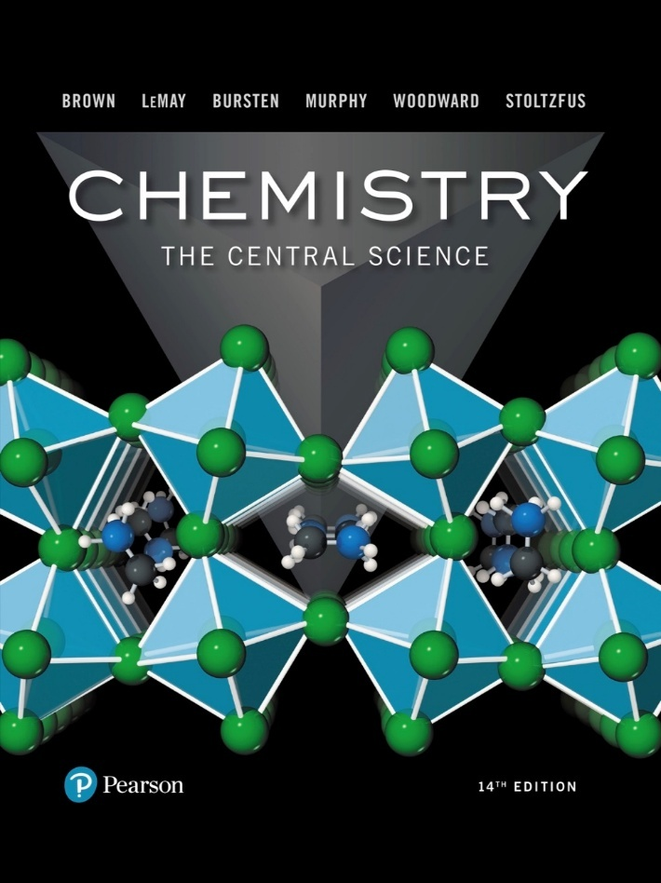
Chemistry: The Central Science
Fourteenth Edition
Chapter 21
Nuclear Chemistry
Copyright © 2018, 2015, 2012 Pearson Education, Inc. All Rights Reserved
Notes:
If this PowerPoint presentation contains mathematical equations, you may need to check that your computer has the following installed:
1) MathType Plugin
2) Math Player (free versions available)
3) NVDA Reader (free versions available)

Slide 2
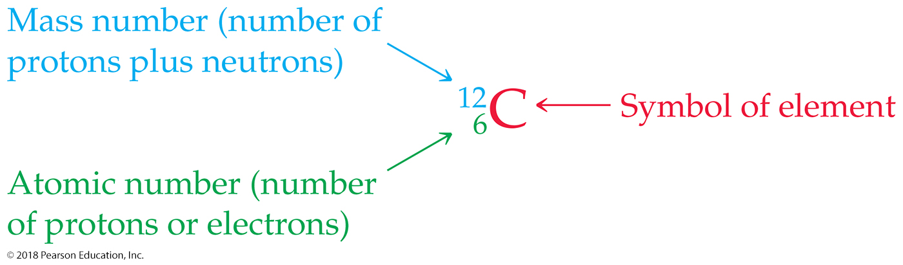
The Nucleus
Remember that the nucleus is composed of the two nucleons, protons and neutrons.
The number of protons is the atomic number.
The number of protons and neutrons together is the mass number.

Slide 3
Isotopes
Not all atoms of the same element have the same mass, due to different numbers of neutrons in those atoms.
There are, for example, three naturally occurring isotopes of uranium:
  Uranium-234
  Uranium-235
  Uranium-238

Slide 4
Radioactivity
Some nuclei change spontaneously, emitting radiation. They are said to be radioactive.
We refer to these as radionuclides.
There are several ways radionuclides can decay into a different nuclide.
We use nuclear equations to show how these nuclear reactions occur.

Slide 5
Nuclear Equations
In chemical equations, atoms and charges need to balance.
In nuclear equations, atomic number and mass number need to balance. This is a way of balancing charge (atomic number) and mass (mass number) on an atomic scale.

Slide 6
Most Common Kinds of Radiation Emitted by a Radionuclide
Table 21.1 Properties of Alpha, Beta, and Gamma Radiation
Type of Radiation
Property | Alpha | Beta | Gamma
Charge | 2+ | 1− | 0
Mass | 6.64 times 10 to the negative twenty-fourth grams | 9.11 times 10 to the negative twenty-eighth grams | 0
Relative penetrating power | 1 | 100 | 10,000
Nature of radiation | super 4 sub 2, H e nuclei | Electrons | High-energy photons

Slide 7
Types of Radioactive Decay (1 of 2)
Alpha decay
Beta decay
Gamma emission
Positron emission
Electron capture

Slide 8
Types of Radioactive Decay (2 of 2)
Table 21.3 Types of Radioactive Decay
Type | Nuclear Equation | Change in Atomic Number | Change in Mass Number
Alpha emission | super Ay sub z, X yields super Ay minus 4 sub Z minus 2, Y plus super 4 sub 2, H e | −2 | −4
Beta emission | super Ay sub Z, X yields super Ay sub Z plus 1, y plus super 0 sub negative 1, e | +1 | Unchanged
Positron emission | , super Ay sub Z, X yields super Ay sub Z minus 1, Y plus super 0 sub positive 1, e | −1 | Unchanged
Electron capture* | super Ay sub Z, X yields super 0 sub negative 1, e yields super Ay sub Z minus 1, Y | −1 | Unchanged
*The electron captured comes from the electron cloud surrounding the nucleus.

Slide 9
Alpha Decay
Alpha decay is the loss of an α-particle (H e-4 nucleus, two protons and two neutrons):
Note how the equation balances:
atomic number: 92 = 90 + 2
mass number: 238 = 234 + 4

Slide 10
Beta Decay
Beta decay is the loss of a β-particle (a high-speed electron emitted by the nucleus):
Balancing: atomic number: 53 = 54 + (–1)
mass number: 131 = 131 + 0

Slide 11
Gamma Emission
Gamma emission is the loss of a γ-ray, which is high-energy radiation that almost always accompanies the loss of a nuclear particle:

Slide 12
Positron Emission
Some nuclei decay by emitting a positron, a particle that has the same mass as, but an opposite charge to, that of an electron:
Balancing: atomic number: 6 = 5 + 1
mass number: 11 = 11 + 0

Slide 13
Electron Capture
An electron from the surrounding electron cloud is absorbed into the nucleus during electron capture.
Balancing: atomic number: 37 + (−1) = 36
mass number: 81 + 0 = 81

Slide 14
Sources of Some Nuclear Particles (1 of 2)
Beta particles:
Positrons:
What happens with electron capture?

Slide 15
Sources of Some Nuclear Particles (2 of 2)
Table 21.2 Particles Found in Nuclear Reactions
Particle | Symbol
Neutron | super 1 sub 0, n or n
Proton | super 1 sub 1, H or p
Electron | super 0 sub negative 1, e
Alpha particle | super 4 sub 2, H e or alpha
Beta particle | super 0 sub negative 1, e or beta, minus
Positron | super 0 sub positive 1, e or beta, plus

Slide 16
Nuclear Stability
Any atom with more than one proton (anything but H) will have repulsions between the protons in the nucleus.
Strong nuclear force helps keep the nucleus together.
Neutrons play a key role stabilizing the nucleus, so the ratio of neutrons to protons is an important factor.

Slide 17
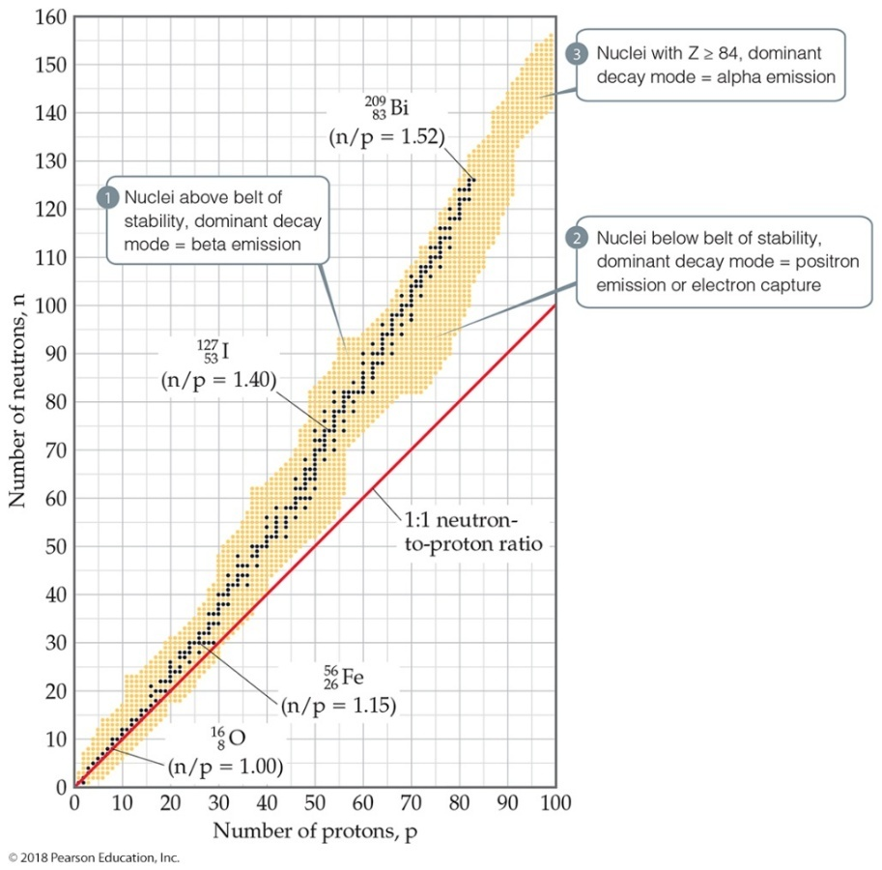
Neutron–Proton Ratios
For smaller nuclei
stable nuclei have a neutron-to-proton ratio close to 1:1.
As nuclei get larger, it takes a larger number of neutrons to stabilize the nucleus.
  The shaded region in the figure is called the belt of stability; it shows what nuclides would be stable.

Slide 18
Unstable Nuclei (1 of 2)
Compare a nucleus to the “belt of stability.”
Nuclei above have too many neutrons; they tend to decay by emitting beta particles.
Nuclei below have too many protons; they tend to become more stable by positron emission or electron capture.

Slide 19
Unstable Nuclei (2 of 2)
Nuclei with large atomic numbers
tend to decay by
alpha emission.

Slide 20
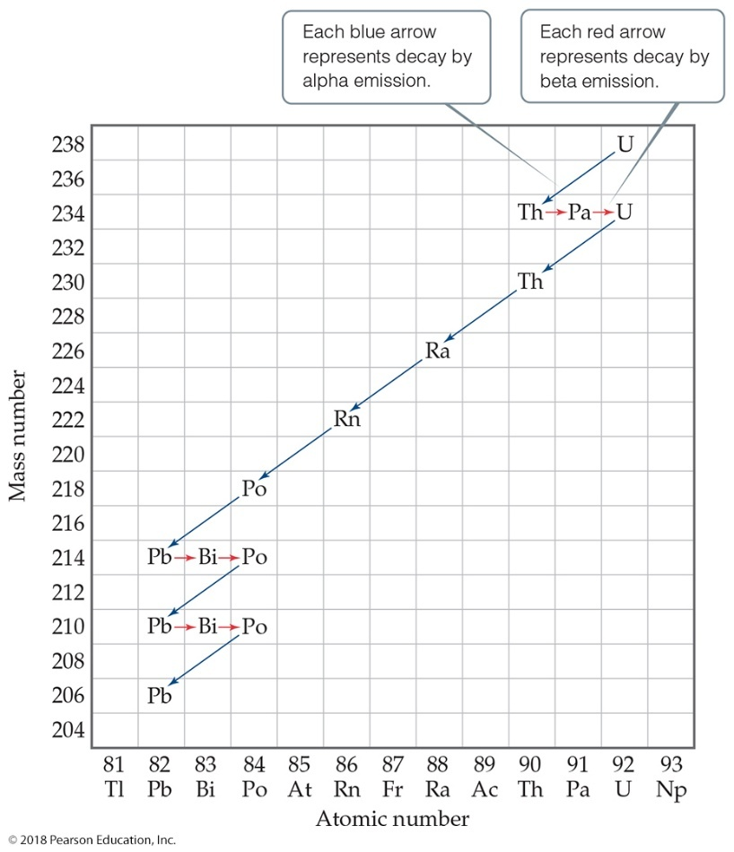
Radioactive Decay Chain
Some radioactive nuclei cannot stabilize by undergoing only one nuclear transformation.
They undergo a series of decays until they form a stable nuclide (often a nuclide of lead).

Slide 21
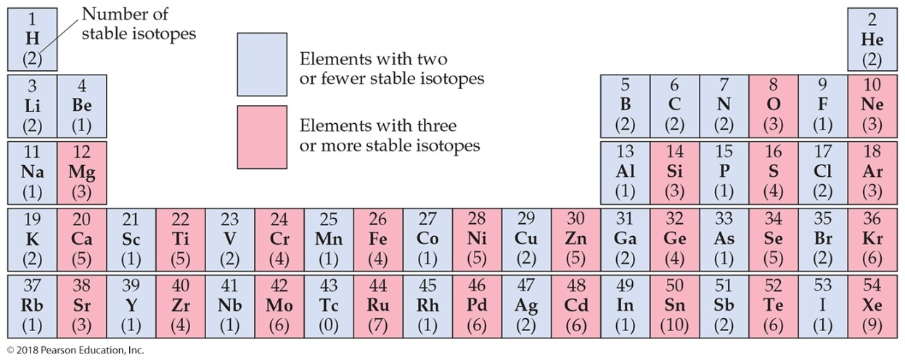
Stable Nuclei (1 of 2)
Magic numbers of 2, 8, 20, 28, 50, or 82 protons or 2, 8, 20, 28, 50, 82, or 126 neutrons result in more stable nuclides.
Nuclei with an even number of protons and neutrons tend to be more stable than those with odd numbers.

Slide 22
Stable Nuclei (2 of 2)
Table 21.4 Number of Stable Isotopes with Even and Odd Numbers of Protons and Neutrons
Number of Stable Isotopes | Proton Number | Neutron Number
157 | Even | Even
53 | Even | Odd
50 | Odd | Even
5 | Odd | Odd

Slide 23
Nuclear Transmutations (1 of 2)
  Nuclear transmutations can be induced by causing a particle to collide with a nucleus.
  Particle accelerators (“atom smashers”) are enormous, using strong magnetic and electric fields to make the particles move so fast.
  A linear accelerator has tubes of variable lengths and charges to make the particle move faster.

Slide 24
Nuclear Transmutations (2 of 2)
  A cyclotron uses D-shaped magnets to keep particles moving in a spiral.
  A synchrotron accelerates particles in a path, which is circular.

Slide 25
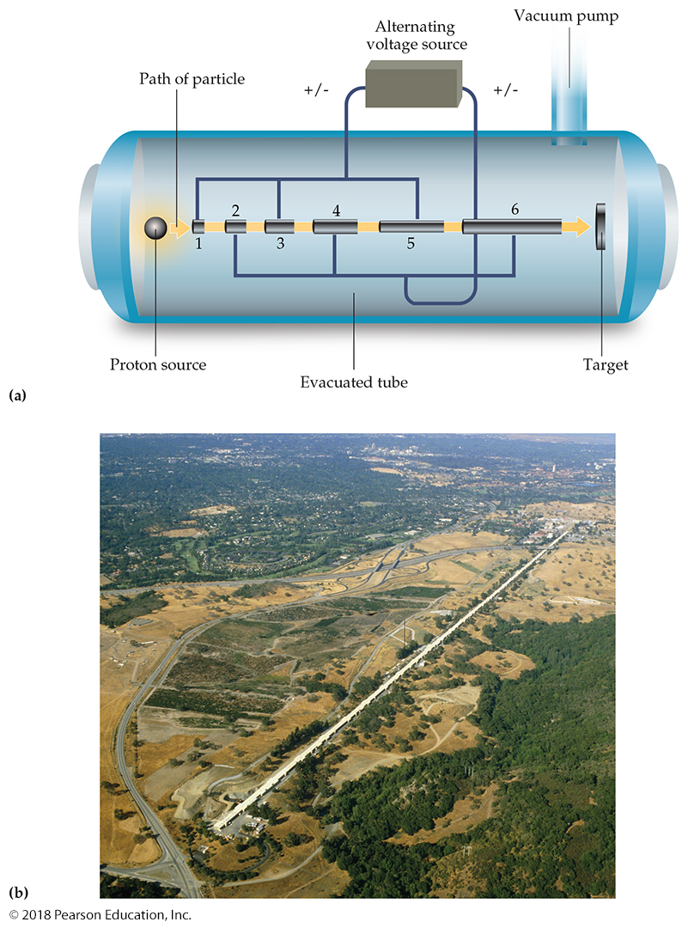
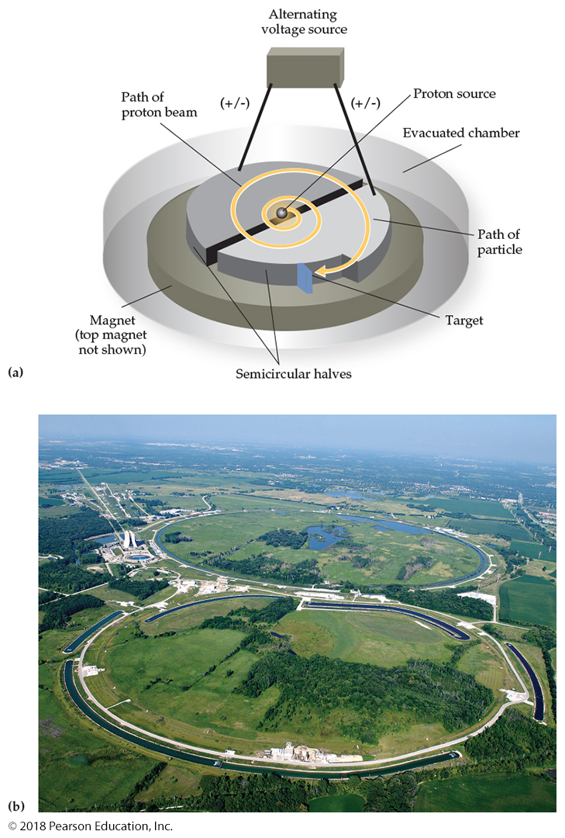
Particle Accelerators

Slide 26
Other Nuclear Transmutations
Use of neutrons:
Most synthetic isotopes used in medicine are prepared by bombarding neutrons at a particle, which won’t repel the neutral particle.
Transuranium elements:
Elements immediately after uranium were discovered by bombarding isotopes with neutrons.
Larger elements (atomic number higher than 110) were made by colliding large atoms with nuclei of light elements with high energy.

Slide 27
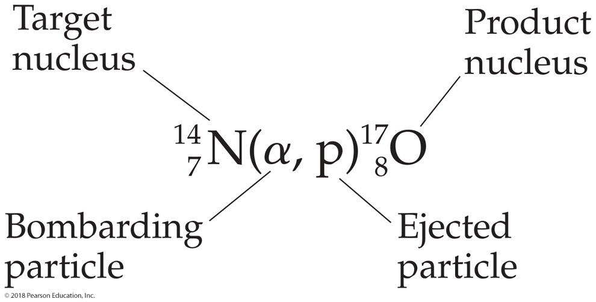
Writing Nuclear Equations for Nuclear Transmutations
Nuclear equations that represent nuclear transmutations are written two ways:
or

Slide 28
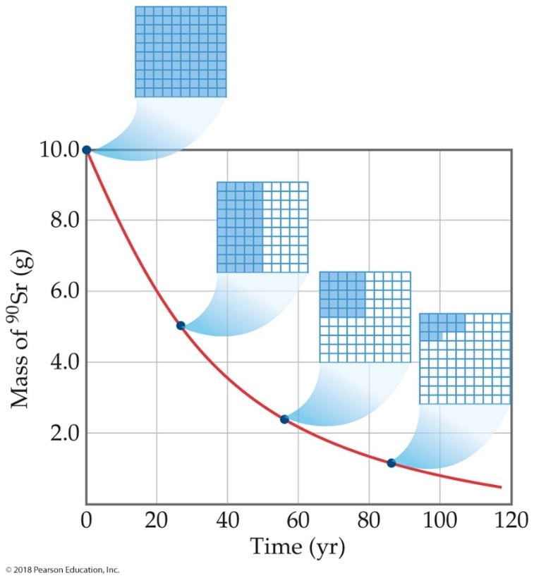
Kinetics of Radioactive Decay
Radioactive decay is a first-order process.
The kinetics of such a process obey this equation:

Slide 29
Half-Life (1 of 2)
The half-life of such a process is
Half-life is the time required for half of a radionuclide sample to decay.

Slide 30
Half-Life (2 of 2)
Table 21.5 The Half-Lives and Type of Decay for Several Radioisotopes
Blank | Isotope | Half-Life (yr) | Type of Decay
Natural radioisotopes | 238 sub 92, U | 4.5 times 10 to the ninth | Alpha
Blank | super 235 sub 92, U | 7.0 times 10 to the eighth | Alpha
Blank | super 232 sub 90, T h | 1.4 times 10 to the tenth | Alpha
Blank | super 40 sub 19, K | 1.3 times 10 to the ninth | Beta
Blank | super 14 sub 6 | 5700 | Beta
Synthetic radioisotopes | super 239 sub 94, P u | 24,000 | Alpha
Blank | super 137 sub 55, C s | 30.2 | Beta
Blank | super 90 sub 38, S r | 28.8 | Beta
Blank | super 131 sub 53, I | 0.022 | Beta

Slide 31
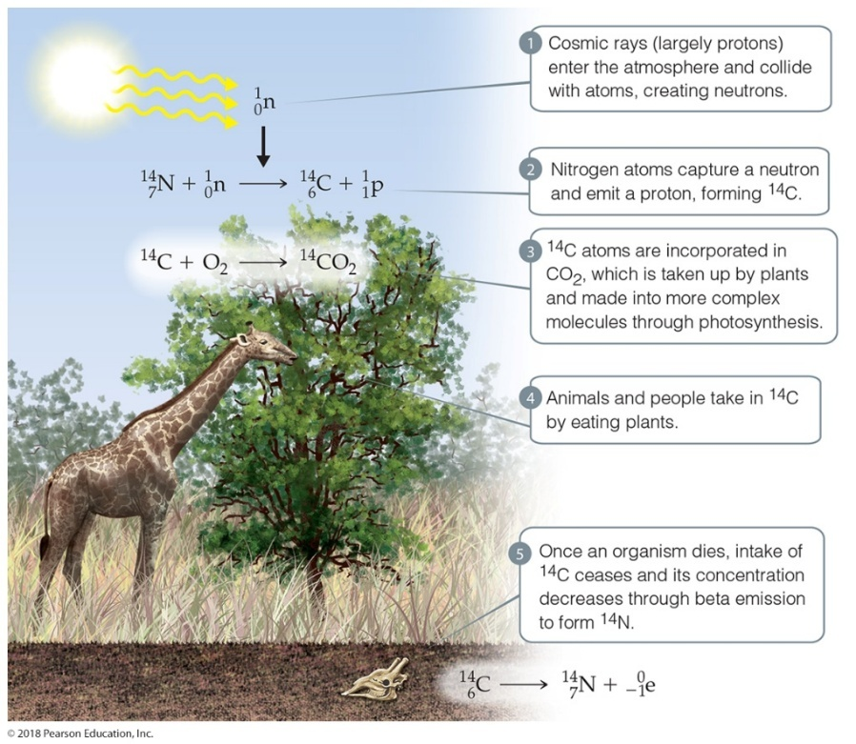
Radiometric Dating
First-order kinetics and half-life information let us date objects using a “nuclear clock.”
Carbon dating: The half-life of C-14 is 5700 years. It is limited to objects up to about 50,000 years old; after this time there is too little radioactivity to measure.
Other isotopes can be used (U-238:Pb-206 in rock).

Slide 32
Measuring Radioactivity: Units
Activity is the rate at which a sample decays.
The units used to measure activity are as follows:
Becquerel (B q): one disintegration per second
Curie (C i):
disintegrations per second,
which is the rate of decay of 1 g of radium

Slide 33
Measuring Radioactivity: Some Instruments
Film badges
Geiger counter
Phosphors (scintillation counters)

Slide 34
Film Badges (1 of 2)
Radioactivity was first discovered by Henri Becquerel because it fogged up a photographic plate.
Film has been used to detect radioactivity since more exposure to radioactivity means darker spots on the developed film.
Film badges are used by people who work with radioactivity to measure their own exposure over time.

Slide 35
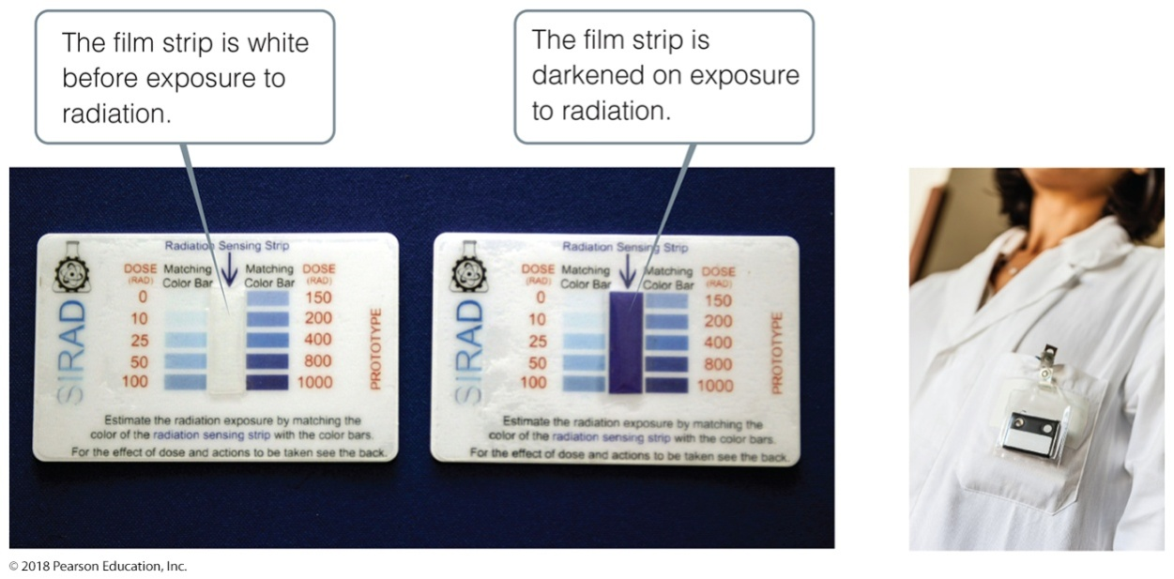
Film Badges (2 of 2)

Slide 36
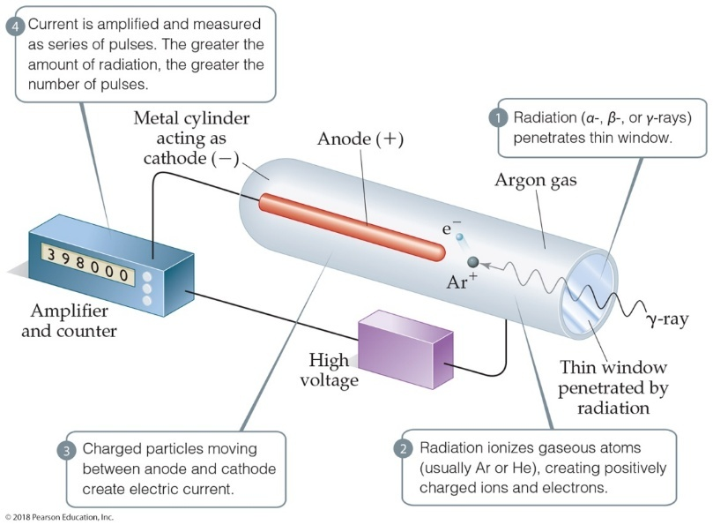
Geiger Counter
A Geiger counter measures the amount of activity present in a radioactive sample.
Radioactivity enters a window and creates ions in a gas; the ions result in an electric current that is measured and recorded by the instrument.

Slide 37
Phosphors
Some substances absorb radioactivity and emit light. They are called phosphors.
An instrument commonly used to measure the amount of light emitted by a phosphor is a scintillation counter. It converts the light to an electronic response for measurement.

Slide 38
Radiotracers
Radiotracers are radioisotopes used to study a chemical reaction.
An element can be followed through a reaction to determine its path and better understand the mechanism of a chemical reaction.
Radionuclides react chemically exactly the same as nonradioactive nuclei of the same element.

Slide 39
Medical Application of Radiotracers (1 of 2)
Radiotracers have found wide diagnostic use in medicine.
Radioisotopes are administered to a patient (usually intravenously) and followed. Certain elements collect more in certain tissues, so an organ or tissue type can be studied based on where the radioactivity collects.

Slide 40
Medical Application of Radiotracers (2 of 2)
Table 21.6 Some Radionuclides Used as Radiotracers
Nuclide | Half-Life | Area of the Body Studied
Iodine-131 | 8.04 days | Thyroid
Iron-59 | 44.5 days | Red blood cells
Phosphorus-32 | 14.3 days | Eyes, liver, tumors
Technetium-99ª | 6.0 hours | Heart, bones, liver, and lungs
Thallium-201 | 73 hours | Heart, arteries
Sodium-24 | 14.8 hours | Circulatory system
ªThe isotope of technetium is actually a special isotope of T c-99 called T c-99m, where the m indicates a so-called metastable isotope.

Slide 41
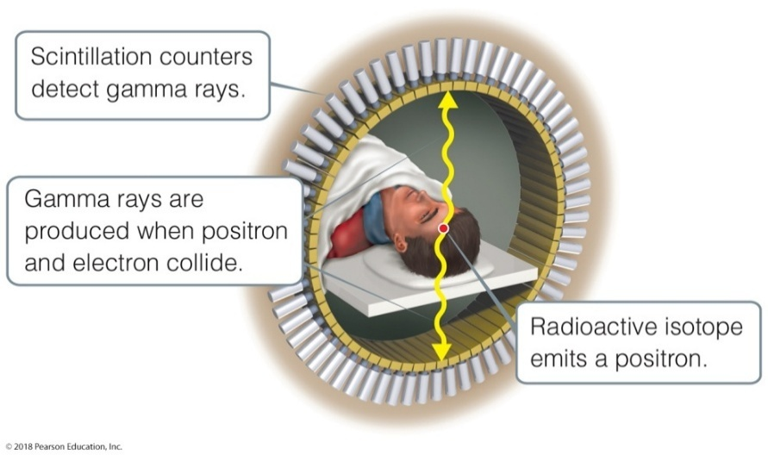
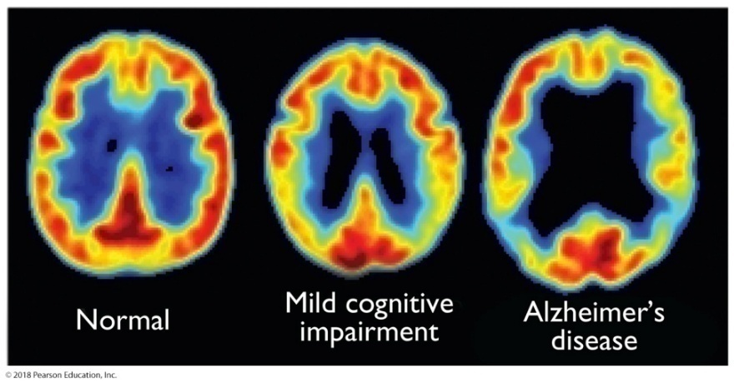
Positron Emission Tomography (P E T Scan)
A compound labeled with a positron emitter is injected into a patient.
Blood flow, oxygen and glucose metabolism, and other biological functions can be studied.
Labeled glucose is used to study the brain, as seen in the figure to the right.

Slide 42
Energy in Nuclear Reactions (1 of 2)
There is a tremendous amount of energy stored in nuclei.
Einstein’s famous equation,
relates directly
to the calculation of this energy.

Slide 43
Energy in Nuclear Reactions (2 of 2)
To show the enormous difference in energy for nuclear reactions, the mass change associated with the α-decay of 1 mol of U-238 to Th-234 is −0.0046 g.
The change in energy, ΔE, is then
(Note: the negative sign means heat is released.)

Slide 44
Mass Defect (1 of 2)
Where does this energy come from?
The masses of nuclei are always less than those of the individual parts.
This mass difference is called the mass defect.
The energy needed to separate a nucleus into its nucleons is called the nuclear binding energy.

Slide 45
Mass Defect (2 of 2)
Table 21.7 Mass Defects and Binding Energies for Three Nuclei
Nucleus | Mass of Nucleus (a m u) | Mass of Individual Nucleons (a m u) | Mass Defect (a m u) | Binding Energy (J) | Binding Energy per Nucleon (J)
super 4 sub 2, H e | 4.00150 | 4.03188 | 0.03038 | 4.53 times 10 to the negative twelfth | 1.13 times 10 to the negative twelfth
super 56 sub 26, F e | 55.92068 | 56.44914 | 0.52846 | 7.90 times 10 to the negative eleventh | 1.41 times 10 to the negative twelfth
238 sub 92, U | 238.00031 | 239.93451 | 1.93420 | 2.89 times 10 to the negative tenth | 1.21 times 10 to the negative twelfth

Slide 46
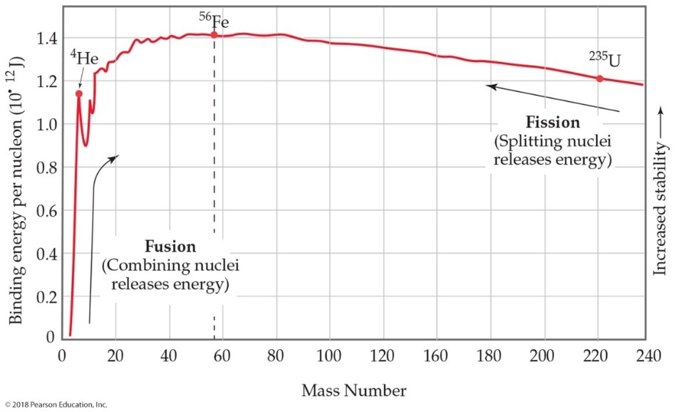
Effects of Nuclear Binding Energy on Nuclear Processes
Dividing the binding energy by the number of nucleons gives a value that can be compared.
Heavy nuclei gain stability and give off energy when they split into two smaller nuclei. This is fission.
Lighter nuclei emit great amounts of energy by being combined in fusion.

Slide 47
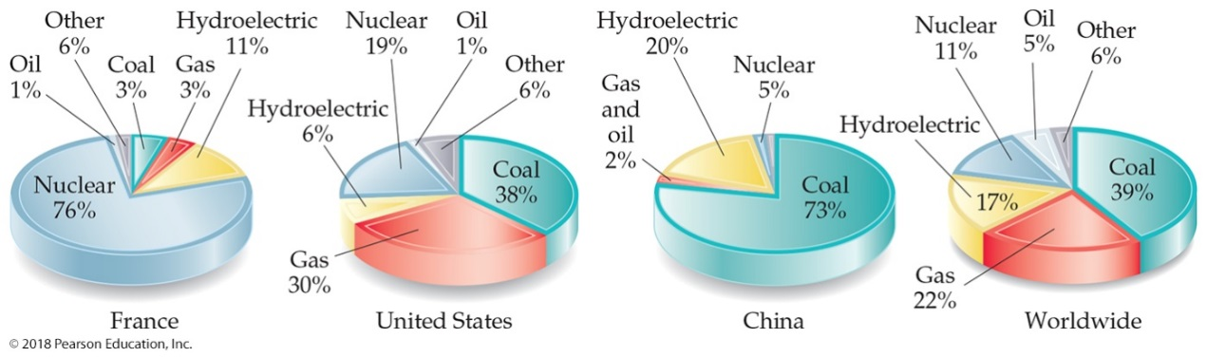
Energy: Chemical vs. Nuclear
Chemical energy is associated with making and breaking chemical bonds.
Nuclear energy is enormous in comparison.
Nuclear energy is due to changes in the nucleus of atoms changing them into different atoms.
13% of worldwide energy comes from nuclear energy.

Slide 48
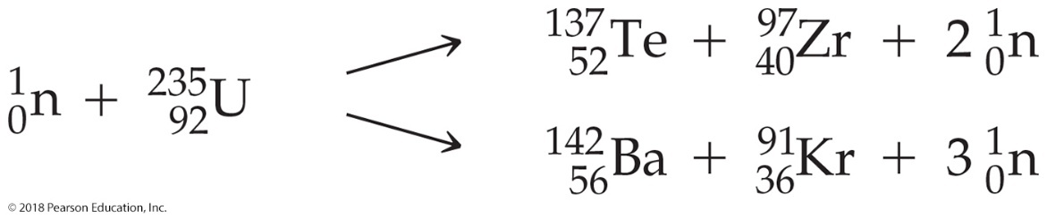
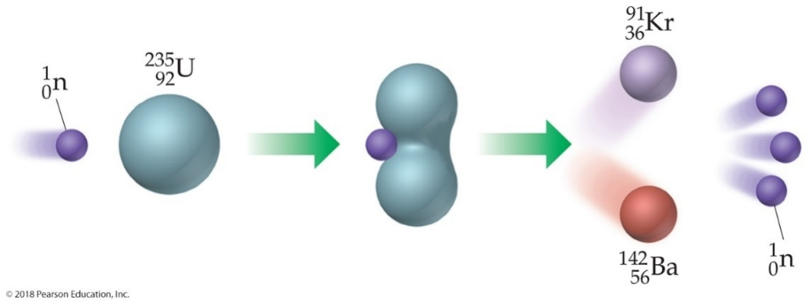
Nuclear Fission (1 of 4)
Commercial nuclear power plants use fission.
Heavy nuclei can split in many ways. The equations below show two ways U-235 can split after bombardment with a neutron.

Slide 49
Nuclear Fission (2 of 4)
Bombardment of the radioactive nuclide with a neutron starts the process.
Neutrons released in the transmutation strike other nuclei, causing their decay and the production of more neutrons.
This process continues in what we call a chain reaction.

Slide 50
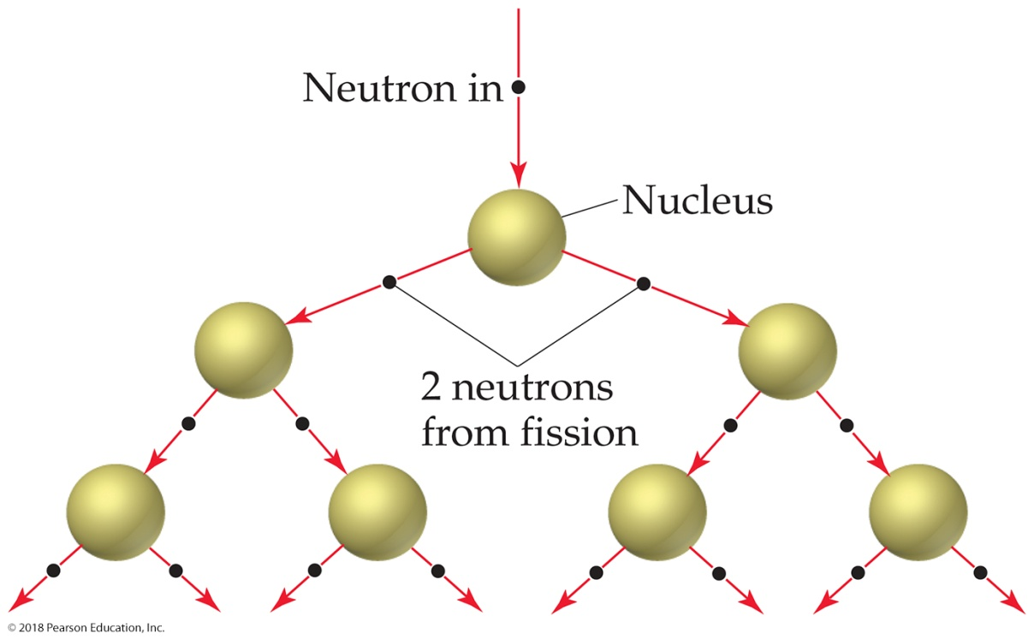
Nuclear Fission (3 of 4)

Slide 51
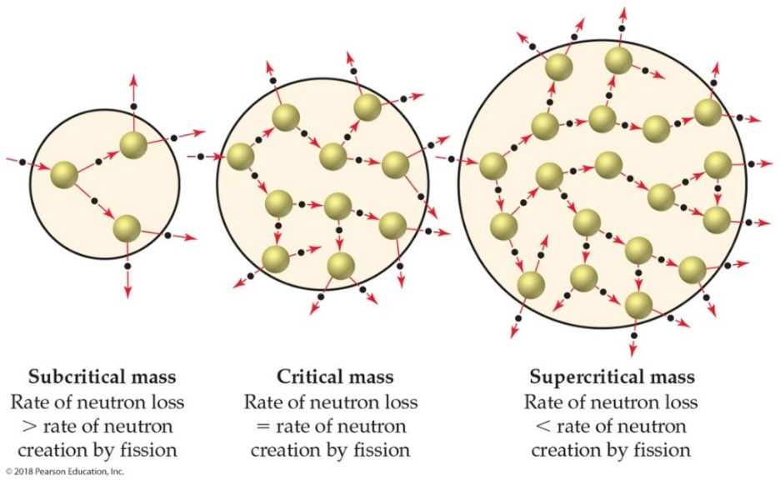
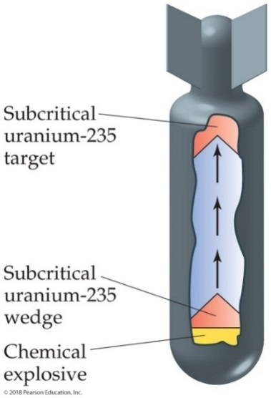
Nuclear Fission (4 of 4)
The minimum mass that must be present for a chain reaction to be sustained is called the critical mass.
If more than critical mass is present (supercritical mass), an explosion will occur. Weapons were created by causing smaller amounts to be forced together to create this mass.

Slide 52
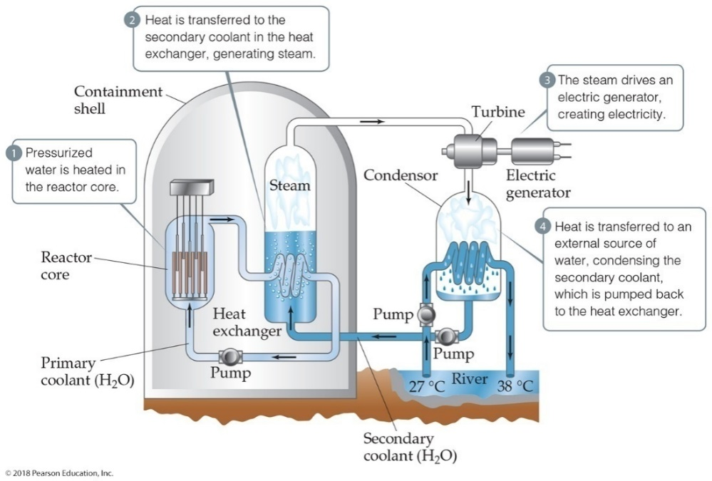
Nuclear Reactors (1 of 2)
In nuclear reactors, the heat generated by the reaction is used to produce steam that turns a turbine connected to a generator. Otherwise, the plant is basically the same as any power plant.

Slide 53
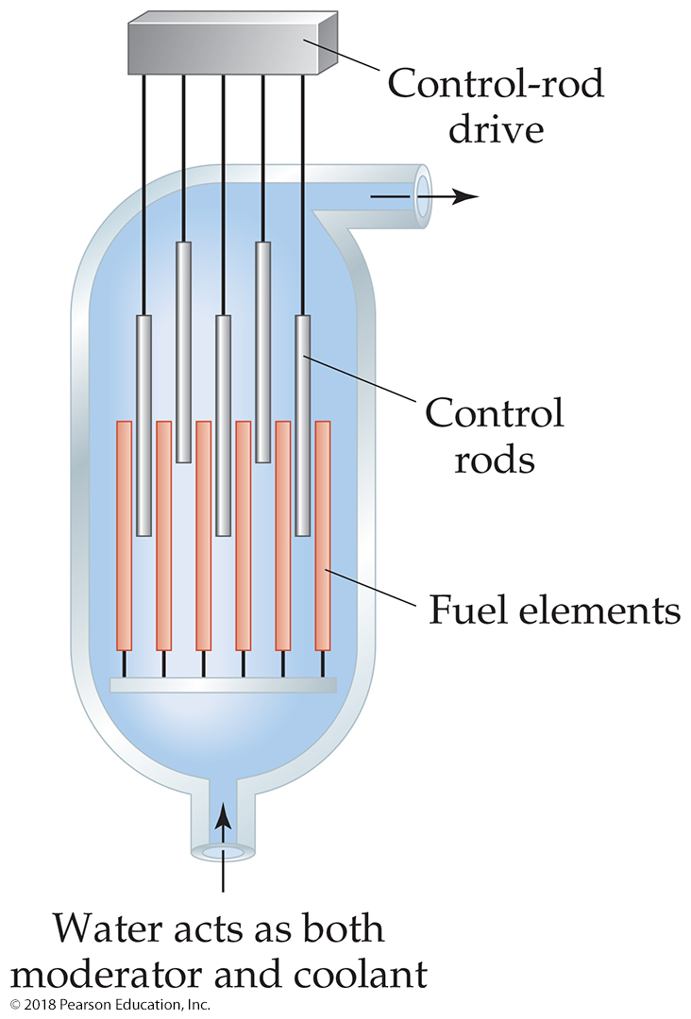
Nuclear Reactors (2 of 2)
The reactor core consists of fuel rods, control rods, moderators, and coolant.
The control rods block the paths of some neutrons, keeping the system from reaching a dangerous supercritical mass.

Slide 54
Nuclear Waste
Reactors must be stopped periodically to replace or reprocess the nuclear fuel.
They are stored in pools at the reactor site.
The original intent was that this waste would then be transported to reprocessing or storage sites.
Political opposition to storage site location and safety challenges for reprocessing have led this to be a major social problem.

Slide 55
Nuclear Fusion (1 of 2)
When small atoms are combined, much energy is released. This occurs on the Sun. The reactions are often called thermonuclear reactions.
If it were possible to easily produce energy by this method, it would be a preferred source of energy.
However, extremely high temperatures and pressures are needed to cause nuclei to fuse.

Slide 56
Nuclear Fusion (2 of 2)
This was achieved using an atomic bomb to initiate fusion in a hydrogen bomb. Obviously, this is not an acceptable approach to producing energy.

Slide 57
Radiation in the Environment
We are constantly exposed to radiation.
Ionizing radiation is more harmful to living systems than nonionizing radiation, such as radiofrequency electromagnetic radiation.
Since most living tissue is ~70% water, ionizing radiation is that which causes water to ionize.
This creates unstable, very reactive O H radicals, which result in much cell damage.

Slide 58
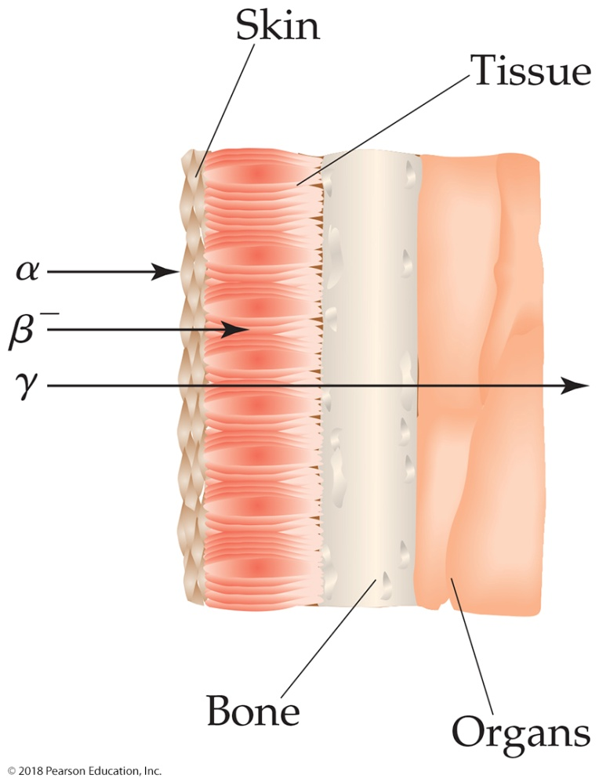
Damage to Cells
The damage to cells depends on the type of radioactivity, the length of exposure, and whether the source is inside or outside the body.
Outside the body, gamma rays are most dangerous.
Inside the body, alpha radiation can cause most harm.

Slide 59
Exposure (1 of 2)
We are constantly exposed to radiation. What amount is safe?
Setting standards for safety is difficult.
Low-level, long-term exposure can cause health issues.
Damage to the growth-regulation mechanism of cells results in cancer.

Slide 60
Exposure (2 of 2)
Table 21.8 Average Abundances and Activities of Natural Radionuclides†
Blank | Potassium-40 | Rubidium-87 | Thorium-232 | Utanium-238
Land elemental abundance (ppm) | 28,000 | 112 | 10.7 | 2.8
Land activity (Bq/kg) | 870 | 102 | 43 | 35
Ocean elemental concentration (mg/L) | 339 | 0.12 | 1 times 10 to the negative seventh | 0.0032
Ocean activity (Bq/L) | 12 | 0.11 | 4 times 10 to the negative seventh | 0.040
Ocean sediments elemental abundance (ppm) | 17,000 | — | 5.0 | 1.0
Ocean sediments activity (Bq/kg) | 500 | — | 20 | 12
Human body activity (Bq) | 4000 | 600 | 0.08 | 0.4‡
†Data from "Ionizing Radiation Exposure of the Population of the United States," Report 93, 1987, and Report 160, 2009, National Council on Radiation Protection.
‡Includes Iead-210 and polonium-210. daughter nuclei of uranium-238.

Slide 61
Radiation Dose (1 of 2)
Two units are commonly used to measure exposure to radiation:
Gray (G y): absorption of 1 J of energy per kg of tissue
Rad (for radiation absorbed dose): absorption of 0.01 J of energy per kg of tissue (100 rad = 1 G y)
Not all forms of radiation harm tissue equally. A relative biological effectiveness (R B E) is used to show how much biological effect there is.

Slide 62
Radiation Dose (2 of 2)
The effective dose is called the rem (S I unit Sievert; 1 S v = 100 rem).
# of rem = (# of rad) (R B E)

Slide 63
Short-Term Exposure (1 of 2)
600 rem is fatal to most humans.
Average exposure per year is about 360 mrem.
Table 21.9 Effects of Short-Term Exposures to Radiation
Dost (rem) | Effect
0-25 | No detectable clinical effects
25-50 | Slight, temporary decrease In white blood cell counts
100-200 | Nausea; marked decrease in white blood cell counts
500 | Death-of half the exposed population within 30 days

Slide 64
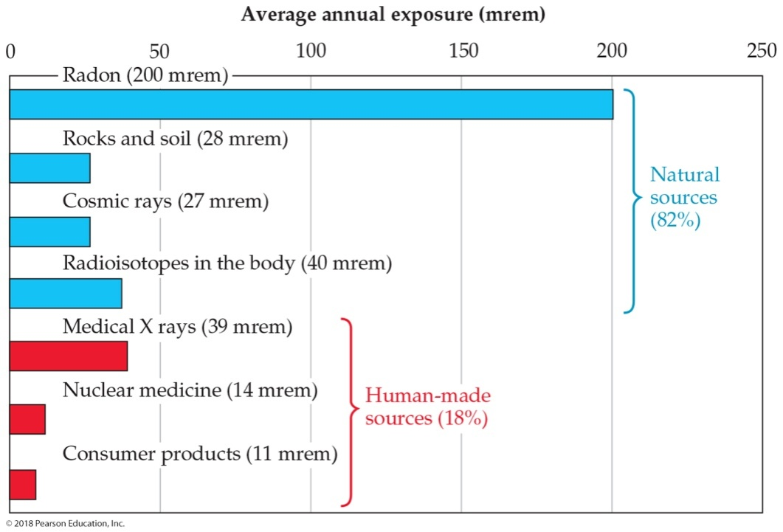
Short-Term Exposure (2 of 2)

Slide 65

Copyright

