Slide 1
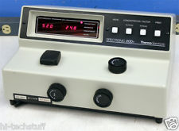
SPECTROSCOPY

Slide 2
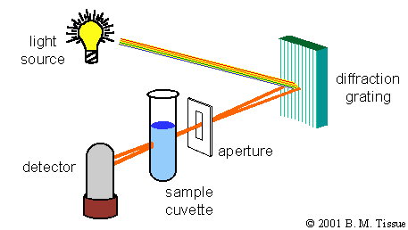
When visible white light strikes a substance, the substance may (1) reflect the light if it is opaque,
(2) transmit the light if it is transparent to the light striking it, or (3) absorb the light.
Substances absorb light by changing their electronic & vibrational quantum states or modes. These modes, which are related to harmonic variations of bond lengths and angles and electronic configurations, have energies on the order of ultraviolet and visible (UV-vis) light.
SPECTROSCOPY is the study of
Light energy interactions with
Matter. To the right is a simple
Spectrophotometer.

Slide 3
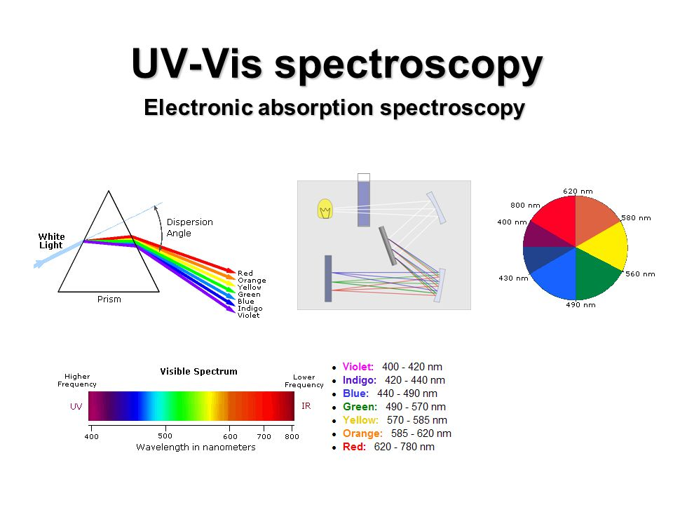

Slide 4
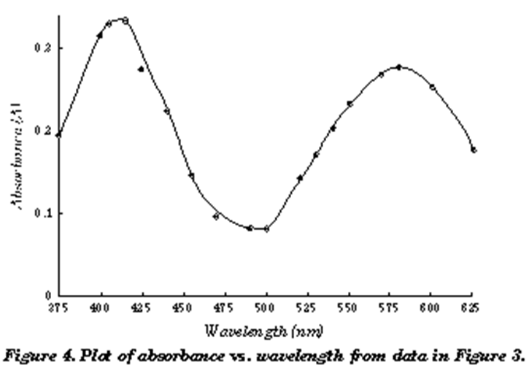
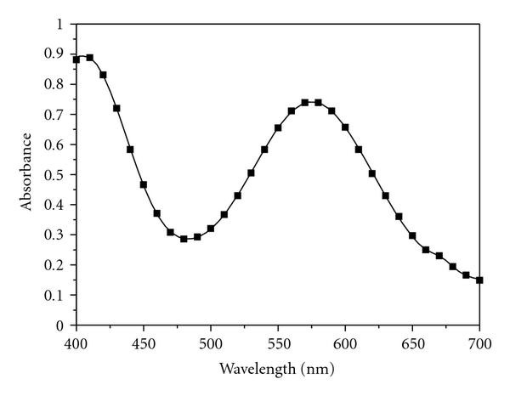
Part one you will create the absorbance spectrum in order to determine the peak wavelength to be used in part two.

Slide 5
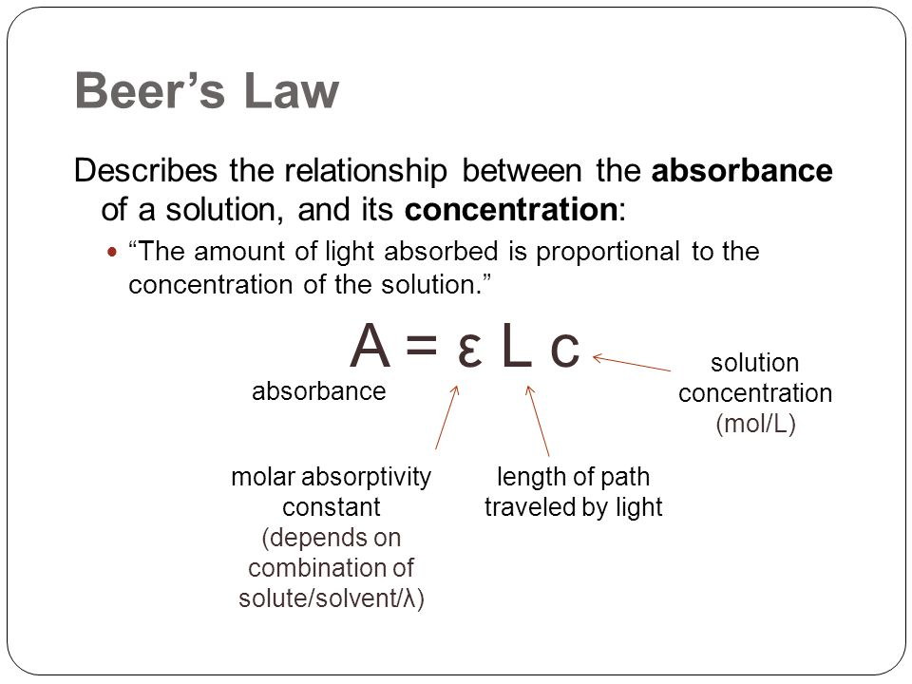
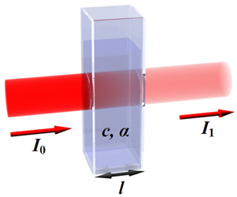

Slide 6


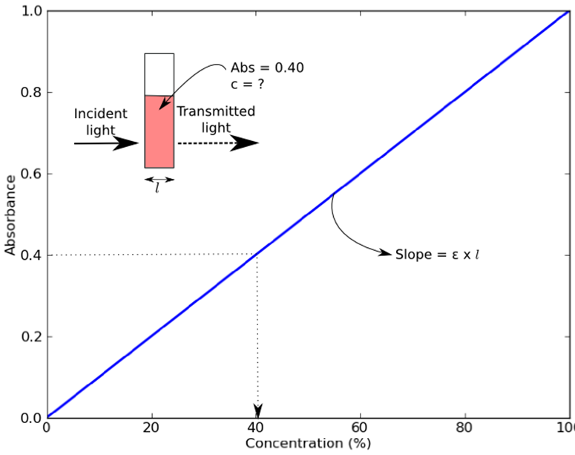
If light is absorbed by the sample, the intensity of the transmitted light exiting the sample (I) will be less than the intensity of the incident light (I_{o}). The ratio of transmitted light intensity to the incident light intensity is the transmittance, T:

Slide 7
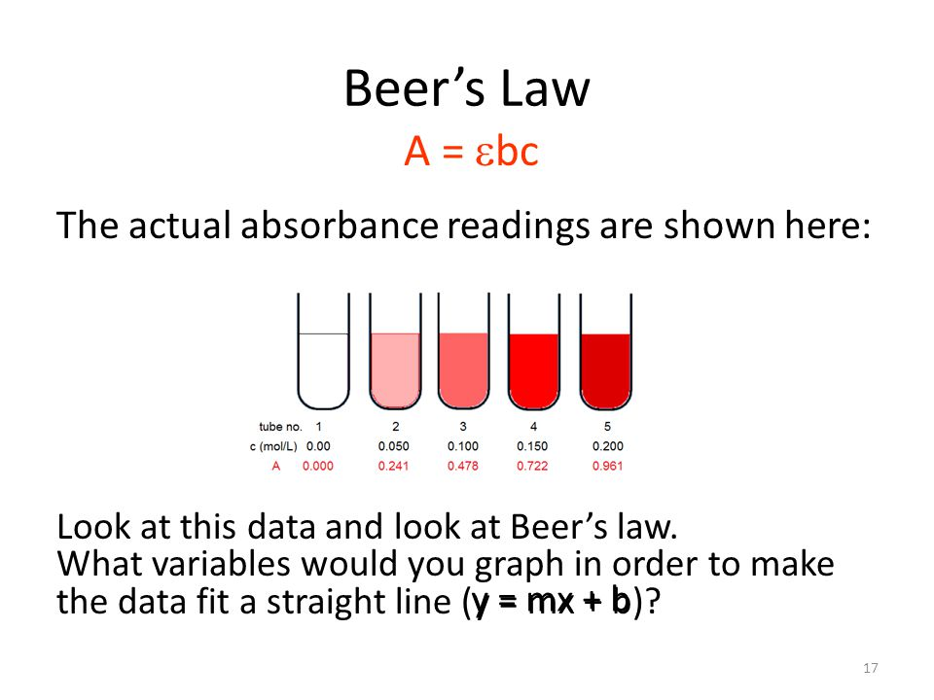

Slide 8
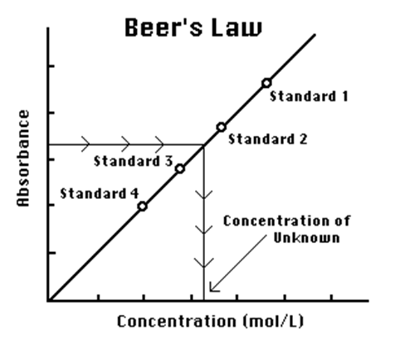
Calibration Curve

Slide 9
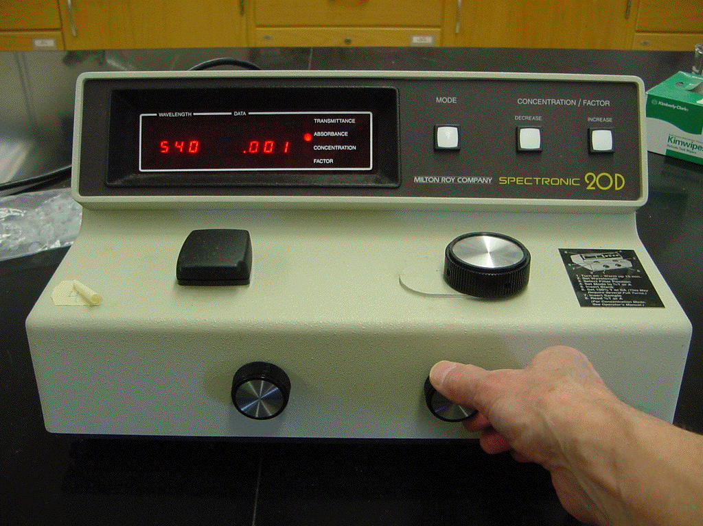

Slide 10
I. How to use the spectrophotometer (Spec 20/20D)
1. Turn on the instrument and let it warm up for at least 5-10 minutes.
2. Select the wavelength with the dial next to the sample compartment.
3. With the sample compartment closed and empty, adjust the % Transmittance (zero percent transmission of light) to read 0% T using the left front dial.
4. Place a clean (no fingerprints), dry cuvette filled approximately 3/4 full of the blank sample (solvent only) in the sample compartment. Close the sample compartment. Adjust the % Transmittance to read 100% T (100 percent transmission of light) using the right front dial.
5. Remove the blank cuvette and place the cuvette containing the sample in the sample compartment. Close the sample compartment. Read and record the value registered on the meter.
Note: Every time the wavelength of light is changed, the instrument must be recalibrated to read 0% T and 100% T with the blank. Repeat steps 2-5.

