Slide 1
Chapter 3 & 4 Brown & Lemay
A pictorial view of chemical reactions and stoichiometry

Slide 2
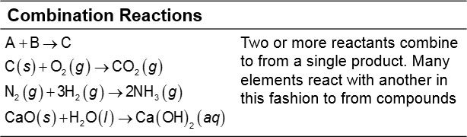
Combination Reactions
In a combination reaction, two or more substances react to form one product.
Table 3.1: Combination and Decomposition Reactions

Slide 3
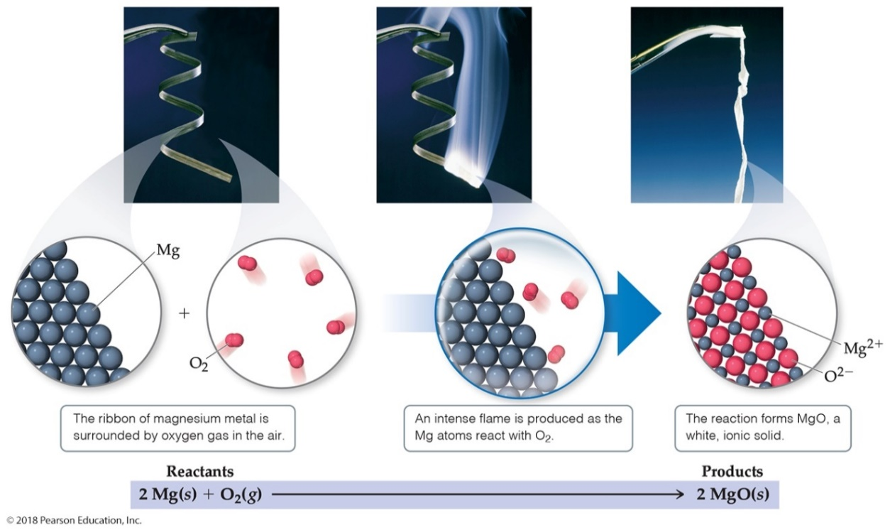
Combination Reaction Predictions: Metal and Nonmetal
You should be able to predict the product of a combination reaction between a metal and a nonmetal, like the one below. (Hint: Remember common charges for Groups!)

Slide 4
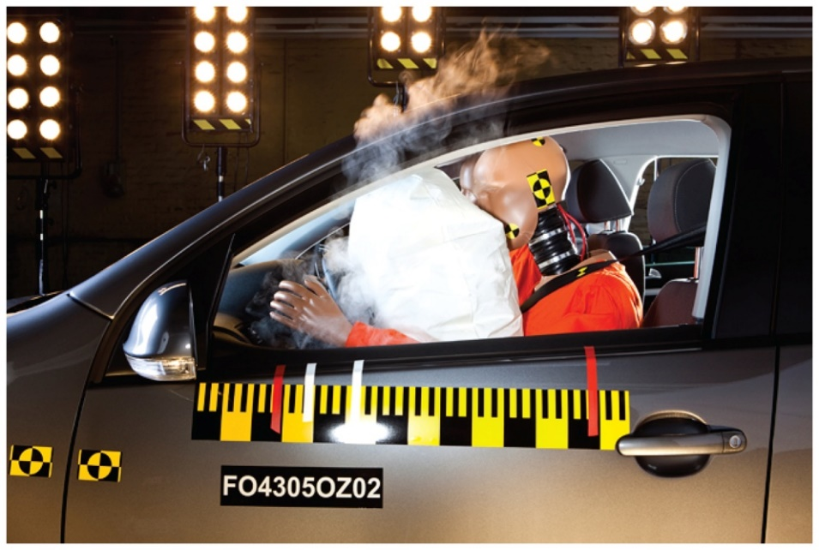
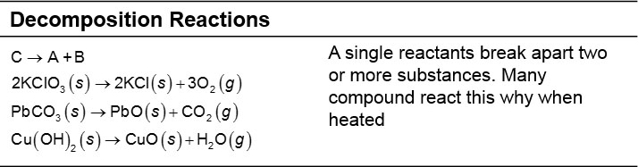
Decomposition Reactions
In a decomposition reaction one substance breaks down into two or more substances.
In the air bag, solid sodium azide releases nitrogen gas quickly.
Table 3.1: Combination and Decomposition Reactions

Slide 5
Decomposition Reaction Predictions: Heating a Metal Carbonate
Metal carbonates decompose when heated to give off carbon dioxide and a metal oxide.
Balancing these equations is based on the charge of the metal.

Slide 6
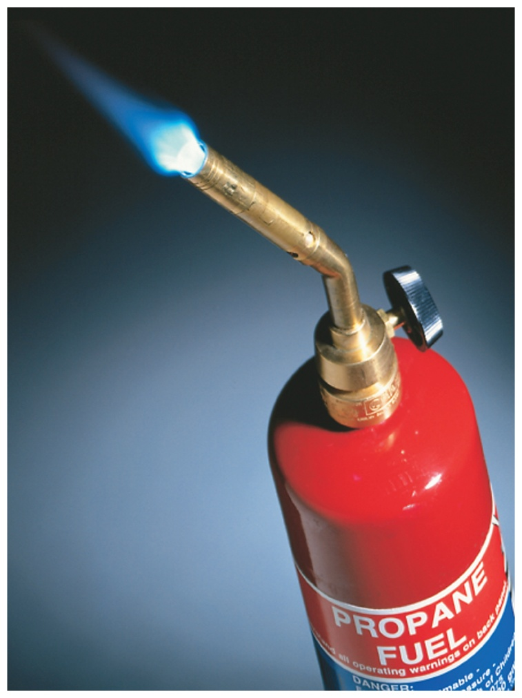
Combustion Reactions
Combustion reactions are rapid reactions that produce a flame.
Combustion reactions most often involve oxygen in the air as a reactant.

Slide 7
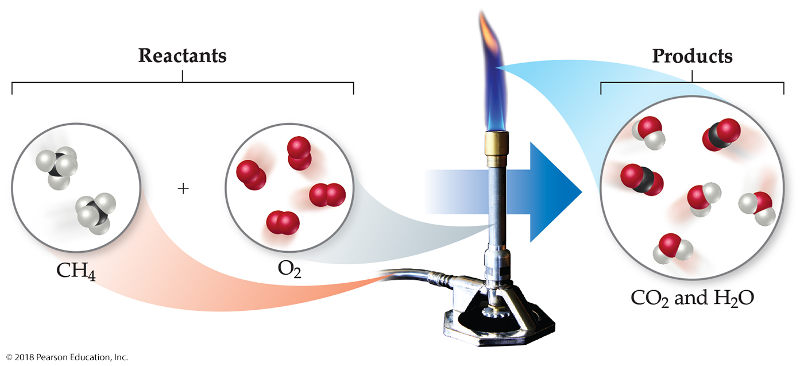
Combustion Reaction Predictions
When burning compounds with C and H in them, the products are C O₂ and H₂O.

Slide 8
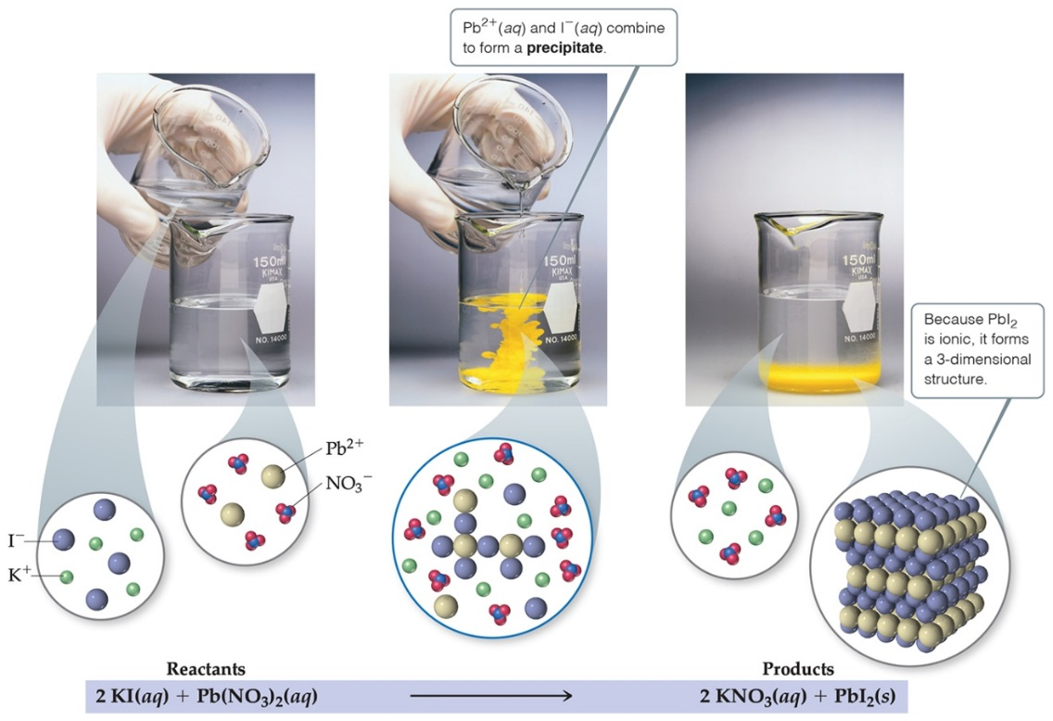
Precipitation Reactions
Precipitation reactions occur when two solutions containing soluble salts are mixed and an insoluble salt is produced. The solid is called a precipitate.

Slide 9
Metathesis (Exchange) Reactions
Metathesis comes from a Greek word that means “to transpose.”
It appears as though the ions in the reactant compounds exchange, or transpose, ions, as seen in the given equation.

Slide 10
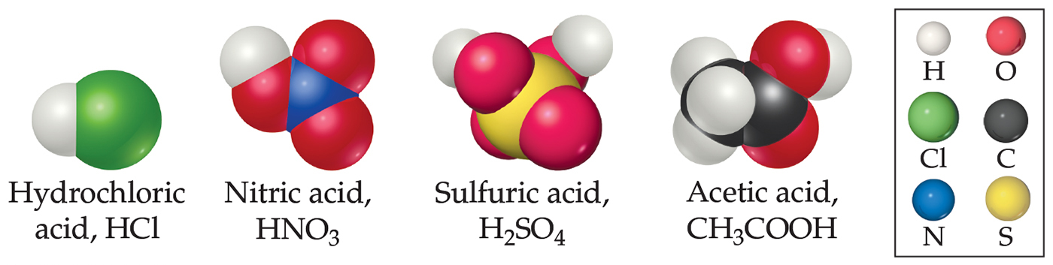
Acids
Acids as substances that ionize in aqueous solution to
form
Because
consists of ONLY a proton, acids are often
called proton donors.

Slide 11
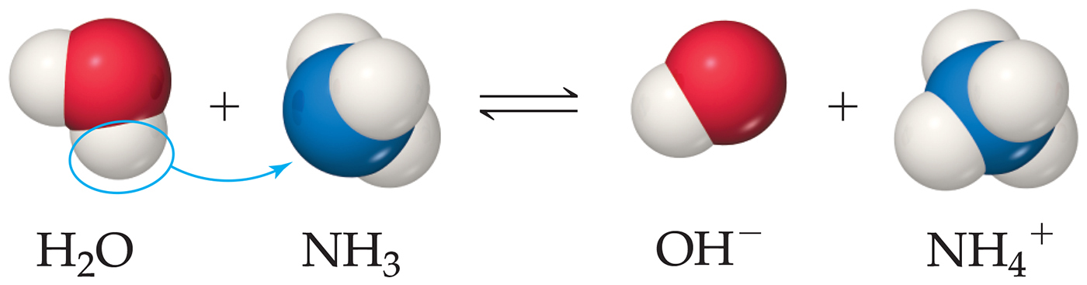
Bases
Bases are substances that react with, or accept,
ions;
they increase the concentration of
when dissolved in
water.
Substances do NOT have to contain
to be a base.

Slide 12
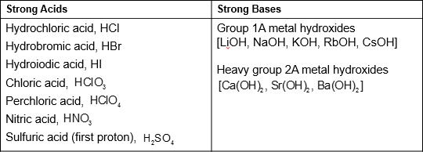
Strong or Weak?
Strong acids completely dissociate in water; weak acids only partially dissociate.
Strong bases dissociate to metal cations and hydroxide anions in water; weak bases only partially react to produce hydroxide anions.
Table 4.2 Common Strong Acids and Bases

Slide 13
Strong or Weak Electrolyte?
Is the substance ionic or molecular? If it is ionic, it is a strong electrolyte. (Solubility?)
Molecular: is it an acid or a base?
If it starts with H or ends in C O O H, it is an acid. If it is NOT on the list of strong acids, it is a weak acid. (Strong acid = strong electrolyte; weak acid = weak electrolyte.)
Strong bases (Table 4.2) are strong electrolytes;
is a weak base (weak
electrolyte).
Table 4.3 Summary of the Electrolytic Behavior of Common Soluble Ionic and Molecular Compounds
BLANK | Strong Electrolyte | Weak Electrolyte | Nonelectrolyte
Ionic | All | None | None
Molecular | Strong acids (see Table 4.2) | Weak acids, weak bases | All other compounds

Slide 14
Neutralization Reactions
Reactions between an acid and a base are called neutralization reactions.
When the base is a metal hydroxide, water and a salt (an ionic compound) are produced.
These equations can be written as molecular, complete ionic, or net ionic equations.

Slide 15
Neutralization Reactions with Gas Formation (1 of 2)
Some metathesis reactions do not give the product expected.
When a carbonate or bicarbonate reacts with an acid, the products are a salt, carbon dioxide, and water.

Slide 16
Neutralization Reactions with Gas Formation (2 of 2)
This reaction gives the predicted product, but you had better carry it out in the hood—the gas produced has the odor of rotten eggs!

Slide 17
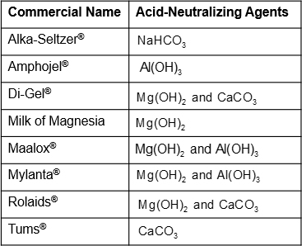
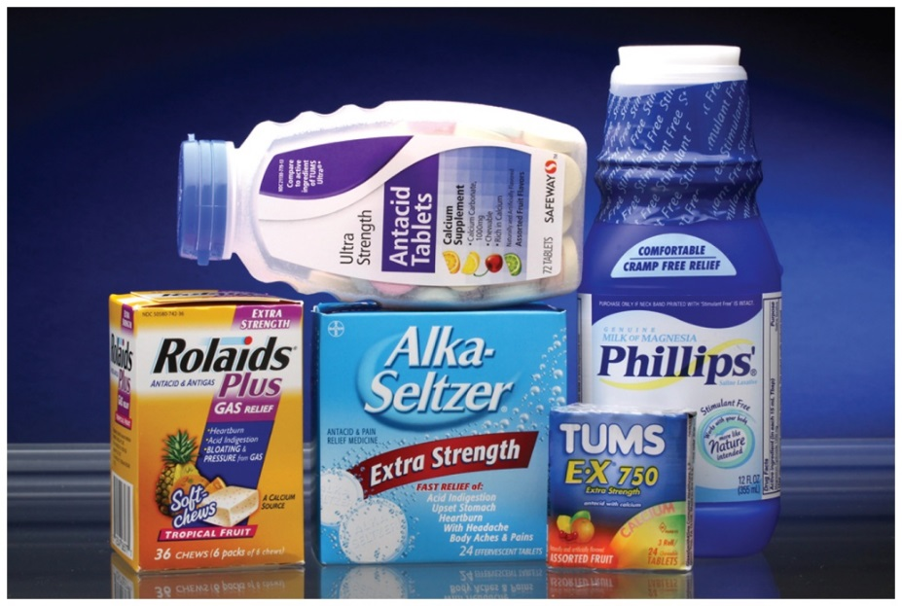
Application of Neutralization Reactions: Antacids
Table 4.4 Some Common Antacids

Slide 18
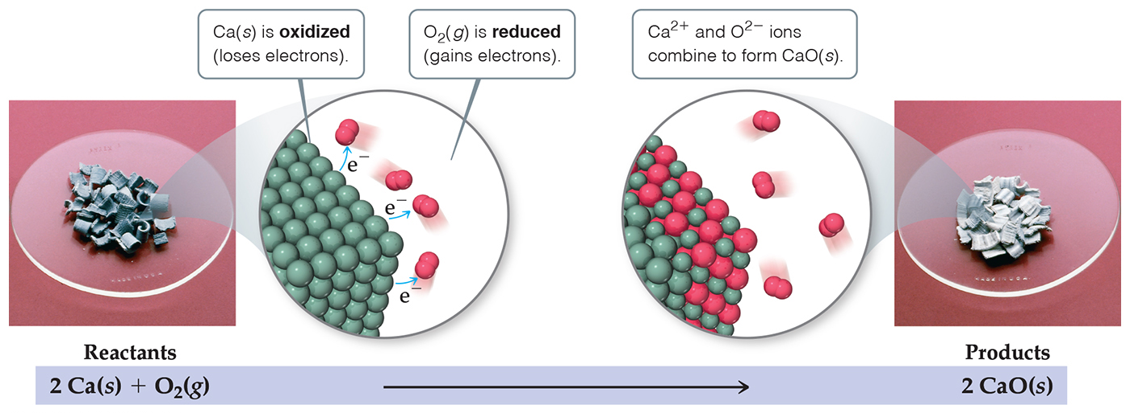
Oxidation-Reduction Reactions
Loss of electrons is oxidation.
Gain of electrons is reduction.
One cannot occur without the other.
The reactions are often called redox reactions.

Slide 19
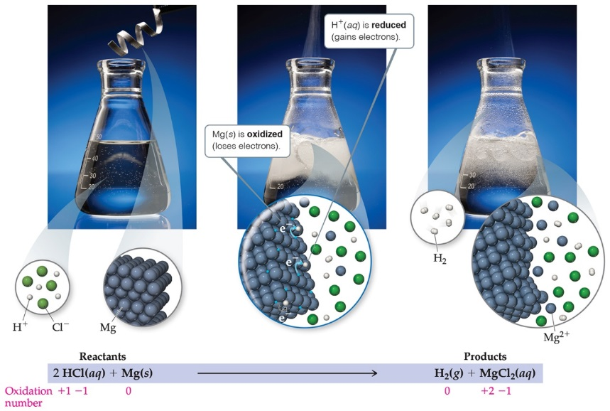
Displacement Reactions
In displacement reactions, ions oxidize an element.
(
oxidizes Mg below.)
The ion is displaced (replaced) in solution.
(Mg replaces
below.)

Slide 20
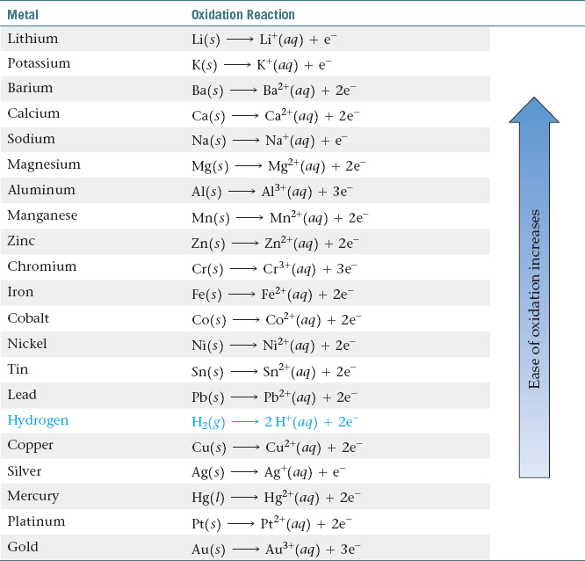
Activity Series and Hydrogen
The elements above hydrogen will react with acids to produce hydrogen gas. Elements below will NOT react!
A reactive metal is oxidized to a cation.
Table 4.5 Activity Series of Metals in Aqueous Solution

Slide 21
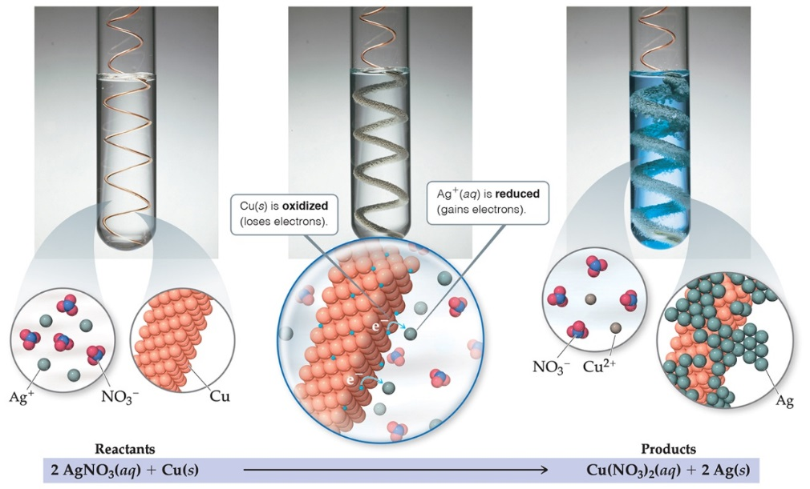
Metal/Acid Displacement Reactions
Elements higher on the activity series are more reactive.
They will exist as ions.
The element below will exist as the element.

Slide 22
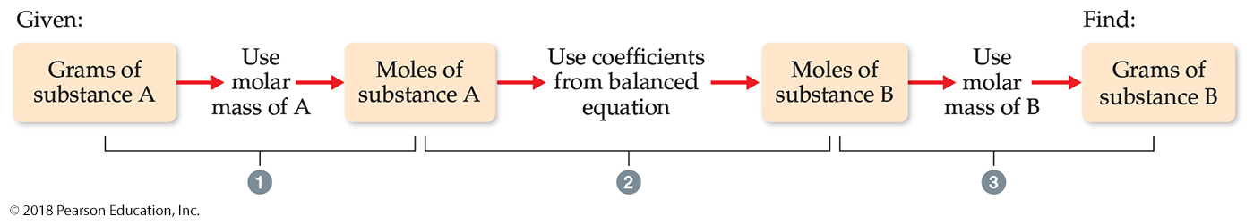
Stoichiometric Calculations
We have already seen in this chapter how to convert from grams to moles or moles to grams.
The new calculation is how to compare two different materials, using the mole ratio from the balanced equation.
The mole ratio comes from the coefficients in the balanced equation.

Slide 23
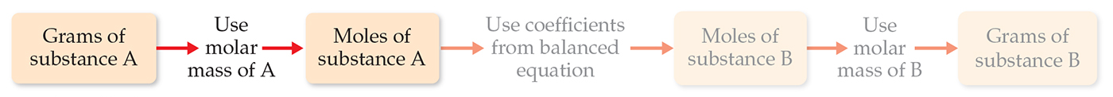
An Example of a Stoichiometric Calculation (1 of 3)
How many grams of water can be produced from 1.00 g of glucose?
There is 1.00 g of glucose to start.
The first step is to convert it to moles.

Slide 24
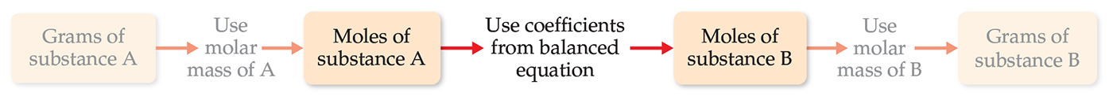
An Example of a Stoichiometric Calculation (2 of 3)
The new calculation is to convert moles of one substance in the equation to moles of another substance.
The mole ratio comes from the coefficients in the balanced equation.

Slide 25
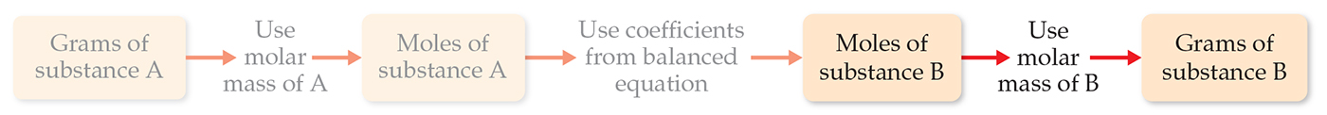
An Example of a Stoichiometric Calculation (3 of 3)
In the last step, moles of water is converted to grams of water.
This gives the answer we wanted.
You can do each step separately OR you can do them in one calculation, as seen above.

Slide 26
Heat and Stoichiometry
Heat does NOT appear in a balanced equation.
However, in Chapter 5 we will see how amounts of heat are related to a balanced equation.
Those amounts depend on stoichiometry as well.

Slide 27
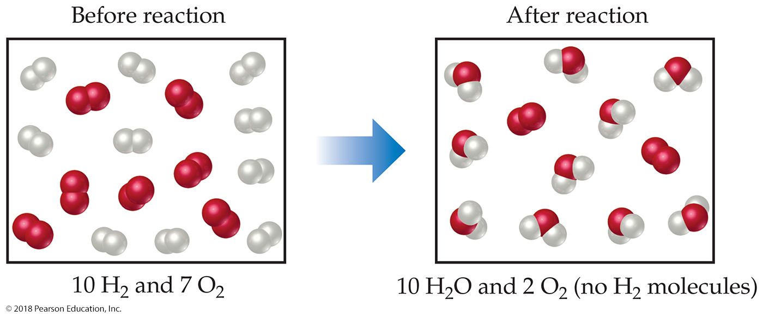
Limiting Reactants (1 of 3)
The limiting reactant is the reactant present in the smallest stoichiometric amount.
In other words, it is the reactant you will run out of first (in this case, the H₂).

Slide 28
Limiting Reactants (2 of 3)
In the example below, the O₂ would be the excess reagent.

Slide 29
Limiting Reactants (3 of 3)
The limiting reactant is used in all stoichiometry calculations to determine amounts of products that are produced and amounts of any other reactant(s) that are used in a reaction.

