Slide 1
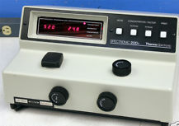
SPECTROSCOPY

Slide 2
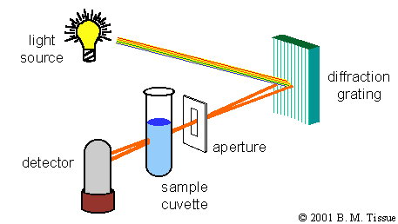
When visible white light strikes a substance, the substance may (1) reflect the light if it is opaque,
(2) transmit the light if it is transparent to the light striking it, or (3) absorb the light.
Substances absorb light by changing their electronic & vibrational quantum states or modes. These modes, which are related to harmonic variations of bond lengths and angles and electronic configurations, have energies on the order of ultraviolet and visible (UV-vis) light.
SPECTROSCOPY is the study of
Light energy interactions with
Matter. To the right is a simple
Spectrophotometer.

Slide 3
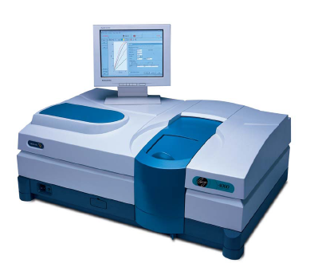
UV/Visible Spectroscopy: Instrumentation
In absorption spectroscopy, we measure ε as a function of wavelength λ
The instrument we use to do this is called a UV/visible Spectrophotometer
The Major Components Are:
A light source
A monochromator
A Sample Compartment
A detector

Slide 4
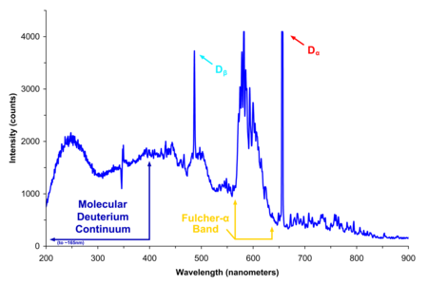
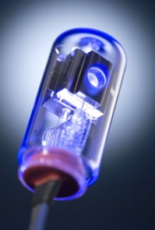
UV/Visible Spectroscopy: Light Sources
Deuterium
D₂ gas is discharged by contact with a high voltage tungsten cathode
Continuous spectrum from ~150 nm - ~370 nm
Usually used in conjunction with a Tungsten/halogen source, which handles the visible spectrum

Slide 5
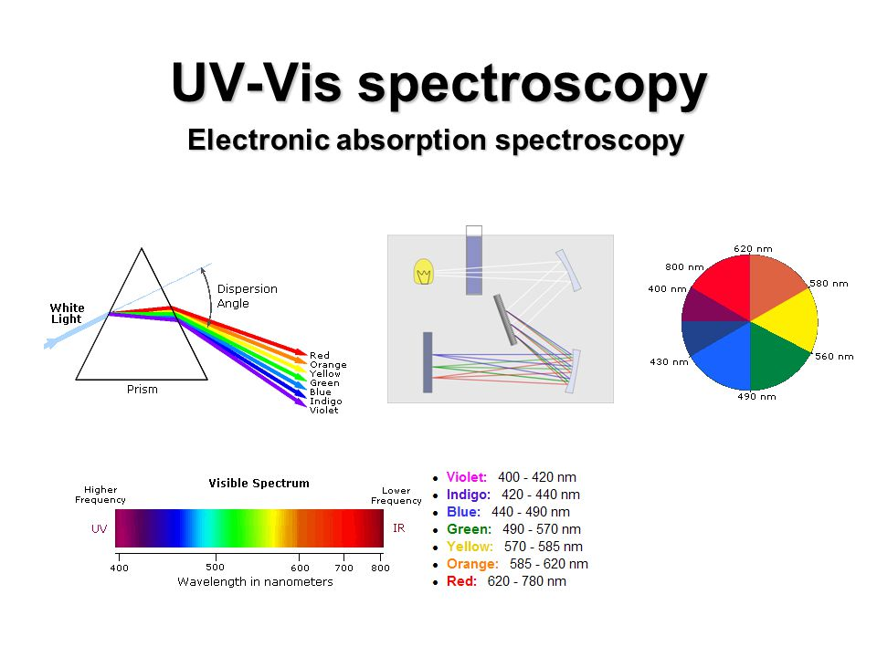

Slide 6
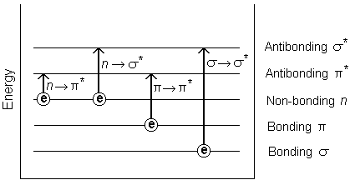
Absorption: Physical Basis
Absorption occurs when the energy contained in a photon is absorbed by an electron resulting in a transition to an excited state
Since photon and electron energy levels are quantized, we can only get specific allowed transitions
E=hν (h = 6.626*10⁻³⁴ J•s)
~ 400 - 700 nm
~ 115 nm
~ 200 – 400 nm
~ 150-250 nm

Slide 7

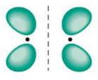
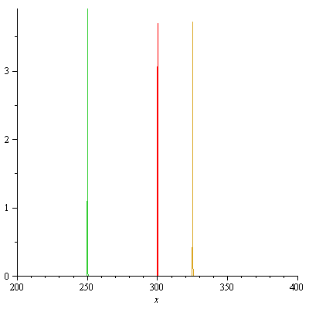
Absorption: Lineshape
hν
π
π*
So, our absorption spectrum should probably look like this:
But they don’t…

Slide 8
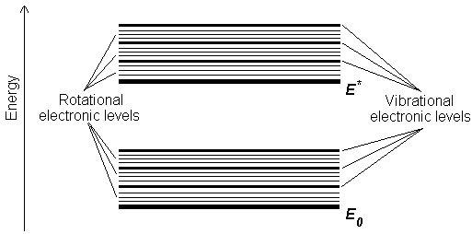
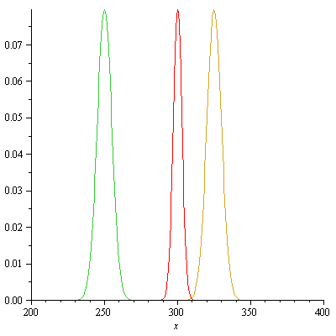
Absorption: Lineshape
This is because molecules are always rotating and vibrating. Each rotational or vibrational state slightly changes the energy of the transition.
So the line shape of our absorption spectra is…
normally distributed

Slide 9
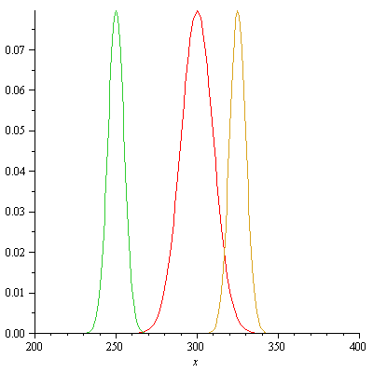
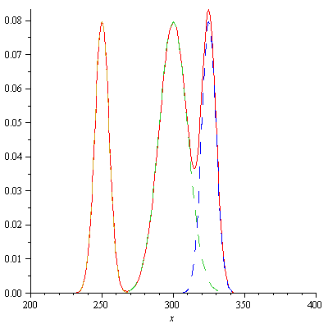
Absorption: Lineshape
Absorption is an additive property, that is, the spectrum is the sum of the Gaussians associated with each transition
This can make looking at complex solutions quite hard, especially if we are trying to say something about intensity

Slide 10
Absorption: Intensity
The absorption efficiency of an analyte is affected by:
The nature of the analyte
The number of available microstates
The solvent (sort of)
The absorption efficiency of an analyte is generally not affected by:
Other (low conc.) solutes
Temperature (within reason)
Concentration
This makes absorption spectroscopy one of the few analytical methods where the signal intensity is directly proportional to the concentration

Slide 11
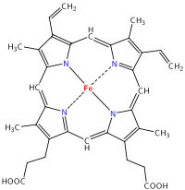
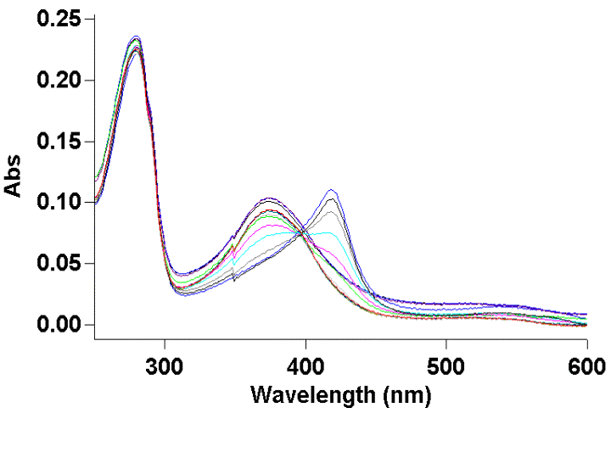
UV/visible: Applications
UV/visible is still used in current research, especially for heme-containing proteins, which have absorbance in the Soret region that is sensitive to the state of the protein
3d shell of Fe²⁺ has 6 electrons
High Spin
Low Spin

Slide 12
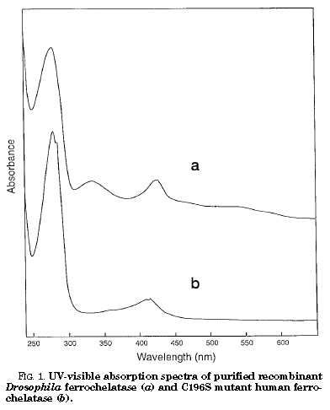

UV/Visible Applications
This paper looks at iron-sulfur clusters in a native and a mutant protein
C196S Mutant lacks broad absorption band between 400-600 nm which is diagnostic of an 2Fe-2S cluster
JBC (1998)Vol. 273, No. 35;28 pp. 22311–22316

Slide 13
STEP 1
When making solutions
500 mL mark
500mL
500mL
Volumetric
flask
Erlenmeyer
flask
Beaker
Very accurate
less accurate
not accurate
This experiment is heavily dependent on preparation of your solutions which will be measured spectroscopically. Remember to only use volumetric flasks and pipets when preparing your solutions.

Slide 14

STEP 2
Wavelength of maximum absorption, λ_{max}
λ_{max}=530 nm
KMnO₄(aq) is a purple solution, notice location of the absorption peaks & which colors are being transmitted.

Slide 15
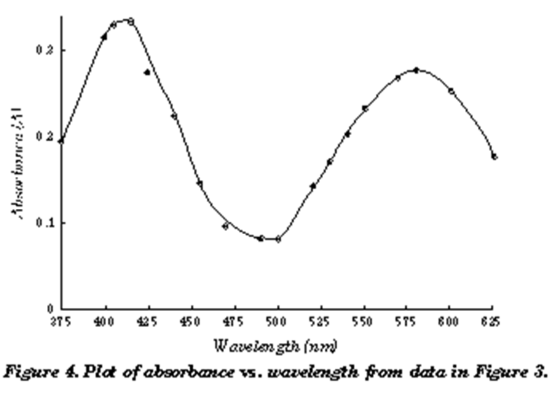
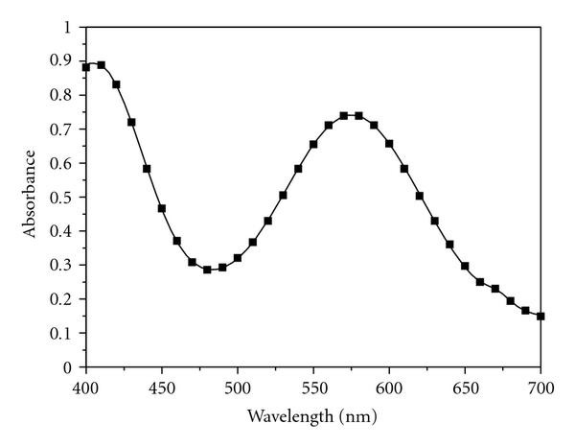
STEP 3
Purpose of the Experiment
In part one of the experiment, you will use the spectrophotometer to determine the absorbance spectrum of Cu(NH₃)₄ solutions. Based on this spectra, you will determine λ_{max}.
2+
Next you will prepare 4-5 solutions of different known concentrations, and measured at λ_{max,} create a calibration curve. In Part two you will measure the equilibrium concentrations of Cu(NH₃)₄
2+

Slide 16
Interaction of light with matter
Definition of absorbance & transmittance
I_{in}
I_{out}
s
Absorbance
Transmittance
Absorbance (A) and transmittance (T) are unitless

Slide 17
Beer-Lambert Law Derivation
The Beer-Lambert law is a result of the fact that a photon has a constant probability of being absorbed as it travels through the sample.
Total cross section of particles concentration
Absorption
Cross section of beam
Populations with constant probabilities of ‘death’ decline exponentially
y
x

Slide 18
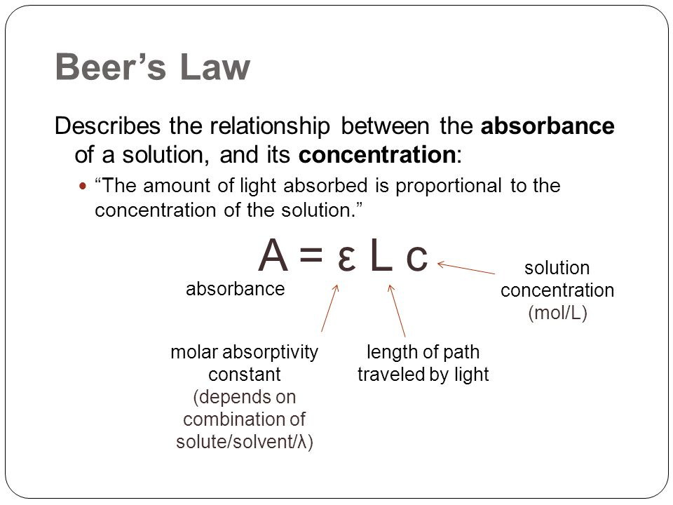
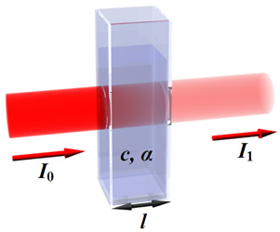

Slide 19
Definition of molar absorptivity
A = ε l c
ε = A / l c
ε - is a measure of the amount of light
absorbed per unit concentration and path length
A substance with a high molar absorptivity will be very effective at absorbing light (at the appropriate wavelength)

Slide 20
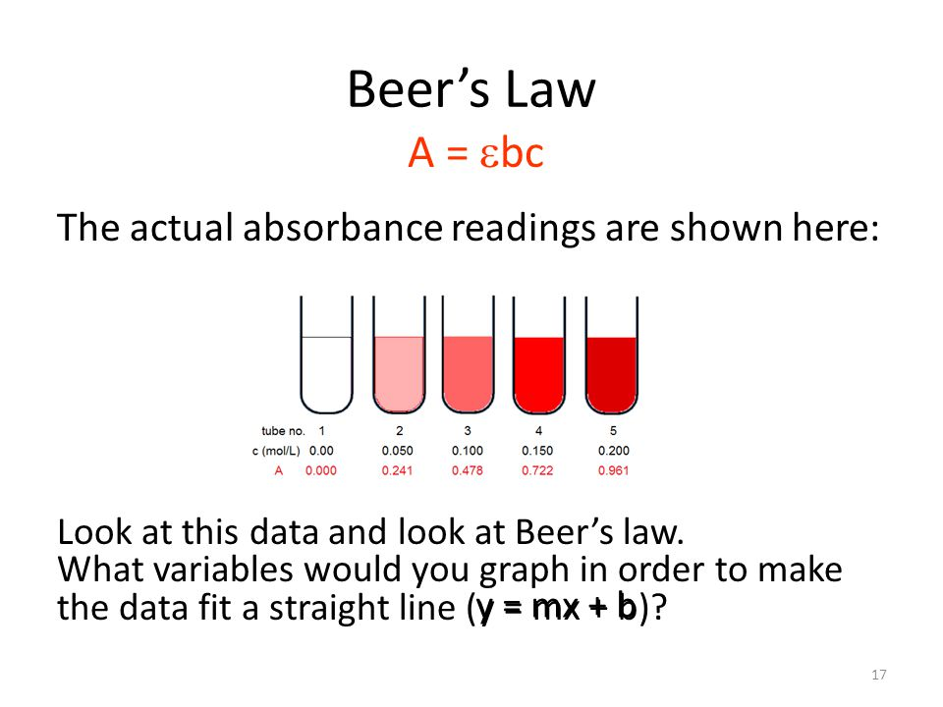

Slide 21


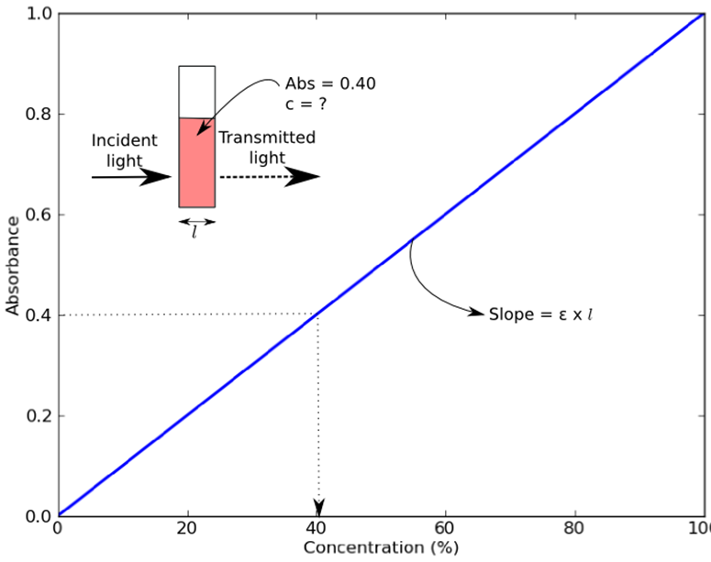
If light is absorbed by the sample, the intensity of the transmitted light exiting the sample (I) will be less than the intensity of the incident light (I_{o}). The ratio of transmitted light intensity to the incident light intensity is the transmittance, T:

Slide 22
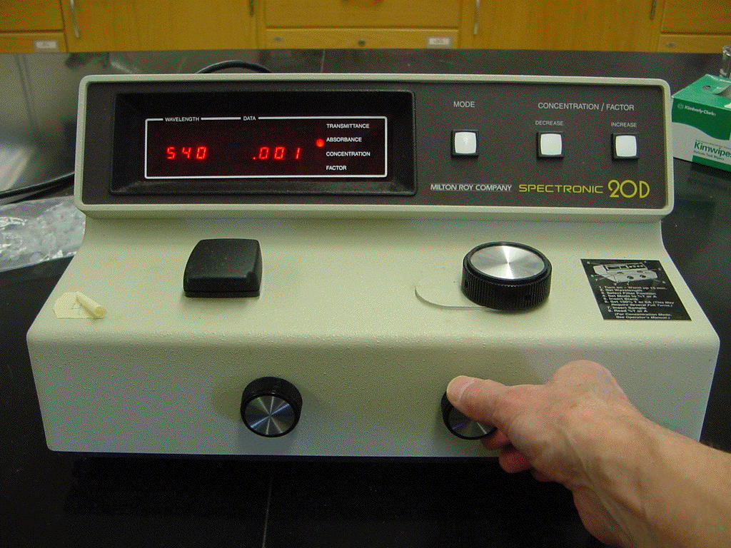

Slide 23
I. How to use the spectrophotometer (Spec 20/20D)
1. Turn on the instrument and let it warm up for at least 5-10 minutes.
2. Select the wavelength with the dial next to the sample compartment.
3. With the sample compartment closed and empty, adjust the % Transmittance (zero percent transmission of light) to read 0% T using the left front dial.
4. Place a clean (no fingerprints), dry cuvette filled approximately 3/4 full of the blank sample (solvent only) in the sample compartment. Close the sample compartment. Adjust the % Transmittance to read 100% T (100 percent transmission of light) using the right front dial.
5. Remove the blank cuvette and place the cuvette containing the sample in the sample compartment. Close the sample compartment. Read and record the value registered on the meter.
Note: Every time the wavelength of light is changed, the instrument must be recalibrated to read 0% T and 100% T with the blank. Repeat steps 2-5.

