Slide 1
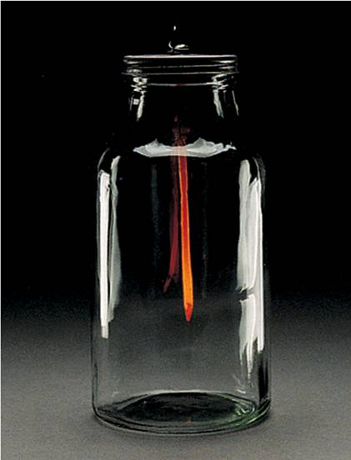
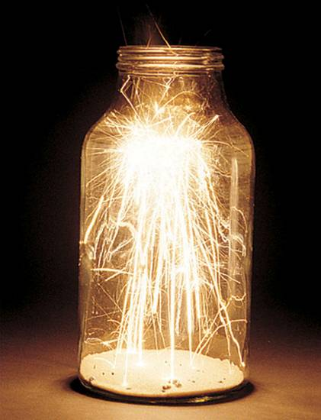
CHEMICAL THERMODYNAMICS
Hot iron nail exposed to oxygen releases lots of heat energy.

Slide 2
The Nature of Energy
I. Types of energy:
      A. Kinetic Energy – energy of motion
      B. Potential Energy – energy due to condition, position, or composition
      Internal energy
      Heat energy, electricity
Units for energy:
A. calorie – (cal) quantity of heat required to change the temperature of one gram of water by one degree Celsius
B. Joule (J) – SI unit for heat 1 cal = 4.184 J

Slide 3
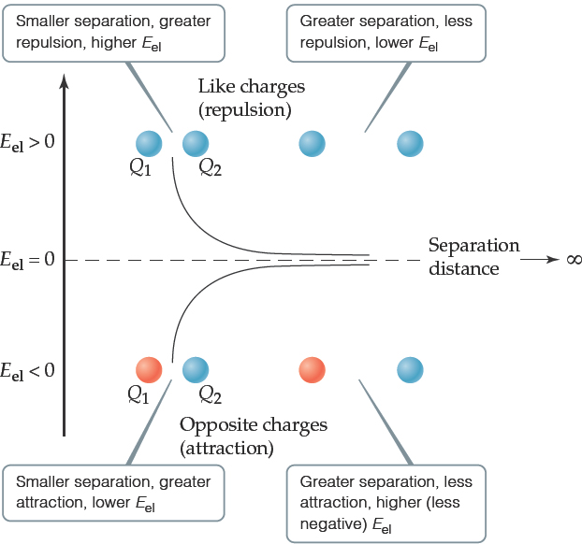
Chemical Energy Is Mainly Potential Energy
The most important form of potential energy in molecules is electrostatic potential energy, E_{el}:
Reminder: the unit of energy commonly used is the Joule:

Slide 4
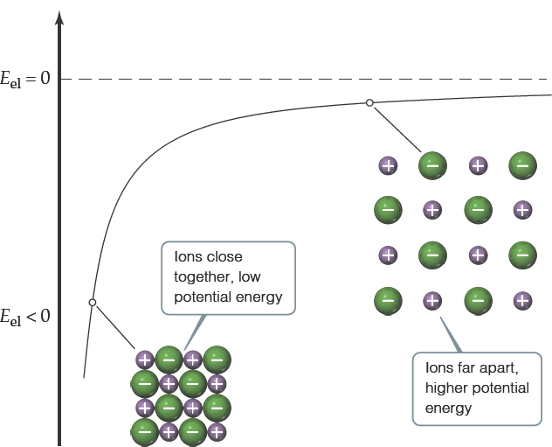
Attraction Between Ions
Electrostatic attraction is seen between oppositely charged ions.
Energy is released when chemical bonds are formed; energy is consumed when chemical bonds are broken.

Slide 5
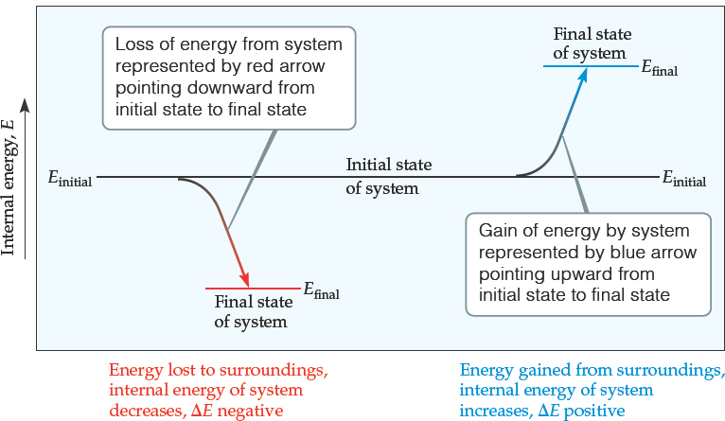
Internal Energy (1 of 2)
The internal energy of a system is the sum of all kinetic and potential energies of all components of the system; we use E to represent it.
We generally don’t know E, only how it changes

Slide 6
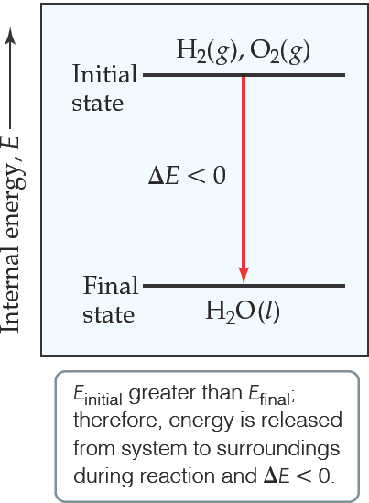
Internal Energy (2 of 2)
By definition, the change in internal energy,
is the final energy of the system minus the initial energy of the system:

Slide 7
UNITS for HEAT ENERGY
Heat energy is usually measured in either Joules, given by the unit (J), and kilojoules (kJ) or in calories, written shorthand as (cal), and kilocalories (kcal).
1 cal = 4.184 J
NOTE: This conversion correlates to the specific heat of water which is 1 cal/g ºC or 4.184 J/g ºC.

Slide 8
Units of Energy
joule (J) is the amount of energy needed to move a 1 kg mass a distance of 1 meter
  1 J = 1 N∙m = 1 kg∙m²/s²
calorie (cal) is the amount of energy needed to raise one gram of water by 1°C
  kcal = energy needed to raise 1000 g of water 1°C
  food Calories = kcals
Energy Conversion Factors
1 calorie (cal) | = | 4.184 joules (J) (exact)
1 Calorie (Cal) | = | 1000 calories (cal)
1 kilowatt-hour (kWh) | = | 3.60 x 10⁶ joules (J)

Slide 9
THERMODYMANICS
Thermodynamics is the study of the motion of heat energy as it is transferred from the system to the surrounding or from the surrounding to the system.
System – the portion of the universe selected for thermodynamic study
Surroundings – the portion of the universe with which a system interacts
The transfer of heat could be due to a physical change or a chemical change.
There are three laws of chemical thermodynamics.

Slide 10
CHEMICAL THERMODYMANICS
The first law of thermodynamics:
Energy and matter can be neither created nor destroyed; only transformed from one form to another. The energy and matter of the universe is constant.
The second law of thermodynamics:
In any spontaneous process there is always an increase in the entropy of the universe. The entropy is increasing.
The third law of thermodynamics:
The entropy of a perfect crystal at 0 K is zero.
There is no molecular motion at absolute 0 K.

Slide 11
HEAT
The energy that flows into or out of a system because of a difference in temperature between the thermodynamic system and its surrounding.
Symbolized by "q".
When heat is evolved by a system, energy is lost and "q” is negative (-).
When heat is absorbed by the system, the energy is added and "q" is positive (+).

Slide 12
HEAT FLOW
Heat can flow in one of two directions:
Exothermic
To give off heat; energy is lost from the system: (-q)
Endothermic
To absorb heat; energy is added to the system: (+q)

Slide 13
Changes in Internal Energy (1 of 2)
the system absorbed energy from the surroundings.

Slide 14
Changes in Internal Energy (2 of 2)
the system released energy to the surroundings.

Slide 15
The First Law of Thermodynamics- A closer look
“The internal energy (ΔE) of an isolated system is constant.”
Internal Energy: the sum of all the kinetic/potential energy of a system.
ΔE = E_{final} – E_{initial} & ΔE = q + w
NOTE:
q = heat added to or liberated from the system
Heat (q) = the energy transferred from a hotter object to a colder one
w = work done on or by the system.
Work (w) = the energy used to cause one object to move against a force

Slide 16
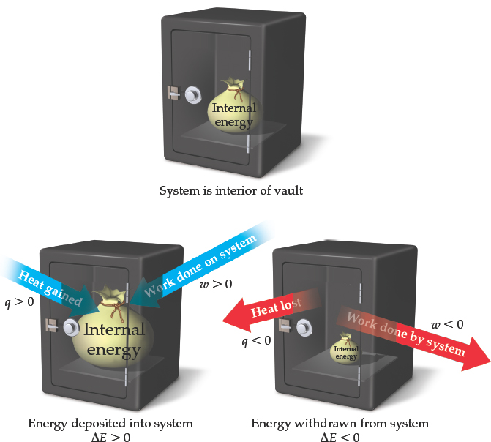
Changes in Internal Energy
When energy is exchanged between the system and the surroundings, it is exchanged as either heat (q) or work (w).
That is,

Slide 17
Sign Convention for q Sign Convention for w
q > 0: Heat is transferred from w > 0: Work is done by the
the surroundings to the system surroundings on the system
q < 0: Heat is transferred from w < 0: Work is done by the
the system to the surroundings system on the surroundings
When heat is transferred from the surroundings to the system, q has a positive value. Likewise, when work is done on the system by the surroundings, w has a positive value.
Both heat added to the system and the work done on the system INCREASE its internal energy.
A POSITIVE value of ΔE indicates that the system has gained energy from its surroundings; a NEGATIVE value of ΔE indicates that the system has lost energy to its surroundings.

Slide 18
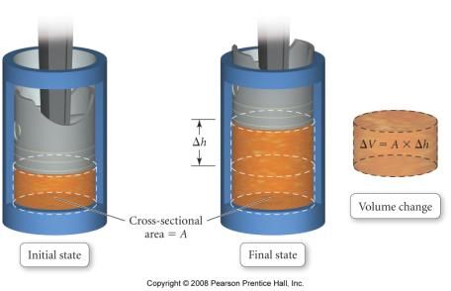
Pressure -Volume Work
PV work is work that is the result of a volume change against an external pressure
when gases expand, ΔV is +, but the system is doing work on the surroundings so w is ─
as long as the external pressure is kept constant
─Work = External Pressure x Change in Volume
w = ─PΔV
  to convert the units to joules use 101.3 J = 1 atm∙L

Slide 19
Example– If a balloon is inflated from 0.100 L to 1.85 L against an external pressure of 1.00 atm, how much work is done?
Given:
Find:
V₁=0.100 L, V₂=1.85 L, P=1.00 atm
w, J
Concept Plan:
Relationships:
P, ΔV
w
101.3 J = 1 atm L
Solution:
Check:
the unit and sign are correct

Slide 20
Lecture Questions on the first law of thermodynamics.
Q #1: An automobile engine does 520 kJ of work and loses 220 kJ of energy as heat. What is the change in internal energy of the engine?
Q #2: A system was heated by using 300 J of heat, yet it was found that its internal energy decreased by 150 J. Was work done on the system or did the system do work?

Slide 21
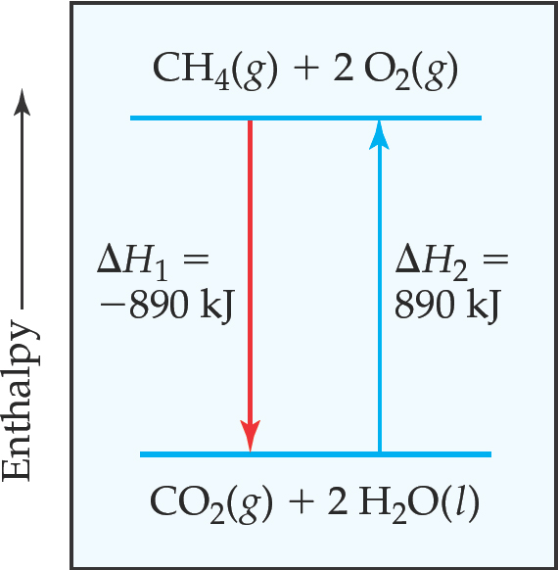
Enthalpy of Reaction (1 of 2)
is the enthalpy of the products minus the enthalpy of the reactants:
The change in enthalpy,

Slide 22
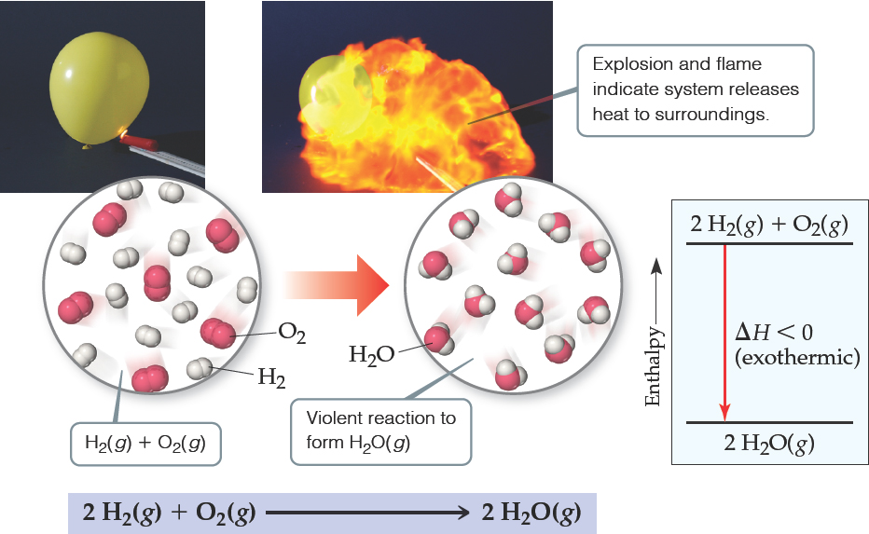
Enthalpy of Reaction (2 of 2)
This quantity,
is called the enthalpy of reaction, or the heat of reaction.

Slide 23
If the heat transfer involves a chemical reaction then q is called:
HEAT OF REACTION
The heat energy (ΔH; enthalpy) required to return a system to the given temperature at the completion of the reaction.
q = ΔH at constant pressure
The heat of reaction can be specific to a reaction like:
HEAT OF COMBUSTION
The quantity of heat energy given off when a specified amount of substance burns in oxygen.
UNITS: kJ/mol (kilojoules per mole) or kcal/mol (kilocalories per mole)

Slide 25
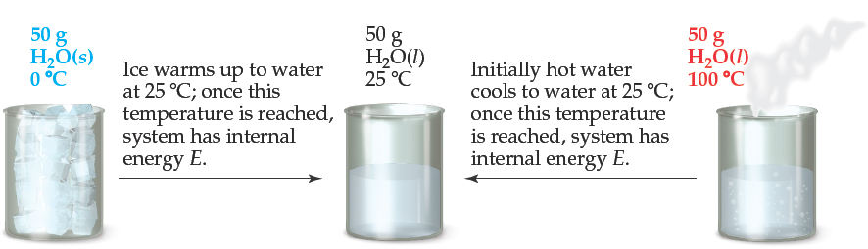
State Functions (1 of 3)
Usually we have no way of knowing the internal energy of a system; finding that value is simply too complex a problem.
However, we do know that the internal energy of a system is independent of the path by which the system achieved that state.
  In the system below, the water could have reached room temperature from either direction.

Slide 26
State Functions (2 of 3)
Therefore, internal energy is a state function.
It depends only on the present state of the system, not on the path by which the system arrived at that state.
And so,

Slide 27
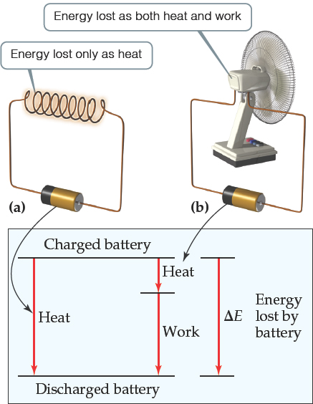
State Functions (3 of 3)
However, q and w are not state functions.
Whether the battery is shorted out or is discharged by running the fan, its
is the same, but q and w are different in the two cases.

Slide 28
Enthalpy
Enthalpy is the internal energy plus the product of pressure and volume: H = E + PV
When the system changes at constant pressure, the change in enthalpy becomes,
ΔH = Δ (E + PV) or ΔH = ΔE + PΔV
BUT!
which we can substitute these into the enthalpy expression:
So, at constant pressure, the change in enthalpy is the heat gained or lost.

Slide 29
    Enthalpy
    The change in enthalpy, ΔH, equals the heat gained or lost by the system when the process occurs under constant pressure (q_{p}).
      i. ΔH = H_{final} – H_{initial} = q_{p}
      ii. A positive value of ΔH indicates that the system has gained heat from the surroundings.
      iii. A negative value of ΔH indicates that the system has released heat to the surroundings.
iv. Enthalpy is a state function.

Slide 30
    Enthalpy Thermodynamic Equations
    Rules:
i. ΔH value is dependent on the phase of the substance.
      2H₂(g) + O₂(g) → 2H₂O(g) ; ΔH = -483.7 kJ
      2H₂(g) + O₂(g) → 2H₂O(l) ; ΔH = -571.7 kJ
      ii. When a thermodynamic equation is multiplied by a factor, the ΔH is also multiplied by the same factor.
      4H₂(g) + 2O₂(g) → 4H₂O(g) ; ΔH = -967.4 kJ
      iii. ΔH value is dependent on the direction of the equation.
      2H₂O(g) → 2H₂(g) + O₂(g); ΔH = +483.7 kJ

Slide 31
    Lecture Questions on enthalpy
1. In the presence of a Pt catalyst, NH₃ will burn in air to give NO. Consider the following gas phase reactions:
4 NH₃ + 5 O₂ → 4 NO + 6 H₂O; ΔH = -906 kJ
What is ΔH for: a) 8 NH₃ + 10 O₂ → 8 NO + 12 H₂O
b) NO + ³/₂ H₂O → NH₃ + ⁵/₄ O₂?
    2. Consider the reaction A → X. The enthalpy change for the reaction represented above is ΔH_{T}. This reaction can be broken down into a series of steps as shown in the following diagram:
Determine the relationship that must exist among the various enthalpy changes in the pathways shown above.

Slide 32
Lecture Questions on Stoichiometry & Enthalpy of Reaction
3a. Hydrogen sulfide burns in air to produce sulfur dioxide and water vapor. If the heat of reaction is -1037 kJ for this reaction, calculate the enthalpy change to burn 36.9 g of hydrogen sulfide in units of kcal?
3b. Sulfur dioxide reacts with water to form hydrogen sulfide gas. What is the enthalpy change for this reaction?
3c. Label both of the above reactions as either endothermic or exothermic.

Slide 33
Summary of Enthalpies of Reaction (ΔH_{rxn})
the enthalpy change that accompanies a reaction.
For an ENDOTHERMIC reaction, the reactants have lower enthalpies than do the products (ΔH is positive).
B. For an EXOTHERMIC reaction, the reactants have higher enthalpies than do the products (ΔH is negative).
Two important rules to apply:
1. The magnitude of ΔH is directly proportional to the amount of reactants or products.
For example, the combustion of one mole of methane evolves 890 kJ of heat:
CH₄(g) + 2O₂(g) → CO₂(g) + 2H₂O(l) ΔH = -890 kJ
The combustion of 2 moles of methane produces 2(-890 kJ) or -1780 kJ of heat.
2. ΔH for a reaction is equal in magnitude but opposite in sign to ΔH for the reverse reaction.
For example, CO₂(g) + 2H₂O(l) → CH₄(g) + 2O₂(g) ΔH = 890 kJ

Slide 34
Workshop EN#1 on Stoichiometry & Enthalpy of Reaction
1. How much heat is released when 4.50 g of methane gas is burned in a constant pressure system? Is this reaction endothermic or exothermic?
CH₄(g) + 2O₂(g) → CO₂(g) + 2H₂O(l) ΔH = -890 kJ
2. Hydrogen peroxide can decompose to water and oxygen by the reaction:
2H₂O₂(l) → 2H₂O(l) + O₂(g) ΔH = -196 kJ
Calculate the value of q when 5.00 g of H₂O₂(l) decomposes at constant pressure.
3. Use the standard heats of reaction given below to determine ΔH° for the following reaction (in kcal): 3V₂O₃(s) → V₂O₅(s) + 4VO(s).
4VO(s) + O2(g) → 2V2O3(s) ΔH° = -180 kcal
2V2O3(s) + O2(g) → 4VO2(s) ΔH° = -108 kcal
4VO2(s) + O2(g) → 2V2O5(s) ΔH° = -58 kcal

Slide 35
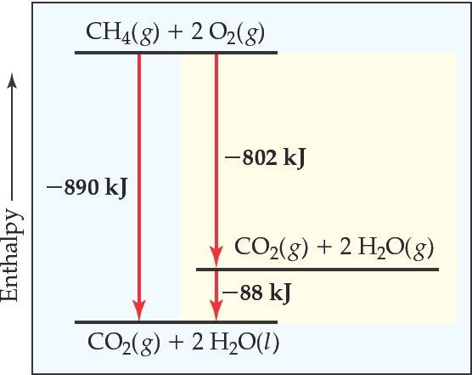
Hess’s Law
Hess’s law: If a reaction is carried out in a series of steps, ΔH for the overall reaction equals the sum of the enthalpy changes for the individual steps.
Because H is a state function, for a particular set of reactants and products, ΔH is the same whether the reaction takes place in one step or in a series of steps.

Slide 36
Hess’s Law
If a reaction is carried out in a series of steps, ΔH for the reaction will be equal to the sum of the enthalpy changes for the individual steps.
For example, consider the reaction of tin and chlorine:
Sn(s) + Cl₂(g) → SnCl₂(s) ΔH = -350 kJ
SnCl₂(s) + Cl₂(g) → SnCl₄(l) ΔH = -195 kJ
Add up both reactions to obtain:
Sn(s) + 2Cl₂(g) → SnCl₄(l) ΔH = -545 kJ

Slide 37
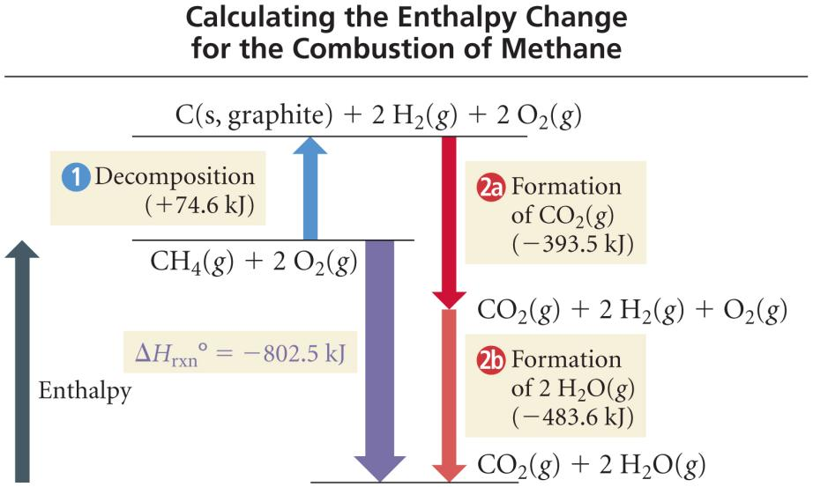
The Combustion of CH₄

Slide 38
Sample 1 - Calculate the Enthalpy Change in the Reaction from theory
2 C₂H₂(g) + 5 O₂(g) → 4 CO₂(g) + 2 H₂O(l)
1. Write formation reactions for each compound from its elements and determine the ΔH_{f}° for each:
2 C(s, gr) + H₂(g) → C₂H₂(g) ΔH_{f}° = +227.4 kJ/mol
C(s, gr) + O₂(g) → CO₂(g) ΔH_{f}° = -393.5 kJ/mol
H₂(g) + ½ O₂(g) → H₂O(l) ΔH_{f}° = -285.8 kJ/mol

Slide 39
Sample 1 - Calculate the Enthalpy Change in the Reaction from theory
2 C₂H₂(g) + 5 O₂(g) → 4 CO₂(g) + 2 H₂O(l)
2. Arrange equations so they add up to desired reaction
2 C₂H₂(g) → 4 C(s) + 2 H₂(g) ΔH° = 2(-227.4) kJ
4 C(s) + 4 O₂(g) → 4CO₂(g) ΔH° = 4(-393.5) kJ
2 H₂(g) + O₂(g) → 2 H₂O(l) ΔH° = 2(-285.8) kJ
2 C₂H₂(g) + 5 O₂(g) → 4 CO₂(g) + 2 H₂O(l)
ΔH = -2600.4 kJ

Slide 40
Lecture Questions on Hess’s Law
1. 2C(graphite) + O₂(g) →2CO (g) ; ΔH = ?
Consider:
CO₂(g) → CO(g) + ½ O₂ (g) ; ΔH = +283.0 kJ
C(s) + O₂(g) → CO₂(g) ; ΔH = -393.5 kJ
2. Acetic acid is contained in vinegar. Suppose the following occurred:
2C_{(graphite)} + 2 H₂ (g) + O₂(g) → CH₃COOH(l); ΔH=?
HC₂H₃O₂(l) + 2 O₂(g) → 2 CO₂(g) + 2 H₂O(l); ΔH= -871 kJ
H₂(g) + ½ O₂(g) → H₂O(l) ; ΔH = -286 kJ
C_{(graphite)} + O₂(g) → CO₂ (g) ; ΔH = -394 kJ

Slide 41
Workshop EN#2 on Hess’s Law
1. Consider the synthesis of propane from solid carbon and hydrogen gas. Determine the enthalpy change for 1 mol of gaseous propane given the following thermochemical data:
C₃H₈(g) + 5O₂(g) → 3CO₂(g) + 4H₂O(l) ΔH° = -2220 kJ
C(s) + O₂(g) → CO₂(g) ΔH° = -394 kJ
H₂(g) + ½O₂(g) → H₂O(l) ΔH° = -286 kJ
2. Diborane (B₂H₆) is a highly reactive boron hydride which was once considered as a possible rocket fuel for the U.S. space program. Calculate the ΔH for the synthesis of diborane from its elements according to the equation:
2B(s) + 3H₂(g) → B₂H₆(g)
using the following data:
(a) 2B(s) + 3/2 O₂(g) → B₂O₃(s) ΔH = -1273 kJ
(b) B₂H₆(g) + 3O₂(g) → B₂O₃(s) + 3H₂O(g) ΔH = -2035 kJ
(c) H₂(g) + ½ O₂(g) → H₂O(l) ΔH = -286 kJ
(d) H₂O(l) → H₂O(g) ΔH = 44 kJ

Slide 42
    Standard Enthalpies of Formation (ΔH_{f}°)
    the change in enthalpy for the reaction that forms 1 mol of the compound from its elements, with all substances in their standard states (i.e. 298 K).
      i. A table of Standard Heats of Formation for some compounds is found in your textbook
      ii. ΔH for a reaction is equal to the sum of the heats of formation of the product compounds minus the sum of the heats of formation of the reactant compounds. Using the symbol Σ to represent the “sum of”:
ΔH_{rxn}° = Σ nΔH_{f}°(products) - Σ mΔH_{f}°(reactants)
where n and m are the stoichiometric coefficients of the
reaction.

Slide 43
Sample 2 - Calculate the Enthalpy Change in the Reaction using the appendix tables
2 C₂H₂(g) + 5 O₂(g) → 4 CO₂(g) + 2 H₂O(l)
ΔH°_{reaction} = Σ n ΔH_{f}°(products) - Σ n ΔH_{f}°(reactants)
ΔH_{rxn} = [(4•ΔH_{CO2} + 2•ΔH_{H2O}) – (2•ΔH_{C2H2} + 5•ΔH_{O2})]
ΔH_{rxn} = [(4•(-393.5) + 2•(-285.8)) – (2•(+227.4) + 5•(0))]
ΔH_{rxn} = -2600.4 kJ

Slide 44
Lecture Questions:
1. Calculate the standard enthalpy of reaction for the following reaction:
4NH₃(g) + 5O₂(g) → 4NO(g) + 6H₂O(l)
ΔH_{f}° (NH₃) = -132.5 kJ/mol; ΔH_{f}° (NO) = 90.37 kJ/mol; ΔH_{f}° (H₂O) = -285.83 kJ/mol
2. Use the enthalpy of combustion of propane gas to calculate the enthalpy of formation of propane gas.
C₃H₈(g) + 5O₂(g) → 3CO₂(g) + 4H₂O(l) ΔH_{c}° = -2220 kJ
ΔH_{f}° (CO₂) = -393.5 kJ/mol; ΔH_{f}° (H₂O) = -285.83 kJ/mol

Slide 45
Breakout/CHAT on Standard Enthalpy:
1. Calculate the standard enthalpy of reaction for the following reactions:
a) 2 NO(g) + O₂(g) → 2NO₂(g)
b) 2 NH₃(g) + ⁷/₂ O₂(g) → 2 NO₂(g) + 3 H₂O(g)
c) Fe₂O₃(s) + 3CO(g) → 2 Fe(s) + 3 CO₂(g)
d) BaCO₃(s) → BaO(s) + CO₂(g)
2. (a) Calculate the heat required to combust 10.0 g of nitrogen monoxide.
Calculate the heat required to combust 25.0 g of ammonia.
(c) Calculate the heat required to produce 25.0 g of iron from iron(III) oxide.
(d) Calculate the heat required to decompose 10.0 g of barium carbonate.

Slide 46
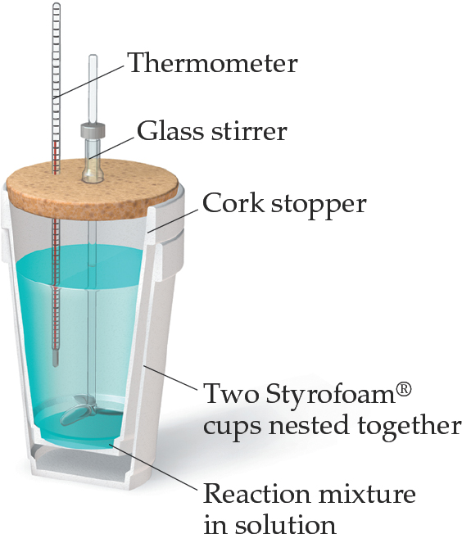
Calorimetry
Since we cannot know the exact enthalpy of the reactants and products, we measure
through calorimetry, the measurement of heat flow.
The instrument used to measure heat flow is called a calorimeter.

Slide 47
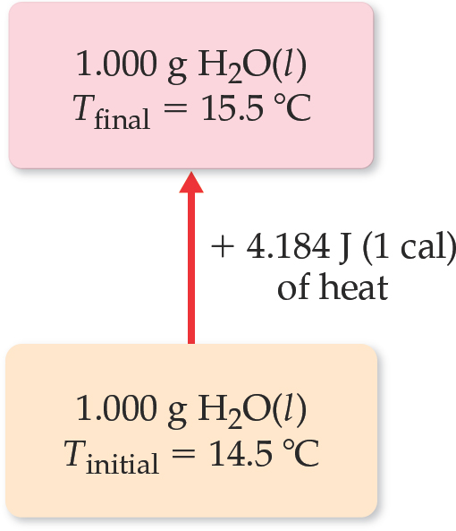
Heat Capacity and Specific Heat
The amount of energy required to raise the temperature of a substance by 1 K (1 degree Celsius) is its heat capacity. If the amount of the substance heated is one gram, it is the specific heat. If the amount is one mole, it is the molar heat capacity.
Table 5.2 Specific Heats of Some Substances at 298 K
Elements | Blank | Compounds | Blank
Substance | Specific Heat (J/g-K) | Substance | Specific Heat (J/g-K)
N₂(g) | 1.04 | H₂O(l) | 4.18
Al(g) | 0.90 | CH₄(g) | 2.20
Fe(s) | 0.45 | CO₂(g) | 0.84
Hg(l) | 0.14 | CaCO₃(s) | 0.82

Slide 48
Calorimetry – measurement of heat flow
HEAT CAPACITY: The quantity of heat needed to raise the temperature of a substance one degree Celsius (or one Kelvin). If the system is a mole of a substance, we use the term molar heat capacity
q = C_{p} ΔT
SPECIFIC HEAT: The quantity of heat required to raise the temperature of one gram of a substance by one degree Celsius (or one Kelvin).
q = s x m x ΔT
***NOTE: BOTH s and C will be provided on a case-by-case basis. You MUST memorize the specific heat of water, 1 cal/g °C = 4.184 J/g °C. Both Cp & s are chemical specific constants found in the textbook or CRC Handbook.

Slide 49
LAW OF CONSERVATION OF ENERGY (LCE)
The law of conservation of energy (the first law of thermodynamics), when related to heat transfer between two objects, can be stated as:
The heat lost by the hot object = the heat gained by the cold object
-q_{hot} = q_{cold}
-m_{h} x s_{h} x ΔT_{h} = m_{c} x s_{c} x ΔT_{c}
where ΔT = T_{final} – T_{initial}

Slide 50
Lecture Questions on SPECIFIC HEAT & LCE
Exactly 500.00 kJ of heat is absorbed by a sample of gaseous He. The temperature increases by 15.0 K.
  a) Calculate the heat capacity of the sample.
  b) the sample weighs 6.42 kg. Compute the specific heat and molar heat capacity of He.
Assuming no heat is lost, what mass of cold water at 0.00ºC is needed to cool 100.0 g of water at 97.6ºC to 12.0 ºC?
-m_{h} x s_{h} x ΔT_{h} = m_{c} x s_{c} x ΔT_{c}
3. Calculate the specific heat of an unknown metal if a 92.00 g piece at 100.0ºC is dropped into 175.0 mL of water at 17.8 ºC. The final temperature of the mixture was 39.4ºC.

Slide 51
Workshop EN#4 on Specific heat & LCE
Determine the energy (in kJ) required to raise the temperature of 100.0 g of water from 20.0 ºC to 85.0 ºC?
Determine the specific heat of an unknown metal that required 2.56 kcal of heat to raise the temperature of 150.00 g from 15.0 ºC to 200.0 ºC?
Assuming no heat is lost to the surronding, what will be the final temperature when 50.0 g of water at 10.0 ºC is mixed with 10.0 g of water at 50.0 _{o}C?

Slide 52

Exchanging Energy Between
System and Surroundings
exchange of heat energy
q = mass x specific heat x ΔTemperature
exchange of work
w = −Pressure x ΔVolume

Slide 53
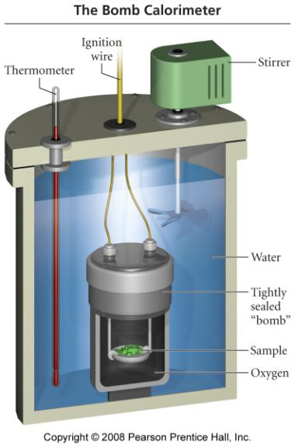
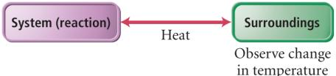
Bomb Calorimeter
used to measure ΔE because it is a constant volume system

Slide 54
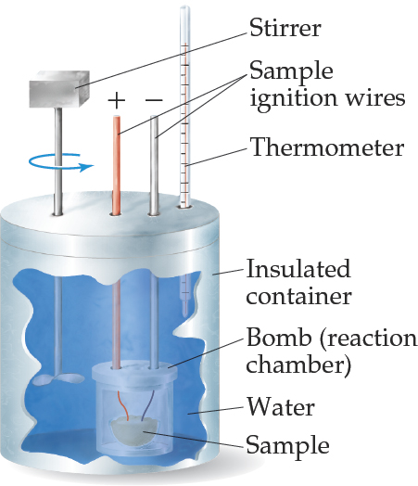
Bomb Calorimetry (1 of 2)
Reactions can be carried out in a sealed “bomb” such as this one.
The heat absorbed (or released) by the water is a very good approximation of the enthalpy change for the reaction.

Slide 55
Bomb Calorimetry (2 of 2)
Because the volume in the bomb calorimeter is constant, what is measured is really the change in internal energy,
For most reactions, the difference is very small.

Slide 56
Example – When 1.010 g of sugar is burned in a bomb calorimeter, the temperature rises from 24.92°C to 28.33°C. If C_{cal} = 4.90 kJ/°C, find ΔE for burning 1 mole
Given:
Find:
1.010 g C₁₂H₂₂O₁₁, T₁ = 24.92°C, T₂ = 28.33°C, C_{cal} = 4.90 kJ/°C
ΔE_{rxn}, kJ/mol
Concept Plan:
Relationships:
C_{cal}, ΔT
q_{cal}
q_{cal}
q_{rxn}
q_{cal} = C_{cal} x ΔT = -q_{rxn}
MM C₁₂H₂₂O₁₁ = 342.3 g/mol
Solution:
Check:
the units and sign are correct

Slide 57
Constant Pressure Calorimetry
By carrying out a reaction in aqueous solution in a simple calorimeter, the heat change for the system can be found by measuring the heat change for the water in the calorimeter.
The specific heat for water is 4.184 J/g∙K. We use this value for dilute solutions.
We can calculate ΔH for the reaction with this equation:

Slide 58
Calorimetry and Chemical Reactions
A heat of reaction, q_{rxn}, is the quantity of heat exchanged between a system and its surroundings when a chemical reaction occurs within the system at constant temperature. If this reaction occurs in an isolated system, the reaction produces a change in the thermal energy of the system. That is, the overall temperature either increases (exothermic; becomes warmer) or decreases (endothermic; becomes cooler).
Heats of reaction are experimentally determined in a calorimeter, a device for measuring quantities of heat. Two common calorimeters are: (1) bomb calorimeter (used for combustion reactions) and (2) “coffee-cup” calorimeter (a simple calorimeter for general chemistry laboratory purposes built from styrofoam cups). As previously mentioned, the heat of reaction is the quantity of heat that the system would have to lose to its surroundings to be restored to its initial temperature. This quantity of heat is the negative of the thermal energy gained by the calorimeter and its contents (q_{calorimeter}).
Therefore: q_{rxn} = -q_{calorimeter}.

Slide 59
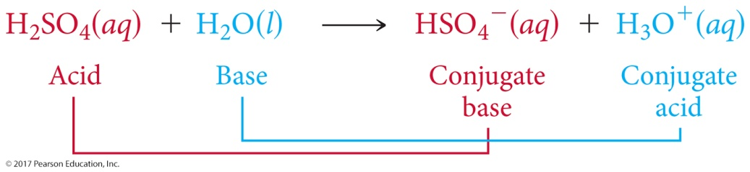

Example : Measuring ΔH Using a Coffee-Cup Calorimeter
When a student mixes 50 mL of 1.0 M HCl and 50 mL of 1.0 M NaOH in a coffee-cup calorimeter, the temperature of the resultant solution increases from 21.0 to 27.5 °C. Calculate the enthalpy change for the reaction in kJ/mol HCl, assuming that the calorimeter loses only a negligible quantity of heat, that the total volume of the solution is 100 mL, that its density is 1.0 g/mL, and that its specific heat is 4.18 J/g-K.
Solution
Analyze Mixing solutions of HCl and NaOH results in an acid-base reaction:
HCl(aq) + NaOH(aq) H₂O(l) + NaCl(aq)
We need to calculate the heat produced per mole of HCl, given the temperature increase of the solution, the number of moles of HCl and NaOH involved, and the density and specific heat of the solution.
Plan The total heat produced can be calculated using Equation 5.22. The number of moles of HCl consumed in the reaction must be calculated from the volume and molarity of this substance, and this amount is then used to determine the heat produced per mol HCl.
Solve
Because the total volume of the solution is 100 mL, its mass is: (100 mL)(1.0 g/mL) = 100 g
The temperature change is: ΔT = 27.5 °C – 21.0 °C = 6.5 °C = 6.5 K
Using Equation 5.22, we have:

Slide 60
Example : Measuring ΔH Using a Coffee-Cup Calorimeter
Continued
Because the process occurs at constant pressure, ΔH = q_{P} = –2.7 kJ
To express the enthalpy change on a molar basis, we use the
fact that the number of moles of HCl is given by the product
of the volume (50 mL = 0.050 L) and concentration
(1.0 M = 1.0 mol/L) of the HCl solution:
Thus, the enthalpy change per mole of HCl is: ΔH = –2.7 kJ/0.050 mol = –54 kJ/mol
Check ΔH is negative (exothermic), as evidenced by the observed increase in the temperature. The magnitude of the molar enthalpy change seems reasonable.
Practice Exercise 1
When 0.243 g of Mg metal is combined with enough HCl to make 100 mL of solution in a constant-pressure calorimeter, the following reaction occurs:
Mg(s) + 2 HCl(aq) MgCl₂(aq) + H₂(g)
If the temperature of the solution increases from 23.0 to 34.1 °C as a result of this reaction, calculate ΔH in kJ/mol Mg. Assume that the solution has a specific heat of 4.18 J/g-°C and a density of 1.00 g/mL. (a) –19.1 kJ/mol
(b) –111 kJ/mol (c) –191 kJ/mol (d) –464 kJ/mol (e) –961 kJ/mol

Slide 61
Example : Measuring ΔH Using a Coffee-Cup Calorimeter
Continued
Practice Exercise 2
When 50.0 mL of 0.100 M AgNO₃ and 50.0 mL of 0.100 M HCl are mixed in a constant-pressure calorimeter, the temperature of the mixture increases from 22.30 to 23.11 °C. The temperature increase is caused by the following reaction:
AgNO₃(aq) + HCl(aq) AgCl(s) + HNO₃(aq)
Calculate ΔH for this reaction in kJ/mol AgNO₃, assuming that the combined solution has a mass of 100.0 g and a specific heat of 4.18 J/g-°C.

Slide 62
Lecture Problems on Calorimetry & Chemical Reactions
When a student mixes 50 mL of 1.0 M HCl and 50 mL of 1.0 M NaOH in a coffee-cup calorimeter, the temperature of the resultant solution increases from 21.0 °C to 27.5 °C. Calculate the enthalpy change for the reaction (in kJ/mol), assuming that the calorimeter loses only a negligible quantity of heat and the density of the solution is 1.0 g/mL.
2. A sample of benzene (C₆H₆) weighing 3.51 g was burned in an excess of oxygen in a bomb calorimeter. The temperature of the calorimeter rose from 25.00 ºC to 37.18 ºC. If the heat capacity was 12.05 kJ/ºC, what is the heat of reaction at 25.00ºC and 1.00 atm?

Slide 63
Workshop EN#5 on Calorimetry & Chemical Rx
1. How much heat is needed to warm 250 g of water from 22 °C to 98 °C? What is the molar heat capacity of water? The specific heat of water is 4.18 J/g K.
2. Large beds of rocks are used in some solar-heated homes to store heat. Calculate the quantity of heat absorbed by 50.0 kg of rocks if their temperature increases by 12 °C. Assume that the specific heat of the rocks is 0.821 J/ g K. What temperature change would these rocks undergo if they absorbed 450 kJ of heat?
3. A 25-g piece of gold (specific heat = 0.129 J/g K) and a 25-g piece of aluminum (specific heat = 0.895 J/g K), both heated to 100 °C, are put in identical calorimeters. Each calorimeter contains 100.0 g of water at 20.0 °C.
a. What is the final temperature in the calorimeter containing the gold?
b. What is the final temperature in the calorimeter containing the aluminum?
c. Which piece of metal undergoes the greater change in energy and why?
4. When 1.00 L of 1.00 M barium nitrate at 25.0ºC is mixed with 1.00L of 1.00M sodium sulfate in a calorimeter, a white solid is formed. The temperature of the mixture is increased to 28.1ºC. Assuming no heat is lost, the specific heat of the final solution is 4.18 K/g ºC, and the density of the final solution is 1.00 g/mL; calculate the molar enthalpy of the white product formed.

Slide 64
Integrative Exercise Putting Concepts Together
Trinitroglycerin, C₃H₅N₃O₉ (usually referred to simply as nitroglycerin), has been widely used as an explosive. Alfred Nobel used it to make dynamite in 1866. Rather surprisingly, it also is used as a medication, to relieve angina (chest pains resulting from partially blocked arteries to the heart) by dilating the blood vessels. At 1 atm pressure and 25 °C, the enthalpy of decomposition of trinitroglycerin to form nitrogen gas, carbon dioxide gas, liquid water, and oxygen gas is –1541.4 kJ/mol.
(a) Write a balanced chemical equation for the decomposition of trinitroglycerin.
(b) Calculate the standard heat of formation of trinitroglycerin.
(c) A standard dose of trinitroglycerin for relief of angina is 0.60 mg. If the sample is eventually oxidized in the body
(not explosively, though!) to nitrogen gas, carbon dioxide gas, and liquid water, what number of calories is
released?
(d) One common form of trinitroglycerin melts at about 3 °C. From this information and the formula for the substance, would you expect it to be a molecular or ionic compound? Explain.
(e) Describe the various conversions of forms of energy when trinitroglycerin is used as an explosive to break
rockfaces in highway construction.
Solution
(a) The general form of the equation we must balance is
C₃H₅N₃O₉(l) N₂(g) + CO₂(g) + H₂O(l) + O₂(g)

Slide 65
Integrative Exercise Putting Concepts Together
Continued
We go about balancing in the usual way. To obtain an even number of nitrogen atoms on the left, we multiply the formula for C₃H₅N₃O₉ by 2, which gives us 3 mol of N₂, 6 mol of CO₂ and 5 mol of H₂O. Everything is then balanced except for oxygen. We have an odd number of oxygen atoms on the right. We can balance the oxygen by using the coefficient for O₂ on the right:
2 C₃H₅N₃O₉(l) 3 N₂(g) + 6 CO₂(g) + 5 H₂O(l) + O₂(g)
We multiply through by 2 to convert all coefficients to whole numbers:
4 C₃H₅N₃O₉(l) 6 N₂(g) + 12 CO₂(g) + 10 H₂O(l) + O₂(g)
(At the temperature of the explosion, water is a gas rather than a liquid as shown in the equation above. The rapid expansion of the gaseous products creates the force of an explosion.)
(b) We can obtain the standard enthalpy of formation of nitroglycerin by using the heat of decomposition of trinitroglycerin together with the standard enthalpies of formation of the other substances in the decomposition equation:
4 C₃H₅N₃O₉(l) 6 N₂(g) + 12 CO₂(g) + 10 H₂O(l) + O₂(g)
The enthalpy change for this decomposition is 4(–1541.4 kJ) = –6165.6 kJ. [We need to multiply by 4 because there are 4 mol of C₃H₅N₃O₉(l) in the balanced equation.]

Slide 66

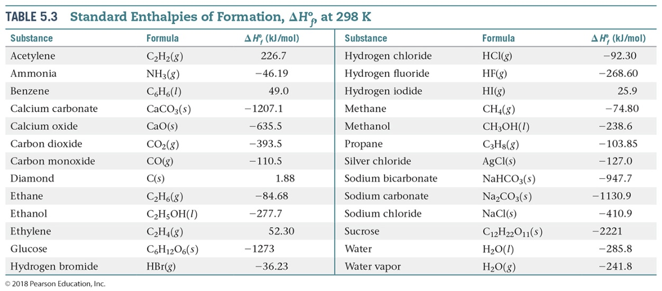
Integrative Exercise Putting Concepts Together
Continued
This enthalpy change equals the sum of the heats of formation of the products minus the heats of formation of the reactants, each multiplied by its coefficient in the balanced equation:
–6165.6 kJ = 6 [N₂(g)] + 12 [CO₂(g)] + 10 [H₂O(l)] + [O₂(g)] – 4 [C₃H₅N₃O₉(l)]
The values for N₂(g) and O₂(g) are zero, by definition. Using the values for H₂O(l) and CO₂(g) from Table 5.3 or Appendix C, we have
–6165.6 kJ = 12(–393.5 kJ) + 10(–285.8 kJ) – 4 [C₃H₅N₃O₉(l)]
[C₃H₅N₃O₉(l)] = –353.6 kJ/mol

Slide 67
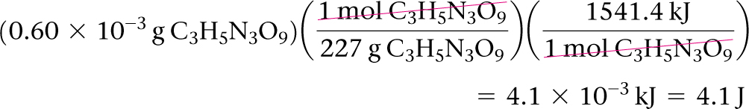
Integrative Exercise Putting Concepts Together
Continued
(c) Converting 0.60 mg C₃H₅N₃O₉(l) to moles and using the fact that the decomposition of 1 mol of C₃H₅N₃O₉(l) yields 1541.4 kJ we have:
(d) Because trinitroglycerin melts below room temperature, we expect that it is a molecular compound. With few exceptions, ionic substances are generally hard, crystalline materials that melt at high temperatures. (Section 2.6 and 2.7) Also, the molecular formula suggests that it is a molecular substance because all of its constituent elements are nonmetals.
(e) The energy stored in trinitroglycerin is chemical potential energy. When the substance reacts explosively, it forms carbon dioxide, water, and nitrogen gas, which are of lower potential energy. In the course of the chemical transformation, energy is released in the form of heat; the gaseous reaction products are very hot. This high heat energy is transferred to the surroundings. Work is done as the gases expand against the surroundings, moving the solid materials and imparting kinetic energy to them. For example, a chunk of rock might be impelled upward. It has been given kinetic energy by transfer of energy from the hot, expanding gases. As the rock rises, its kinetic energy is transformed into potential energy. Eventually, it again acquires kinetic energy as it falls to Earth. When it strikes Earth, its kinetic energy is converted largely to thermal energy, though some work may be done on the surroundings as well.

Slide 68
Thermodynamics related to a change in State of Matter.

Slide 69
CHANGES OF STATE
A solid changes to a liquid at its melting point, and a liquid changes to a gas at its boiling point. This warming process can be represented by a graph called a heating curve. This figure shows ice being heated at
a constant rate.
When heating ice at a constant rate, energy flows into the ice, the vibration within the crystal increase and the temperature rises (A→B). Eventually, the molecules begin to break free from the crystal and melting occurs (B→C). During the melting process all energy goes into breaking down the crystal structure; the temperature remains constant.

Slide 70
HEATING CURVE
120
F
VAPOR (STEAM)→
100
D
↑
LIQUID TO VAPOR
(WATER TO STEAM)
E
80
60
←LIQUID (HEATING)
40
SOLID TO
LIQUID (ICE
TO WATER)
↓
20
0
B
C
←SOLID (ICE)
A
-20
→HEAT ADDED→

Slide 71
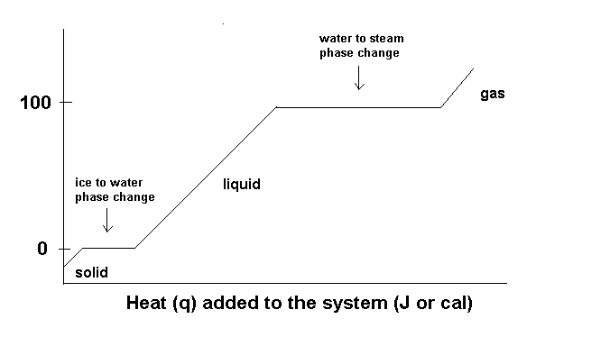
Water and the Changes of State
The energy required to heat (or cool) a solid (or heat/cool a liquid or a gas) can be calculated using q = msΔT. It requires additional energy to change states. The energy required to convert a specific amount of the solid to a liquid is known as the heat of fusion (q = ΔH_{fus}) and the energy required to convert a specific amount of a liquid to a gas is the heat of vaporization (q = ΔH_{vap}).
The total amount of energy can be calculated from q_{T} = q₁ + q₂ + q₃...
Heating curve for water
Temperature ºC

Slide 72
Workshop EN#6 on phase transition enthalpy
When ice at 0ºC melts to a liquid at 0ºC, it absorbs 0.334 kJ of heat/gram. Suppose the heat needed to melt 35.0 g of ice is absorbed from the water contained in the glass. If this water has a mass of 0.210 kg at 21ºC, what is the final temperature of the water?
Ethanol, C₂H₅OH, melts at -114ºC and boils at 78.0 ºC. The heat of fusion is 5.02 kJ/mol and the heat of vaporization is 38.56 kJ/mol. The specific heat of the solid and liquid ethanol are 0.97 J/gK and 2.3 J/gK, respectively. How much heat is required to convert 50.0 g of ethanol at -150.0 ºC to the vapor state at 78.0ºC?

