Slide 1
GENERAL SOLUTION CHEMISTRY
MOLARITY

Slide 2
PROPERTIES OF SOLUTIONS
1. A solution is composed of:
the solute: the minor component (least number of moles)
the solvent: the major component (largest number of moles)
2. Soluble / Insoluble: A soluble substance readily dissolves in the solvent. An insoluble substance will NOT dissolve readily in a solvent.
3. Miscible / immiscible: Two liquids are miscible in each other if they readily mix to form a uniform solution. Two immiscible liquids will always separate out into two distinct layers.
4. Solubility describes the amount of solute that will dissolve in a solvent. For example, 35.7 g of NaCl will dissolve in 100 mL of water at 0ºC , no more.

Slide 3
GENERAL PROPERTIES OF SOLUTIONS
1. A solution is a homogeneous mixture of two or more components.
2. It has variable composition.
3. The dissolved solute is molecular or ionic in size.
4. A solution may be either colored or colorless but is generally transparent.
5. The solute remains uniformly distributed throughout the solution and will not settle out through time.
6. The solute can be separated from the solvent by physical methods.

Slide 4
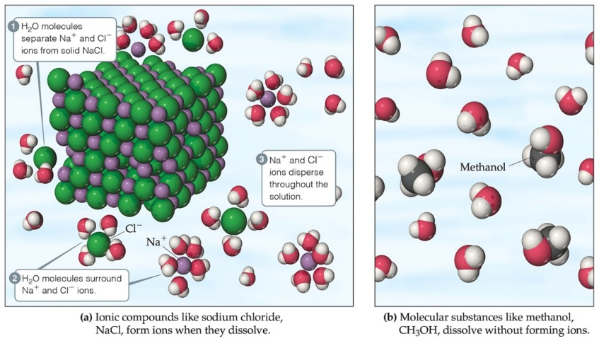
Aqueous Solutions
Substances can dissolve in water by different ways:
Ionic compounds dissolve by dissociation, where water surrounds the separated ions.
Molecular compounds interact with water, but most do NOT dissociate.
Some molecular substances react with water when they dissolve.
All substances dissolve by solvation, surrounding of the solute by solvent.

Slide 5
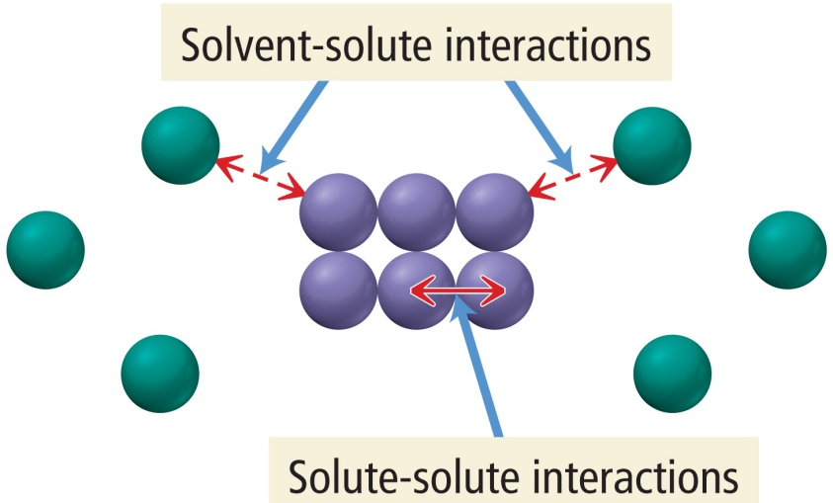
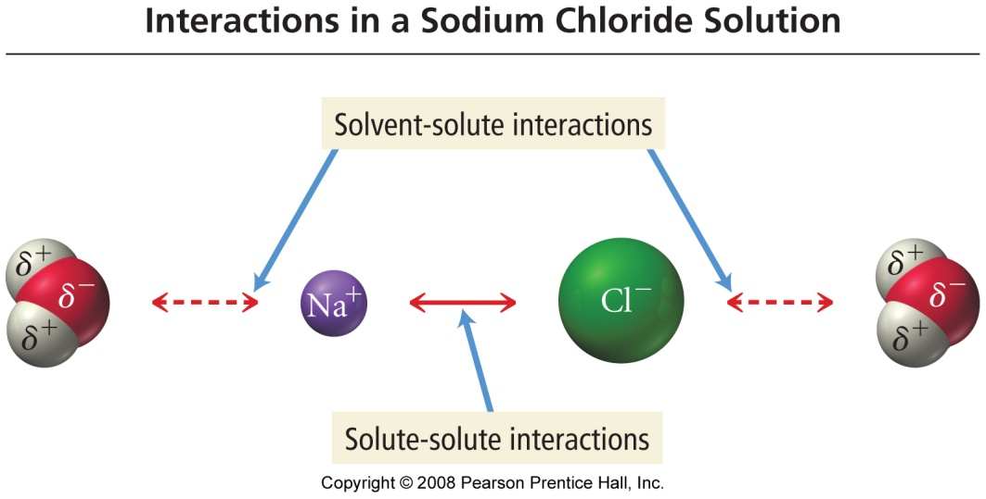
What Happens When a Solute Dissolves?
there are attractive forces between the solute particles holding them together
there are also attractive forces between the solvent molecules
when we mix the solute with the solvent, there are attractive forces between the solute particles and the solvent molecules
if the attractions between solute and solvent are strong enough, the solute will dissolve

Slide 6
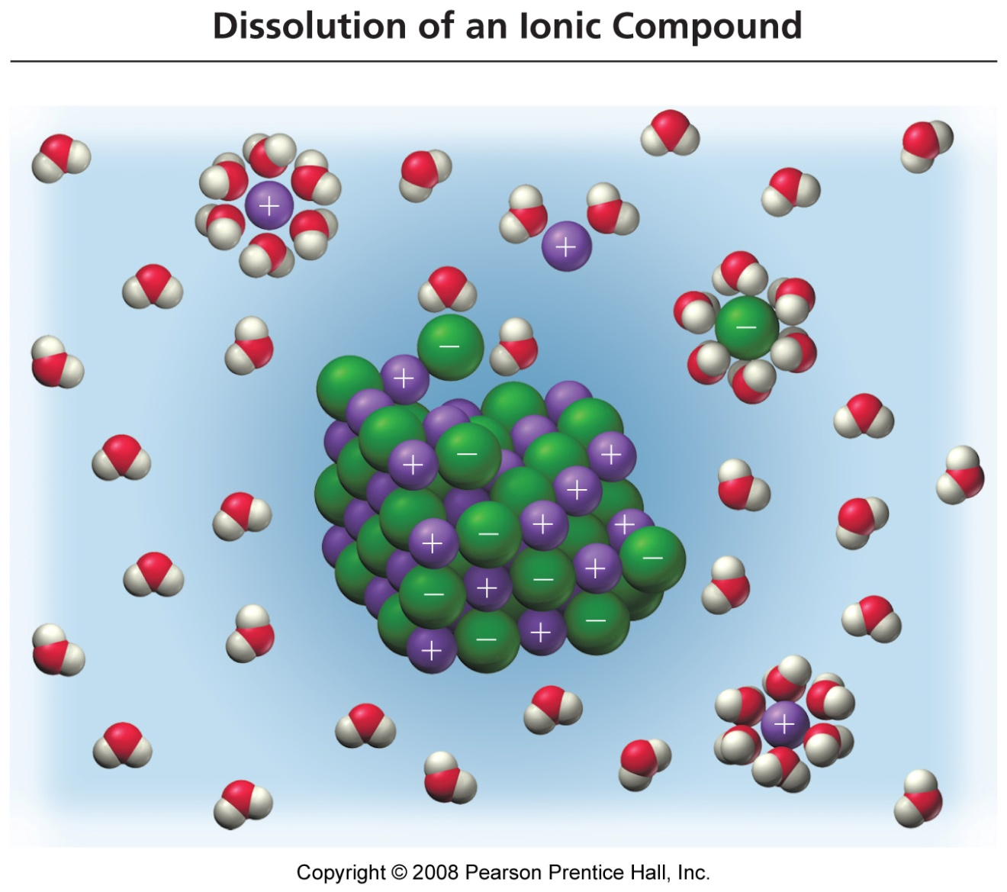
Table Salt Dissolving in Water
Each ion is attracted to the surrounding water molecules and pulled off and away from the crystal
When it enters the solution, the ion is surrounded by water molecules, insulating it from other ions
The result is a solution with free moving charged particles able to conduct electricity

Slide 7
Salt vs. Sugar Dissolved in Water
ionic compounds dissociate into ions when they dissolve
molecular compounds do not dissociate when they dissolve

Slide 8
ELECTROLYTES
Electrolytes are species which conducts electricity when dissolved in water. Acids, Bases, and Salts are all electrolytes.
Salts and strong Acids or Bases form Strong Electrolytes. Salt and strong acids (and bases) are fully dissociated therefore all of the ions present are available to conduct electricity.
HCl_{(s)} + H₂O → H₃O⁺ + Cl⁻
Weak Acids and Weak Bases for Weak Electrolytes.
Weak electrolytes are partially dissociated therefore not all species in solution are ions, some of the molecular form is present. Weak electrolytes have less ions avalible to conduct electricity.
NH₃ + H₂O ⇔ NH₄⁺ + OH⁻

Slide 9
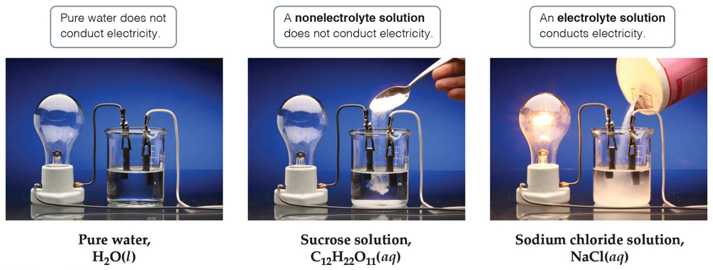
Electrolytes
A strong electrolyte dissociates completely when dissolved in water.
A weak electrolyte only dissociates partially when dissolved in water.
A nonelectrolyte does NOT dissociate in water.

Slide 10
CALCULATING MOLARITY
A measurement of the concentration of a solution
Molarity (M) is equal to the moles of solute (n) per liter of solution M = n / V = mol / L
1. Calculate the molarity of a solution prepared by mixing 1.5 g of NaCl in 500.0 mL of water.
2. How many grams of LiOH is needed to prepare 250.0 mL of a 1.25 M solution?
3. What is the molarity of hydroiodic acid if the solution is 47.0% HI by mass and has a density of 1.50 g/mL?

Slide 11
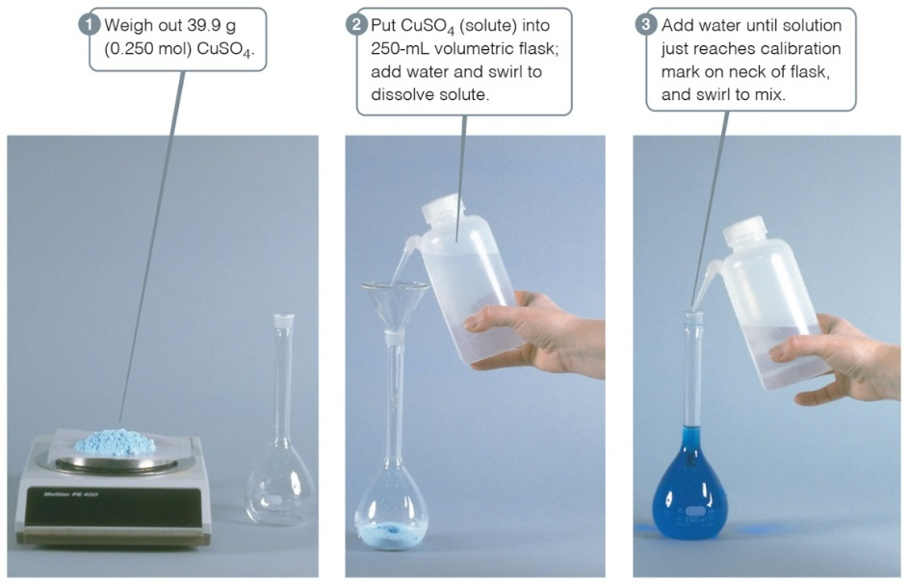
Mixing a Solution
To create a solution of a known molarity, weigh out a known mass (and, therefore, number of moles) of the solute.
Then add solute to a volumetric flask, and add solvent to the line on the neck of the flask.

Slide 12
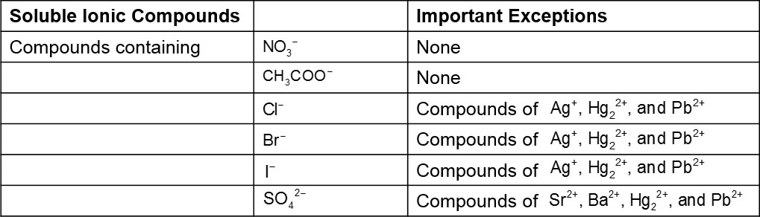
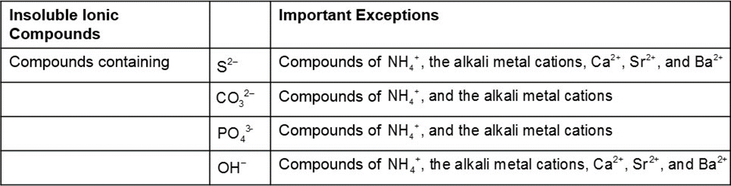
Solubility of Ionic Compounds
Not all ionic compounds dissolve in water.
A list of solubility rules is used to decide what combination of ions will dissolve.
Table 4.1 Solubility Guidelines for Common Ionic Compounds in Water

Slide 13
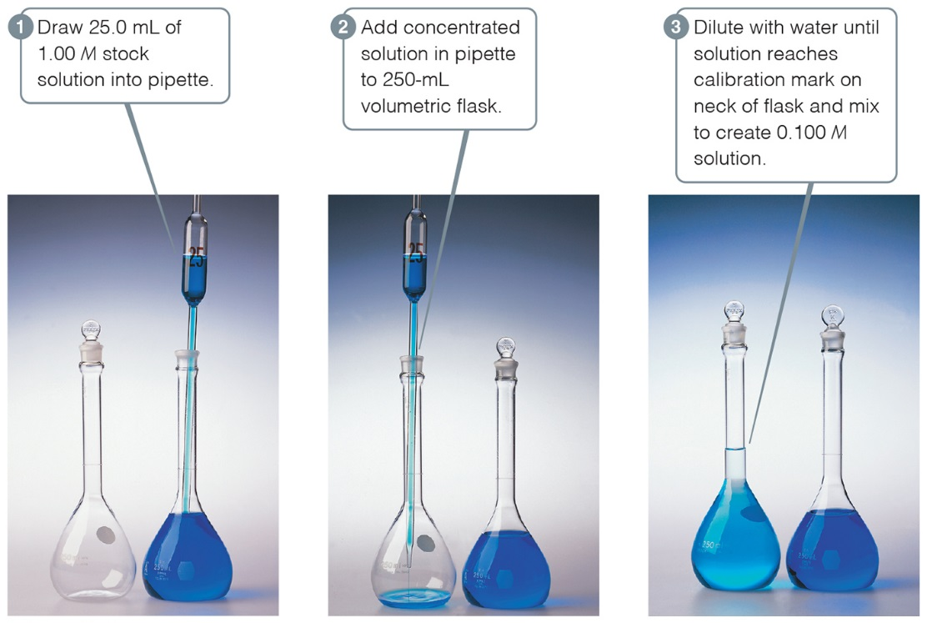
Dilution
A solution can be diluted by adding ONLY solvent. The concentration is LOWER, but the MOLES don’t change.

Slide 14
MOLARITY & DILUTION
M₁V₁ = M₂V₂
The act of diluting a solution is to simply add more water (the solvent) thus leaving the amount of solute unchanged.
Since the amount or moles of solute before dilution (n_{b}) and the moles of solute after the dilution (n_{a}) are the same: n_{b} = n_{a}
And the moles for any solution can be calculated by n=MV
A relationship can be established such that
M_{b}V_{b} = n_{b} = n_{a} = M_{a}V_{a}
Or simply : M_{b}V_{b} = M_{a}V_{a}

Slide 15
MOLARITY
& dilution EXAMPLE
Given a 6.00 M HCl solution, how would you prepare 250.0 mL of 0.150 M HCl?
M₁ = 6.00 mol/L M₂ = 0.150
V₁ = ? mL V₂ = 250.0 mL
M₁V₁ = M₂V₂
M₂ V₂ = V₁ = (0.150 mol/L) (250.0 mL) = 6.25 mL of 6 M HCl
M₁ 6.00 mol/L
You would need 6.25 mL of the 6.00 M HCl reagent which would be added to about 100 mL of DI water in a 250.0 mL graduated cylinder then more water would be added to the mixture until the bottom of the menicus is at 250.0 mL. Mix well.

Slide 16
Workshop M#1 on Molarity
1. Calculate the concentration of a NaCl solution made by diluting 20.0 mL of 2.55 M with 235.0 mL of water. CHAT
2. Describe in detail how you would prepare 0.500 liters of 0.456 M Li₃PO₄ solution from (a) 6.00 M Li₃PO₄ and (b) from pure solid Li₃PO₄
3. Calculate the molarity of a solution made by
dissolving 5.00 g of glucose in sufficient water to form 100 mL of solution.
4. How much 3.0 M H₂SO₄ would be required to make 500 mL of 0.10 M H₂SO₄? How much water must be added to the more concentrated solution to make the less concentrated solution?
5. If 21.4 g of solid zinc are treated with 3.13 L 0.200 M HCl, how many grams of hydrogen gas will theoretically be formed? How much of which reactant will be left unreacted? The products of this reaction are hydrogen gas and zinc chloride.

Slide 17
Extra problems
2.4 M
_________6. What is the concentration of 250.0 mL of 0.60 moles of HCl?
_________ 7. What volume of 0.7690 M LiOH will contain 55.3 g of LiOH?
_________ 8. How many liters of water must be added to 100.0 mL of 4.50 M HBr to make a solution that is 0.250 M HCl?
_________ 9. How many grams of barium sulfate that will precipitate when 500.0 mL of 0.340 M BaCl₂ and 300.0 mL of 1.70 M Na₂SO₄ are mixed?
10. How would you prepare 850.0 mL of a 0.020 M ferric chloride solution if you start with crystals of FeCl₃ . 6H₂O?
3.00 L
1.80 L
39.6 g
Weigh out 4.59 g of the hydrated salt to a graduated cylinder with 800.0 mL then add enough DI water to make 850 mL exactly.

Slide 18
MOLARITY & dilution
1. Given a 3.50 M HBr solution, how would you prepare 834.5 mL of 0.0122 M HBr?
2. What is the concentration of the resulting salt solution when 50.0 mL of 2.0 M lead(II) nitrate is mixed with 50.0 mL of 2.0 M potassium iodide?

Slide 19
Extra problems
1. What is the concentration of 35.0 mL of 0. 0556 moles of KCl?
2. How many grams of KCl is needed to prepare 50.0 mL of a 0.10 M solution?
3. How many milliliters of water must be added to 30.0 mL of 9.0 M KCl to make a solution that is 0.50 M KCl?
4. How many grams of calcium carbonate will precipitate when 500.0 mL of 0.340 M CaCl₂ and 300.0 mL of 1.70 M Na₂CO₃ are mixed?
5. What is the concentration of the product solution (assuming the volumes are additive) when 500.0 mL of 0.340 M CaCl₂ and 300.0 mL of 1.70 M Na₂CO₃ are mixed?

Slide 20
TITRATION
Titration of a strong acid with a strong base
ENDPOINT = POINT OF NEUTRALIZATION = EQUIVALENCE POINT
At the end point for the titration of a strong acid with a strong base, the moles of acid (H⁺) equals the moles of base (OH⁻) to produce the neutral species water (H₂O). If the mole ratio in the balanced chemical equation is NOT 1:1 then you must rely on the mole relationship and handle the problem like any other stoichiometry problem.
MOLES OF ACID = MOLES OF BASE
n_{acid} = n_{base}
Remember: M = n/V

Slide 21
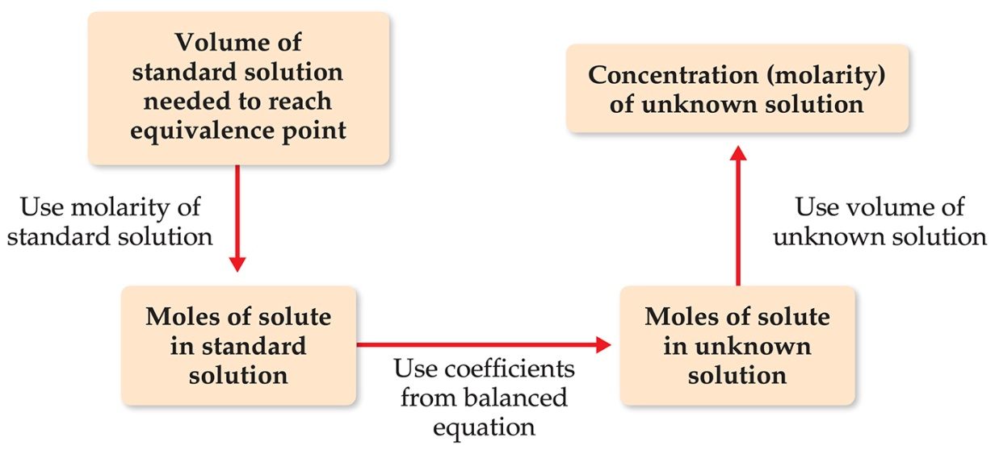
Titration
A solution of known concentration, called a standard solution, is used to determine the unknown concentration of another solution.
The reaction is complete at the equivalence point, which is based on the seen end point (color change).

Slide 22
Acid-Base Titrations
Acid-base titrations are an example of volumetric analysis, a technique in which one solution is used to analyze another. The solution used to carry out the analysis is called the titrant and is delivered from a device called a buret, which measures the volume accurately. The point in the titration at which enough titrant has been added to react exactly with the substance being determined is called the equivalence point (or stoichiometric point). This point is often marked by the change in color of a chemical called an indicator. The titration set-up is illustrated in the schematic shown above.

Slide 23
Acid-Base Titrations
The following requirements must be met in order for a titration to be successful:
The concentration of the titrant must be known (called the standard solution).
The exact reaction between the titrant and reacted substance must be known.
The equivalence point must be known. An indicator that changes color at, or very near, the equivalence point is often used.
The point at which the indicator changes color is called the end point. The goal is to choose an indicator whose end point coincides with the equivalence point. NOTE: Equivalence Point ≠ End Point! WHY???
5. The volume of titrant required to reach the equivalence point must be known (measured) as accurately as possible.

Slide 24
Acid-Base Titrations
When a substance being analyzed contains an acid, the amount of acid present is usually determined by titration with a standard solution containing hydroxide ions. The pH at certain points in the titration can be taken using different indicators, or alternatively, a pH meter can be used to give a readout of the exact pH.
pH = - Log [H₃O⁺]
pH > 7 is referred to as a base
pH < 7 is referred to as an acid
What is the pH of a 0.00122 M HCl solution?
If the hydronium ion concentration is 3.256 x 10⁻⁵, what is its pH?

Slide 25
Workshop M#2 on Titration:
1. What is the molarity of an NaOH solution if 48.0 mL is needed to neutralize 35.0 mL of 0.144 M H₂SO₄?
A sample of an iron ore is dissolved in acid, and the iron is converted to Fe⁺². The sample is then titrated with 47.20 mL of 0.02240 M MnO₄⁻ solution. The oxidation-reduction reaction that occurs during titration is:
8H⁺(aq) + MnO₄⁻(aq) + 5Fe⁺²(aq) → Mn⁺²(aq) + 5Fe⁺³(aq) + H₂O(l)
A. How many moles of permanganate ion were added to the solution?
B. How many moles of iron(II) ion were in the sample?
C. How many grams of iron were in the sample?
D. If the sample had a mass of 0.8890 g, what is the percentage of iron in the sample?

Slide 26
Lecture Problems (1 of 2)
1. What is the molarity of an HNO₃ solution if 23.54 mL is needed to neutralize 34.56 mL of 0.255 M Ca(OH)₂?
2. A solid sample of Zn(OH)₂ is added to 0.400 L of 0.550 M solution of HBr. The solution that remains is still acidic. It is then titrated with 0.500 M KOH solution and 165 mL of the KOH solution was required to reach the equivalence point. What was the mass of Zn(OH) ₂ added to the HBr solution?

Slide 27
Lecture Problems (2 of 2)
3. A 2.00 g of an impure sample of potassium dichromate, K₂Cr₂O₇, was dissolved in dil. sulfuric acid and made up to 250 mL in a calibrated volumetric flask. A 25.0 mL aliquot of this solution pipetted into a conical flask and excess potassium iodide solution and starch indicator were added. The liberated iodine was titrated with 0.100 M sodium thiosulfate, Na₂S₂O₃, and the starch turned colorless after 25.0 mL was added.
(a) Write a balanced equation for the reaction between the dichromate ion and the iodide ion which produces chromium (III) and iodine.
(b) Write a balanced redox equation for the reaction between the thiosulfate ion and iodine which produces the tetrathionate ion and iodide.
(c) Calculate both the moles of sodium thiosulfate used in the titration and the number of moles of iodine titrated.
(d) Calculate the moles of dichromate ion that reacted to give the iodine titrated in the titration.
(e) Calculate mass of potassium dichromate in the 25.0 mL aliquot titrated.
(f) Calculate the total mass of potassium dichromate in the original sample (how pure was it?)

