Slide 1
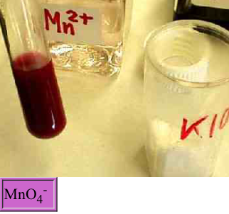
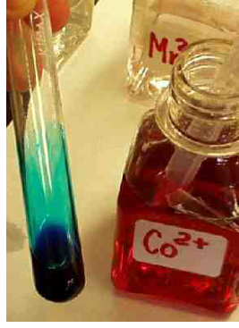
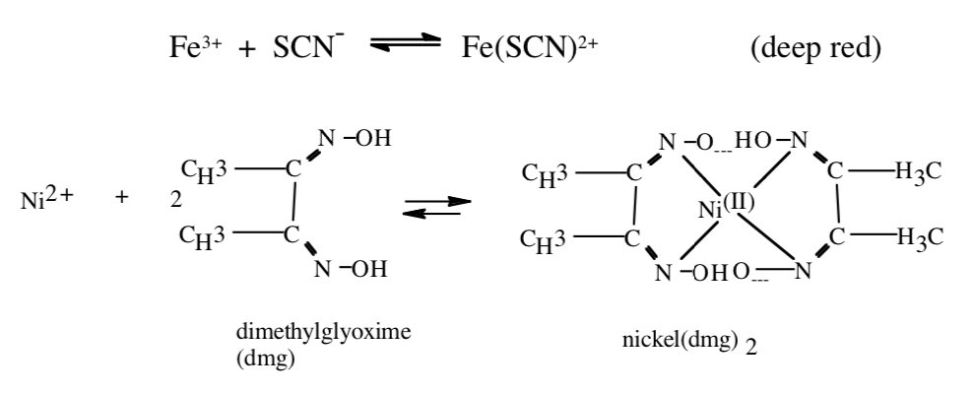
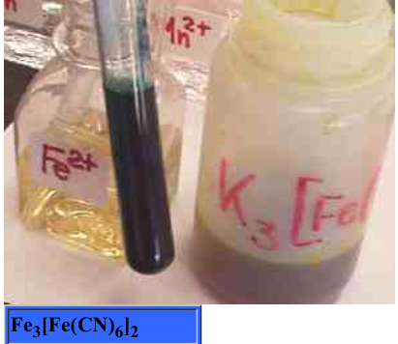


CHAPTER 3 CHEMICAL REACTIONS
cooking
fireworks

Slide 2
ASPECTS THAT DRIVE A CHEMICAL REACTION
Energy Changes in Chemical Reactions
Note: We will learn more about this in the next chapter. For now, consider thermodynamic equations.
CH₄(g) + O₂(g) → CO₂(g) + H₂O(g) + heat energy exothermic
Heat energy + NH₄Cl(s) → NH₄⁺(aq) + Cl⁻(aq) endothermic
SO before we learn why chemical reactions occur, we must know the types of reactions possible.
ΔH
ΔH

Slide 3
TYPES OF COMBUSTION REACTIONS
A reaction which generally involves the presence of oxygen and releases energy (exothermic).
• Hydrocarbons and other organic compounds combine with excess oxygen to form carbon dioxide and water.
Propanol (CH₃CH₂CH₂OH) is burned completely in air.
Metals combine with oxygen to form metallic oxides.
Calcium metal is heated strongly in the presence of oxygen.
• Nonmetallic hydrides combine with oxygen to form water and nonmetal oxides.
Gaseous diborane, B₂H₆, is burned in excess oxygen.
CH₃CH₂CH₂OH(l) + 5O₂ (g) → 3CO₂(g) + 4H₂O(g)
Ca(s) + 2O₂ (g) → CaO (g)
B₂H₆(g) + 3O₂ (g) → B₂O₃(s) + 3H₂O(g)

Slide 4
TYPES OF COMBUSTION Rx
CHAT PROBLEMS
Q1: If nonmetallic sulfides combine with oxygen to form sulfur dioxide and nonmetal oxides, give the formula for the nonmetal oxide produced when Carbon disulfide vapor is burned in excess oxygen.
Write the balanced chemical equation.
Q2: In general, if sulfur is present then SO₂ is formed and if nitrogen is present, NO₂ is formed. Write a balanced chemical equation for the reaction of oxygen with ammonia(NH₃) in the presence of a catalyst, platinum.
_{Pt}
4 NH₃(g) + 7 O₂ (g) → 4 NO₂(g) + 6 H₂O(g)

Slide 5
SYNTHESIS or COMBINATION REACTIONS
A metal combines with a nonmetal to form a binary salt.
Sodium metal is dropped into a container of chlorine gas.
Lithium metal is dropped into a container of nitrogen gas.
• Nonmetallic oxides and water form acids. (The nonmetal retains its oxidation number).
Dinitrogen pentoxide is bubbled into water.
CHAT QUESTION:
What gas must be bubbled into water to make nitrous acid?
2Na(s) + Cl₂(g) → 2NaCl(s)
6Li(s) + N₂(g) → 2Li₃N(s) lithium azide
N₂O₅(g) + H₂O(l) → 2 HNO₃(aq)
HNO₂(aq) nitrous acid with N⁺³ = N₂O₃(g)

Slide 6
SYNTHESIS or COMBINATION REACTIONS
• Metallic oxides and nonmetallic oxides form salts.
Solid calcium oxide is added to sulfur trioxide.
CHAT QUESTION
Propose an equation for the reaction between solid iron(II) oxide and carbon dioxide.
CaO(s) + SO₃(aq) → CaSO₄(s)
FeO (s) + CO₂(aq) → FeCO₃(s)

Slide 7
DECOMPOSITION REACTIONS
• Metallic carbonates decompose into metallic oxides and carbon dioxide.
A sample of magnesium carbonate is heated.
• Metallic chlorates decompose into metallic chlorides and oxygen.
A sample of magnesium chlorate is heated.
Ammonium carbonate decomposes into ammonia, water, and carbon dioxide.
MgCO₃ (s) → MgO(s) + CO₂(g)
Mg(ClO₃ )₂(s) → MgCl₂(s) + O₂(g)
Mg(ClO₃ )₂(s) → MgCl₂(s) + O₂(g)
(NH₄)₂CO₃(s) → CO₂(g) + H₂O(g) + 2NH₃ (g)
(NH₄)₂CO₃(s) → CO₂(g) + H₂O(g) + 2NH₃ (g)

Slide 8
DECOMPOSITION
Some common reactions should be memorized.
• Sulfurous acid (H₂SO₃) decomposes into sulfur dioxide and water.
• Carbonic acid (H₂CO₃) decomposes into carbon dioxide and water.
• Hydrogen peroxide decomposes into water and oxygen.
• Ammonium hydroxide decomposes into ammonia and water.

Slide 9
SINGLE REPLACEMENT/DISPLACEMENT
Use a standard reduction potential table or the Activity Series
For metal displacements, the metal with the more POSITIVE reduction potential (i.e. less active) will be replaced; for halogens, the displacement order follows the periodic table, fluorine being the most reactive. Consider the following example:
Magnesium metal is added to an aqueous solution of nickel sulfate.
Aluminum turnings are added to a solution of iron(III) chloride.
• Active nonmetals replace less active nonmetals from their compounds in aqueous solution.
Chlorine gas is bubbled into a solution of potassium iodide.
Mg(s) + NiSO₄ (aq) → ?
Mg(s) + NiSO₄ (aq) → Ni(s) + MgSO₄ (aq)
Al(s) + FeCl₃ (aq) → Fe(s) + AlCl₃ (aq)
KI(aq) + Cl₂ (g) → KCl(aq) + I₂ (g)

Slide 10
In the previous single replacement reaction examples, the reaction was written as molecular equations. Although this equation shows the reactants and products of the reaction, it does not give a very clear picture of what truly occurs in solution. In fact, such an aqueous solution actually contains individual IONS, not molecules, in solution. Ions such as these that do NOT participate directly in the reaction are called spectator ions. Net Ionic equations include only those solution components directly involved in the reaction. Chemists usually write the net ionic equation for a reaction in solution because it gives the actual forms of the reactants and products and only includes the species that undergo a change. Write the following single displacement reactions as net ionic equations.
• Active metals replace hydrogen in acids.
Lithium is added to hydrochloric acid (HCl).
• Active metals replace hydrogen in water.
Sodium is added to water.
Li(s) + HCl(aq) → LiCl (aq) + H₂ (g)
Li(s) + 2H⁺ (aq) → Li⁺ (aq) + H₂ (g)
Na(s) + H₂O(l) → NaOH (aq) + H₂ (g)
Na(s) + H₂O(l) → Na⁺ + OH⁻ + H₂ (g)

Slide 11
ACTIVITY SERIES OF SOME SELECTED METALS
A brief activity series of selected metals, hydrogen and halogens are shown
below. The series are listed in descending order of chemical reactivity, with the most active metals and halogens at the top (the elements most likely to undergo oxidation). Any metal on the list will replace the ions of those metals (to undergo reduction) that appear anywhere underneath it on the list.
METALS HALOGENS
K (most oxidized F₂
Ca Cl₂
Na Br₂
Mg l₂
Al
Zn
Fe
Ni
Sn
Pb
H
Cu
Ag
Hg
Au(least oxidized)
More reactive
Oxidation refers to the loss of
electrons and reduction refers to the
gain of electrons
Least reactive

Slide 12
DOUBLE REPLACEMENT (or metathesis)
All double replacement reactions must have a driving force to allow for it to go to completion. This driving force is the removal of at least one pair of ions from solution, which can occur in one of two ways:
1. formation of a precipitate*
2. formation of a gas
* formation of a precipitate – apply the solubility rules
Solubility Rules: Please note that “soluble” refers to the ability to dissolve in a solvent, while “insoluble” refers to a solid or precipitate. The Solubility Rules are summarized on the next slide.

Slide 13
NEGATIVE ION POSITIVE ION SOLUBILITY
Chloride (Cl⁻), Bromide (Br⁻), Ag⁺, Pb²⁺, Hg₂²⁺, Cu⁺ Insoluble
Iodide (I⁻)
Phosphate (PO₄³⁻) Carbonate All positive ions EXCEPT Insoluble
(CO₃²⁻), Sulfite (SO₃²⁻), alkali ions and NH₄⁺
Hydroxide (OH⁻),
Sulfate (SO₄²⁻) Ca²⁺, Sr²⁺, Ba²⁺, Ra²⁺, Ag⁺, Pb²⁺ Insoluble
Sulfide (S²⁻) All positive ions EXCEPT alkali Insoluble ions, alkaline earth ions, NH₄⁺
*** All nitrates, perchlorates, and most acetates are soluble.***
Example: A solution of potassium chloride is mixed with a solution of silver nitrate.

Slide 14
Formation of a Gas
Common gases formed in metathesis reaction are listed below:
H₂S Any sulfide (salt of S²⁻) plus any acid form H₂S(g) and a salt.
Solid iron(II) sulfide is mixed with hydrochloric acid.
CO₂ Any carbonate (salt of CO₃²⁻) plus any acid form CO₂(g), H₂O, and a salt.
Potassium carbonate is reacted with nitric acid.
FeS(s) + 2HCl(aq) → FeCl₂ (aq) + H₂S(g)
FeS(s) + 2HCl(aq) → ?
FeS(s) + 2H⁺(aq) → Fe²⁺ (aq) + H₂S(g) net ionic
K₂CO₃ (aq) + 2HNO₃(aq) → H₂CO₃(aq) + 2KNO₃(aq)
K₂CO₃ (aq) + 2HNO₃(aq) → ?
K₂CO₃ (aq) + 2HNO₃(aq) → H₂O (l) + CO₂(g) + 2KNO₃(aq)
K⁺CO₃ ²⁻ (aq) + 2H⁺NO₃⁻ (aq) → H₂O (l) + CO₂(g) + 2K⁺NO₃⁻ (aq)
CO₃ ²⁻ (aq) + 2H⁺ (aq) → H₂O (l) + CO₂(g)
H₂CO₃(aq) → H₂O (l) + CO₂(g)

Slide 15
Formation of a Gas
Common gases formed in metathesis reaction are listed below:
SO₂ Any sulfite (salt of SO₃²⁻) plus any acid form SO₂(g), H₂O, and a salt.
Sodium sulfite is combined with hydrochloric acid.
SO₂ Any sulfite (salt of SO₃²⁻) plus any acid form SO₂(g), H₂O, and a salt.
Potassium sulfite is combined with nitric acid.
Na₂SO₃(s) + 2HCl(aq) → NaCl(aq) + SO₂(g) + H₂O(l)
Na₂SO₃(s) + 2HCl(aq) → ?
Na₂SO₃(s) + 2H⁺(aq) → Na⁺ (aq) + SO₂(g) + H₂O(l) net ionic
K₂SO₃ (aq) + 2HNO₃(aq) → H₂SO₃(aq) + 2KNO₃(aq)
K₂SO₃ (aq) + 2HNO₃(aq) → ?
K₂SO₃ (aq) + 2HNO₃(aq) → H₂O (l) + SO₂(g) + 2KNO₃(aq)
K⁺SO₃ ²⁻ (aq) + 2H⁺NO₃⁻ (aq) → H₂O (l) + SO₂(g) + 2K⁺NO₃⁻ (aq)
H₂SO₃(aq) → H₂O (l) + SO₂(g)
SO₃ ²⁻ (aq) + 2H⁺ (aq) → H₂O (l) + SO₂(g)
CHAT

Slide 16
ACID/BASE REACTIONS:
Acid + Base → Salt + Water
One mole of hydrogen ions will react with one mole of hydroxide ions to produce one mole of water. Diprotic (acids with two ionizable hydrogens) and triprotic (acids with three ionizable hydrogens) acids will also be encountered.
Arrhenius Acid – a compound that releases H⁺ (proton)/ H₃O⁺ (hydronium ion) in water.
An aqueous nitric acid solution:
B. Arrhenius Base – a compound that produces OH⁻ in water.
Potassium hydroxide pellets are dissolved in water:
C. Brønsted-Lowry Acid – proton donor.
Nitric acid reacts with potassium hydroxide.
H₂O(l)
HNO₃(aq) → H₃O⁺ (aq) + NO₃⁻ (aq)
H₂O(l)
KOH(s) → K⁺ + OH⁻
HNO₃(aq) + KOH(s) → H₂O(l) + KNO₃(aq)
H⁺ (aq) + KOH(s) → H₂O(l) + K⁺ (aq) net ionic
H⁺ NO₃⁻(aq) + KOH(s) → H₂O(l) + K⁺ + NO₃⁻ (aq)

Slide 17
ACID/BASE REACTIONS:
Acid + Base → Salt + Water
D. Brønsted-Lowry Base – proton acceptor
Sulfuric acid reacts with barium hydroxide.
E. Strong Acid – fully dissociates in solution, releasing H⁺ ion(s)
Hydrobromic acid reacts with calcium hydroxide.
Weak Acid – does NOT fully dissociate in solution
Acetic acid reacts with potassium hydroxide.
Strong Base – completely protonated in solution
Hydrochloric acid reacts with sodium hydroxide.
H. Weak Base – NOT completely protonated in solution
Nitric acid reacts with ammonium hydroxide.
email
HBr(aq) + Ca(OH)₂(aq) → H₂O(l) + CaBr₂(aq)
HC₂H₃O₂(aq) + KOH(aq) ↔ KC₂H₃O₂(aq) + H₂O(l)

Slide 18
ACID/BASE REACTIONS:
STRONG vs WEAK
_ completely ionized _ partially ionized
_ strong electrolyte _ weak electrolyte
_ ionic/very polar bonds _ some covalent bonds
Strong Acids: Strong Bases:
HClO₄ LiOH
H₂SO₄ NaOH
HI KOH
HBr Ca(OH)₂
HCl Sr(OH)₂
HNO₃ Ba(OH)₂

Slide 19
OXIDATION/REDUCTION
(commonly abbreviated REDOX)
The last set of reactions that we will cover involve the transfer of electrons between reactants. Such reactions are called oxidation-reduction reactions, or REDOX.
When an atom, ion, or molecule has become more positively charged, we say that is has been oxidized. Loss of electrons by a substance is called oxidation. For example, when solid calcium loses two electrons, it is oxidized to Ca⁺² in solution. This can be represented by the following half-reaction: Ca → Ca⁺² + 2e⁻
Leo Ger
Oxidation = loss of e-
In contrast, when an atom, ion, or molecule has become more negatively charged, we say that it is reduced. Gain of electrons by a substance is called reduction. For example, when fluorine gains electrons, it is converted to the fluoride ion as shown in the following half-reaction:
F₂ + 2e⁻ → 2F⁻
Overall, when one reactant loses electrons, another reactant must gain them. As such, the oxidation of one substance is ALWAYS accompanied by the reduction of another as electrons are transferred between them.
Reducton = gain of e-

Slide 20
ELECTRON TRANSFER
Reduction-Oxidation Rx (REDOX)
A reaction in which electrons are transferred from one species to another.
- oxidation means the loss of electrons
- reduction means the gain of electrons
- electrolyte is a substance dissolved in water which produces an electrically conducting solution
- nonelectrolyte is a substance dissolved in water which does not conduct electricity.
Combustion reactions are redox reactions
CH₄(g) + 2O₂(g) → 2H₂O(g) + CO₂(g)
Rusting is a redox reaction:
4Fe(s) + 3O₂(g) → 2Fe₂O₃(s)
Electrochemistry involves redox reactions:
Cu(s) + 2AgNO₃(aq) → 2Ag(s) + Cu(NO₃)₂(aq)
Notes:
20

Slide 21
Rules for Balancing Oxidation/Reduction Reactions
Half Reaction Method
1. Write the corresponding half reactions.
2. Balance all atoms except O and H.
3. Balance O; add H₂O as needed.
4. Balance H as acidic (H⁺).
5. Add electrons to both half reactions and balance.
6. Add the half reactions; cross out “like” terms.
7. If basic or alkaline, add the equivalent number of hydroxides
(OH⁻) to counterbalance the H⁺ (remember to add to both sides
of the equation). Recall that H⁺ + OH⁻ → H₂O.

Slide 22
Balancing Redox Reactions:
acidic: Cr₂O₇²⁻ + Fe²⁺ → Cr³⁺ + Fe³⁺
Cr₂O₇²⁻ → Cr³⁺
Fe²⁺ → e⁻ + Fe³⁺
______________________________________________________
14H⁺ + Cr₂O₇²⁻ + 6 Fe²⁺ → 2Cr³⁺ + 6 Fe³⁺ + 7 H₂O
Cr₂O₇²⁻ → 2Cr³⁺ + 7 H₂O
6e⁻ + 14H⁺ + Cr₂O₇²⁻ 2Cr³⁺ + 7 H₂O
14H⁺ + Cr₂O₇²⁻ 2Cr³⁺ + 7 H₂O
6( Fe²⁺ → e⁻ + Fe³⁺ )
Notes:
22

Slide 23
Balancing Redox Reactions:
Basic: Co²⁺_{(aq)} + H₂O_{2(aq)} → Co(OH)₃↓ + H₂O
2e⁻ + 2H⁺ + H₂O₂ → 2H₂O
H₂O₂ → H₂O
3H₂O + Co²⁺ → Co(OH)₃ + 3H⁺ + 1e⁻
Co²⁺ → Co(OH)₃
________________________________________
2H⁺ + H₂O₂ + 6H₂O + 2Co²⁺ → 2H₂O + 2Co(OH)₃ + 6H⁺
H₂O₂ + 4H₂O + 2Co²⁺ → 2Co(OH)₃ + 4H⁺
Acidic
Add OH- to both sides
4OH⁻ + H₂O₂ + 4H₂O + 2Co²⁺ → 4H₂O + 2Co(OH)₃
4OH⁻ + H₂O₂ + 2Co²⁺ → 2Co(OH)₃
Basic
Notes:
23

Slide 24
Br₂ (aq) + OH⁻ (aq) → Br⁻ (aq) + BrO₃⁻ (aq) + H₂O (l)
in acidic solution
2. MnO₄⁻(aq) + C₂O₄⁻²(aq) → CO₂(g) + Mn⁺²(aq)
in basic solution
3. CrO₄²⁻ (aq) + CN⁻ (aq) → CNO⁻ (aq) + Cr(OH)₄⁻ (aq)
in basic solution
4. Fe(OH)₂ (s) + CrO₄²⁻ (aq) → Fe₂O₃ (s) + Cr(OH)₄⁻ (aq)
in basic solution

Slide 25
CHEMICAL EQUILIBRIA
H₂CO₃ ⇔ CO₂ + H₂O
CaCO₃ ⇔ CaO + CO₂
CH₃COOH ⇔H⁺ + CH₃COO⁻
NH₃ + H₂O ⇔ NH₄OH

