Slide 1
Complex Ion Formation
transition metals tend to be good Lewis acids
they often bond to one or more H₂O molecules to form a hydrated ion
H₂O is the Lewis base, donating electron pairs to form coordinate covalent bonds
Ag⁺(aq) + 2 H₂O(l) ⇔ Ag(H₂O)₂⁺(aq)
ions that form by combining a cation with several anions or neutral molecules are called complex ions
e.g., Ag(H₂O)₂⁺
the attached ions or molecules are called ligands
e.g., H₂O
1
Notes:
1

Slide 2
Complex Ion Equilibria
if a ligand is added to a solution that forms a stronger bond than the current ligand, it will replace the current ligand
Ag(H₂O)₂⁺_{(aq)} + 2 NH_{3(aq)} ⇔ Ag(NH₃)₂⁺_{(aq)} + 2 H₂O_{(l)}
generally H₂O is not included, since its complex ion is always present in aqueous solution
Ag⁺_{(aq)} + 2 NH_{3(aq)} ⇔ Ag(NH₃)₂⁺_{(aq)}
2
Notes:
2

Slide 3
Formation Constant
the reaction between an ion and ligands to form a complex ion is called a complex ion formation reaction
Ag⁺_{(aq)} + 2 NH_{3(aq)} ⇔ Ag(NH₃)₂⁺_{(aq)}
the equilibrium constant for the formation reaction is called the formation constant, K_{f}
3
Notes:
3

Slide 4
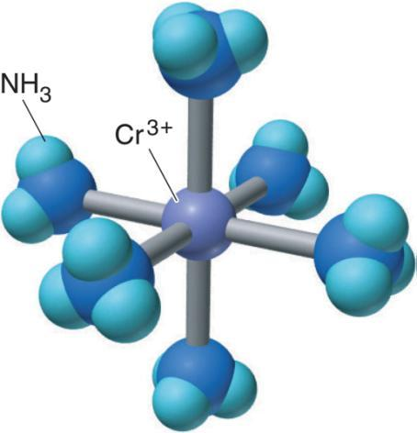
Cr(NH₃)₆³⁺, a typical complex ion.
Notes:
4

Slide 5
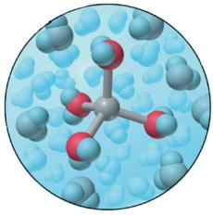

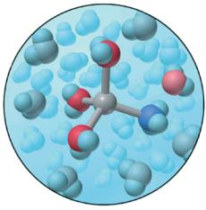
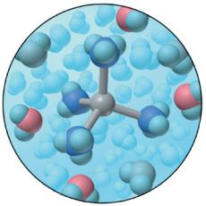
The stepwise exchange of NH₃ for H₂O in M(H₂O)₄²⁺.
NH₃
M(H₂O)₄²⁺
3NH₃
M(H₂O)₃(NH₃)²⁺
M(NH₃)₄²⁺
Notes:
5

Slide 6
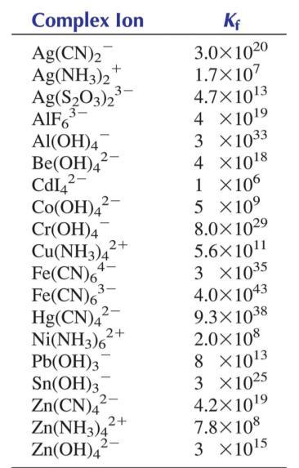
Formation Constants (K_{f}) at 25ºC
Notes:
6

Slide 7
K_{f} = Formation Constant
M⁺ + L⁻ ←→ ML
K_{d} = Dissociation constant
ML ←→ M⁺ + L⁻
K_{d} = 1
K_{f}
Notes:
7

Slide 8
The Effect of Complex Ion Formation on Solubility
In general: the solubility of an ionic compound containing a metal cation, that forms a complex ion, increases in the presence of aqueous ligands
8
Notes:
8

Slide 9
COMPLEX ION EQUILIBRIA
Transition metal Ions form coordinate covalent bonds with
molecules or anions having a lone pair of e-.
AgCl_{(s)} ←→ Ag⁺ + Cl⁻ K_{sp} = 1.82 x 10⁻¹⁰
Ag⁺ + 2NH₃ ←→ Ag(NH₃)₂⁺ K_{f} = 1.7 x 10⁷
AgCl + 2NH₃ ←→ Ag(NH₃)₂⁺ + Cl⁻ K_{eq} = K_{sp} x K_{f}
Complex Ion: Ag(NH₃)₂⁺ which bonds like: H₃N:Ag:NH₃
metal = Lewis acid
ligand = Lewis base
K_{f} = [Ag(NH₃)₂⁺] [Ag⁺][NH₃]₂
adding NH₃ to a solution in equilibrium with AgCl_{(s)} increases the solubility of Ag⁺
Notes:
9

Slide 10
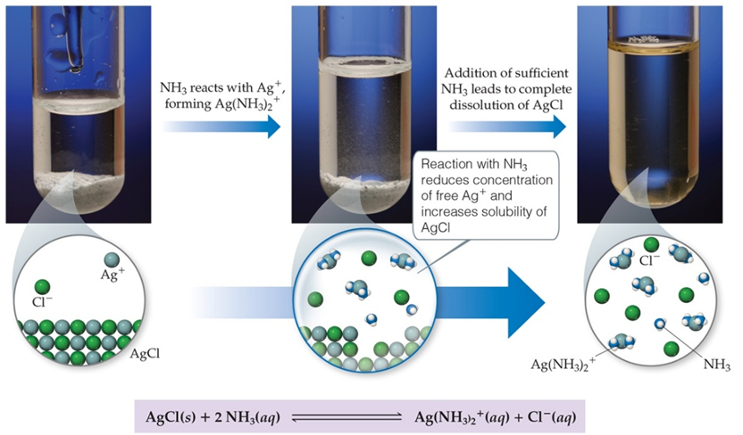
How Complex Ion Formation Affects Solubility
Silver chloride is insoluble. It has a K_{sp} of 1.6x10⁻¹⁰. In the presence of NH₃ the solubility greatly increases because Ag⁺ will form complex ions with NH₃.

Slide 11
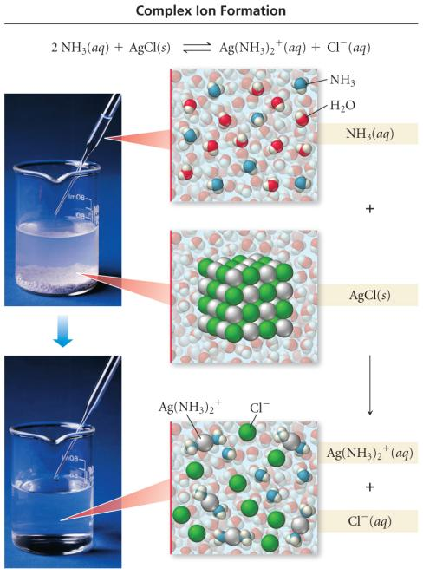
11
Notes:
11

Slide 12
Example – 200.0 mL of 1.5 x 10⁻³ M Cu(NO₃)₂ is mixed with 250.0 mL of 0.20 M NH₃. What is the [Cu²⁺] at equilibrium?
Write the formation reaction and K_{f} expression. Look up K_{f} value
Determine the concentration of ions in the diluted solutions
Cu²⁺(aq) + 4 NH₃(aq) ⇔ Cu(NH₃)₄²⁺(aq)
12
Notes:
12

Slide 13
Example – 200.0 mL of 1.5 x 10⁻³ M Cu(NO₃)₂ is mixed with 250.0 mL of 0.20 M NH₃. What is the [Cu²⁺] at equilibrium?
Create an ICE table. Since K_{f} is large, assume all the Cu²⁺ is converted into complex ion, then the system returns to equilibrium
Cu²⁺(aq) + 4 NH₃(aq) ⇔ Cu(NH₃)₂²⁺(aq)
 | [Cu²⁺] | [NH₃] | [Cu(NH₃)₂²⁺]
Initial | 6.7E-4 | 0.11 | 0
Change | -≈6.7E-4 | -4(6.7E-4) | + 6.7E-4
Equilibrium | x | 0.11 | 6.7E-4
13
Notes:
13

Slide 14
Example – 200.0 mL of 1.5 x 10⁻³ M Cu(NO₃)₂ is mixed with 250.0 mL of 0.20 M NH₃. What is the [Cu²⁺] at equilibrium?
Substitute in and solve for x
confirm the “x is small” approximation
Cu²⁺(aq) + 4 NH₃(aq) ⇔ Cu(NH₃)₂²⁺(aq)
 | [Cu²⁺] | [NH₃] | [Cu(NH₃)₂²⁺]
Initial | 6.7E-4 | 0.11 | 0
Change | -≈6.7E-4 | -4(6.7E-4) | + 6.7E-4
Equilibrium | x | 0.11 | 6.7E-4
since 2.7 x 10⁻¹³ << 6.7 x 10⁻⁴, the approximation is valid
14
Notes:
14

Slide 15
Sample Problem 2
Calculating the Effect of Complex-Ion Formation
on Solubility
PROBLEM:
In black-and-white film developing, excess AgBr is removed from the film negative by “hypo”, an aqueous solution of sodium thiosulfate (Na₂S₂O₃), through formation of the complex ion Ag(S₂O₃)₂³⁻. Calculate the solubility of AgBr in (a) H₂O; (b) 1.0M hypo. K_{f} of Ag(S₂O₃)₂³⁻ is 4.7x10¹³ and K_{sp} AgBr is 5.0x10⁻¹³.
PLAN:
Write equations for the reactions involved. Use K_{sp} to find S, the molar solubility. Consider the shifts in equilibria upon the addition of the complexing agent.
SOLUTION:
Notes:
15

Slide 16

Workshop F #1 on Complex Ion Formation
Q 1. Calculate [Ag⁺] present in a solution at equilibrium when concentrated NH₃ is added to a 0.010 M solution of AgNO₃ to give an equilibrium concentration of [NH₃] = 0.20M.
Q2. Silver chloride usually does not ppt in solution of 1.0 M NH₃. However AgBr has a smaller Ksp. Will AgBr ppt from a solution containing 0.010 M AgNO₃, 0.010 M NaBr and 1.0 M NH₃? Ksp = 5.0 x 10⁻¹³
Q3. Calculate the molar solubility of AgBr in 1.0M NH₃?
Notes:
16

Slide 17
Solubility of Amphoteric Metal Hydroxides
many metal hydroxides are insoluble
all metal hydroxides become more soluble in acidic solution
shifting the equilibrium to the right by removing OH⁻
some metal hydroxides also become more soluble in basic solution
acting as a Lewis base forming a complex ion
substances that behave as both an acid and base are said to be amphoteric
some cations that form amphoteric hydroxides include Al³⁺, Cr³⁺, Zn²⁺, Pb²⁺, and Sb²⁺
17
Notes:
17

Slide 18
Amphoteric Complexes
Most MOH and MO compounds are insoluble in water but some will dissolve in a strong acid or base. Al³⁺, Cr³⁺, Zn²⁺, Sn²⁺, Sn⁴⁺, and Pb²⁺ all form amphoteric complexes with water.
Al(H₂O)₆³⁺ + OH- ⇆ Al(H₂O)₅(OH)²⁺ + H₂O
Al(H₂O)₅(OH)²⁺ + OH- ⇆ Al(H₂O)₄(OH)₂⁺ + H₂O
Al(H₂O)₄(OH)₂⁺ + OH- ⇆ Al(H₂O)₃(OH)₃ ↓ + H₂O
Al(H₂O)₃(OH)₃ ↓ + OH- ⇆ Al(H₂O)₂(OH)₄⁻ + H₂O
Notes:
18

Slide 19
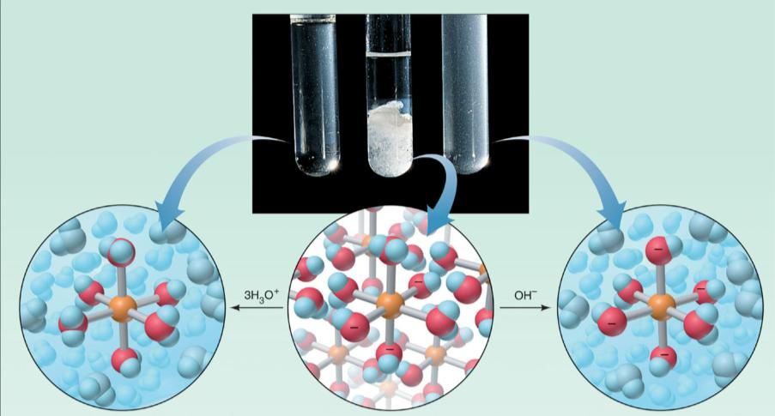
The amphoteric behavior of aluminum hydroxide.
3H₂O(l) + Al(H₂O)₃(OH)₃(s)
Al(H₂O)₃(OH)₃(s)
Al(H₂O)₃(OH)₄⁻(s) + H₂O(l)
Notes:
19

Slide 20
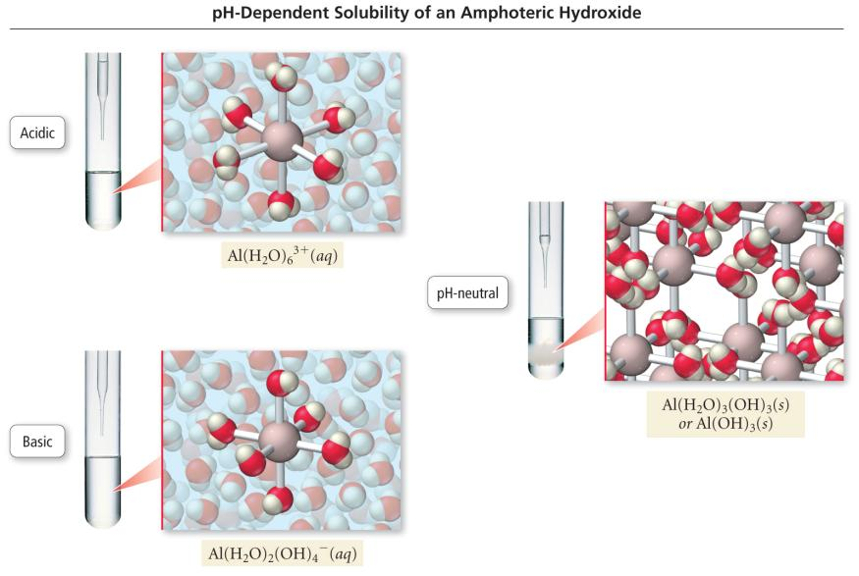
20
Notes:
20

Slide 21
3 STEPS TO DETERMINING THE ION CONCENTRATION
AT EQUILIBRIUM
I. Calculate the [Ion]_{i} that occurs after dilution but before the reaction starts.
II. Calculate the [Ion] when the maximum amount of solid is formed.
- we will determine the limiting reagent and assume all
of that ion is used up to make the solid.
- The [ ] of the other ion will be the stoichiometric equivalent.
III. Calculate the [Ion] at equilibrium*.
*Since we assume the reaction went to completion, yet by definition a slightly soluble can’t, we must account for some of the solid re-dissolving back into solution.
Notes:
21

Slide 22
Lecture Problems on [ION] at Equilibrium
1. When 50.0 mL of 0.100 M AgNO₃ and 30 mL of 0.060 M Na₂CrO₄ are mixed, a precipitate of silver chromate is formed. The solubility product is 1.9 x 10⁻¹². Calculate the [Ag⁺] and [CrO₄²⁻] remaining in solution at equilibrium.
2. Suppose 300 mL of 8 x 10⁻⁶ M solution of KCl is added to 800 mL of 0.004 M solution of AgNO₃. Calculate [Ag⁺] and [Cl⁻] remaining in solution at equilibrium.
Notes:
22

Slide 23
Qualitative Analysis
an analytical scheme that utilizes selective precipitation to identify the ions present in a solution is called a qualitative analysis scheme
wet chemistry
a sample containing several ions is subjected to the addition of several precipitating agents
addition of each reagent causes one of the ions present to precipitate out
23
Notes:
23

Slide 24
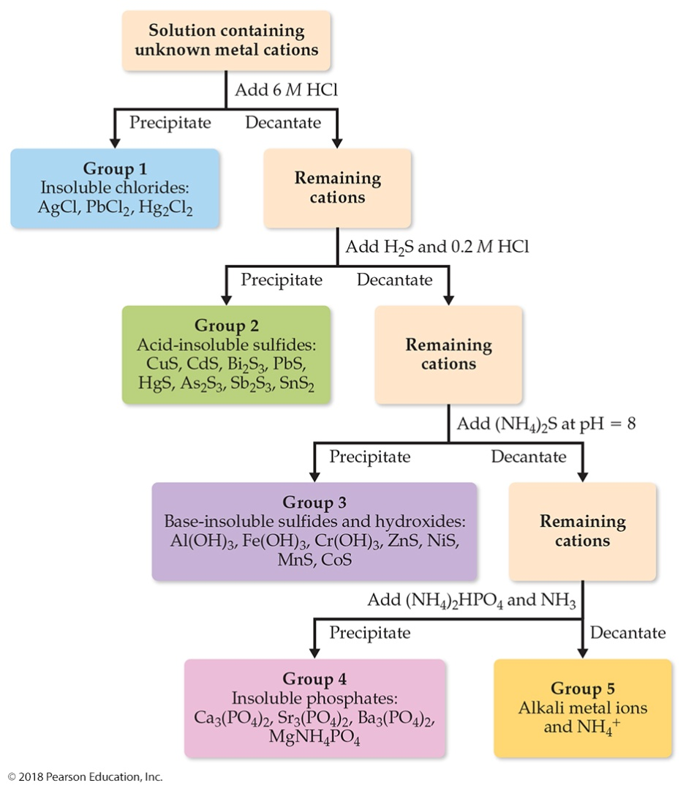
Qualitative Analysis of Ions
One can use differences in solubilities of salts to separate ions in a mixture. This has been used for qualitative analysis of the presence of ions in a solution.

Slide 25

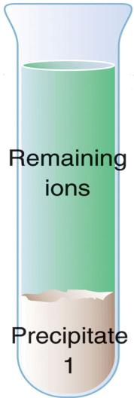
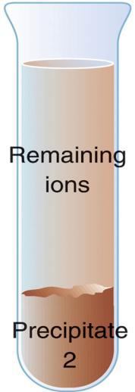
Qualitative Analysis
The general procedure for separating ions in qualitative analysis.
Add precipitating ion
Add precipitating ion
Centrifuge
Centrifuge
Notes:
25

Slide 26
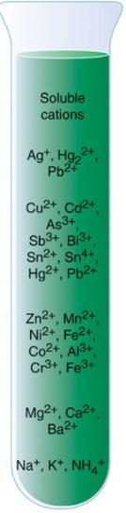
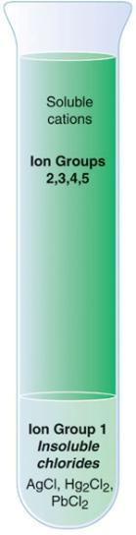
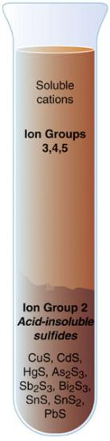
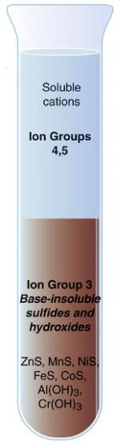
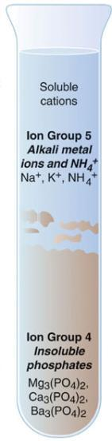
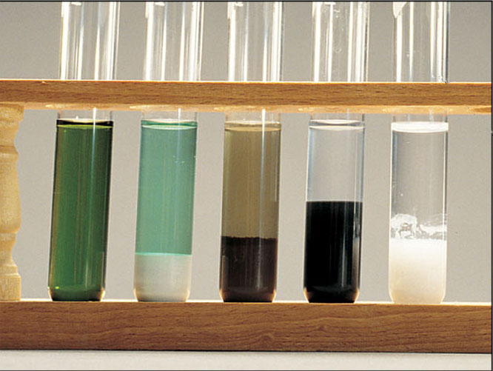
A qualitative analysis scheme for separating cations into five ion groups.
Acidify to pH 0.5; add H₂S
Add NH₃/NH₄⁺ buffer(pH 8)
Add (NH₄)₂HPO₄
Add
6M HCl
Centrifuge
Centrifuge
Centrifuge
Centrifuge
Notes:
26

Slide 27



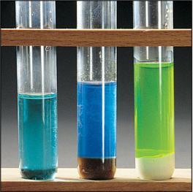
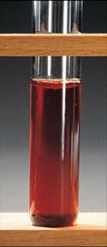



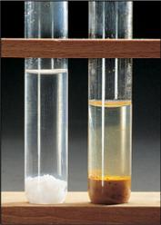
Extra:
A qualitative analysis scheme for Ag⁺,Al³⁺,Cu²⁺, and Fe³⁺
Step 1 Add NH₃(aq)
Step 2 Add HCl
Centrifuge
Centrifuge
Step 3 Add NaOH
Step 4 Add HCl, Na₂HPO₄
Step 5 Dissolve in HCl and add KSCN
Centrifuge
Notes:
27

Slide 28
Selective Precipitation
a solution containing several different cations can often be separated by addition of a reagent that will form an insoluble salt with one of the ions, but not the others
a successful reagent can precipitate with more than one of the cations, as long as their K_{sp} values are significantly different
28
Notes:
28

Slide 29
Sample Problem 3
Separating Ions by Selective Precipitation
PROBLEM:
A solution consists of 0.20M MgCl₂ and 0.10M CuCl₂. Calculate the [OH⁻] that would separate the metal ions as their hydroxides. K_{sp} of Mg(OH)₂= is 6.3x10⁻¹⁰; K_{sp} of Cu(OH)₂ is 2.2x10⁻²⁰.
PLAN:
Both precipitates are of the same ion ratio, 1:2, so we can compare their K_{sp} values to determine which has the greater solubility.
It is obvious that Cu(OH)₂ will precipitate first so we calculate the [OH⁻] needed for a saturated solution of Mg(OH)₂. This should ensure that we do not precipitate Mg(OH)₂. Then we can check how much Cu²⁺ remains in solution.
SOLUTION:
Mg(OH)₂(s) Mg²⁺(aq) + 2OH⁻(aq) K_{sp} = 6.3x10⁻¹⁰
Cu(OH)₂(s) Cu²⁺(aq) + 2OH⁻(aq) K_{sp} = 2.2x10⁻²⁰
[OH⁻] needed for a saturated Mg(OH)₂ solution =
= 5.6x10⁻⁵M
Notes:
29

Slide 30
Sample Problem 3
Separating Ions by Selective Precipitation
continued
Use the K_{sp} for Cu(OH)₂ to find the amount of Cu remaining.
[Cu²⁺] = K_{sp}/[OH⁻]² = 2.2x10⁻²⁰/(5.6x10⁻⁵)² =
7.0x10⁻¹²M
Since the solution was 0.10M CuCl₂, virtually none of the Cu²⁺ remains in solution.
Notes:
30

Slide 31
Workshop F#2 on [ION] at Equilibrium
1. Consider zinc hydroxide, Zn(OH)₂, where K_{sp} = 1.9 x 10⁻¹⁷.
A. Determine the solubility of zinc hydroxide in pure water.
B. How does the solubility of zinc hydroxide in pure water compare with that in a solution buffered at pH 6.00? Quantitatively demonstrate the difference (if any) in solubility. Is zinc hydroxide more or less soluble at pH 6.00?
C. If enough base is added, the OH⁻ ligand can coordinately bind with the Zn⁺² ion to form the soluble zincate ion, [Zn(OH)₄]⁻². The formation constant, K_{f}, of the full complex ion [Zn(OH)₄]⁻² can be calculated from the following successive equilibrium expressions shown:
Zn²⁺ (aq) + OH⁻ ⇔ ZnOH⁺ (aq) K₁ = 2.5 x 10⁴
ZnOH ⁺ (aq) + OH⁻(aq) ⇔ Zn(OH)₂(s) K₂ = 8.0 x10⁶
Zn(OH)₂(s) + OH⁻(aq) ⇔ Zn(OH)₃⁻(aq) K₃ = 70
Zn(OH)₃⁻(aq) + OH⁻(aq) ⇔ Zn(OH)₄²⁻(aq) K₄ = 33
Determine the value of K_{f} for the zincate ion.
Notes:
31

Slide 32
Workshop F2 on [ION] at Equilibrium
2. Calculate the free ion concentration of Cr³⁺ when 0.01 moles of chromium(III) nitrate is dissolved in 2.00 liters of a pH 10 buffer.
3. Calculate the pH required to precipitate out ZnS from a solution mixture containing 0.010 M Zn²⁺ and 0.01M Cu²⁺. Will CuS precipitate out under these conditions?
4. Will a precipitate of silver carbonate form (K_{sp} = 6.2 x 10⁻¹²) when 100.0 mL of 1.00 x 10⁻⁴ M AgNO₃(aq) and 200.0 mL of 3.00 x 10⁻³ M Na₂CO₃(aq) are mixed? What will be the remaining concentration of ions present in solution?
5. Calculate the molar solubility of AgBr in 2.0 M NH₃?
Notes:
32

