Slide 1
MEASUREMENTS
There are different types of measurements that can be made in the laboratory like mass, time, volume, and length.
These measurements can be made using either the metric system or the English system. The metric system is based on increments of 10.
    1 base = 100 centibases “c” = centi
    1 base = 1000 millibases “m” = milli 1 kbase = 1000 bases
    1 base = 10⁶ microbases “μ” = micro k = kilo
    1 base = 10⁹ nanobases “n” = nano
The first step to understanding measurements is to learn the types, symbols, & units associated with these measurements.

Slide 2
MEASUREMENTS
Unit | Metric | English
Length | Meter (m) | Inches (in) or Feet (ft)
Mass | Gram (g) | Pounds (lb)
Volume | Liters (L) | Gallon (gal)
Temperature | Celsius (°C) and Kelvin (K) | Fahrenheit (°F)
Area | Square meters (m²) | Square feet (ft²)
Time | Seconds (s) | Minutes (min) or Hours (hr)
Heat | Calories (cal) or Joules (J) | British Thermal Units (BTU)
Pressure | Atmospheres (atm), Torr, or mmHg | Pounds/sq in (lb/in²)
There are different types of measurements that can be made in the lab for length, mass, volume, temperature, area, time, heat and pressure.

Slide 3
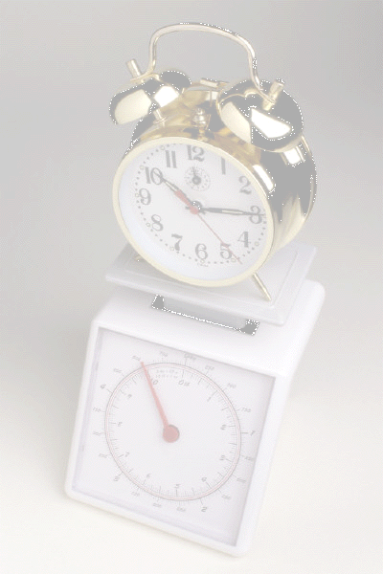
MEASUREMENTS
A balance is used to measure mass in the laboratory.
Metric English
Mass gram pounds
g lb.....
Time is measured the same in both systems. A clock, wristwatch, or stopwatch will be used in the laboratory.
Time seconds hour minutes
s hr min

Slide 4
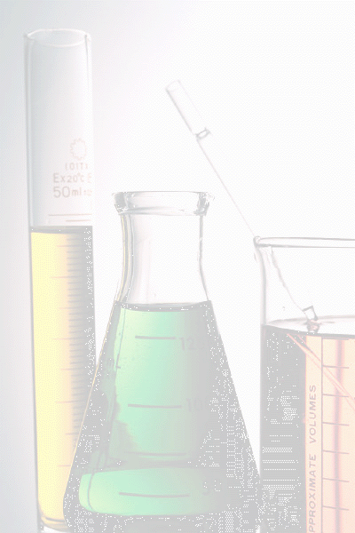
MEASUREMENTS
Metric English
A ruler is used to measure length.
Length meter inches, feet
m in ft
Area is defined as length x width, so a ruler is used.
Area square meter square feet
m² ft²
Volume is defined as length x width x height so either a ruler or a graduated cylinder can be used.
Volume Liter or cubic centimeter gallon, quart
L cm³ gal qt

Slide 5
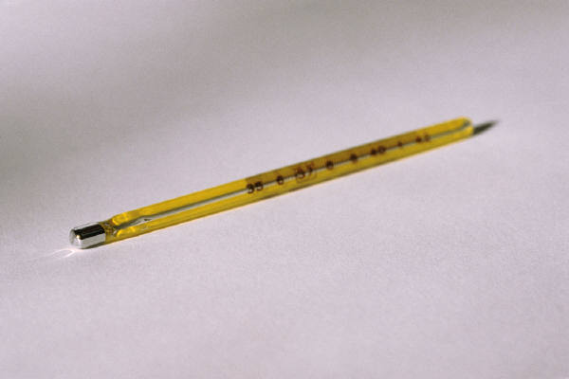
MEASUREMENTS
TEMPERATURE
A physical property of matter that determines the direction of heat flow.
Temperature is measured with a thermometer.
Measured on three scales.
Fahrenheit ºF ºF = (1.8 ºC) + 32
Celsius ºC ºC = (ºF - 32)/1.8
Kelvin K K = ºC + 273.15

Slide 6

MEASUREMENTS
HEAT
The relative heat energy that is transferred from one object to another can also be measured.
Heat energy is usually measured in calories (cal) or joules (J).
1 cal = 4.184 J

Slide 7
MEASUREMENTS
Putting it all together:
Length (variable in a math equation = L )
⇒ symbol for units: cm stands for centimeter, mm is millimeters, μm is micrometer, & nm is nanometer.
Mass (variable “m”)
⇒ symbol for units: cg stands for centigram, mg is milligram, μg is microgram, & ng is nanogram.
Volume (variable “V”)
⇒ symbol for units: cL stands for centiliter, mL is milliliter, μL is microliter, & nL is nanoliter.

Slide 8
MEASUREMENTS
Since two different measuring systems exist, a scientist must be able to convert from one system to the other.
CONVERSIONS
Length ⇒ 1 in = 2.54 cm
⇒ 1 mi = 1.61 km
Mass ⇒ 1 lb.... = 454 g
⇒ 1 kg = 2.2 lb....
Volume ⇒ 1 qt = 946 mL
⇒ 1 L = 1.057 qt
⇒ 4 qt = 1 gal
⇒ 1 mL = 1 cm³

Slide 9
Dimensional Analysis
Dimensional Analysis (also call unit analysis) is one method for solving math problems that involve measurements. The basic concept is to use the units associated with the measurement when determining the next step necessary to solve the problem. Always start with the given measurement then immediately follow the measurement with a set of parentheses.
Keep in mind, try to ask yourself the following questions in order to help yourself determine what to do next.
1. Do I want that unit?
If not, get rid of it by dividing by it if the unit is in the numerator, (if the unit is in the denominator, then multiply).
2. What do I want?
Place the unit of interest in the opposite position in the parentheses.
Numerator
Denominator

Slide 10
Dimensional Analysis
1. Let’s try converting 15.0 μL (microliters) into L (liters).
15.0 μL → L
Start with what is given and then immediately write a set of parentheses after the measurement:
15.0 μL ( ______)
Next ask yourself: “Do I want μL?” If the answer is no then get rid to μL by dividing by that unit, that is, place it in the bottom of the parenthesis.
15.0 μL(_______) =
μL
Now ask yourself, “What do I want?” In this case it is liters (L) so the unit “L” should be placed in the numerator (top).
15.0 μL (____ L__) =
μL
Lastly place the correct numbers with the appropriate unit. Then plug the number into your calculator and the problem is solved.
15.0 μL(__1 L__) = 1.5 x 10⁻⁵ L
1x10⁶ μL
See that wasn’t so bad?!

Slide 11
CONVERSIONS
Convert the following:
1. 28.0 m → mm
To convert from m to mm you need to look up the relationship between meters (m) to millimeters (mm). There are 1000 mm in 1 m.
28.0 m ( 1000 mm ) = 28.0 x 10⁴ mm
1 m
Remember to ask yourself, do you want meters? No? Then get rid of it by placing it on the bottom in the parenthesis. What do you want? mm? Then put it on top in the parenthesis. This is Dimensional Analysis.
2. 65.9 lb → kg
Looking up the conversion, there are 2.2 lb. for every 1 kg.
65.9 lb ( 1 kg ) = 30.0 kg
2.2 lb

Slide 12
CONVERSIONS
Convert the following:
1. 7.00 in³ → mL
There is no direct conversion from in³ to mL so now you will have to develop a multi-step process that will start with in³ and end with mL. If you memorize that 1 mL = 1 cm³, this problem becomes easy. All you need to look up is the relationship between in and cm.
1 in = 2.54 cm 1 mL = 1 cm³
7.00 in³ ( 2.54 cm )³ ( 1 mL ) = ?
1 in 1 cm³
Place the conversion inside the parenthesis and the cube on the outside. Then cube the number inside the parenthesis.
7.00 in³ ( 16.387 cm³ ) ( 1 mL ) = 115 mL
1 in³ 1 cm³

Slide 13
CONVERSIONS & WORD PROBLEMS
Now it is time to apply these techniques to word problems. Nothing changes but it helps if you separate the words from the numbers. Therefore your first step should be to make a list.
1. How many miles will a car drive on 23.0 L of gasoline if the car averages 59.0 km/gal?
mi = ? 23.0 L 59.0 km / gal
Note that mi & km are units for length and L & gal are units for volume. Looking at the units you should notice that you will need to convert km to mi and L to gal so list the conversion factors you will use. You can only convert units of the same measurement type (You can not directly convert km to gal, unless there is an additional stipulation connecting the two units like the 59.0 km/gal.
1 mi = 1.61 km 1 L = 1.0567 qt 4 qt = 1 gal
Always start with the single unit measurement:
23.0L (1.0567 qt ) (1 gal) ( 59.0 km ) (_1 mi_) = 223 mi
1L 4 qt 1 gal 1.61 km

Slide 14
PRACTICE STUDY PROBLEM #2
A study of gemstones and dimensional analysis:
The basic unit for gemstones is the carat. One carat is equal to 200 milligrams. A well-cut diamond of one carat measures 0.25 inches exactly in diameter. Right click for answers
_____ 1. The Star of India sapphire (Al₂O₃, corundum) weighs 563 carats. What is the weight of the gemstone in milligrams?
_____ 2. The world’s largest uncut diamond (C, an allotrope of carbon) was the Cullinan Diamond. It was discovered 1/25/1905 in Transvaal, South Africa. It weighed 3,106 carats. Calculate this weight in grams.
_____ 3. The Cullinan Diamond was cut into nine major stones and 96 smaller brilliants. The total weight of the cut stones was 1063 carats, only 35% of the original weight! What weight (in kilograms) of the Cullinan Diamond was not turned into gemstones?
_____ 4. Emerald is a variety of green beryl (Be₃Al₂Si₆O₁₈) that is colored by a trace of chromium, which replaces aluminum in the beryl structure. The largest cut emerald was found in Carnaiba, Brazil Aug. 1974. It weighs 86,136 carats. Assuming the diamond carat to size relationship stands for emeralds, calculate the approximate diameter of this stone in meters.
_____ 5. The largest cut diamond, the Star of Africa, is a pear-shaped diamond weighing 530.2 carats. It is 2.12 in long, 4.4 cm wide, and 250 mm thick at its deepest point. What is the minimum volume (in liters) of a box that could be used to hide this diamond.
1.13 x 10⁵ mg
621.2 g
0.3948 kg
546.96 m
0.59 L

Slide 15
GROUP STUDY PROBLEM # 2
_____1. Water boils at 212 ºF, what is the boiling point of water in ºC?
_____2. What is the boiling point of water in Kelvin?
_____3. Convert 25.0 ng to cg
_____4. Convert 25.0 kJ to cal
_____5. Convert 25.0 lb to mg
_____6. Convert 25.0 ft³ to L
_____7. How many liters of gasoline will be used to drive 725 miles in a car that averages 27.8 miles per gallon?
_____8. Diamonds crystallize directly from rock melts rich in magnesium and saturated carbon dioxide gas that has been subjected to high pressures and temperatures exceeding 1677 K. Calculate this temperature in Fahrenheit.
_____9. D.J. promised to bake 200 dozen cookies and deliver them to a bake sale. If each cookie weighs 3.5 ounces, how many kilograms will 200 dozen cookies weigh?
_____10. One box of envelopes contains 500 envelopes. A case of envelopes contains 8 boxes of envelopes and cost $38.49. What is the cost, in cents, of an envelope?

