Slide 1
Solubility Equilibria
all ionic compounds dissolve in water to some degree
  however, many compounds have such low solubility in water that we classify them as insoluble
we can apply the concepts of equilibrium to salts dissolving, and use the equilibrium constant for the process to measure relative solubilities in water
1
Notes:
1

Slide 2
SOLUBILITY
Saturated Solution
BaSO_{4(s)} ←→ Ba²⁺_{(aq)} + SO₄²⁻_{(aq)}
Equilibrium expresses the degree of solubility of solid in water.
K_{sp} = solubility product constant
K_{sp} = K_{eq} [BaSO₄]_{(s)}
K_{sp} = [Ba²⁺] [SO₄²⁻] = 1.1 x 10⁻¹⁰
K_{sp} represents the amount of dissolution (how much solid dissolved into ions), the smaller the K_{sp} value, the smaller the amount of ions in solution (more solid is present).
Notes:
2

Slide 3

Table 1 Solubility-Product Constants (K_{sp}) of Selected Ionic Compounds at 25⁰C
Name, Formula
K_{sp}
Aluminum hydroxide, Al(OH)₃
3 x 10⁻³⁴
Cobalt (II) carbonate, CoCO₃
1.0 x 10⁻¹⁰
Iron (II) hydroxide, Fe(OH)₂
4.1 x 10⁻¹⁵
Lead (II) fluoride, PbF₂
3.6 x 10⁻⁸
Lead (II) sulfate, PbSO₄
1.6 x 10⁻⁸
Mercury (I) iodide, Hg₂I₂
4.7 x 10⁻²⁹
Silver sulfide, Ag₂S
8 x 10⁻⁴⁸
Zinc iodate, Zn(IO₃)₂
3.9 x 10⁻⁶
Notes:
3

Slide 4
SOLUBILITY
1. Write the solubility product expression for each of the following:
a) Ca₃(PO₄)₂
b) Hg₂Cl₂
c) HgCl_{2.}
2. In a particular sample, the concentration of silver ions was 1.2 x10⁻⁶ M and the concentration of bromide was 1.7x10⁻⁶ M. What is the value of K_{sp} for AgBr?
Notes:
4

Slide 5
Solubility vs. Solubility Product
Solubility: The quantity of solute that dissolves to form a saturated solution. (^{g}/_{L})
K_{sp}: The equilibrium between the ionic solid and the saturated solution.
Molar Solubility: (n _{solute}/L _{saturated solution})
Notes:
5

Slide 6
Molar Solubility
solubility is the amount of solute that will dissolve in a given amount of solution
  at a particular temperature
the molar solubility is the number of moles of solute that will dissolve in a liter of solution
  the molarity of the dissolved solute in a saturated solution
for the general reaction:
M_{n}X_{m}(s) ⇔ nM^{m+}(aq) + mX^{n−}(aq)
6
Notes:
6

Slide 7
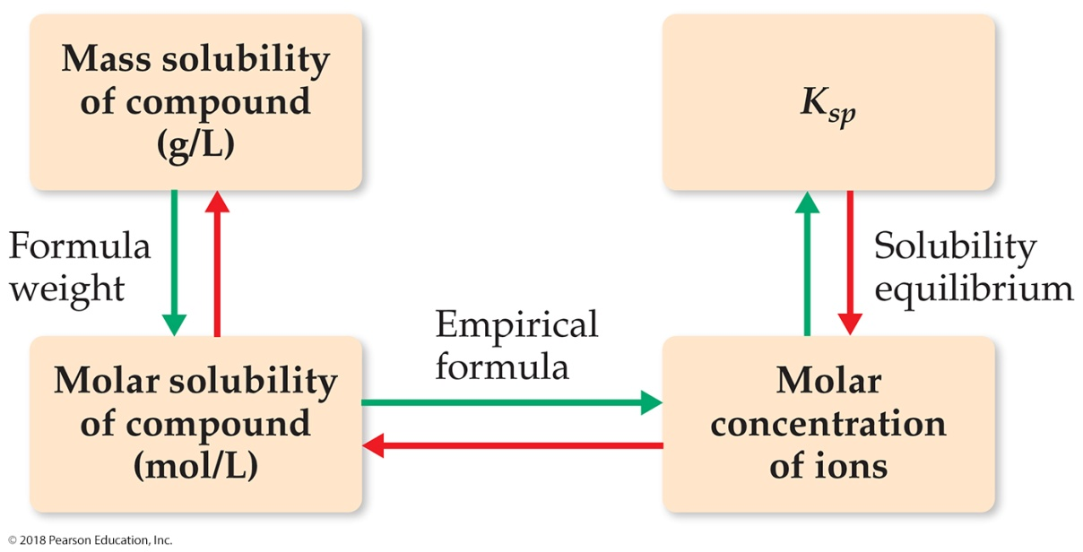
Solubility vs. Solubility Product

Slide 8
Interconverting solubility and Ksp
SOLUBILITY
OF
COMPOUND
(g/L)
MOLAR
SOLUBILITY
OF
COMPOUND
(mol/L)
MOLAR
CONCENTRATION
OF
IONS
K_{sp}
Notes:
8

Slide 9
Example– Calculate the molar solubility of PbCl₂ in pure water at 25°C
Write the dissociation reaction and K_{sp} expression
Create an ICE table defining the change in terms of the solubility of the solid
PbCl₂(s) ⇔ Pb²⁺(aq) + 2 Cl⁻(aq)
K_{sp} = [Pb²⁺][Cl⁻]²
 | [Pb²⁺] | [Cl⁻]
Initial | 0 | 0
Change | +S | +2S
Equilibrium | S | 2S
9
Notes:
9

Slide 10
Example– Calculate the molar solubility of PbCl₂ in pure water at 25°C
Substitute into the K_{sp} expression
Find the value of K_{sp} from Table 16.2, plug into the equation and solve for S
K_{sp} = [Pb²⁺][Cl⁻]²
K_{sp} = (S)(2S)²
 | [Pb²⁺] | [Cl⁻]
Initial | 0 | 0
Change | +S | +2S
Equilibrium | S | 2S
10
Notes:
10

Slide 11
Practice – Determine the K_{sp} of PbBr₂ if its molar solubility in water at 25°C is 1.05 x 10⁻² M
11
Notes:
11

Slide 12
Practice Problems on Solubility vs. Solubility Product
1. A student finds that the solubility of BaF₂ is 1.1 g in l.00 L of water. What is the value of Ksp?
2. Exactly 0.133 mg of AgBr will dissolve in 1.00 L of water. What is the value of Ksp for AgBr?
3. Calomel (Hg₂Cl₂) was once used in medicine. It has a Ksp = 1.3 x 10⁻¹⁸. What is the solubility of Hg₂Cl₂ in g/L?
Notes:
12

Slide 13
K_{sp} and Relative Solubility
molar solubility is related to K_{sp}
but you cannot always compare solubilities of compounds by comparing their K_{sp}’s
in order to compare K_{sp}’s, the compounds must have the same dissociation stoichiometry
13
Notes:
13

Slide 14
Relationship Between K_{sp} and Solubility at 25⁰C
No. of Ions
Formula
Cation:Anion
K_{sp}
Solubility (M)
2
MgCO₃
1:1
3.5 x 10⁻⁸
1.9 x 10⁻⁴
2
PbSO₄
1:1
1.6 x 10⁻⁸
1.3 x 10⁻⁴
2
BaCrO₄
1:1
2.1 x 10⁻¹⁰
1.4 x 10⁻⁵
3
Ca(OH)₂
1:2
5.5 x 10⁻⁶
1.2 x 10⁻²
3
BaF₂
1:2
1.5 x 10⁻⁶
7.2 x 10⁻³
3
CaF₂
1:2
3.2 x 10⁻¹¹
2.0 x 10⁻⁴
3
Ag₂CrO₄
2:1
2.6 x 10⁻¹²
8.7 x 10⁻⁵
Notes:
14

Slide 15
Solubility and Common Ion effect
CaF_{2(s)} ←→ Ca²⁺_{(aq)} + 2F⁻_{(aq)}
The addition of Ca²⁺ or F⁻ shifts the equilibrium. According to Le Chatelier’s Principle, more solid will form thus reducing the solubility of the solid.
Solubility of a salt decreases when the solute of a common ion is added.
Notes:
15

Slide 16
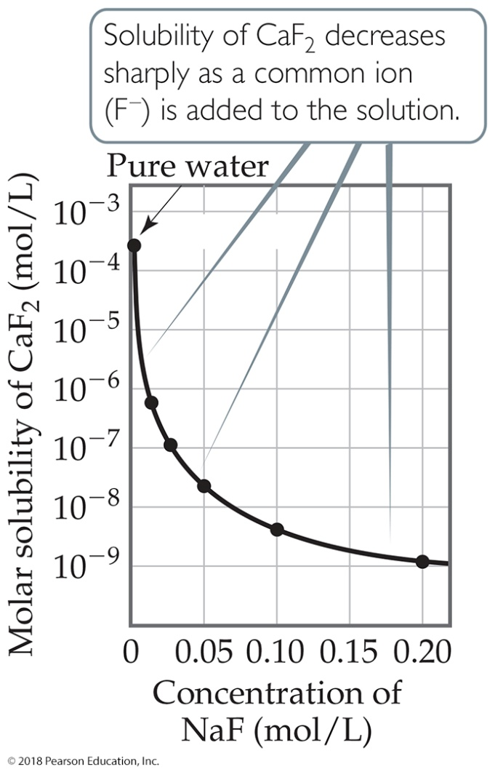
Factors Affecting Solubility
The common-ion effect
  If one of the ions in a solution equilibrium is already dissolved in the solution, the solubility of the salt will decrease.
  If either calcium ions or fluoride ions are present, then calcium fluoride will be less soluble.

Slide 17
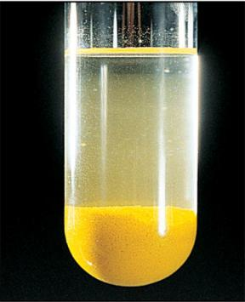
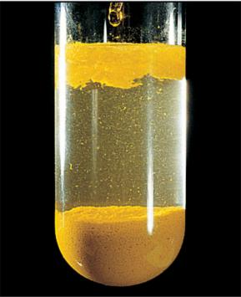
The effect of a common ion on solubility
CrO₄²⁻ added
PbCrO₄(s) Pb²⁺(aq) + CrO₄²⁻(aq)
PbCrO₄(s) Pb²⁺(aq) + CrO₄²⁻(aq)
Notes:
17

Slide 18
Lecture Problems on Solubility and Common Ion effect
CaF_{2(s)} ←→ Ca²⁺_{(aq)} + 2F⁻_{(aq)}
The K_{sp} of the above equation is 3.2 x 10⁻¹¹. (a) Calculate the molar solubility in pure water.
(b) Calculate the molar solubility in 3.5x10⁻⁴ M Ca(NO₃)₂.
2. What is the molar solubility of silver chloride in 1.0 L of solution that contains 2.0 x 10⁻² mol of NaCl?
Notes:
18

Slide 19
Example– Calculate the molar solubility of CaF₂ in 0.100 M NaF at 25°C
Write the dissociation reaction and K_{sp} expression
Create an ICE table defining the change in terms of the solubility of the solid
CaF₂(s) ⇔ Ca²⁺(aq) + 2 F⁻(aq)
K_{sp} = [Ca²⁺][F⁻]²
 | [Ca²⁺] | [F⁻]
Initial | 0 | 0.100
Change | +S | +2S
Equilibrium | S | 0.100 + 2S
19
Notes:
19

Slide 20
Example – Calculate the molar solubility of CaF₂ in 0.100 M NaF at 25°C
Substitute into the K_{sp} expression assume S is small
Find the value of K_{sp} from Table 16.2, plug into the equation and solve for S
K_{sp} = [Ca²⁺][F⁻]²
K_{sp} = (S)(0.100 + 2S)²
K_{sp} = (S)(0.100)²
 | [Ca²⁺] | [F⁻]
Initial | 0 | 0.100
Change | +S | +2S
Equilibrium | S | 0.100 + 2S
20
Notes:
20

Slide 21
Ion-Product Expression (Q_{sp})
& Solubility Product Constant (K_{sp})
For the hypothetical compound, M_{p}X_{q}
At equilibrium Q_{sp} = [M^{n+}]^{p} [X^{z-}]^{q} = K_{sp}
Notes:
21

Slide 22
CRITERIA FOR PRECIPITATION OF DISSOLUTION
BaSO_{4(s)} ←→ Ba²⁺_{(aq)} + SO₄²⁻_{(aq)}
Equilibrium can be established from either direction.
Q (the Ion Product) is used to determine whether or not precipitation will occur.
Q < K → solid dissolves
Q = K equilibrium (saturated solution)
Q > K ← ppt
Notes:
22

Slide 23
Precipitation
precipitation will occur when the concentrations of the ions exceed the solubility of the ionic compound
if we compare the reaction quotient, Q, for the current solution concentrations to the value of K_{sp}, we can determine if precipitation will occur
  Q = K_{sp}, the solution is saturated, no precipitation
  Q < K_{sp}, the solution is unsaturated, no precipitation
  Q > K_{sp}, the solution would be above saturation, the salt above saturation will precipitate
some solutions with Q > K_{sp} will not precipitate unless disturbed – these are called supersaturated solutions
Notes:
23

Slide 24
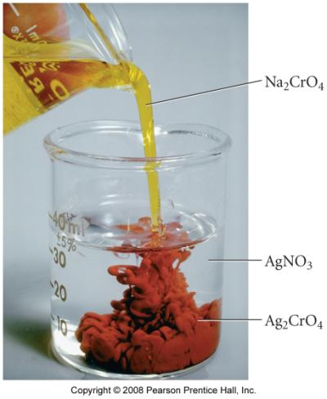
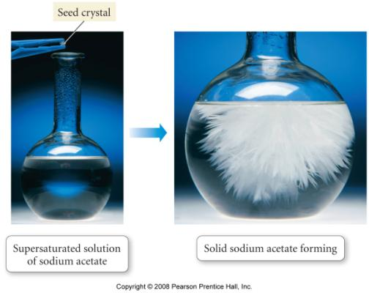
a supersaturated solution will precipitate if a seed crystal is added
precipitation occurs if Q > K_{sp}
Notes:
24

Slide 25
Sample Problem
Predicting Whether a Precipitate Will Form
PROBLEM:
A common laboratory method for preparing a precipitate is to mix solutions of the component ions. Does a precipitate form when 0.100L of 0.30M Ca(NO₃)₂ is mixed with 0.200L of 0.060M NaF?
PLAN:
Write out a reaction equation to see which salt would be formed. Look up the K_{sp} valus in a table. Treat this as a reaction quotient, Q, problem and calculate whether the concentrations of ions are > or < K_{sp}. Remember to consider the final diluted solution when calculating concentrations.
Notes:
25

Slide 26
Lecture Problems on PRECIPITATION
1. Calcium phosphate has a K_{sp} of 1x10⁻²⁶, if a sample contains 1.0x10⁻³ M Ca²⁺ & 1.0x10⁻⁸ M PO₄³⁻ ions, calculate Q and predict whether Ca₃(PO₄)₂ will precipitate?
Exactly 0.400 L of 0.50 M Pb²⁺ & 1.60 L of 2.5 x 10⁻² M Cl⁻ are mixed together to form 2.00L. Calculate Q and predict if a ppt will occur. What if 2.5 x 10⁻⁸ Cl⁻ was used?
K_{sp} = 1.6 x 10⁻⁵
Notes:
26

Slide 27
Selective Precipitation
a solution containing several different cations can often be separated by addition of a reagent that will form an insoluble salt with one of the ions, but not the others
a successful reagent can precipitate with more than one of the cations, as long as their K_{sp} values are significantly different
27
Notes:
27

Slide 28
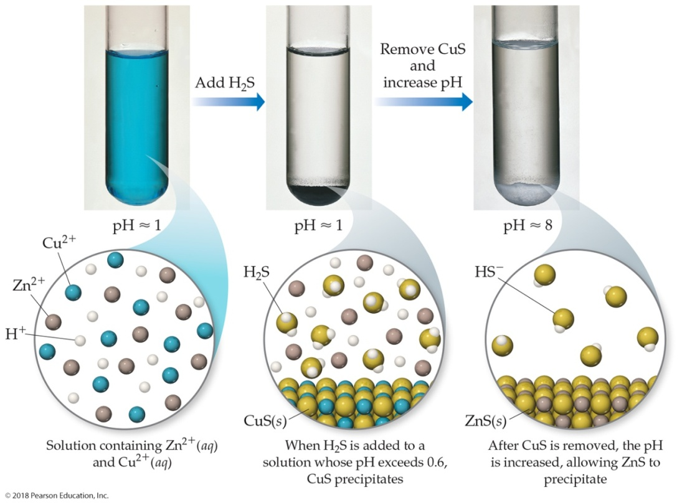
Selective Precipitation of Ions
Ions can be separated from solution based on their
solubilities in the presence of different ions

Slide 29
Example - What is the minimum [OH⁻] necessary to just begin to precipitate Mg²⁺ (with [0.059]) from seawater?
precipitating may just occur when Q = K_{sp}
29
Notes:
29

Slide 30
Example - What is the [Mg²⁺] when Ca²⁺ (with [0.011]) just begins to precipitate from seawater?
precipitating Mg²⁺ begins when [OH⁻] = 1.9 x 10⁻⁶ M
30
Notes:
30

Slide 31
Example - What is the [Mg²⁺] when Ca²⁺ (with [0.011]) just begins to precipitate from seawater?
precipitating Mg²⁺ begins when [OH⁻] = 1.9 x 10⁻⁶ M
precipitating Ca²⁺ begins when [OH⁻] = 2.06 x 10⁻² M
31
Notes:
31

Slide 32
pH affects SOLUBILITY
CaF₂ ←→ Ca²⁺ + 2F⁻
2F⁻ + 2H⁺ ←→ 2HF
CaF₂ + 2H⁺ ←→ Ca²⁺ + 2HF
Salts of weak acids are more soluble in acidic solutions. Thus shifting the solubility to the right. Salts with anions of strong acids are largely unaffected by pH.
Notes:
32

Slide 33
pH affects SOLUBILITY
CaF₂ ←→ Ca²⁺ + 2F⁻ K_{sp} = 3.2x10⁻¹¹
2F⁻ + 2H⁺ ←→ 2HF 1/K_{a} = 1.5x10³
CaF₂ + 2H⁺ ↔ Ca²⁺ + 2HF
K_{T} = K_{sp} x 1/K_{a}
Notes:
33

Slide 34
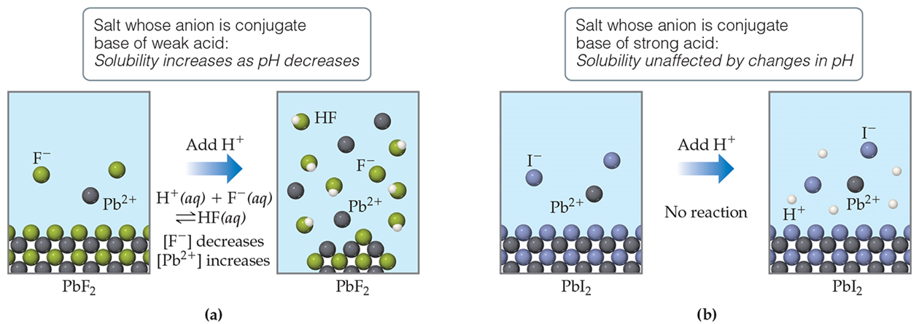
p H Affects Solubility
If a substance has a basic anion, it will be more soluble in an acidic solution.
Remember that buffers control p H. When a buffer is used, there is no change in concentration of hydroxide ion!

Slide 35
pH affects Solubility
for insoluble ionic hydroxides, the higher the pH, the lower the solubility of the ionic hydroxide
  and the lower the pH, the higher the solubility
  higher pH = increased [OH⁻]
M(OH)_{n}(s) ⇔ M^{n+}(aq) + nOH⁻(aq)
for insoluble ionic compounds that contain anions of weak acids, the lower the pH, the higher the solubility
M₂(CO₃)_{n}(s) ⇔ 2 M^{n+}(aq) + nCO₃²⁻(aq)
H₃O⁺(aq) + CO₃²⁻ (aq) ⇔ HCO₃⁻ (aq) + H₂O(l)
35
Notes:
35

Slide 36
Sample Problem
Predicting the Effect on Solubility of Adding
Strong Acid
PROBLEM:
Write balanced equations to explain whether addition of H₃O⁺ from a strong acid affects the solubility of these ionic compounds:
(a) Lead (II) bromide
(b) Copper (II) hydroxide
(c) Iron (II) sulfide
PLAN:
Write dissolution equations and consider how strong acid would affect the anion component.
Notes:
36

Slide 37
Lecture Problems on the EFFECT OF pH ON SOLUBILITY
1. Consider the two slightly soluble salts BaF₂ and AgBr. Which of these two would have its solubility more affected by the addition of a strong acid? Would the solubility of that salt increase or decrease.
Notes:
37

Slide 38
3 STEPS TO DETERMINING THE ION CONCENTRATION
AT EQUILIBRIUM
I. Calculate the [Ion]_{i} that occurs after dilution but before the reaction starts.
II. Calculate the [Ion] when the maximum amount of solid is formed.
- we will determine the limiting reagent and assume all
of that ion is used up to make the solid.
- The [ ] of the other ion will be the stoichiometric equivalent.
III. Calculate the [Ion] at equilibrium*.
*Since we assume the reaction went to completion, yet by definition a slightly soluble can’t, we must account for some of the solid re-dissolving back into solution.
Notes:
38

Slide 39
Lecture Problems on [ION] at Equilibrium
1. When 50.0 mL of 0.100 M AgNO₃ and 30 mL of 0.060 M Na₂CrO₄ are mixed, a precipitate of silver chromate is formed. The solubility product is 1.9 x 10⁻¹². Calculate the [Ag⁺] and [CrO₄²⁻] remaining in solution at equilibrium.
2. Suppose 300 mL of 8 x 10⁻⁶ M solution of KCl is added to 800 mL of 0.004 M solution of AgNO₃. Calculate [Ag⁺] and [Cl⁻] remaining in solution at equilibrium.
Notes:
39

Slide 40

Workshop S#1 on [ION] at Equilibrium
1. Consider zinc hydroxide, Zn(OH)₂, where K_{sp} = 1.9 x 10⁻¹⁷.
A. Determine the solubility of zinc hydroxide in pure water.
B. How does the solubility of zinc hydroxide in pure water compare with that in a solution buffered at pH 6.00? Quantitatively demonstrate the difference (if any) in solubility. Is zinc hydroxide more or less soluble at pH 6.00?
C. If enough base is added, the OH⁻ ligand can coordinately bind with the Zn⁺² ion to form the soluble zincate ion, [Zn(OH)₄]⁻². The formation constant, K_{f}, of the full complex ion [Zn(OH)₄]⁻² can be calculated from the following successive equilibrium expressions shown:
Zn²⁺ (aq) + OH⁻ ⇔ ZnOH⁺ (aq) K₁ = 2.5 x 10⁴
ZnOH ⁺ (aq) + OH⁻(aq) ⇔ Zn(OH)₂(s) K₂ = 8.0 x10⁶
Zn(OH)₂(s) + OH⁻(aq) ⇔ Zn(OH)₃⁻(aq) K₃ = 70
Zn(OH)₃⁻(aq) + OH⁻(aq) ⇔ Zn(OH)₄²⁻(aq) K₄ = 33
Determine the value of K_{f} for the zincate ion.
2. Calculate the free ion concentration of Cr³⁺ when 0.01 moles of chromium(III) nitrate is dissolved in 2.00 liters of a pH 10 buffer.
3. Calculate the pH required to precipitate out ZnS from a solution mixture containing 0.010 M Zn²⁺ and 0.01M Cu²⁺. Will CuS precipitate out under these conditions?
4. Will a precipitate of silver carbonate form (K_{sp} = 6.2 x 10⁻¹²) when 100.0 mL of 1.00 x 10⁻⁴ M AgNO₃(aq) and 200.0 mL of 3.00 x 10⁻³ M Na₂CO₃(aq) are mixed? What will be the remaining concentration of ions present in solution?
Notes:
40

