Slide 1

THE MOLE “n”
The mole term is similar to the “dozen” term.
Just as a dozen represents “12”; the mole represents 6.022 x 10²³. A very large amount.
This is due to atoms & molecules being very small.

Slide 2
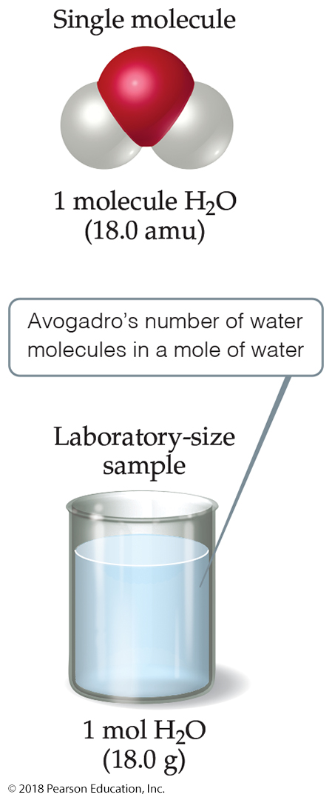
Avogadro’s Number
In a lab, we cannot work with individual molecules. They are too small.
One mole (abbreviated: m o l) is the amount of particles found in exactly 12 g of C-12.
6.022 x 10²³ atoms or molecules is the
number of particles in one mole.

Slide 3
Chemical Packages - Moles
mole = number of particles equal to the number of atoms in 12 g of C-12
1 atom of C-12 weighs exactly 12 amu
1 mole of C-12 weighs exactly 12 g
The number of particles in 1 mole is called Avogadro’s Number = 6.0221421 x 10²³
1 mole of C atoms weighs 12.01 g and has 6.022 x 10²³ atoms
the average mass of a C atom is 12.01 amu

Slide 4
Relationship Between Moles and Mass
The mass of one mole of atoms is called the molar mass
The molar mass of an element, in grams, is numerically equal to the element’s atomic mass, in amu
The lighter the atom, the less a mole weighs
The lighter the atom, the more atoms there are in 1 g

Slide 5
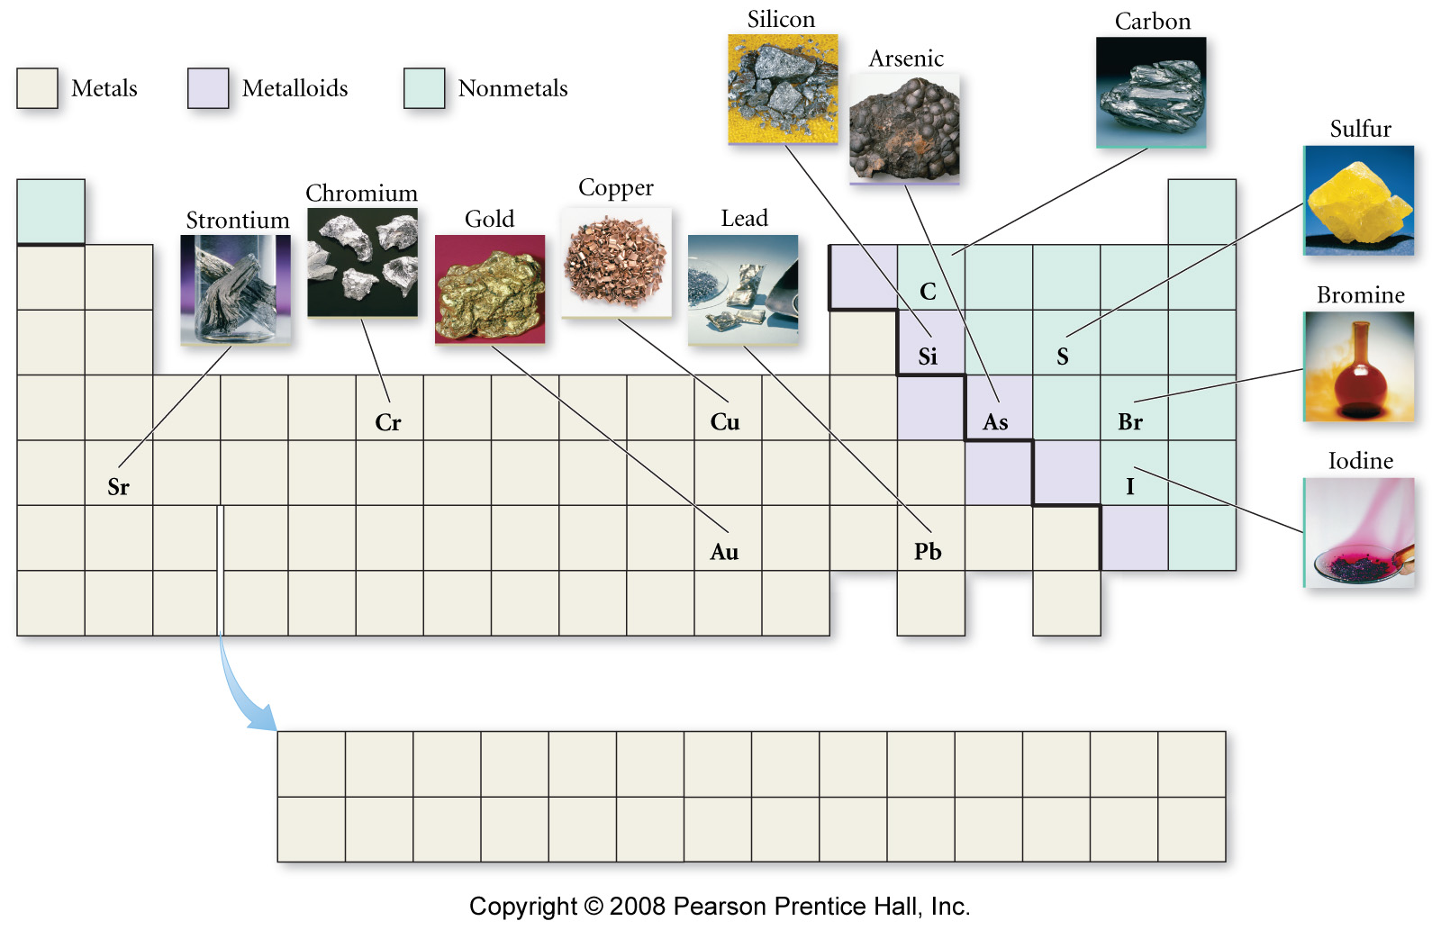
Mole and Mass Relationships
1 mole
sulfur
32.06 g
1 mole
carbon
12.01 g

Slide 6
THE MOLE & MOLAR MASS
The atomic or formula mass (weight) is measured in reference to the mole.
The atomic/formula mass is also known as the MOLAR MASS.
Molar mass = MM = m/n or mass/mole.
Units for molar mass is grams per mole or g/mol.
For example:
H = 1.008 amu
= 1.008 g/mol
= 6.022 x 10²³ atoms
= 1 molar mass
K₂CO₃ =
2K + C + 3O=
2(39.10 g/mol) + 12.011g/mol + 3(16.00g/mol) =
138.11g/mol

Slide 7
Simple MOLE Calculations
MM = ^{m}/_{n}
1) What mass of NH₄NO₃ contains 3.15 moles of NH₄NO₃?
2) How many total & H - atoms are in 6.34 g of (NH₄)₃PO₄

Slide 8
Calculations involving the mole
1. Calculate the formula weight of sucrose, C₁₂H₂₂O_{11.}
2. Calculate the number of moles in 28.0 g of water.
3. How many oxygen atoms are present in 4.20 g of NaHCO₃?
4. Calculate how many methane (CH₄) molecules there are in 25.0 g of methane.

Slide 9
Simple MOLE Calculations
CHAT
1) How many moles of Mg are contained in 15.0 grams of Mg?
2) How many atoms of Mg are contained in 15.0 grams of Mg?

Slide 10
Workshop 3A on the MOLE
Problem #1: Calculate the formula weight of calcium nitrate.
Problem #2: How many moles of glucose, C₆H₁₂O₆, are in 538 g?
Problem #3: How many glucose molecules are there in 5.23 g of glucose?
Problem #4: Calculate the number of moles in 325 mg of aspirin, which has the following
structural formula:

Slide 11
Activity on the mole
1. The molar mass of sodium is________, of phosphorous is _________, of oxygen is ________. What is the molar mass of sodium phosphate?
2. Which has the LEAST mass:
a) 0.19 moles of CaCO₃
b) 6.12 x 10²² formula units of Fe₂O₃
c) 1 mole of oxygen molecules
d) 15.9 moles of hydrogen molecules
e) 5.0 moles of helium gas

Slide 12
PERCENT COMPOSITION
The percent composition is the mass percentage of each type of atom(element) in a compound.
% X =
(total atomic mass of X / molar mass which contains X)
For Example:
Calculate the percent composition of nicotine, C₁₀H₁₄N₂.
Molar mass = 10C + 14H + 2N = 162 g/mol
%C = (10C / C₁₀H₁₄N₂)100 = (120 g/mol /162 g/mol)100=74.1%
%H = (14H / C₁₀H₁₄N₂)100 = (14 g/mol / 162 g/mol)100 = 8.6%
%N = (2 N / C₁₀H₁₄N₂)100 = (28 g/mol / 162 g/mol)100 = 17.3%

Slide 13
PERCENT COMPOSITION
Q1. How many grams of lithium will combine with 20.0 g of sulfur to form Li₂S?
Q2.A student prepares a compound of tungsten chloride from 3.946 g of tungsten and 3.806 g of chlorine. Assuming the reaction goes to completion, calculate the percent composition.

Slide 14
Workshop 3B on The Mole
Calculate the percent composition of aluminum sulfate and barium hydroxide dihydrate.
2. A solution of sulfuric acid contained 65% H₂SO₄ by mass and had a density of 1.56 g/mL. How many moles of acid are present in 1.00 L of the solution?
3. What mass of sodium will contain the same number of atoms as 100.0 g of potassium?

Slide 15
EMPIRICAL FORMULA
Assume 100g sample Calculate mole ratio
Use Atomic Masses
Mass % of
elements
Empirical
Formula
Grams of
each
element
Moles of
each
element

Slide 16
EMPIRICAL FORMULA
Step 1: If given the % composition, assume a 100g sample then convert % to grams.
Step 2: Use the atomic masses to convert grams to moles.
Step 3: Divide the moles of each element by the SMALLEST mole fraction.
Step 4: The results from step 3 should be a whole number, if not, make it so by multiplying by a common factor.

Slide 17
Determining Empirical Formulas—an Example (1 of 4)
The compound para-aminobenzoic acid (you may have seen it listed as PABA on your bottle of sunscreen) is composed of carbon (61.31%), hydrogen (5.14%), nitrogen (10.21%), and oxygen (23.33%). Find the empirical formula of PABA.

Slide 18
Determining Empirical Formulas—an Example (2 of 4)
Allow for 100.00 g of para-aminobenzoic acid and converting to moles:

Slide 19
Determining Empirical Formulas—an Example (3 of 4)
Calculate the mole ratio by dividing by the smallest number of moles:

Slide 20
Determining Empirical Formulas—an Example (4 of 4)
These are the subscripts for the empirical formula:
C₇H₇NO₂

Slide 21
Empirical Formula
Hydroquinone, used as a photographic developer, is 65.4% carbon, 5.5% hydrogen, and 29.1% oxygen by mass. What is the empirical formula of hydroquinone?
Molecular Formula
Adipic acid is used in the manufacture of nylon. The percent composition of the acid is 49.3% carbon, 6.9% hydrogen, and 43.8% oxygen by mass. The molecular weight of the compound is 146 g/mol. What is the molecular formula?

Slide 22
Workshop 3D on Percent Composition, Empirical Formula, and Molecular Formula Determination
1. Calculate the percentage composition of sucrose, C₁₂H₂₂O₁₁.
2. Ascorbic acid (vitamin C) contains 40.92 percent C, 4.58 percent H, and 54.50 percent O by mass. What is the empirical formula of ascorbic acid?
3. Mesitylene, a hydrocarbon that occurs in small amounts of crude oil, has an empirical formula of C₃H₄. The experimentally determined molecular weight of this substance is 121 amu. What is the molecular formula of mesitylene?
4. Sorbitol, used as a sweetener in some sugar-free foods, has a molecular formula of 182 amu and a mass percent composition of 39.56% C, 7.74% H, and 52.70% O. What are the empirical and molecular formulas of sorbitol?

Slide 23
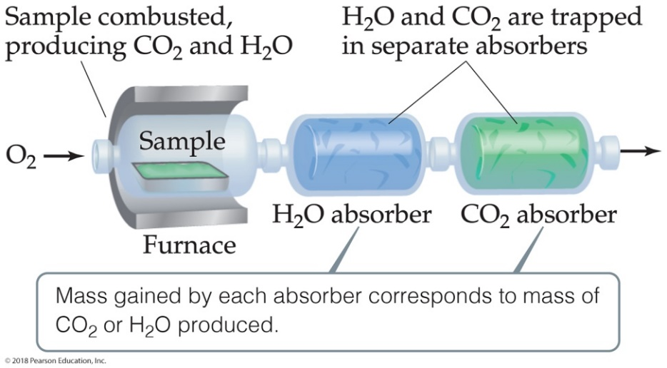
Combustion Analysis (1 of 3)
Compounds containing C, H, and O are routinely analyzed through combustion in a chamber.
Mass of C is determined from the mass of C O₂ produced.
Mass of H is determined from the mass of H₂O produced.
Mass of O is determined by the difference of the mass of the compound used and the total mass of C and H.
Note: The mass of O in the compound can NOT be determined from C O₂ and H₂O because oxygen is added during the combustion.

Slide 24

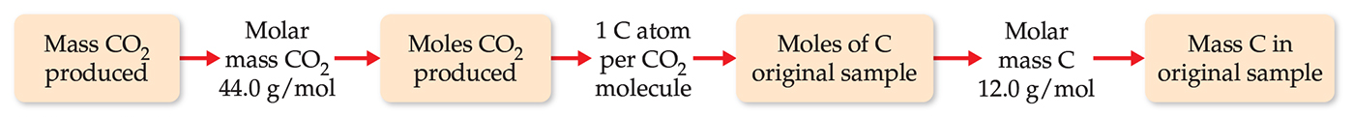
Combustion Analysis (2 of 3)
Mass of C is determined from the mass of C O₂ produced.

Slide 25
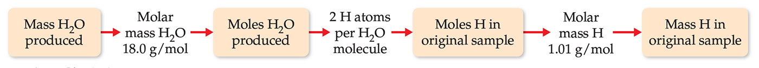
Combustion Analysis (3 of 3)
Mass of H is determined from the mass of H₂O produced.

Slide 26
Empirical Formula
Combustion Analysis
Menthol (MM = 156.3 g/mol), a strong smelling substance used in cough drops, is a compound of carbon, hydrogen, and oxygen. When 0.1595 g of menthol was subjected to combustion analysis, it produced 0.449 g of CO₂ and 0.184 g of water. What is its molecular formula?

Slide 27
Extra Lecture problems
1. A 5.325-g sample of methyl benzoate, a compound used in the manufacture of perfumes, is found to contain 3.758 g of C, 0.316 g of H, and 1.251 g of O. What is the empirical formula of this substance?
2. A compound contains only carbon, hydrogen, and oxygen. Combustion of 10.68 mg of the compound yields 16.01 mg of CO₂ and 4.37 mg of H₂O. The molar mass of the compound is 176.1 g/mol. What are the empirical and molecular formulas of the compound?

Slide 28
Workshop 3E on Combustion Analysis
1. Cyclopropane, a substance used with oxygen as a general anesthetic, contains only two elements, carbon and hydrogen. When 1.00 g of this substance is completely combusted, 3.14 g of CO₂ and 1.29 g of H₂O are produced. What is the empirical formula of cyclopropane?
2. Isobutyl propionate is the substance that provides the flavor for rum extract. Combustion of a 1.152 g sample of this carbon-hydrogen-oxygen compounds yields 2.726 g CO₂ and 1.116 g H₂O. What is the empirical formula of isobutyl propionate?

Slide 29
WRITING CHEMICAL EQUATIONS
Reactants (starting materials) → Products (ending materials)
(g) = gas (l) = liquid (s) = solid
(aq) = aqueous Δ = heat → = yields
^{(dissolved in water)}
X
→ = catalyst + = combines
The number of molecules (moles) involved in the reaction are written in the front of the chemical formula.

Slide 30
CHEMICAL EQUATIONS
CHEMICAL EQUATIONS represent chemical reactions which, in turn, are driven by changes like:
Change Observation
formation of a precipitate solid is formed
formation of water heat is formed
formation of a gas bubbles formed
other changes are:
Electrochemistry electrons are transferred
Thermochemistry heat is transferred

Slide 31
BALANCING CHEMICAL EQUATIONS Mg + O₂ → MgO
First list all atoms in order of metals, nonmetals, then “H” & “O” last. Leave the species that is split between more than one compound for last.
Mg - 1 Mg - 1
O - 2 O - 1
Next, start with the top atom; one Mg on the reactant side and one Mg atom on the product side. The Mg atom is balanced. Now do oxygen, two “O” atoms on the reactant side and one on the product side. The product side needs to change so place a “2” in front of MgO. Remember you can not change the formula.
Mg + O₂ → 2 MgO
This now makes the list:
Mg - 1 Mg - 2
O - 2 O - 2
If a two is placed in front of the Mg on the reactant side;
2 Mg + O₂ → 2 MgO
Mg - 2 Mg - 2
O - 2 O - 2
Now the equation is balanced.

Slide 32
Balance the following molecular equations
1. NaBr(aq) + Cl₂(g) → NaCl(aq) + Br₂(l)
2. SbCl₃(aq) + Na₂S(aq) → Sb₂S₃(s) + NaCl(aq)
3. Mg(OH)₂ (aq) + H₂SO₄ (aq)→ H₂O (l) + MgSO₄ (aq)
4. C₂H₄(g) + O₂(g) → CO₂(g) + H₂O(g)

Slide 33
WORKSHOP 3C
Balance the following molecular equations :
1. KI(aq) + Cl₂(g) → KCl(aq) + I₂(s)
2. FeBr₃(aq) + Li₂S(aq) → Fe₂S₃(s) + LiBr(aq)
3. Al(OH)₃ (aq) +H₂SO₄ (aq)→ H₂O (l) + Al₂(SO₄)₃ (aq)
4. C₃H₈(g) + O₂(g) → CO₂(g) + H₂O(g)

Slide 34
CHEMICAL EQUATIONS
There are three basic types of chemical equations:
Molecular, Ionic, & Net ionic.
MOLECULAR EQUATIONS are written as if all substances were molecular, even though some substances may exist as ions.
HCl (aq) + NaOH (aq) → NaCl (aq) + H₂O (l)
IONIC EQUATIONS have the substances which exist as ions written in ionic form.
H⁺ _{(aq)} + Cl⁻ _{(aq)} + Na⁺ _{(aq)} + OH⁻_{(aq)} → Na⁺ _{(aq)} + Cl⁻ _{(aq)} + H₂O _{(l)}
Precipitation, Acid/base, and Redox reactions can all be written depicting the appropriate substances as ions
NET IONIC EQUATIONS are ionic equations with the Spectator ions removed.
H⁺ _{(aq)} + OH⁻_{(aq)} → H₂O _{(l)}
SPECTATOR IONS do not participate in a reaction (that is they do not react to form a new substance). Common Spectator ions are Group I, many Group II, and NO₃⁻ (nitrate) and C₂H₃O₂⁻ (acetate) ions.

Slide 35
Write the molecular, ionic, & net ionic equations.
1. Aqueous Ammonium hydroxide decomposes into ammonia gas and liquid water.
2. Solid calcium carbonate reacts with hydrochloric acid to produce a gas, water, and aqueous salt.
3. The following two solutions are mixed; cobalt iodide & lithium sulfate, what happens?

Slide 36
Workshop 3F Write the molecular, ionic, & net ionic equations.
Aqueous sodium acetate is mixed with aqueous cobalt (II) chloride to produce cobalt (II) acetate and sodium chloride solutions.
Solid silver chloride is dissolved in nitric acid to produce aqueous silver nitrate and hydrochloric acid.
Solid iron (II) sulfide reacts with hydrobromic acid to produce hydrogen sulfide gas and iron (II) bromide solution.
Sulfuric acid is mixed with potassium hydroxide.

