Slide 1
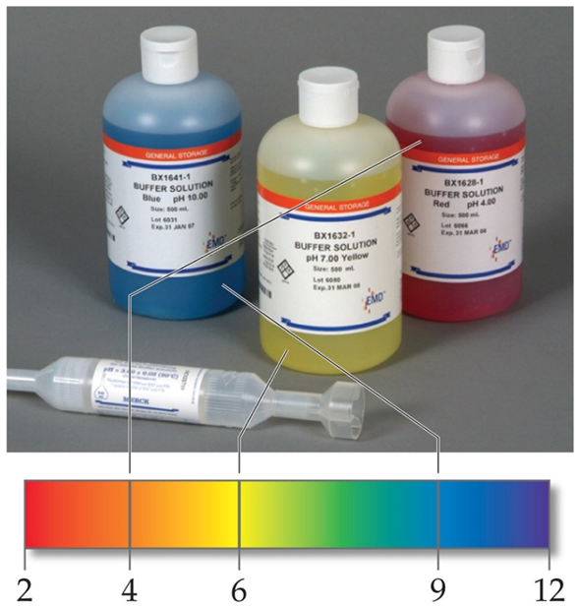
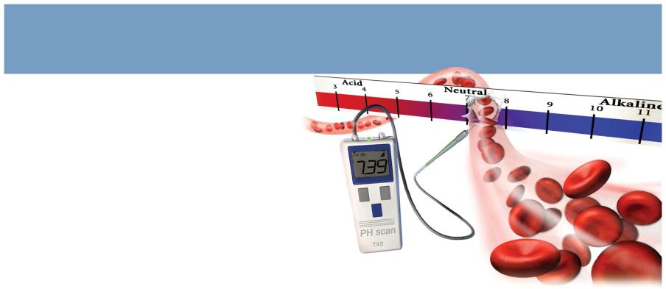
Introduction to Buffers
These solutions contain relatively high concentrations of both the acid and base. Their concentrations are approximately equal.

Slide 2
COMMON ION EFFECT
HC₂H₃O₂ ←→ H⁺ + C₂H₃O₂⁻
NaC₂H₃O₂ strong electrolyte
HC₂H₃O₂ weak electrolyte
Addition of NaC₂H₃O₂ causes equilibrium to shift to the left ←, decreasing [H⁺] eq
Dissociation of weak acid decreases by adding strong electrolyte w/common Ion. “Predicted from the Le Chatelier’s Principle.”

Slide 3
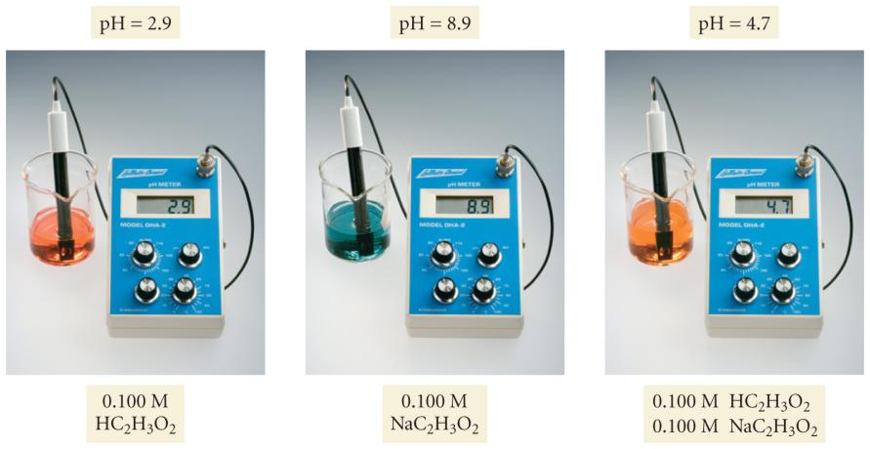
Common Ion Effect

Slide 4
Lecture Problems on the COMMON ION EFFECT
A shift of an equilibrium induced by an Ion common to the equilibrium.
HC₇H₅O₂ + H₂O ←→ C₇H₅O₂⁻ + H₃O⁺
Benzoic Acid
1. Calculate the degree of ionization of benzoic acid in a 0.15 M solution where sufficient HCl is added to make 0.010 M HCl in solution.
2. Compare the degree of ionization to that of a 0.15 M benzoic Acid solution
Ka = 6.3 x 10⁻⁵

Slide 5

Workshop B #1 on the COMMON ION EFFECT
1. Calculate [F-] and pH of a solution containing 0.10 mol of HCl and 0.20 mol of HF in a 1.0 L solution.
2. What is the pH of a solution made by adding 0.30 mol of acetic acid and 0.30 mol of sodium acetate to enough water to make 1.0 L of solution?

Slide 6
BUFFERS
A buffer is a solution characterized by the ability to resist changes in pH when limited amounts of acids or bases are added to it.
Buffers contain both an acidic species to neutralize OH- and a basic species to neutralize H₃O⁺.
An important characteristic of a buffer is it’s capacity to resist change in pH. This is a special case of the common Ion effect.
Ways to Make a Buffer
Mix a weak acid and a salt of its conjugate base or a weak base and a salt of its conjugate acid.
Add strong acid and partially neutralize a weak base or add strong base and partially neutralize a weak acid.

Slide 7
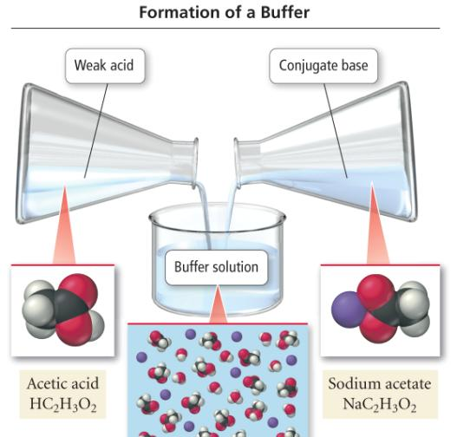
Making an Acid Buffer

Slide 8
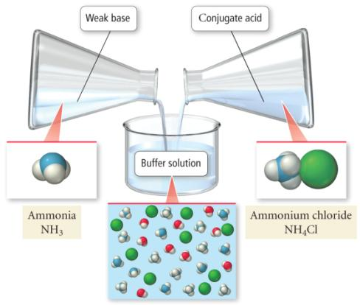
Basic Buffers
B:_{(aq)} + H₂O_{(l)} ⇔ H:B⁺_{(aq)} + OH⁻_{(aq)}
buffers can also be made by mixing a weak base, (B:), with a soluble salt of its conjugate acid, H:B⁺Cl⁻
H₂O_{(l)} + NH₃ _{(aq)} ⇔ NH₄⁺_{(aq)} + OH⁻_{(aq)}

Slide 9
Buffering Effectiveness
a good buffer should be able to neutralize moderate amounts of added acid or base
however, there is a limit to how much can be added before the pH changes significantly
the buffering capacity is the amount of acid or base a buffer can neutralize
the buffering range is the pH range the buffer can be effective
the effectiveness of a buffer depends on two factors (1) the relative amounts of acid and base, and (2) the absolute concentrations of acid and base

Slide 10
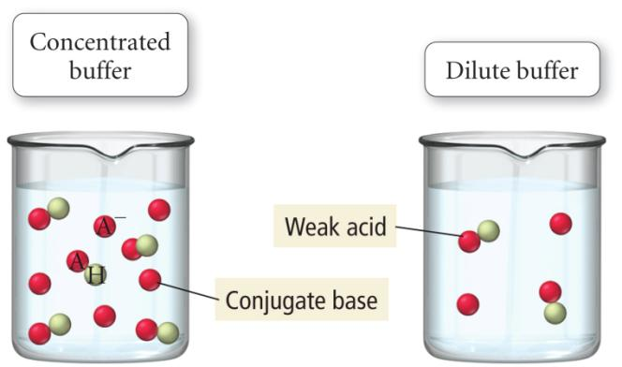
Buffering Capacity
a concentrated buffer can neutralize more added acid or base than a dilute buffer

Slide 11
How Buffers Work
H₂O
new
HA
HA
HA
A⁻
A⁻
⇔
+
H₃O⁺
Added
H₃O⁺

Slide 12
Buffer after addition Buffer with equal Buffer after
of H₃O+ concentrations of addition of OH-
conjugate acid & base
CH₃COOH
CH₃COO⁻
CH₃COO⁻
CH₃COO⁻
CH₃COOH
CH₃COOH
H₃O⁺
← ←
OH⁻
→→
H₂O + CH₃COOH ← H₃O⁺ + CH₃COO⁻ CH₃COOH + OH⁻ → CH₃COO⁻ + H₂O

Slide 13
How Buffers Work
H₂O
new
A⁻
A⁻
HA
A⁻
HA
⇔
+
H₃O⁺
Added
HO⁻

Slide 14
Buffer Capacity and Buffer Range
Buffer capacity is the ability to resist pH change.
The more concentrated the components of a buffer, the greater
the buffer capacity.
The pH of a buffer is distinct from its buffer capacity.
A buffer has the highest capacity when the component
concentrations are equal.
Buffer range is the pH range over which the buffer acts effectively.
Buffers have a usable range within ± 1 pH unit of the pK_{a} of
its acid component.

Slide 15
Sample Problem 1
Preparing a Buffer
PROBLEM:
An environmental chemist needs a carbonate buffer of pH 10.00 to study the effects of the acid rain on limsetone-rich soils. How many grams of Na₂CO₃ must she add to 1.5L of freshly prepared 0.20M NaHCO₃ to make the buffer? K_{a} of HCO₃⁻ is 4.7x10⁻¹¹.
PLAN:
We know the K_{a} and the conjugate acid-base pair. Convert pH to [H₃O⁺], find the number of moles of carbonate and convert to mass.
SOLUTION:

Slide 16
How Much Does the pH of a Buffer Change When an Acid or Base Is Added?
though buffers do resist change in pH when acid or base are added to them, their pH does change
calculating the new pH after adding acid or base requires breaking the problem into 2 parts
a stoichiometry calculation for the reaction of the added chemical with one of the ingredients of the buffer to reduce its initial concentration and increase the concentration of the other
  added acid reacts with the A⁻ to make more HA
  added base reacts with the HA to make more A⁻
an equilibrium calculation of [H₃O⁺] using the new initial values of [HA] and [A⁻]

Slide 17
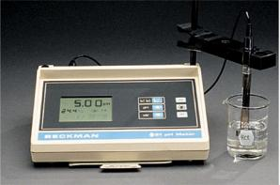
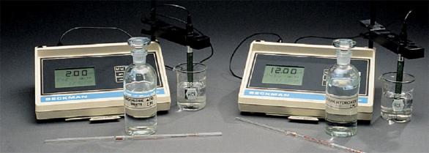
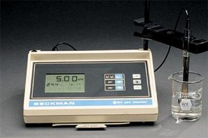
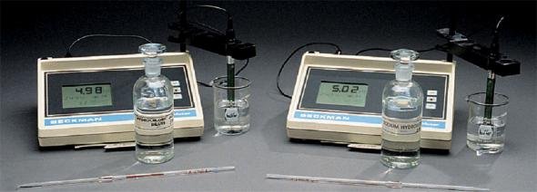
The effect of addition of acid or base to …
acid added
base added
an unbuffered solution
acid added
base added
or a buffered solution

Slide 18
Buffer after Buffer with equal Buffer after
addition of concentrations of addition of
OH⁻ weak acid and its H⁺
conjugate base
X⁻
HX
HX
X⁻
HX
X⁻
OH⁻
H⁺
OH⁻ + HX → H₂O + X⁻
H⁺ + X⁻ → HX

Slide 19
PROCEDURE FOR CALCULATION OF pH (buffer)
Add strong acid
Neutralization
X⁻ + H₃O → HX + H₂O
Use Ka, [HX]
and [X⁻] to
calculate
[H⁺]
Buffer containing
HA and X⁻
Recalculate
[HX] and[X⁻]
pH
Neutralization
HX + OH⁻ → X⁻ + H₂O
Add strong base
Stoichiometric calculation Equilibrium calculation

Slide 20
Lecture problems on the ADDITION OF A STRONG ACID OR STRONG BASE TO A BUFFER
1. A buffer is made by adding 0.3 mol of acetic acid and 0.3 mol of sodium acetate to 1.0 L of solution. If the pH of the buffer is 4.74
A. Calculate the pH of a solution after 0.02 mol of NaOH is added
B. after 0.02 mol HCl is added.

Slide 21
MAKING A BUFFER:
How would you make a buffer pH 4.25 starting from 250 mL of 0.25 M HCHO2 and the solid salt?
Lecture Problems
TESTING A BUFFER:
What will be the pH of this solution after 1.0 mL of 0.1 M NaOH is added to this buffer?

Slide 22
BUFFER Workshop B #2
1. What is the pH of a buffer that is 0.12 M in lactic acid (HC₃H₅O₃) and 0.10 M sodium lactate?
Lactic acid K_{a} = 1.4 x 10⁻⁴
2. How many moles of NH₄Cl must be added to 2.0 L of 0.10 M NH₃ to form a buffer whose pH is 9.00?

Slide 23
Henderson-Hasselbalch Equation
calculating the pH of a buffer solution can be simplified by using an equation derived from the K_{a} expression called the Henderson-Hasselbalch Equation
the equation calculates the pH of a buffer from the K_{a} and initial concentrations of the weak acid and salt of the conjugate base
  as long as the “x is small” approximation is valid

Slide 24
Deriving the Henderson-Hasselbalch Equation

Slide 25
Example - What is the pH of a buffer that is 0.050 M HC₇H₅O₂ and 0.150 M NaC₇H₅O₂?
Assume the [HA] and [A⁻] equilibrium concentrations are the same as the initial
Substitute into the Henderson-Hasselbalch Equation
Check the “x is small” approximation
HC₇H₅O₂ + H₂O ⇔ C₇H₅O₂⁻ + H₃O⁺
K_{a} for HC₇H₅O₂ = 6.5 x 10⁻⁵

Slide 26
Lecture Problems on Henderson - Hasselbach Equation
Q1. A buffer is made by adding 0.3 mol of acetic acid and 0.3 mol of sodium acetate to 1.0 L of solution. If the pH of the buffer is 4.74; calculate the pH of a solution after 0.02 mol of NaOH is added.
Q2. How would a chemist prepare an NH₄Cl/NH₃ buffer solution (K_{b} for NH₃ = 1.8 x 10⁻⁵) that has a pH of 10.00? Explain utilizing appropriate shelf reagent quantities.

Slide 27
Do I Use the Full Equilibrium Analysis or the Henderson-Hasselbalch Equation?
the Henderson-Hasselbalch equation is generally good enough when the “x is small” approximation is applicable
generally, the “x is small” approximation will work when both of the following are true:
the initial concentrations of acid and salt are not very dilute
the K_{a} is fairly small
for most problems, this means that the initial acid and salt concentrations should be over 1000x larger than the value of K_{a}

Slide 28
In Class Practice - What is the pH of a buffer that is 0.14 M HF (pK_{a} = 3.15) and 0.071 M KF?

Slide 29
Effect of Relative Amounts of Acid and Conjugate Base
a buffer is most effective with equal concentrations of acid and base
Buffer 1
0.100 mol HA & 0.100 mol A⁻
Initial pH = 5.00
Buffer 12
0.18 mol HA & 0.020 mol A⁻
Initial pH = 4.05
pK_{a} (HA) = 5.00
HA + OH⁻ ⇔ A⁻ + H₂O
after adding 0.010 mol NaOH
pH = 5.09
after adding 0.010 mol NaOH
pH = 4.25
 | HA | A⁻ | OH⁻
mols Before | 0.100 | 0.100 | 0
mols added | - | - | 0.010
mols After | 0.090 | 0.110 | ≈ 0
 | HA | A⁻ | OH⁻
mols Before | 0.18 | 0.020 | 0
mols added | - | - | 0.010
mols After | 0.17 | 0.030 | ≈ 0

Slide 30
Effect of Absolute Concentrations of Acid and Conjugate Base
a buffer is most effective when the concentrations of acid and base are largest
Buffer 1
0.50 mol HA & 0.50 mol A⁻
Initial pH = 5.00
Buffer 12
0.050 mol HA & 0.050 mol A⁻
Initial pH = 5.00
pK_{a} (HA) = 5.00
HA + OH⁻ ⇔ A⁻ + H₂O
after adding 0.010 mol NaOH
pH = 5.02
after adding 0.010 mol NaOH
pH = 5.18
 | HA | A⁻ | OH⁻
mols Before | 0.50 | 0.500 | 0
mols added | - | - | 0.010
mols After | 0.49 | 0.51 | ≈ 0
 | HA | A⁻ | OH⁻
mols Before | 0.050 | 0.050 | 0
mols added | - | - | 0.010
mols After | 0.040 | 0.060 | ≈ 0

Slide 31
Buffering Range
we have said that a buffer will be effective when
0.1 < [base]:[acid] < 10
substituting into the Henderson-Hasselbalch we can calculate the maximum and minimum pH at which the buffer will be effective
Lowest pH
Highest pH
therefore, the effective pH range of a buffer is pK_{a} ± 1
when choosing an acid to make a buffer, choose one whose is pK_{a} is closest to the pH of the buffer

Slide 32
Example – Which of the following acids would be the best choice to combine with its sodium salt to make a buffer with pH 4.25?
Chlorous Acid, HClO₂ pK_{a} = 1.95
Nitrous Acid, HNO₂ pK_{a} = 3.34
Formic Acid, HCHO₂ pK_{a} = 3.74
Hypochlorous Acid, HClO pK_{a} = 7.54

Slide 33
In class Practice – What ratio of NaCHO₂ : HCHO₂ would be required to make a buffer with pH 4.25?
Formic Acid, HCHO₂, pK_{a} = 3.74

Slide 34
Workshop on Buffers & Henderson - Hasselbach Equation B #3
1. A solution was prepared by mixing 100.0 mL of a 1.2 M propionic acid solution, HC₃H₅O₂(aq), where K_{a} = 1.3 x 10⁻⁵, and 400.0 mL of a 0.50 M sodium propionate solution, NaC₃H₅O₂(aq).
A. What is the pH of this solution?
B. What is the pH of the solution after the addition of 0.10 mol of NaOH(aq)?
C. What is the pH of the solution after the addition of 0.050 mol of HI(aq)?
2. How many grams of sodium hypobromite (NaBrO) should be added to 1.00 L of 0.050 M hypobromous acid (HBrO, K_{a} = 2.5 x 10⁻⁹) to form a buffer solution of pH 9.15? Assume that no volume change occurs when the NaBrO is added.

Slide 35
Titration
in an acid-base titration, a solution of unknown concentration (titrant) is slowly added to a solution of known concentration from a burette until the reaction is complete
  when the reaction is complete we have reached the endpoint of the titration
an indicator may be added to determine the endpoint
  an indicator is a chemical that changes color when the pH changes
when the moles of H₃O⁺ = moles of OH⁻, the titration has reached its equivalence point

Slide 36
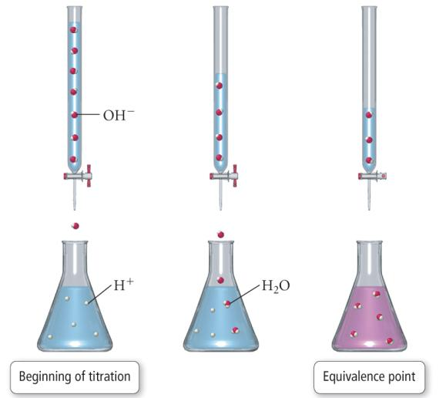
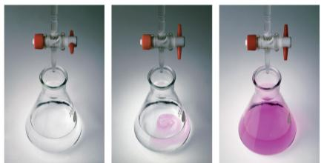
Titration

Slide 37
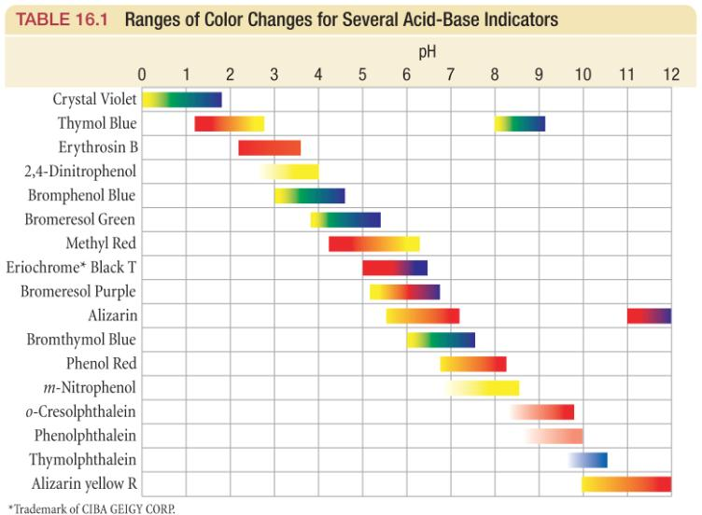
Acid-Base Indicators

Slide 38
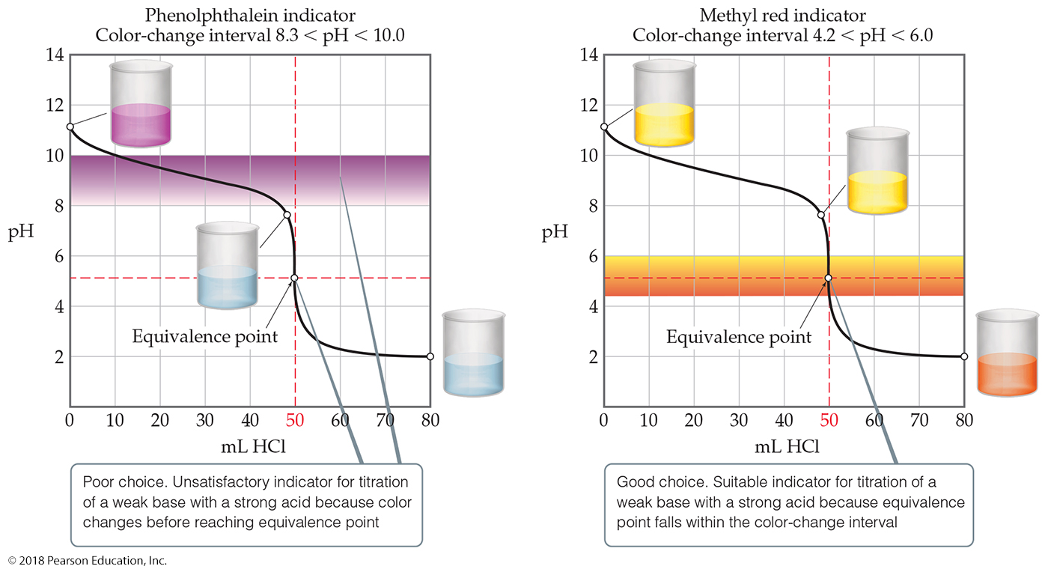
Indicator Choice Can Be Critical!

Slide 39
Monitoring pH During a Titration
the general method for monitoring the pH during the course of a titration is to measure the conductivity of the solution due to the [H₃O⁺]
  using a probe that specifically measures just H₃O⁺
the endpoint of the titration is reached at the equivalence point in the titration – at the inflection point of the titration curve
if you just need to know the amount of titrant added to reach the endpoint, we often monitor the titration with an indicator

Slide 40
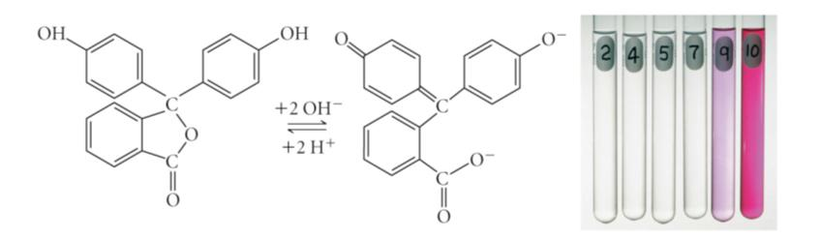
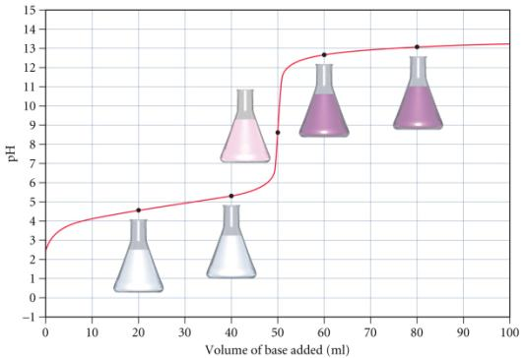
Phenolphthalein

Slide 41
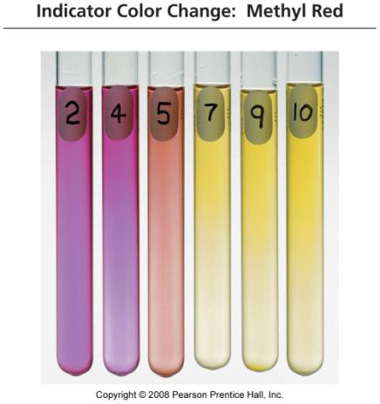
Methyl Red

Slide 42
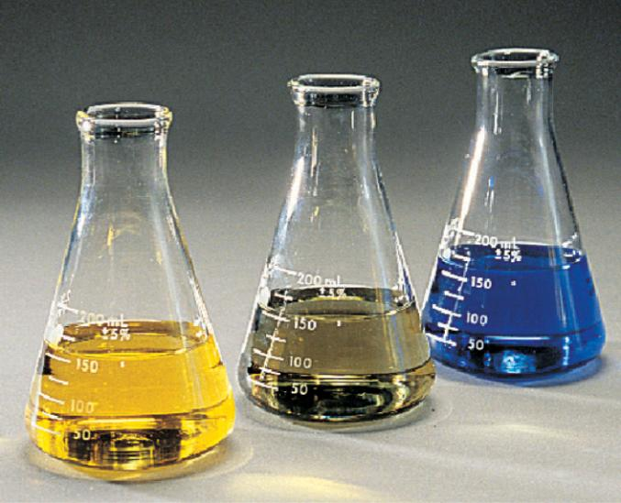
The color change of the indicator bromthymol blue.
basic
acidic
change occurs over ~2pH units

Slide 43
Titration Curve
a plot of pH vs. amount of added titrant
the inflection point of the curve is the equivalence point of the titration
prior to the equivalence point, the known solution in the flask is in excess, so the pH is closest to its pH
the pH of the equivalence point depends on the pH of the salt solution
  equivalence point of neutral salt, pH = 7
  equivalence point of acidic salt, pH < 7
  equivalence point of basic salt, pH > 7
beyond the equivalence point, the unknown solution in the burette is in excess, so the pH approaches its pH

Slide 44
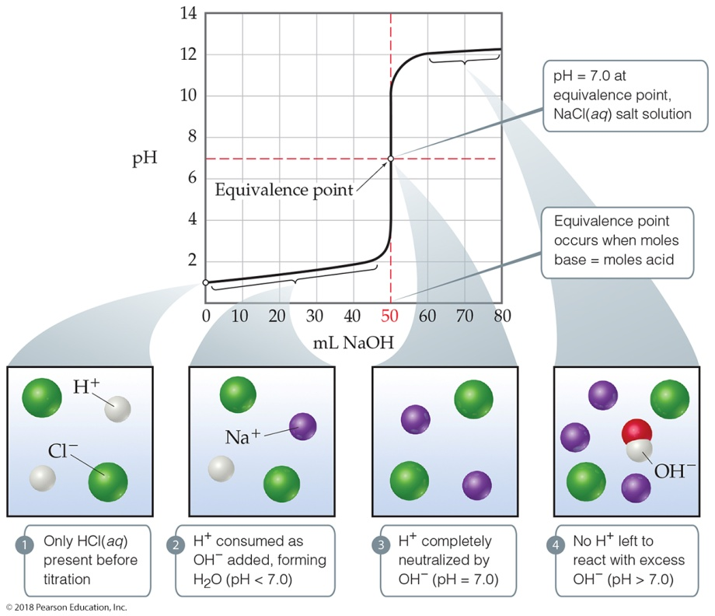
Titration of a Strong Acid with a Strong Base (1 of 3)
From the start of the titration to near the equivalence point, the pH goes up slowly.
Just before (and after) the equivalence point, the pH rises rapidly.

Slide 45
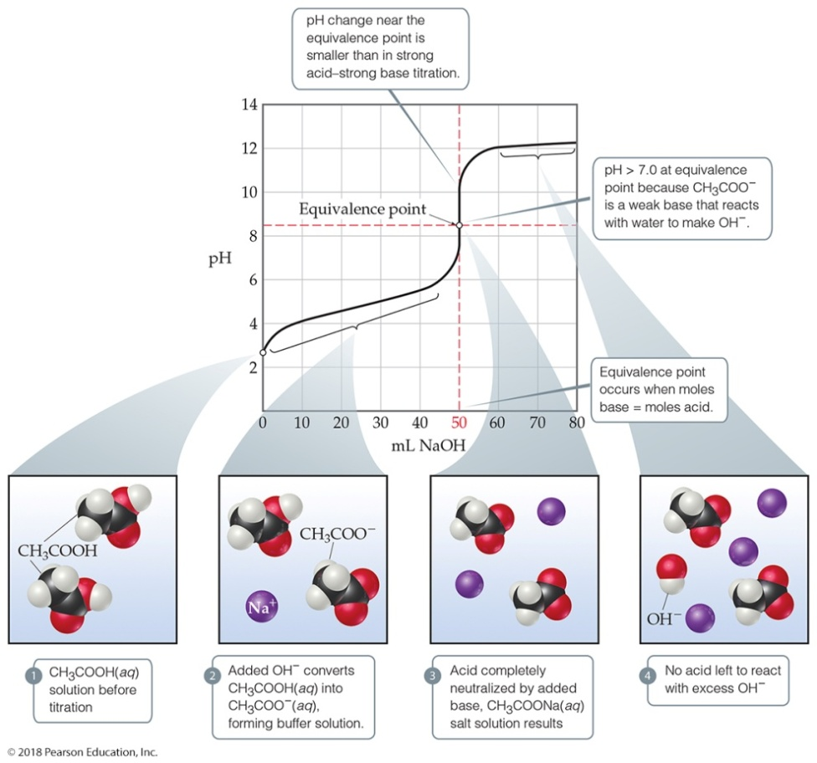
Titration of a Weak Acid with a Strong Base
Use
to find initial p H.
Find the p H in the “buffer region” using stoichiometry followed by the Henderson–Hasselbalch equation.
At the equivalence point the p H is >7. Use the conjugate base of the weak acid to determine the p H.

Slide 46
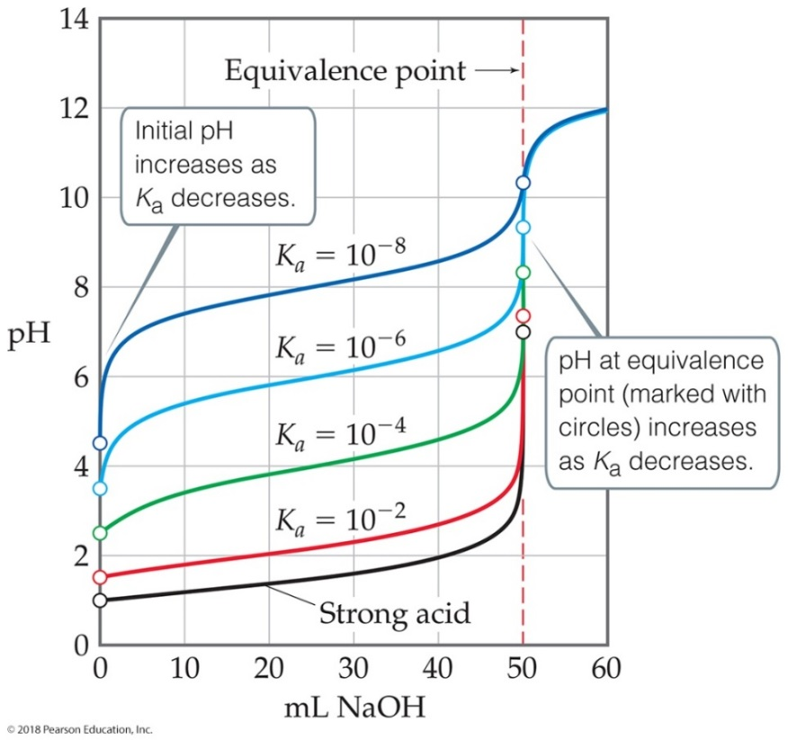
Ways That a Weak Acid Titration Differs from a Strong Acid Titration
A solution of weak acid has a higher initial p H than a strong acid.
The p H change near the equivalence point is smaller for a weak acid. (This is at least partly due to the buffer region.)
The p H at the equivalence point is greater than 7 for a weak acid.

Slide 47
ACID - BASE TITRATION
For a strong acid reacting with a strong base, the point of
neutralization is when a salt and water is formed
∴ pH = ?. This is also called the equivalence point.
Three types of titration curves
- SA + SB
- WA + SB
- SA + WB
Calculations for SA + SB
1. Calculate the pH if the following quantities of 0.100 M NaOH is added to 50.0 mL of 0.10 M HCl.
A. 49.0 mL
B. 50.0 mL
C. 51.0 mL
Skip to WB/SB
SA/SB graph

Slide 48
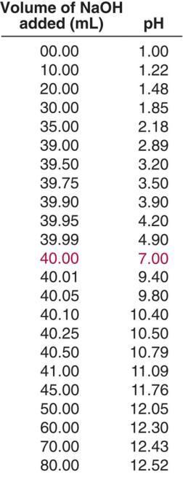
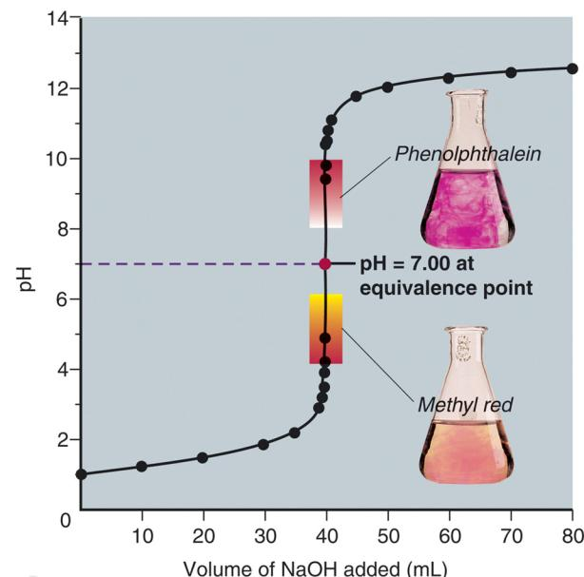
Curve for a strong acid-strong base titration

Slide 49
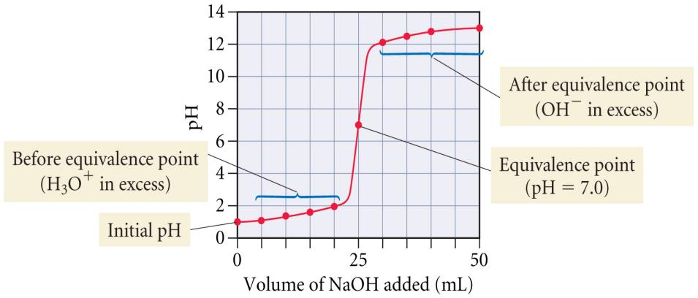
Titration Curve:
Unknown Strong Base Added to Strong Acid

Slide 50
EXAMPLE 1
Titration of 25 mL of 0.100 M HCl with 0.100 M NaOH
HCl_{(aq)} + NaOH_{(aq)} → NaCl_{(aq)} + H₂O_{(aq)}
initial pH = -log(0.100) = 1.00
initial mol of HCl = 0.0250 L x 0.100 mol/L = 2.50 x 10⁻³
before equivalence point
added 5.0 mL NaOH
5.0 x 10⁻⁴ mol NaOH
2.00 x 10⁻³ mol HCl

Slide 51
Titration of 25 mL of 0.100 M HCl with 0.100 M NaOH
HCl_{(aq)} + NaOH_{(aq)} → NaCl_{(aq)} + H₂O_{(aq)}
at equivalence, 0.00 mol HCl and 0.00 mol NaOH
pH at equivalence = 7.00
after equivalence point
added 30.0 mL NaOH
5.0 x 10⁻⁴ mol NaOH xs

Slide 52
Titration of 25 mL of 0.100 M HCl with 0.100 M NaOH
HCl_{(aq)} + NaOH_{(aq)} → NaCl_{(aq)} + H₂O_{(aq)}
at equivalence, 0.00 mol HCl and 0.00 mol NaOH
pH at equivalence = 7.00
after equivalence point
added 30.0 mL NaOH
5.0 x 10⁻⁴ mol NaOH xs

Slide 53
Titration of 25.0 mL of 0.100 M HCl with 0.100 M NaOH
The 1st derivative of the curve is maximum at the equivalence point
Since the solutions are equal concentration, the equivalence point is at equal volumes

Slide 54
STRONG BASE WITH WEAK ACID
WA + OH⁻ ←→ A⁻ + H₂O
for each mole of OH⁻ consumed 1 mol WA needed to produce 1 mol of A⁻ when WA is in excess, need to consider proton transfer between WA and H₂O to create A⁻ and H₃O⁺
WA + H₂O ←→ A⁻ + H₃O⁺
1. Stoichiometric calculation: allow SB to react with WA, solution product = WA & CB
2. Equilibrium calculation: use Ka and equil. to calculate [WA] and CB and H⁺

Slide 55
Titrating Weak Acid with a Strong Base
the initial pH is that of the weak acid solution
  calculate like a weak acid equilibrium problem
    e.g., 15.5 and 15.6
before the equivalence point, the solution becomes a buffer
  calculate mol HA_{init} and mol A⁻_{init} using reaction stoichiometry
  calculate pH with Henderson-Hasselbalch using mol HA_{init} and mol A⁻_{init}
half-neutralization pH = pK_{a}

Slide 56
Titrating Weak Acid with a Strong Base
at the equivalence point, the mole HA = mol Base, so the resulting solution has only the conjugate base anion in it before equilibrium is established
  mol A⁻ = original mole HA
    calculate the volume of added base like Ex 4.8
  [A⁻]_{init} = mol A⁻/total liters
  calculate like a weak base equilibrium problem
    e.g., 15.14
beyond equivalence point, the OH is in excess
  [OH⁻] = mol MOH xs/total liters
  [H₃O⁺][OH⁻]=1 x 10⁻¹⁴

Slide 58
PROCEDURE FOR CALCULATION OF pH (TITRATION)
Solution
containing
weak acid
and strong
base
Neutralization
Calculate
[HX] and
[X⁻] after
reaction
HX + OH⁻ → X⁻ + H₂O
Use Ka, [HX], and
[X⁻] to calculate
[H⁺]
pH
Stoichiometric calculation Equilibrium calculation
Pink Example Blue Example Practice Problems

Slide 59
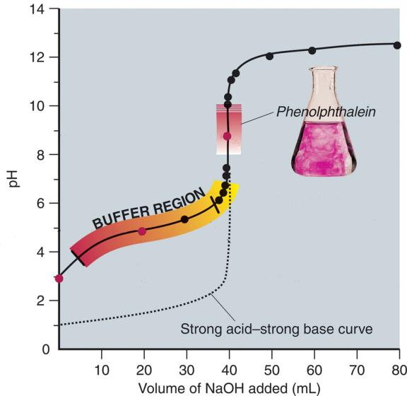
Titration of 40.00mL of 0.1000M HPr with 0.1000M NaOH
Curve for a weak acid-strong base titration
pK_{a} of HPr = 4.89
pH = 8.80 at equivalence point
[HPr] = [Pr⁻]
methyl red

Slide 60
EXAMPLE 2
We’ve seen what happens when a strong acid is titrated with a strong base but what happens when a weak acid is titrated? What is the fundamental difference between a strong acid and a weak acid? To compare with what we learned about the titration of a strong acid with a strong base, let’s calculate two points along the titration curve of a weak acid, HOAc, with a strong base, NaOH.
Q: If 30.0 mL of 0.200 M acetic acid, HC₂H₃O₂, is titrated with 15.0 ml of 0.100 M sodium hydroxide, NaOH, what is the pH of the resulting solution? Ka for acetic acid is 1.8 x 10⁻⁵.
Step 1: Write a balanced chemical equation describing the action:
HC₂H₃O₂ + OH⁻ → C₂H₃O₂ + H₂O
why did I exclude Na⁺?
Step 2: List all important information under the chemical equation:
HC₂H₃O₂ + OH⁻ → C₂H₃O₂ + H₂O
0.20 M 0.10M
30mL 15mL

Slide 61
Step 3: How many moles are initially present? What are we starting with before the titration?
n(HOAc)i = (0.03 L)(0.200M) = 0.006 moles
n(OH⁻)i = (0.015L)(0.100M) = 0.0015 moles
Q: What does this calculation represent?
A: During titration OH⁻ reacts with HOAc to form 0.0015
moles of Oac⁻ leaving 0.0045 moles of HOAc left in solution.
Step 4: Since we are dealing with a weak acid, ie., partially dissociated, an equilibrium can be established. So we need
to set up a table describing the changes which exist during
equilibrium.
HC₂H₃O₂ + OH⁻ → C₂H₃O₂⁻ + H₂O
i 0.006 0.0015 0 ---
Δ -.0015 -.0015 0.0015
eq 0.0045 0 0.0015
[HOAc] = n/V = 0.0045/0.045 L = 0.100 M
[OAc-] = n/V = 0.0015/0.045 L = 0.033 M

Slide 62
Step 5: To calculate the pH, we must first calculate the [H⁺]
Q: What is the relationship between [H⁺] and pH?
A: acid-dissociation expression, products over reactants.
Q: Which reaction are we establishing an equilibrium
acid-dissociation expression for?
HC₂H₃O₂ → C₂H₃O₂⁻ + H⁺
Ka = [Oac⁻] [H⁺]/[HOAc] = 1.8 x 10⁻⁵
solve for [H+] = Ka[HOAc]/[OAc⁻] = (1.8 x 10⁻⁵)(0.100)/0.033
= 5.45 x 10⁻⁵ M
Step 6: Calculate the pH from pH = -Log [H⁺]
pH = 4.26

Slide 63
So at this point, we have a pH of 4.26, Is this the equivalence point?
Is the equivalence point at pH = 7 as with a strong acid titration?
Q: By definition, how is the equivalence point calculated?
A: moles of base = moles of acid
Let’s calculate the pH at the equivalence point.
Step 1: Calculate the number of moles of base used to reach the
equivalence point.
n(HOAc)i = (0.03 L)(0.200 M) = 0.006 moles
there is a 1:1 mole ration between the acid and the base
therefore 0.006 moles of base are needed.
This corresponds to 60 ml of 0.10 M NaOH. The molarity of
the base solution titrated is moles of OAc- produced/total
volume: 0.006 moles/0.090 L = 0.067 M

Slide 64
Step 2: At the equivalence point, the solution contains NaOAC,
so we may treat this problem similar to the calculation
of the pH of a salt solution.
NaC₂H₃O₂ + H₂O → HC₂H₃O₂ + OH⁻
i 0.067 --- 0 0
Δ -x x x
eq 0.067-x x x
Kb = [HOAc][OH-]/[OAc-] = 5.556 x 10⁻¹⁰
= x* x /0.067
x = [OH⁻] = 6.1 x 10⁻⁶
pOH = -Log[OH⁻] = 5.21
pKw - pOH = pH = 14 - 5.21 = 8.79 at the equivalence
point
Skip to
Practice
Problems

Slide 65

EXAMPLE 3
Titration of 25 mL of 0.100 M HCHO₂ with 0.100 M NaOH
HCHO_{2(aq)} + NaOH_{(aq)} → NaCHO_{2(aq)} + H₂O_{(aq)}
Initial pH:
K_{a} = 1.8 x 10⁻⁴
 | [HCHO₂] | [CHO₂⁻] | [H₃O⁺]
initial | 0.100 | 0.000 | ≈ 0
change | -x | +x | +x
equilibrium | 0.100 - x | x | x

Slide 66
Titration of 25 mL of 0.100 M HCHO₂ with 0.100 M NaOH
HCHO_{2(aq)} + NaOH_{(aq)} → NaCHO₂ _{(aq)} + H₂O_{(aq)}
initial mol of HCHO₂ = 0.0250 L x 0.100 mol/L = 2.50 x 10⁻³
before equivalence
added 5.0 mL NaOH
 | HA | A⁻ | OH⁻
mols Before | 2.50E-3 | 0 | 0
mols added | - | - | 5.0E-4
mols After | 2.00E-3 | 5.0E-4 | ≈ 0

Slide 67
Titration of 25 mL of 0.100 M HCHO₂ with 0.100 M NaOH
HCHO_{2(aq)} + NaOH_{(aq)} → NaCHO₂ _{(aq)} + H₂O_{(aq)}
initial mol of HCHO₂ = 0.0250 L x 0.100 mol/L = 2.50 x 10⁻³
at equivalence
CHO₂⁻_{(aq)} + H₂O_{(l)} ⇔ HCHO_{2(aq)} + OH⁻_{(aq)}
added 25.0 mL NaOH
 | [HCHO₂] | [CHO₂⁻] | [OH⁻]
initial | 0 | 0.0500 | ≈ 0
change | +x | -x | +x
equilibrium | x | 5.00E-2-x | x
K_{b} = 5.6 x 10⁻¹¹
 | HA | A⁻ | OH⁻
mols Before | 2.50E-3 | 0 | 0
mols added | - | - | 2.50E-3
mols After | 0 | 2.50E-3 | ≈ 0
[OH⁻] = 1.7 x 10⁻⁶ M

Slide 68
Titration of 25 mL of 0.100 M HCHO₂ with 0.100 M NaOH
HCHO_{2(aq)} + NaOH_{(aq)} → NaCHO₂ _{(aq)} + H₂O_{(aq)}
after equivalence point
added 30.0 mL NaOH
5.0 x 10⁻⁴ mol NaOH xs

Slide 69

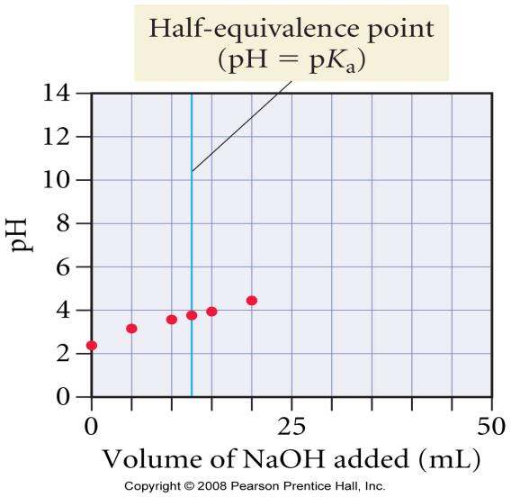
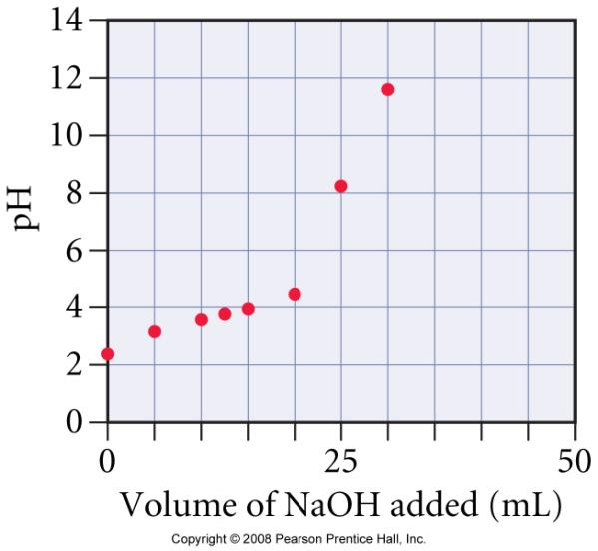
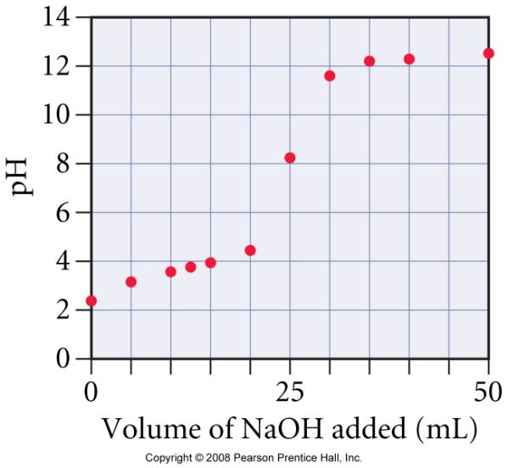
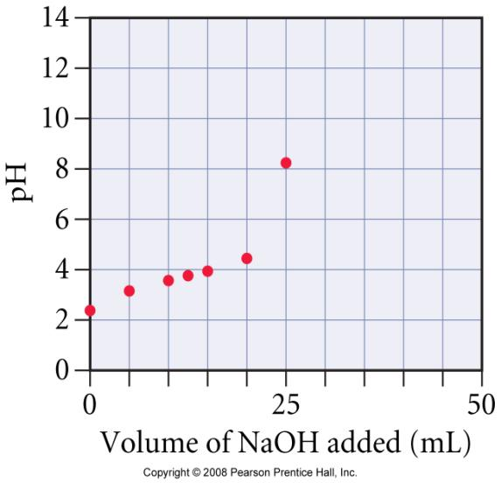
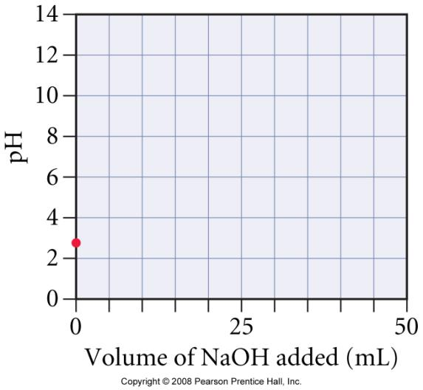
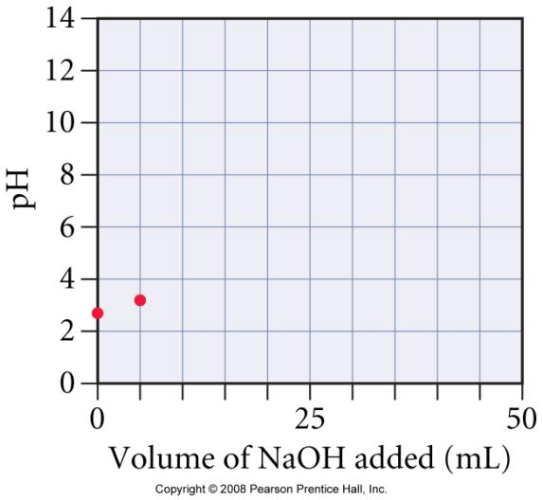
Adding NaOH to HCHO₂
added 30.0 mL NaOH
0.00050 mol NaOH xs
pH = 11.96
added 35.0 mL NaOH
0.00100 mol NaOH xs
pH = 12.22
initial HCHO₂ solution
0.00250 mol HCHO₂
pH = 2.37
added 5.0 mL NaOH
0.00200 mol HCHO₂
pH = 3.14
added 10.0 mL NaOH
0.00150 mol HCHO₂
pH = 3.56
added 25.0 mL NaOH
equivalence point
0.00250 mol CHO₂⁻
[CHO₂⁻]_{init} = 0.0500 M
[OH⁻]_{eq} = 1.7 x 10⁻⁶
pH = 8.23
added 12.5 mL NaOH
0.00125 mol HCHO₂
pH = 3.74 = pK_{a}
half-neutralization
added 40.0 mL NaOH
0.00150 mol NaOH xs
pH = 12.36
added 15.0 mL NaOH
0.00100 mol HCHO₂
pH = 3.92
added 50.0 mL NaOH
0.00250 mol NaOH xs
pH = 12.52
added 20.0 mL NaOH
0.00050 mol HCHO₂
pH = 4.34

Slide 70
Titration of 25.0 mL of 0.100 M HCHO₂ with 0.100 M NaOH
The 1st derivative of the curve is maximum at the equivalence point
pH at equivalence = 8.23
Since the solutions are equal concentration, the equivalence point is at equal volumes

Slide 71
1: Calculate the pH for the titration of HOAc by NaOH after 35 mL of 0.10 M NaOH has been added to 50 mL of 0.100 M HOAc.
2. If 45.0 mL of 0.250 M acetic acid, HC₂H₃O₂, is titrated with 18.0 mL of 0.125 M sodium hydroxide, NaOH:
What is the pH of the resulting solution? K_{a} for acetic acid is 1.8x10⁻⁵.
What is the pH at the equivalence point?

Slide 72
Workshop on Titration B #4
1. Consider the titration of 40.0 mL of 0.250 M HF (K_{a} = 6.6 x 10⁻⁴) with 0.200 M NaOH.
a) What is the pH of the solution before any base is added?
b) What is the pH of the solution when 10.0 mL of 0.200 M NaOH is added?
c) What is the pH of the solution at the halfway point of the titration?
d) What is the pH of the solution at the equivalence point of the titration?
e) What is the pH of the solution when 80.0 mL of 0.200 M NaOH is added?
2. A 50.0 mL sample of 0.25 M benzoic acid, HC₇H₅O₂, is titrated with 0.199 M NaOH solution. The K_{a} of benzoic acid is 6.3 x 10⁻⁵.
a) What is the pH, pOH, and [H₃O⁺] of the benzoic acid solution prior to the titration?
b) What is the pH of the solution when 30.0 mL of 0.199 M NaOH solution is added to the original sample?
c) What is the pH of the solution at the half-way point of the titration?
d) What is the pH of the solution at the equivalence point of the titration?
e) What is the pH of the solution when 70.0 mL of 0.199 M NaOH solution is added to the original sample?
f) Which of the following would be the best indicator to use for this titration? Justify your answer.
Methyl red K_{a} = 1 x 10⁻⁵
Cresol red K_{a} = 1 x 10⁻⁸
Alizarin yellow K_{a} = 1 x 10⁻¹¹

Slide 73
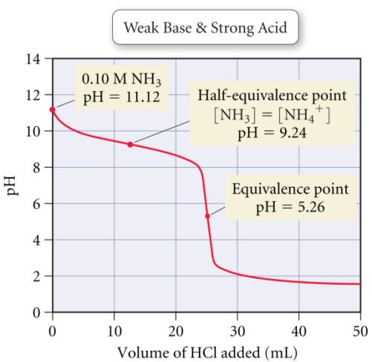
Titration Curve of a Weak Base with a Strong Acid

Slide 74
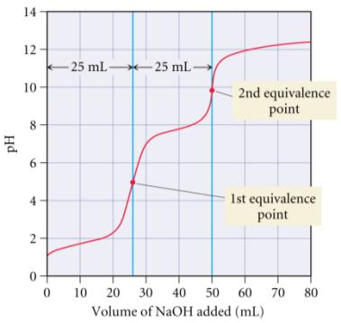
Titration of a Polyprotic Acid
if K_{a1} >> K_{a2}, there will be two equivalence points in the titration
  the closer the K_{a}’s are to each other, the less distinguishable the equivalence points are
titration of 25.0 mL of 0.100 M H₂SO₃ with 0.100 M NaOH

Slide 75
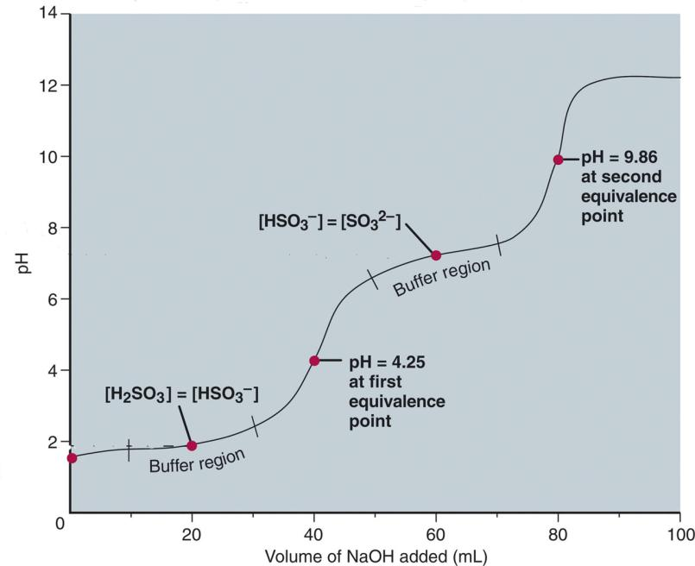
Curve for the titration of a weak polyprotic acid.
pK_{a} = 7.19
pK_{a} = 1.85
Titration of 40.00mL of 0.1000M H₂SO₃ with 0.1000M NaOH

Slide 76
KEY POINTS
1. Weak acid has a higher pH since it is partially dissociated and less [H+] is present
2. pH rises rapidly in the beginning and slowly towards the equivalence point.
3. The pH at the equivalence point is not 7 (only applies to strong acid titration).

