Slide 1
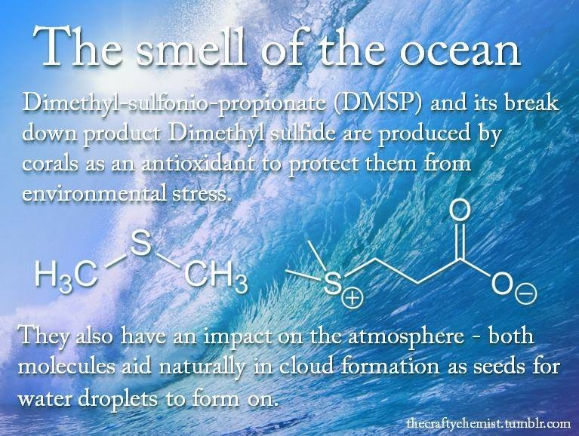
Nomenclature
The language of chemistry

Slide 2
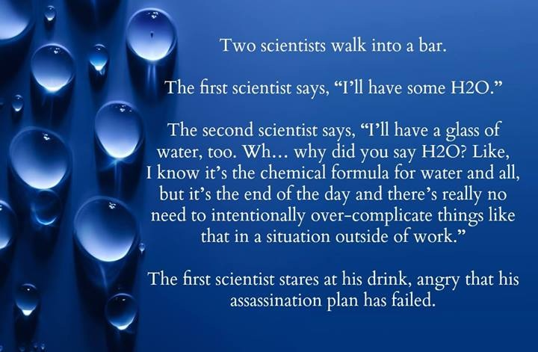

Slide 3
Assigning Oxidation States
The concept of oxidation numbers (or oxidation states) was devised as a simple way of keeping track of electrons in reactions. We use the following rules for assigning oxidation numbers:
Free Elements (Na, O₂, etc.) 0
Group 1 Elements in a compound¹ +1
Group 2 Elements in a compound +2
Group 3 Elements in a compound +3
“O” in a compound² -2
“F” in a compound -1
¹Exception to this rule occurs for hydrogen in hydrides (e.g. LiH, where the oxidation state of hydrogen is –1).
²Exception to this rule occurs in peroxides (e.g. H₂O₂, where the oxidation state of oxygen is –1).

Slide 4
NOTE: Three transition metals, Cd²⁺, Zn²⁺ and Ag⁺, are understood to exist in these oxidation states (numbers); therefore, Roman numerals are NOT included in parentheses. Also note that the mercury(I) ion is written as a diatomic ion (dimer): Hg₂⁺².
Practice
Determine the oxidation state of each underlined atom:
KMnO₄, ClO₄⁻, and S₂O₃²⁻.

Slide 5
Chemical Bonds
Bonds
“glue”
Ionic
Covalent
Metallic
e- transfer
Crystal lattice
ions
Na + Cl Na⁺ Cl ⁻
“salts”
very strong bonds generally between metals and non metals.
Solids at room temp.
Poor conductors of electricity in a solid state
sharing
“molecules”
hypothetical charge
H + H H H
. orbital overlap
Bonding e- are localized between two atoms
Formed between two nonmetals
“sea” of e-
e- are delocalized.
+
-

Slide 6
Common Polyatomic Ions – YOU MUST MEMORIZE THESE!!!
acetate C₂H₃O₂⁻ hydrogen phosphate HPO₄²⁻
ammonium NH₄⁺ hydrogen sulfate HSO₄⁻
carbonate CO₃²⁻ hydroxide OH⁻
chromate CrO₄²⁻ nitrate NO₃⁻
hypochlorite ClO⁻ nitrite NO₂⁻
chlorite ClO₂⁻ oxalate C₂O₄²⁻
chlorate ClO₃⁻ permanganate MnO₄⁻
perchlorate ClO₄⁻ peroxide O₂²⁻
cyanide CN⁻ phosphate PO₄³⁻
dichromate Cr₂O₇²⁻ sulfate SO₄²⁻
dihydrogen phosphate H₂PO₄⁻ sulfite SO₃²⁻
hydrogen carbonate HCO₃⁻ thiocyanate SCN⁻

Slide 7
Nomenclature

Slide 8
Naming Acids
There are two main types of acids that we will encounter at the onset of this course, binary acids, and oxoacids.
    1. Binary Acids – certain compounds of H with other nonmetal atoms.
    Examples: HF(aq) = hydrofluoric acid
    HCl(aq) = hydrochloric acid
    HBr(aq) = hydrobromic acid
    HI(aq) = hydroiodic acid
    H₂S(aq) = hydrosulfuric acid
    2. Oxoacids – Hydrogen with two other nonmetals, one of which is oxygen.
    Examples: HClO = hypochlorous acid
    HClO₂ = chlorous acid
    HClO₃ = chloric acid
    HClO₄ = perchloric acid
    HNO₂ = nitrous acid
HNO₃ = nitric acid

Slide 9
Naming Hydrates and Simple Organic Compounds
Hydrates are ordinary chemical substances that have associated with them a certain number of water molecules. For example, CuSO₄•5H₂O is read copper(II) sulfate pentahydrate. As we will see in section 2, when determining the overall molecular weight of this particular compound, you ADD five water molecules to the initial CuSO₄ (as opposed to multiply, where the “•” is commonly misinterpreted by beginner chemistry students; more on this later)!
When dealing with organic (or carbon-containing) compounds, we refer to the following prefixes:
Number of Carbons Prefix
1 Meth-
2 Eth-
3 Prop-
4 But-
5 Pent-
6 Hex-
7 Hept-
8 Oct-
9 Non-
10 Dec-

Slide 10
Naming Simple Organic Compounds
Compounds containing only carbon and hydrogen are called hydrocarbons. Hydrocarbons that contain only carbon-carbon single bonds are called alkanes. The simplest alkane is methane (CH₄), followed by ethane (C₂H₆ or CH₃CH₃), etc. The names of the alkanes are composed of two parts: a prefix indicating the number of carbon atoms, and the suffix “-ane” indicating that the molecule contains only carbon-carbon single bonds.
Hydrocarbons that contain only carbon=carbon double bonds are called alkenes. The simplest alkene is ethene (C₂H₄ or CH₂CH₂) followed by propene (C₃H₆).

Slide 11
Lecture Questions
1. Name each of the following compounds:
    A. HClO₄ (s) & (aq) E. KMnO₄
    B. Ca₃(PO₄)₂ F. K₂Cr₂O₇
    C. AlI₃ G. SiF₄
D V₂O₅ H. Ca(HSO₃)₂
2. Write formulas for the following compounds:
A. chromium(III) carbonate B. potassium chlorate
C. octane D. cobalt(II) chloride heptahydrate
E. sodium hydroxide F. potassium hypochlorite
G. aluminum hydroxide H. Lead(IV) oxide
I. peroiodic acid J. Nitrous acid

Slide 12
Workshop on Nomenclature – Page 1
1. Name each of the following compounds:
    A. Al₂(SO₄)₃ I. CH₃CH₂CH₂CH₂CH₃
    B. Pb(NO₃)₂ J. Li₂C₂O₄
    C. BaSO₃ K. TiO₂
D. NaNO₂ L. BaCl₂•8H₂O
    E. NaCl M. NO
    F. MgCl₂ N. NaHSO₄
    G. RbBr O. N₂F₄
    H. CsF P. FePO₄
2. Write formulas for the following compounds:
A. potassium dichromate G. ammonium acetate
sulfur hexafluoride H. ammonium hydrogen sulfate
sodium dihydrogen phosphate I. cobalt(III) nitrate
lithium nitride J. mercury(I) chloride
hydrogen cyanide I. ammonium chromate
sodium peroxide J. copper(I) bromide
copper(II) acetate K. germanium dioxide
F. carbon tetrafluoride L. butane

Slide 13
Workshop on nomeclature – page 2
3. The formulas and common names for several substances are given below. What are the systematic names for these substances?
    A. sugar of lead Pb(C₂H₃O₂)₂
    B. blue vitrol CuSO₄
    C. quicklime CaO
    D. milk of magnesia Mg(OH)₂
    E. laughing gas N₂O
4. Writing Names and Formulas of Compounds
A. Calcium hydroxide ____________________
B. Nickel(II) phosphate ____________________
C. Beryllium iodide ____________________
D. Chromium(III) sulfide ____________________
E. Diphosphorus tetroxide ____________________
F. Aluminum oxide ____________________
G. Ammonium nitrate ____________________
H. Phosphorus pentachloride _________________

Slide 14
Workshop on Nomenclature – page 3
5. Name each of the following compounds.
    A. Na₃PO₄ ________________________________
    B. PF₅ ________________________________
    D. FeBr₃ ________________________________
    E. Cu₂O ________________________________
    F. Cr(OH)₃ ________________________________
    G. Rb₂SO₄ ________________________________
    H. N₂O ________________________________
    I. HI (aq) ________________________________
    J. KH ________________________________
    K. Cr₂O₃ ________________________________
L. MgSO₄•6H₂O ________________________________ M. CH₃CH₂CH₃ ________________________________

