Slide 1
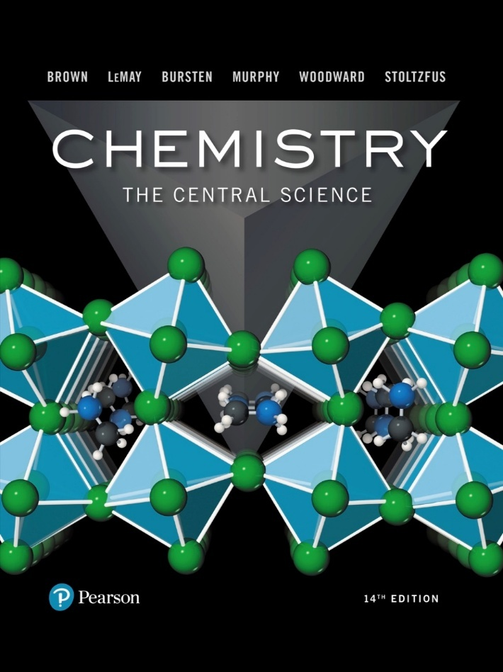
Chemistry: The Central Science
Fourteenth Edition
Chapter 16
Acid–Base Equilibria
Notes:
If this PowerPoint presentation contains mathematical equations, you may need to check that your computer has the following installed:
1) MathType Plugin
2) Math Player (free versions available)
3) NVDA Reader (free versions available)

Slide 2
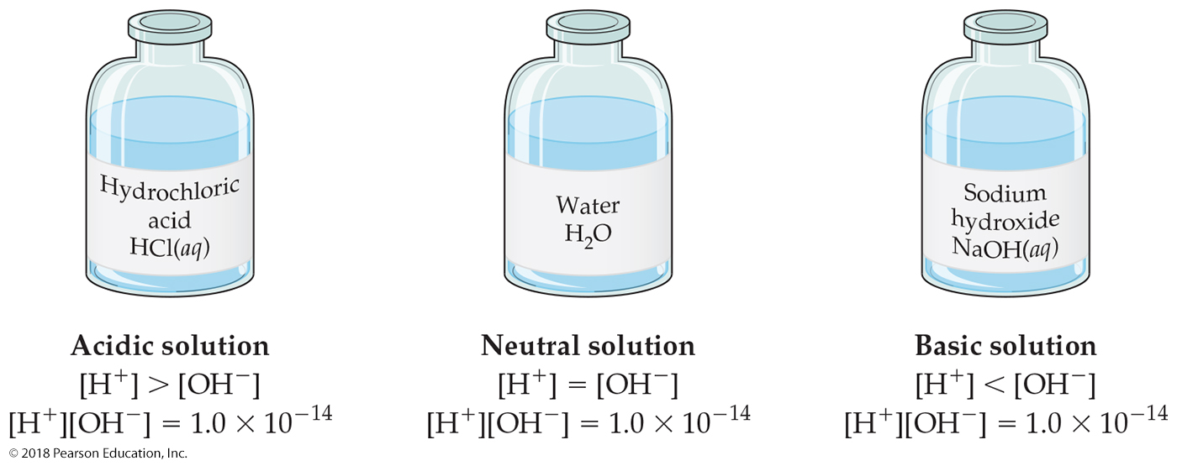
Aqueous Solutions Can Be Acidic, Basic, or Neutral
If a solution is neutral,
If a solution is acidic,
If a solution is basic,

Slide 3
ACIDS & BASES
Acids:
- acids are sour tasting
- Arrhenius acid: Any substance that when
dissolved in water, increases the concentration
of hydronium ion (H₃O⁺)
- Bronsted-Lowry acid: A proton donor
- Lewis Acid: An Electron acceptor
Bases:
- bases are bitter tasting and slippery
- Arrhenius base: Any substance that when
dissolved in water, increases the concentration
of hydroxide ion (OH⁻)
- Bronsted-Lowery base: A proton acceptor
- Lewis base: An electron donor
Click on topic for greater detail

Slide 4
Common Acids

Slide 5
Common Bases

Slide 6
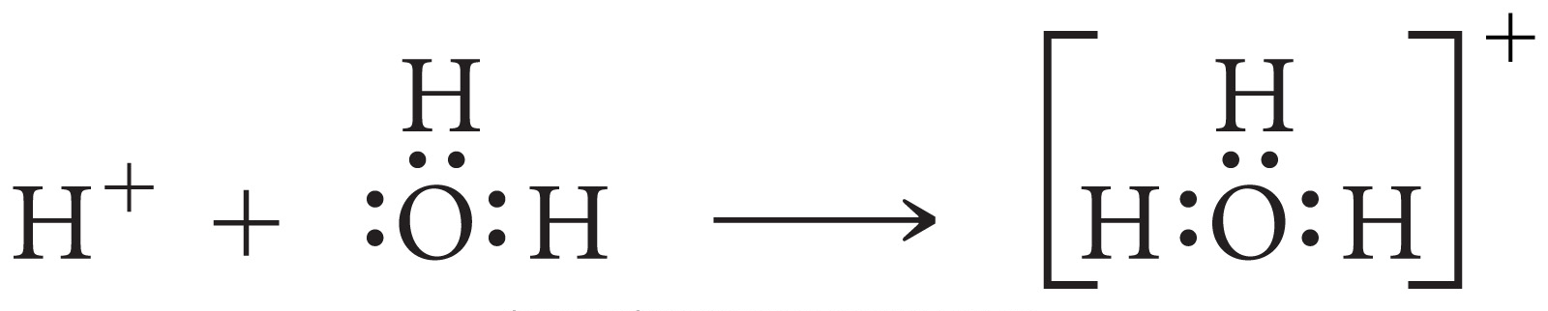
Hydronium Ion
the H⁺ ions produced by the acid are so reactive they cannot exist in water
  H⁺ ions are protons!!
instead, they react with a water molecule(s) to produce complex ions, mainly hydronium ion, H₃O⁺
H⁺ + H₂O → H₃O⁺
  there are also minor amounts of H⁺ with multiple water molecules, H(H₂O)_{n}⁺

Slide 7
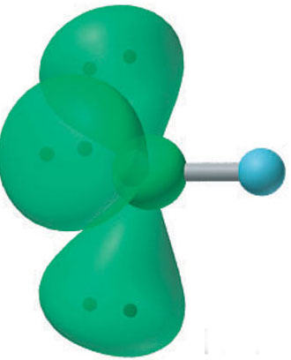
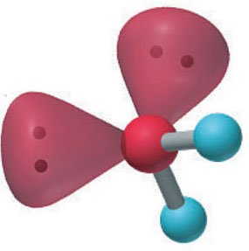
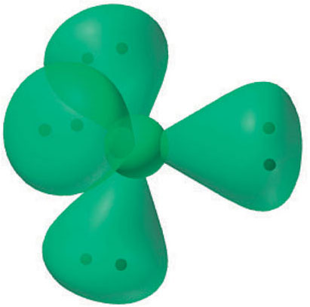
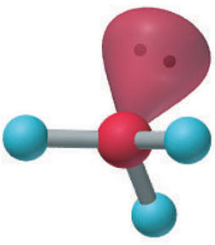
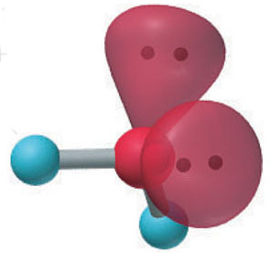
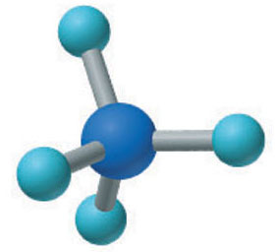
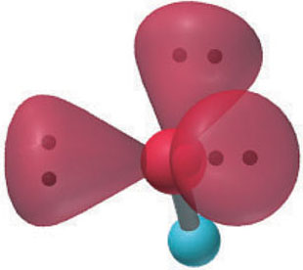
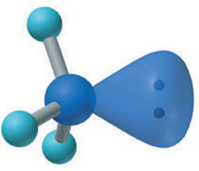
Proton transfer as the essential feature of a Brønsted-
Lowry acid-base reaction.
Lone pair binds H⁺
+
HCl
+
H₂O
Cl⁻
H₃O⁺
(acid, H⁺ donor)
(base, H⁺ acceptor)
Lone pair binds H⁺
+
+
NH₃
H₂O
NH₄⁺
OH⁻
(base, H⁺ acceptor)
(acid, H⁺ donor)
back

Slide 8
Molecules as Lewis Acids
An acid is an electron-pair acceptor.
A base is an electron-pair donor.
Examples & Problems
acid
base
adduct
M(H₂O)₄²⁺(aq)
M²⁺
H₂O(l)
adduct
back

Slide 9
Lewis Acid - Base Theory
electron sharing
electron donor = Lewis Base = nucleophile
  must have a lone pair of electrons
electron acceptor = Lewis Acid = electrophile
  electron deficient
when Lewis Base gives electrons from lone pair to Lewis Acid, a covalent bond forms between the molecules
Nucleophile: + Electrophile → Nucleophile:Electrophile
product called an adduct

Slide 10
Example - Complete the Following
Lewis Acid-Base Reactions
Label the Nucleophile and Electrophile
OH
H C H
+ OH⁻¹ ⇔
⊕
OH
H C H
OH
H C H
OH
••
+ OH⁻¹ ⇔
•
•
⊕
••
Nucleophile
Electrophile

Slide 11
Practice - Complete the Following
Lewis Acid-Base Reactions
Label the Nucleophile and Electrophile
BF₃ + HF ⇔
CaO + SO₃ ⇔
KI + I₂ ⇔

Slide 12
Practice - Complete the Following
Lewis Acid-Base Reactions
Label the Nucleophile and Electrophile
BF₃ + HF ⇔ H⁺¹BF₄⁻¹
CaO + SO₃ ⇔ Ca⁺²SO₄⁻²
KI + I₂ ⇔ KI₃
F
B F
F
F
B F
F
Elec
Nuc
••
-1
H F
••
+
H⁺¹
F
••
Nuc
Elec
O
S O
O
-2
••
O
S O
O
Ca⁺² O ⁻²
••
••
+
Ca⁺²
O
••
Nuc
Elec
••
K⁺¹ I ⁻¹
I I
K⁺¹ I I I ⁻¹
••
••
+
••

Slide 13
Indicators
chemicals which change color depending on the acidity/basicity
many vegetable dyes are indicators
  anthocyanins
litmus
  from Spanish moss
  red in acid, blue in base
phenolphthalein
  found in laxatives
  red in base, colorless in acid

Slide 14
Amphoteric Substances
amphoteric substances can act as either an acid or a base
  have both transferable H and atom with lone pair
water acts as base, accepting H⁺ from HCl
HCl(aq) + H₂O(l) → Cl–(aq) + H₃O⁺(aq)
water acts as acid, donating H⁺ to NH₃
NH₃(aq) + H₂O(l) ⇔ NH₄⁺(aq) + OH–(aq)

Slide 15
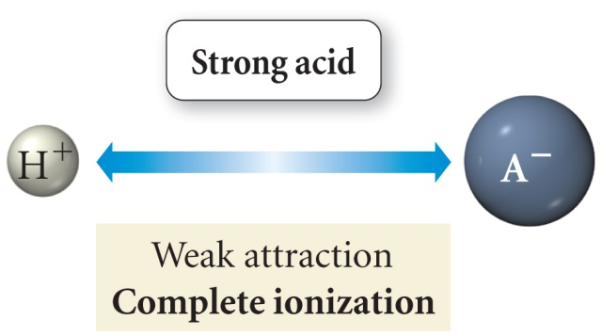
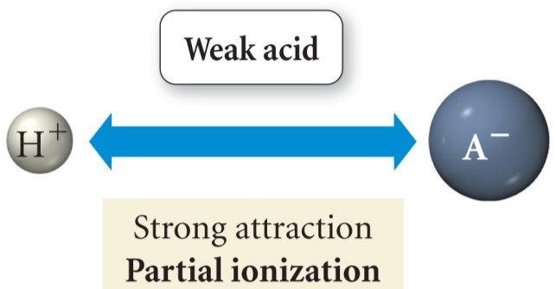
Strengths of Acids & Bases
commonly, acid or base strength is measured by determining the equilibrium constant of a substance’s reaction with water
HAcid + H₂O ⇔ Acid⁻¹ + H₃O⁺¹
Base: + H₂O ⇔ HBase⁺¹ + OH⁻¹
the farther the equilibrium position lies to the products, the stronger the acid or base
the position of equilibrium depends on the strength of attraction between the base form and the H⁺
  stronger attraction means stronger base or weaker acid

Slide 16
STRONG VS WEAK
- completely ionized - partially ionized
- strong electrolyte - weak electrolyte
- ionic bonds - some covalent bonds
STRONG ACIDS: STRONG BASES:
HClO₄ / HClO₃ LiOH
H₂SO₄ NaOH
Hl KOH
HBr Ca(OH)₂
HCl Sr(OH)₂
HNO₃ Ba(OH)₂

Slide 17
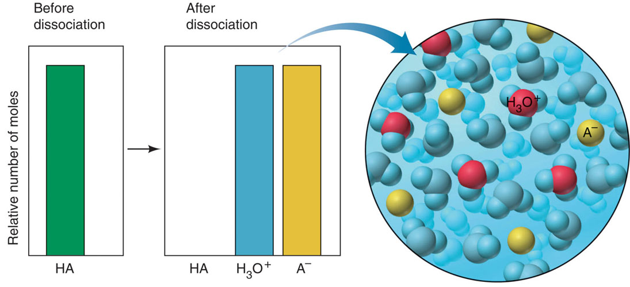
The extent of dissociation for strong acids.
Strong acid: HA(g or l) + H₂O(l) H₂O⁺(aq) + A⁻(aq)

Slide 18
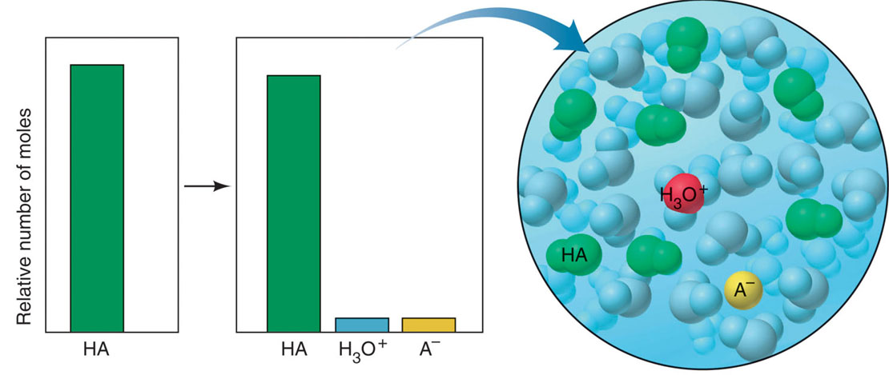
The extent of dissociation for weak acids.
Weak acid: HA(aq) + H₂O(l) H₂O⁺(aq) + A⁻(aq)

Slide 19
General Trends in Acidity
the stronger an acid is at donating H, the weaker the conjugate base is at accepting H
higher oxidation number = stronger oxyacid
  H₂SO₄ > H₂SO₃; HNO₃ > HNO₂
cation stronger acid than neutral molecule; neutral stronger acid than anion
  H₃O⁺¹ > H₂O > OH⁻¹; NH₄⁺¹ > NH₃ > NH₂⁻¹
  base trend opposite

Slide 20
Predict the product and describe each species as strong or weak acids or bases.
HI + Sr(OH)₂ →
H₃O⁺ + C₅H₅N →

Slide 21
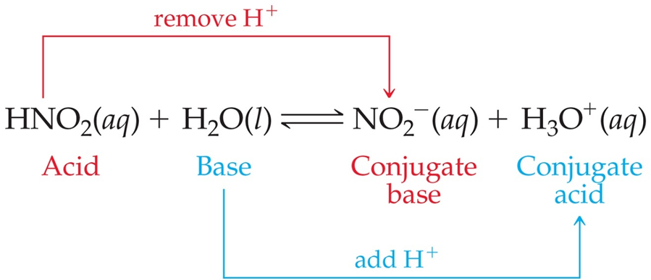
THE CONJUGATE PAIRS IN SOME ACID-BASE REACTIONS
Reaction 1 HF + H₂O ←→ F⁻ + H₃O⁺
Reaction 2 HCOOH + CN⁻ ←→ HCOO⁻ + HCN
Reaction 3 NH₄⁺ + CO₃²⁻ ←→ NH₃ + HCO₃⁻

Slide 22
CONJUGATE ACID-BASE PAIRS
ACID BASE
HCl Cl⁻
H₂SO₄ HSO₄⁻
HNO₃ NO₃⁻
H⁺(aq) H₂O
HSO₄⁻ SO₄²⁻
H₃PO₄ H₂PO₄
HF F⁻
HC₂H₃O₂ C₂H₃O₂
H₂CO₃ HCO₃⁻
H₂S HS⁻
H₂PO₄⁻ HPO₄²⁻
NH₄⁺ NH₃
HCO₃⁻ CO₃²⁻
HPO₄²⁻ PO₄³⁻
H₂O OH⁻
HS⁻ S²⁻
OH⁻ O₂⁻
H₂ H⁻
100 percent
ionized in
H₂O
strong
negligible
Base
strength
increases
↓
↓
↓
↓
↑
↑
↑
↑
Acid
strength
increases
weak
weak
100 percent
protonated in
H₂O
negligible
strong

Slide 23
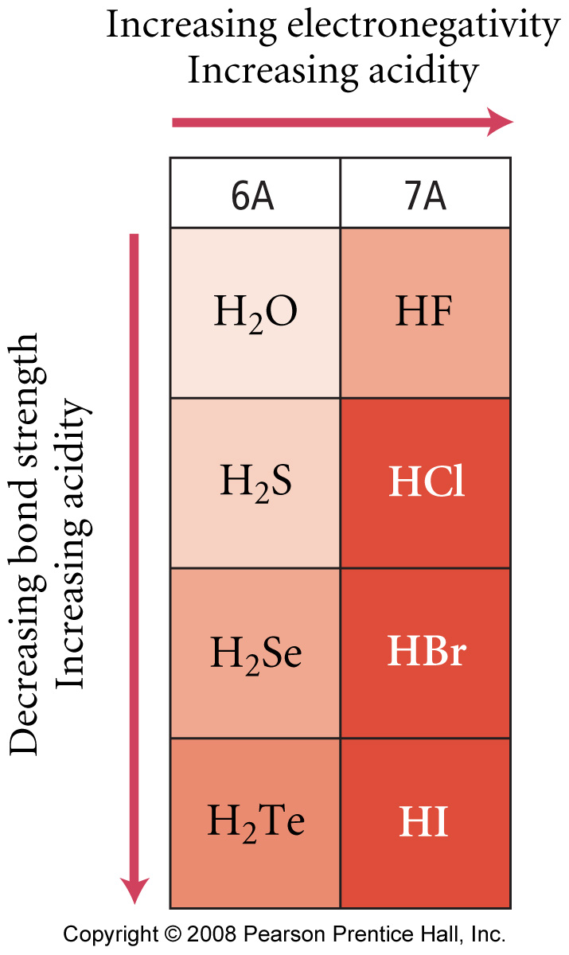
Strengths of Binary Acids
the more δ+ H-X δ- polarized the bond, the more acidic the bond
the stronger the H-X bond, the weaker the acid
binary acid strength increases to the right across a period
  H-C < H-N < H-O < H-F
binary acid strength increases down the column
  H-F < H-Cl < H-Br < H-I

Slide 24
Strengths of Oxyacids, H-O-Y
the more electronegative the Y atom, the stronger the acid
  helps weakens the H-O bond
the more oxygens attached to Y, the stronger the acid
  further weakens and polarizes the H-O bond

Slide 25
Back 1 slide 29
A
C
I
D
S
T
R
E
N
G
T
H
Acid Base
HCl Cl⁻
H₂SO₄ HSO₄⁻
HNO₃ NO₃⁻
H₃O⁺ H₂O
HSO₄⁻ SO₄²⁻
H₂SO₃ HSO₃⁻
H₃PO₄ H₂PO₄⁻
HF F⁻
CH₃COOH CH₃COO⁻
H₂CO₃ HCO₃⁻
H₂S HS⁻
HSO₃⁻ SO₃²⁻
H₂PO₄⁻ HPO₄²⁻
NH₄⁺ NH₃
HCO₃⁻ CO₃²⁻
HPO₄²⁻ PO₄³⁻
H₂O OH⁻
HS⁻ S²⁻
OH⁻ O²⁻
BACK 2 SLIDE 31
B
A
S
E
S
T
R
E
N
G
T
H
STRONG
WEAK
NEGLIGIBLE
NEGLIGIBLE
WEAK
STRONG

Slide 26
The strength of an acid depends on how easily the proton, H⁺, is lost or removed from an H - X bond.
Greater Acid Strength:
- more polar bonds
- larger “X” atom
- oxo acids: higher electronegativity
- oxo acids: more oxygen atoms
- oxo acids: more hydrogen atoms
List the following in order of increasing strength:
l. HI, HF, HCl
2. H₂O, CH₄, HF
3. HIO₃, HClO₃, HBrO₃
4. HBrO, HBrO₃, HBrO₂
5. HI, H₂SO₄, HClO₄, HNO₃

Slide 27
Classifying Acid and Base Strength from the Chemical Formula
SAMPLE PROBLEM
Classify each of the following compounds as a strong acid, weak acid, strong base, or weak base.
(a) H₂SO₄
(b) (CH₃)₂CHCOOH
(c) KOH
(d) (CH₃)₂CHNH₂
Pay attention to the text definitions of acids and bases. Look at O for acids as well as the -COOH group; watch for amine groups and cations in bases.
PLAN:
SOLUTION:

Slide 28
Workshop AB #1
1) Place the following in order of increasing acid strength.
a) HBrO₂ HBrO₃ HBrO HBrO₄
b) HCN HClO₂ HNO₃ H₂PO₄⁻
2) Give the conjugate base for each acid list below and determine which one will have the strongest conjugate base? Explain your reasoning.
A) HCl B) HClO₄ C) HNO₃ D) HCN E) HI
3) Predict the product and describe each substance as either an acid or base, or conjugate, as strong or weak, & as Lewis or Bronsted-Lowery.
BCl₃ + NH₃ ↔ _________________________________________________
B) H₂O + AlF₃ ↔ __________________________________________________
C) NH₃ + H₂O ↔ __________________________________________________
D) H₂O + SiF₄ ↔ ___________________________________________________
4) Are any of the substances mentioned on this workshop amphoteric? Which ones? _____________________

Slide 29
Measuring Acidity: pH of Some Common Solutions
pH [H⁺] [OH⁻] pOH
--14 1 x 10⁻¹⁴ 1 x 10⁻⁰ 0
--13 1 x 10⁻¹³ 1 x 10⁻¹ 1
--12 1 x 10⁻¹² 1 x 10⁻² 2
--11 1 x 10⁻¹¹ 1 x 10⁻³ 3
--10 1 x 10⁻¹⁰ 1 x 10⁻⁴ 4
-- 9 1 x 10⁻⁹ 1 x 10⁻⁵ 5
-- 8 1 x 10⁻⁸ 1 x 10⁻⁶ 6
-- 7 1 x 10⁻⁷ 1 x 10⁻⁷ 7
-- 6 1 x 10⁻⁶ 1 x 10⁻⁸ 8
-- 5 1 x 10⁻⁵ 1 x 10⁻⁹ 9
-- 4 1 x 10⁻⁴ 1 x 10⁻¹⁰ 10
-- 3 1 x 10⁻³ 1 x 10⁻¹¹ 11
-- 2 1 x 10⁻² 1 x 10⁻¹² 12
-- 1 1 x 10⁻¹ 1 x 10⁻¹³ 13 -- 0 1 x 10⁰ 1 x 10⁻¹⁴ 14
M
O
R
E
B
A
S
I
C
NaOH, 0.1 M……………..
Household bleach………..
Household ammonia…….
Lime Water………………
Milk of Magnesia………..
Borax…………………….
Baking Soda…………….
Egg White, Sea Water…..
Human blood, Tears……..
M
O
R
E
A
C
I
D
I
C
Milk……………………….
Saliva………………………
Rain………………………..
Black Coffee……………….
Banana…………………….
Tomatoes………………….
Wine……………………….
Cola, Vinegar……………..
Lemon Juice………………
Gastric Juice……………..

Slide 30
pH
Practice Problems on pH:
1. A 0.0015M NaOH solution has what pOH? [OH⁻]?
2. A 0.00015M nitric acid solution has what pH? [H⁺]?
I. pOH = -Log [OH-] [OH-] = 10^{-pOH}
pH = -Log [H+] [H+] = 10^{-pH}

Slide 31
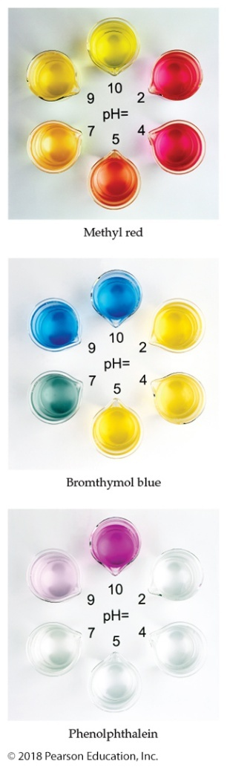
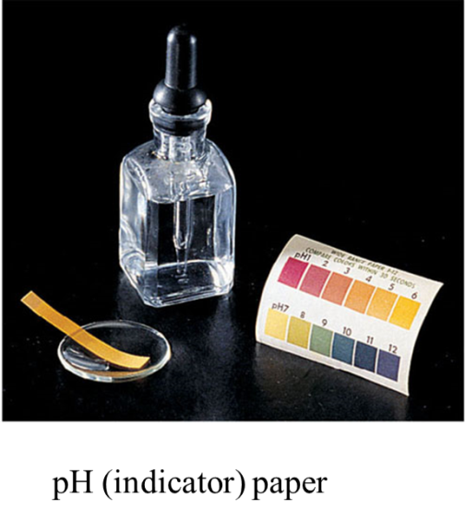
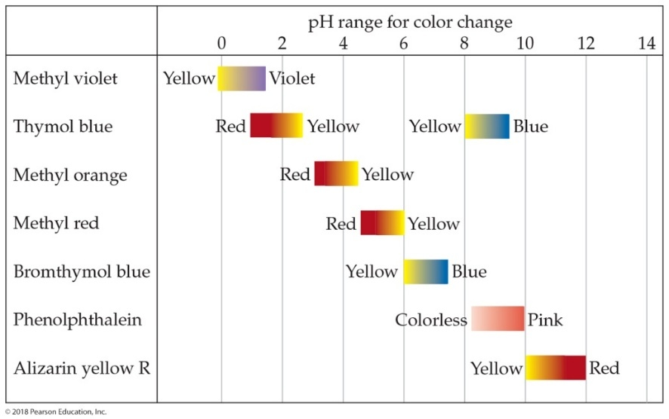
How Do We Measure p H?
One method is with indicators.
They give less accurate, but quick measurements.
An indicator is a compound that has one color in its acid form and another color in its basic form.

Slide 32
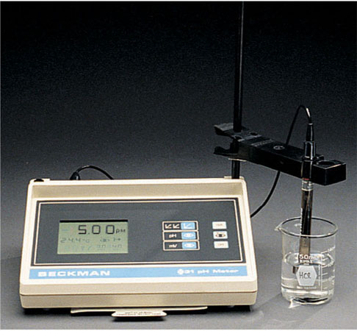
Methods for measuring the pH of an aqueous solution
Another way to measure pH is with a pH meter.
pH meters are used for accurate measurement of pH; electrodes indicate small changes in voltage to detect pH.
pH meter

Slide 33
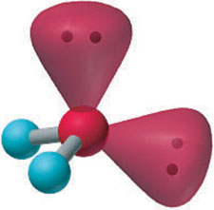
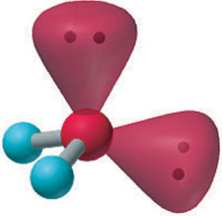
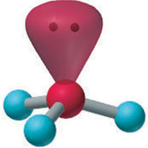
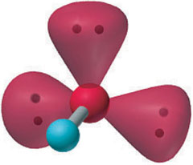
Autoionization of Water and the pH Scale
+
H₂O(l)
H₂O(l)
+
H₃O⁺(aq)
OH⁻(aq)

Slide 34
AUTO - IONIZATION
A reaction in which two like molecules react to give Ions.
2 H₂O ←→ H₃O⁺ + OH⁻
K= [H₃O⁺] [OH⁻] but [H₂O] is essentially
[H₂O]² constant
∴ K[H₂O]² = [H₃O⁺] [OH⁻]
Kw = [H₃O⁺] [OH⁻]
K_{w} = Ion-product constant for water.
K_{w} = 1 x 10⁻¹⁴ at 25°C

Slide 35
pH & Water
Due to auto ionization of water,
K_{w} = [H⁺] [OH⁻] so take the log
Log K_{w} = Log [H⁺] [OH⁻]
= Log [H⁺] + log [OH⁻]
therefore:
p K_{w} = pH + pOH or 14 = pH + pOH

Slide 36
Sig. Figs. & Logs
when you take the log of a number written in scientific notation, the digit(s) before the decimal point come from the exponent on 10, and the digits after the decimal point come from the decimal part of the number
log(2.0 x 10⁶) = log(10⁶) + log(2.0)
= 6 + 0.30303… = 6.30303...
since the part of the scientific notation number that determines the significant figures is the decimal part, the sig figs are the digits after the decimal point in the log
log(2.0 x 10⁶) = 6.30

Slide 37
pH
Lecture Problems on pH:
1. A 0.0015M NaOH solution has what pH? [H⁺]?
2. A 0.00015M nitric acid solution has what pOH? [OH⁻]?
3. A 6.44x10⁻⁵ M Ca(OH)₂ solution has what pH? pOH?
4. A solution has pOH of 12.7, what is the [H⁺]?

Slide 38
Workshop AB#2 on pH
1. A 3.998x10⁻⁹ M Ba(OH)₂ solution has what pH? pOH?
2. An unknown solution has pH of 2.7, what is the [H⁺] & [OH⁻]?
In an art restoration project, a conservator prepares copper-plate etching solutions by diluting concentrated HNO₃ to 2.0M, 0.30M, and 0.0063M HNO₃.
Calculate [H₃O⁺], pH, [OH-], and pOH of the three solutions at 25ºC.

Slide 39
WEAK ACIDS/BASES & EQUILIBRIUM
HA(aq) ←→ H⁺ (aq) + A⁻ (aq)
K_{a} = [H⁺] [A⁻] K_{a} = acid dissociation constant
[HA]
B⁻ + H₂O ←→ HB⁺ + OH⁻
K_{b} = K[H₂O] = [HB⁺] [OH⁻]
[B-] K_{b} = base dissociation constant
The magnitude of K_{a} or K_{b} refers to the strength of the acid.
Small K_{a} value = weak acid
Small K_{b} value = weak base
K = [HB⁺] [OH⁻]
[B⁻] [H₂O]

Slide 40
Strong acids dissociate completely into ions in water.
HA(g or l) + H₂O(l) H₃O⁺(aq) + A⁻(aq)
K_{a} >> 1
Weak acids dissociate very slightly into ions in water.
HA(aq) + H₂O(l) H₃O⁺(aq) + A⁻(aq)
K_{a} << 1
The Acid-Dissociation Constant
[H₃O⁺][A⁻]
stronger acid higher [H₃O⁺]
K_{c} =
[H₂O][HA]
larger K_{a}
[H₃O⁺][A⁻]
K_{c}[H₂O] = K_{a} =
[HA]
smaller K_{a} lower [H₃O⁺]
weaker acid

Slide 41
SAMPLE PROBLEM:
Predicting the Net Direction of an Acid-Base
Reaction
PROBLEM:
Predict the net direction and whether K_{a} is greater or less than 1 for each of the following reactions (assume equal initial concentrations of all species):
(a) H₂PO₄⁻(aq) + NH₃(aq) HPO₄²⁻(aq) + NH₄⁺(aq)
(b) H₂O(l) + HS⁻(aq) OH⁻(aq) + H₂S(aq)
PLAN:
Identify the conjugate acid-base pairs and then consult SLIDE 24 to determine the relative strength of each. The stronger the species, the more preponderant its conjugate.
SOLUTION:

Slide 42
pK
a way of expressing the strength of an acid or base is pK
pK_{a} = -log(K_{a}), K_{a} = 10^{-pKa}
pK_{b} = -log(K_{b}), K_{b} = 10^{-pKb}
the stronger the acid, the smaller the pK_{a}
  larger K_{a} = smaller pK_{a}
    because it is the –log

Slide 43
The Relationship Between K_{a} and pK_{a}
Acid Name (Formula)
K_{a} at 25⁰C
pK_{a}
Hydrogen sulfate ion (HSO₄⁻)
1.02x10⁻²
1.991
Nitrous acid (HNO₂)
7.1x10⁻⁴
3.15
Acetic acid (CH₃COOH)
1.8x10⁻⁵
4.74
Hypobromous acid (HBrO)
2.3x10⁻⁹
8.64
Phenol (C₆H₅OH)
1.0x10⁻¹⁰
10.00

Slide 44
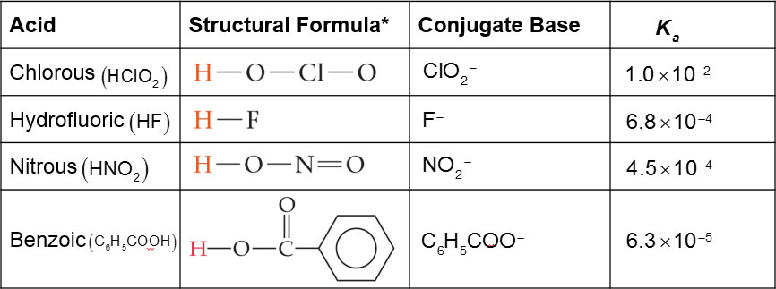
Weak Acids
Table 16.2 Some Weak Acids in Water at 25 degree Celsius
*The proton that ionizes is shown in red.

Slide 45
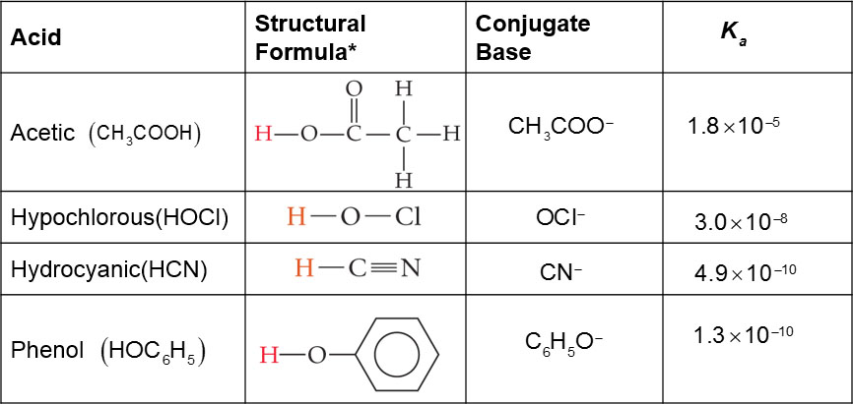
Weak Acids
[Table 16.2 continued]
*The proton that ionizes is shown in red.

Slide 46
GENERAL STEPS FOR CALCULATING THE pH (pOH) OF A WEAK ACID (BASE)
Step 1: Write a balanced chemical equation describing the “action”.
Step 2: Make a list of given and implied information.
Step 3: Write the equilibrium constant equation associated with the balanced
chemical equation in Step 1.
Step 4: An equilibrium table should be set up since we are dealing with a weak
acid (partially dissociated species). The table should describe the
changes which occurred in order to establish equilibrium.
Step 5: Substitute the equilibrium values from Step 4 into the equilibrium
constant equation in Step 3. Solve for x. If the expression can not be solved with basic algebra, try either the quadratic equation or the
successive-approximation method.
Step 6: Calculate the pH (pOH) using the expression:
pH = -Log [H⁺] or pOH = -Log [OH⁻]

Slide 47
Percent Ionization
another way to measure the strength of an acid is to determine the percentage of acid molecules that ionize when dissolved in water – this is called the percent ionization
  the higher the percent ionization, the stronger the acid
since [ionized acid]_{equil} = [H₃O⁺]_{equil}

Slide 48
Lecture Problems on
CALCULATING Ka or pH FOR A WEAK ACID
Q 1: Calculate the pH of a 0.20 M HCN solution.
Q 2a: Calculate the percent of HF molecules ionized in a 0.10 M HF solution.
Q 2b: Compare the above value to the percent obtained for a 0.010 M HF solution.

Slide 49
Workshop AB #3 on
CALCULATING Ka or pH FOR A WEAK ACID
Q 1: Calculate the pH of a 0.035 M H₂S solution.
Q 2. A student prepared a 0.10M solution of formic acid HCHO₂ and measured it’s pH, at 25°C, pH = 2.38
a) calculate K_{a}
b) what percent of acid Ionizes?

Slide 50
RECALL
[HA]_{dissociated}
Percent HA dissociation =
x 100
[HA]_{initial}
Polyprotic acids
acids with more than more ionizable proton
[H₃O⁺][H₂PO₄⁻]
H₃PO₄(aq) + H₂O(l) H₂PO₄⁻(aq) + H₃O⁺(aq)
K_{a1} =
[H₃PO₄]
= 7.2x10⁻³
H₂PO₄⁻(aq) + H₂O(l) HPO₄²⁻(aq) + H₃O⁺(aq)
[H₃O⁺][HPO₄²⁻]
K_{a2} =
[H₂PO₄⁻]
= 6.3x10⁻⁸
[H₃O⁺][PO₄³⁻]
HPO₄²⁻(aq) + H₂O(l) PO₄³⁻(aq) + H₃O⁺(aq)
K_{a3} =
[HPO₄²⁻]
K_{a1} > K_{a2} > K_{a3}
= 4.2x10⁻¹³

Slide 51
SAMPLE PROBLEM
Calculating Equilibrium Concentrations for a Polyprotic Acid
Ascorbic acid (H₂C₆H₆O₆; H₂Asc for this problem), known as vitamin C, is a diprotic acid (K_{a1} = 1.0x10⁻⁵ and K_{a2} = 5x10⁻¹²) found in citrus fruit. Calculate [H₂Asc], [HAsc⁻], [Asc²⁻], and the pH of 0.050M H₂Asc.
PROBLEM:
PLAN:
Write out expressions for both dissociations and make assumptions.
K_{a1} >> K_{a2} so the first dissociation produces virtually all of the H₃O⁺.
K_{a1} is small so [H₂Asc]_{initial} ≈ [H₂Asc]_{diss}
After finding the concentrations of various species for the first dissociation, we can use them as initial concentrations for the second dissociation.
SOLUTION:

Slide 52
Lecture Problems on POLYPROTIC ACIDS
The solubility of CO₂ in pure H₂O at 25ºC and 0.1 atm is 0.0037 M.
a) What is the pH of a 0.0037 M solution of H₂CO₃?
b) What is the [CO₃²⁻] produced?

Slide 53
Workshop AB #4 on POLYPROTIC ACIDS
Q1. Calculate the pH of a 0.045M sulfurous acid solution.
H₂SO₃ ←→ H⁺ + HSO₃⁻
Ka₁ = 1.7 x 10⁻²
HSO₃-←→ H⁺ + SO₃²⁻
Ka₂ = 6.4 x 10⁻⁸
Ka₁ > Ka₂

Slide 54
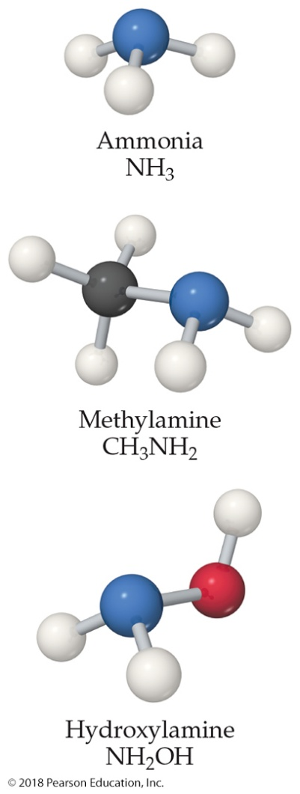
Types of Weak Bases
Two main categories
Neutral substances with an atom that has a nonbonding pair of electrons that can accept H⁺ (like ammonia and the amines)
Anions of weak acids, which are their conjugate bases

Slide 55
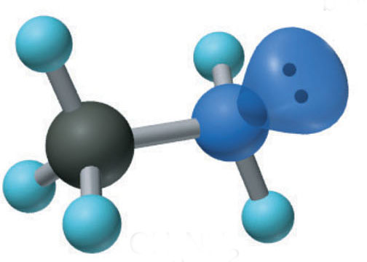
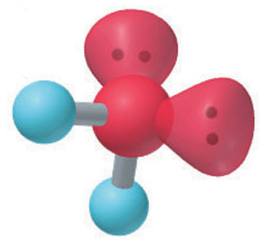
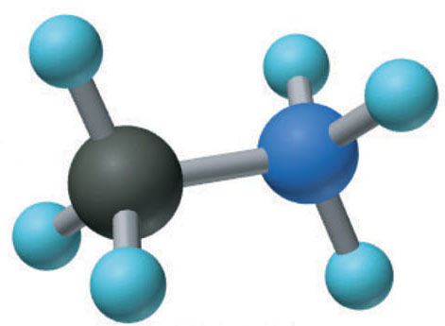
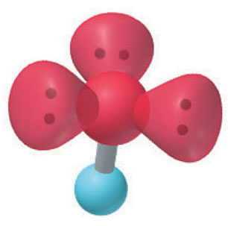
Abstraction of a proton from water by methylamine.
Lone pair binds H⁺
+
CH₃NH₂
H₂O
methylamine
+
CH₃NH₃⁺
OH⁻
methylammonium ion

Slide 56
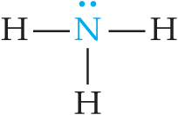
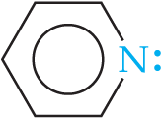
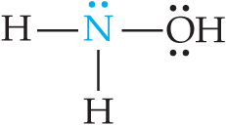
Base-Dissociation Constants
Table 16.4 Some Weak Bases in Water at 25 degree Celsius
Base | Structural Formula* | Conjugate Acid | K sub b
Ammonia N H 3 | Structural formula, N with a lone pair single bonded leftward, rightward, and downward to H atoms. N is the atom that accepts the proton, shown in blue. | N H 4, plus | 1.8 times 10 to the negative fifth
Pyridine C 5 H 5 N | Structural formula, N with a lone pair is shown on the right side of a hexagonal ring. N is the atom that accepts the proton, shown in blue. | C 5 H 5 N H, plus | 1.7 times 10 to the negative ninth
Hydroxylamine H O N H 2 | Structural formula, N with a lone pair single bonded leftward and downward to H atoms, and rightward to O H. The O has 2 lone pairs. N is the atom that accepts the proton, shown in blue. | H O N H 3, plus | 1.1 times 10 to the negative eighth
*The atom that accepts the proton is shown in blue.

Slide 57
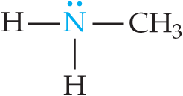

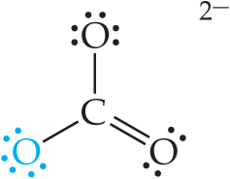

Base-Dissociation Constants
[Table 16.4 continued]
Base | Structural Formula* | Conjugate Acid | K sub b
Methylamine C H 3, N H 2 | Structural formula, N with one lone pair single bonded leftward and downward to H atoms, and rightward to C H 3. N is the atom that accepts the proton, shown in blue. | C H 3, N H 3, plus | 4.4 times 10 to the negative fourth
Hydrosulfide ion H S, minus | Structural formula, H single bonded to S, with 3 lone pairs. The structure has a negative charge. S is the atom that accepts the proton, shown in blue. | H 2 S | 1.8 times 10 to the negative seventh
Carbonate ion C O 3, 2 minus | Structural formula, a central C single bonded upward to O with 3 lone pairs, downward and leftward to O with 3 lone pairs, and double bonded downward and rightward to O with 2 lone pairs. The structure has a charge of 2 minus. The O with 3 lone pairs on the lower left is the atom that accepts the proton, shown in blue. | H C O 3, minus | 1.8 times 10 to the negative fourth
Hypochlorite ion C l O, minus | Structural formula, C l with 3 lone pairs single bonded to O with 3 lone pairs. The structure has a negative charge. O is the atom that accepts the proton, shown in blue. | H C l O | 3.3 times 10 to the negative seventh

Slide 58
WEAK BASES & EQUILIBRIUM
B⁻ + H₂O ←→ HB⁺ + OH⁻
K = [HB⁺] [OH⁻]
[B⁻] [H₂O]
K_{b} = K[H₂O] = [HB⁺] [OH⁻]
[B-]
K_{b} = base dissociation constant
Q. Calculate [OH⁻] and pH of a 0.15M NH₃ solution.

Slide 59
Q1. What is the pH of a 0.012 M solution of nicotinic acid, HC₆H₄NO₂? (K_{a} = 1.4 x 10⁻⁵ @ 25°C)
Workshop AB #5 on Base Equilibria
Q2. Find the pH of a 0.0015 M morphine solution, K_{b}=1.6x10⁻⁶
Q3. Calculate the pH of a 0.0010 M Ba(OH)₂ solution and determine if it is acidic, basic, or neutral

Slide 60
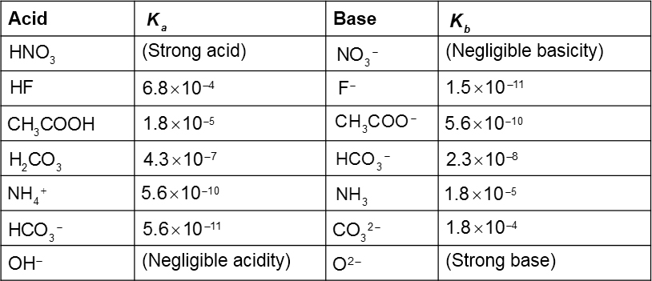
Relationship between K_{a} and K_{b}
Table 16.5 Some Conjugate Acid-Base Pairs

Slide 61
RELATIONSHIP BETWEEN Ka AND Kb
A. NH₄⁺ ←→ NH₃ + H⁺
B. NH₃ + H₂O ←→ NH₄⁺ + OH⁻
K_{a} = [NH₃] [H⁺]
[NH₄⁺]
K_{b} = [NH₄⁺] [OH⁻]
[NH₃]
Add equation A to equation B to get the net reaction:
H₂O ←→ H⁺ + OH⁻
Next : Equation A + Equation B = Equation C
K₁ x K₂ = K₃
K_{a}K_{b} = [NH₃] [H⁺] [NH₄⁺] [OH⁻] = [OH⁻] [H⁺] = K_{w}
[NH₄⁺] [NH₃]
Q. Calculate K_{b} for F⁻ if K_{a} = 6.8 x 10⁻⁴

Slide 62
WORHSHOP AB #6 on Acid/Base equilibria
Q1. What is the percent ionization of a 0.0850 M HC₂H₃O₂ solution.
Q2. What is the molarity of an aqueous HCN solution if the pH is 5.7?
Q3. Calculate the pOH of a 0.351 M aqueous solution of NH₃.
Q4. Calculate the pH of a 0.025M solution of citric acid.
Q5. Give K_{b} for all of the K_{a}’s listed below.
K_{a} (acetic acid) = 1.8 x 10⁻⁵ K_{b} (ammonia) = 1.8 x 10⁻⁵
K_{a} (hydrocyanic) = 4.9 x 10⁻¹⁰ K_{a2} (citric acid) = 1.7 x 10⁻⁵
K_{a1} (citric acid) = 7.4 x 10⁻⁴ K_{a3} (citric acid) = 4.0 x 10⁻⁷

Slide 63
Acid–Base Properties of Salts
Many ions react with water to create
The reaction with water is often called hydrolysis.
To determine whether a salt is an acid or a base, you need to look at the cation and anion separately.
The cation can be acidic or neutral.
The anion can be acidic, basic, or neutral.

Slide 64
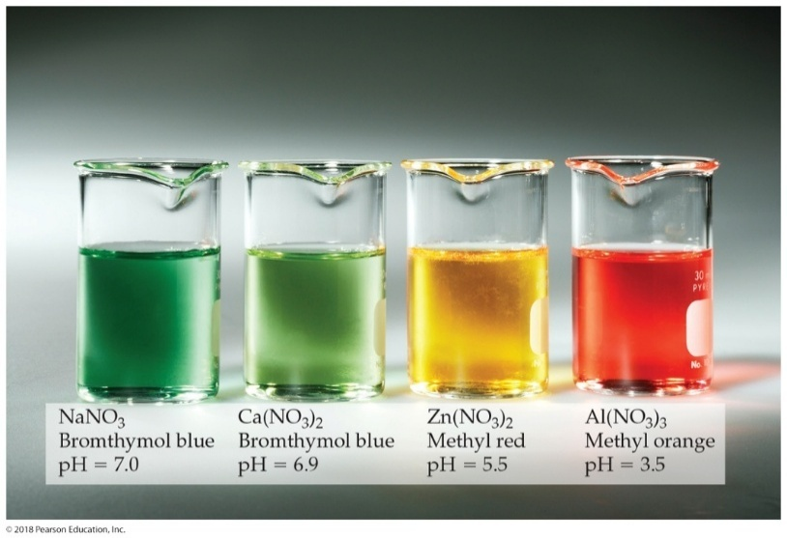
Cations
Group I or group II metal cations are neutral.
Polyatomic cations are typically the conjugate acids of
a weak base; for example,
Transition and post-transition metal cations are acidic. Why? (There are no H atoms in these cations!)

Slide 65
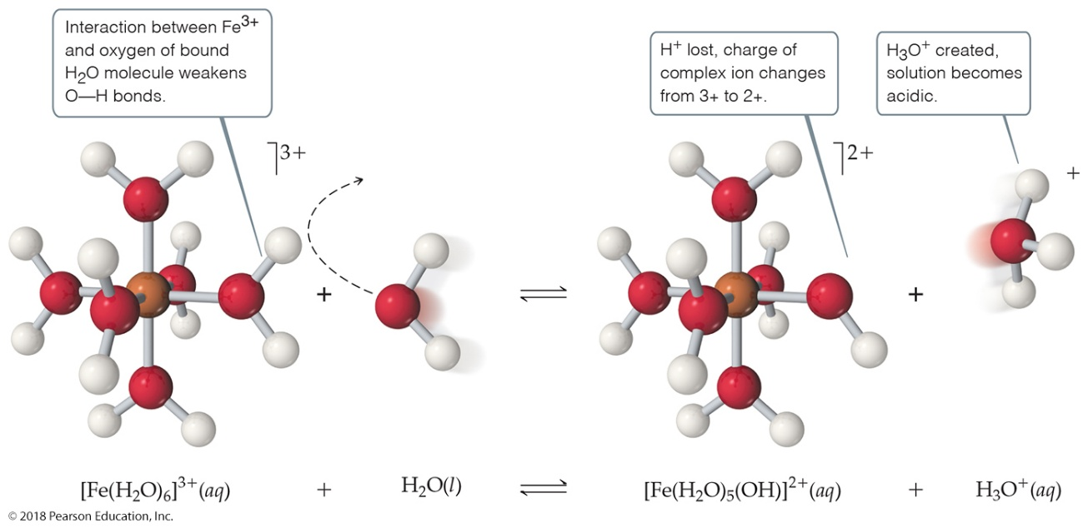
Hydrated Cations
Transition and post-transition metals form hydrated cations.
The water attached to the metal is more acidic than free water molecules, making the hydrated ions acidic.

Slide 66
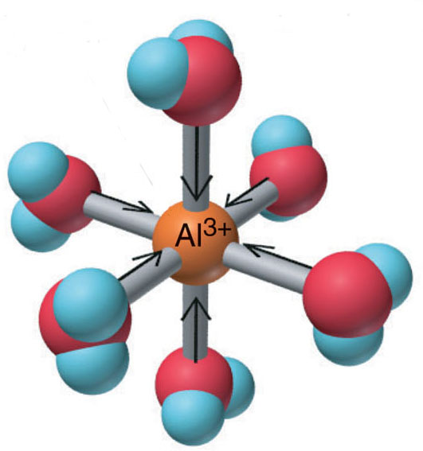
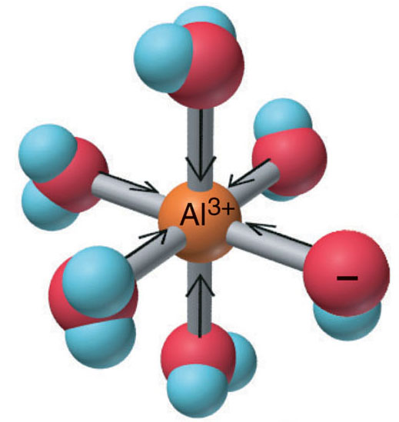
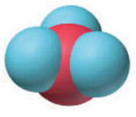
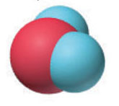
The acidic behavior of the hydrated Al³⁺ ion.
Electron density drawn toward Al³⁺
Nearby H₂O acts as base
H₂O
H₃O⁺
Al(H₂O)₆³⁺
Al(H₂O)₅OH²⁺

Slide 67
Acid-Base Properties of Salts
salts are water soluble ionic compounds
salts that contain the cation of a strong base and an anion that is the conjugate base of a weak acid are basic
  NaHCO₃ solutions are basic
    Na⁺ is the cation of the strong base NaOH
    HCO₃⁻ is the conjugate base of the weak acid H₂CO₃
salts that contain cations that are the conjugate acid of a weak base and an anion of a strong acid are acidic
  NH₄Cl solutions are acidic
    NH₄⁺ is the conjugate acid of the weak base NH₃
    Cl⁻ is the anion of the strong acid HCl

Slide 68
Anions as Weak Bases
every anion can be thought of as the conjugate base of an acid
therefore, every anion can potentially be a base
  A⁻(aq) + H₂O(l) ⇔ HA(aq) + OH⁻(aq)
the stronger the acid is, the weaker the conjugate base is
  an anion that is the conjugate base of a strong acid is pH neutral
  Cl⁻(aq) + H₂O(l) ← HCl(aq) + OH⁻(aq)
    since HCl is a strong acid, this equilibrium lies practically completely to the left
  an anion that is the conjugate base of a weak acid is basic
  F⁻(aq) + H₂O(l) ⇔ HF(aq) + OH⁻(aq)
    since HF is a weak acid, the position of this equilibrium favors the right

Slide 69
SALT SOLUTIONS
1. Salts derived from strong bases and strong acids have pH = 7
NaCl Ca(NO₃)₂
2. Salts derived from strong bases and weak acids have pH > 7
NaClO Ba(C₂H₃O₂)₂
3. Salts derived from weak bases and strong acids have pH < 7
NH₄Cl Al(NO₃)₃
4. Salts derived from weak base and weak acids, pH is dependent on extent
NH₄CN Fe₂(CO₃)₃ NH₄C₂H₃O₂

Slide 70
1. SA/SB: Why neutral?
2. SB/WA Why basic?
3. WB/SA: Why Acidic?
NH₄CN
5. FeCO₃
neither cation nor anion hydrolyzes
anion = strong CB ∴ hydrolyzes to produce OH⁻ , so Basic
cation = strong CA ∴ hydrolyzes to produce H⁺ so Acidic
CN⁻ = Kb = 2 x 10⁻⁵
NH₄⁺ = Ka = 5.6 x 10⁻¹⁰
CN⁻ hydrolyzes more than NH₄⁺
pH > 7 basic
more basic than acidic
Ka Slide 65
Fe³⁺ = 6 x 10⁻³ Ka
CO₃²⁻ = Ka₁ = 4.5 x 10⁻⁷ Ka₂ = 4.7 x 10⁻¹¹
Kb₁ = 2.2 x 10⁻⁸ Kb₂ = 2.13 x 10⁻⁴

Slide 71
Table 6 K_{a} Values of Some Hydrated Metal Ions at 25⁰C
Free Ion
Hydrated Ion
K_{a}
Fe³⁺
Fe(H₂O)₆³⁺(aq)
6 x 10⁻³
Sn²⁺
Sn(H₂O)₆²⁺(aq)
4 x 10⁻⁴
Cr³⁺
Cr(H₂O)₆³⁺(aq)
1 x 10⁻⁴
Al³⁺
Al(H₂O)₆³⁺(aq)
1 x 10⁻⁵
Cu²⁺
Cu(H₂O)₆²⁺(aq)
3 x 10⁻⁸
ACID STRENGTH
Pb²⁺
Pb(H₂O)₆²⁺(aq)
3 x 10⁻⁸
Zn²⁺
Zn(H₂O)₆²⁺(aq)
1 x 10⁻⁹
Co²⁺
Co(H₂O)₆²⁺(aq)
2 x 10⁻¹⁰
Ni²⁺
Ni(H₂O)₆²⁺(aq)
1 x 10⁻¹⁰

Slide 72
Table 5 THE BEHAVIOR OF SALTS IN WATER
Salt Solution pH Nature of Ions Ion that reacts
(Examples) with water
Neutral 7.0 Cation of strong base None
[NaCl, KBr, Anion of strong acid
Ba(NO₃)₂]
Acidic <7.0 Cation of weak base Cation
[NH₄Cl, NH₄NO₃, Anion of strong acid
CH₃NH₃Br]
Acidic <7.0 Small, highly charged Cation
[Al(NO₃)₃, cation
CrCl₃, FeBr₃] Anion of strong acid
Basic >7.0 Cation of strong base Anion
[CH₃COONa, Anion of weak acid
KF, Na₂CO₃]

Slide 73
Ex 15.16 - Determine whether a solution of the following salts is acidic, basic, or neutral
SrCl₂
AlBr₃
CH₃NH₃NO₃

Slide 74
Ex 15.16 - Determine whether a solution of the following salts is acidic, basic, or neutral
NaCHO₂
NH₄F

Slide 75
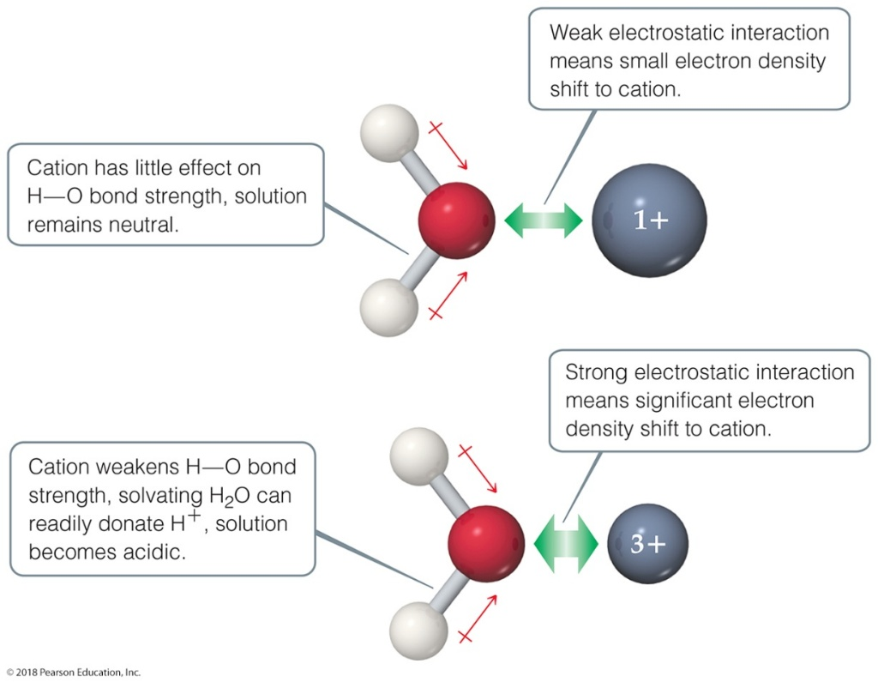
Lewis Acid–Base Chemistry and Hydrated Metal Cations
The hydrated metal cations are primary examples of electron pair donor/acceptor chemistry.
Higher charges result in stronger water to metal bonds, making them stronger acids.

Slide 76
ACID/BASE PROPERTIES OF SALT SOLUTIONS
HYDROLYSIS
Ions react with water to generate either H⁺ or OH⁻
A⁻ + H₂O ←→ HA + OH⁻
Practice Problems on Hydrolysis:
Q. Predict whether Na₂HPO₄ will form an acidic or basic solution.
Q. Predict whether K₂HC₇H₅O₇ will form an acidic or basic solution.

Slide 77
CALCULATING pH OF SALT SOLUTIONS
Q1. Household bleach is 5% solution of sodium hypochlorite NaClO. Calculate the [OH⁻] and pH of a 0.70 M NaClO solution.
Kb = 3.5 x 10⁻⁸
Q2. Calculate the hydronium and hydroxide concentrations as well as the pH of a 0.85M Ferric chloride solution.

Slide 78
Workshop AB #7 on pH of salts
Determine the pH of a 0.62 M NH₄NO₃ solution at 25°C.
The K_{b} for NH₃ is 1.76 × 10⁻⁵.
2) Calculate the pH of a 0.800 M NaCH₃CO₂ solution. K_{a} for acetic acid, CH₃CO₂H, is 1.8 × 10⁻⁵.
3) Calculate the pH of a 1.60 M KBrO solution. Ka for hypobromous acid, HBrO, is 2.0 × 10⁻⁹.
28) Calculate the pH of a 1.60 M CH₃NH₃Cl solution. K_{b} for methylamine, CH₃NH₂, is 3.7 × 10⁻⁴.

