Slide 1
Chapter 2 Atoms, Elements, & Isotopes

Slide 2
Early Philosophy of Matter
Some philosophers believed that matter had an ultimate, tiny, indivisible particle
Leucippus and Democritus
Other philosophers believed that matter was infinitely divisible
Plato and Aristotle
Since there was no experimental way of proving who was correct, the best debater was the person assumed correct, i.e., Aristotle

Slide 3
Scientific Revolution
in the late 16th century, the scientific approach to understanding nature became established; started understanding the importance of experimentation.
Experiments preformed in the eighteenth and nineteenth centuries led to an organized atomic theory by John Dalton in the early 1800s:
The law of conservation of mass
The law of constant composition
The law of multiple proportions

Slide 4
Law of Conservation of Mass
The total mass of substances present at the end of a chemical process is the same as the mass of substances present before the process took place.
This law was discovered by Antoine Lavoisier.
This law was one of the laws on which Dalton’s atomic theory was based.
EXAMPLE
A 7.12 g sample of magnesium is heated with 1.80 g of bromine. All the bromine is used up, and 2.07 g of magnesium bromide is produced. What mass of magnesium remains unreacted?
Mg + Br₂ → MgBr₂ unbalanced at this time is ok m_{Mg} = unreacted?
7.12g 1.80 g 2.07g
LCM means m_{products} = m_{reactans} therefore products mass – reactant mass = unreacted if there is leftovers = 2.07g – (7.12 + 1.80g) = 6.85 g unreacted! Since the problem states that all of the bromine was used up [FYI: 2.07 – 1.80 = 0.27 g Mg used] therefore 6.85 g of Mg was unused!

Slide 5
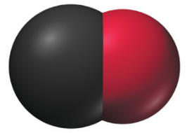
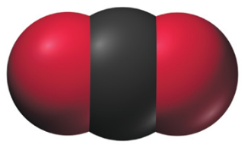
Law of Definite Proportions/Composition
Compounds have a definite composition. That means that the relative number of atoms of each element in the compound is the same in any sample.
This law was discovered by Joseph Proust.
This law was one of the laws on which Dalton’s atomic theory was based.
carbon combines with oxygen to form two different compounds, carbon monoxide and carbon dioxide
carbon monoxide contains 1.33 g of oxygen for every 1.00 g of carbon
carbon dioxide contains 2.67 g of oxygen for every 1.00 g of carbon
since there are twice as many oxygen atoms per carbon atom in carbon dioxide than in carbon monoxide, the oxygen mass ratio should be 2

Slide 6
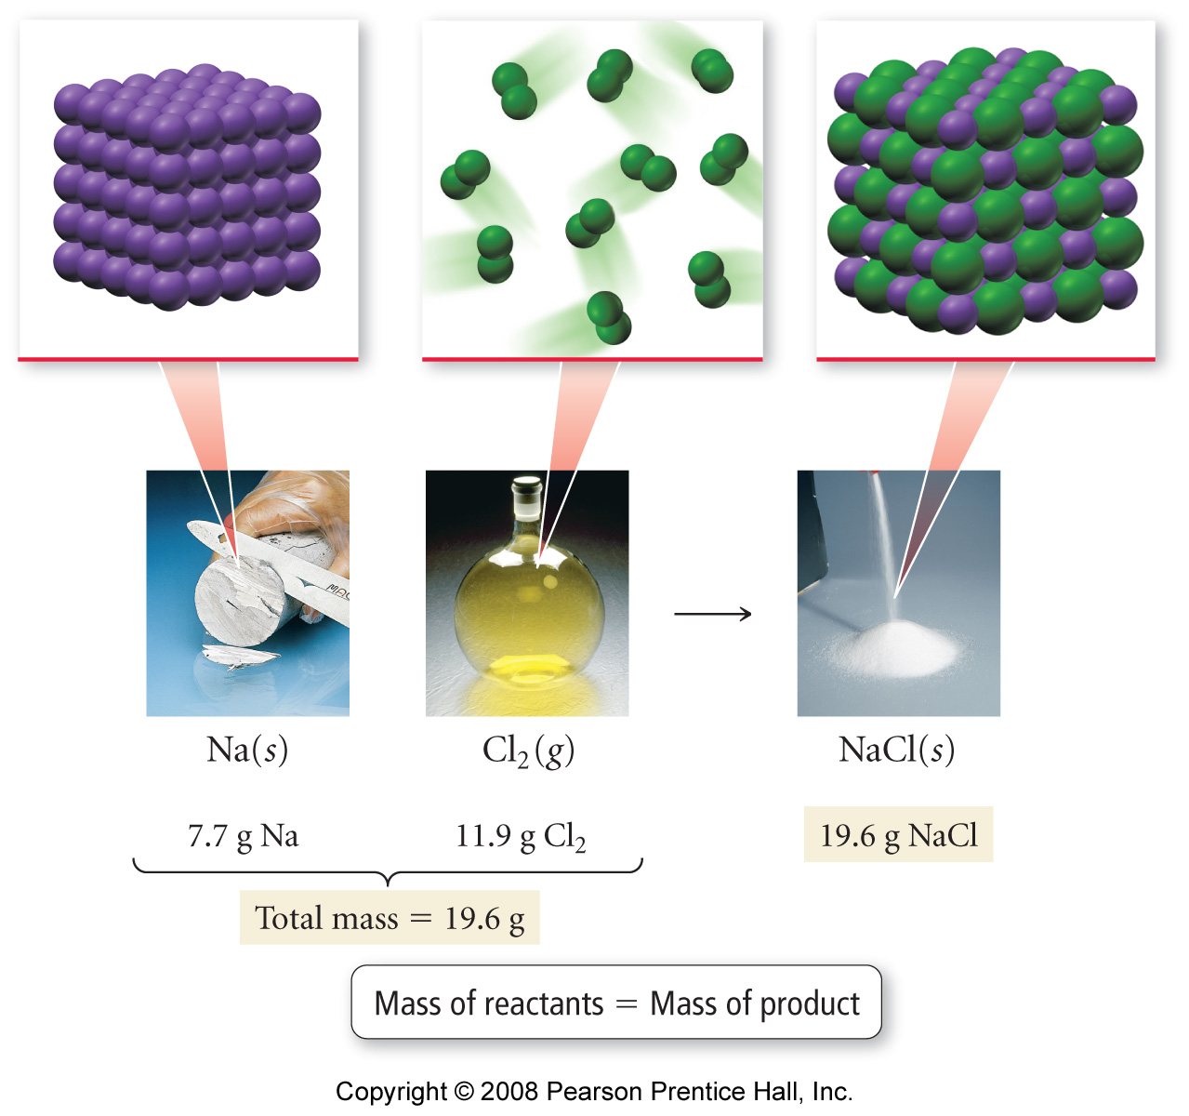
Reaction of Sodium with Chlorine to Make Sodium Chloride
the mass of sodium and chlorine used is determined by the number of atoms that combine
since only whole atoms combine and atoms are not changed or destroyed in the process, the mass of sodium chloride made must equal the total mass of sodium and chlorine atoms that combine together
7.7 g Na + 11.9 g Cl₂ → 19.6 g NaCl

Slide 7
Reaction of Sodium with Chlorine to Make Sodium Chloride
the mass of sodium and chlorine used is determined by the number of atoms that combine
since only whole atoms combine and atoms are not changed or destroyed in the process, the mass of sodium chloride made must equal the total mass of sodium and chlorine atoms that combine together
7.7 g Na + 11.9 g Cl₂ → 19.6 g NaCl

Slide 8
Proportions in Sodium Chloride
a 100.0 g sample of sodium chloride contains 39.3 g of sodium and 60.7 g of chlorine
a 200.0 g sample of sodium chloride contains 78.6 g of sodium and 121.4 g of chlorine
a 58.44 g sample of sodium chloride contains 22.99 g of sodium and 35.44 g of chlorine

Slide 9
Law of Multiple Proportions
If two elements, A and B, form more than one compound, the masses of B that combine with a given mass of A are in the ratio of small whole numbers.
John Dalton discovered this law while developing his atomic theory.
When two or more compounds exist from the same elements, they can not have the same relative number of atoms.

Slide 10
Dalton’s Atomic Theory
Dalton proposed a theory of matter based on it having ultimate, indivisible particles to explain these laws
Each element is composed of tiny, indestructible particles called atoms
All atoms of a given element has the same mass and other properties that distinguish them from atoms of other elements
Atoms combine in simple, whole-number ratios to form molecules of compounds
In a chemical reaction, atoms of one element cannot change into atoms of another element
they simply rearrange the way they are attached

Slide 11
CHEMICAL LAWS – LECTURE QUESTIONS
LAW OF CONSERVATION OF MASS
A 7.12 g sample of magnesium is heated with 1.80 g of bromine. All the bromine is used up, and 2.07 g of magnesium bromide is produced. What mass of magnesium remains unreacted?
Law of Definite Proportions
A 0.100 g sample of magnesium, when combined with oxygen, yields 0.166 g of magnesium oxide. What masses of magnesium and oxygen must be combined to make exactly 2.00 g of magnesium oxide?
Law of Multiple Proportions
The following data were obtained for compounds of iodine and fluorine:
Compound Mass of Iodine (g) Mass of Fluorine (g)
A 1.000 0.1497
B 0.500 0.2246
C 0.750 0.5614
D 1.000 1.0480
If the formula for compound A is IF, what are the formulas for compounds B, C, and D?

Slide 12
Workshop 2A on CHEMICAL LAWS
LAW OF CONSERVATION OF MASS
When 10.00 g of marble chips, calcium carbonate, are treated with50.0 mL of hydrochloric acid (d = 1.096 g/mL), the marble chips dissolve resulting in a solution and releasing the gas carbon dioxide. The final solution weighed 60.4 g. How many liters of carbon dioxide was released if the density of the gas is 1.798 g/L?
Law of Definite Proportions
Galena, a mineral of lead and sulfur contained 2.030 g of lead in a 2.345 g sample. (a) calculate the mass of sulfur in the sample. (b) calculate the mass fraction of lead. © calculate the mass percent of lead. (d) How much reactant is needed to produce 15.000 g of product, galena?
Combined Laws
Aluminum metal reacts with bromine, a red-brown liquid with a noxious odor. The reaction is vigorous and produces aluminum bromide, a white crystalline material. A sample of 27.062 g of aluminum yields 266.705 g of aluminum bromide. How many grams of bromine will react with 15.00 g of Al?
☺

Slide 13
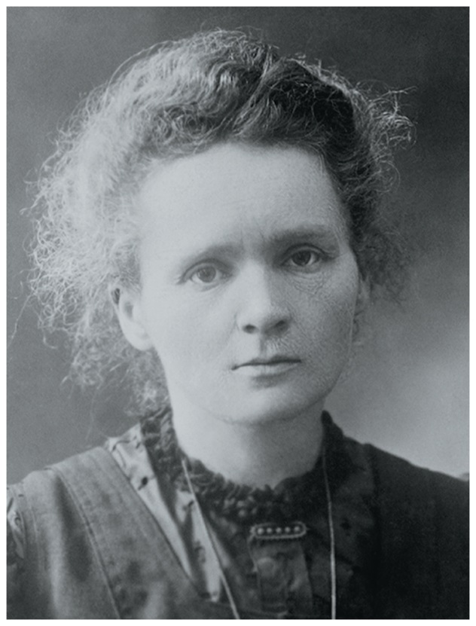
Radioactivity (1 of 2)
Radioactivity is the spontaneous emission of high-energy radiation by an atom.
It was first observed by Henri Becquerel in the late 1800s.
Marie and Pierre Curie also studied it.
Its discovery showed that the atom had more subatomic particles and energy associated with it and these energetic particles could penetrate matter

Slide 14
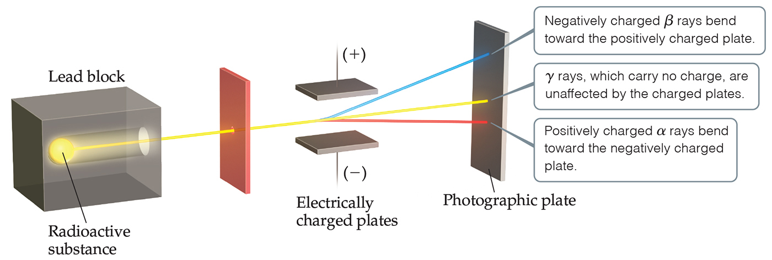
Radioactivity (2 of 2)
Three types of radiation were discovered by Ernest Rutherford:
​
particles (positively charged)
​
particles (negatively charged, like electrons)
​
rays (uncharged)

Slide 15
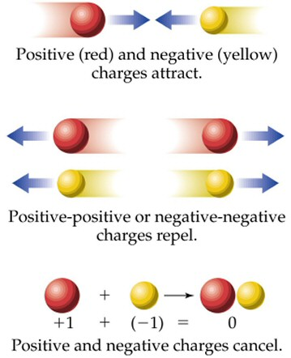
Some Notes on Charge
Two kinds of charge called + and –
Opposite charges attract
+ attracted to –
Like charges repel
+ repels +
– repels –
To be neutral, something must have no charge or equal amounts of opposite charges

Slide 16
Charged Atoms
when atoms gain or lose electrons, they acquire a charge
charged particles are called ions
when atoms gain electrons, they become negatively charged ions, called anions
when atoms lose electrons, they become positively charged ions, called cations
ions behave much differently than the neutral atom
e.g., The metal sodium, made of neutral Na atoms, is highly reactive and quite unstable. However, the sodium cations, Na⁺, found in table salt are very nonreactive and stable
since materials like table salt are neutral, there must be equal amounts of charge from cations and anions in them

Slide 17
Atomic Structures of Ions
Metals form cations
For each positive charge, the ion has 1 less electron than the neutral atom
Na atom = 11 p⁺ and 11 e⁻, Na⁺ ion = 11 p⁺ and 10 e⁻
Ca atom = 20 p⁺ and 20 e⁻, Ca²⁺ ion = 20 p⁺ and 18 e⁻
Cations are named the same as the metal
sodium Na → Na⁺ + 1e⁻ sodium ion
calcium Ca → Ca²⁺ + 2e⁻ calcium ion

Slide 18
Atomic Structures of Ions
Nonmetals form anions
For each negative charge, the ion has 1 more electron than the neutral atom
F = 9 p⁺ and 9 e⁻, F─ = 9 p⁺ and 10 e⁻
P = 15 p⁺ and 15 e⁻, P^{3─} = 15 p⁺ and 18 e⁻
Anions are named by changing the ending of the name to -ide
fluorine F + 1e⁻ → F─ fluoride ion
oxygen O + 2e⁻ → O^{2─} oxide ion

Slide 19
ATOMIC THEORY OF MATTER

Slide 20
Discovery of Subatomic Particles
In Dalton’s view, the atom was the smallest particle possible. Many discoveries led to the fact that the atom itself was made up of smaller particles.
Electrons and cathode rays
Radioactivity
Nucleus, protons, and neutrons

Slide 21
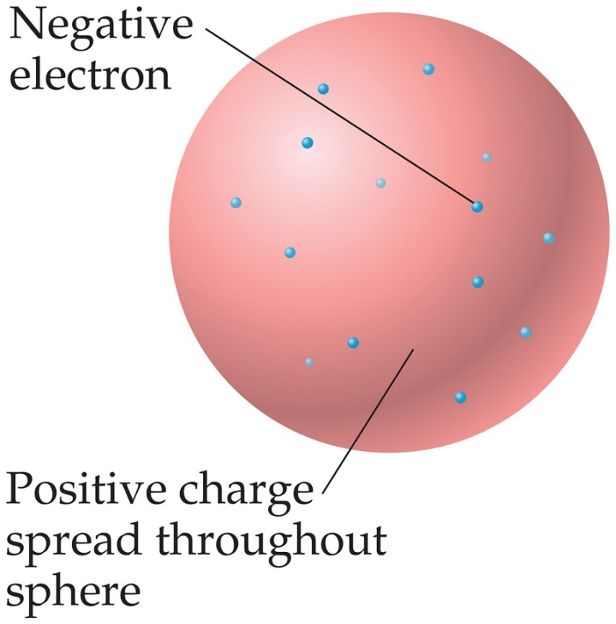
The Atom, Circa 1900
The prevailing theory was that of the “plum pudding” model, put forward by J. J. Thomson.
It featured a positive sphere of matter with negative electrons embedded in it.

Slide 22
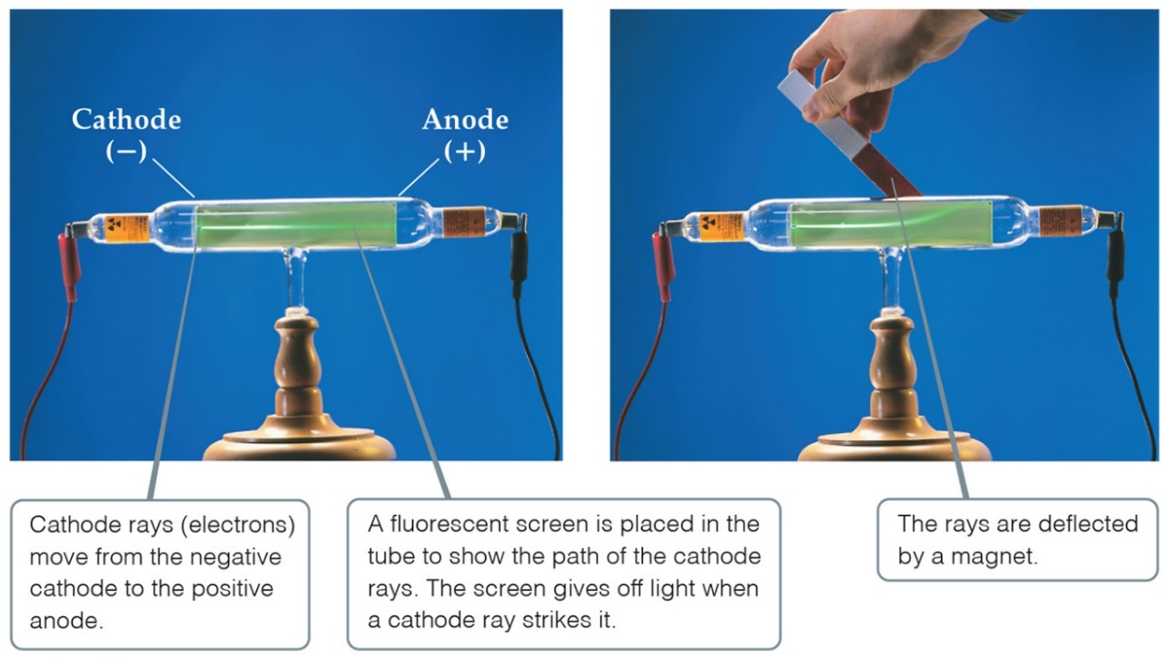
The Electron (Cathode Rays)
Streams of negatively charged particles were found to emanate from cathode tubes, causing fluorescence.
J. J. Thomson is credited with their discovery (1897).

Slide 23
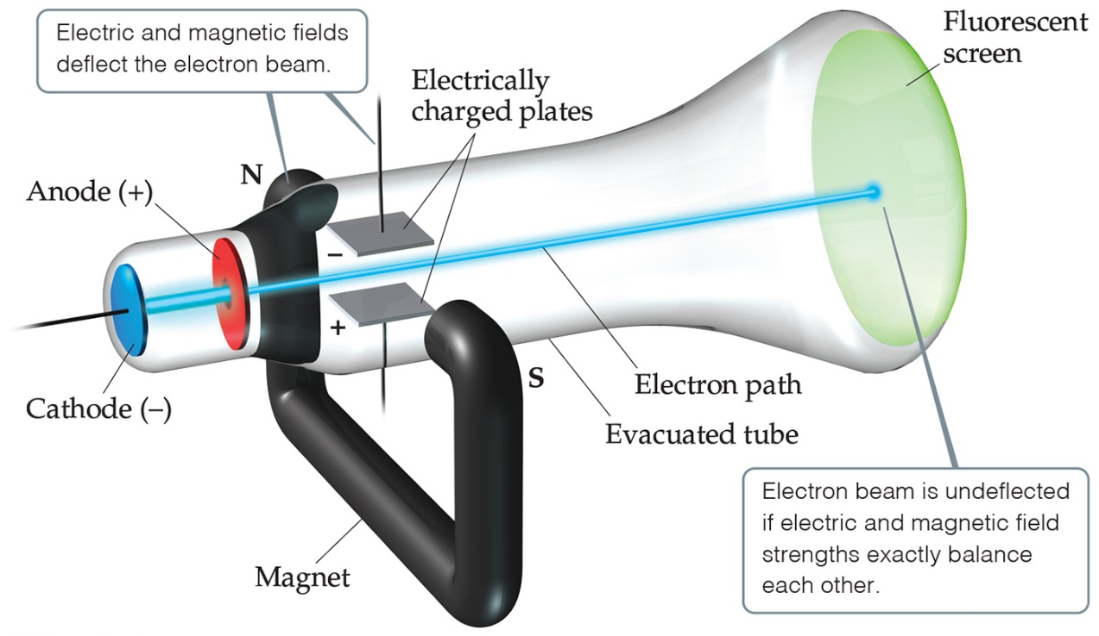
The Electron
Thomson measured the charge/mass ratio of the electron to be
coulombs/gram (C/g).

Slide 24
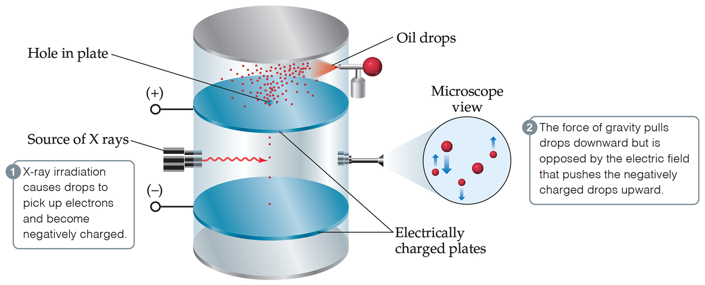
Millikan Oil-Drop Experiment (Electrons)
Once the charge/mass ratio of the electron was known, determination of either the charge or the mass of an electron would yield the other.
Robert Millikan determined the charge on the electron in 1909.

Slide 25
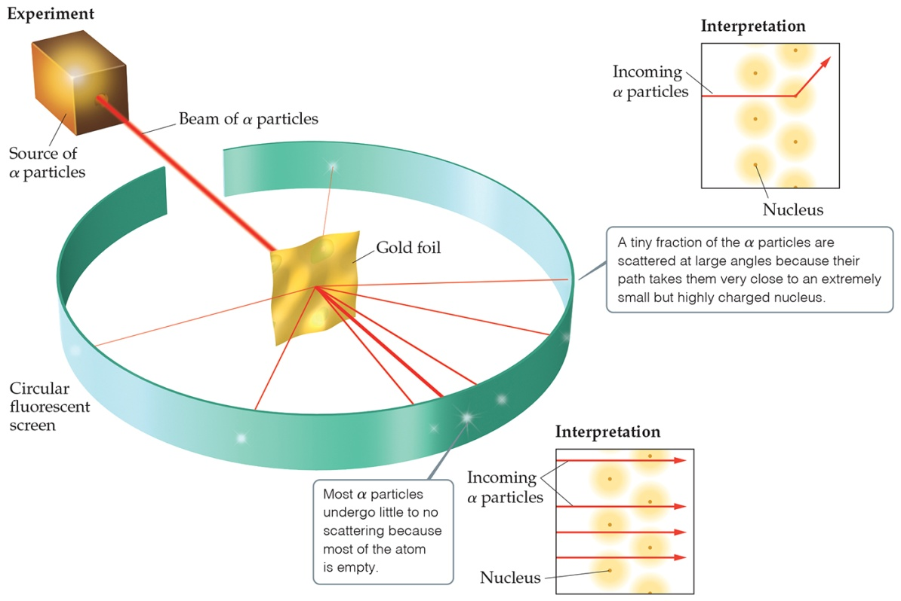
Discovery of the Nucleus
Ernest Rutherford shot
particles at a thin sheet of
foil and observed the pattern of scatter of the particles.

Slide 26
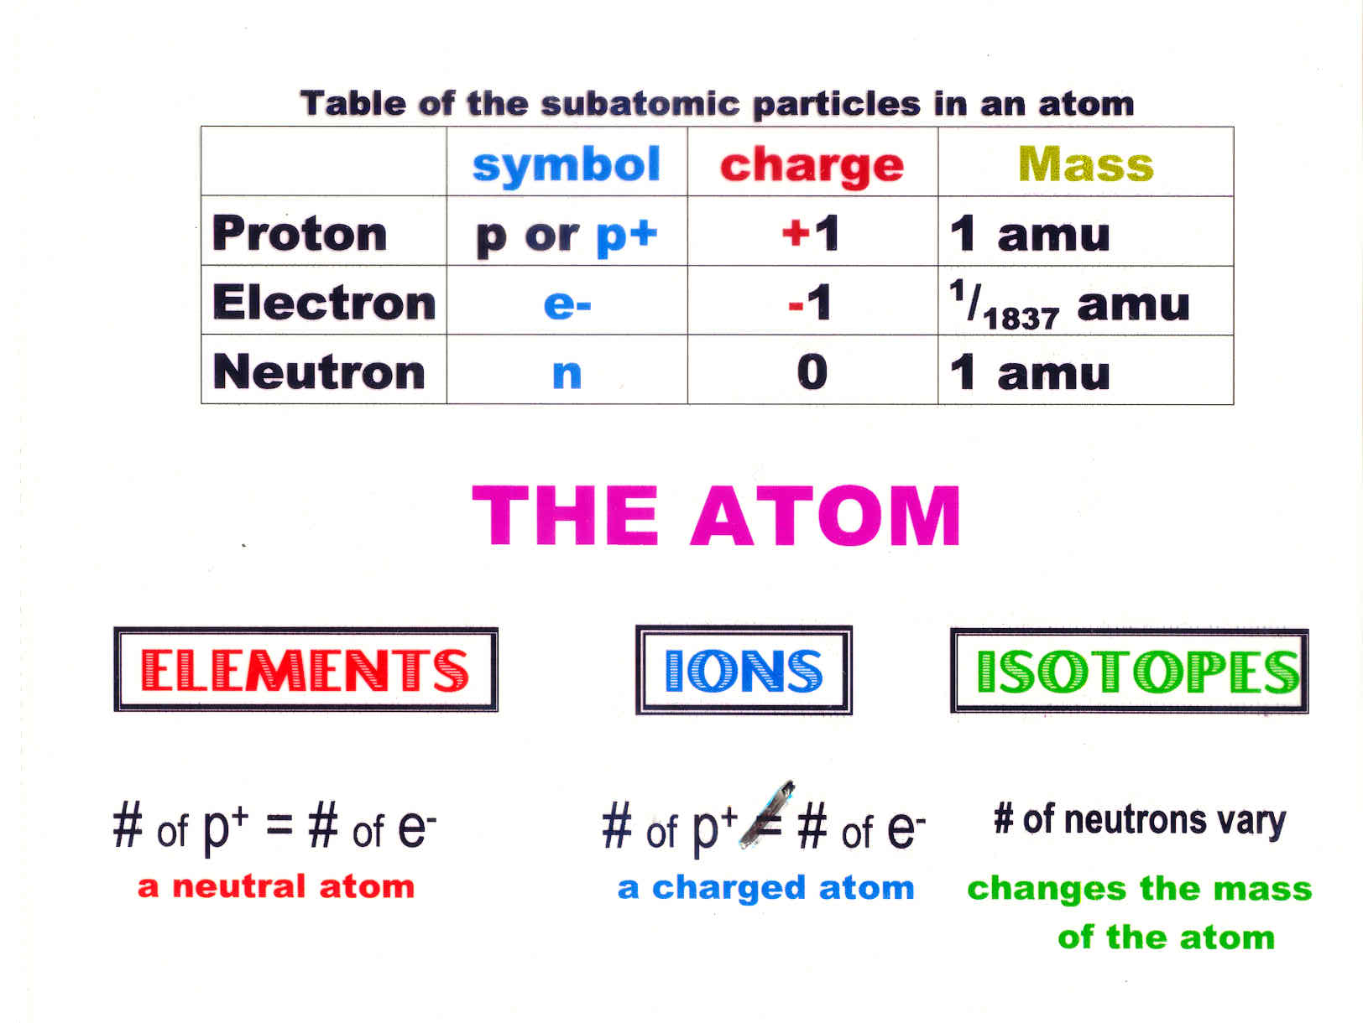
may come in one of three forms:

Slide 27
Subatomic Particles

Slide 28
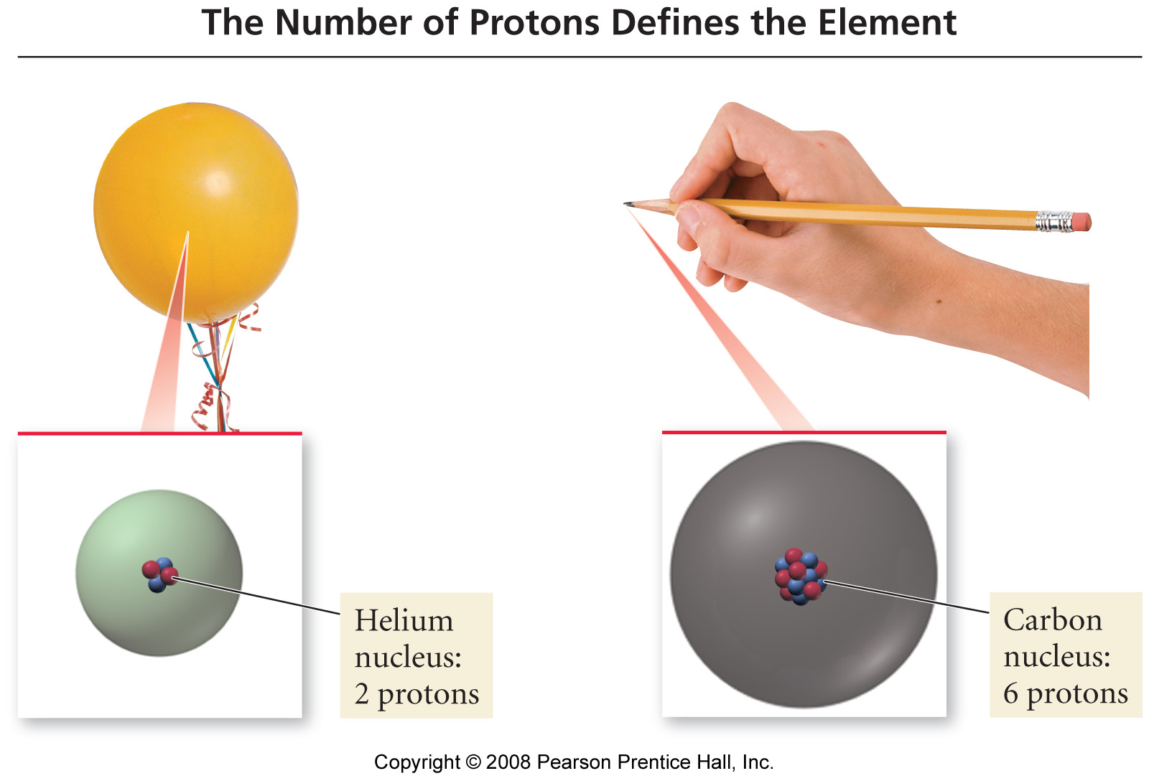

Slide 29
Structure of the Nucleus
Soddy discovered that the same element could have atoms with different masses, which he called isotopes
there are 2 isotopes of chlorine found in nature, one that has a mass of about 35 amu and another that weighs about 37 amu
The observed mass is a weighted average of the weights of all the naturally occurring atoms
the percentage of an element that is 1 isotope is called the isotope’s natural abundance
the atomic mass of chlorine is 35.45 amu

Slide 30
Isotopes
Isotopes are atoms of the same element with different masses.
Isotopes have different numbers of neutrons, but the same number of protons.
The table below lists four isotopes for carbon.
Table 2.2 Some Isotopes of Carbonª
Symbol | Number of Protons | Number of Electrons | Number of Neutrons
 | 6 | 6 | 5
 | 6 | 6 | 6
 | 6 | 6 | 7
 | 6 | 6 | 8
ª Almost 99% of the carbon found in nature is

Slide 31
Isotopes
all isotopes of an element are chemically identical
undergo the exact same chemical reactions
all isotopes of an element have the same number of protons
isotopes of an element have different masses
isotopes of an element have different numbers of neutrons
isotopes are identified by their mass numbers
protons + neutrons

Slide 32
Isotopes
Atomic Number
Number of protons
Z
Mass Number
Protons + Neutrons
Whole number
A
Abundance = relative amount found in a sample
A
Z

Slide 33
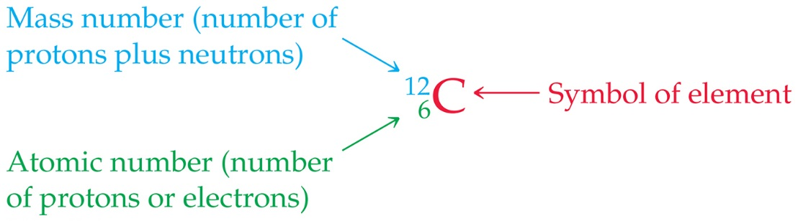
Atoms of an Element
Elements are represented by a one or two letter symbol, for which the first letter is always capitalized. C is the symbol for carbon.
All atoms of the same element have the same number of protons, which is called the atomic number. It is written as a subscript Before the symbol. 6 is the atomic number for carbon.
The mass number is the total number of protons and neutrons in the nucleus of an atom. It is written as a superscript Before the symbol.

Slide 34
An Example: Neon
Symbol
Number of Protons
Number of Neutrons
A, Mass Number
Percent Natural Abundance
Ne-20 or
10
10
20
90.48%
Ne-21 or
10
11
21
0.27%
Ne-22 or
10
12
22
9.25%

Slide 35
Practice Problems for isotopes
Complete the following table:
Symbol Atomic # Charge Mass number # of proton # of neutrons # of electrons
H 0 3
Li 7 2
Al 0 27
_____ +2 58 28
_____ 78 +4 120
1 1 2 1
3 0 10 3
☺

Slide 36
Atomic Mass Unit (amu)
Atoms have extremely small masses.
The heaviest known atoms have a mass of approximately
A mass scale on the atomic level is used, where an atomic mass unit (a m u) is the base unit.

Slide 37
Lecture Questions on Isotopes
1. An element consists of 90.51% of an isotope with a mass of 19.992 amu, 0.27% of an isotope with a mass of 20.994 amu, and 9.22% of an isotope with a mass of 21.990 amu. Calculate the average atomic mass and identify the element.
2. The average atomic weight of lithium is 6.941 amu. The two naturally occurring isotopes of lithium have the following masses: ⁶Li, 6.01512 amu; ⁷Li, 7.01600 amu. Calculate the percent abundance of ⁶Li and ⁷Li in naturally occurring lithium.
A
T
O
M
I
C
M
A
S
S

Slide 38
WORKSHOP 2B on Isotopes
1. The element with an atomic number 53 contains many protons, neutrons, and electrons?
2. The mass of one atom of an isotope is 9.746 x 10⁻²³ g. One atomic mass unit has the mass of 1.6606 x 10⁻²⁴ g. The atomic mass of this isotope is?
3. (Element X has three naturally occurring isotopes, 24X (isotopic mass 23.9850 amu, abundance 78.99%), 25X (isotopic mass 24.9858 amu, abundance 10.00%), and 26X (isotopic mass 25.9826 amu, abundance 11.01%). Calculate the average atomic mass.
4. The element silver has two naturally occurring isotopes: ¹⁰⁹Ag and ¹⁰⁷Ag with a mass of 106.905 amu. Silver consists of 51.82% ¹⁰⁷Ag and has an average atomic mass of 107.868 amu. Calculate the mass of ¹⁰⁹Ag.

Slide 39
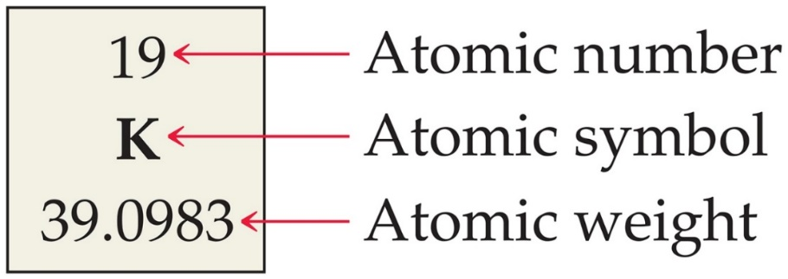
Reading the Periodic Table
Boxes on the periodic table list the atomic number Above the symbol.
The atomic weight of an element is listed below the symbol on the periodic table.

Slide 40
Atomic Mass
we previously learned that not all atoms of an element have the same mass
isotopes
we generally use the average mass of all an element’s atoms found in a sample in calculations
however the average must take into account the abundance of each isotope in the sample
we call the average mass the atomic mass

Slide 41
Mass Spectrometry
masses and abundances of isotopes are measured with a mass spectrometer
atoms or molecules are ionized, then accelerated down a tube
some molecules into fragments are broken during the ionization process
these fragments can be used to help determine the structure of the molecule
their path is bent by a magnetic field, separating them by mass
similar to Thomson’s Cathode Ray Experiment

Slide 42
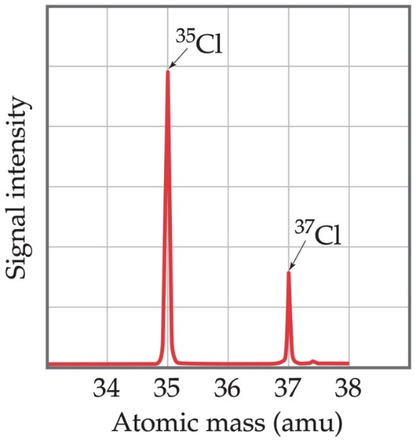
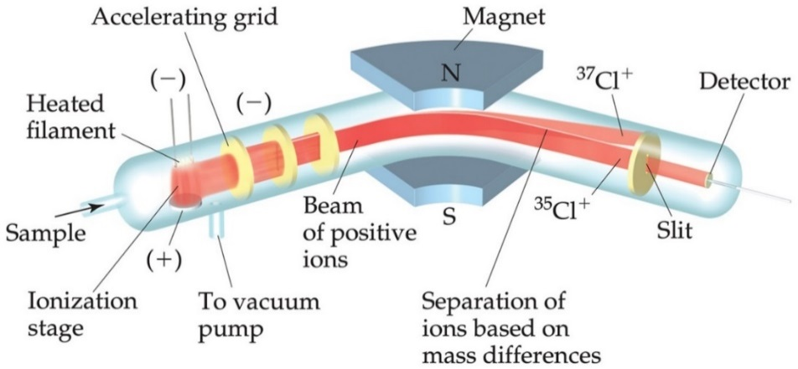
Atomic Weight Measurement
Atomic and molecular weight can be measured using a mass spectrometer (below).
The spectrum of chlorine showing two isotopes is seen on the right. Abundances can also be determined this way.

Slide 43
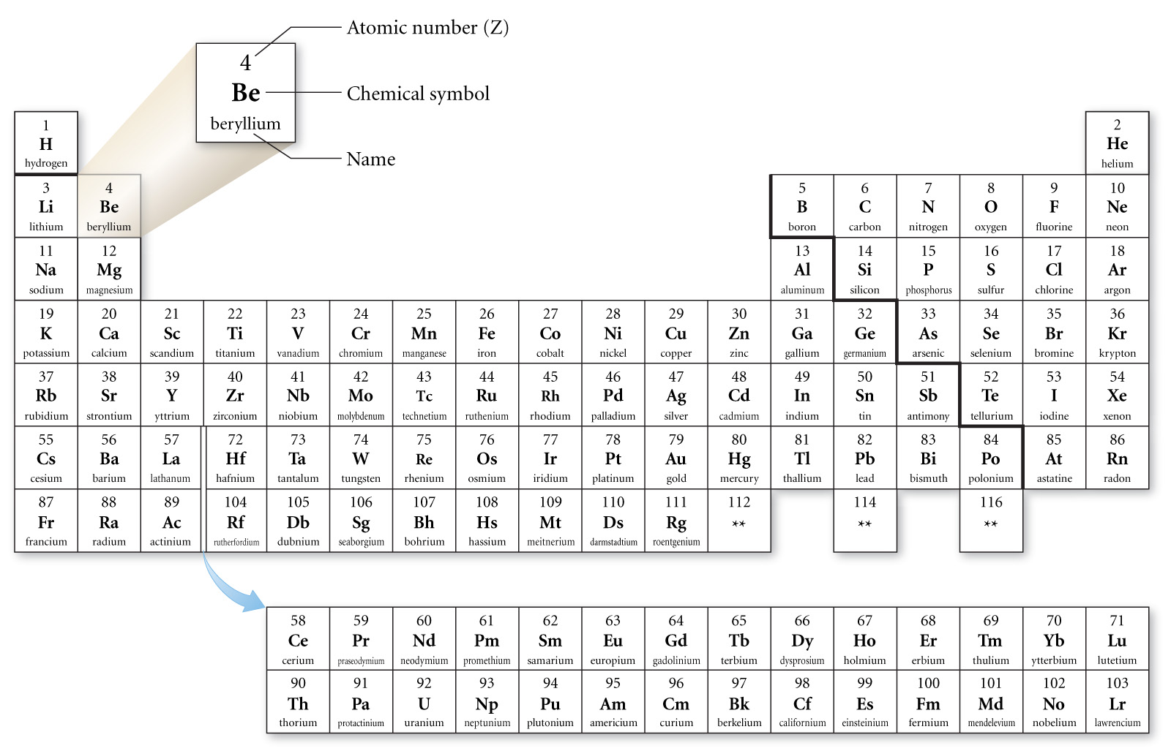
The Periodic Table of Elements

Slide 44
Mendeleev
order elements by atomic mass
saw a repeating pattern of properties
Periodic Law – When the elements are arranged in order of increasing atomic mass, certain sets of properties recur periodically
put elements with similar properties in the same column
used pattern to predict properties of undiscovered elements
where atomic mass order did not fit other properties, he re-ordered by other properties
Te & I

Slide 45
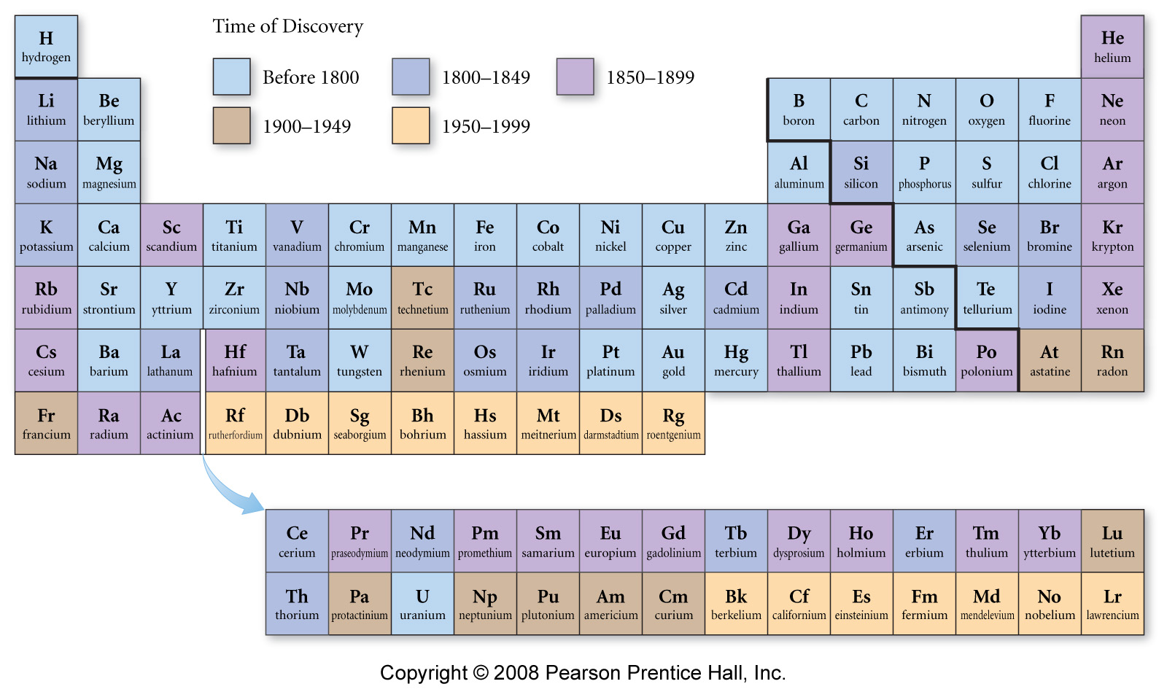
Periodic Pattern

Slide 46
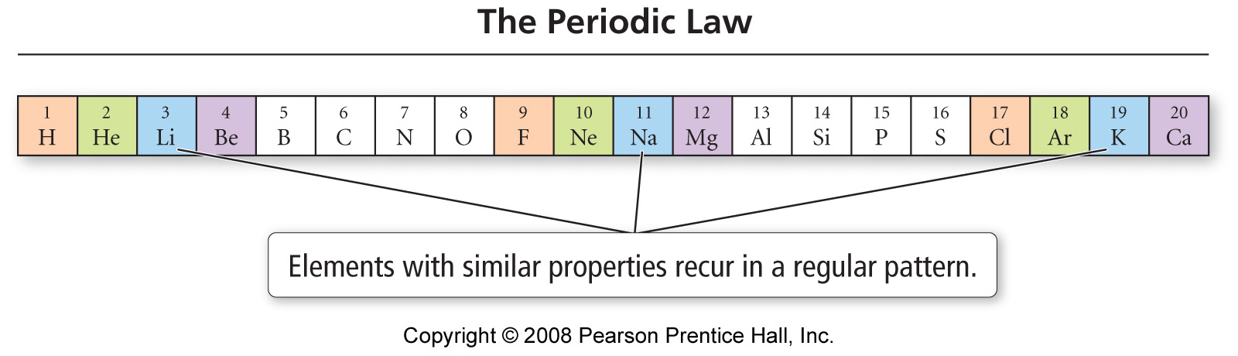
Periodic Pattern

Slide 47
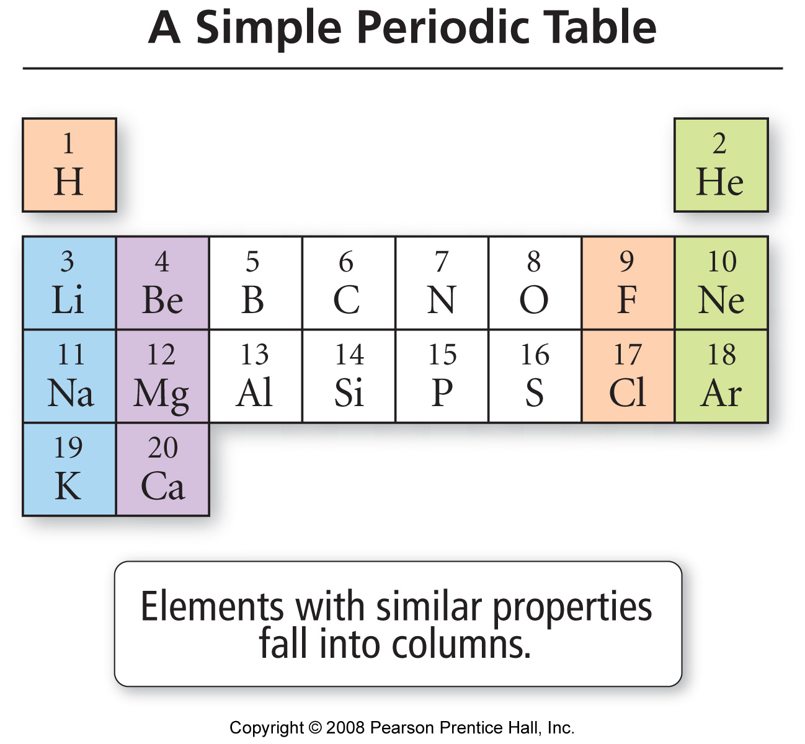
Periodic Pattern

Slide 48
Periodic Pattern
nm H₂O
a/b
H
1 H₂
m Li₂O
b
7 LiH
m/nm BeO
a/b
9 BeH₂
nm B₂O₃
a
11 ( BH₃)_{n}
nm CO₂
a
12 CH₄
nm N₂O₅
a
14 NH₃
nm O₂
16 H₂O
nm
19 HF
Li
Be
B
C
N
O
F
m Na₂O
b
23 NaH
m MgO
b
24 MgH₂
m Al₂O₃
a/b
27 (AlH₃)
nm/m SiO₂
a
28 SiH₄
nm P₄O₁₀
a
31 PH₃
nm SO₃
a
32 H₂S
nm Cl₂O₇
a
35.5 HCl
Na
Mg
Al
Si
P
S
Cl
m = metal, nm = nonmetal, m/nm = metalloid
a = acidic oxide, b = basic oxide, a/b = amphoteric oxide

Slide 49
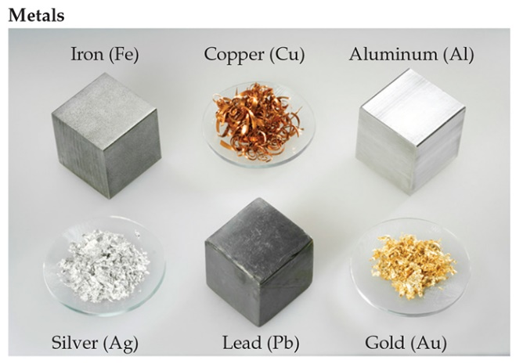
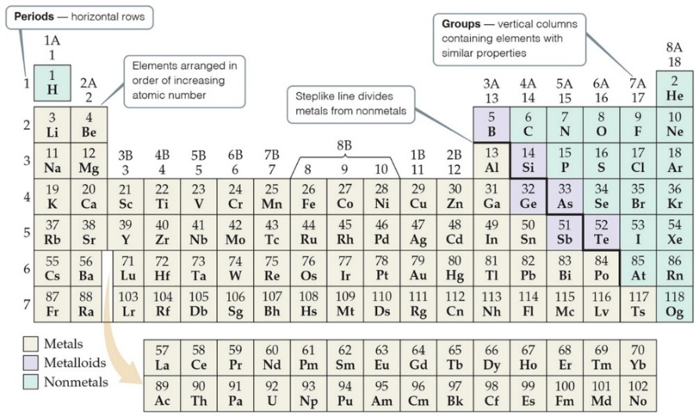
Periodic Table
Metals are on the left side of the periodic table.
Some properties of metals include
Shiny luster
Conducting heat and electricity
Solids (except mercury)

Slide 50
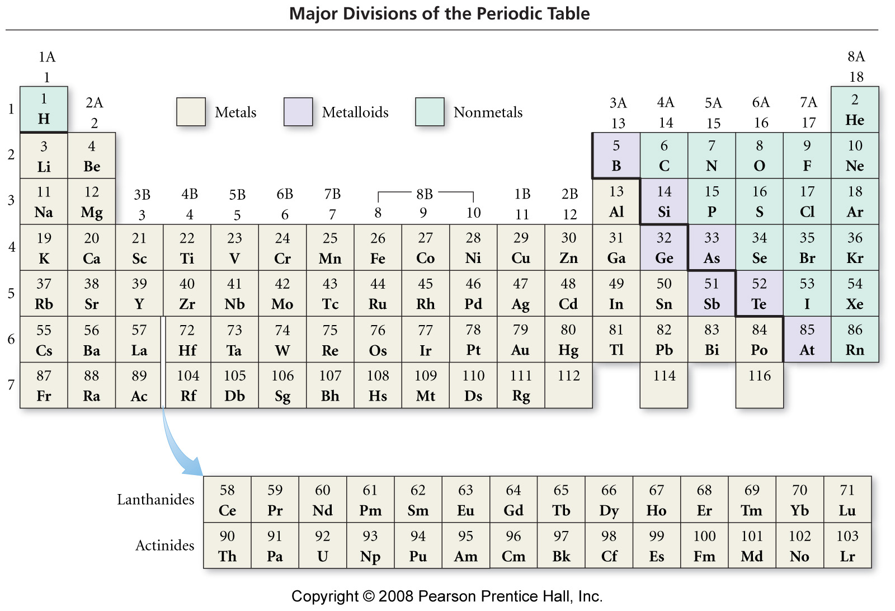

Slide 51
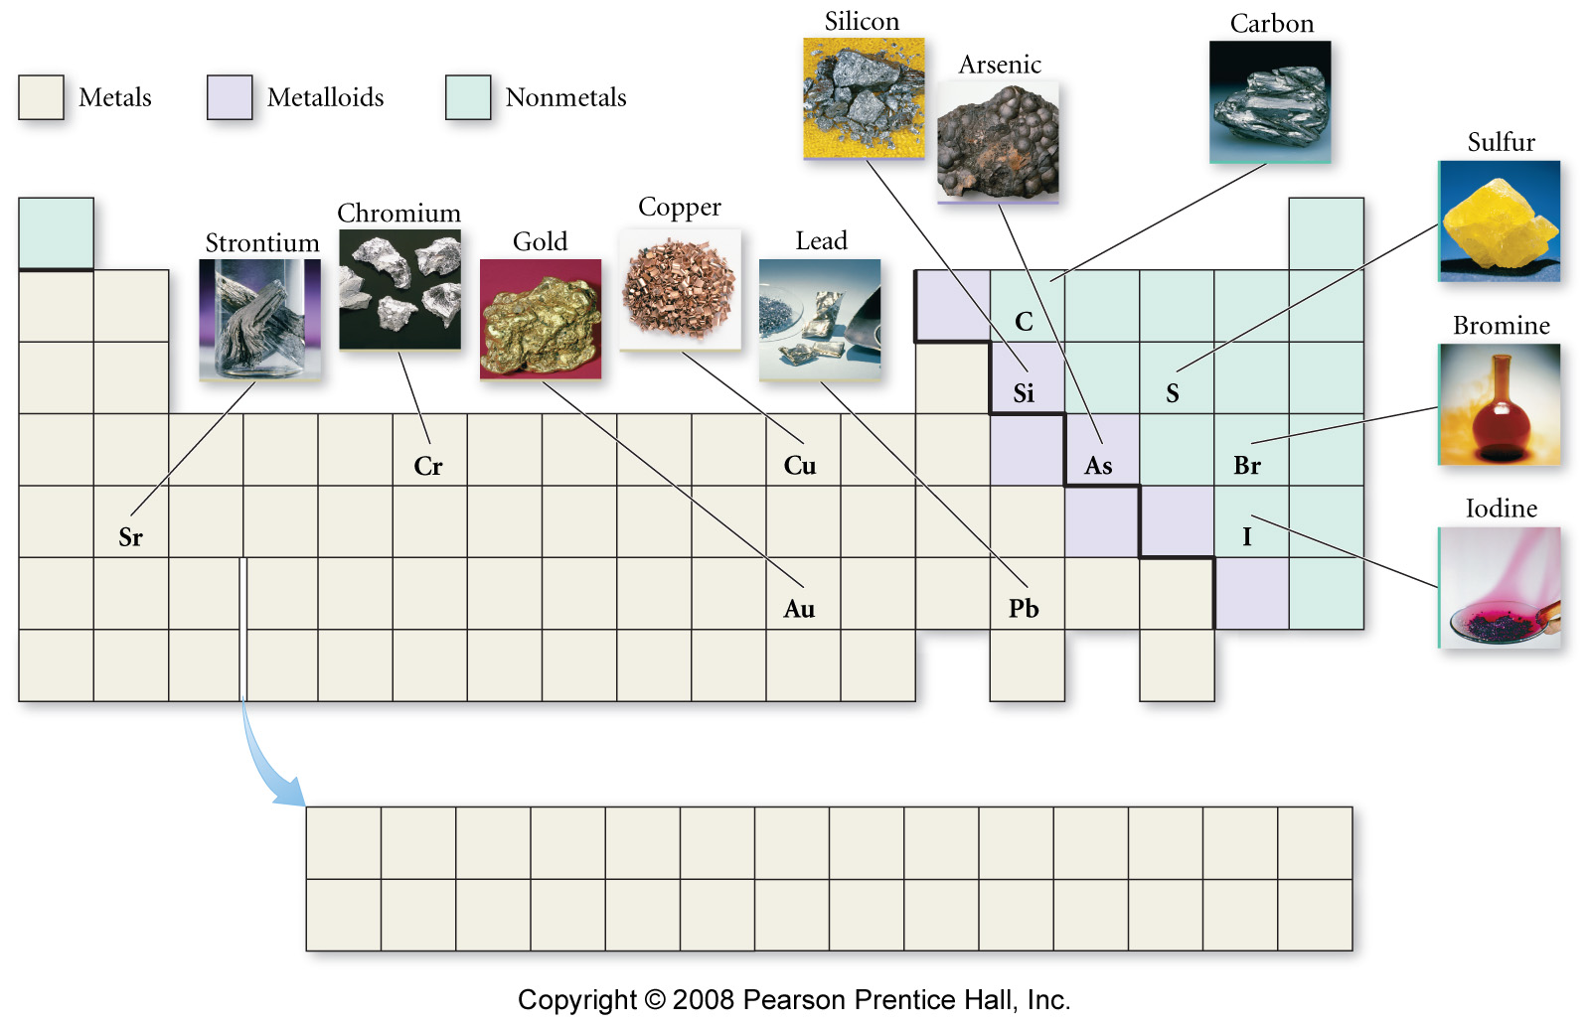

Slide 52
Patterns in Metallic Character
= Metal
= Metalloid
= Nonmetal

Slide 53
Metals
solids at room temperature, except Hg
reflective surface
shiny
conduct heat
conduct electricity
malleable
can be shaped
ductile
drawn or pulled into wires
lose electrons and form cations in reactions
about 75% of the elements are metals
lower left on the table

Slide 54


Periodic Table
Nonmetals are on the right side of the periodic table (they include H).
They can be solid (like carbon), liquid (like bromine), or gas (like neon) at room temperature.

Slide 55
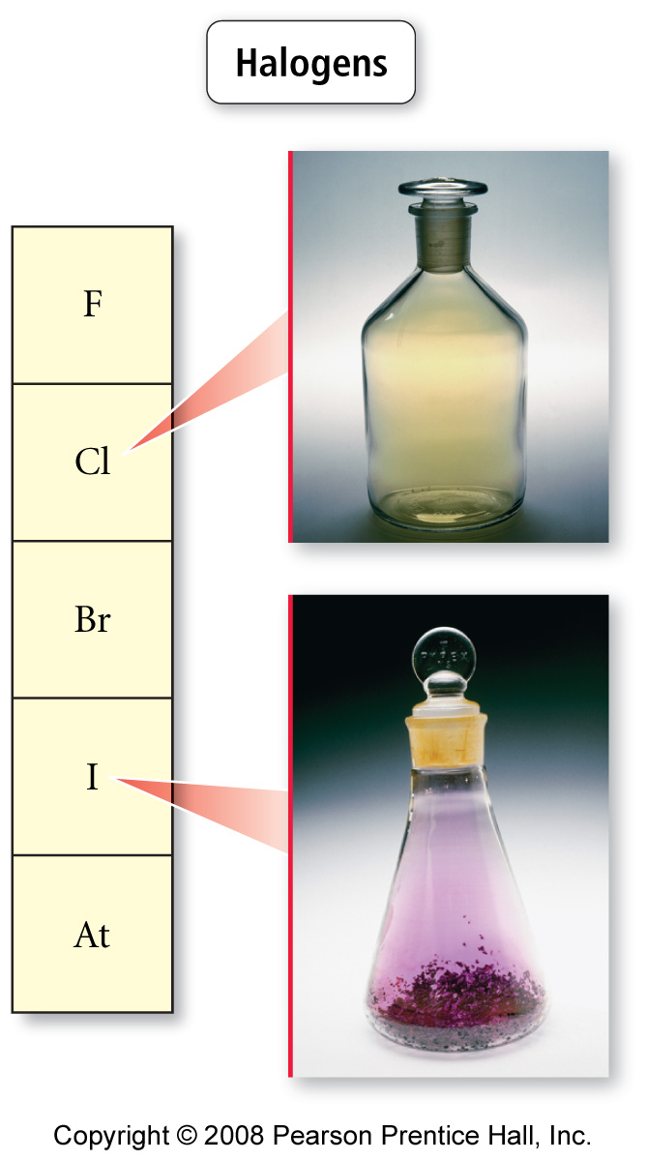
Nonmetals
Sulfur, S(s)
found in all 3 states
poor conductors of heat
poor conductors of electricity
solids are brittle
gain electrons in reactions to become anions
upper right on the table
except H
Bromine, Br₂(l)
decorative picture
Chlorine, Cl₂(l)

Slide 56
Metalloids
show some properties of metals and some of nonmetals
also known as semiconductors
Properties of Silicon
shiny
conducts electricity
does not conduct heat well
brittle

Slide 57
The Modern Periodic Table
Elements with similar chemical and physical properties are in the same column
columns are called Groups or Families
designated by a number and letter at top
rows are called Periods
each period shows the pattern of properties repeated in the next period

Slide 58
Notes:
find table that includes rare earth elements

Slide 59
The Modern Periodic Table
Main Group = Representative Elements = “A” groups
Transition Elements = “B” groups
all metals
Bottom Rows = Inner Transition Elements = Rare Earth Elements
metals
really belong in Period 6 & 7

Slide 60
= Halogens
= Alkali Metals
= Lanthanides
= Alkali Earth Metals
= Actinides
= Noble Gases
= Transition Metals
Notes:
60
add pictures of elements from text

Slide 61
Diatomic Molecules
These seven elements occur naturally as molecules containing two atoms:
Hydrogen
Nitrogen
Oxygen
Fluorine
Chlorine
Bromine
Iodine

Slide 62
Important Groups - Hydrogen
nonmetal
colorless, diatomic gas
very low melting point and density
reacts with nonmetals to form molecular compounds
HCl is acidic gas
H₂O is a liquid
reacts with metals to form hydrides
metal hydrides react with water to form H₂
HX dissolves in water to form acids

Slide 63
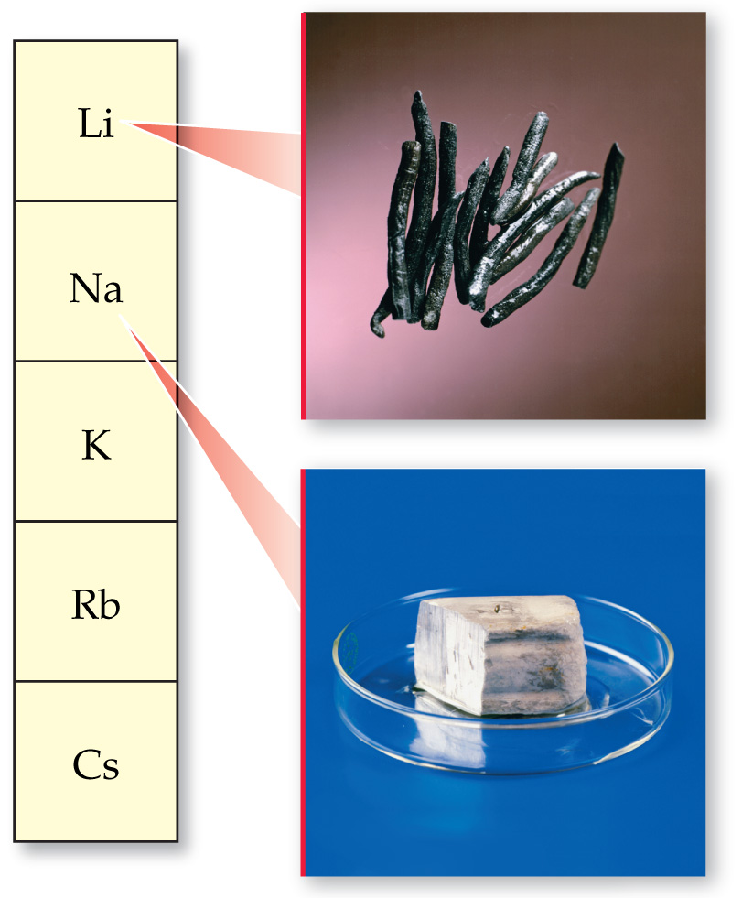
Important Groups - Alkali Metals
Group IA = Alkali Metals
hydrogen usually placed here, though it doesn’t belong
soft, low melting points, low density
flame tests → Li = red, Na = yellow, K = violet
very reactive, never find uncombined in nature
tend to form water-soluble compounds, therefore crystallized from seawater then molten salt electrolyzed
colorless solutions
react with water to form basic (alkaline) solutions and H₂
2 Na + 2 H₂O → 2 NaOH + H₂
releases a lot of heat
lithium
sodium
potassium
rubidium
cesium

Slide 64
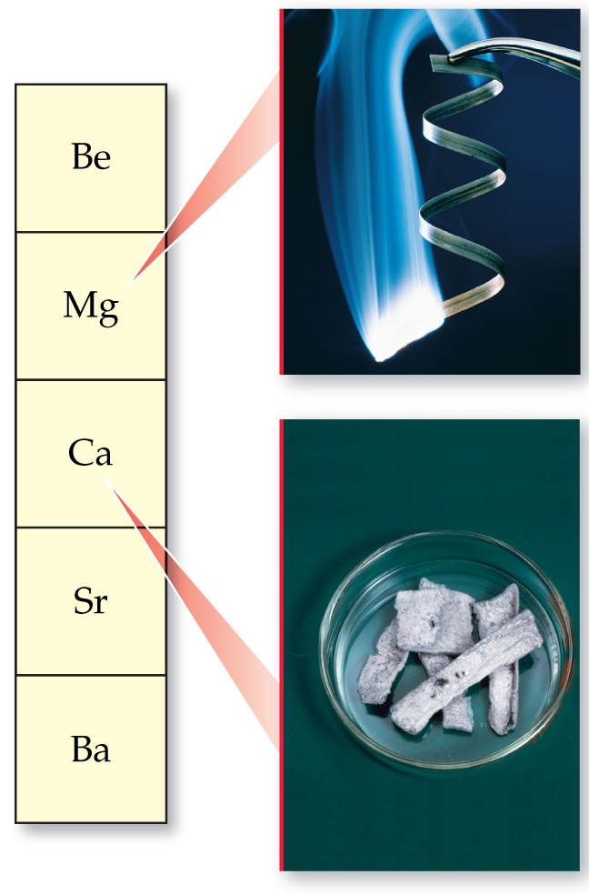
Important Groups - Alkali Earth Metals
Group IIA = Alkali Earth Metals
harder, higher melting, and denser than alkali metals
Mg alloys used as structural materials
flame tests → Ca = red, Sr = red, Ba = yellow-green
reactive, but less than corresponding alkali metal
form stable, insoluble oxides from which they are normally extracted
oxides are basic = alkaline earth
reactivity with water to form H₂ → Be = none; Mg = steam; Ca, Sr, Ba = cold water
beryllium
magnesium
calcium
strontium
barium

Slide 65
Important Groups - Halogens
Group VIIA = Halogens
nonmetals
F₂ and Cl₂ gases; Br₂ liquid; I₂ solid
all diatomic
very reactive
Cl_{2,} Br₂ react slowly with water
Br₂ + H₂O → HBr + HOBr
react with metals to form ionic compounds
HX all acids
HF weak < HCl < HBr < HI
fluorine
chlorine
bromine
iodine
astatine

Slide 66
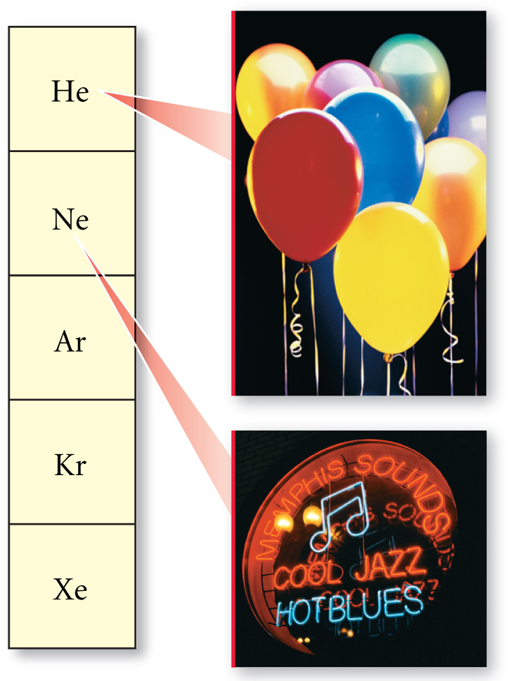
Important Groups - Noble Gases
Group VIIIA = Noble Gases
all gases at room temperature
very low melting and boiling points
very unreactive, practically inert
very hard to remove electron from or give an electron to
helium
neon
argon
krypton
xenon

Slide 67
Ion Charge and the Periodic Table
the charge on an ion can often be determined from an element’s position on the Periodic Table
metals are always positively charged ions, nonmetals are negatively charged ions
for many main group metals, the charge = the group number
for nonmetals, the charge = the group number - 8

Slide 68
1A
2A
3A
5A
6A
7A
Li⁺¹
N⁻³
O⁻²
F⁻¹
Na⁺¹
Mg⁺²
Al⁺³
S⁻²
Cl⁻¹
K⁺¹
Ca⁺²
Se⁻²
Br⁻¹
Rb⁺¹
Sr⁺²
Te⁻²
I⁻¹
Cs⁺¹
Ba⁺²

Slide 69
Reacting Atoms
when elements undergo chemical reactions, the reacting elements do not turn into other elements
Statement 4 of Dalton’s Atomic Theory
this requires that all the atoms present when you start the reaction will still be there after the reaction
since the number of protons determines the kind of element, the number of protons in the atom does not change in a chemical reaction
however, many reactions involve transferring electrons from one atom to another

Slide 70
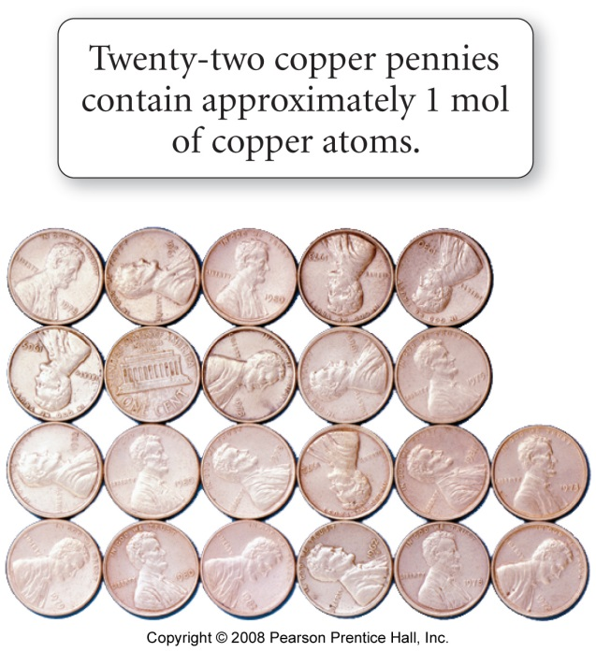
Counting Atoms by Moles
If we can find the mass of a particular number of atoms, we can use this information to convert the mass of an element sample into the number of atoms in the sample.
The number of atoms we will use is 6.022 x 10²³ and we call this a mole
1 mole = 6.022 x 10²³ things
Like 1 dozen = 12 things

Slide 71
Chemical Packages - Moles
mole = number of particles equal to the number of atoms in 12 g of C-12
1 atom of C-12 weighs exactly 12 amu
1 mole of C-12 weighs exactly 12 g
The number of particles in 1 mole is called Avogadro’s Number = 6.0221421 x 10²³
1 mole of C atoms weighs 12.01 g and has 6.022 x 10²³ atoms
the average mass of a C atom is 12.01 amu

Slide 72
Relationship Between Moles and Mass
The mass of one mole of atoms is called the molar mass
The molar mass of an element, in grams, is numerically equal to the element’s atomic mass, in amu
The lighter the atom, the less a mole weighs
The lighter the atom, the more atoms there are in 1 g

Slide 73
Mole and Mass Relationships
1 mole
sulfur
32.06 g
1 mole
carbon
12.01 g

Slide 74
Workshop 2C on the Periodic Table
1. Which of the following statements concerning the element iodine is not correct?
a) Iodine gives up electrons readily
b) Iodine is in the fifth period of the periodic table
c) Iodine has chemical properties similar to those of chlorine
d) Iodine is a halogen
e) One molecule of iodine contains two atoms
2. With respect to location in the periodic table, metals are on the , nonmetals on the and the two are separated by the .
3. The molar mass of sodium is_______________, of phosphorous is __________, of oxygen is _________. What is the molar mass of sodium phosphate?
4. If one (1) atom of an element weighs 2.0 x 10⁻²3 grams, what is the symbol for that element?
5. Which has the LEAST mass:
a) 0.19 moles of CaCO3
b) 6.12 x 10²² formula units of Fe2O3
c) 1 mole of oxygen molecules
d) 15.9 moles of hydrogen molecules
e) 5.0 moles of helium gas
6. List the most common ion for the first 20 elements.

