Slide 1
Kinetics applies to the speed of a reaction, the concentration of product that appears (or of reactant that disappears) per unit time.
Equilibrium applies to the extent of a reaction, the concentration of product that has appeared after an unlimited time, or once no further change occurs.
At equilibrium: rate_{forward} = rate_{reverse}
A system at equilibrium is dynamic on the molecular level; no further net change is observed because changes in one direction are balanced by changes in the other.
Notes:
1

Slide 2
CHEMICAL EQUILIBRIUM - RATES OF REACTION
k_{F}
Reactants ←→ products
k_{B}
Chemical reactions are a dynamic process, that is, reactions involve both forward and reverse processes.
Chemical Equilibrium is reached by a reaction mixture
when the rates of forward and reverse reactions becomes equal.
k_{F} = k_{B}
NO net change appears obvious although the system is
still in constant motion.
Notes:
2

Slide 3
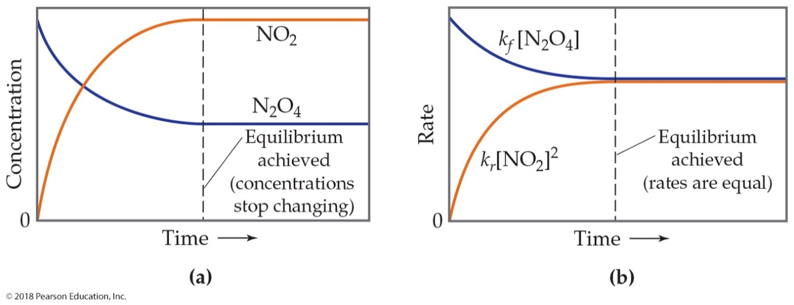
The Concept of Equilibrium
As a system approaches equilibrium, both the forward and reverse reactions are occurring.
At equilibrium, the forward and reverse reactions are proceeding at the same rate.
Once equilibrium is achieved, the amount of each reactant and product remains constant.

Slide 4
Reaction Dynamics
Initially, only the forward
reaction takes place.
As the forward reaction proceeds
it makes products and uses reactants.
Because the reactant concentration
decreases, the forward reaction slows.
As the products accumulate, the
reverse reaction speeds up.
Once equilibrium is established,
the forward and reverse reactions
proceed at the same rate, so the
concentrations of all materials
stay constant.
Eventually, the reaction proceeds
in the reverse direction as fast as
it proceeds in the forward direction.
At this time equilibrium is established.
Rate
Rate Forward
Rate Reverse
Time
Notes:
4

Slide 5
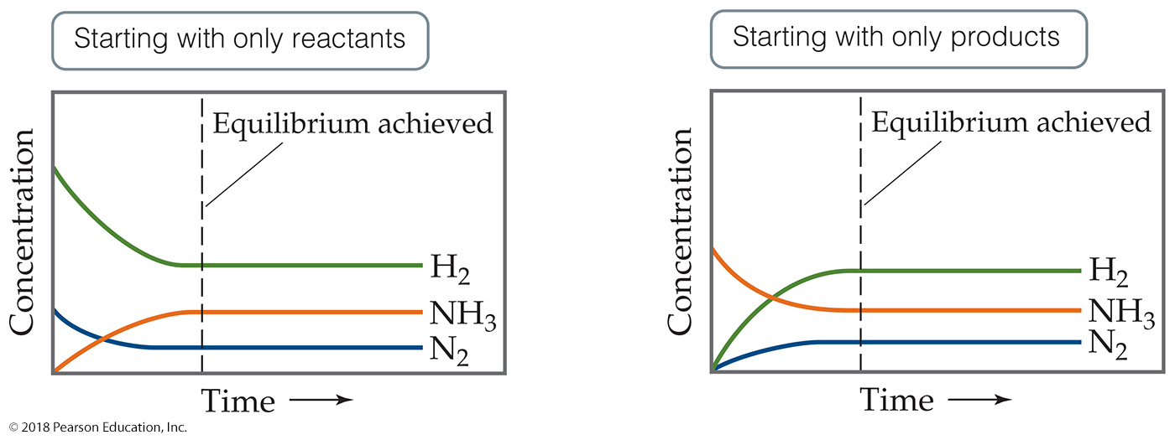
What Do You Start with to Reach Equilibrium?
The figure shows that it doesn’t matter whether you start with reactants or products; an equilibrium will be reached.
N₂ + 3H₂ ↔ 2NH₃
Note: Relative amount of change is based on stoichiometry.

Slide 6
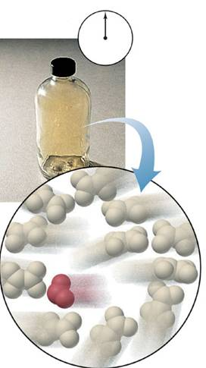
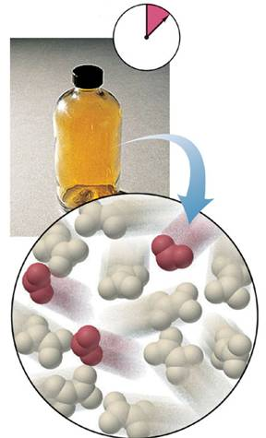
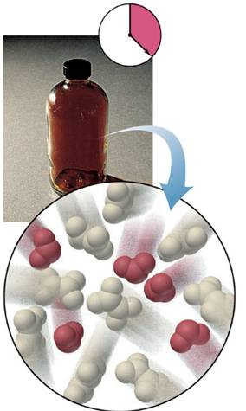
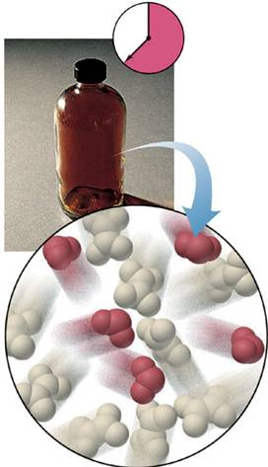
Reaching equilibrium on the macroscopic and molecular levels.
N₂O₄(g) 2NO₂(g)
Notes:
6

Slide 7
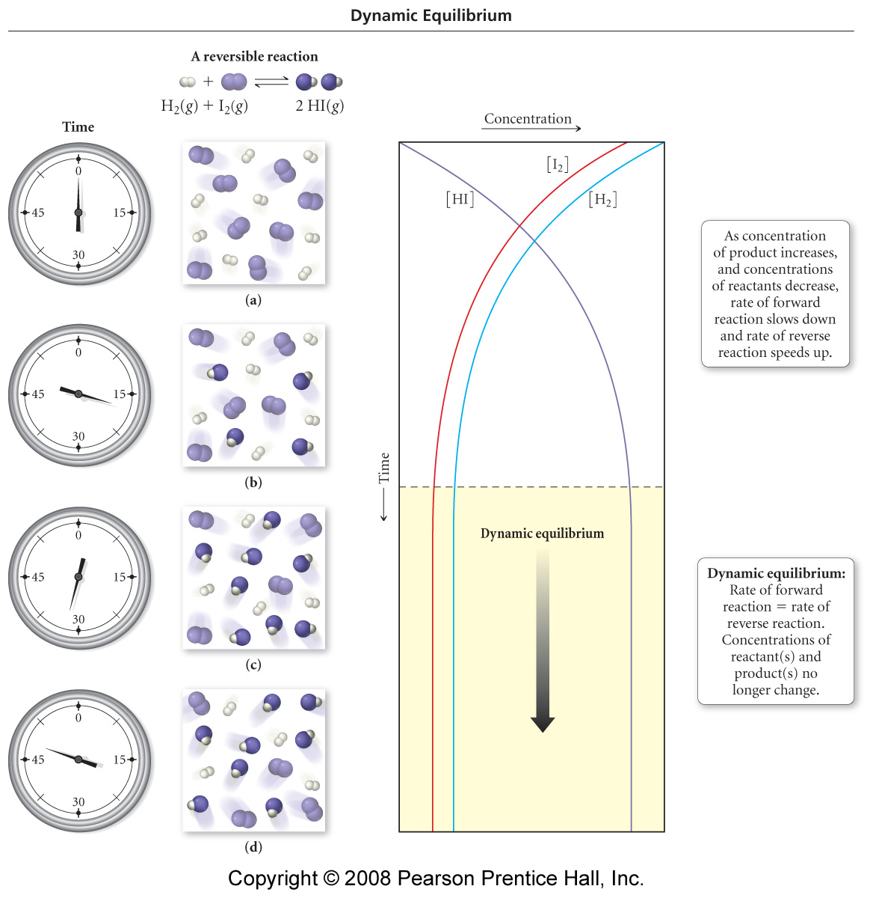
H₂(g) + I₂(g) ⇔ 2 HI(g)
at time 0, there are only reactants in the mixture, so only the forward reaction can take place
[H₂] = 8, [I₂] = 8, [HI] = 0
at time 16, there are both reactants and products in the mixture, so both the forward reaction and reverse reaction can take place
[H₂] = 6, [I₂] = 6, [HI] = 4
7
Notes:
7

Slide 8
H₂(g) + I₂(g) ⇔ 2 HI(g)
at time 32, there are now more products than reactants in the mixture − the forward reaction has slowed down as the reactants run out, and the reverse reaction accelerated
[H₂] = 4, [I₂] = 4, [HI] = 8
at time 48, the amounts of products and reactants in the mixture haven’t changed – the forward and reverse reactions are proceeding at the same rate – it has reached equilibrium
Notes:
8

Slide 9
LAW OF MASS ACTION
K ≡ equilibrium constant
aA + bB ←→ cC + dD
K = Products
Reactants
K = [C]^{c} [D]^{d} = Q reaction quotient
[B]^{b} [A]ª
Write the equilibrium equation for:
a. H₂O + H₂O ←→ H₃O+ + OH⁻
b. 4NH_{3(g)} + 30_{2(g)} ←→ 2N_{2(g)} + 6H₂O_{(g)}
c. N_{2(g)} + 3H_{2(g)} ←→ 2NH_{3(g)}
Notes:
9

Slide 10
Workshop Question EQ1
HOMOGENEOUS EQUILIBRIA
H_{2(g)} + I_{2(g)} ←→ 2HI_{(g)}
Kc = then K_{p} = _________
2O_{3(g)} ←→ 3O_{2(g)}
Kp = K_{c} = ________
[P_{HI}]²
[P_{I2}][P_{H2}]
(P_{O2})³
(P_{O3})²
HETEROGENEOUS EQUILIBRIA
2H₂O_{(l)} ←→ H₃O⁺_{(aq)_} + OH_{-(aq)}
C₂H₅OH_{(l)} + 3O_{2(g)} ←→ 2CO_{2(g)} + 3H₂O_{(g)}
Kc = [H₃O⁺][OH⁻]
Kc = _____________
Notes:
10

Slide 11
HETEROGENEOUS EQUILIBRIA
Substance in more than one phase
1. CaCO_{3(s)} ←→ CaO_{(s)} + CO_{2(g)}
Kc = [CaO][CO₂]
[CaCO₃]
How do the [ ] of solid express?
Pure solids & liquid have constant [conc. ]
?
Notes:
11

Slide 12
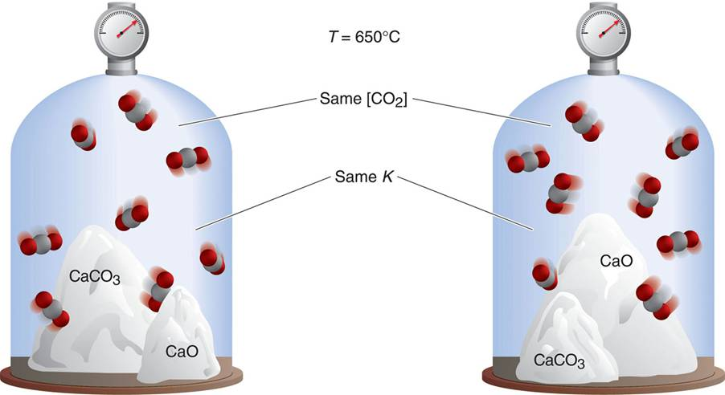
The reaction quotient for a heterogeneous system.
solids do not change their concentrations
Notes:
12

Slide 13
Q. Each of the mixtures listed below was placed in a closed container and allowed to stand. Which of these mixtures is capable of attaining the equilibrium, expressed by 1
a) pure CaCO₃
b) CaO & P_{CO2} > Kp
c) solid CaCO₃ & P_{CO2} > Kp
d) CaCO₃ & CaO
Notes:
13

Slide 14
LE CHATELIER’S PRINICIPLE
“If a system at equilibrium is disturbed by a change in
temperature, pressure, or concentration of one of its
components, that system will shift it’s equilibrium position as to ‘counteract’ the effect of the disturbance.”
Equilibrium can be disturbed by:
- adding or removing components
- a change in pressure
- a change in volume
- a change in temperature
Notes:
14

Slide 15
PREDICTING THE DIRECTION OF THE SHIFT
I. CATALYST
A catalyst increases the rate at which equilibrium is achieved but not the composition of the equilibrium mixture.
Catalysts increase the rate of both the forward & reverse reactions.
Equilibrium is achieved faster, but the equilibrium composition remains unaltered.
Activation energy is lowered, allowing equilibrium to be established at lower temperatures.
Notes:
15

Slide 16
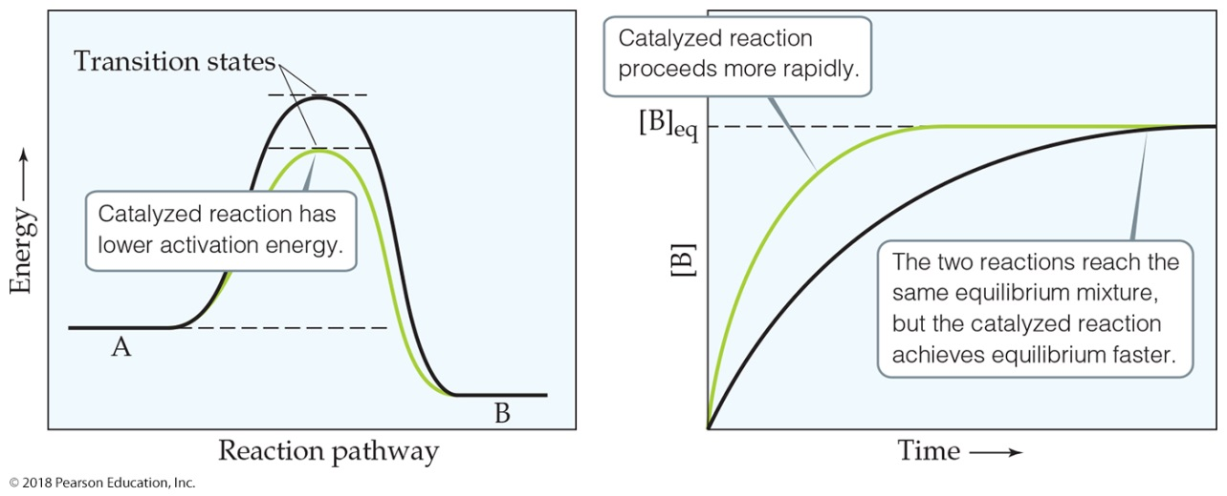
Catalysts

Slide 17
PREDICTING THE DIRECTION OF THE SHIFT
II. THE REACTION QUOTIENT
Q < K: the reaction shifts to the products
Q > K: the reaction shifts to the reactants
(We will look at this aspect later)
III. CHANGES IN VOLUME
Reducing the volume of a gas at equilibrium causes
the system to shift in the direction that reduces
the number of moles of gas.
Notes:
17

Slide 18
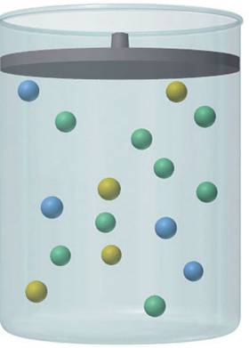
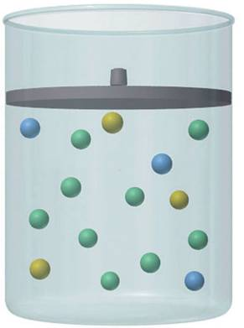
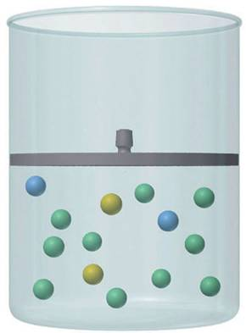
The effect of pressure (volume) on an equilibrium system.
+
lower P
(higher V)
more moles of gas
higher P
(lower V)
fewer moles of gas
Notes:
18

Slide 19
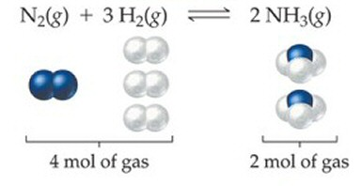
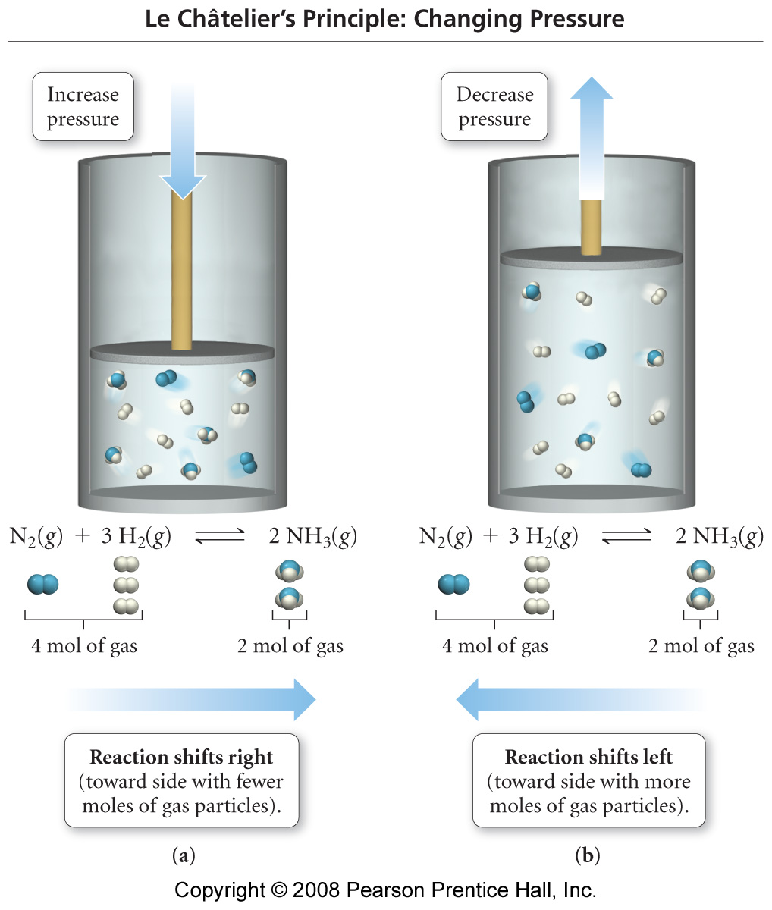
The Effect of Volume Changes on Equilibrium
When the pressure is decreased by increasing the volume, the position of equilibrium shifts toward the side with the greater number of molecules – the reactant side.
Since there are more gas molecules on the reactants side of the reaction, when the pressure is increased the position of equilibrium shifts toward the products.
19
Notes:
19

Slide 20
Sample Problem
Predicting the Effect of a Change in Volume (Pressure) on the Equilibrium Position
PROBLEM:
How would you change the volume of each of the following reactions to increase the yield of the products.
(a) CaCO₃(s) CaO(s) + CO₂(g)
(b) S(s) + 3F₂(g) SF₆(g)
(c) Cl₂(g) + I₂(g) 2ICl(g)
PLAN:
When gases are present a change in volume will affect the concentration of the gas. If the volume decreases (pressure increases), the reaction will shift to fewer moles of gas and vice versa.
SOLUTION:
Notes:
20

Slide 21
IV. CHANGES IN TEMPERATURE
When heat is added to a system, the equilibrium
shifts in the direction that absorbs heat. Cooling has the opposite effect and shifts the equilibrium towards the side which produces heat.
Endothermic Reactions:
heat + Reactants → Products
An increase in temperature leads to a shift towards the products, a decrease leads to a shift towards the reactants. (K_{eq} increases)
Exothermic Reactions:
Reactants → Products + heat
An increase in temperature leads to a shift towards reactants. (K_{eq} decreases)
Notes:
21

Slide 22
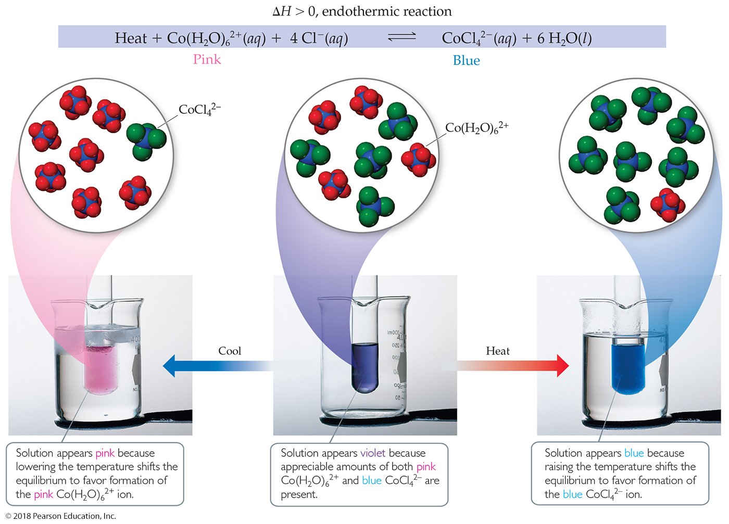
An Endothermic Equilibrium

Slide 23
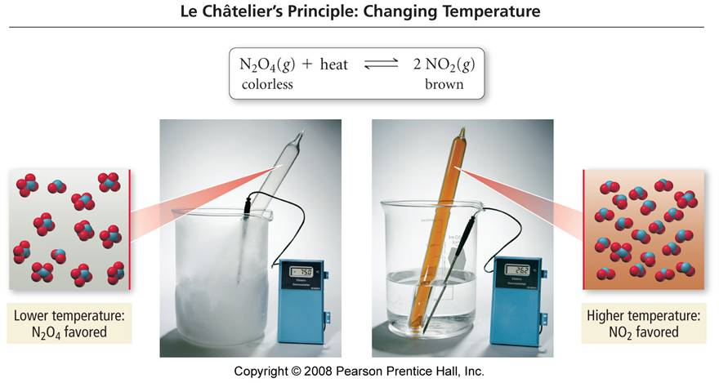
The Effect of Temperature Changes on Equilibrium
Notes:
23

Slide 24
Sample Problem
Predicting the Effect of a Change in Temperature on the Equilibrium Position
PROBLEM:
How does an increase in temperature affect the concentration of the underlined substance and K_{c} for the following reactions?
(a) CaO(s) + H₂O(l) Ca(OH)₂(aq) ΔH⁰ = -82kJ
(b) CaCO₃(s) CaO(s) + CO₂(g) ΔH⁰ = 178kJ
(c) SO₂(g) S(s) + O₂(g) ΔH⁰ = 297kJ
PLAN:
Express the heat of reaction as a reactant or a product. Then consider the increase in temperature and its effect on K_{c}.
SOLUTION:
Notes:
24

Slide 25
Practice - Le Châtelier’s Principle
The reaction 2 SO₂(g) + O₂(g) ⇔ 2 SO₃(g) with ΔH° = -198 kJ is at equilibrium. How will each of the following changes affect the equilibrium concentrations of each gas once equilibrium is re-established?
  adding more O₂ to the container
  condensing and removing SO₃
  compressing the gases
  cooling the container
  doubling the volume of the container
  warming the mixture
  adding the inert gas helium to the container
  adding a catalyst to the mixture
Notes:
25

Slide 26

Workshop # GE 1
N₂O_{4(g)} ←→ 2 NO_{2(g)} ΔH = 58 kJ
In which direction will the equilibrium shift when each of the following changes are made to a system at equilibrium?
A) add N₂O₄
B) remove NO₂
C) increase the total pressure by adding N₂
D) increase the volume of the container
E) decrease the temperature
Notes:
26

Slide 27
Workshop # GE 2
PCl_{5(g)} ←→ PCl_{3(g)} + Cl_{2(g)} ΔH = 88 kJ
In which direction will the equilibrium shift when each of the following changes are made to a system at equilibrium?
A) add Cl₂
B) temperature is increased
C) the volume of the reaction system is decreased
D) PCl₅ is added
E) a catalyst is added
Notes:
27

Slide 28
II. The Reaction Quotient - Q
At any time, t, the system can be sampled to determine the amounts of reactants and products present. A ratio of products to reactants, calculated in the same manner as K tells us whether the system has come to equilibrium (Q = K) or whether the reaction has to proceed further from reactants to products (Q < K) or in the reverse direction from products to reactants (Q > K).
We use the molar concentrations of the substances in the reaction. This is symbolized by using square brackets - [ ].
For a general reaction aA + bB cC + dD where a, b, c, and d are the numerical coefficients in the balanced equation, Q (and K) can be calculated as
[C]^{c}[D]^{d}
Q =
[A]ª[B]^{b}
Notes:
28

Slide 29
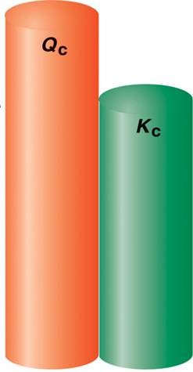
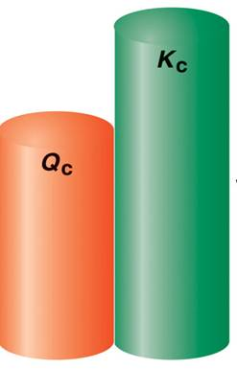
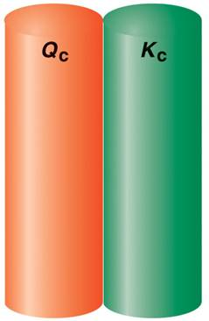
Reaction direction and the relative sizes of Q and K.
Reaction Progress
Reaction Progress
reactants products
Equilibrium:
no net change
reactants products
Notes:
29

Slide 30
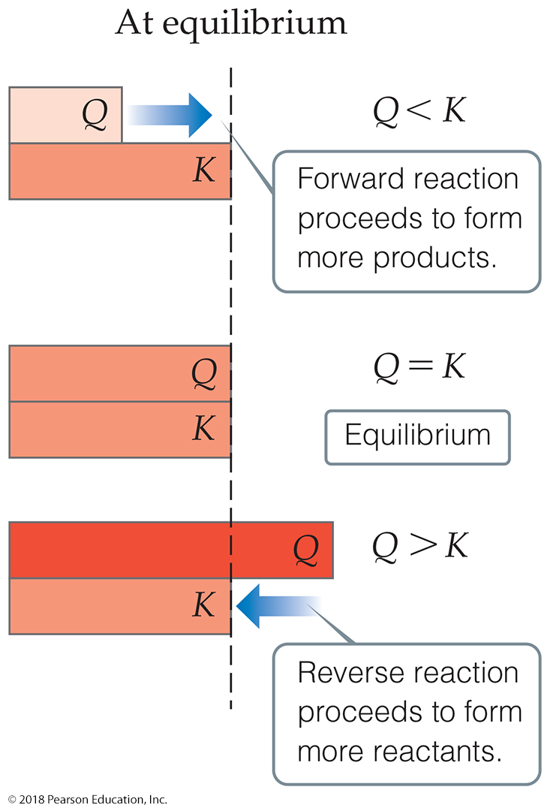
Comparing Q and K
Nature wants Q = K.
If Q < K, nature will make the reaction proceed to products.
If Q = K, the reaction is in equilibrium.
If Q > K, nature will make the reaction proceed to reactants.

Slide 31
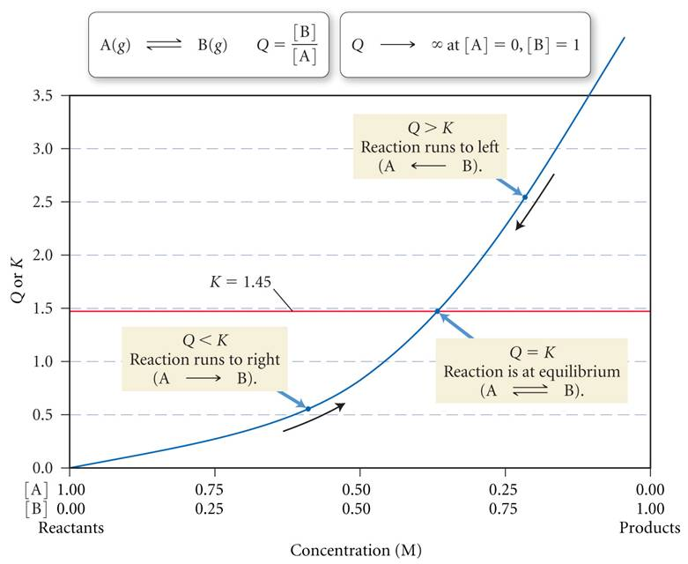
Q, K, and the Direction of Reaction
31
Notes:
31

Slide 32

Predicting the direction of reaction:
Q > K forms more reactants
←
Q = K equilibrium
Q < K forms more products
→
Note: 1. K_{f} = 1
K_{r}
2. K = K^{n} If the balanced equation is multiplied
by a factor then the K (& Q) is
multiplied by the exponent.
Notes:
32

Slide 33
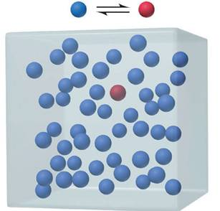
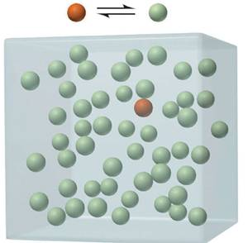
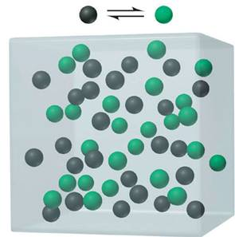
INTERPRETATION OF K
The range of equilibrium constants
small K
large K
intermediate K
Notes:
33

Slide 34
UNDERSTANDING THE DIRECTION OF REACTIONS AND K_{eg}
The following reaction is a means of “fixing” nitrogen:
N_{2(g)} + O_{2(g)} ←→ 2 NO_{(g)}
A. If the value for Q at 25°C is 1 x 10⁻³⁰, describe
the feasibility of this reaction for Nitrogen
fixation.
B. Write the equilibrium expression, K_{c}
C. Write the equilibrium expression for
2NO_{(g)} ←→ N_{2(g)} + O_{2(g)}
D. Determine the K_{c} for “C”
Notes:
34

Slide 35
Workshop # GE 3
1) The equilibrium constant is given for one of the reactions below. Determine the value of the missing equilibrium constant. Which reaction is the most feasible at this temperature and explain why?
2 SO₂(g) + O₂(g) ⇌ 2 SO₃(g) K_{c} = 1.7 × 10⁶
SO₃(g) ⇌ ¹/₂ O₂(g) + SO₂(g) K_{c} = ?
2) The equilibrium constant is given for two of the reactions below. Determine the value of the missing equilibrium constant.
A(g) + 2B(g) ⇌ AB₂(g) K_{c} = 59
AB₂(g) + B(g) ⇌ AB₃(g) K_{c} = ?
A(g) + 3B(g) ⇌ AB₃(g) K_{c} = 478
3) Consider the following reaction and its equilibrium constant: I₂(g) ⇌ 2I(g) Kp = 0.209
Write the equilibrium expression. If a reaction mixture contains 0.89 atm I₂ and 1.77 atm I. Which of the following statements is TRUE concerning this system?
A) The reaction will shift in the direction of reactants.
B) The reaction quotient will increase.
C) The reaction will shift in the direction of products.
D) The equilibrium constant will decrease.
E) The system is at equilibrium.

Slide 36
K as either K_{c} or K_{p}
K_{c} = the equilibrium constant using concentrations.
K_{p} = the equilibrium constant using pressure
K_{p} = K_{c}(RT) ^{Δn gas}
Δn is the difference between the number of moles of products and moles of reactants
R = 0.082 L atm / mol K
Notes:
36

Slide 37
K_{c} vs. K_{p}
K_{p} = K_{c}(RT) ^{Δn gas} R = 0.082 L atm/ mol K
For the following write K_{p} then K_{c} for:
N_{2(g)} + 3H_{2(g)} ←→ 2NH_{3(g)}
Calculate K_{p} if K_{c} = 0.105
Notes:
37

Slide 38
Workshop # GE 4 (K_{c} vs. K_{p})
Write K_{p} then K_{c} for:
1. N₂O_{4(g)} ←→ 2NO_{2(g)}
2. Calculate K_{c} if K_{p} = 0.245 for Q#1
2SO_{3(g)} ←→ 2SO_{2(g)} + O_{2(g)}
if K_{c}= 4.07x10⁻³, what is K_{p}?
Notes:
38

