Slide 1

Properties of the
Three Phases of Matter
fixed = keeps shape when placed in a container
indefinite = takes the shape of the container

Slide 2
Degrees of Freedom
Particles may have one or several types of freedom of motion.
  and various degrees of each type
Translational freedom is the ability to move from one position in space to another.
Rotational freedom is the ability to reorient the particle’s direction in space.
Vibrational freedom is the ability to oscillate about a particular point in space.

Slide 3
States and Degrees of Freedom
The molecules in a gas have complete freedom of motion.
  Their kinetic energy overcomes the attractive forces between the molecules.
The molecules in a solid are locked in place; they cannot move around.
  Though they do vibrate, they don’t have enough kinetic energy to overcome the attractive forces.
The molecules in a liquid have limited freedom—they can move around a little within the structure of the liquid.
  They have enough kinetic energy to overcome some of the attractive forces, but not enough to escape each other.

Slide 5
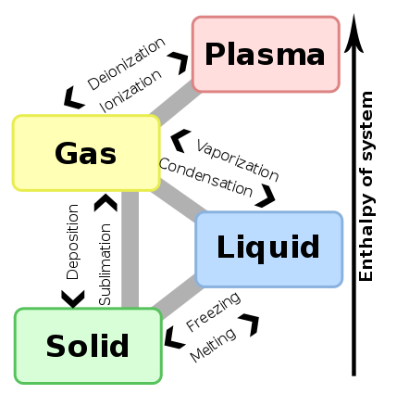

Slide 6
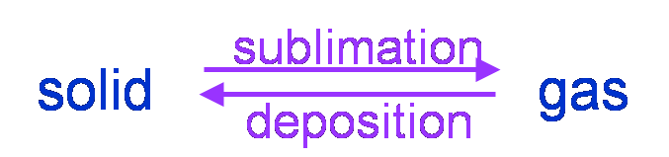
Sublimation and Deposition
Molecules in the solid have thermal energy that allows them to vibrate.
Surface molecules with sufficient energy may break free from the surface and become a gas. This process is called sublimation.
The capturing of vapor molecules into a solid is called deposition.
The solid and vapor phases exist in dynamic equilibrium in a closed container.
  at temperatures below the melting point
  Therefore, molecular solids have a vapor pressure.

Slide 7
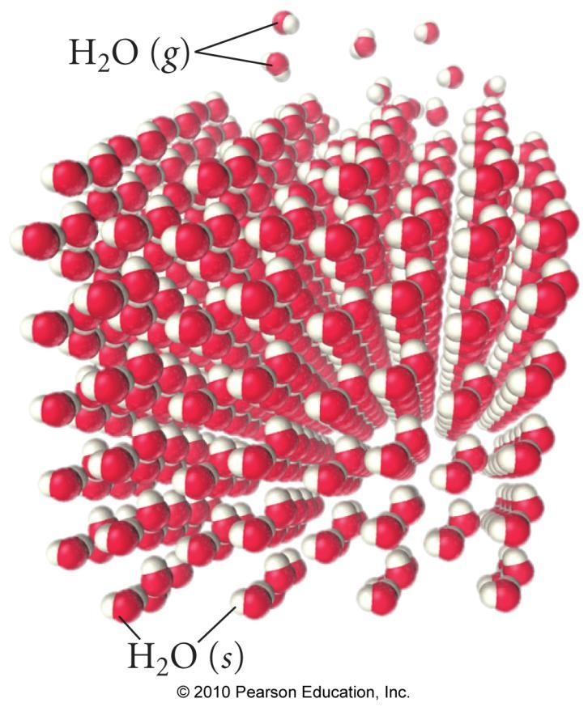
Sublimation

Slide 8
Phase Diagrams
Phase diagrams describe the different states and state changes that occur at various temperature/pressure conditions.
Regions represent states.
Lines represent state changes.
  The liquid/gas line is the vapor pressure curve.
  Both states exist simultaneously.
  The critical point is the furthest point on the vapor pressure curve.
The triple point is the temperature/pressure condition where all three states exist simultaneously.
For most substances, freezing point increases as pressure increases.

Slide 9
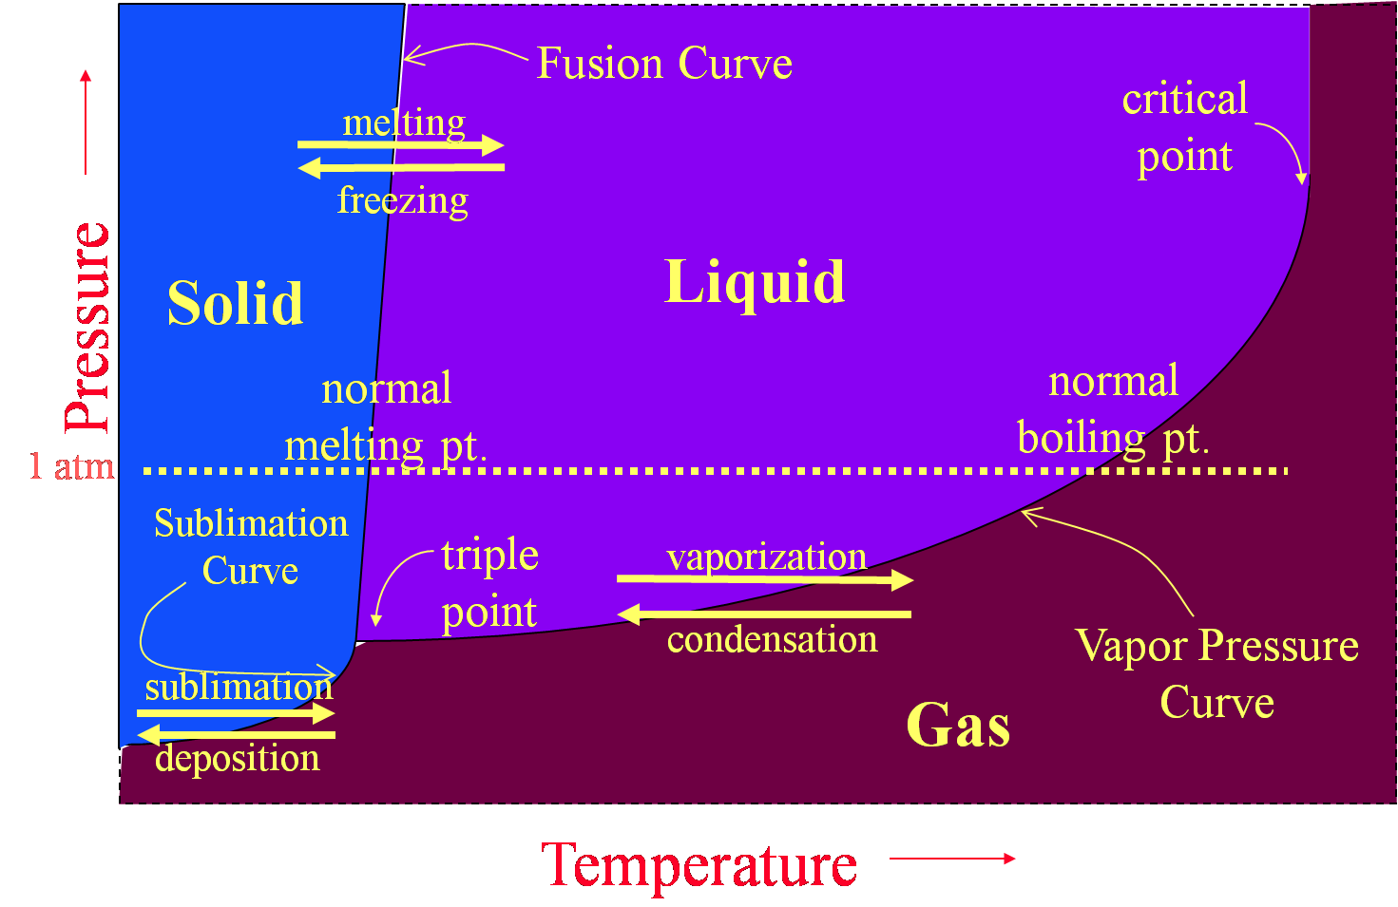
Phase Diagrams

Slide 10
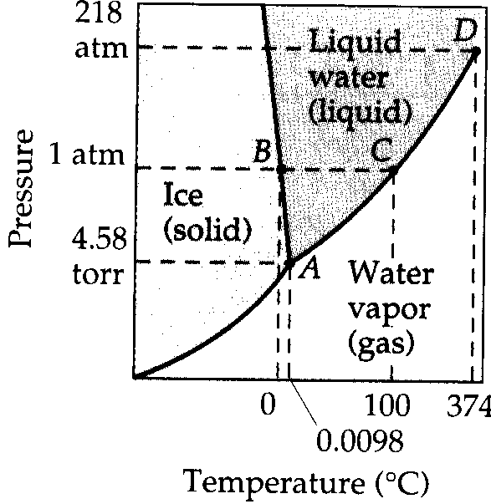
Phase Diagrams
A phase diagram allows for the prediction of the state of matter at any given temperature & pressure.
Key aspects:
-critical point
-normal boiling point
-triple point

Slide 11
The Critical Point
The temperature required to produce a supercritical fluid is called the critical temperature.
The pressure at the critical temperature is called the critical pressure.
At the critical temperature or higher temperatures, the gas cannot be condensed to a liquid, no matter how high the pressure gets.

Slide 12
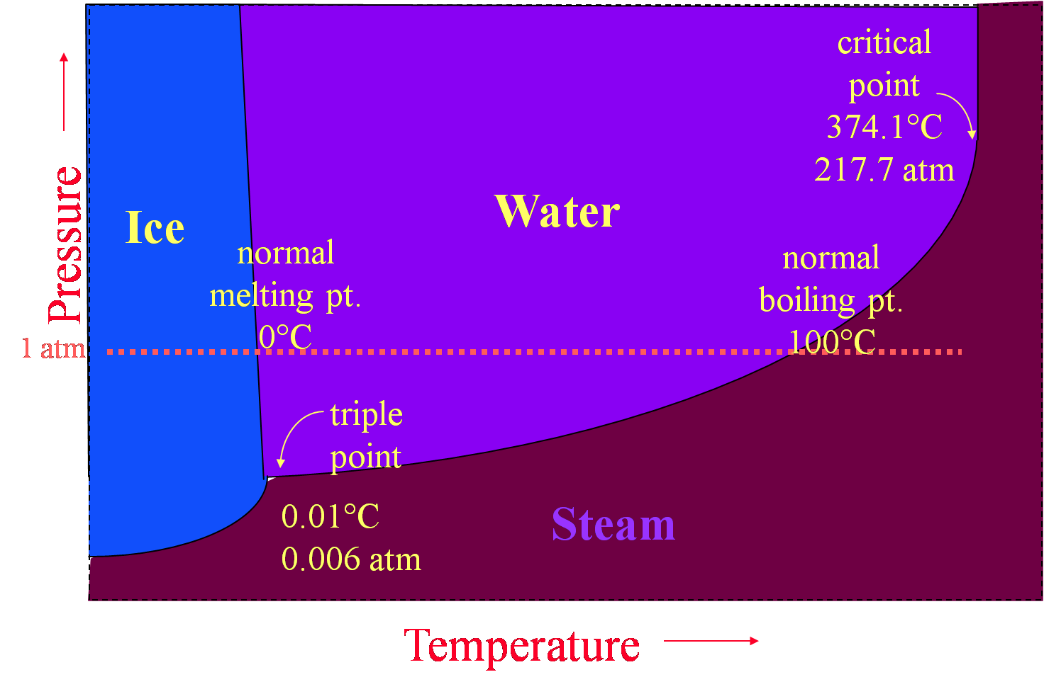
Phase Diagram of Water

Slide 13
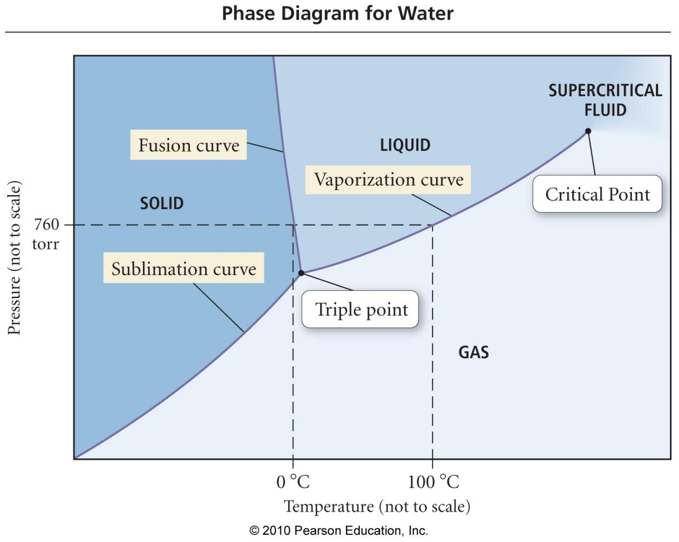

Slide 14
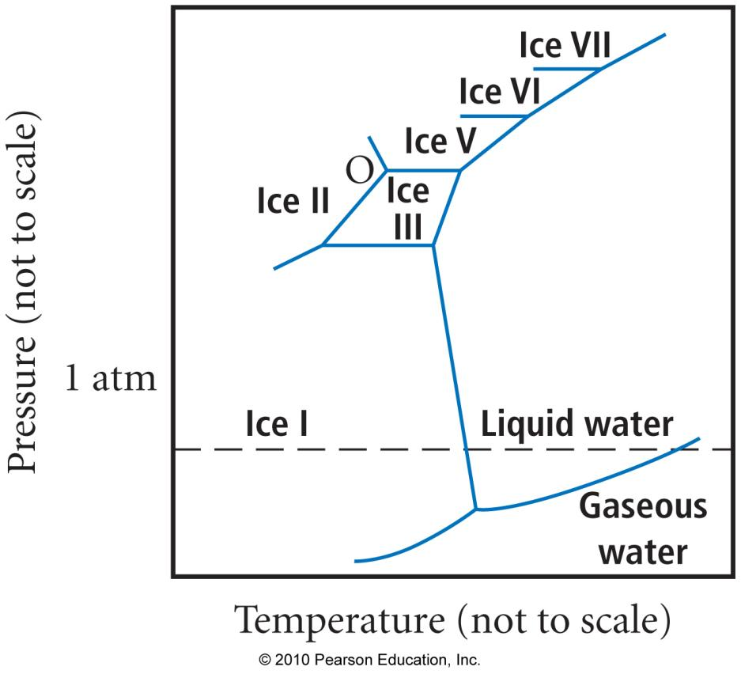
Morphic Forms of Ice

Slide 15
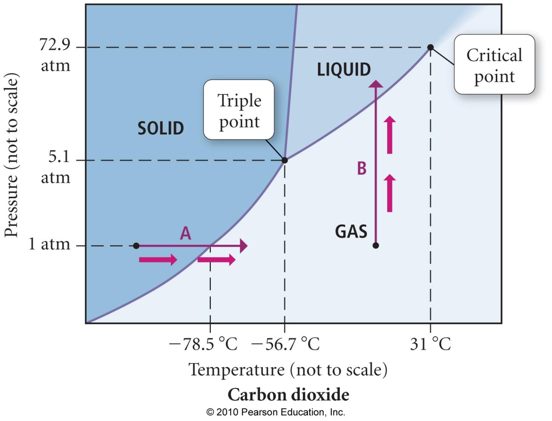

Slide 16

Practice—Consider the phase diagram of CO₂ shown. What phase(s) is (are) present at each of the following conditions?
20.0 °C, 72.9 atm
−56.7 °C, 5.1 atm
10.0 °C, 1.0 atm
−78.5 °C, 1.0 atm
50.0 °C, 80.0 atm
20.0 °C, 72.9 atm liquid
−56.7 °C, 5.1 atm solid, liquid, gas
10.0 °C, 1.0 atm gas
−78.5 °C, 1.0 atm solid, gas
50.0 °C, 80.0 atm scf

Slide 17
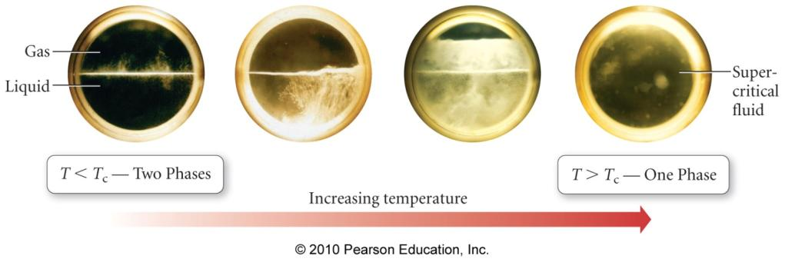
Supercritical Fluid
As a liquid is heated in a sealed container, more vapor collects causing the pressure inside the container to rise.
  and the density of the vapor to increase
  and the density of the liquid to decrease
At some temperature, the meniscus between the liquid and vapor disappears and the states commingle to form a supercritical fluid.
Supercritical fluids have properties of both gas and liquid states.

Slide 18
SPECIFIC HEAT re-visited
The quantity of heat required to raise the temperature of one
gram of a substance by one degree Celsius (or one Kelvin)
q = s x m x ΔT
ENTHALPY OF A PHASE CHANGE
The heat energy required to undergo a change in phase
occurs at constant temperature and is associated with the average change in distance between molecules.
For water:
ΔHº _{fus} = 335 J/g or 6.02 kJ/mol
ΔHº_{vap} = 2260 J/g or 40.7 kJ/mol

Slide 19
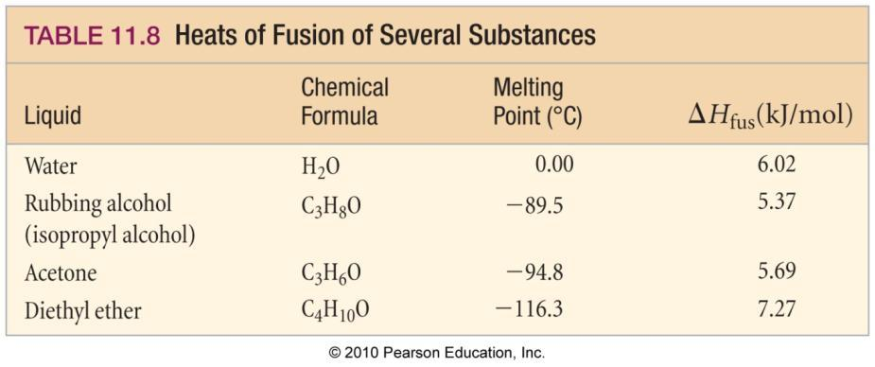
Heat of Fusion
The amount of heat energy required to melt one mole of the solid is called the heat of fusion, ΔH_{fus}.
  sometimes called the enthalpy of fusion
always endothermic, therefore ΔH_{fus} is +
somewhat temperature dependent
ΔH_{crystallization} = −ΔH_{fusion}
generally much less than ΔH_{vap}
ΔH_{sublimation} = ΔH_{fusion} + ΔH_{vaporization}

Slide 20
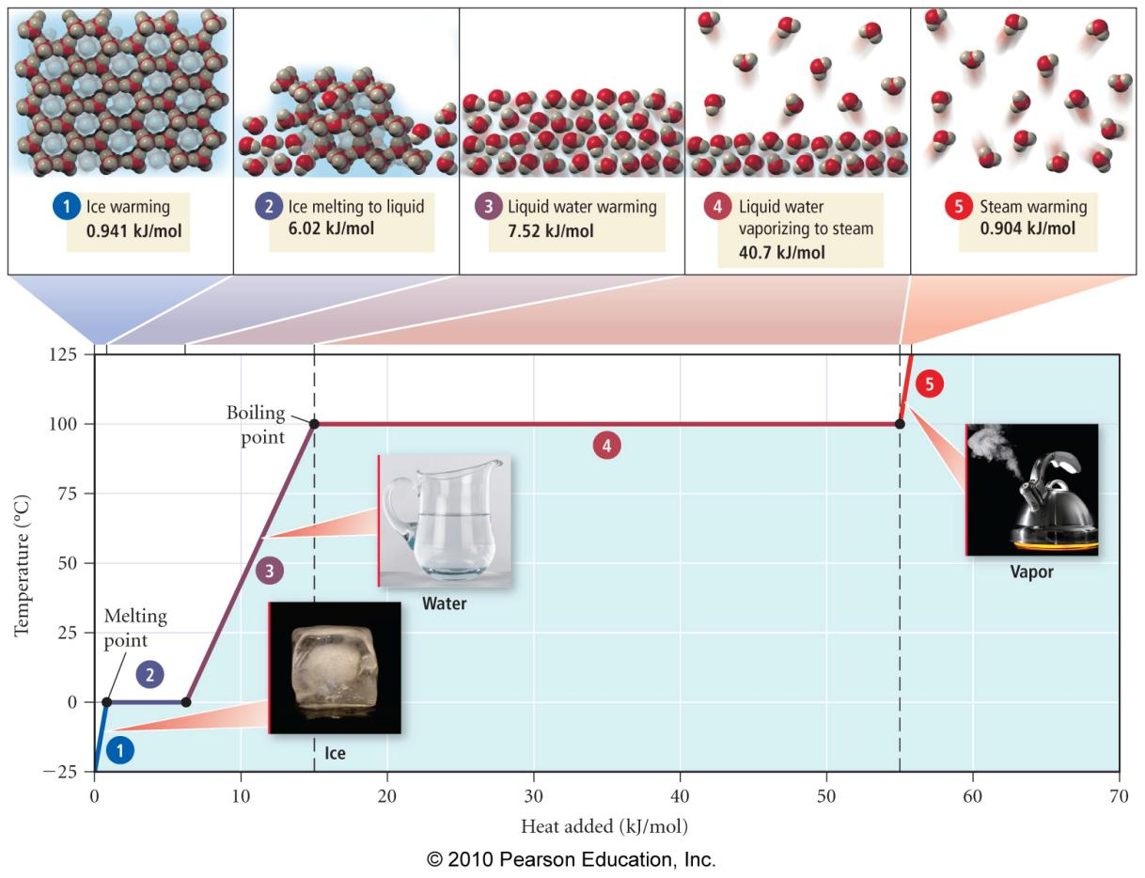
Heating Curve of Water

Slide 21
HEATING - COOLING CURVE
Calculate the amount of energy required to convert
50.0 g of ice at 0.0 ºC to steam at 100.0ºC
ΔH_{vap}
g
100 -
T (ºC)
0 -
l
ΔH_{fus}
s
Energy (J)
q_{total} = q_{(s)} + ΔH_{fus} + q_{(l)} + ΔH_{vap} + q_{(g)}

Slide 22
Water and the Changes of State
Q. How many kilojoules of energy are needed to change 15.0 g of ice at -5.00ºC to steam at 125.0 ºC?
The first step is to design a pathway:
q₁ = msΔT for ice from -5.0 to 0.0 ºC, the specific heat of ice is 4.213 J/g ºC
q₂ = ΔH_{fus} for ice to liquid at 0.0ºC
q₃ = msΔT for liquid 0.0ºC to 100.0 ºC
q₄ = ΔH_{vap} for liquid to steam at 100.0ºC
q₅ = msΔT for steam 100.0 to 125.0 ºC; the specific heat of steam is 1.900 J/g ºC
so q_{T} = q₁ + q₂ + q₃ + q₄ + q₅
The next step is to calculate each q:
q₁= (15.0 g) (4.213 J/g ºC) (0.0 - (-5.0) ºC) = 316 J
q₂ = (335 J / g) (15.0 g) = 5025 J
q₃= (15.0 g) (4.184 J/g ºC) (100.0 - (0.0) ºC) = 6276 J
q₄ = (2260 J / g) (15.0 g) = 33900 J
q₅= (15.0 g) (1.900 J/g ºC) (110 - 100 ºC) = 285 J
q_{T} = 316 J + 5025 J + 6276 J + 33900 J + 285 J = 45.8 kJ

Slide 23
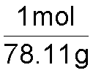
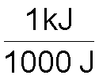


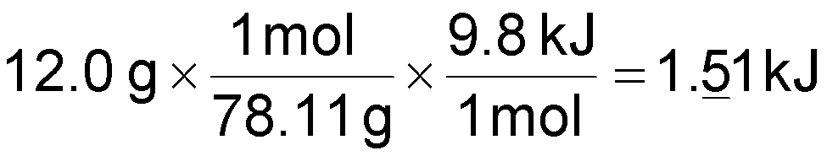
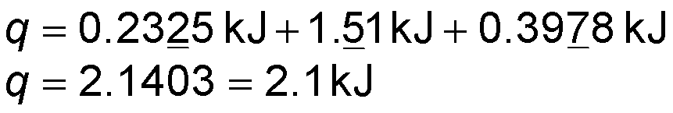
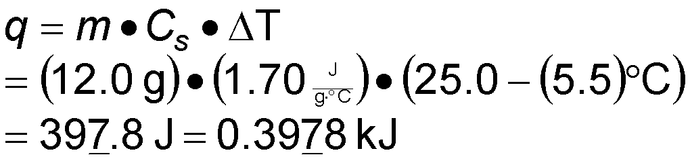
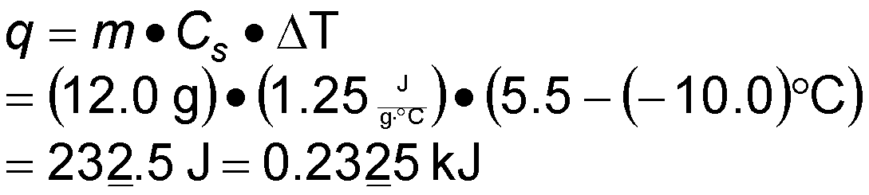
Practice—How much heat is needed to raise the temperature of a 12.0-g benzene sample from −10.0 °C to 25.0 °C?
Given:
Find:
12.0 g benzene, seg 1 (T₁ = −10.0 °C, T₂ = 5.5 °C), seg 2 = melting, seg 3 (T₁ = 5.5 °C, T₂ = 25.0 °C)
kJ
12.0 g benzene, seg 1 = 0.2325 kJ,
seg 2 = melting, seg 3 (T₁ = 5.5 °C, T₂ = 25.0 °C)
kJ
12.0 g benzene, seg 1 = 0.2325 kJ,
seg 2 = 1.51 kJ, seg 3 (T₁ = 5.5 °C, T₂ = 25.0 °C)
kJ
12.0 g benzene, seg 1 = 0.2325 kJ,
seg 2 = 1.51 kJ, seg 3 = 0.3978 kJ
kJ
Conceptual Plan:
Relationships:
g
g
g
J
mol
J
kJ
kJ
Seg 3
kJ
Seg 2
Seg 1
ΔH_{fus} 9.8 kJ/mol, 1 mol = 78.11 g, 1 kJ = 1000 J, q = m∙C_{s}∙ΔT
C_{s},sol = 1.25 J/g °C, C_{s},liq = 1.70 J/g °C
Solution:

Slide 24
INTERMOLECULAR FORCES
INTRAMOLECULAR > INTERMOLECULAR
(covalent, ionic) (van der Waals, etc)
“ between atoms” “between molecules”
TYPES
Neutral Molecules: 1. Dipole-dipole forces
2. London Dispersion
3. Hydrogen bonding
Ions: 1. Ion-dipole force

Slide 25
INTERMOLECULAR FORCES
STRENGTH:
BOILING POINTS AND MELTING POINTS ARE DEPENDENT ON STRENGTH OF INTERMOLECULAR FORCES.
STRONG FORCE ≡ HIGH BOILING POINT
Type of interaction Approximate Energy
(kJ/mol)
Intermolecular
van der Waals 0.1 to 10
(London, dipole-dipole)
Hydrogen bonding 10 to 40
Chemical bonding
Ionic 100 to 1000
Covalent 100 to 1000

Slide 26
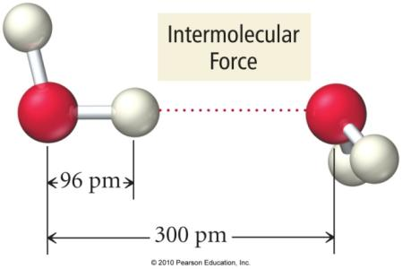
Why are molecules attracted to each other?
Intermolecular attractions are due to attractive forces between opposite charges.
  + ion to − ion
  + end of polar molecule to − end of polar molecule
    H-bonding especially strong
  Even nonpolar molecules will have temporary charges.
larger the charge = stronger attraction
longer the distance = weaker attraction
However, these attractive forces are small relative to the bonding forces between atoms.
  generally smaller charges
  generally over much larger distances

Slide 27
Trends in the Strength of
Intermolecular Attraction
The stronger the attractions between the atoms or molecules, the more energy it will take to separate them.
Boiling a liquid requires addition of enough energy to overcome all the attractions between the particles.
  however, not breaking the covalent bonds
The higher the normal boiling point of the liquid, the stronger the intermolecular attractive forces.

Slide 28
LONDON DISPERSION FORCES
- all molecules and compounds
- involves instantaneous dipoles
- strength is dependent on Molar Mass (size)
- contributes more than dipole-dipole
- shape contributes to strength

Slide 29
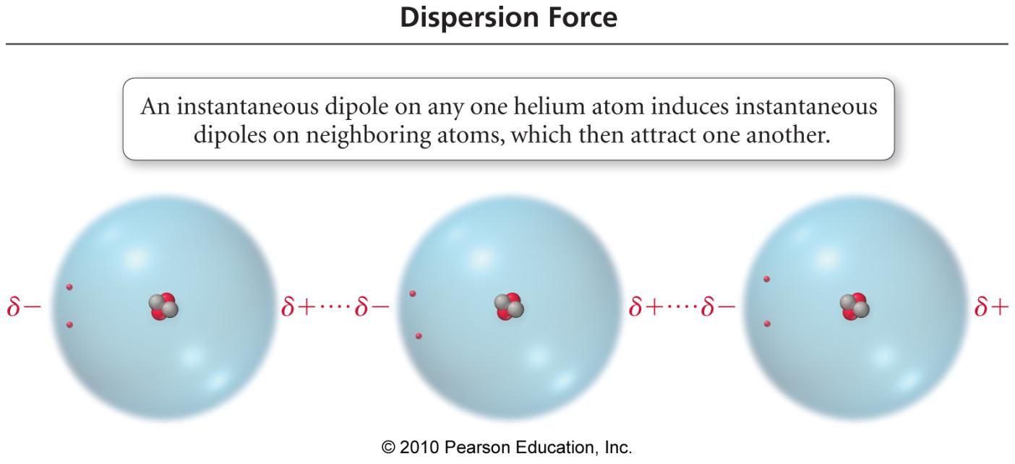
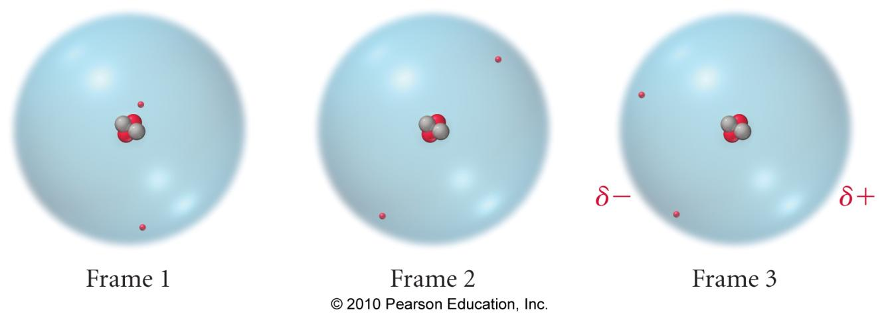

Slide 30
Size of the Induced Dipole
The magnitude of the induced dipole depends on several factors.
polarizability of the electrons
  volume of the electron cloud
  larger molar mass = more electrons = larger electron cloud = increased polarizability = stronger attractions
shape of the molecule
  more surface-to-surface contact = larger induced dipole = stronger attraction
+
+
+
+
+
+
+
-
-
-
-
-
-
-
Molecules that are flat have more surface interaction than spherical ones.
Larger molecules have more electrons, leading to increased polarizability.
+
+
+
+
+
+
+
+
+
+
+
+
+
+
+
+
+
+
+
−
−
-
-
−
-
−
−
−
−
−
−
−
−
-
-
−
−

Slide 31
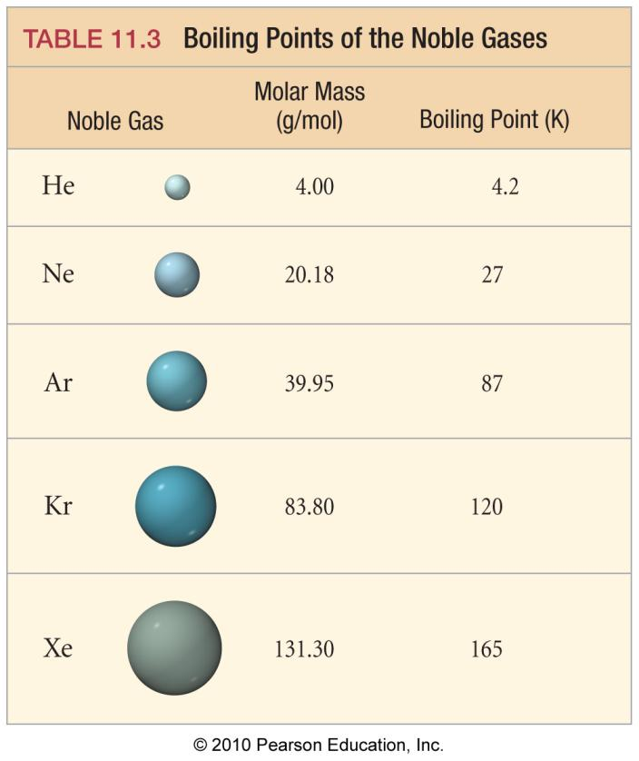
Effect of Molecular Size on Size of Dispersion Force
As the molar mass increases, the number of electrons increases. Therefore, the strength of the dispersion forces increases.
The noble gases are all nonpolar atomic elements.
The stronger the attractive forces between the molecules, the higher the boiling point will be.

Slide 32
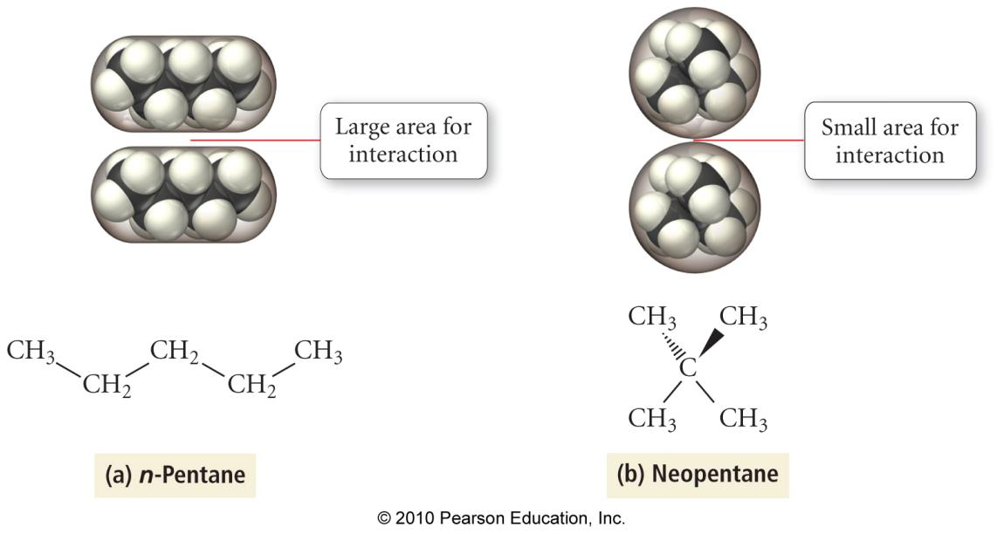
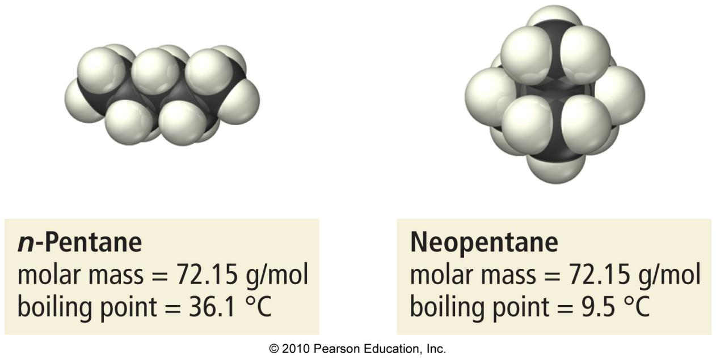
Effect of Molecular Shape on Size of Dispersion Force

Slide 33
DIPOLE-DIPOLE FORCES
- between neutral polar molecules
- weaker force than ion-dipole
- positive dipole attracted to negative dipole
- molecules should be relatively close together
- strength is dependent on polarity of bonds.

Slide 34
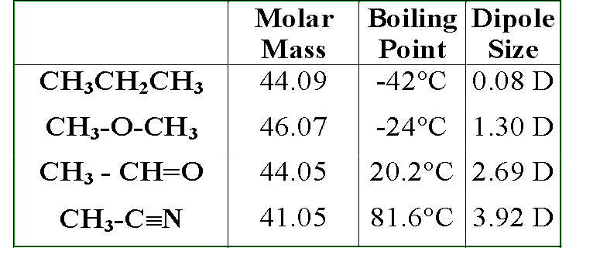
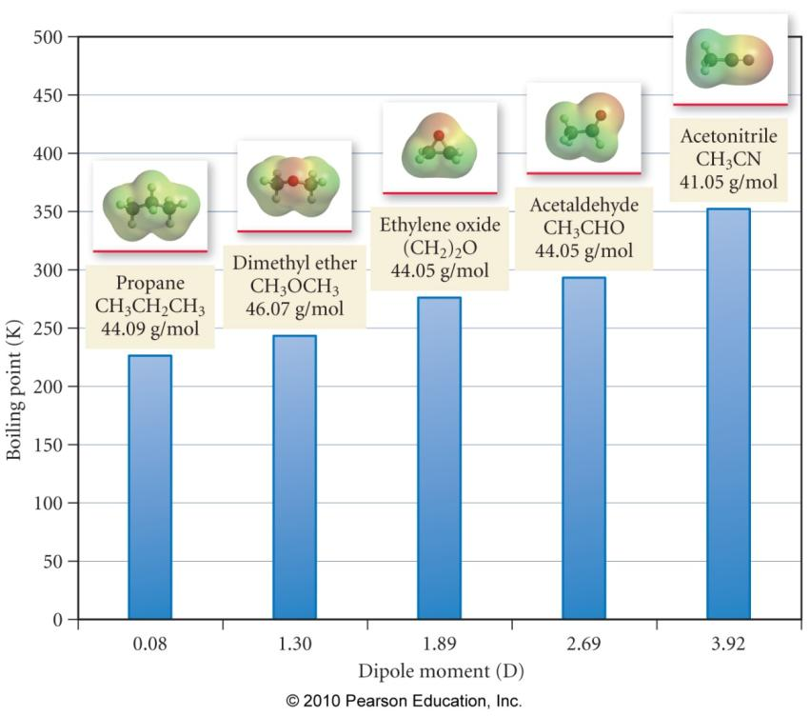

Slide 35
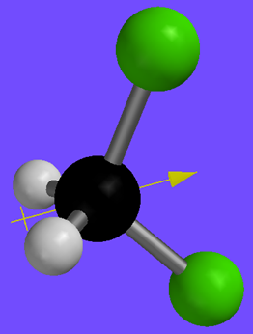
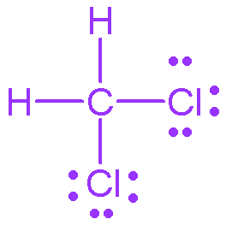
Example 11.1b Determine if dipole–dipole attractions occur between CH₂Cl₂ molecules.
Given:
Find:
CH₂Cl₂, EN C = 2.5, H = 2.1, Cl = 3.0
Are dipole–dipole attractions present?
Conceptual Plan:
Relationships:
Formula
Lewis
Structure
Bond
Polarity
Molecule
Polarity
EN Difference
Shape
Molecules that have dipole–dipole attractions must be polar.
Solution:
Cl—C
3.0 − 2.5 = 0.5
polar
polar molecule; therefore dipole–dipole attractions
C—H
2.5 − 2.1 = 0.4
nonpolar

Slide 36
HYDROGEN BONDING
AN INTERMOLECULAR ATTRACTION THAT EXISTS
BETWEEN A HYDROGEN ATOM IN A POLAR BOND
AND AN UNSHARED ELECTRON PAIR ON A NEARBY
ELECTRONEGATIVE SPECIES, USUALLY
O, F, and N
NOTE: (A special type of dipole-dipole interaction)
- stronger than dipole-dipole and London dispersion forces
- Accounts for water’s unusual properties
- high boiling point
- solid Less dense than liquid
- universal solvent
- high heat capacity

Slide 37
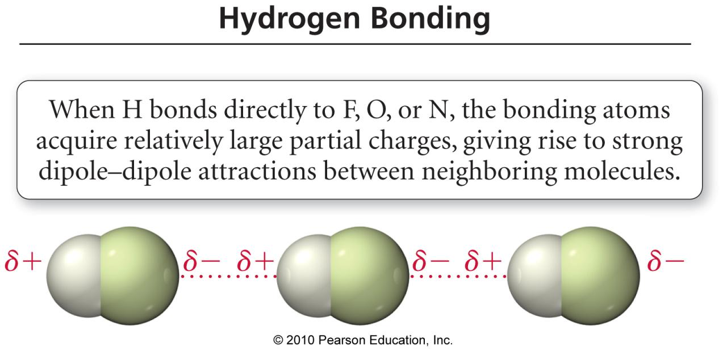
H-Bonding
HF

Slide 38
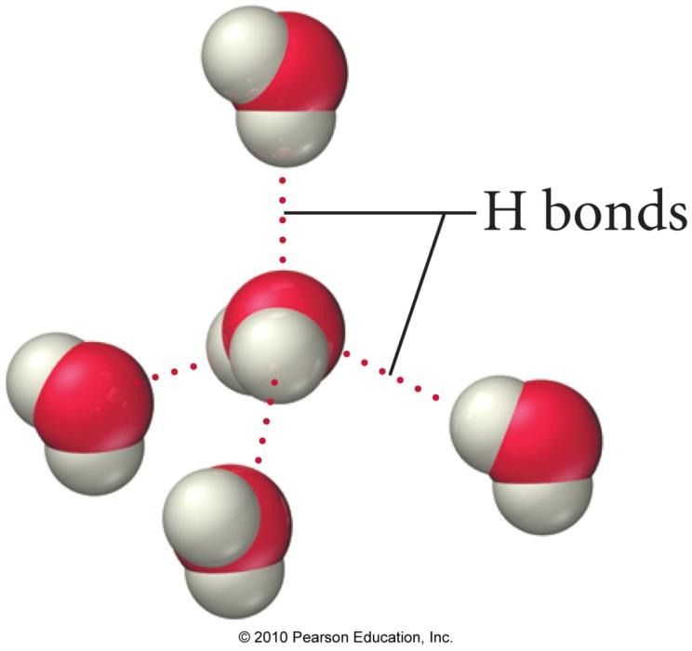
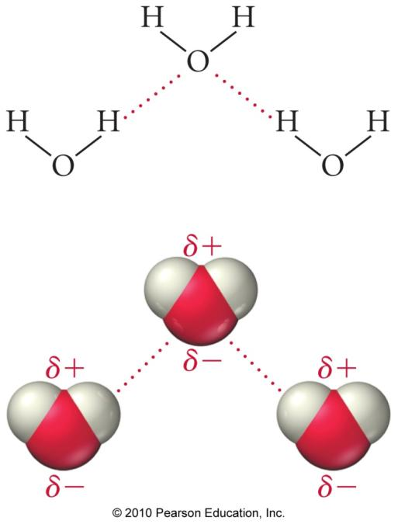
H-Bonding in Water

Slide 39
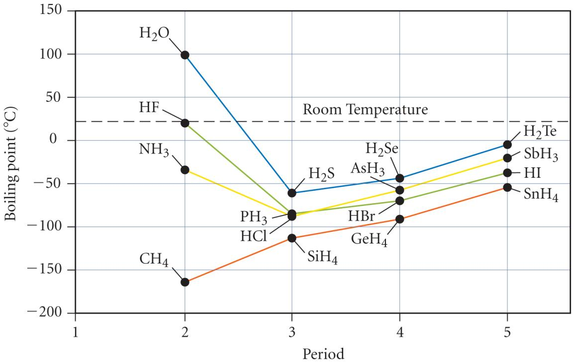
For nonpolar molecules, like the hydrides of group 4, the intermolecular attractions are due to dispersion forces. Therefore, they increase down the column causing the boiling point to increase.
HF, H₂O, and NH₃ have unusally strong dipole–dipole attractions called hydrogen bonds. Therefore, they have higher boiling points than you would expect from the general trends.
Polar molecules, like the hydrides of groups 5–7, have both dispersion forces and dipole–dipole attractions. Therefore, they have higher boiling points than the corresponding group 4 molecules.

Slide 40
ION-DIPLE FORCES
- between ions and polar molecules
- strength is dependent on charge of the ions or polarity of the bonds
- usually involved with salts & H₂0

Slide 41
Attractive Forces and Solubility
Solubility depends, in part, on the attractive forces of the solute and solvent molecules.
  like dissolves like
  Miscible liquids will always dissolve in each other.
Polar substances dissolve in polar solvents.
  hydrophilic groups = OH, CHO, C=O, COOH, NH₂, Cl
Nonpolar molecules dissolve in nonpolar solvents.
  hydrophobic groups = C–H, C–C
Many molecules have both hydrophilic and hydrophobic parts. Solubility in water becomes a competition between the attraction of the polar groups for the water and the attraction of the nonpolar groups for their own kind.

Slide 42
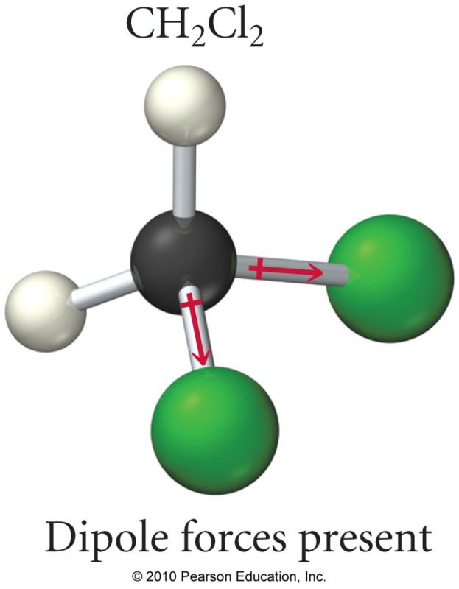
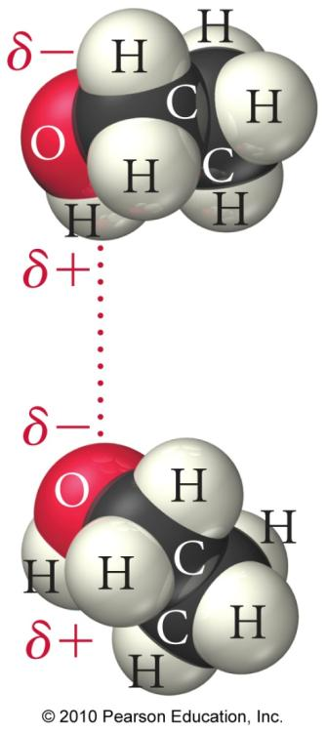
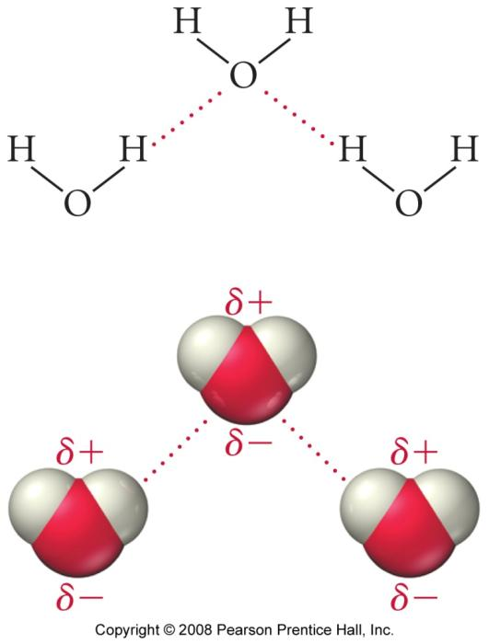
Polar Solvents
Dichloromethane
(methylene chloride)
Ethanol
(ethyl alcohol)
Water

Slide 43
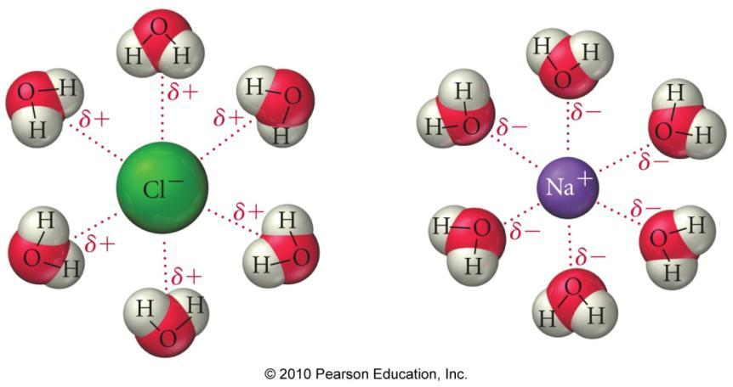
Ion–Dipole Attraction
In a mixture, ions from an ionic compound are attracted to the dipole of polar molecules.
The strength of the ion–dipole attraction is one of the main factors that determines the solubility of ionic compounds in water.

Slide 44
FLOWCHART OF INTERMOLECULAR FORCES
Interacting molecules or ions
Are polar Are ions Are polar
molecules involved? molecules
involved? and ions both
present?
Are hydrogen
atoms bonded to N,
O, or F atoms?
London forces Dipole-dipole hydrogen bonding Ion-dipole Ionic
only (induced forces forces Bonding
dipoles)
Examples: Examples: Examples Example: Examples:
Ar(l), I₂(s) H₂S, CH₃Cl liquid and solid KBr in NaCl,
H₂O, NH₃, HF H₂O NH₄NO₃
NO
NO
YES
NO
YES
Yes
YES
NO
Van der Waals forces

Slide 45
Liquids
Properties and
Structure

Slide 46
PROPERTIES OF LIQUIDS
1. VISCOSITY
- The resistance of a liquid to flow
- Depends on attractive forces between molecules
and structural features which cause greater
interaction (entanglement).
2. SURFACE TENSION
- The energy required to increase the surface area of a liquid by a unit amount (E/A)
- Due to interactions between molecules and the lack of interaction if there are no molecules to interact with.
- The layer of molecules on the surface behaves differently than the interior.
  because the cohesive forces on the surface molecules have a net pull into the liquid interior

Slide 47
1. Factors Affecting Viscosity
The stronger the intermolecular attractive forces, the higher the liquid’s viscosity will be.
The more spherical the molecular shape, the lower the viscosity will be.
  Molecules roll more easily.
  Less surface-to-surface contact lowers attractions.
Raising the temperature of a liquid reduces its viscosity.
  Raising the temperature of the liquid increases the average kinetic energy of the molecules.
  The increased molecular motion makes it easier to overcome the intermolecular attractions and flow.

Slide 48
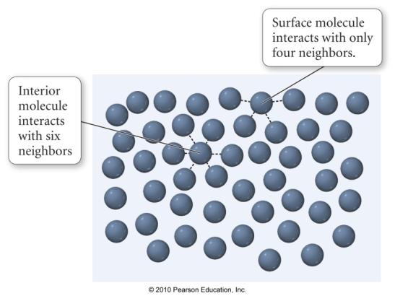
2. Surface Tension
Because they have fewer neighbors to attract them, the surface molecules are less stable than those in the interior.
  have a higher potential energy
The surface tension of a liquid is the energy required to increase the surface area a given amount.
  surface tension of H₂O = 72.8 mJ/m²
    at room temperature
  surface tension of C₆H₆ = 28 mJ/m²

Slide 49
Factors Affecting
Surface Tension
The stronger the intermolecular attractive forces, the higher the surface tension will be.
Raising the temperature of a liquid reduces its surface tension.
  Raising the temperature of the liquid increases the average kinetic energy of the molecules.
  The increased molecular motion makes it easier to stretch the surface.

Slide 50
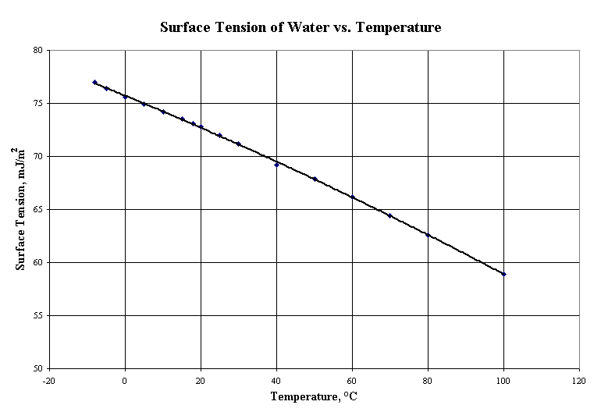

Slide 51
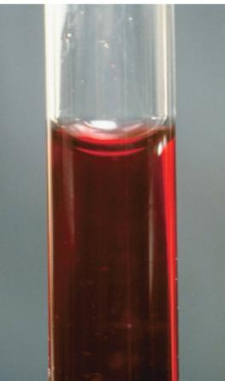
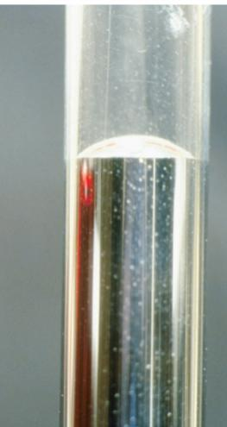
Meniscus
The curving of the liquid surface in a thin tube is due to the competition between adhesive and cohesive forces.
The meniscus of water is concave in a glass tube because its adhesion to the glass is stronger than its cohesion for itself.
The meniscus of mercury is convex in a glass tube because its cohesion for itself is stronger than its adhesion for the glass.
  Metallic bonds are stronger than intermolecular attractions.

Slide 52
VAPOR PRESSURE
The pressure exerted by a vapor in equilibrium with
its liquid or solid state.
1. Vapor pressure changes with intermolecular forces and temperature
2. Vapor pressure involves a dynamic equilibrium
liquid←→gas
3. Volatile vs nonvolatile
4. Clausius - Clapeyron equation
-relates vapor pressure and liquid temperature

Slide 53
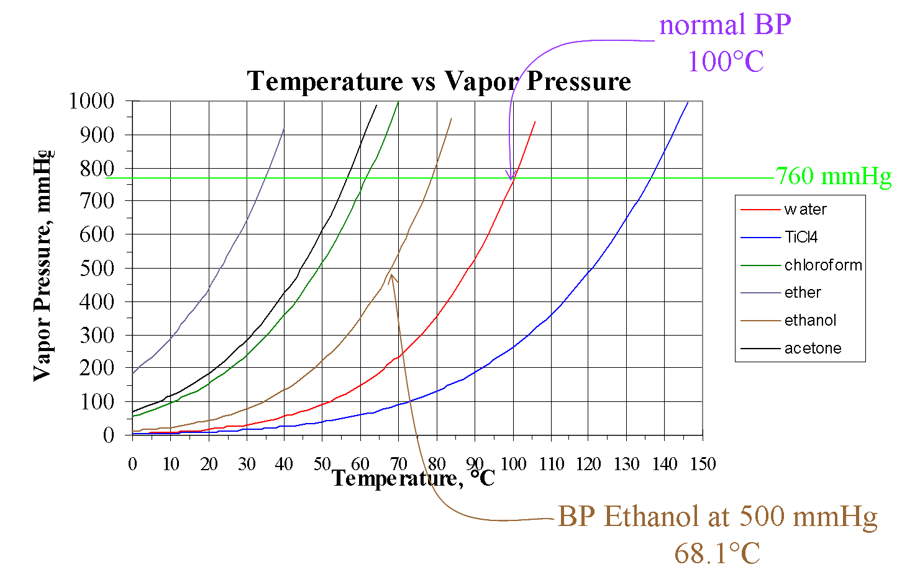
1. Vapor Pressure Curves

Slide 54
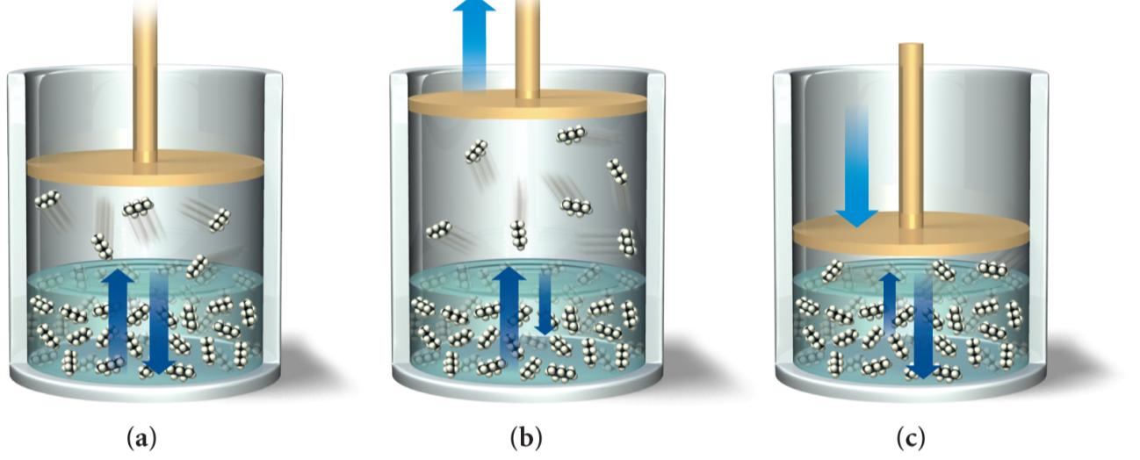
2. Changing the Container’s Volume Disturbs the Equilibrium
Initially, the rate of vaporization and condensation are equal and the system is in dynamic equilibrium.
When the volume is increased, the rate of vaporization becomes faster than the rate of condensation.
When the volume is decreased, the rate of vaporization becomes slower than the rate of condensation.

Slide 55
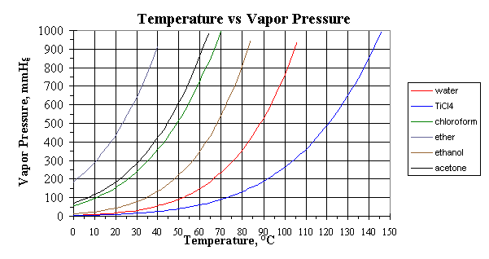
Practice—Which of the following is the most volatile?
  water
  TiCl₄
  ether
  ethanol
  acetone
  water
  TiCl₄
  ether
  ethanol
  acetone

Slide 56
Practice—Which of the following has the strongest intermolecular attractions?
  water
  TiCl₄
  ether
  ethanol
  acetone
  water
  TiCl₄
  ether
  ethanol
  acetone

Slide 57
Practice—Which of the following has the highest normal boiling point?
  water
  TiCl₄
  ether
  ethanol
  acetone
  water
  TiCl₄
  ether
  ethanol
  acetone

Slide 58
3. Effect of Intermolecular Attraction on Evaporation and Condensation
The weaker the attractive forces between molecules, the less energy they will need to vaporize.
Also, weaker attractive forces means that more energy will need to be removed from the vapor molecules before they can condense.
The net result will be more molecules in the vapor phase, and a liquid that evaporates faster—the weaker the attractive forces, the faster the rate of evaporation.
Liquids that evaporate easily are said to be volatile.
  e.g., gasoline, fingernail polish remover
  Liquids that do not evaporate easily are called nonvolatile.
    e.g., motor oil

Slide 59
4. CLAUSIUS - CLAPEYRON EQUATION
In general, the higher the temperature, the weaker the
intermolecular forces, and therefore the higher the vapor pressure. The non-linear relationship between vapor pressure and temperature is given by the Clausius - Clapeyron equation.
In P = (-ΔH_{vap}/RT) + C : a straight line if lnP vs. 1/T
It describes the amount of energy required to vaporize 1 mole of
molecules in the liquid state
R = 8.31 J/mol K T = Kelvin P = vapor pressure
In P₂ = -ΔH_{vap} 1 - 1
P₁ R T₂ T₁
Q. The vapor pressure of ethanol at 34.9ºC is 100.0 mmHg and at 78.5ºC it’s 760.0 mmHg. What is the heat of vaporization of ethanol?

Slide 60
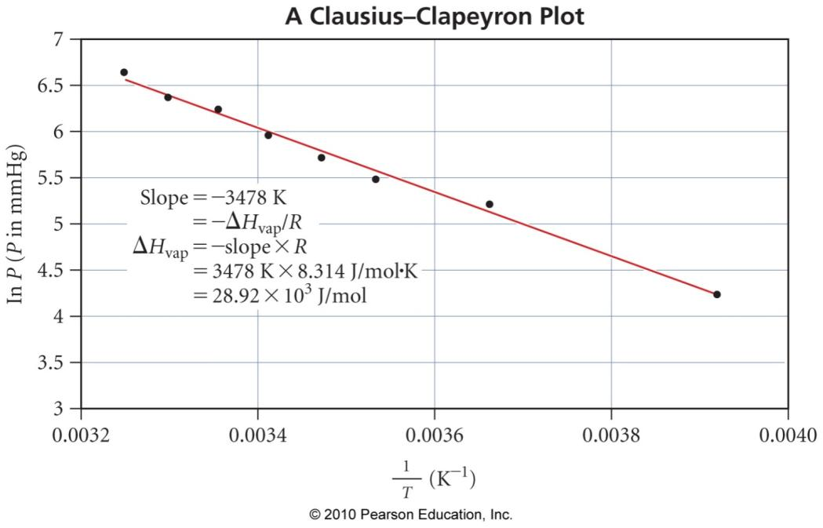
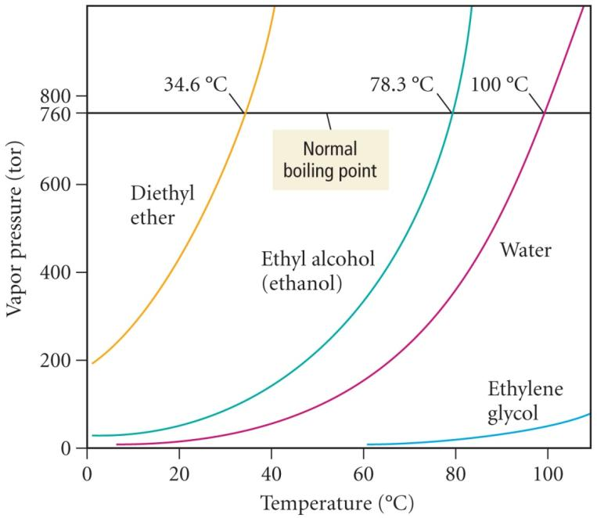
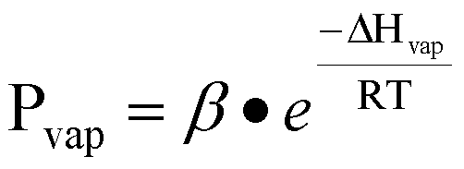
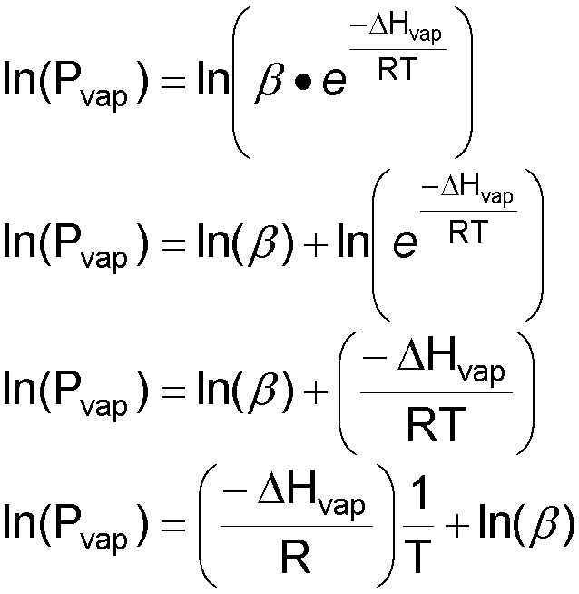
Clausius–Clapeyron Equation
A graph of ln(P_{vap}) vs. 1/T is a straight line.
the slope of the line × 8.314 J/mol∙K = ΔH_{vap}
  in J/mol
The graph of vapor pressure vs. temperature is an exponential growth curve.
The logarithm of the vapor pressure vs. inverse absolute temperature is a linear function.

Slide 61
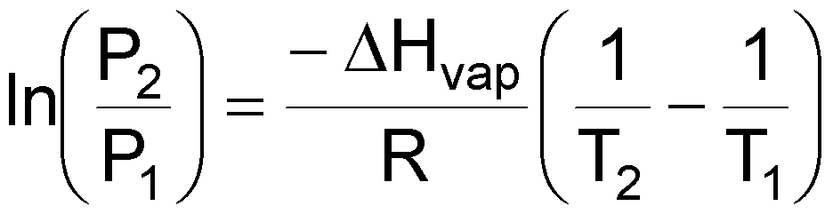
Clausius–Clapeyron Equation
Two-Point Form
The equation below can be used with just two measurements of vapor pressure and temperature.
  However, it generally gives less precise results.
    Fewer data points will not give as precise an average because there is less averaging out of the errors.
      as with any other sets of measurements
can also be used to predict the vapor pressure if you know the heat of vaporization and the normal boiling point
  Remember: the vapor pressure at the normal boiling point is 760 torr.

Slide 62
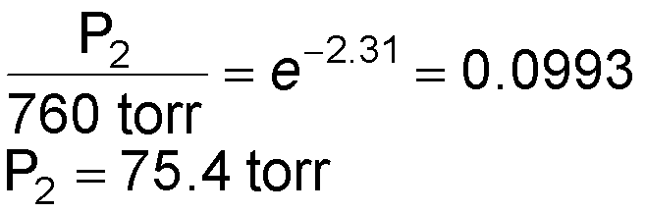
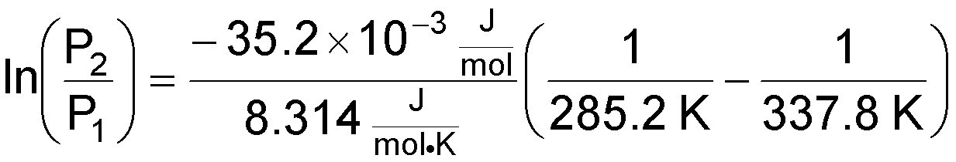


Example 11.5 Calculate the vapor pressure of methanol at 12.0 °C.
Given:
Find:
T₁ = BP = 64.6 °C, P₁ = 760 torr, ΔH_{vap} = 35.2 kJ/mol,
T₂ = 12.0 °C
P₂, torr
T₁ = BP = 337.8 K, P₁ = 760 torr, ΔH_{vap} = 35.2 kJ/mol,
T₂ = 285.2 K
P₂, torr
Conceptual Plan:
Relationships:
P₁, T₁, ΔH_{vap}
P₂
T(K) = T(°C) + 273.15
Solution:
Check:
The units are correct, and the size makes sense since the vapor pressure is lower at lower temperatures.

Slide 63




Calculate the vapor pressure of water at 25.0 °C.
Given:
Find:
T₁ = BP = 100.0 °C, P₁ = 760 torr, ΔH_{vap} = 40.7 kJ/mol,
T₂ = 25.0 °C
P₂, torr
T₁ = BP = 373.2 K, P₁ = 760 torr, ΔH_{vap} = 40.7 kJ/mol,
T₂ = 298.2 K
P₂, torr
Conceptual Plan:
Relationships:
P₁, T₁, ΔH_{vap}
P₂
T(K) = T(°C) + 273.15
Solution:
Check:
The units are correct, and the size makes sense since the vapor pressure is lower at lower temperatures.

Slide 64
SOLIDS
Properties and
Structure

Slide 65


Solids
Some solids have their particles arranged in an orderly geometric pattern—we call these crystalline solids.
  salt and diamonds
Other solids have particles that do not show a regular geometric pattern over a long range—we call these amorphous solids.
  plastic and glass

Slide 66


Slide 67
Crystal Lattice
When allowed to cool slowly, the particles in a liquid will arrange themselves to give the maximum attractive forces.
  therefore, minimize the energy
The result will generally be a crystalline solid.
The arrangement of the particles in a crystalline solid is called the crystal lattice.
The smallest unit that shows the pattern of arrangement for all the particles is called the unit cell.

Slide 68
Unit Cells
Unit cells are three-dimensional.
  usually containing two or three layers of particles
Unit cells are repeated over and over to give the macroscopic crystal structure of the solid.
Starting anywhere within the crystal results in the same unit cell.
Each particle in the unit cell is called a lattice point.
Lattice planes are planes connecting equivalent points in unit cells throughout the lattice.

Slide 69
7 Unit Cells
c
c
c
c
b
b
b
a
a
a
a
b
Cubic
a = b = c
all 90°
Tetragonal
a = c < b
all 90°
Orthorhombic
a ≠ b ≠ c
all 90°
Monoclinic
a ≠ b ≠ c
2 faces 90°
c
c
c
b
b
b
a
a
a
Hexagonal
a = c < b
2 faces 90°
1 face 120°
Rhombohedral
a = b = c
no 90°
Triclinic
a ≠ b ≠ c
no 90°

Slide 70
Unit Cells
The number of other particles each particle is in contact with is called its coordination number.
  For ions, it is the number of oppositely charged ions an ion is in contact with.
Higher coordination number means more interaction, therefore, stronger attractive forces holding the crystal together.
The packing efficiency is the percentage of volume in the unit cell occupied by particles.
  The higher the coordination number, the more efficiently the particles are packing together.

Slide 71

Cubic Unit Cells
all 90° angles between corners of the unit cell
lengths of all the edges are equal
if the unit cell is made of spherical particles
  ⅛ of each corner particle is within the cube
  ½ of each particle on a face is within the cube
  ¼ of each particle on an edge is within the cube

Slide 72
Cubic Unit Cells—
Simple Cubic
eight particles, one at each corner of a cube
⅛ of each particle lies in the unit cell
  each particle part of eight cells
  total = 1 particle in each unit cell
    8 corners × ⅛
edge of unit cell = twice the radius
coordination number of 6
2r

Slide 73



Simple Cubic

Slide 74

Cubic Unit Cells—
Body-Centered Cubic
nine particles, one at each corner of a cube + one in center
⅛ of each corner particle lies in the unit cell
  two particles in each unit cell
    8 corners × ⅛
    + 1 center
edge of unit cell = (4/√ 3) times the radius of the particle
coordination number of 8

Slide 75


Body-Centered Cubic

Slide 76

Cubic Unit Cells—
Face-Centered Cubic
14 particles, one at each corner of a cube + one in center of each face
⅛ of each corner particle + ½ of face particle lies in the unit cell
  four particles in each unit cell
    8 corners × ⅛
    + 6 faces × ½
edge of unit cell = 2√ 2 times the radius of the particle
coordination number of 12

Slide 77


Face-Centered Cubic

Slide 78



Example 11.6 Calculate the density of Al if it crystallizes in a fcc and has a radius of 143 pm.
Given:
Find:
face-centered cubic, V = 6.618 × 10^{–23} cm³, m = 1.792 × 10^{–22} g
density, g/cm³
face-centered cubic, r = 1.43 × 10^{–8} cm, m = 1.792 × 10^{–22} g
density, g/cm³
face-centered cubic, r = 143 pm
density, g/cm³
Conceptual Plan:
Relationships:
fcc
mass
r
l
V
# atoms × mass of 1 atom
l = 2r√2
V = l³
m, V
d
d = m/V
1 cm = 10² m, 1 pm = 10⁻¹² m
V = l³, l = 2r√2, d = m/V
fcc = 4 atoms/uc, Al = 26.982 g/mol, 1 mol = 6.022 × 10²³ atoms
Solution:
Check:
The accepted density of Al at 20 °C is 2.71 g/cm³, so the answer makes sense.

Slide 79
Closest-Packed Structures
First Layer
With spheres, it is more efficient to offset each row in the gaps of the previous row than to line up rows and columns.

Slide 80
Closest-Packed Structures—
Second Layer
The second-layer atoms can sit directly over the atoms in the first—called an AA pattern.
Or, the second layer can sit over the holes in the first—called an AB pattern.

Slide 81
Closest-Packed Structures—
Third Layer, with Offset 2nd Layer
The third-layer atoms can align directly over the atoms in the first—called an ABA pattern.
Or, the third layer can sit over the uncovered holes in the first—called an ABC pattern.
Cubic Closest-Packed
Face-Centered Cubic
Hexagonal Closest-Packed

Slide 82


Hexagonal Closest-Packed Structures

Slide 83


Cubic Closest-Packed Structures

Slide 84



Slide 85
CYRSTALLINE SOLIDS
Type of solid lattice site Type of force properties of examples
particle type between particles solids
IONIC positive & electrostatic high M.P. NaCl
negative ions attraction nonvolatile Ca(NO₃)₂
hard & brittle
poor conductor
POLAR polar dipole-dipole & moderate M.P. Sucrose,
MOLECULAR molecules London Dispersion moderate C₁₂H₂₂O₁₁
forces volatility Ice, H₂O
NONPOLAR Nonpolar London Dispersion low M.P., Argon, Ar,
MOLECULAR molecules & forces volatile Dry Ice, CO₂ atoms
MACRO- atoms covalent bonds extremely high Diamond, C
MOLECULAR between atoms M.P. nonvolatile Quartz, SiO₂
Covalent- Arranged in Very Hard
Network Network Poor conductor
METALLIC metal atoms attraction between variable M.P. Cu, Fe
outer electrons low volatility Al, W
and positive good conductor
atomic centers

Slide 86
TYPE OF MELTING POINT HARDNESS ELECTRICAL
SOLID OF SOLID & BRITTLENESS CONDUCTIVITY
Molecular Low soft & brittle Nonconducting
Metallic Variable Variable hardness, conducting
malleable
Ionic High to very hard & brittle Nonconducting
high solid
(conducting
liquid)
Covalent Very high Very hard Usually
Network nonconducting

Slide 87
CRYSTALLINE SOLIDS
- Composed of crystal lattices
- the geometric arrangement of lattice points of a crystal consists of unit cells
- smallest unit from which atoms can be stacked in 3-D
- unit cells (there are different types; see transparencies)
- edge lengths and angles are used to describe the unit cell
3 types of unit cells
- primitive (simple)
- body center cubic
- face centered cubic
- metals and salts are usually cubic
Ni = FCC Na=BCC NaCl=FCC
In FCC corners and face are shared with other units
Question: Determine the net number of ions in LiF (FCC)
Li⁺ = 1/4 (Li per edge) (12 edges) = 3
1 (center) (1 center) = 1
F⁻ = 1/8 (per corner) (8 corners) = 1
1/2 (face) (6 faces) = 3

Slide 88
Ionic Solids
lattice sites occupied by ions
held together by attractions between oppositely charged ions
  nondirectional
  Therefore, every cation attracts all anions around it, and vice versa.
The coordination number represents the number of close cation–anion interactions in the crystal.
The higher the coordination number, the more stable the solid.
  lowers the potential energy of the solid
The coordination number depends on the relative sizes of the cations and anions that maintains charge balance.
  Generally, anions are larger than cations.
  The number of anions that can surround the cation is limited by the size of the cation.
  The closer in size the ions are, the higher the coordination number is.

Slide 89


Ionic Crystals
CsCl
coordination number = 8
Cs⁺ = 167 pm
Cl─ = 181 pm
NaCl
coordination number = 6
Na⁺ = 97 pm
Cl─ = 181 pm

Slide 90
Lattice Holes
Tetrahedral
Hole
Octahedral
Hole
Simple Cubic
Hole

Slide 91
Lattice Holes
In hexagonal closest-packed or cubic closest-packed lattices, there are eight tetrahedral holes and four octahedral holes per unit cell.
In a simple cubic lattice, there is 1 cubic hole per unit cell.
Number and type of holes occupied determine formula (empirical) of the salt.
= Octahedral
= Tetrahedral

Slide 92
Cesium Chloride Structures
coordination number = 8
⅛ of each Cl─ (184 pm) inside the unit cell
whole Cs⁺ (167 pm) inside the unit cell
  cubic hole = hole in simple cubic arrangement of Cl─ ions
Cs:Cl = 1: (8 × ⅛)
Therefore, the formula is CsCl.

Slide 93

Rock Salt Structures
coordination number = 6
Cl─ ions (181 pm) in a face-centered cubic arrangement
  ⅛ of each corner Cl─ inside the unit cell
  ½ of each face Cl─ inside the unit cell
each Na⁺ (97 pm) in holes between Cl─
  octahedral holes
  1 in center of unit cell
  ¼ of each edge Na⁺ inside the unit cell
Na:Cl = (¼ × 12) + 1: (⅛ × 8) + (½ × 6) = 4:4 = 1:1
Therefore, the formula is NaCl.

Slide 94

Zinc Blende Structures
coordination number = 4
S^{2─} ions (184 pm) in a face-centered cubic arrangement
  ⅛ of each corner S^{2─} inside the unit cell
  ½ of each face S^{2─} inside the unit cell
each Zn²⁺ (74 pm) in holes between S^{2─}
  tetrahedral holes
  1 whole in ½ the holes
Zn:S = (4 × 1) : (⅛ × 8) + (½ × 6) = 4:4 = 1:1
Therefore, the formula is ZnS.

Slide 95

Fluorite Structures
coordination number = 4
Ca²⁺ ions (99 pm) in a face-centered cubic arrangement
  ⅛ of each corner Ca²⁺ inside the unit cell
  ½ of each face Ca²⁺ inside the unit cell
each F─ (133 pm) in holes between Ca²⁺
  tetrahedral holes
  1 whole in all the holes
Ca:F = (⅛ × 8) + (½ × 6): (8 × 1) = 4:8 = 1:2
Therefore, the formula is CaF₂.
  fluorite structure common for 1:2 ratio
usually get the antifluorite structure when the cation:anion ratio is 2:1
  The anions occupy the lattice sites and the cations occupy the tetrahedral holes.

Slide 96
Practice—Gallium arsenide crystallizes in a cubic closest-packed array of arsenide ions with gallium ions in ½ the tetrahedral holes. What is the ratio of gallium ions to arsenide ions in the structure and the empirical formula of the compound?
As = cpp = 4 atoms per unit cell
Ga = ½ (8 tetrahedral holes per unit cell)
Ga = 4 atoms per unit cell
Ga:As = 4 atoms:4 atoms per unit cell = 1:1
The formula is GaAs.

Slide 97
MOLECULAR SOLIDS
- frozen noble gases, Ne
- needs large number of atoms surrounding center for maximum attraction (see transparency)
- close packing arrangement variations:
-- hexagonal close-packing structure (ABABABA…); 6-unit cell (hcp)
-- cubic close-packed structure (ccp); ABC ABC ABC ...
Similar to FCC
Coordination number = the number of nearest neighbors; 12 for close-pack structures

Slide 98
Molecular Solids
The lattice sites are occupied by molecules.
  CO₂, H₂O, C₁₂H₂₂O₁₁
The molecules are held together by intermolecular attractive forces.
  dispersion forces, dipole–dipole attractions, and H-bonds
Because the attractive forces are weak, they tend to have low melting points.
  generally <300 °C

Slide 99
Nonbonding Atomic Solids
noble gases in solid form
solid held together by weak dispersion forces
  very low melting
tend to arrange atoms in closest-packed structure
  either hexagonal cp or cubic cp
  maximizes attractive forces and minimizes energy

Slide 100
METALLIC SOLIDS
- sea of electrons; delocalized (bonding is non-directional)
-many metals are cubic or hexagonal close-packed crystals
COVALENT NETWORK
-directional covalent bonds
-diamond, Si, Ge, gray Sn are tetrahedral, sp3 hybridized, FCC
-graphite is hexagonal flat sheets; sp2 hybridized; electrical properties are due to the increased delocalization of the electrons.

Slide 101
Metallic Atomic Solids
solid held together by metallic bonds
  strength varies with sizes and charges of cations
    coulombic attractions
melting point varies
mostly closest-packed arrangements of the lattice points
  cations

Slide 102

Metallic Structure

Slide 103

Metallic Bonding
metal atoms release their valence electrons
metal cation “islands” fixed in a “sea” of mobile electrons
+
+
+
+
+
+
+
+
+
e⁻
e⁻
e⁻
e⁻
e⁻
e⁻
e⁻
e⁻
+
+
+
+
+
+
+
+
+
e⁻
e⁻
e⁻
e⁻
e⁻
e⁻
e⁻
e⁻
+
+
+
+
+
+
+
+
+

Slide 104
Crystal Structure of Metals at Room Temperature
= body-centered cubic
= other
= hexagonal closest
packed
= cubic cp, face-centered
= diamond

Slide 105
Network Covalent Solids
Atoms are attached to the nearest neighbors by covalent bonds.
Because of the directionality of the covalent bonds, these do not tend to form closest-packed arrangements in the crystal.
Because of the strength of the covalent bonds, these have very high melting points.
  generally >1000 °C
The dimensionality of the network affects other physical properties.

Slide 106
The Diamond Structure— a Three-Dimensional Network
The carbon atoms in a diamond each have four covalent bonds to surrounding atoms.
  sp³
  tetrahedral geometry
This effectively makes each crystal one giant molecule held together by covalent bonds.
  You can follow a path of covalent bonds from any atom to every other atom.

Slide 107

Properties of Diamond
very high melting, ~3800 °C
  need to overcome some covalent bonds
very rigid
  due to the directionality of the covalent bonds
very hard
  due to the strong covalent bonds holding the atoms in position
  used as abrasives
electrical insulator
thermal conductor
  best known
chemically very nonreactive

Slide 108
The Graphite Structure— a Two-Dimensional Network
In graphite, the carbon atoms in a sheet are covalently bonded together.
  forming six-membered flat rings fused together
    similar to benzene
    bond length = 142 pm
  sp²
    Each C has three sigma bonds and one pi bond.
  trigonal-planar geometry
  each sheet a giant molecule
The sheets are then stacked and held together by dispersion forces.
  Sheets are 341 pm apart.

Slide 109

Properties of Graphite
hexagonal crystals
high melting, ~3800 °C
  need to overcome some covalent bonding
slippery feel
  Because there are only dispersion forces holding the sheets together, they can slide past each other.
    glide planes
  lubricants
electrical conductor
  parallel to sheets
thermal insulator
chemically very nonreactive

Slide 110
X-RAY DIFFRACTION
- Determining crystal structure
x-ray diffraction used to obtain structure of
proteins (1962 Nobel Prize myoglobin) &
hemoglobin
- Due to order structure - crystals consists of repeating planes
- Planes act as reflecting surfaces
- X-ray reflecting off surface creates diffraction pattern
constructive interference gives more intense (higher
amplitude) weaves.
- only at certain angles will x-rays stay in-phase
- creates light and dark areas on photographs
- used to determine type of unit cell and size
- if molecular, then can determine position of each atom
nλ = 2d sin θ Bragg’s equation
d=distance between atomic planes θ =angle of reflection

