Slide 1
      Chemical Bonding: Putting it Together
1. chemical bond:
-ionic bond:
-covalent bond:
-Electronegativity:
-Polar Covalent:
2. octet rule:
EXCEPTIONS
3. Lewis dot structure
Formal Charge:
Resonance:
Isomers:
4. Types of Bonds:
-Single vs. double
vs.triple bonds:
-Bond Strength:
-Bond Length:
5. VSEPR Model
6. Polarity of Molecules
7. Valence Bond Theory
8. M.O. Theory

Slide 2
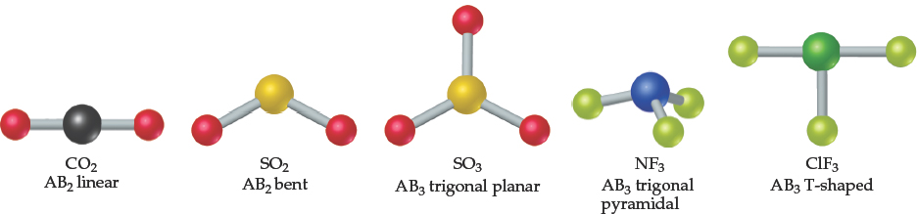
Molecular Shapes - Review
Lewis structures show bonding and lone pairs but do not denote shape.
However, we use Lewis structures to help us determine shapes.
Here we see some common shapes for molecules with two or three atoms connected to a central atom.

Slide 3
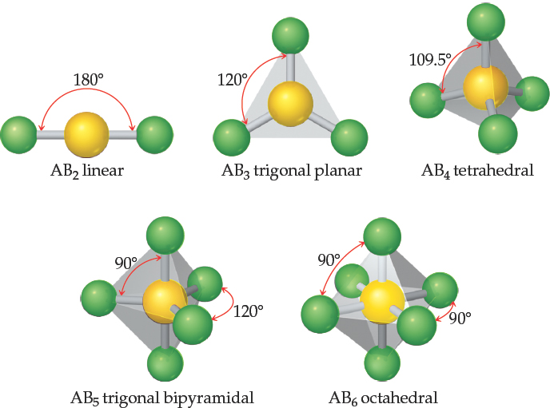
What Determines the Shape of a Molecule?
The bond angles and bond lengths determine the shape and size of molecules.
Electron pairs repel each other.
Electron pairs are as far apart as possible; this allows predicting the shape of the molecule.
This is the valence-shell electron-pair repulsion (V S E P R) model.

Slide 4
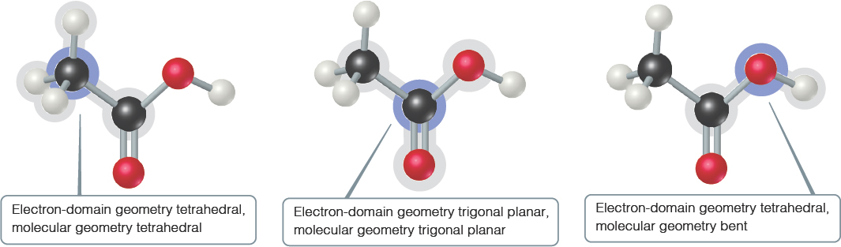
Shapes of Larger Molecules
For larger molecules, look at the geometry about each atom rather than the molecule as a whole.

Slide 5
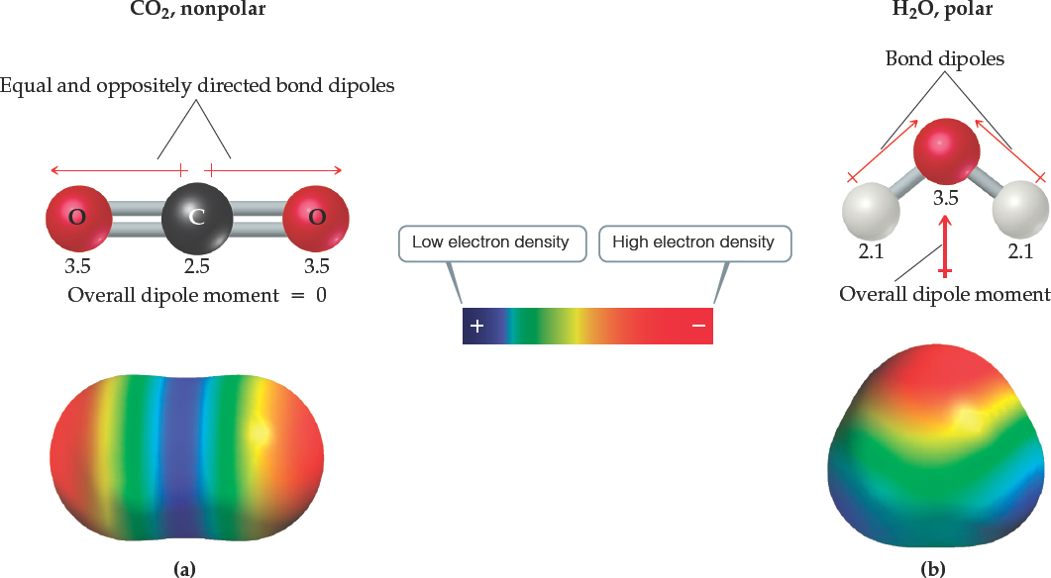
Comparison of the Polarity of Two Molecules
A nonpolar molecule
A polar molecule

Slide 6
Valence Bond Theory
Based on Quantum Mechanics, it is an approximation theory that tries to explain the electron pair or covalent bond using quantum mechanics.
A bond will form if:
(1) an orbital on one atom comes to occupy a portion of the same region of space as an orbital on the other atom. “orbitals overlap”
(2) the total number of electrons in both orbitals is no more than 2.
(3) the strength of a bond depends on the amount of overlap.
“the greater the overlap=the greater the strength”
(4) the electrons are attracted to both nuclei thus pulling the atoms together.

Slide 7
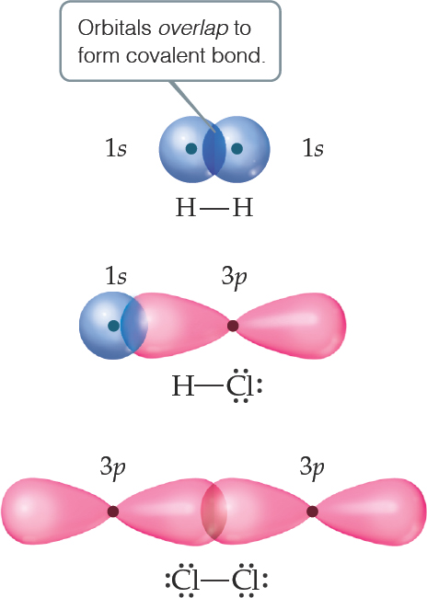
Valence-Bond Theory (1 of 2)
In valence-bond theory, electrons of two atoms begin to occupy the same space.
This is called “overlap” of orbitals.
The sharing of space between two electrons of opposite spin results in a covalent bond.

Slide 8
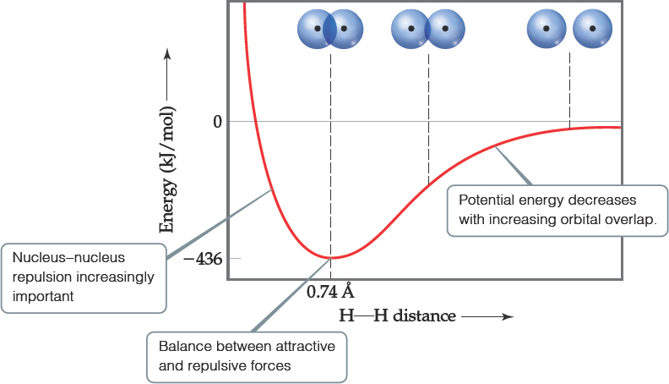
Valence-Bond Theory (2 of 2)
Increased overlap brings the atoms together until a balance is reached between the like charge repulsions and the electron-nucleus attraction.
Atoms can’t get too close because the internuclear repulsions get too great.

Slide 9
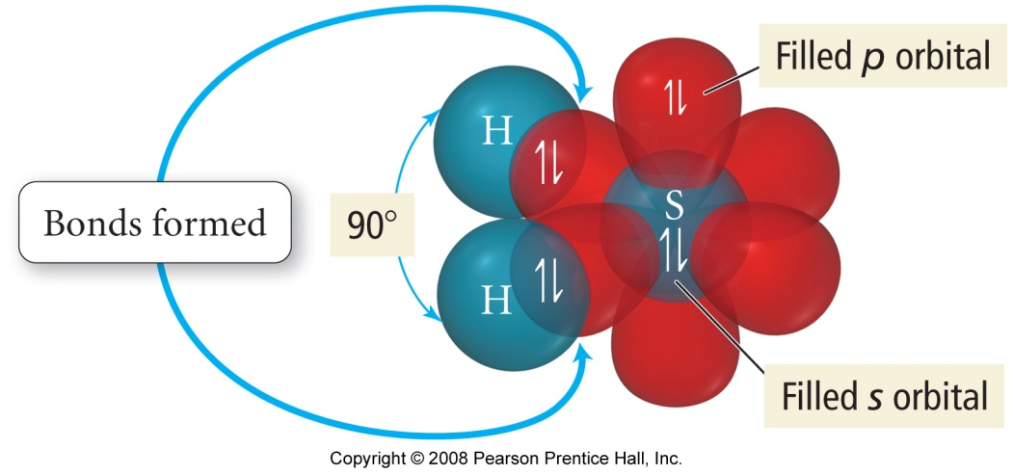
Orbital Diagram for the
Formation of H₂S
H
↑↓
H-S bond
1s
↑
+
↑↓
↑
↑
↑↓
S
1s
↑
3s
3p
↑↓
H-S bond
H
Predicts Bond Angle = 90°
Actual Bond Angle = 92°

Slide 10
Hybrid Orbitals
Hybridization:
Hybrid orbitals are orbitals used to describe the bonding that is obtained by taking combinations of atomic orbitals of the isolated atoms.
CH₄
C ___ ____ ____ ____ → ___ ___ ___ ___
s p hybridzation sp³
Rule:
The number of hybrid orbitals formed always equal the number of atomic orbitals used.

Slide 11
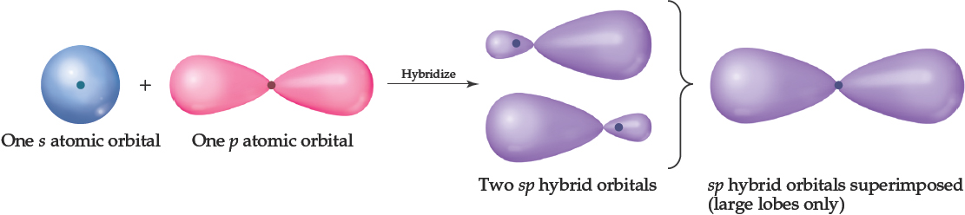
s p Orbitals
Mixing the s and p orbitals yields two degenerate orbitals that are hybrids of the two orbitals.
The s p hybrid orbitals each have two lobes like a p orbital.
One of the lobes is larger and more rounded, as is the s orbital.

Slide 12
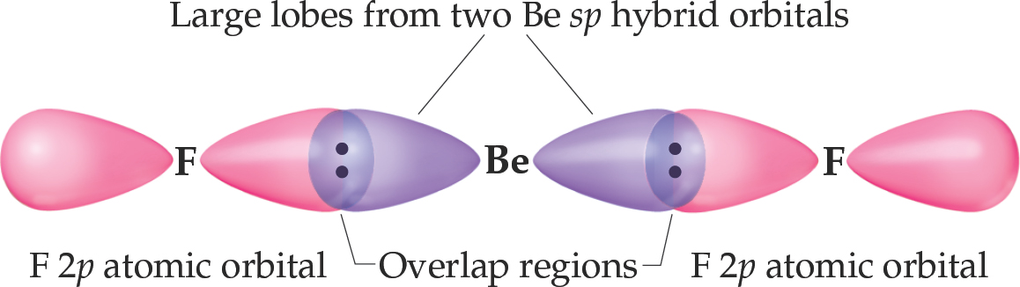
Position of sp Orbitals
These two degenerate orbitals would align themselves 180° from each other.
This is consistent with the observed geometry of B e compounds (like B e F₂) and V S E P R: linear.

Slide 13
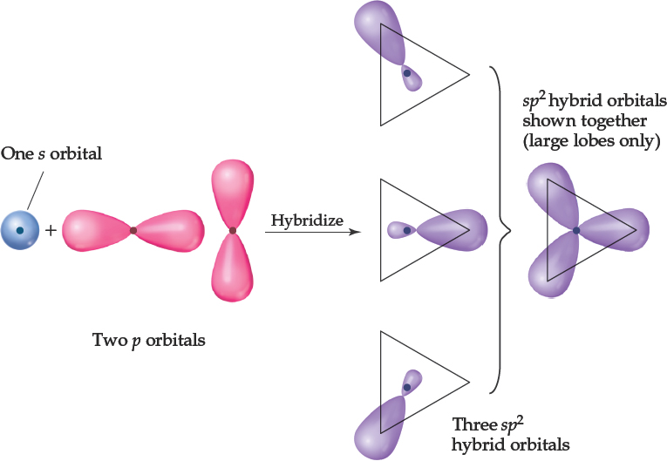
Boron—Three Electron Domains Gives sp² Hybridization
Using a similar model for boron leads to three degenerate

Slide 14
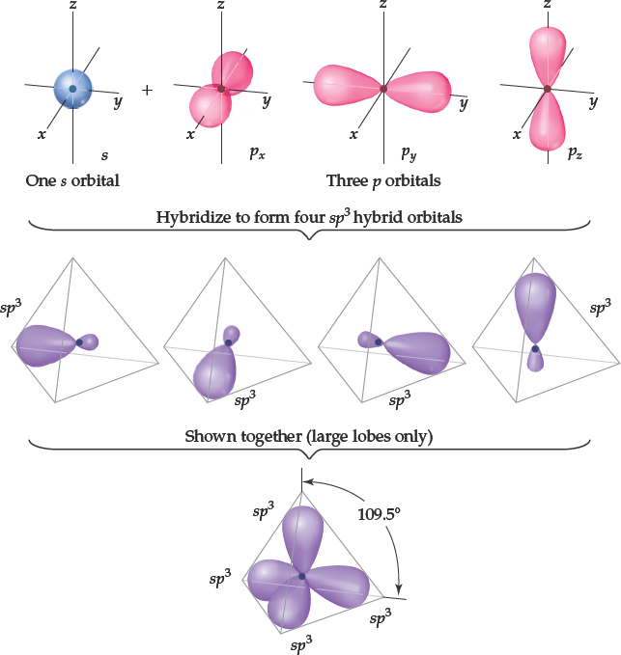
Carbon: sp³ Hybridization
With carbon, we get four degenerate

Slide 15
Carbon Hybridizations
Unhybridized
↑↓
↑
↑
2s
2p
sp hybridized
↑
↑
↑
↑
2sp
2p
sp² hybridized
↑
↑
↑
↑
2sp²
2p
sp³ hybridized
↑
↑
↑
↑
2sp³

Slide 16
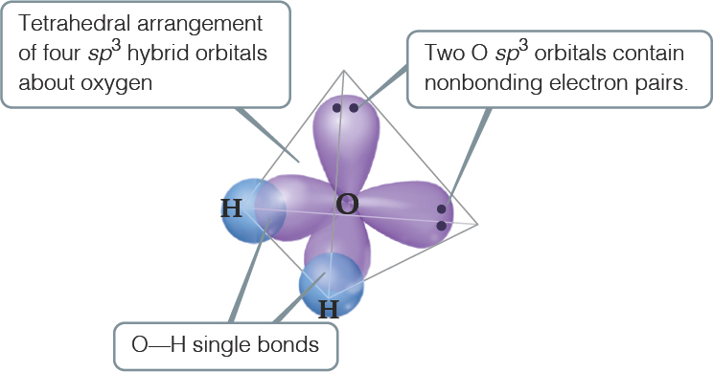
What Happens with Water?
We started this discussion with H₂O and the angle question: Why is it 104.5 degrees instead of 90 degrees?
Oxygen has two bonds and two lone pairs—four electron domains.
The result is
hybridization!

Slide 17
Hybrid Orbitals
Draw the Lewis structure
Use VSEPR for molecular geometry
From the geometry, deduce the type of hybrid orbital on the central atom.
Assign electrons to hybrid orbitals of the central atom, one at a time, pairing only if necessary.
Form bonds to the central atom by overlapping singularly occupied orbitals of outer atoms to the central atom.

Slide 18
Hypervalent Molecules
The elements that have more than an octet
Valence-bond model would use d orbitals to make more than four bonds.
This view works for period 3 and below.
Theoretical studies suggest that the energy needed would be too great for this.
A more detailed bonding view is needed than we will use in this course.

Slide 19
While VSEPR provides a simple means for predicting shapes of molecules, it does not explain why bonds exist between atoms. Instead, lets turn to Valence Bond Theory, relying on hybridization to further describe the overlap of atomic orbitals that form molecular orbitals:
Atomic Orbital Set Hybrid Orbital Set Electronic Geometry s, p Two sp Linear
s, p, p Three sp² Trigonal Planar
s, p, p, p Four sp³ Tetrahedral
s, p, p, p, d Five sp³d Trigonal Bipyramidal s, p, p, p, d, d Six sp³d² Octahedral
Each single bond in a molecule represents a σ bond; each subsequent bond within each single (σ) bond represents a π bond. Once the framework of a molecule is set up using the appropriate hybrid orbitals for σ bonds, the remaining orbitals may mix together to form π bonds.

Slide 20
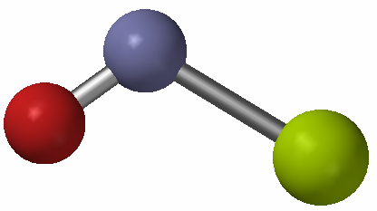
Practice - Predict the Hybridization and Bonding Scheme of All the Atoms in NClO
N = 3 electron groups = sp²
O = 3 electron groups = sp²
Cl = 4 electron groups = sp³

Slide 21
Determine the hybridization of the following
HF H₂O
NH₃ BeF₂
BCl₃ PCl₅
XeF₄ N₂F₄

Slide 22
MULTIPLE BONDS
One hybrid orbital is needed for each bond whether single or multiple and for each lone pair.
σ (sigma) bond:
Cylindrical shape about the bond axis. It is either composed of 2 “s” orbitals overlapping or directional orbitals overlapping along the axis.
π (pi) bonds:
The electron distribution is above & below the bond axis and forms a sideways overlap of two parallel “p” orbitals.
Draw the valence bond sketch and give the hybridization for the following:
C₂H₄ N₂H₂ ClF₂⁻
C₂F₂Cl₂ CH₂O

Slide 23
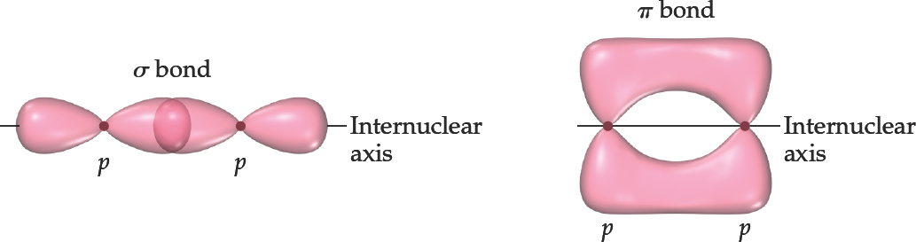
Sigma (σ) and Pi (π) Bonds
Sigma bonds are characterized by
head-to-head overlap.
cylindrical symmetry of electron density about the internuclear axis.
Pi bonds are characterized by
sideways overlap.
electron density above and below the internuclear axis.

Slide 24
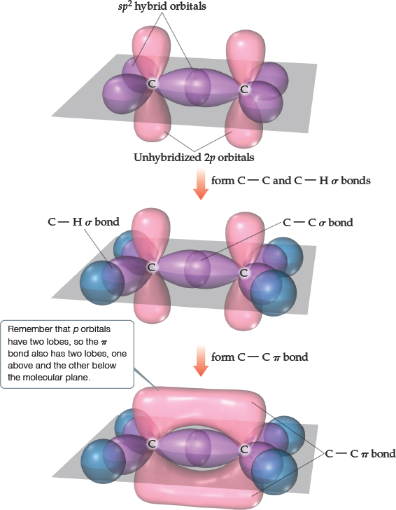
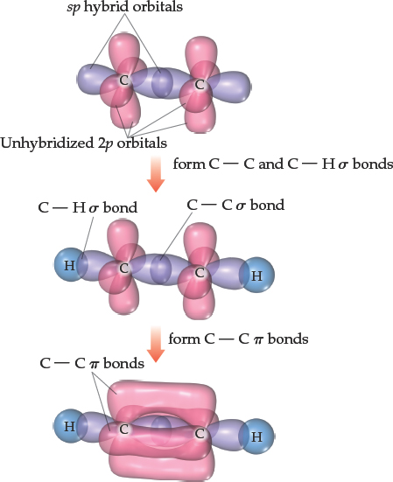
Bonding in Molecules
Single bonds are always
Multiple bonds have one
all other bonds are

Slide 25
Localized or Delocalized Electrons
Bonding electrons
that are specifically shared between two atoms are called localized electrons.
In many molecules, we can’t describe all electrons that way (resonance); the other electrons (shared by multiple atoms) are called delocalized electrons.

Slide 26
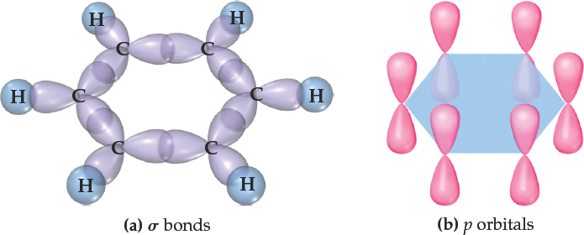
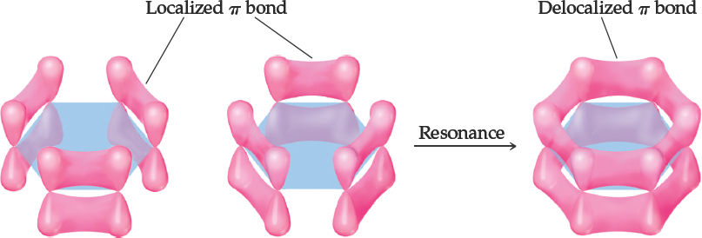
Benzene
The organic molecule benzene
has
and a p
orbital on each C atom, which form delocalized bonds using one electron from each p orbital.

Slide 27
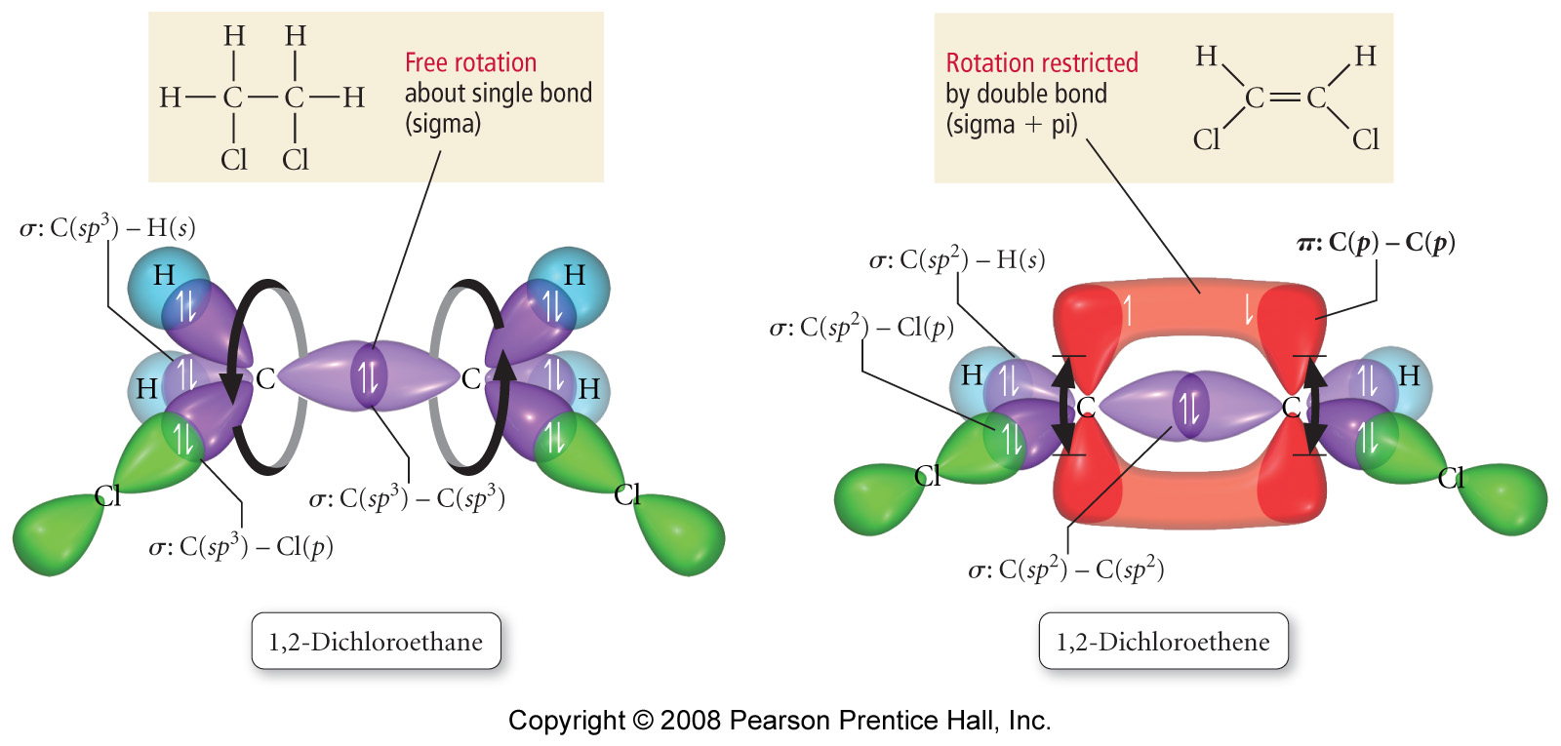

Slide 28
Workshop on hybridization
Determine the hybridization of the central atom. How many sigma (σ) and pi (π) bonds are contained within each compound?
A. carbon tetrabromide B. AsH₃
C. formate ion, HCO₂⁻ D. ethanol
E. CH₃NH₂ F. CN⁻
G. SF₆ H. XeF₄
I. ClF3 J. AsF₅
K. AsO₄⁻³ L. IO₄⁻
M. Sulfuric Acid N. Phosphoric Acid
O. CH₂Br₂ P. CS₂
Q. NO₂⁻ R. PCl₃
S. C₂H₂Br₂

Slide 29
Failures of Valence Bond Theory
Assumed the electrons were localized; did not account for resonance.
Assumed radicals do not exist; all electrons were paired.
Gave no information on bond energies; did not explain the following general trends:
(i) An increase in bond coenergy rresponded to an increase in bond order
(ii) A decrease in bond length corresponds to an increase in bond order.

Slide 30
Molecular Orbital (M O) Theory (1 of 2)
Wave properties are used to describe the energy of the electrons in a molecule.
Molecular orbitals have many characteristics like atomic orbitals:
Maximum of two electrons per orbital
Electrons in the same orbital have opposite spin
Definite energy of orbital
Can visualize electron density by a contour diagram

Slide 31
More on M O Theory
They differ from atomic orbitals because they represent the entire molecule, not a single atom.
Whenever two atomic orbitals overlap, two molecular orbitals are formed: one bonding, one antibonding.
Bonding orbitals are constructive combinations of atomic orbitals.
Antibonding orbitals are destructive combinations of atomic orbitals. They have a new feature unseen before: A nodal plane occurs where electron density equals zero.

Slide 32
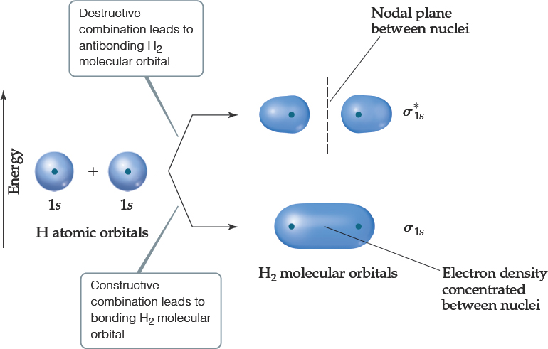
Molecular Orbital (M O) Theory (2 of 2)
Whenever there is direct overlap of orbitals, forming a bonding and an antibonding orbital, they are called sigma (σ) molecular orbitals. The antibonding orbital is distinguished with an asterisk as
Here is an example for the formation of a hydrogen molecule from two atoms.

Slide 33
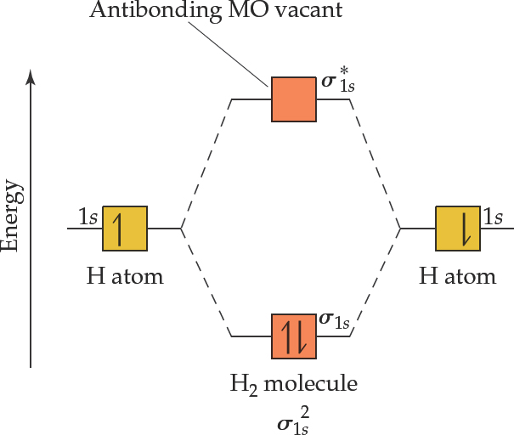
M O Diagram
An energy-level diagram, or M O diagram, shows how orbitals from atoms combine to form molecular orbitals.
In
the two electrons go into the bonding molecular orbital (lower in energy).

Slide 34
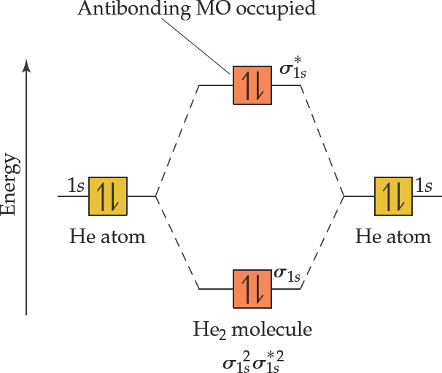
Can H e₂ Form? Use M O Diagram and Bond Order to Decide!
Therefore He₂ does not exist.

Slide 35
Molecular Orbital Theory
Just as atomic orbitals are solutions to the quantum mechanical treatment of atoms, molecular orbitals (MO’s) are solutions to the molecular problem. Hence, another method often used to describe bonding is the molecular orbital model. In this model, the electrons are assumed to be delocalized rather than always located between a given pair of atoms (i.e. the orbitals extend over the entire molecule).
There is still one fundamental difficulty encountered with this model when dealing with polyelectronic atoms – the electron correlation problem. Since one cannot account for the details of the electron movements, one cannot deal with the electron-electron interactions in a specific way. We can only make approximations that allow the solution of the problem but do not destroy the model’s physical integrity. The success of these approximations can only be measured by comparing predictions from the theory with experimental observations.

Slide 36
Guiding Principles for the Formation of Molecular Orbitals
The number of M O s formed equals the number of A O s combined.
A O s combine with A O s of similar energy.
The effectiveness with which two A O s combine is proportional to their overlap.
Each M O can accommodate at most two electrons with opposite spin. (They follow the Pauli exclusion principle.)
When M O s of the same energy are populated, one electron enters each orbital (same spin) before pairing. (They follow Hund’s rules.)

Slide 37
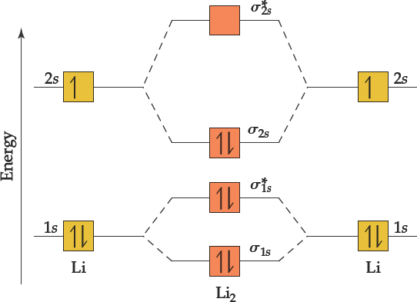
M O s, Bonding, and Core Electrons
occurs at high temperatures.
Lewis structure:
The M O diagram is on the right.
Notice that core electrons don’t play a major part in bonding, so we usually don’t include them in the M O diagram.

Slide 38
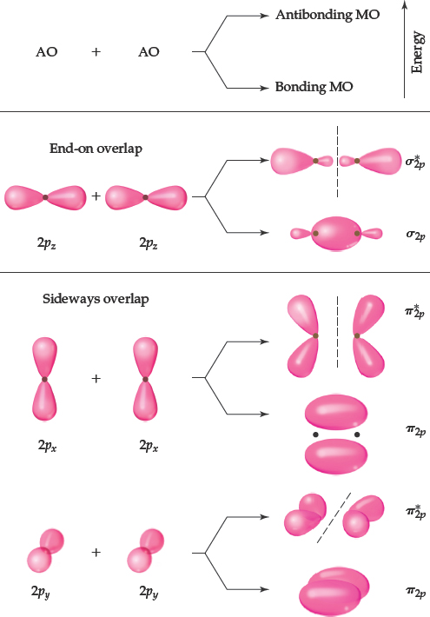
M O s from p-Orbitals
p-orbitals also undergo overlap.
They result in either direct or sideways overlap.

Slide 39
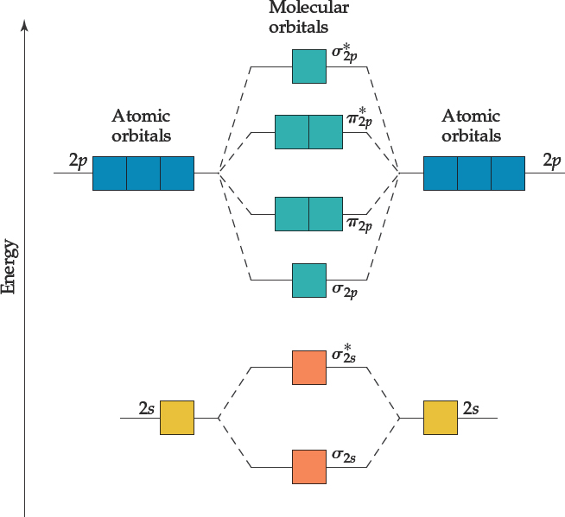
M O Diagrams for the Second Period p-Block Elements
There are σ and
orbitals from s and p atomic orbitals.
There are π and
orbitals from p atomic orbitals.
Since direct overlap is stronger, the effect of raising and lowering energy is greater for σ and

Slide 40
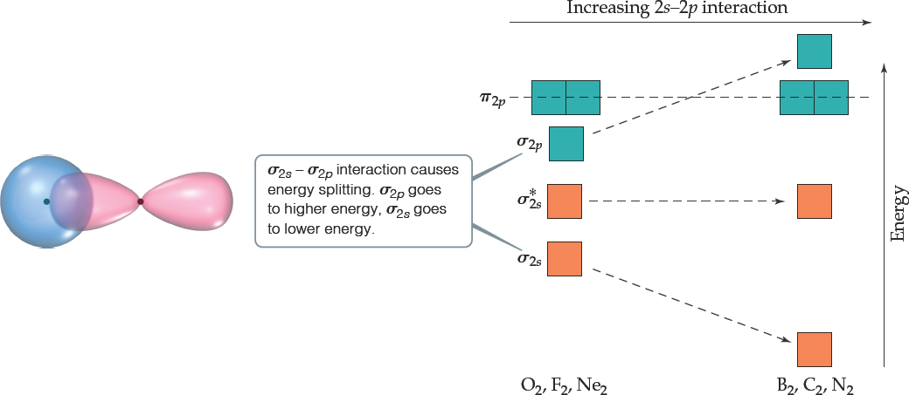
s and p Orbital Interactions
In some cases, s orbitals can interact with the p_{z} orbitals more than the p_{x} and p_{y} orbitals.
It raises the energy of the p_{z} orbital and lowers the energy of the s orbital.
The p_{x} and p_{y} orbitals are degenerate orbitals.

Slide 41
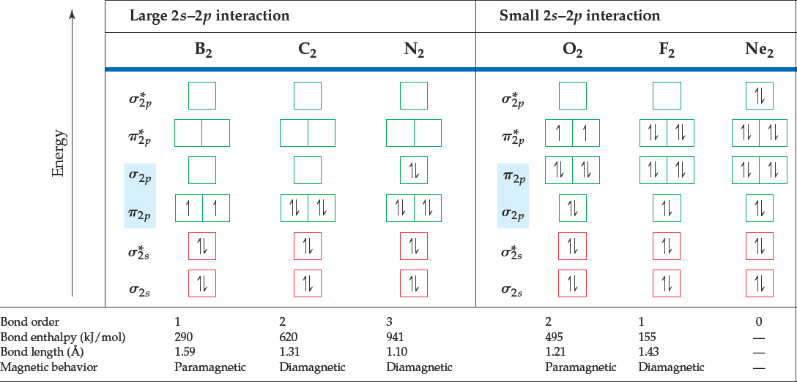
M O Diagrams for Diatomic Molecules of Second Period Elements

Slide 42
M O Diagrams and Magnetism
Diamagnetism is the result of all electrons in every orbital being spin-paired. These substances are weakly repelled by a magnetic field.
Paramagnetism is the result of the presence of one or more unpaired electrons in an orbital.
Is oxygen
paramagnetic or diamagnetic? Look back at the M O diagram! It is paramagnetic.

Slide 43
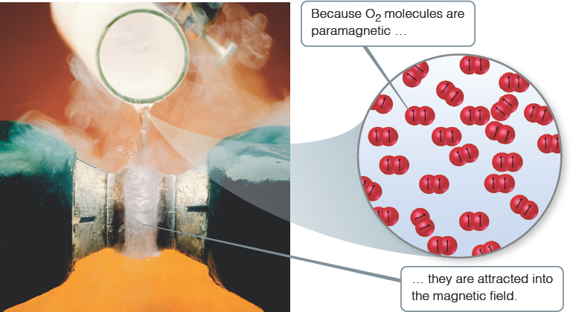
Paramagnetism of Oxygen
Lewis structures would not predict that
is paramagnetic.
The M O diagram clearly shows that
is paramagnetic.
Both show a double bond (bond order = 2).

Slide 44
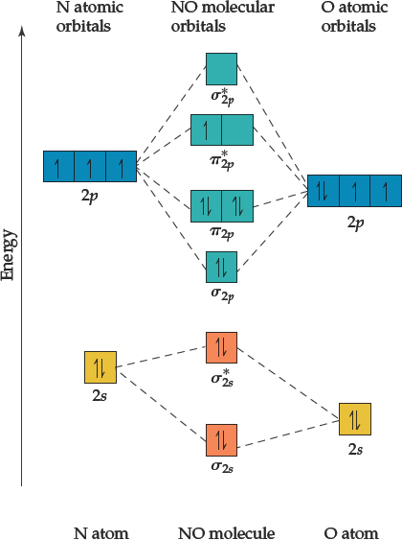
Heteronuclear Diatomic Molecules
Diatomic molecules can consist of atoms from different elements.
How does a M O diagram reflect differences?
The atomic orbitals have different energy, so the interactions change slightly.
The more electronegative atom has orbitals lower in energy, so the bonding orbitals will more resemble them in energy.

Slide 45
Molecular Orbital Theory
A theory of the electronic structure of molecules in terms of molecular orbitals, that may spread over several atoms or the entire molecule.
Assumes electronic structure of molecules mimics electronic structure of atoms.
Uses rules similar to Pauli Exclusion Principle.
Molecular orbitals are a combination of atomic orbitals.
Orbital interactions are dependent on
(a) energy difference between orbitals
(b) magnitude of overlap

Slide 46
Molecular Orbital Theory
H + H → H – H
1s¹ 1s¹ 1s²
Ψ_{1s} + Ψ_{1s} ≡ electrons found between 2 nuclei » Bonding orbitals!
Ψ_{1s} - Ψ_{1s} ≡ electrons found eleswhere » Antibonding orbitals *
_{ground state}
___
___ σ_{1s}* ____
1s ___ 1s
σ_{1s}

Slide 47
The following vocabulary terms are crucial in terms of understanding of Molecular Orbital (MO) Theory. Consider the following:
1. bonding molecular orbitals: lower in energy than the atomic orbitals of which it is composed. Electrons in this type of orbital favor the molecule; that is, they will favor bonding.
2. antibonding molecular orbitals: higher in energy than the atomic orbitals of which it is composed. Electrons in this type of orbital will favor the separated atoms. Unstable but can exist!

Slide 48
Consider the MO diagrams for the diatomic molecules and ions of the first-period elements:

Slide 49
The following vocabulary terms are crucial in terms of understanding of Molecular Orbital (MO) Theory. Consider the following:
3. bond order: the difference between the number of bonding electrons and the number of antibonding electrons, divided by 2. Bond order is an indication of strength.
B.O. = ½ (n_{b} – n_{a})
n_{b} = the number of bonding electrons
n_{a} = number of antibonding electrons
“Larger bond orders indicate greater bond strength.”

Slide 50
The following vocabulary terms are crucial in terms of understanding of Molecular Orbital (MO) Theory. Consider the following:
4. sigma (σ) molecular orbitals: The electron probability of both bonding and antibonding molecular orbitals is centered along the line passing through the two nuclei, where the electron probability is the same along any line drawn perpendicular to the bond axis at a given point on the axis. They are designated σ_{s} for the bonding MO and σ_{s}* for the antibonding MO.
5. pi (π) molecular orbitals: p orbitals that overlap in a parallel fashion also produce bonding and antibonding orbitals, where the electron probability lies above and below the line between the nuclei. They are designated π_{p} for the bonding MO and π_{p}* for the antibonding MO.

Slide 51
The following are some useful ideas about molecular orbitals and how electrons are assigned to them:
1. The number of MOs formed is equal to the number of atomic orbitals combined.
2. Of the two MOs formed when two atomic orbitals are combined, one is a bonding MO at a lower energy than the original atomic orbitals. The other is an antibonding MO at a higher energy.
3. In ground-state configurations, electrons enter the lowest energy MOs available.
4. The maximum number of electrons in a given MO is two (Pauli Exclusion Principle).
5. In ground-state configurations, electrons enter MOs of identical energies singly before pairing begins (Hund’s Rule).

Slide 52
Consider one of the possible molecular orbital energy-level diagram for diatomic molecules of the second-period elements:
σ_{1s}² σ_{1s}^{*2} σ_{2s}² σ_{2s}^{*2} π_{2p}⁴ σ_{2p}² π_{2p}^{*4} σ_{2p}^{*2}
Z < 7

Slide 53
The other possible molecular orbital energy-level diagrams for diatomic molecules of the second-period elements:
Z > 8

Slide 54
What if the two diatomic elements (or ions) are different? Then you must take electronegativity into account when constructing the molecular orbital energy diagram:
Finally, consider a diatomic molecule where one of the bonded atoms is hydrogen:

Slide 55
For the following give:
  MO configuration & diagram
  Bond order
  Paramagnetic or diamagnetic?
(homonuclear):
O₂ F₂ Mg₂
CO CO⁺ CO⁻
NO NO⁺ NO⁻
(heteronuclear): HF
(delocalization): O₃ C₆H₆

Slide 56
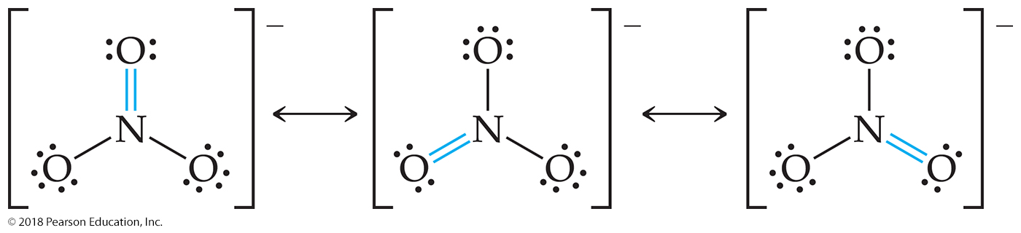
Sample Exercise 9.7 Delocalized Bonding
Describe the bonding in the nitrate ion, NO₃–. Does this ion have delocalized π bonds?
Solution
Analyze Given the chemical formula for a polyatomic anion, we are asked to describe the bonding and determine whether the ion has delocalized π bonds.
Plan Our first step is to draw Lewis structures. Multiple resonance structures involving the placement of the double bonds in different locations would suggest that the π component of the double bonds is delocalized.
Solve In Section 8.6 we saw that NO₃– has three resonance structures:
In each structure, the electron-domain geometry at nitrogen is trigonal planar, which implies sp² hybridization of the N atom. It is helpful when considering delocalized π bonding to consider atoms with lone pairs that are bonded to the central atom to be sp² hybridized as well. Thus, we can envision that each of the O atoms in the anion has three sp² hybrid orbitals in the plane of the ion. Each of the four atoms has an unhybridized p orbital oriented perpendicular to the plane of the ion.

Slide 57
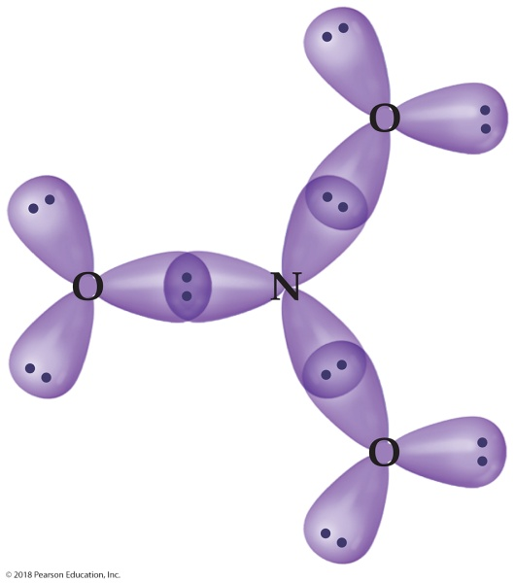
Sample Exercise 9.7 Delocalized Bonding
Continued
The NO₃– ion has 24 valence electrons. We can first use the sp² hybrid orbitals on the four atoms to construct the three N — O σ bonds. That uses all of the sp² hybrids on the N atom and one sp² hybrid on each O atom. Each of the two remaining sp² hybrids on each O atom is used to hold a nonbonding pair of electrons. Thus, for any of the resonance structures, we have the following arrangement in the plane of the ion:
Notice that we have accounted for a total of 18 electrons—6 in the three N — O σ bonds, and 12 as nonbonding pairs on the O atoms. The remaining six electrons will reside in the π system of the ion.

Slide 58
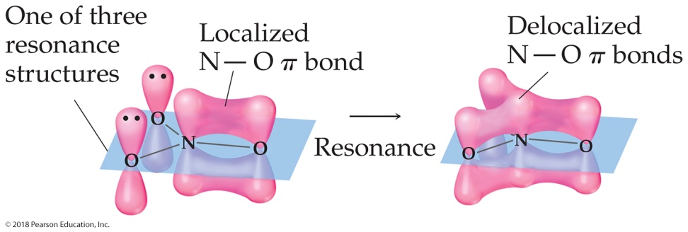
Sample Exercise 9.7 Delocalized Bonding
Continued
The four p orbitals—one on each of the four atoms—are used to build the π system. For any one of the three resonance structures shown, we might imagine a single localized N — O π bond formed by the overlap of the p orbital on N and a p orbital on one of the O atoms. The remaining two O atoms have nonbonding pairs in their p orbitals. Thus, for each of the resonance structures, we have the situation shown in Figure 9.27. Because each resonance structure contributes equally to the observed structure of NO₃–, however, we represent the π bonding as delocalized over the three N — O bonds, as shown in the figure. We see that the NO₃– ion has a six-electron π system delocalized among the four atoms in the ion.
Practice Exercise 1
How many electrons are in the π system of the ozone molecule, O₃? (a) 2 (b) 4 (c) 6 (d) 14 (e) 18
Practice Exercise 2
Which of these species have delocalized bonding: SO₂, SO₃, SO₃^{2–}, H₂CO, NH₄⁺?
Figure 9.27 Localized and delocalized representations of the six-electron π system in NO₃–.

Slide 59
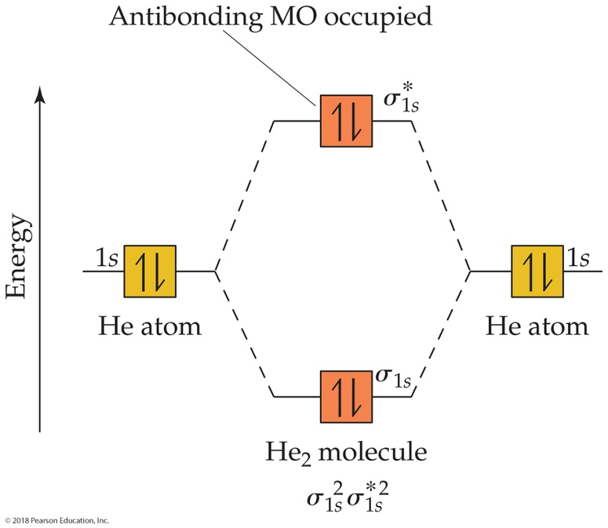
Sample Exercise 9.8 Bond Order
What is the bond order of the He₂⁺ ion? Would you expect this ion to be stable relative to the separated He atom and He⁺ ion?
Solution
Analyze We will determine the bond order for the He₂⁺ ion and use it to predict whether the ion is stable.
Plan To determine the bond order, we must determine the number of electrons in the molecule and how these electrons populate the available MOs. The valence electrons of He are in the 1s orbital, and the 1s orbitals combine to give an MO diagram like that for H₂ or He₂ (Figure 9.33). If the bond order is greater than 0, we expect a bond to exist, and the ion is stable.

Slide 60
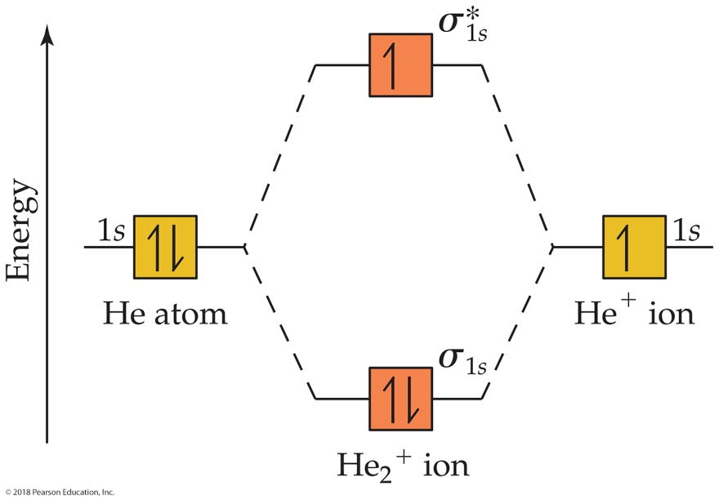
Sample Exercise 9.8 Bond Order
Continued
Solve The energy-level diagram for the He₂⁺ ion is shown in Figure 9.34. This ion has three electrons. Two are placed in the bonding orbital and the third in the antibonding orbital. Thus, the bond order is
Bond order = (2 – 1) =
Because the bond order is greater than 0, we predict the He₂⁺ ion to be stable relative to the separated He and He+. Formation of He₂⁺ in the gas phase has been demonstrated in laboratory experiments.

Slide 61
Sample Exercise 9.8 Bond Order
Continued
Practice Exercise 1
How many of the following molecules and ions have a bond order of : H₂, H₂⁺, H₂–, and He₂²⁺?
(a) 0 (b) 1 (c) 2 (d) 3 (e) 4
Practice Exercise 2
What are the electron configuration and the bond order of the H₂– ion?

Slide 62
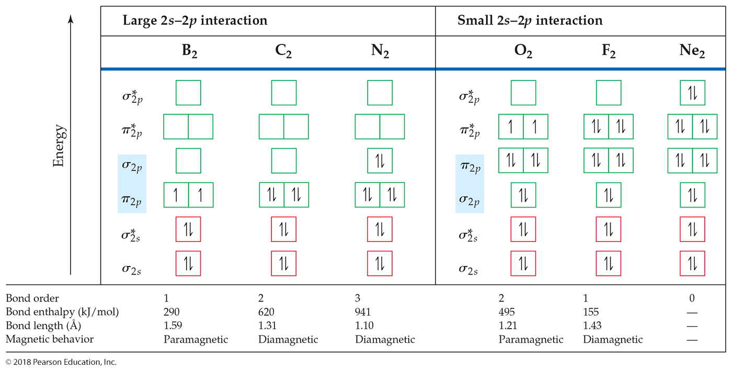
Sample Exercise 9.9 Molecular Orbitals of a Period 2 Diatomic Ion
For the O₂⁺ ion predict (a) number of unpaired electrons, (b) bond order, (c) bond enthalpy and bond length.
Solution
Analyze Our task is to predict several properties of the cation O₂⁺.
Plan We will use the MO description of O₂⁺ to determine the desired properties. We must first determine the number of electrons in O₂⁺ and then draw its MO energy diagram. The unpaired electrons are those without a partner of opposite spin. The bond order is one-half the difference between the number of bonding and antibonding electrons. After calculating the bond order, we can use Figure 9.43 to estimate the bond enthalpy and bond length.

Slide 63

Sample Exercise 9.9 Molecular Orbitals of a Period 2 Diatomic Ion
Continued
Solve
(a) The O₂⁺ ion has 11 valence electrons, one fewer than O₂. The electron removed from O₂ to form O₂⁺ is one of the two unpaired electrons (see Figure 9.43). Therefore, O₂⁺ has one unpaired electron.
(b) The molecule has eight bonding electrons (the same as O₂) and three antibonding electrons (one fewer than O₂). Thus, its bond order is
(8 – 3) = 2
(c) The bond order of O₂⁺ is between that for O₂ (bond order 2) and N₂ (bond order 3). Thus, the bond enthalpy and bond length should be about midway between those for O₂ and N₂, approximately 700 kJ/mol and 1.15 Å. (The experimentally measured values are 625 kJ/mol and 1.123 Å.)

Slide 64
Sample Exercise 9.9 Molecular Orbitals of a Period 2 Diatomic Ion
Continued
Practice Exercise 1
Place the following molecular ions in order from smallest to largest bond order: C₂²⁺, N₂–, O₂–, and F₂–.
(a) C₂²⁺ < N₂– < O₂– < F₂–
(b) F₂– < O₂– < N₂– < C₂²⁺
(c) O₂– < C₂²⁺ < F₂– < N₂–
(d) C₂²⁺ < F₂– < O₂– < N₂–
(e) F₂– < C₂²⁺ < O₂– < N₂–
Practice Exercise 2
Predict the magnetic properties and bond orders of (a) the peroxide ion, O₂^{2–}; (b) the acetylide ion, C₂^{2–}.

Slide 65
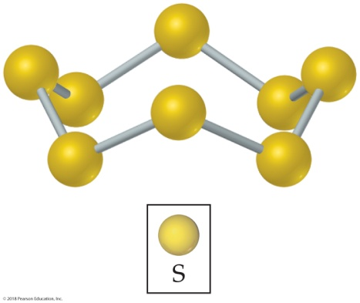
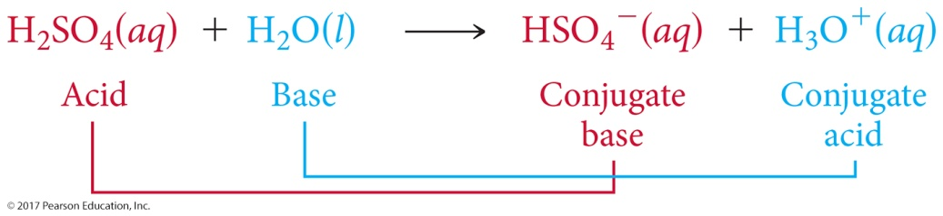
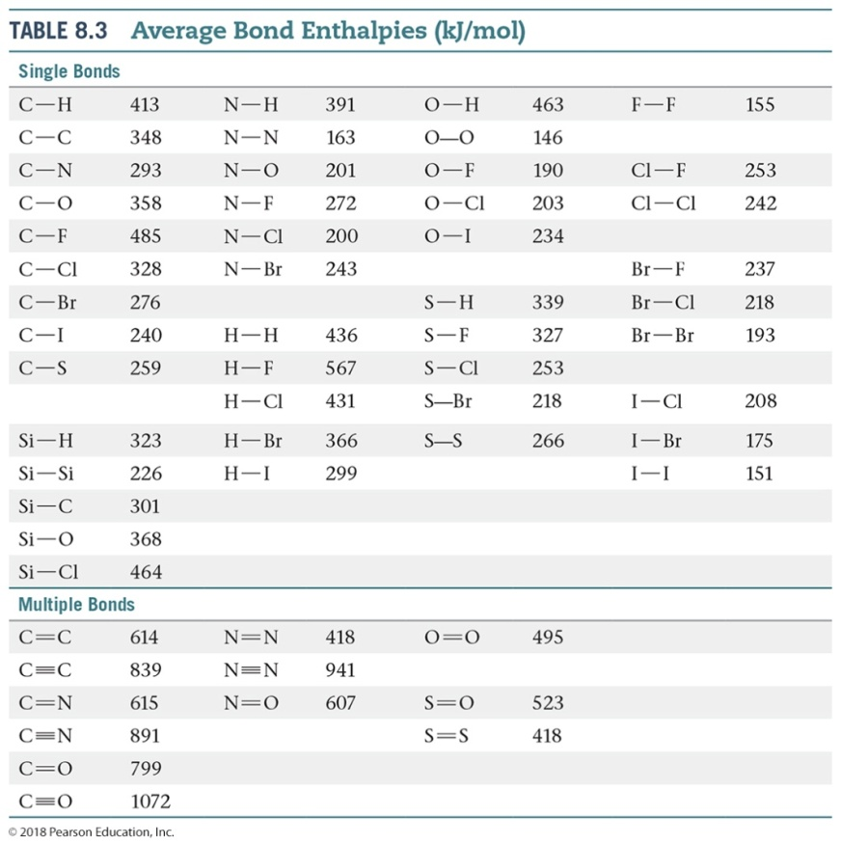
Sample Integrative Exercise Putting Concepts Together
Elemental sulfur is a yellow solid that consists of S₈ molecules. The structure of the S₈ molecule is a puckered, eight-membered ring (see Figure 7.27). Heating elemental sulfur to high temperatures produces gaseous S₂ molecules:
S₈(s) 4 S₂(g)
(a) The electron configuration of which period 2 element is most similar to that of sulfur? (b) Use the VSEPR model to predict the S — S — S bond angles in S8 and the hybridization at S in S8. (c) Use MO theory to predict the sulfur–sulfur bond order in S2. Do you expect this molecule to be diamagnetic or paramagnetic? (d) Use average bond enthalpies (Table 8.3) to estimate the enthalpy change for this reaction. Is the reaction exothermic or endothermic?

Slide 66
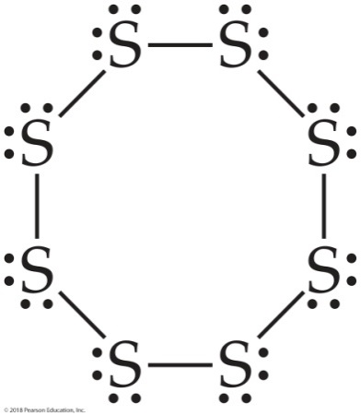
Sample Integrative Exercise Putting Concepts Together
Continued
Solution
(a) Sulfur is a group 6A element with an [Ne]3s²3p⁴ electron configuration. It is expected to be most similar electronically to oxygen (electron configuration, [He]2s²2p⁴), which is immediately above it in the periodic table.
(b) The Lewis structure of S₈ is
There is a single bond between each pair of S atoms and two nonbonding electron pairs on each S atom. Thus, we see four electron domains around each S atom and expect a tetrahedral electron-domain geometry corresponding to sp³ hybridization. Because of the nonbonding pairs, we expect the S — S — S angles to be somewhat less than 109.5°, the tetrahedral angle. Experimentally, the S — S — S angle in S₈ is 108°, in good agreement with this prediction. Interestingly, if S₈ were a planar ring, it would have S — S — S angles of 135°. Instead, the S₈ ring puckers to accommodate the smaller angles dictated by sp³ hybridization.

Slide 67

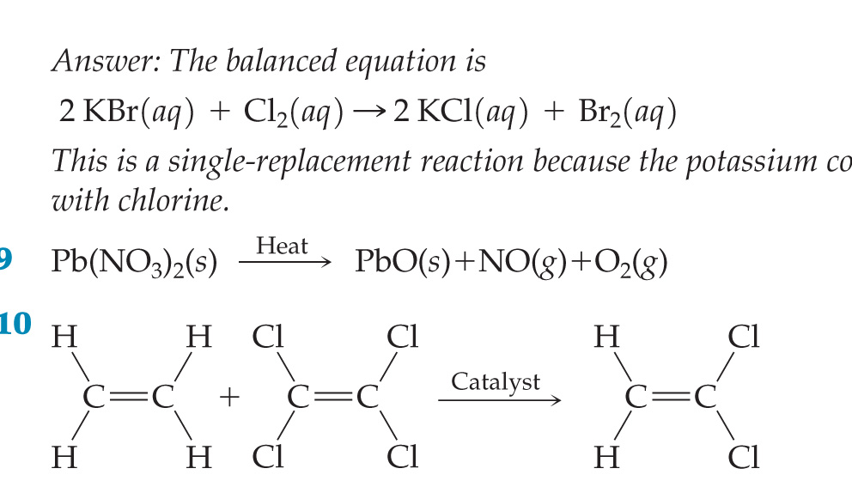
Sample Integrative Exercise Putting Concepts Together
Continued
(c) The MOs of S₂ are analogous to those of O₂, although the MOs for S₂ are constructed from the 3s and 3p atomic orbitals of sulfur. Further, S₂ has the same number of valence electrons as O₂. Thus, by analogy with O₂, we expect S₂ to have a bond order of 2 (a double bond) and to be paramagnetic with two unpaired electrons in the
molecular orbitals of S₂.
(d) We are considering the reaction in which an S₈ molecule falls apart into four S₂ molecules. From parts (b) and (c), we see that S₈ has S — S single bonds and S₂ has S S double bonds. During the reaction, therefore, we are breaking eight S — S single bonds and forming four S S double bonds. We can estimate the enthalpy of the reaction by using Equation 5.33 and the average bond enthalpies in Table 8.3:
ΔH_{rxn} = 8 D(S — S) – 4 D(S S)
= 8(266 kJ) – 4(418 kJ) = +456 kJ
Recall that D(X — Y) represents the X — Y bond enthalpy. Because ΔH_{rxn} > 0, the reaction is endothermic (Section 5.3). The very positive value of ΔH_{rxn} suggests that high temperatures are required to cause the reaction to occur.

Slide 68
Workshop on MO Theory
#1 Consider the C₂²⁻ ion for the following problem.
A. Draw the Molecular Orbital diagram. Make sure to include the proper atomic orbitals for each ion as well as properly label all bonding and antibonding molecular orbitals.
    B. Calculate the bond order for the ion based on the Molecular Orbital diagram.
    C. Determine whether the ion is diamagnetic or paramagnetic? Justify your answer based on the Molecular Orbital diagram.
#2: Draw the Molecular Orbital energy diagram for the O₂⁺ ion.
#3: Draw the Molecular Orbital energy diagram for the CO molecule.
#4: Draw the Molecular Orbital energy diagram for the HBr molecule.

Slide 69
      Valence Band Theory
Metallic Conductor: An electronic conductor in which the electrical conductivity decreases as the temperature is raised. The resistance of the metal to conduct electricity decreases as the temperature is raised because when heated, the atoms vibrate more vigorously, passing electrons collide with the vibrating atoms, and hence do not pass through the solid as readily.
Semiconductor: An electronic conductor in which the electrical conductivity increases as the temperature is raised. There are two types of semiconductors: n-type and p-type (see schematic below).
n-type: Doping with an element of extra negative charge (electrons) into a system. There is NO extra room for these electrons in the valence band; consequently, they are promoted into the conduction band, where they have access to many vacant orbitals within the energy band they occupy and serve as electrical carriers.
p-type: Doping with an element of less electrons in order to create electron vacancies or positive holes in the system. Because the valence band is incompletely filled, under the influence of an applied field, electrons can move from occupied molecular orbitals to the few that are vacant, thereby allowing current to flow.

Slide 70
Insulator: Does NOT conduct electricity.
Superconductor: A solid that has zero resistance to an electric current. Some metals become superconductors at very low temperatures, and other compounds turn into superconductors at relatively high temperatures.
* electrons are not mobile * Example: Si doped with As * Example: Si doped with In

