Slide 1
BOND ENTHALPY

Slide 2
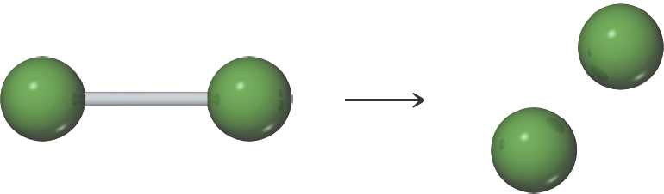
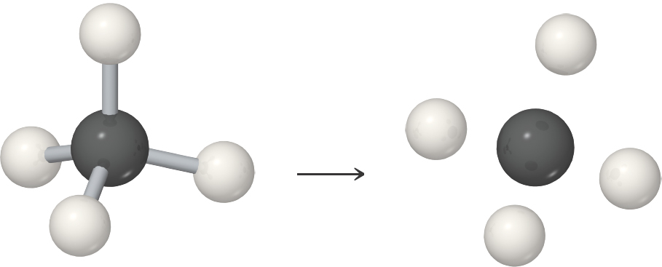
Bond Enthalpy
The enthalpy associated with breaking one mole of a particular bond in a gaseous substance.

Slide 3
Potential Energy Diagram
The overall energy term involved is due to the net potential energy, which results from the attractive & repulsive forces between charged particles, and the Kinetic energy due to the motion of the electrons.
The zero point energy is defined as where the atoms are at infinite separation.
At very short distances the energy rises steeply due to the repulsive forces that exist when atoms are close together.
The bond length is at a distance where the system has minimal energy.

Slide 4
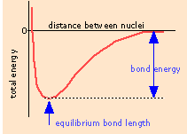
back

Slide 5
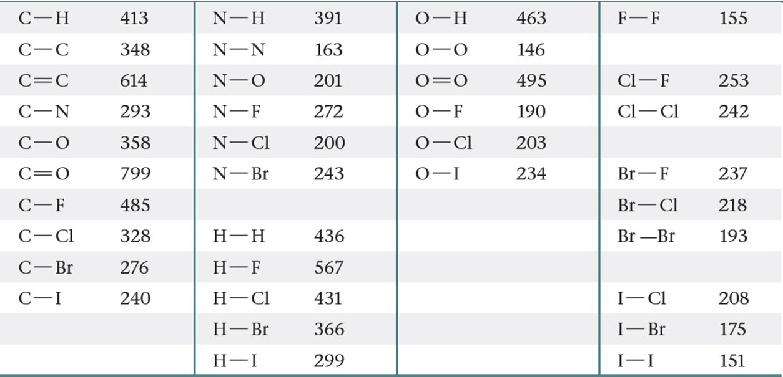
Bond Enthalpy
The bond enthalpy is always positive because energy is required to break chemical bonds.
Energy is always released when a bond forms between gaseous fragments.
The greater the bond enthalpy, the stronger the bond.

Slide 6
BOND LENGTH
“THE DISTANCE BETWEEN NUCLEI AT ITS MINIMUM ENERGY.
In order to break covalent bonds the BOND DISSOCIATION ENERGY must be added to the system.
In general the larger the BDE, the stronger the bond.
Average bond lengths can be estimated by using the trends in the periodic table.
C-C 1.54 A C=C 1.34 A C≡C 1.20 A

Slide 7
Bond Energy (also called Enthalpy) BDE
“the difference between the standard molar enthalpies of a molecule X-Y and its fragments X and Y”. NOTE: This is an APPROXIMATION!
BDE is the energy required to overcome the attraction between two atoms in a bond, it is related to the bond strength. It is the standard enthalpy change for breaking a bond in 1 mol of gaseous molecules.
ΔH° = ΣBE (bonds broken) – ΣBE (bonds made)
If:
ΔH°_{break} > 0 endothermic
ΔH°_{formation} < 0 exothermic

Slide 8
STEP 1: Drawing Lewis Structures
Step 1: Calculate the total number of valence electrons in the molecule or ion
Step 2: Determine the central atom(s) of the molecule or ion – usually it’s the least electronegative atom.
Step 3: Draw a tentative diagram for the molecule or ion.
Rules
A hydrogen atom always forms one bond. Hydrogen is always a terminal atom in a Lewis diagram – an atom that is bonded to only one other atom.
A carbon atom normally forms four bonds
When several carbon atoms appear in the same molecule, the are often bonded to each other.

Slide 9
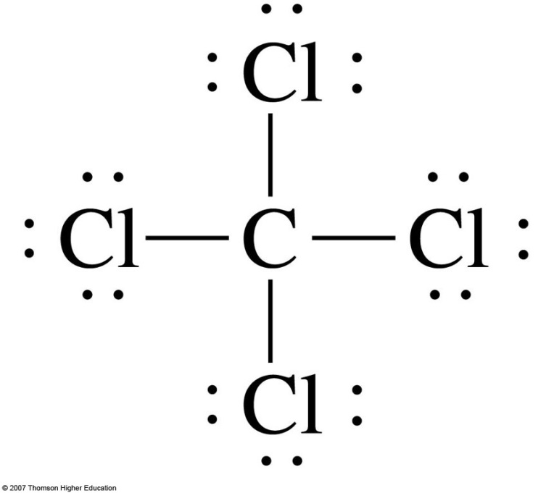
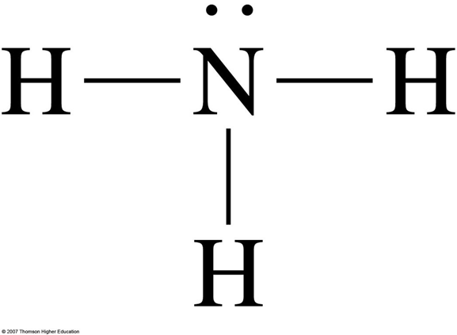
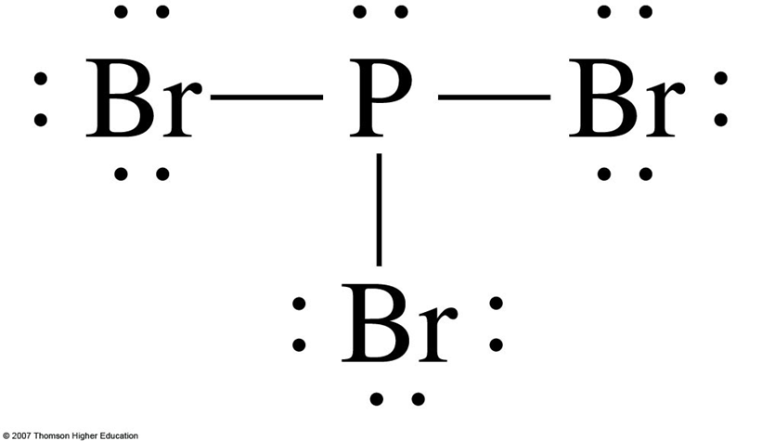

Slide 10
Bond Enthalpies and Enthalpy of Reaction
Add bond energy for all bonds made (+)
Subtract bond energy for all bonds broken (−)
The result is an estimate of ΔH.

Slide 11
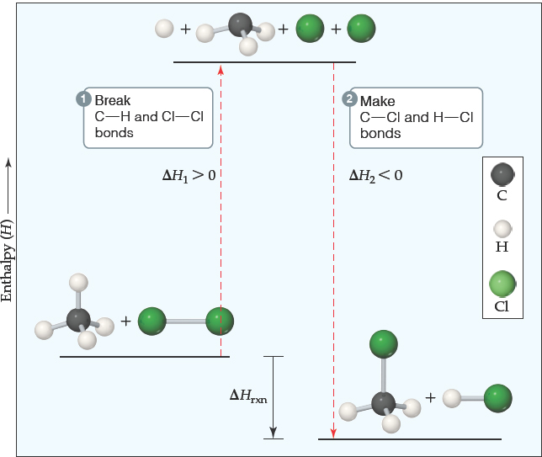
Bond Enthalpies and Enthalpy of Reaction
So, we can predict whether a chemical reaction will be endothermic or exothermic using bond energies.

Slide 12
Bond Energies (Enthalpies) BDE
ΔH° = ΣBE (bonds broken) – ΣBE (bonds made)
A. All bond enthalpies listed in your textbook are POSITIVE because heat must be supplied to break a bond.
B. Therefore, bond breaking is always ENDOTHERMIC, and bond formations is always EXOTHERMIC.
C. Assume that the average bond energy applies regardless of the specific molecular environment; intermolecular interactions are expected to be minimal and hence are NOT taken into account.
D. These calculations are limited to cases where ALL reactants/products are in the gas phase!

Slide 13
Estimate the Enthalpy of the Following Reaction
H₂(g) + O₂(g) → H₂O₂(g)
reaction involves breaking 1mol H-H and 1 mol O=O and making 2 mol H-O and 1 mol O-O
bonds broken (energy cost)
(+436 kJ) + (+498 kJ) = +934 kJ
bonds made (energy release)
2(464 kJ) + (142 kJ) = -1070
ΔH_{rxn} = (+934 kJ) + (-1070. kJ) = -136 kJ
(Appendix ΔH°_{f} = -136.3 kJ/mol)

Slide 14
Examples on Bond Energy
Problem #1: Estimate the enthalpy change of the reaction between gaseous iodoethane and water vapor:
CH₃CH₂I(g) + H₂O(g) → CH₃CH₂OH(g) + HI(g)
Bond Energies (kJ/mol): C-O 360 H-O 463
C-I 238 H-I 299

Slide 15
Examples on Bond Energy
Problem #2: Estimate the standard enthalpy of the following reaction:
CCl₃CHCl₂(g) + 2HF(g) → CCl₃CHF₂(g) + 2HCl(g)
Bond Energies (kJ/mol): C-F 485 C-Cl 339
H-F 565 H-Cl 431

