Slide 1
      Chemical Bonding: An Introduction
1. chemical bond:
-ionic bond:
-covalent bond:
-Electronegativity:
-Polar Covalent:
2. octet rule:
EXCEPTIONS
3. Lewis dot structure
Formal Charge:
Resonance:
Isomers:
4. Types of Bonds:
-Single vs. double
vs.triple bonds:
-Bond Strength:
-Bond Length:
5. VSEPR Model
6. Polarity of Molecules

Slide 2
Rules for writing Lewis dot structures for molecules:
1. Write the skeletal structure of the compound showing which atoms are bonded to what other atoms. Consider the following useful tips:
A. The least electronegative atom usually occupies the central position in a molecule.
B. Molecules are often symmetrical.
2. Determine the sum of the valence electrons for all atoms in the molecule. For polyatomic ions,
A. add an electron for every negative charge; or
B. subtract an electron for every positive charge.
3. A pair of bonding electrons between atoms is designated with a solid line, which represents TWO electrons. Remember that atoms can be bonded in multiple manners (i.e. double and triple bonds).
4. Arrange the rest of the electrons (dots) around the atoms so that every atom has eight electrons (an octet). Remember that if the central atom is from row 3 or higher of the periodic table, it may constitute an exception to the octet rule (i.e. it can possess more than 8 surrounding electrons). Also recall that elements in.Groups I, II, and III do not obey the octet rule either. The general rule for these atoms is that the number of valence electrons = number of bonds.
5. Calculate the formal charge for each atom in your molecule; recall that the best Lewis dot structure is the one that minimizes formal charge amongst all the atoms (note: this may not necessarily mean “0”, but perhaps as close to “0” as possible).

Slide 3
A Example of LEWIS DOT STRUCTURES
1. Arrange the symbols such that the least electronegative element is in the center and the other elements are surrounding the central atom.
O C O
2. Count the total number of electrons from the valence electrons. Remember the number of valence electrons for a representative element is the same as the group number First place pairs of electrons between two atoms, then place the rest of the electrons around the other atoms. Green first then pink. . . . .
: O : C : O :
. . . .
3. Keep track of the total numbr of valence electrons for the compound by adding the valence electrons from each atom. If the compound is an ion then add electrons (dots) for each negative charge or subtract electrons (dots) for each positive charge.
4 for C and 6 for O (twice) = 16 electrons
4. Now move the dots around so that you have 8 dots (the octet rule) around each element (do not forget the exceptions) while at the same time keeping the dots in pairs. Electrons, at this point, exist as pairs (the buddy system).
5. EXCEPTIONS TO THE OCTET RULE: Group I, II, and III need only 2, 4, and 6 electrons, respectively, around that atom.

Slide 4
LEWIS DOT STRUCTURES
6. If there are too few pairs to give each atom eight electrons, change the single bonds between two atoms to either double or triple bonds by moving the unbonded pairs of electrons next to a bonding pair.
. . . .
: O : : C : : O :
7. Once the octet rule has been satisfied for each atom in the molecule then you may replace each pair of dots between two atoms with a dash.
. . . .
: O = C = O :
8. Now check your structure by
a) count the total number of electrons to make sure you did not lose or gain electrons during the process.
b) Use FORMAL CHARGE (FC) calculations as a guideline to the correct structure. A zero formal charge is usually a good indication of a stable structure.
FC (X) = # of valence electrons - (1/2 bonding electrons + nonbonding electrons)
For our example: FC(C) = 4 - (¹/₂ 8 + 0) = 0
FC(O) = 6 - (¹/₂ 4 + 4) = 0

Slide 5
Practice - Lewis Structures
CO₂
SeOF₂
NO₂⁻¹
H₃PO₄
SO₃⁻²
P₂H₄

Slide 6
Practice - Lewis Structures
CO₂
SeOF₂
NO₂⁻¹
16 e⁻
:
:
:O::C::O:
26 e⁻
18 e⁻

Slide 7
Practice - Lewis Structures
CO₂
SeOF₂
NO₂⁻¹
H₃PO₄
SO₃⁻²
P₂H₄
16 e⁻
:
:
:O::C::O:
32 e⁻
26 e⁻
26 e⁻
18 e⁻
14 e⁻

Slide 8
FORMAL CHARGE
Formal charge is the “charge” assigned to an atom in a molecule, (1) assuming equal sharing of the electrons & (2) without considering electronegativity effects.
FC(X) = #VE – (1/2 BE + NBE)
“Formal Charge of (element in compound) = # valence electrons for element – (½ bonding electrons + nonbonding electrons)”

Slide 9
FORMAL CHARGE EXAMPLE
Predict the most stable structure: ONC⁻ or OCN⁻ or NOC⁻
. . .. . . .. .. ..
:O::N::C: or :O::C::N: or :N::O::C:
1) Total electrons is:
(6e⁻ for O) + (5e⁻ for N) + (4e⁻ for C) + (1e⁻ for negative charge) = 16 e- total. All structures fulfill the octet rule.
2) FC (X) = # of valence electrons - (1/2 bonding electrons + nonbonding electrons)
structure#1: structure #3:
FC(C) = 4 - (¹/₂ 4 + 4) = -2 FC(C) = 4 - (¹/₂ 4 + 4) = -2
FC(O) = 6 - (¹/₂ 4 + 4) = 0 FC(O) = 6 - (¹/₂ 8 + 0) = +2
FC(N) = 5 -(¹/₂ 8 + 0) = +1 FC(N) = 5 -(¹/₂ 4 + 4) = -1
structure#2:
FC(C) = 4 - (¹/₂ 8 + 0) = 0
FC(O) = 6 - (¹/₂ 4 + 4) = 0
FC(N) = 5 -(¹/₂ 4 + 4) = -1
structure #2 has the combination with the lowest formal charge. It also has the negative formal charge on one of the more electronegative atoms. Calculate the formal charge for the most stable structure: . .
:O:C:::N:
. .
(-1, 0, 0)

Slide 10
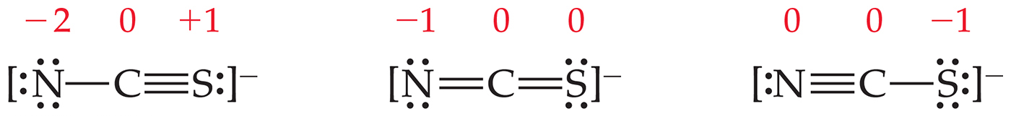
Writing Lewis Structures
The dominant Lewis structure:
is the one in which atoms have formal charges closest to zero.
puts a negative formal charge on the most electronegative atom.
As such, it can be used to decide which structure is best.

Slide 11
Practice - Assign Formal Charges
CO₂
SeOF₂
NO₂⁻¹
H₃PO₄
SO₃⁻²
P₂H₄

Slide 12
Practice - Assign Formal Charges
-1
CO₂
SeOF₂
NO₂⁻¹
H₃PO₄
SO₃⁻²
P₂H₄
P = +1
rest 0
all 0
-1
-1
Se = +1
S = +1
-1
-1
-1
all 0

Slide 13
Resonance
when there is more than one Lewis structure for a molecule that differ only in the position of the electrons, they are called resonance structures
the actual molecule is a combination of the resonance forms – a resonance hybrid
  it does not resonate between the two forms, though we often draw it that way
look for multiple bonds or lone pairs
O S O
O S O
••
••
••
••
••
••
•
•
••
••
•
•
•
•
•
•
•
•
••
••
•
•
••
••

Slide 14
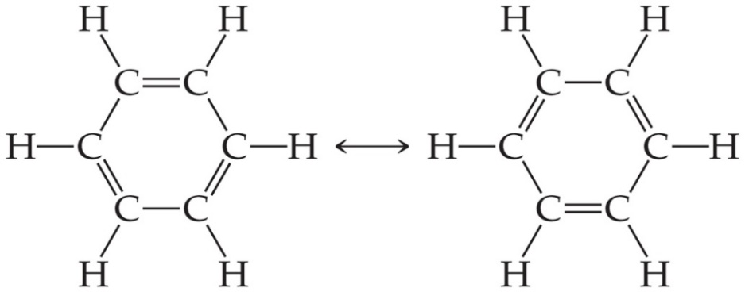
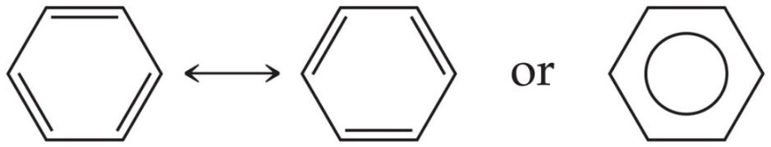
Resonance
The organic compound benzene, C₆H₆, has two resonance structures.
It is commonly depicted as a hexagon with a circle inside to signify the delocalized electrons in the ring.
Localized electrons are specifically on one atom or shared between two atoms; delocalized electrons are shared by multiple atoms.

Slide 15
Practice - Identify Structures with Better or Equal Resonance Forms and Draw Them
-1
CO₂
SeOF₂
NO₂⁻¹
H₃PO₄
SO₃⁻²
P₂H₄
P = +1
all 0
-1
-1
Se = +1
S = +1
-1
-1
-1
all 0

Slide 16
Practice - Identify Structures with Better or Equal Resonance Forms and Draw Them
CO₂
SeOF₂
NO₂⁻¹
H₃PO₄
SO₃⁻²
P₂H₄
-1
all 0
none
+1
-1
all 0
S = 0
in all
res. forms
+1
-1
-1
none

Slide 17
ISOMERS & Coordinate Covalent Bonds:
Structural isomers are compounds that possess the same chemical formula but different connectivity among the various atoms. For example, consider the formula C₂H₆O, which can be written in two different ways: (1) CH₃CH₂OH or (2) CH₃OCH₃:
Draw the various structural isomers for the hexane molecule:
Now consider a bond in which both electrons originate from one of the atoms, known as the coordinate covalent bond. While this type of bond is common to all transition metal complexes (Chemistry 102), it can also be formed among main group elements, particularly among Lewis Acid/Base complexes.
Recall that we define a Lewis base as an electron pair donor, and a Lewis acid as an electron pair acceptor. The form of the reaction is therefore:
Acid + :base → complex
For example, boron trichloride and ammonia react in a Lewis Acid-Base reaction as follows:

Slide 18
Exceptions to the Octet Rule
There are three types of ions or molecules that do not follow the octet rule:
  Ions or molecules with an odd number of electrons
  Ions or molecules with less than an octet
  Ions or molecules with more than eight valence electrons (an expanded octet)

Slide 19
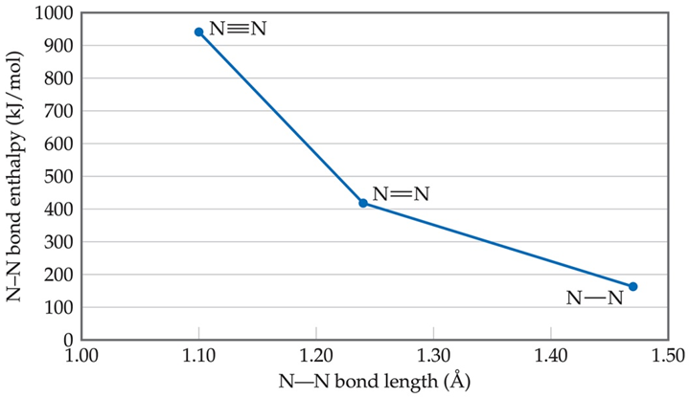
Bond Length & Bond Strength
The bond length is the distance between the nuclei in a bond. Bond length is related to the sum of the covalent radii of the bonded atoms. The average bond lengths are given in your textbook in a table.
There is a close relationship between bond length, bond order and bond energy.
Bond bond Order bond length bond energy
C-O 1 143 358
C=O 2 123 745
C=O 3 113 1070
- Triple bonds are stronger & shorter than double which are stronger & shorter than single bonds. Note: this does not necessarily relate to reactivity. Triple and double bonds in many organic reactions are more reactive than single bonds.

Slide 20
Average Bond Enthalpies- revisited
Bond enthalpies are positive, because bond breaking is an endothermic process.
These are averages over many compounds; not every bond for a pair of atoms has the same bond energy.
Table 8.3 Average Bond Enthalpies (kJ/mol)
Single Bonds | Blank | Blank | Blank | Blank | Blank | Blank | Blank
C¬H | 413 | N¬H | 391 | O¬H | 463 | F¬F | 155
C¬C | 348 | N¬N | 163 | O—O | 146 | Blank | Blank
C¬N | 293 | N¬O | 201 | O¬F | 190 | C l¬F | 253
C¬O | 358 | N¬F | 272 | O¬C l | 203 | C l¬C l | 242
C¬F | 485 | N¬C l | 200 | O¬I | 234 | Blank | Blank
C¬Cl | 328 | N¬B r | 243 | Blank | Blank | Br¬F | 237
C¬Br | 276 | Blank | Blank | S¬H | 339 | B r¬C l | 218
C¬I | 240 | H¬H | 436 | S¬F | 327 | B r¬B r | 193

Slide 21
Average Bond Enthalpies
Single Bonds | Blank | Blank | Blank | Blank | Blank | Blank | Blank
C¬S | 259 | H¬F | 567 | S¬C l | 253 | Blank | Blank
Blank | Blank | H¬C l | 431 | S—B r | 218 | I¬C l | 208
S i¬H | 323 | H¬B r | 366 | S—S | 266 | I¬B r | 175
S i¬S i | 226 | H¬I | 299 | Blank | Blank | I¬I | 151
S i¬C | 301 | Blank | Blank | Blank | Blank | Blank | Blank
S i¬O | 368 | Blank | Blank | Blank | Blank | Blank | Blank
S i¬Cl | 464 | Blank | Blank | Blank | Blank | Blank | Blank
Multiple Bonds | Blank | Blank | Blank | Blank | Blank | Blank | Blank
C“C | 614 | N“N | 418 | O“O | 495 | Blank | Blank
C‚C | 839 | N‚N | 941 |  |  | Blank | Blank
C“N | 615 | N“O | 607 | S“O | 523 | Blank | Blank
C‚N | 891 | Blank | Blank | S“S | 418 | Blank | Blank
C“O | 799 | Blank | Blank | Blank | Blank | Blank | Blank
C‚O | 1072 | Blank | Blank | Blank | Blank | Blank | Blank

Slide 22
LECTURE Problems on Lewis structure:
Draw the best possible Lewis dot structures for each of the following compounds or ions shown below, and include resonance where appropriate:
A. CH₂F₂ B. PH₃
C. H₂SO₄ D. NO₃¹⁻
Cl₂O F. C₆F₆
Q1: While sulfur forms SF₄ & SF₆, no equivalent compounds of oxygen, OF₄ & OF₆ are known. Explain.
Q2: Draw all resonance structures for NO₂-, predict the bond lengths and place them in order of increasing bond length.

Slide 23
WORKSHOP 1 on Lewis structure:
Draw the best possible (use formal charge) Lewis dot structures for each of the following compounds or ions shown below, and include resonance where appropriate:
A. CH₂CHCN B. OF₂
C. H₂CO_{2 (formic acid)} D. MnO₄⁻
E. SCl₂ F. SeF₄
AlF₃ H. ONCl
Q1: Based on their Lewis Structures, predict the relative S-O bond length for SO₂, SO₃, SO₄²⁻
Q2: Based on their Lewis Structures, predict the relative N-O bond length for NO, NO₂⁻, NO₃⁻

Slide 24
VSEPR MODEL
Valence Shell Electron Pair Repulsion Model
A model for predicting the shapes of molecules and ions in which valence shell electron pairs are arranged about each atom so that electron pair repulsion is minimized. VSEPR states that electron pairs repel one another, whether they are in chemical bonds (bonding pairs) or unshared (lone pairs). Electron pairs assume orientations about an atom to minimize repulsions.
ELECTRONIC GEOMETRY
The general shape of a molecule determined by the number of electron pairs around the central atom occupying different quadrants. Gives starting point for bond angle.
MOLECULAR GEOMETRY
The general shape of a molecule determined by the relative positions of the atomic nuclei. The nonbonding electron pairs modifiy the geometry.

Slide 25
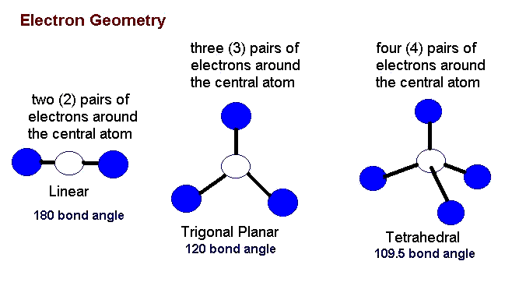
VSEPR MODEL
I. Draw the Lewis dot structure.
II. Determine the electronic geometry by counting the number of pairs of electrons around the central atom occupying different quadrants (top, bottom, left, right). This geometry gives the initial bond angle.
Pairs of e- geometry bond angle
2 linear 180º
3 trigonal planar 120º
4 tetrahderal 109.5º
5 trigonal bipyramidal 120º & 90º
6 octahedral 90º
The structure for the first three geometries is given in these notes, the other two can be found in your textbook.

Slide 26
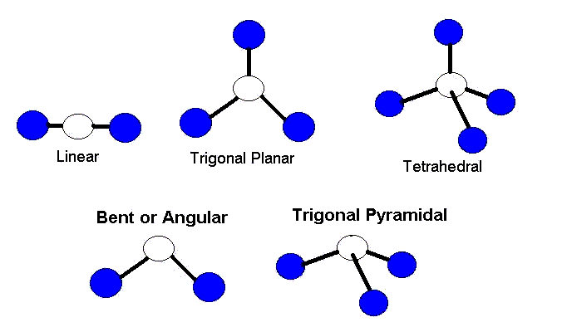
VSEPR MODEL
III. Next, using the electronic geometry, determine the number of bonding and nonbonding electron pairs then arrange the electron pairs as far apart as possible.
___ nonbonding pairs require more space than bonding pairs.
___ multiple bonds require more space than single bonds.
IV. The direction in space of the bonding pairs give the molecular geometry modified by the position of the nonbonding pairs.

Slide 27
Table describing Molecular Geometry
VSPER Theory
Number of electronic bonding nonbonding molecular
e- pairs geometry e- pairs e- pairs geometry
2 linear 2 0 linear
3 trigonal planar 3 0 trigonal planar
3 trigonal planar 2 1 bent
4 tetrahedral 4 0 tetrahedral
4 tetrahdral 3 1 trigonal pyramidal
4 tetrahedral 2 2 bent

Slide 28
Trigonal Bipyramidal (5)
Trigonal Bipyramidal Seesaw T-shaped Linear
(0) (1) (2) (3)
Octahedral (6)
Octahedral Square Pyramidal Square Planar
(0) (1) (2)
The above flow chart summarizes the relationship between the electronic to molecular geometries for trigonal bipyramidal & octahedral. The number in parenthesis denotes the number of nonbonding pairs of electrons.

Slide 29
Lecture Examples on Lewis structure & VSEPR:
Draw the best possible Lewis dot structures incorporating VSEPR model for each of the following compounds or ions shown below, and include resonance hybrids or isomers where appropriate:
A. C₂H₂F₂ B. PH₃
C. H₂SO₄ D. NO₃⁻
E. C₆F₆ F. AsO₄⁻³
G. PtF₄ H. TeF₄
I. ClF₂ J. PF₅
K. IO₃⁻ L. Cl₂O

Slide 30
Workshop 2 on Lewis Structure & VSEPR Model
Consider all the following compounds/ions. Use VSEPR & Lewis Structures to predict the shape for each molecule. Draw that molecule. Predict the approximate bond angles where appropriate and determine whether the molecule is polar or nonpolar.
A. carbon tetrabromide B. AsH₃
C. formate ion, HCO²⁻ D. SCN⁻
E. CH₃NH₂ F. HCN
G. SF₆ H. XeF₄
I. ClF₃ J. AsF₅
K. AsO₄⁻³ L. IO₄⁻
M. Sulfuric Acid N. CS₂
O. Phosphoric Acid P. CH₂Br₂ Q. NO₂⁻ R. PCl₃
S. C₂H₂Br₂

Slide 31
POLARITY OF MOLECULES
Molecules can also be described as either polar or nonpolar.
When the individual dipole moments associated with each bond in the molecule cancel out due to symmetry or if no dipole moment exist, the molecule can be classified as a nonpolar molecule. Nonpolar molecules have no overall dipole moment. Otherwise, if an overall dipole moment exist, the molecule is polar.

Slide 32
Workshop 3 on Molecular Structure
1. The CO₃²⁻ ion has three possible Lewis dot structures.
A. Draw the corresponding electron-dot diagrams and assign formal charges to all the atoms present.
B. Consider the following bond lengths:
C-O 1.43 Å C=O 1.23 Å C≡O 1.09 Å
Rationalize the experimental observation that all three C-O bonds have identical bond lengths of 1.36 Å.
Show that the formation of Al₂Cl₆ from AlCl₃ molecules is a Lewis acid/base reaction.
Which compound has zero dipole moment?
a) SiCl₄ b) OF₂ c) XeF₄ d) PH₃
Why does ammonia have a larger dipole moment than NF₃?

