Slide 1
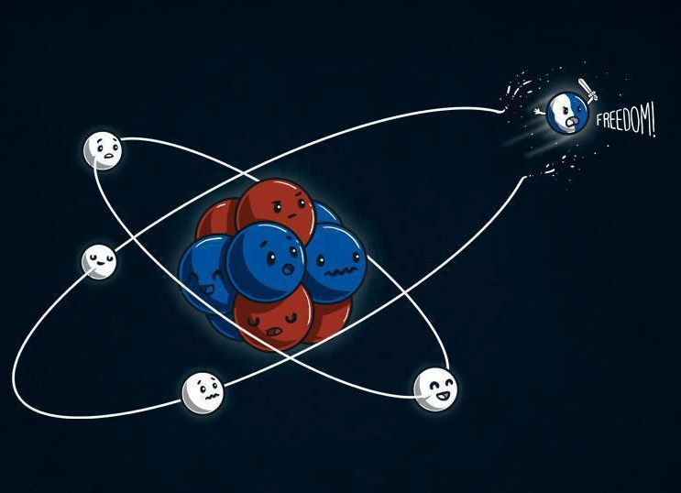
IONIC RADIUS
WHY DO ATOMS BOND TO FORM COMPOUNDS?

Slide 2
Chemical Bonds:
the attractive (intramolecular) forces, ie.“ the glue”, strong enough to maintain a group of atoms together for an indefinite amount of time.
There are three basic types of bonds: Ionic, Covalent, & Metallic.

Slide 3
Bonding
Bonds
“glue”
Ionic
Covalent
Metallic
e- transfer
ΔEN > 1.6
Crystal lattice
ions
Na + Cl Na⁺
3s¹ 3s²3p⁵ Cl ⁻
“salts”
very strong bonds generally between metals and non metals.
Solids at room temp.
Poor conductors of electricity in a solid state
sharing
1.6 > ΔEN > 0
“molecules”
hypothetical charge
H + H H H
1s¹ 1s¹ 1s²
orbital overlap
Bonding e- are localized between two atoms
Formed between two nonmetals
“sea” of e-
e- are delocalized.
+
-

Slide 4
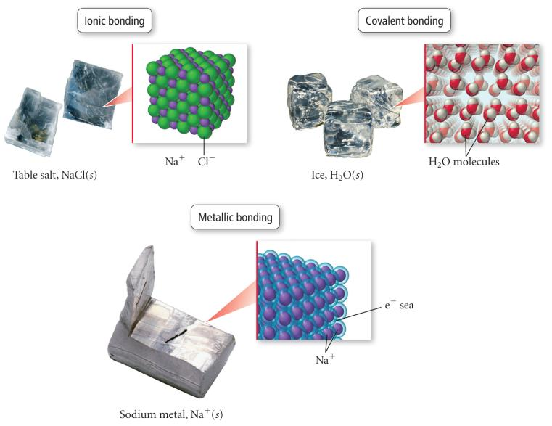
Types of Bonding

Slide 5
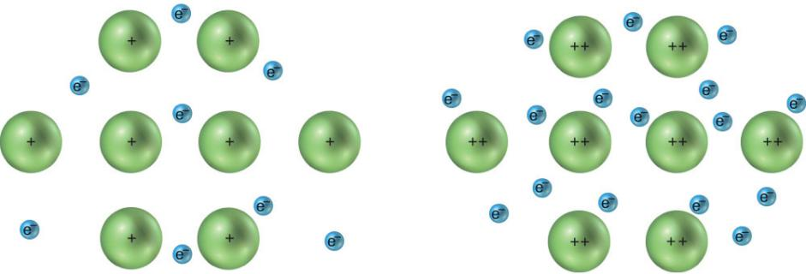
METALLIC BONDS

Slide 6
Metallic Bonds
low ionization energy of metals allows them to lose electrons easily
the simplest theory of metallic bonding involves the metals atoms releasing their valence electrons to be shared by all to atoms/ions in the metal
  - an organization of metal cation islands in a sea of electrons
  electrons delocalized throughout the metal structure
bonding results from attraction of cation for the delocalized electrons

Slide 7
Metallic Bonds
metallic solids conduct electricity & heat
as temperature increases, electrical conductivity decreases
metallic solids reflect light
metallic solids are malleable and ductile
metals generally have high melting points and boiling points
  - all but Hg are solids at room temperature
- melting points generally increase to right across
period
- melting points generally decrease down column

Slide 8
Why Do Atoms Bond?
processes are spontaneous if they result in a system with lower potential energy
chemical bonds form because they lower the potential energy between the charged particles that compose atoms
the potential energy between charged particles is directly proportional to the product of the charges
the potential energy between charged particles is inversely proportional to the distance between the charges

Slide 9
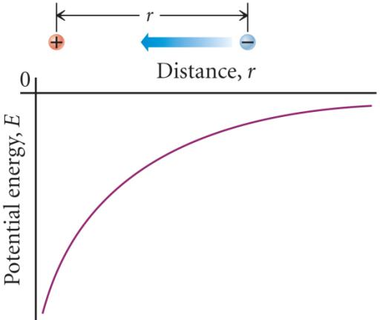
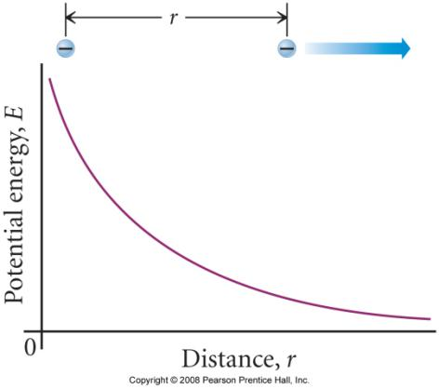
Potential Energy Between Charged Particles
The repulsion between like-charged particles increases as the particles get closer together. To bring them closer requires the addition of more energy.
The attraction between opposite-charged particles increases as the particles get closer together. Bringing them closer lowers the potential energy of the system.

Slide 10
Bonding
a chemical bond forms when the potential energy of the bonded atoms is less than the potential energy of the separate atoms
have to consider following interactions:
  nucleus-to-nucleus repulsion
  electron-to-electron repulsion
  nucleus-to-electron attraction

Slide 11
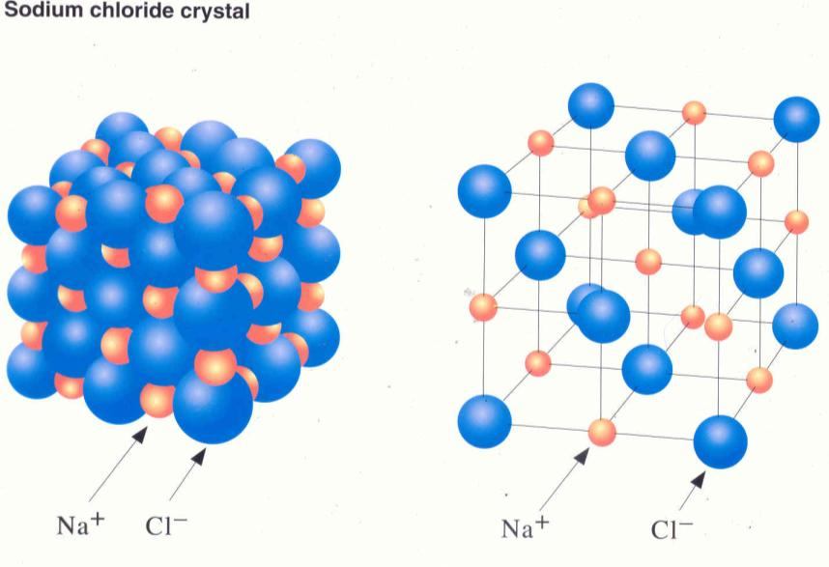
IONIC BONDS

Slide 12
IONIC RADIUS
The ionic radius is a measure of the size of the spherical region (electron probability) around the nucleus of an ion.
Isoelectronic: refers to different species having the same electron configuration
- In general; the ionic radius of cations decreases going left to right across a period until the ion becomes an anion (Group V) then there is an abrupt increase in ionic radius. From Group V to Group VII the radius once again decreases.
- The ionic radius increases going down a group.

Slide 13
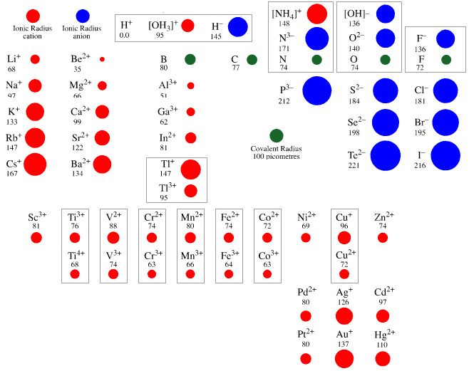
IONIC RADIUS

Slide 14
IONIC BONDS
- EXIST BETWEEN IONS OF OPPOSITE CHARGE
- ARE THE RESULT OF ELECTON TRANSFER BETWEEN IONS
- ARE HELD TOGETHER BY ATTRACTIVE ELECTRO STATIC FORCES k Q₁Q₂
E = r
- GENERALLY INVOLVE BONDING BETWEEN GROUP I & GROUP II CATIONS WITH GROUP VI & VII ANIONS.
- OCCURS BETWEEN IONS WITH VERY DIFFERENT
ELECTRONEGATIVITIES

Slide 15
Potential Energy Between Charged Particles
∈₀ is a constant
  = 8.85 x 10⁻¹² C²/J∙m
for charges with the same sign, E_{potential} is + and the magnitude gets less positive as the particles get farther apart
for charges with the opposite signs, E_{potential} is − and the magnitude gets more negative as the particles get closer together
remember: the more negative the potential energy, the more stable the system becomes

Slide 16
ATTRACTIVE FORCES
Coulomb’s law gives:
E = ⁻kQ₁Q₂ = -(8.99 X 10⁹ ^{J}_{C}^{M}) (1.6 X 10 ⁻¹⁹C)²
r ≈ 3.5 x 10⁻¹⁰m
E = -6.59 X 10⁻¹⁹J
The molar value is
E • NA = -6.59 X 10⁻¹⁹ J • 6.022 x 10²³ ( KJ)
1000J
= - 397 KJ/mol
This is the amount of energy released for electrostatic attraction
Na⁺ (mol) + Br⁻ (mol) → Na⁺ Br⁻ (mol)
BUT it does not tell the whole story. Additional energy is
actually released during the formation of the Salt, NaBr.
This means the formation of a crystal is not as simple as moving two opposing charged Ions near each other.

Slide 17
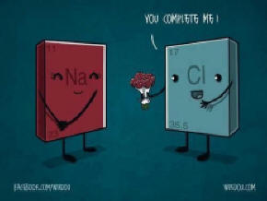
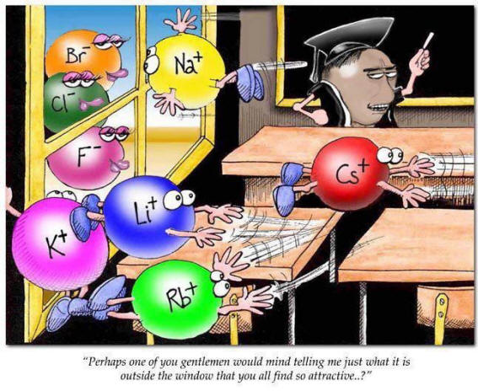
LATTICE ENERGY & Born-Haber Cycle

Slide 18
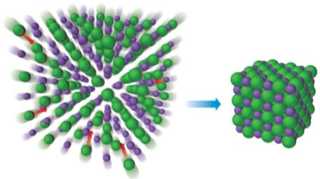
Lattice Energy
the lattice energy is the energy released when the solid crystal forms from separate ions in the gas state
  always exothermic
  hard to measure directly, but can be calculated from knowledge of other processes
lattice energy depends directly on size of charges and inversely on distance between ions

Slide 19
Lattice Energy (2 of 2)
Table 8.1 Lattice Energies for Some Ionic Compounds
Compound | Lattice Energy (kJ/mol) | Compound | Lattice Energy (kJ/mol)
L i F | 1030 | M g C l₂ | 2526
L iCl | 834 | S r C l₂ | 2127
L iI | 730 | Blank | blank
N aF | 910 | M g O | 3795
N aCl | 788 | C a O | 3414
N a B r | 732 | S r O | 3217
N al | 682 | Blank | blank
K F | 808 | S c N | 7547
K C l | 701 | blank | blank
K B r | 671 | blank | blank
C s C l | 657 | blank | blank
C s I | 600 | blank | blank

Slide 20
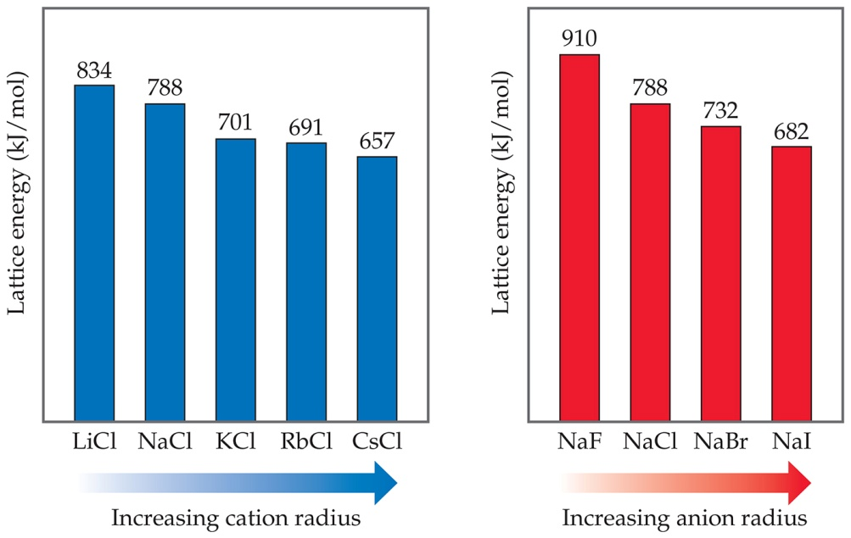
Trends in Lattice Energy
Lattice energy increases with:
Increasing charge on the ions
Decreasing size of ions

Slide 21
Lattice Energy
THE ENERGY REQUIRED TO COMPLETELY SEPARATE ONE MOLE OF AN IONIC SOLID INTO ITS GASEOUS IONS.
NaBr_{(s)} → Na⁺_{(g)} + Br⁻_{(g)} ΔH= +751 kJ/mol
endothermic process!
- the magnitude of the lattice energy depends on the amount of charge on the Ionic species
(low charge = low lattice energy)
  larger ion ► weaker attraction ► smaller lattice energy
  larger charge ► stronger attraction ► larger lattice energy
- the attractive interactions Increase with increasing charge and decreasing distances.

Slide 22
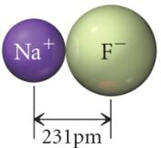
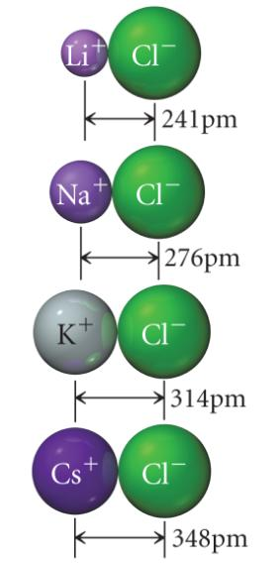
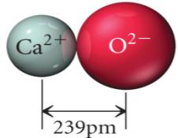
  larger ion ► weaker attraction ► smaller lattice energy
Lattice Energy =
-910 kJ/mol
Metal Chloride | Lattice Energy (kJ/mol)
LiCl | -834
NaCl | -787
KCl | -701
CsCl | -657
Lattice Energy =
-3414 kJ/mol
  larger charge ► stronger attraction ► larger lattice energy

Slide 23
Example 9.2 – Order the following ionic compounds in order of increasing magnitude of lattice energy.
CaO, KBr, KCl, SrO
First examine the ion charges and order by product of the charges
Ca²⁺& O²⁻, K⁺ & Br─, K⁺ & Cl─, Sr²⁺ & O^{2─}
(KBr, KCl) < (CaO, SrO)
Then examine the ion sizes of each group and order by radius; larger < smaller
(KBr, KCl) same cation, Br─ > Cl─ (same Group)
(CaO, SrO) same anion, Sr²⁺ > Ca²⁺ (same Group)
KBr < KCl < (CaO, SrO)
KBr < KCl < SrO < CaO

Slide 24
Born-Haber Cycle
method for determining the lattice energy of an ionic substance by using other reactions
  use Hess’s Law to add up heats of other processes
ΔH°_{f}(salt) = ΔH°_{f}(metal atoms, g) + ΔH°_{f}(nonmetal atoms, g) + ΔH°_{f}(cations, g) + ΔH°_{f}(anions, g) + ΔH°_{f}(crystal lattice)
  ΔH°_{f}(crystal lattice) = Lattice Energy
  metal atoms (g) → cations (g), ΔH°_{f} = ionization energy
    don’t forget to add together all the ionization energies to get to the desired cation
      M²⁺ = 1st IE + 2nd IE
  nonmetal atoms (g) → anions (g), ΔH°_{f} = electron affinity

Slide 25
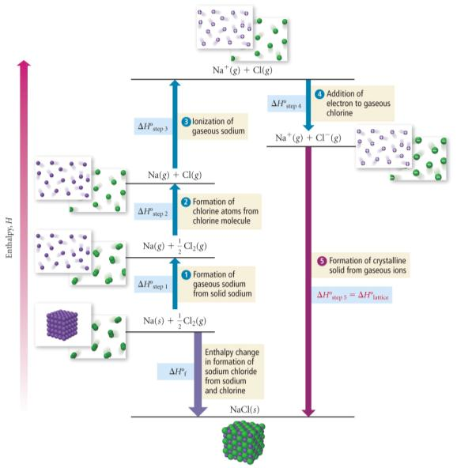
Born-Haber Cycle for NaCl

Slide 26
Born-Haber cycle for NaCl
The transfer of an electron from an Na atom to a Cl atom is not in itself energetically favorable; it requires 147 kJ/mol of energy (step 1).
493 kJ of energy is released when these oppositely charged ions come together to form ion pairs (step 2a)
Additional energy 293 kJ is released when these ion pairs form the solid crystal (step 2b)
The lattice energy released when 1 mol of Na+ & Cl- ions react to produce NaCl (s) is 786 kJ/mol
The overall process of NaCl formation is energetically favorable, releasing 639 kJ/mol if gaseous Na & Cl atoms are initially used.

Slide 27
Born-Haber cycle for NaCl
Na(s) → Na(g) ΔH₁ = 108 kJ
½Cl₂(g) → Cl(g) ΔH₂ = 120 kJ
Na(g) → Na⁺(g) + e⁻(g) ΔH₃ = 496 kJ
Cl(g) + e⁻(g) → Cl⁻(g) ΔH₄ = -349 kJ
Na⁺(g) + Cl⁻(g) → NaCl(s) ΔH₅ = -786 kJ
__________________________________________________
Na(s) + ½Cl₂(g) → NaCl(s) ΔHº_{f} = ?
**Step 1:Sublimation of sodium, Step 2: dissociation of chlorine, Step 3: ionization of sodium, Step 4: formation of chloride ion, Step 5: formation of sodium chloride from ions.

Slide 28
Practice - Given the Information Below, Determine the Lattice Energy of MgCl₂
Mg(s) → Mg(g) ΔH₁°_{f} = +147.1 kJ/mol
½ Cl₂(g) → Cl(g) ΔH₂°_{f} = +121.3 kJ/mol
Mg(g) → Mg⁺¹(g) ΔH₃°_{f} = +738 kJ/mol
Mg⁺¹(g) → Mg⁺²(g) ΔH₄°_{f} = +1450 kJ/mol
Cl(g) → Cl⁻¹(g) ΔH₅°_{f} = -349 kJ/mol
Mg(s) + Cl₂(g) → MgCl₂(s) ΔH₆°_{f} = -641.3 kJ/mol

Slide 29
Practice - Given the Information Below, Determine the Lattice Energy of MgCl₂
Mg(s) → Mg(g) ΔH₁°_{f} = +147.1 kJ/mol
½ Cl₂(g) → Cl(g) ΔH₂°_{f} = +121.3 kJ/mol
Mg(g) → Mg⁺¹(g) ΔH₃°_{f} = +738 kJ/mol
Mg⁺¹(g) → Mg⁺²(g) ΔH₄°_{f} = +1450 kJ/mol
Cl(g) → Cl⁻¹(g) ΔH₅°_{f} = -349 kJ/mol
Mg(s) + Cl₂(g) → MgCl₂(s) ΔH₆°_{f} = -641.3 kJ/mol

Slide 30
The Born-Haber Cycle
1. For a given solid, the difference in molar enthalpy between the solid and a gas of widely separated ions is called the lattice enthalpy (energy) of the solid. That is, lattice enthalpy (or energy) is the energy required to separate gaseous ions from a solid.
MX_{(s)} → M⁺_{(g)} + X⁻_{(g)}
    A. The lattice enthalpy of a solid CANNOT be measured directly.
    B. However, it can be calculated by utilizing the first law of thermodynamics and, in particular, the fact that enthalpy is a state function.
    C. This calculation invokes the use of a Born-Haber cycle, a closed path of steps, one of which is the formation of a solid lattice from its gaseous ions. The cycle traces the enthalpy changes that occur:
      1. beginning with the pure elements,
      2. atomize the pure elements to form gaseous atoms,
      3. ionize the atoms to form gaseous ions,
      4. allow the ions to form an ionic solid,
      5. AND convert the solid back into the pure elements.

Slide 31
Workshop 1 on Born-Haber Process
Problem #1: Devise and use a Born-Haber cycle to calculate the lattice enthalpy of potassium chloride.
Problem #2: Calculate the lattice enthalpy of calcium chloride.
Problem #3: Calculate the lattice enthalpy of magnesium bromide.

Slide 32
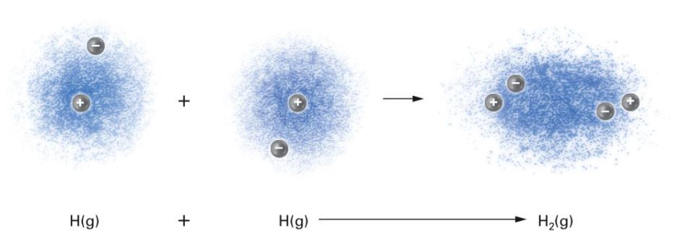
COVALENT BONDS

Slide 33
ELECTRONEGATIVITY
- A PROPERTY OF ALL ATOMS
- IS THE ABILITY OF AN ATOM TO ATTRACT A PAIR OF SHARED ELECTRONS.
- METALS GENERALLY HAVE LOW ELECTONEGATIVITY VALUES, METALS TEND TO LOSE ELECTRONS.
- NONMETALS GENERALLY HAVE HIGH ELECTRONEGATIVITY VALUES, NONMETALS TEND TO GAIN ELECTRONS.
- FLOURINE HAS THE HIGHEST VALUE (4.0) AND FRANCIUM HAS THE LOWEST (0.7)
- GENERAL TREND
INCREASES GOING ACROSS A PERIOD AND DECREASES GOING DOWN A COLUMN

Slide 34
CHEMICAL BONDS
COVALENT BONDS
- ARE FORMED BY THE SHARING OF A PAIR OF
ELECTRONS BETWEEN TWO ATOMS.
- INVOLVES THE OVERLAPPING OF THE VALENCE
ORBITALS.
- THE PROBABLITY OF FINDING THE VALENCE
ELECTRON OF ONE ATOM IS HIGHEST BETWEEN
THE TWO NUCLEI.
- EACH VALENCE ELECTRON IS EQUALLY
ATTRACTED TO BOTH NUCLEI, WHICH
STABILIZES THE MOLECULE.
- GENERALLY FULFILLS THE OCTET RULE FOR
BOTH ATOMS.
- OCCURS BETWEEN ATOMS OF SIMILAR
ELECTRONEGATIVITIES ( Δ≅ 0 OR VERY SMALL)

Slide 35
Potential Energy Diagram
The overall energy term involved is due to the net potential energy, which results from the attractive & repulsive forces between charged particles, and the Kinetic energy due to the motion of the electrons.
The zero point energy is defined as where the atoms are at infinite separation.
At very short distances the energy rises steeply due to the repulsive forces that exist when atoms are close together.
The bond length is at a distance where the system has minimal energy.

Slide 36
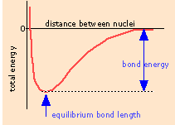

Slide 37
BOND LENGTH
“THE DISTANCE BETWEEN NUCLEI AT ITS MINIMUM ENERGY.
In order to break covalent bonds the BOND DISSOCIATION ENERGY must be added to the system.
In general the larger the BDE, the stronger the bond.
Average bond lengths can be estimated by using the trends in the periodic table.
C-C 1.54 A C=C 1.34 A C≡C 1.20 A

Slide 38
BOND ORDER
Describes the number of electron pairs being shared between any two bonded atoms.
Single bonds ≡ B.O. of 1
Double bonds ≡ B.O. of 2
Triple bonds ≡ B. O. of 3

Slide 39
DIPOLE MOMENT & POLARITY
Polarity is a term that describes the charge distribution about either a bond or a molecule.
If the electrons involved in a bond are unequally distributed along the bond axis and the electrons reside closer to the more electronegative atom, this bond is refered to as a POLAR covalent bond.
If the electrons are equally distributed (shared) along the bond axis then this type of bond is called NONPOLAR covalent bonds.
A dipole moment can be used to visualize the polarity of the bond and is represented by an arrow pointing towards the more electronegative atom and a “+” on the tail.

Slide 40
POLARITY OF A BOND
+ + +
H-Cl S - N C - O
2.1 - 3.0 2.5 - 3.0 2.5 - 3.5
Δ = 0.9 Δ = 0.5 Δ = 1.0
If bonds were formed between any of the above examples, the bond would be refered to as a polar covalent bond. A dipole moment can be drawn in each case because the difference in electronegativity is greateer than zero. The example below has zero difference in electronegativity and no dipole can be drawn.
S - C nonpolar covalent bond
2.5 - 2.5
Δ = 0

Slide 41
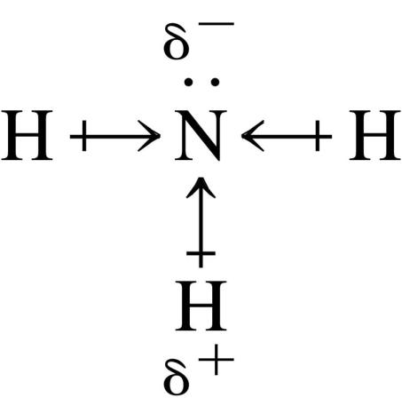
dipole moment, μ, is a measure of bond polarity
  it is directly proportional to the size of the partial charges and directly proportional to the distance between them
    μ = (q)(r)
    (not Coulomb’s Law)
    measured in Debyes, D

Slide 42
Electronegativity and Bond Polarity
If difference in electronegativity between bonded atoms is 0, the bond is pure covalent
  equal sharing
If difference in electronegativity between bonded atoms is 0.1 to 0.4, the bond is nonpolar covalent
If difference in electronegativity between bonded atoms 0.5 to 1.9, the bond is polar covalent
If difference in electronegativity between bonded atoms larger than or equal to 2.0, the bond is ionic
Percent Ionic Character
4%
51%
“100%”
0
0.4
2.0
4.0
Electronegativity Difference

Slide 43
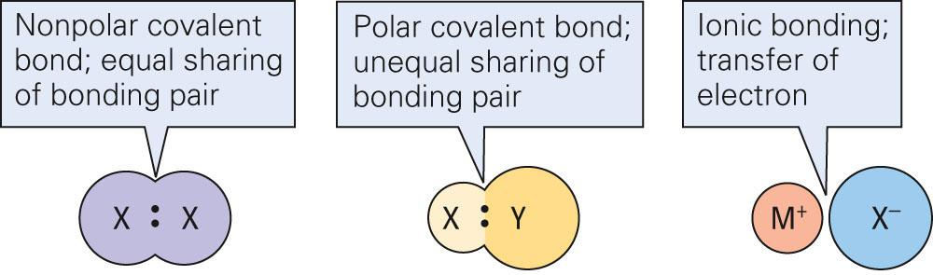
Chemical Bonds

