Slide 1
ELECTRON
CONFIGURATION

Slide 2
Electron Configuration
Electron configuration is a shorthand notation for describing the arrangement of the electrons about the nucleus.
General Format using the quantum numbers:
n l ^{e-}
RULES:
1. Fill the lowest energy levels first.
1s 2s 2p 3s 3p 4s 3d 4p
2. No more than two electrons per orbital.
n = principle quantum number
l = angular momentum quantum number
e- = number of electrons
Lowest

Slide 3
Electron Configuration
Examples:
H : 1s¹ He: 1s² Li : 1s² 2s¹
Co: 1s² 2s² 2p⁶ 3s² 3p⁶ 4s² 3d⁷
Br: 1s² 2s² 2p⁶ 3s² 3p⁶ 4s² 3d¹⁰ 4p⁵
The condensed electron configuration distinguishes the core electrons from the valence electrons. CORE electrons are tightly held to the nucleus and resemble a noble gas configuration. VALENCE electrons are the outer most electrons and are involved in chemical reactions.
Examples of the condensed configuration:
Li:[He] 2s¹ Co:[Ar] 4s² 3d⁷
Br:[Ar] 4s² 3d¹⁰ 4p⁵

Slide 4
A few principles to consider:
Aufbau Principle: The procedure for arriving at the ground-state electron configurations of atoms and molecules in order of increasing atomic number. To proceed from one atom to the next, we add a proton and some neutrons to the nucleus and then describe the orbital into which the added electron goes.
Hund’s Rule: Whenever orbitals of equal energy (degenerate) are available, electrons occupy these orbitals singly before pairing begins.
Core vs. Valence electrons: inner vs. outermost electrons (latter contained within outermost shell)

Slide 5
s¹
s²
p¹ p² p³ p⁴ p⁵
s²
1
2
3
4
5
6
7
p⁶
d¹ d² d³ d⁴ d⁵ d⁶ d⁷ d⁸ d⁹ d¹⁰
f² f³ f⁴ f⁵ f⁶ f⁷ f⁸ f⁹ f¹⁰ f¹¹ f¹² f¹³ f¹⁴ f¹⁴d¹

Slide 6
Electron Configuration from the Periodic Table
1A
8A
1
2
3
4
5
6
7
2A
3A
4A
5A
6A
7A
Ne
3s²
P
3p³
P = [Ne]3s²3p³
P has 5 valence electrons

Slide 7
Sublevel Splitting in Multielectron Atoms
the sublevels in each principal energy level of Hydrogen all have the same energy – we call orbitals with the same energy degenerate
or other single electron systems
for multielectron atoms, the energies of the sublevels are split
caused by electron-electron repulsion
the lower the value of the l quantum number, the less energy the sublevel has
s (l = 0) < p (l = 1) < d (l = 2) < f (l = 3)

Slide 8
APPLICATION OF QUANTUM CHEMISTRY – The multi-electron atom
subshells
shielded
effective nuclear charge, Z_{eff},
penetrate
order : s < p < d < f.

Slide 9
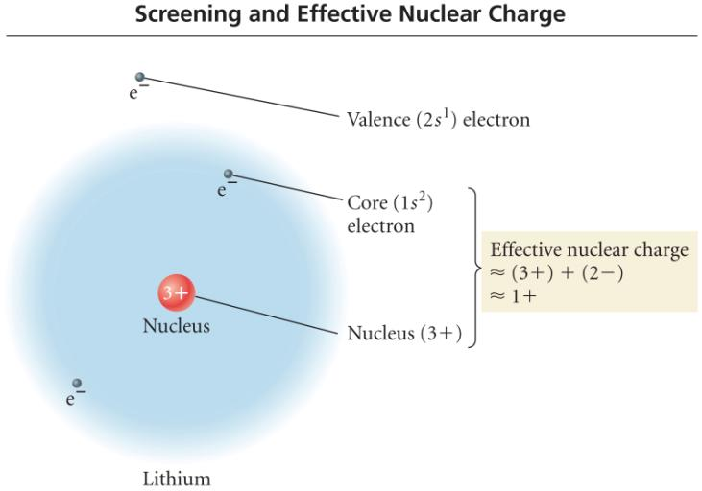
Screening & Effective Nuclear Charge

Slide 10
Many-Electron Atoms
We have to examine the balance of attractions and repulsions in the atom to explain why subshells of a given shell have different energies. As well as being attracted by the nucleus, each electron in a many-electron atom is repelled by the other electrons present. As a result, it is less tightly bound to the nucleus than it would be if those other electrons were absent. We say that each electron is shielded from the full attraction of the nucleus by the other electrons in the atom. The shielding effectively reduces the pull of the nucleus on an electron. The effective nuclear charge, Z_{eff}, experienced by the electron is always less than the actual nuclear charge, Z, because the electron-electron repulsions work against the pull of the nucleus. Note that the other electrons do not “block” the influence of the nucleus; they simply provide additional repulsive Coulombic interactions that partly counteract the pull of the nucleus. Finally, an s-electron of any shell can be found very close to the nucleus, so we say that it can penetrate through the inner shells. A p-electron penetrates much less. Because a p-electron penetrates less than an s-electron through the inner shells of the atom, it is more effectively shielded from the nucleus and hence experiences a smaller effective nuclear charge than an s-electron does. That is, an s-electron is bound more tightly than a p-electron and has a slightly lower (more negative) energy. In a many-electron atom, because of the effects of penetration and shielding, the order of energies of orbitals in a given shell is typically s < p < d < f.

Slide 11
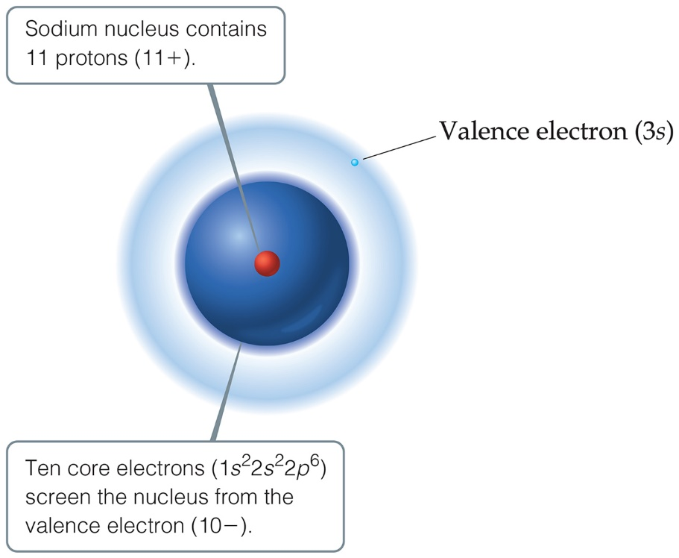
Effective Nuclear Charge (1 of 2)
Many properties depend on attractions between valence electrons and the nucleus.
Electrons are both attracted to the nucleus and repelled by other electrons.
The forces an electron experiences depend on both factors.

Slide 12
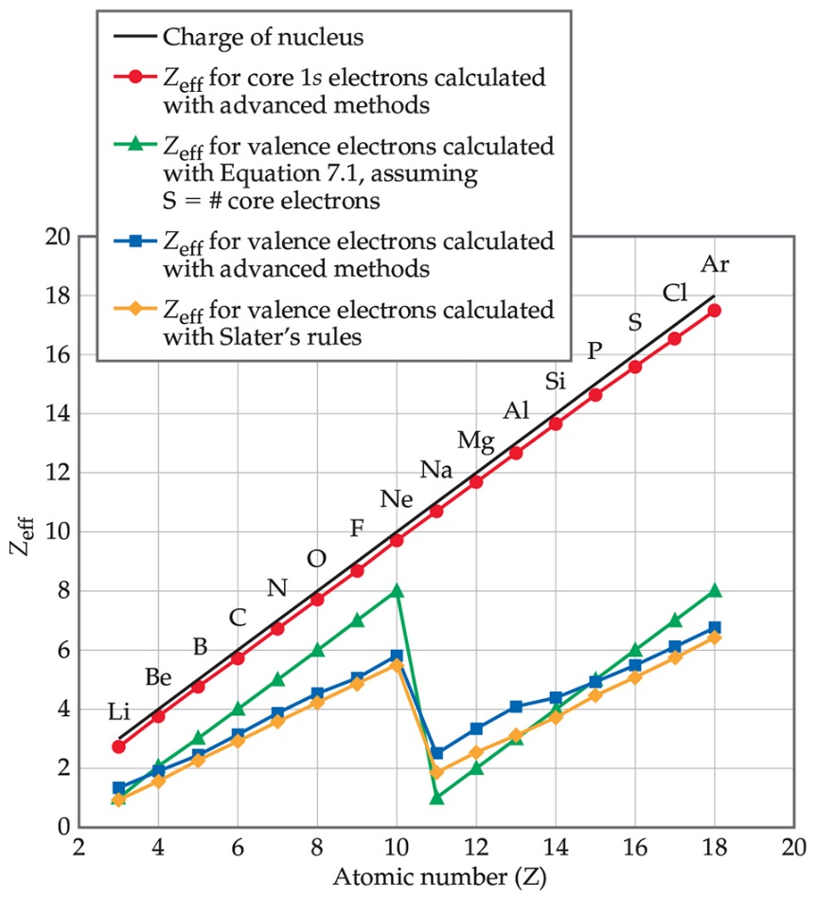
Effective Nuclear Charge (2 of 2)
The effective nuclear charge, Z_{eff}, is found this way:
Z_{eff} = Z − S
where Z is the atomic number and S is a screening constant, usually close to the number of inner electrons.
Effective nuclear charge is a periodic property:
It increases across a period.
It increases slightly down a group.

Slide 13
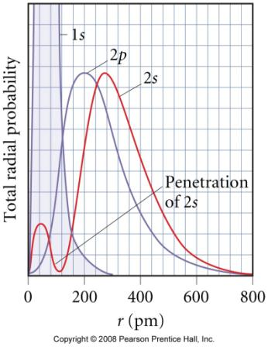
Penetrating and Shielding
the radial distribution function shows that the 2s orbital penetrates more deeply into the 1s orbital than does the 2p
the weaker penetration of the 2p sublevel means that electrons in the 2p sublevel experience more repulsive force, they are more shielded from the attractive force of the nucleus
the deeper penetration of the 2s electrons means electrons in the 2s sublevel experience a greater attractive force to the nucleus and are not shielded as effectively
the result is that the electrons in the 2s sublevel are lower in energy than the electrons in the 2p

Slide 14
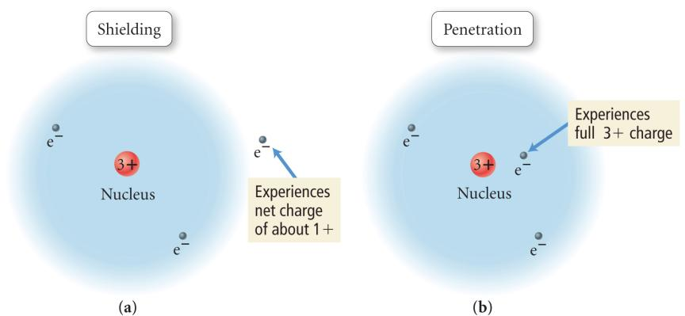
Penetration & Shielding

Slide 15
Orbital Diagrams
Orbital diagrams are written in order of increasing energy levels starting with the lowest energy level the 1s orbital.
___ ___ ___ 4p
___ ___ ___ ___ ___ 3d
___ 4s
___ ___ ___ 3p
___ 3s
___ ___ ___ 2p
___ 2s
___ 1s
RULES:
(1) fill the lowest energy level first
(2) fill each orbital in a subshell with one electron first before you double up.
(3) Completely fill each subshell before proceeding to the next energy level.
Remember the order!!

Slide 16
6d
7s
5f
6p
5d
6s
4f
5p
4d
5s
4p
3d
Energy
4s
3p
Notice the following:
because of penetration, sublevels within an energy level are not degenerate
penetration of the 4th and higher energy levels is so strong that their s sublevel is lower in energy than the d sublevel of the previous energy level
the energy difference between levels becomes smaller for higher energy levels
3s
2p
2s
1s

Slide 17
QUANTUM MECHANICS & ORBITAL DIAGRAMS
Orbital Energy Levels:
_ _ _
6p _ _ _ _ _
5d _ _ _ _ _ _ _
__ 4f
E 6s _ _ _
n 5p _ _ _ _ _
e 4d
r __
g 5s _ _ _
y 4p _ _ _ _ _
3d
__
4s _ _ _
3p
__
3s _ _ _
2p
__
2s
__
1s
Example of Ionization Energies:
Al_{(g)} → Al⁺_{(g)} + e⁻ I₁ = 580 kJ/mol
Al⁺_{(g)} → Al²⁺_{(g)} + e⁻ I₂ = 1815 kJ/mol
Al²⁺_{(g)} → Al³⁺_{(g)} + e⁻ I₃ = 2740 kJ/mol
Al³⁺_{(g)} → Al⁴⁺_{(g)} + e⁻ I₄ = 11,600 kJ/mol

Slide 18
Electron Configuration from the Periodic Table
1A
8A
1
2
3
4
5
6
7
2A
3A
4A
5A
6A
7A
3d¹⁰
Ar
4s²
As
4p³
As = [Ar]4s²3d¹⁰4p³
As has 5 valence electrons

Slide 19
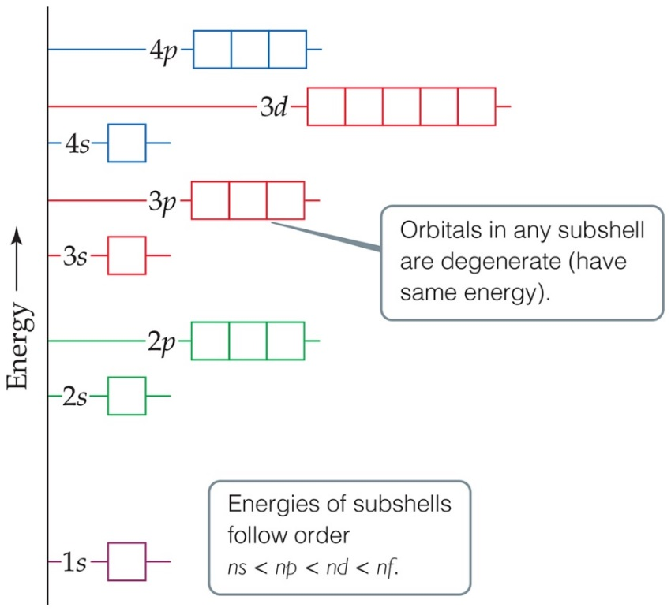
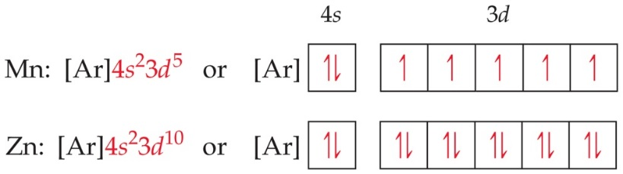
Transition Metals
Argon (atomic number 18) ends period 3. Its electron configuration is
Potassium (atomic number 19) might be expected to have electrons in 3d. But 4s fills next.
Transition metals follow the filling of 4s by filling 3d in the 4th period.

Slide 20
Transition Elements
for the d block metals, the principal energy level is one less than valence shell
one less than the Period number
sometimes s electron “promoted” to d sublevel
Zn
Z = 30, Period 4, Group 2B
[Ar]4s²3d¹⁰
4s
3d
for the f block metals, the principal energy level is two less than valence shell
two less than the Period number they really belong to
sometimes d electron in configuration
Eu
Z = 63, Period 6
[Xe]6s²4f ⁷
6s
4f

Slide 21
Lanthanides and Actinides
The elements which fill the f orbitals have special names as a portion of a period, not as a group.
The lanthanide elements (atomic numbers 57 to 70) have electrons entering the 4f sublevel.
The actinide elements (including Uranium, at. no. 92, and Plutonium, at. no. 94) have electrons entering the 5f sublevel.

Slide 22
Electron configuration: transition and inner-transition Elements.
In general we use the Aufbau (or building up) principle to determine electron configuration, but as with most chemistry, there are exceptions to the rule. Look to the right.
Unfortunately, the Aufbau rule cannot predict all electron configuration as it doesn't take into account electron-electron interactions and other quantum mechanical effects. In the end the Aufbau is only a rule of thumb. Electronic levels have to be found using quantum calculations taking into account electron-electron interactions (not to mention spin orbit coupling).
Chromium | [Ar] 3d⁵ 4s¹
Copper | [Ar] 3d¹⁰ 4s¹
Niobium | [Kr] 4d⁴ 5s¹
Molybdenum | [Kr] 4d⁵ 5s¹
Ruthenium | [Kr] 4d⁷ 5s¹
Rhodium | [Kr] 4d⁸ 5s¹
Palladium | [Kr] 4d¹⁰ 5s⁰
Silver | [Kr] 4d¹⁰ 5s¹
Lanthanum | [Xe] 5d¹ 6s²
Cerium | [Xe] 4f¹ 5d¹ 6s²
Gadolinium | [Xe] 4f⁷ 5d¹ 6s²
Platinum | [Xe] 4f¹⁴ 5d⁹ 6s¹
Gold | [Xe] 4f¹⁴ 5d¹⁰ 6s¹
Actinium | [Rn] 6d¹ 7s²
Thorium | [Rn] 6d² 7s²
Protactinium | [Rn] 5f² 6d¹ 7s²
Uranium | [Rn] 5f³ 6d¹ 7s²
Neptunium | [Rn] 5f⁴ 6d¹ 7s²
Curium | [Rn] 5f⁷ 6d¹ 7s²

Slide 23
Practice – Use the Periodic Table to write the short electron configuration and orbital diagram for each of the following
Na (at. no. 11)
Te (at. no. 52)
Tc (at. no. 43)

Slide 24
Practice – Use the Periodic Table to write the short electron configuration and orbital diagram for each of the following
Na (at. no. 11) [Ne]3s¹
Te (at. no. 52) [Kr]5s²4d¹⁰5p⁴
Tc (at. no. 43) [Kr]5s²4d⁵
3s
5s
4d
5p
5s
4d

Slide 25
Lecture Questions
1. Determine the ground-state electron configuration for each of the following elements:
A. sulfur B. polonium
2. Predict the number of valence electrons present in each of the following atoms (include the outermost d-electrons when necessary):
A. B B. Ba C. Bi
3. Determine the ground-state electron configuration for each of the following ions:
A. Al⁺³ B. Tc⁺⁴
4. Predict the number of valence electrons present for each of the following ions:
A. In⁺ B. Tc⁺²
5. Give the ground-state electron configuration and number of unpaired electrons expected for each of the following ions:
A. Ga³⁺ B. Cu⁺²
6. For each of the following ground-state ions, predict the type of orbital that the electrons of highest energy will occupy:
A. Fe⁺² B. Bi⁺³

Slide 26
Workshop on electron configuration
1. Determine the ground-state electron configuration for each of the following elements (see last page of this section for sample energy levels):
A. chlorine B. cesium
C. vanadium D. rhenium
2. Predict the number of valence electrons present in each of the following atoms (include the outermost d-electrons):
A. Sn B. La C. Mn D. Zn
3. Determine the ground-state electron configuration for each of the following ions:
A. Co⁺³ B. Mo⁺² C. Ra⁺²
D. I⁻ E. Ir⁺ F. Ru⁺⁴
4. Predict the number of valence electrons present for each of the following ions:
A. Tl⁺ B. Po⁺² C. Ta⁺² D. Re⁺
5. Give the ground-state electron configuration and number of unpaired electrons expected for each of the following ions:
A. Ga⁺ B. Cu⁺¹ C. Pb⁺² D. Se⁻²
6. For each of the following ground-state ions, predict the type of orbital that the electrons of highest energy will occupy:
A. Fe⁺³ B. B⁺³ C. As⁺³ D. Os⁺

Slide 27
Chapter 7 PERIODICITY

Slide 28
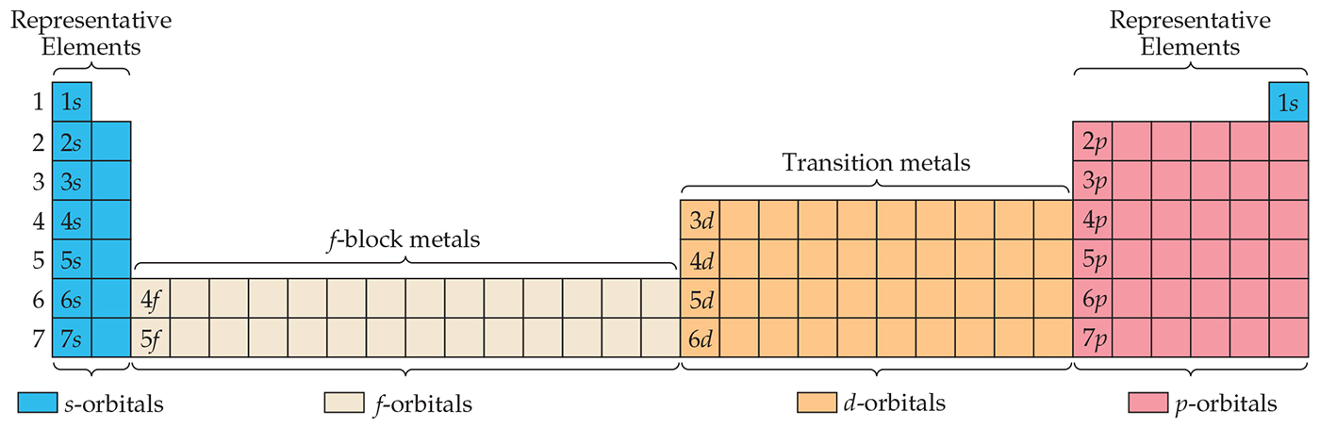
Periodic Table
We fill orbitals in increasing order of energy.
Different blocks on the periodic table correspond to different types of orbitals: s = blue, p = pink (s and p are representative elements); d = orange (transition elements); f = tan (lanthanides and actinides, or inner transition elements)
The s and p blocks are called the main-group elements.

Slide 29
PERIODICITY
Diamagnetic vs. Paramagnetic species:
Diamagnetic has all its electrons paired and is slightly repelled by a magnetic field
Paramagnetic has one or more unpaired electrons and is attracted into a magnetic field.
Which group(s) on the periodic table will have elements that are always diamagnetic?

Slide 30
Periodic Trends
1. Atomic Radius
2. Ionization Energy – energy needed to remove an electron from gaseous atom
increases
Decreases across
Increases
down
Decreases
down
Increases across

Slide 31
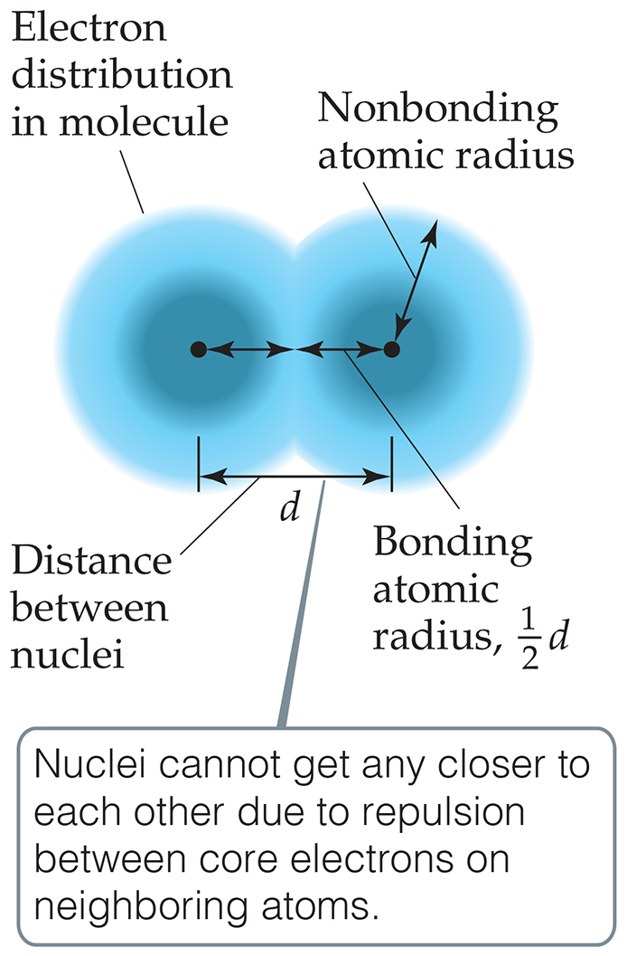
What Is the Size of an Atom?
The nonbonding atomic radius, or van der Waals radius, is half of the shortest distance separating two nuclei during a collision of atoms.
The bonding atomic radius, or covalent radius, is half the distance between nuclei in a bond.

Slide 32
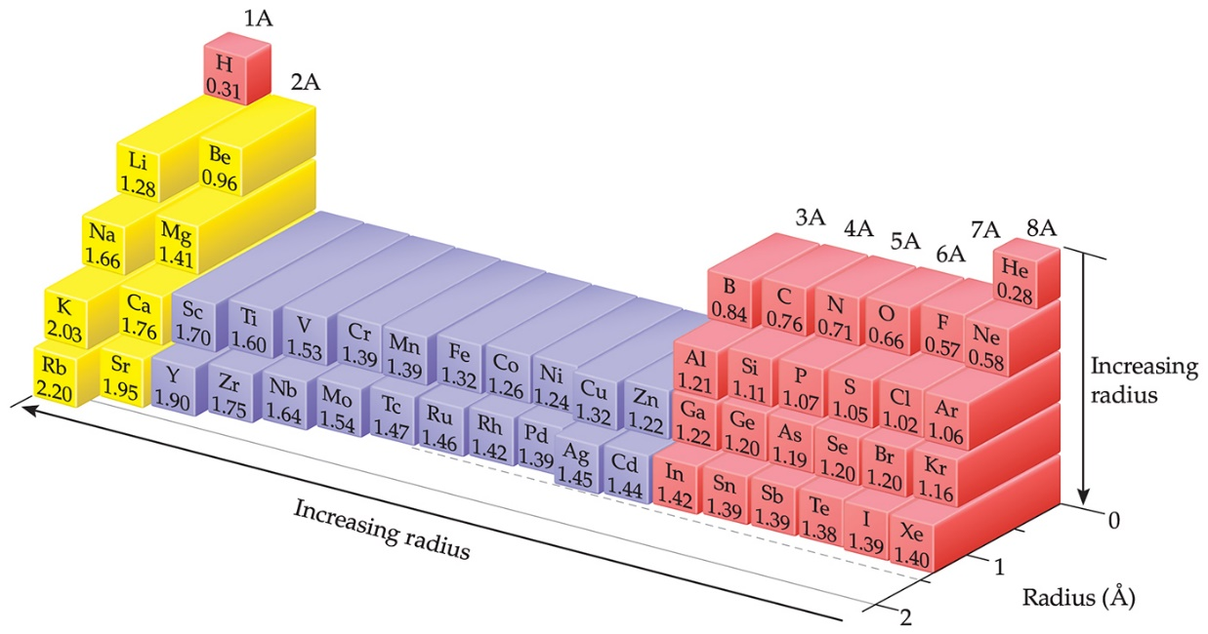
Sizes of Atoms
This figure shows the trend in bonding atomic radius.
The bonding atomic radius tends to
decrease from left to right across a period (Z_{eff} ↑).
increase from top to bottom of a group (n ↑).

Slide 33
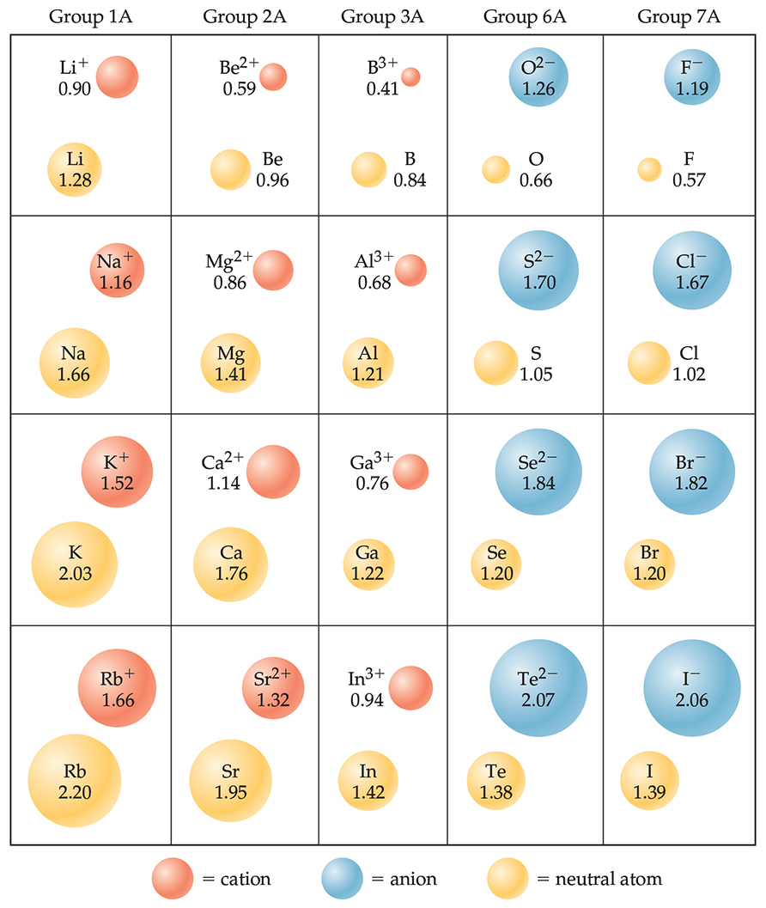
Sizes of Ions (1 of 2)
Determined by interatomic distances in ionic compounds
Ionic size depends on
the nuclear charge.
the number of electrons.
the orbitals in which electrons reside.

Slide 34
Sizes of Ions (2 of 2)
Cations are smaller than their parent atoms:
The outermost electron is removed and repulsions between electrons are reduced.
Anions are larger than their parent atoms:
Electrons are added and repulsions between electrons are increased.

Slide 35
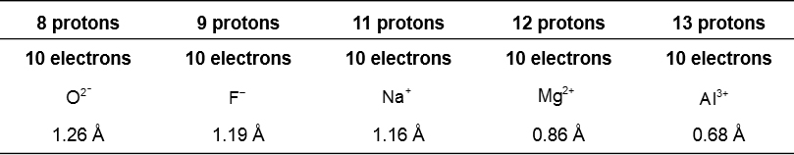
Size of Ions—Isoelectronic Series
In an isoelectronic series, ions have the same number of electrons.
Ionic size decreases with an increasing nuclear charge.
An isoelectronic series (10 electrons)
Note increasing nuclear charge with decreasing ionic radius as atomic number increases
Increasing nuclear charge →
Decreasing ionic radius →

Slide 36
Ionization Energy (I)
The ionization energy is the minimum energy required to remove an electron from the ground state of a gaseous atom or ion.
The first ionization energy is that energy required to remove the first electron.
The second ionization energy is that energy required to remove the second electron.
Note: The higher the ionization energy, the more difficult it is to remove an electron!

Slide 37
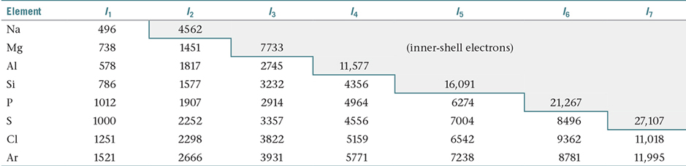
Ionization Energy
It requires more energy to remove each successive electron.
When all valence electrons have been removed, it takes a great deal more energy to remove the next electron (a core electron).
Table 7.2 Successive Values of Ionization Energies, I, for the Elements Sodium through Argon (kJ/m o l)

Slide 38
Periodic Trends in First Ionization Energy (I₁)
I₁ generally increases across a period.
I₁ generally decreases down a group.
The s- and p-block elements show a larger range of values for I₁. (The d-block generally increases slowly across the period; the f-block elements show only small variations.)

Slide 39
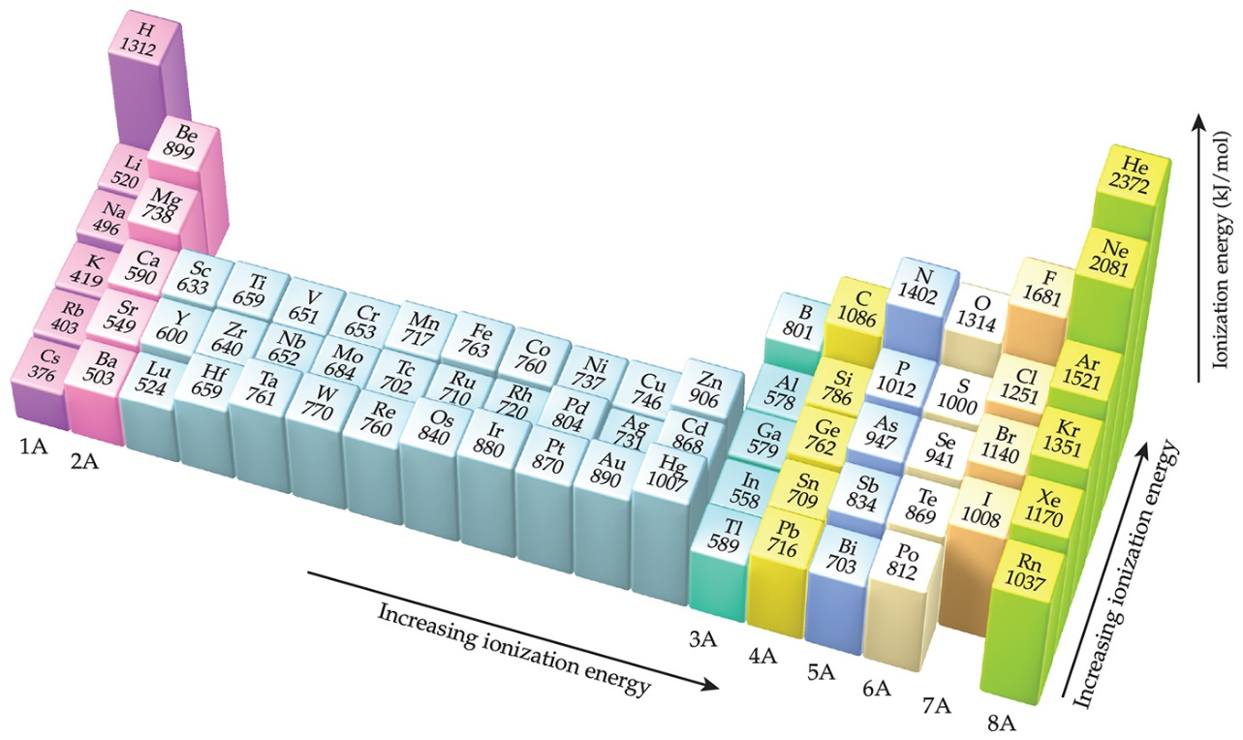
Factors That Influence Ionization Energy
Smaller atoms have higher I values.
I values depend on effective nuclear charge and average distance of the electron from the nucleus.

Slide 40
Electron Affinity
Electron affinity is the energy change accompanying the addition of an electron to a gaseous atom:
It is typically exothermic, so, for most elements, it is negative!

Slide 41
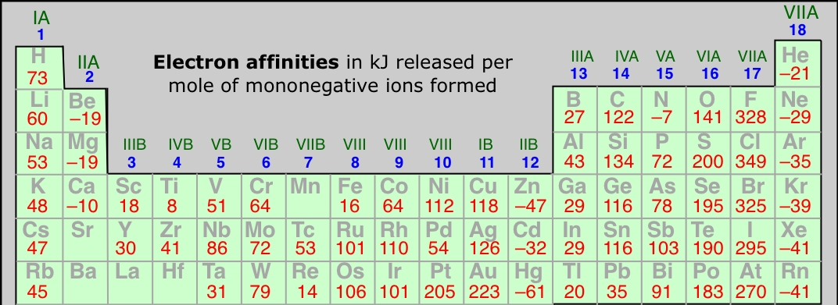
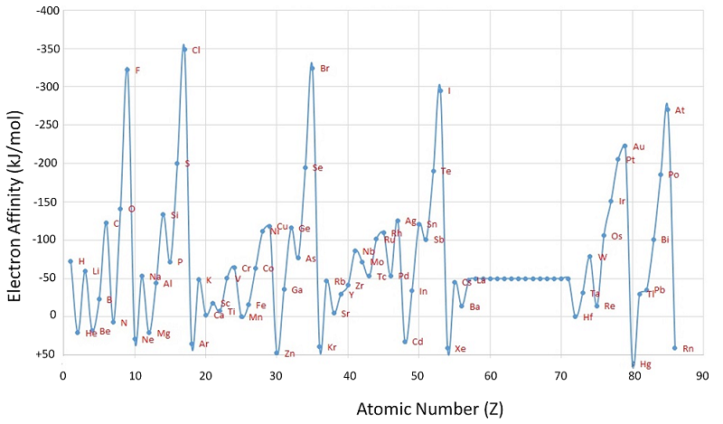
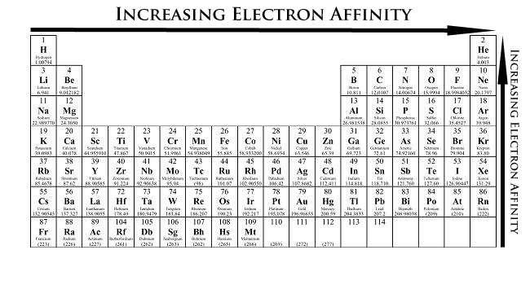
3. Electron Affinity – energy released when an electron is added to gaseous atom

Slide 42
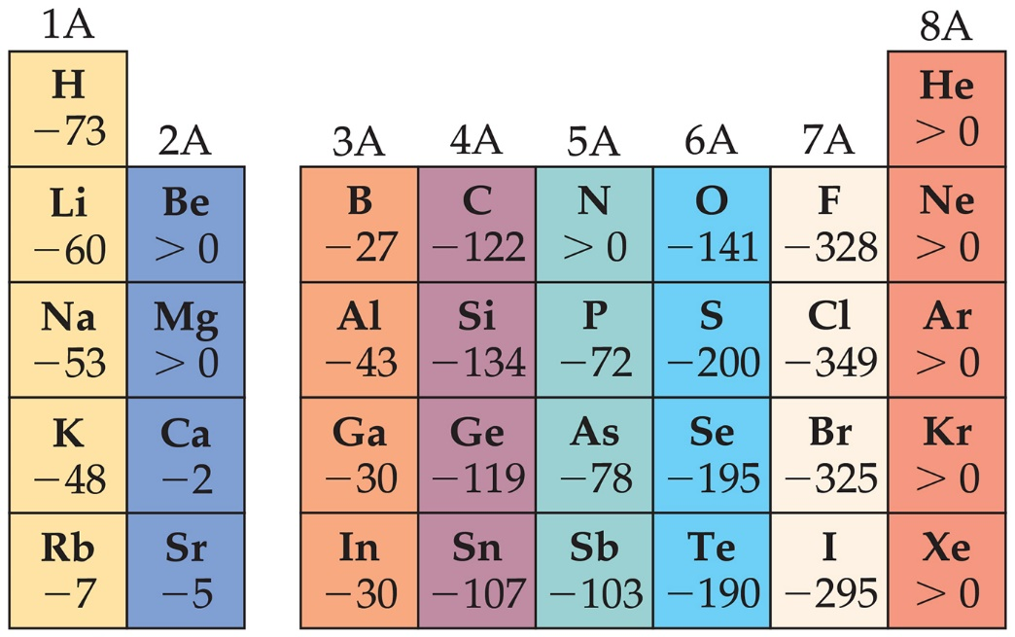
General Trend in Electron Affinity
Not much change in a group.
Across a period, it generally increases. Three notable exceptions include the following:
Group 2A: s sublevel is full!
Group 5A: p sublevel is half-full!
Group 8A: p sublevel is full!
*Note: The electron affinity for many of these elements is
positive

Slide 43
3. Electron Affinity – energy released when an electron is added to gaseous atom
4. Electronegativity – the electron pulling power of an atom when it is part of a molecule (denoted with the Greek letter χ)
5. Metallic Character

Slide 44
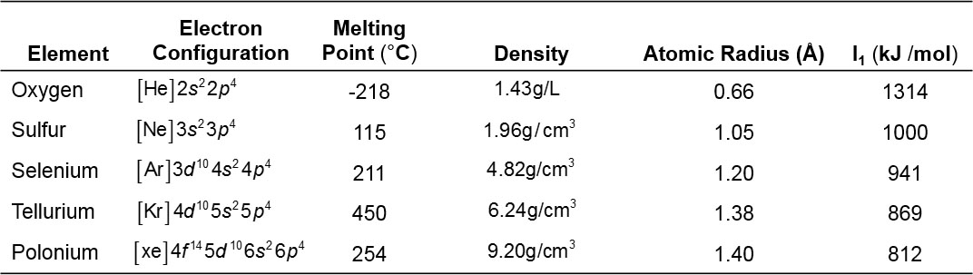
Group 6A—Increasing in Metallic Character down the Group
Table 7.6 Some Properties of the Group 6A Elements
Oxygen, sulfur, and selenium are nonmetals.
Tellurium is a metalloid.
The radioactive polonium is a metal.
Trend: Oxygen is more likely to form –2 anion; polonium is most likely to have a positive charge.

Slide 45
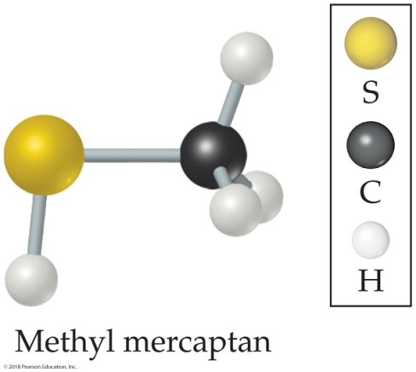
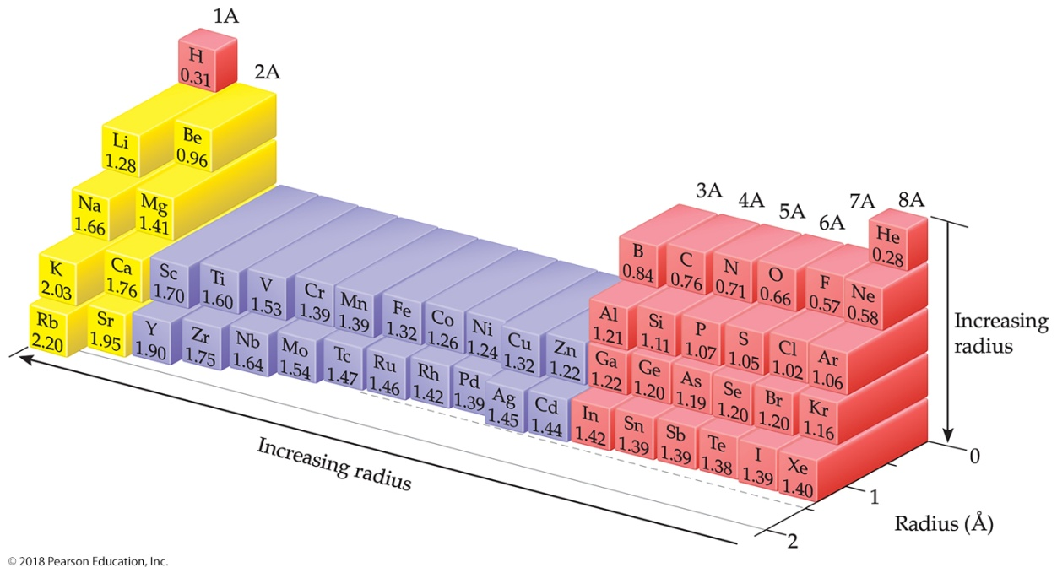
Example: Bond Lengths in a Molecule from atomic radius
Natural gas used in home heating and cooking is odorless. Because natural gas leaks pose the danger of explosion or suffocation, various smelly substances are added to the gas to allow detection of a leak. One such substance is methyl mercaptan, CH₃SH. Use Figure 7.7 to predict the lengths of the C—S, C—H, and S—H bonds in this molecule.

Slide 46
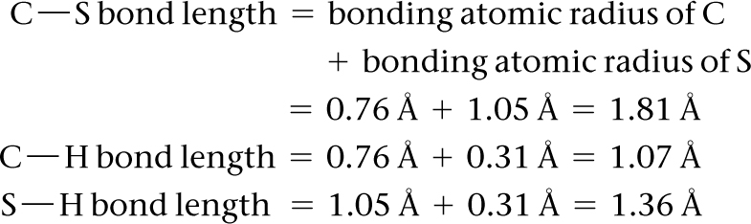
Example: Bond Lengths in a Molecule from atomic radius
Continued
Solution
Analyze and Plan We are given three bonds and told to use Figure 7.7 for bonding atomic radii. We will assume that each bond length is the sum of the bonding atomic radii of the two atoms involved.
Solve
Check The experimentally determined bond lengths are C—S = 1.82 Å, C—H = 1.10 Å, and S—H = 1.33 Å. (In general, the lengths of bonds involving hydrogen show larger deviations from the values predicted from bonding atomic radii than do bonds involving larger atoms.)
Comment Notice that our estimated bond lengths are close but not exact matches to the measured bond lengths. Bonding atomic radii must be used with some caution in estimating bond lengths.

Slide 47
Example: Bond Lengths in a Molecule from atomic radius
Continued
Practice Exercise 1
Hypothetical elements X and Y form a molecule XY₂, in which both Y atoms are bonded to atom X (and not to one another). The X—X distance in the elemental form of X is 2.04 Å, and the Y—Y distance in elemental Y is 1.68 Å. What would you predict for the X—Y distance in the XY₂ molecule? (a) 0.84 Å (b) 1.02 Å (c) 1.86 Å (d) 2.70 Å (e) 3.72 Å
Practice Exercise 2
Using Figure 7.7, predict which is longer, the P—Br bond in PBr₃ or the As—Cl bond in AsCl₃.

Slide 48
Integrative Exercise Putting Concepts Together
The element bismuth (Bi, atomic number 83) is the heaviest member of group 5A. A salt of the element, bismuth subsalicylate, is the active ingredient in Pepto-Bismol®, an over-the-counter medication for gastric distress.
(a) Based on values presented in Figure 7.7 and Tables 7.5 and 7.6, what might you expect for the bonding atomic radius of bismuth?
(b) What accounts for the general increase in atomic radius going down the group 5A elements?
(c) Another major use of bismuth has been as an ingredient in low-melting metal alloys, such as those used in fire sprinkler systems and in typesetting. The element itself is a brittle white crystalline solid. How do these characteristics fit with the fact that bismuth is in the same periodic group with such nonmetallic elements as nitrogen and phosphorus?
(d) Bi₂O₃ is a basic oxide. Write a balanced chemical equation for its reaction with dilute nitric acid. If 6.77 g of Bi₂O₃ is dissolved in dilute acidic solution to make 0.500 L of solution, what is the molarity of the solution of Bi³⁺ ion?
(e) ²⁰⁹Bi is the heaviest stable isotope of any element. How many protons and neutrons are present in this nucleus?
(f) The density of Bi at 25 °C is 9.808 g ⁄ cm³. How many Bi atoms are present in a cube of the element that is 5.00 cm on each edge? How many moles of the element are present?

Slide 49
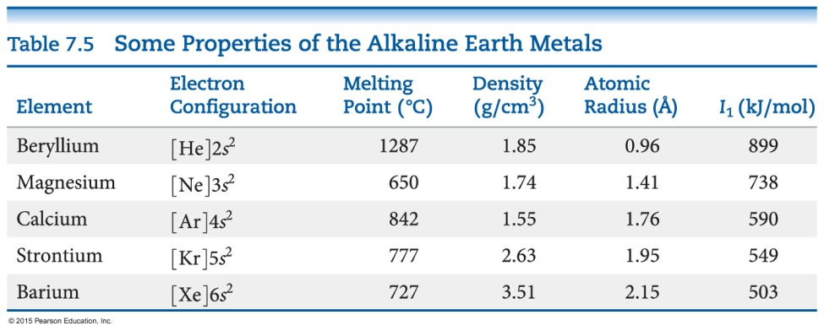
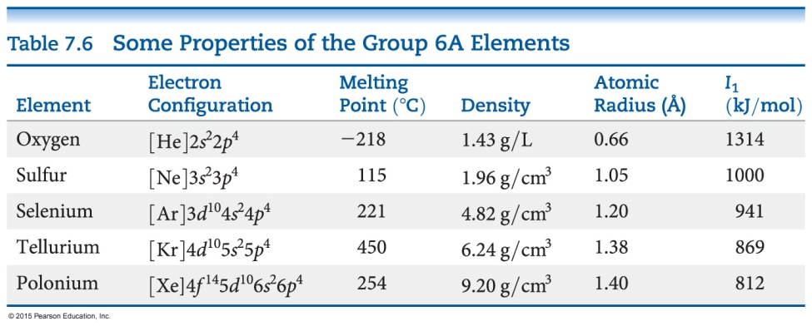
Integrative Exercise Putting Concepts Together
Continued

Slide 50
Integrative Exercise Putting Concepts Together
Continued
Solution
(a) Bismuth is directly below antimony, Sb, in group 5A. Based on the observation that atomic radii increase as we go down a column, we would expect the radius of Bi to be greater than that of Sb, which is 1.39 Å. We also know that atomic radii generally decrease as we proceed from left to right in a period. Tables 7.5 and 7.6 each give an element in the same period, namely Ba and Po. We would therefore expect that the radius of Bi is smaller than that of Ba (2.15 Å) and larger than that of Po (1.40 Å). We also see that in other periods, the difference in radius between the neighboring group 5A and group 6A elements is relatively small. We might therefore expect that the radius of Bi is slightly larger than that of Po—much closer to the radius of Po than to the radius of Ba. The tabulated value for the atomic radius on Bi is 1.48 Å, in accord with our expectations.
(b) The general increase in radius with increasing atomic number in the group 5A elements occurs because additional shells of electrons are being added, with corresponding increases in nuclear charge. The core electrons in each case largely screen the outermost electrons from the nucleus, so the effective nuclear charge does not vary greatly as we go to higher atomic numbers. However, the principal quantum number, n, of the outermost electrons steadily increases, with a corresponding increase in orbital radius.
(c) The contrast between the properties of bismuth and those of nitrogen and phosphorus illustrates the general rule that there is a trend toward increased metallic character as we move down in a given group. Bismuth, in fact, is a metal. The increased metallic character occurs because the outermost electrons are more readily lost in bonding, a trend that is consistent with its lower ionization energy.

Slide 51
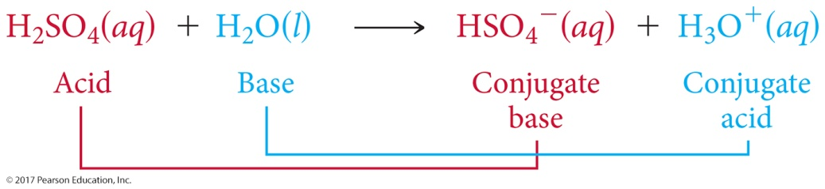
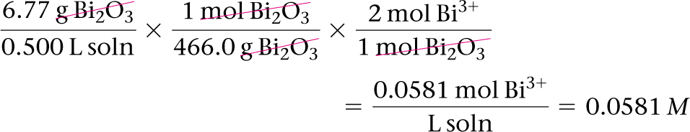
Integrative Exercise Putting Concepts Together
Continued
(d) Following the procedures described in Section 4.2 for writing molecular and net ionic equations, we have the following:
Molecular equation:
Bi₂O₃(s) + 6 HNO₃(aq) 2 Bi(NO₃)₃(aq) + 3 H₂O(l)
Net ionic equation:
Bi₂O₃(s) + 6 H⁺(aq) 2 Bi³ + (aq) + 3 H₂O(l)
In the net ionic equation, nitric acid is a strong acid and Bi(NO₃)₃ is a soluble salt, so we need to show only the reaction of the solid with the hydrogen ion forming the Bi³⁺(aq) ion and water. To calculate the concentration of the solution, we proceed as follows (Section 4.5):
(e) Recall that the atomic number of any element is the number of protons and electrons in a neutral atom of the element. (Section 2.3) Bismuth is element 83; there are therefore 83 protons in the nucleus. Because the atomic mass number is 209, there are 209 – 83 = 126 neutrons in the nucleus.

Slide 52
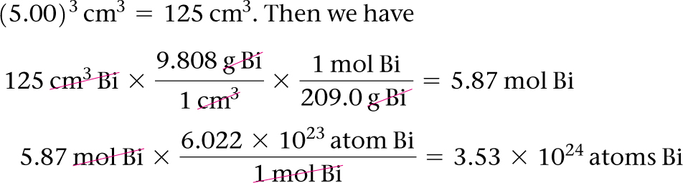
Integrative Exercise Putting Concepts Together
Continued
(f) We can use the density and the atomic weight to determine the number of moles of Bi, and then use Avogadro’s number to convert the result to the number of atoms. (Sections 1.4 and 3.4) The volume of the cube is (5.00)³ cm³ = 125 cm³. Then we have

Slide 53
Workshop on periodic trends
1. Arrange the following in terms of DECREASING atomic radius & then first ionization energy & then electronegativity:
Be, B, C, N, O, F, Ne
2. Why is the first ionization energy of aluminum slightly lower than the first ionization energy for magnesium?
3. Why is the second ionization energy for sodium so much greater than its first ionization energy?
4. Arrange the following in terms of DECREASING atomic (or ionic) radii:
O⁺, O, O⁻
5. Give a reason why the electronegativity for F is so much greater than the electronegativity for Fr.

