Slide 1
Chapter 1 Matter, Measurement, and Problem Solving

Slide 2
The Scientific Approach to Knowledge
philosophers try to understand the universe by reasoning and thinking about “ideal” behavior; they argue and/or discuss their best ideas.
scientists try to understand the universe through empirical knowledge gained through observation and experiment; ie. The scientific method.

Slide 3
SCIENTIFIC METHOD
1. FACT : An observable event; indisputable evidence which does not explain but simply is.
2. HYPOTHESIS: A guess to try to explain an observation.
3. EXPERIMENT: A systematic exploration of an observation or concept.
4. THEORY: An explanation of the facts; it can be proven by experiment and it confirms an hypothesis.
5. LAW: A theory which has undergone rigorous experimentation and no contradiction can be found.
Note: MODEL: A visual or mathematical device or method used to demonstrate a theory or concept.

Slide 4
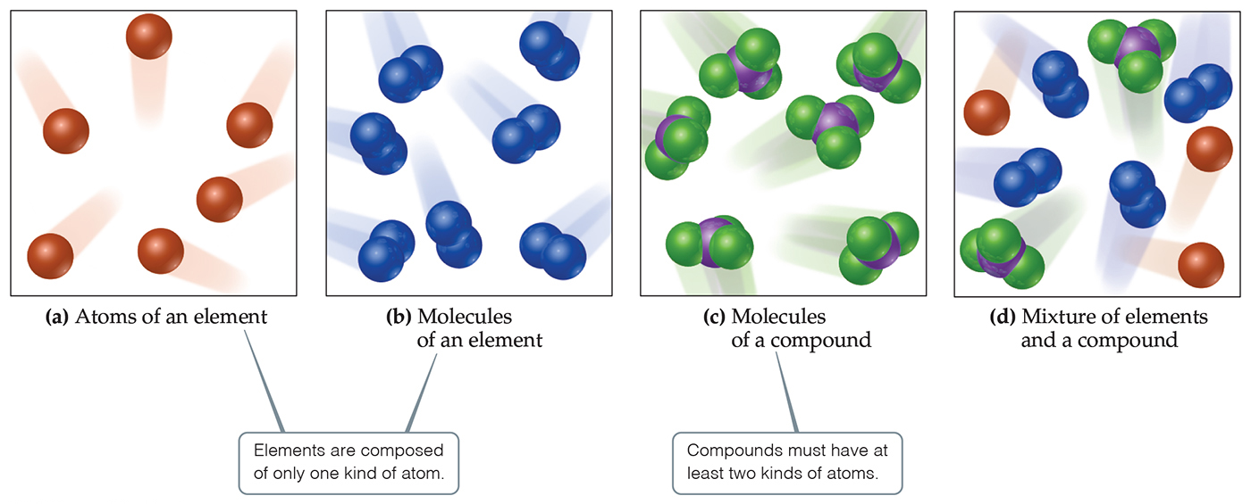
Chemistry is the study of Matter
Matter is anything that has mass and takes up space.

Slide 5
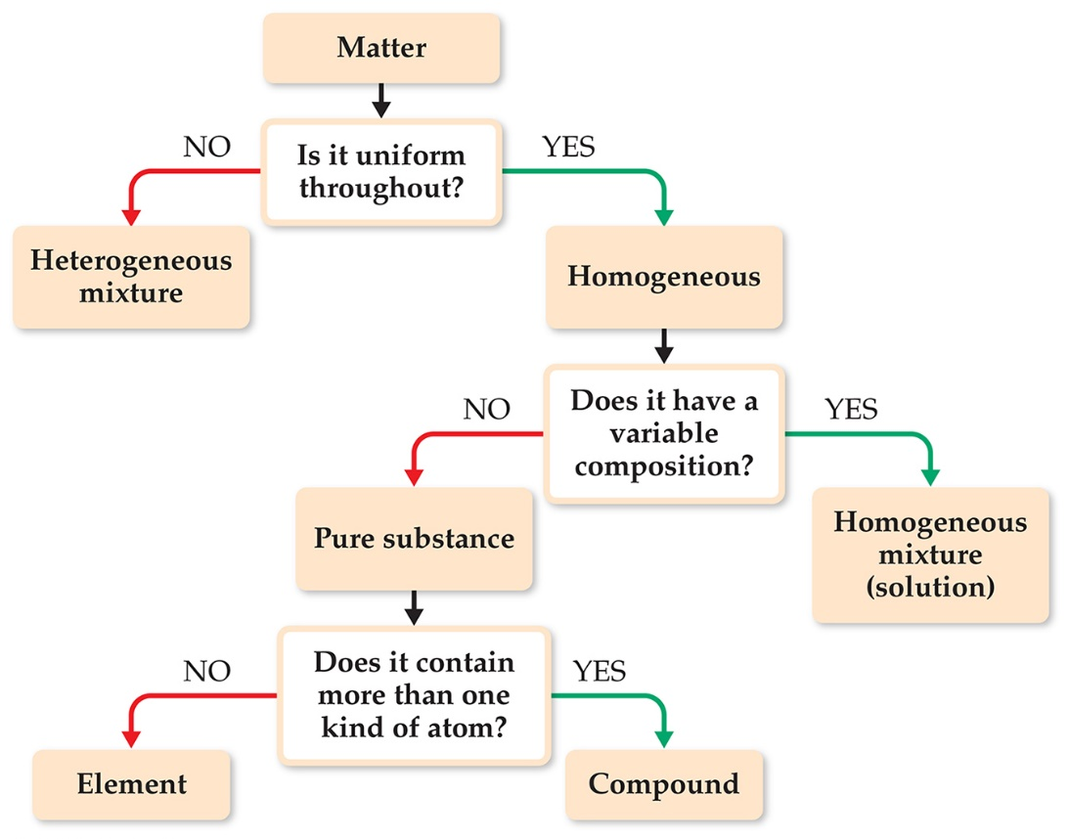
Classification of Matter Based on Composition
With this scheme, you can determine how to classify any type of matter.
Homogeneous mixture
Heterogeneous mixture
Element
Compound

Slide 6
Classification of Matter by Composition
matter whose composition does not change from one sample to another is called a pure substance
made of a single type of atom or molecule
because composition is always the same, all samples have the same characteristics
matter whose composition may vary from one sample to another is called a mixture
two or more types of atoms or molecules combined in variable proportions
because composition varies, samples have the different characteristics

Slide 7
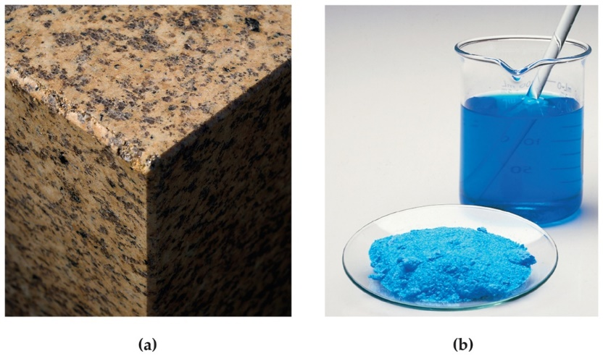
Classification of Matter—Mixtures
Mixtures exhibit the properties of the substances that make them.
Mixtures can vary in composition throughout a sample (heterogeneous; atoms or molecules not mixed uniformly) or can have the same composition throughout the sample (homogeneous; atoms or molecules mixed uniformly).
A homogeneous mixture is also called a solution.
If you take an aliquot of the solution shown to the left; each aliquot studied would yield the same analysis.

Slide 8
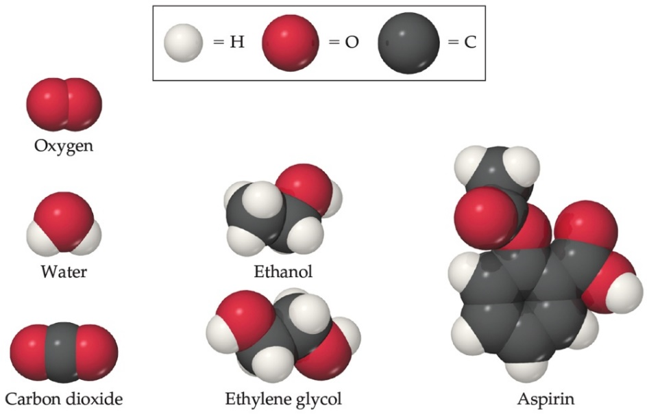
Classification of Matter Based on Composition A substance has distinct properties and a composition that does not vary from sample to sample.
Atoms are the building blocks of matter.
Each element is made of a unique kind of atom, but can be made of more than one atom of that kind.
A compound is made of atoms from two or more different elements.
Note: Balls of different colors are used to represent atoms of different elements. Attached balls represent connections between atoms that are seen in nature. These groups of atoms are called molecules.

Slide 9
ELEMENTS to MEMORIZE
Aluminum Al Manganese Mn
Antimony Sb Mercury Hg
Argon Ar Neon Ne
Arsenic As Nickel Ni
Barium Ba Nitrogen N
Beryllium Be Oxygen O
Boron B
Bromine Br Phosphorus P
Calcium Ca Platinum Pt
Carbon C Plutonium Pu
Cesium Cs Potassium K
Chlorine Cl Radium Ra
Chromium Cr Radon Rn
Cobalt Co
Copper Cu Selenium Se
Fluorine F Silicon Si
Gallium Ga Silver Ag
Germanium Ge Sodium Na
Gold Au Strontium Sr
Helium He Sulfur S
Hydrogen H Tin Sn
Iodine I Titanium Ti
Iron Fe Tungsten W
Krypton Kr Uranium U
Lead Pb Xenon Xe
Lithium Li Zinc Zn
Magnesium Mg

Slide 10
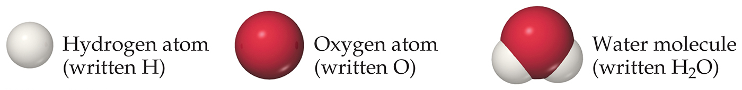
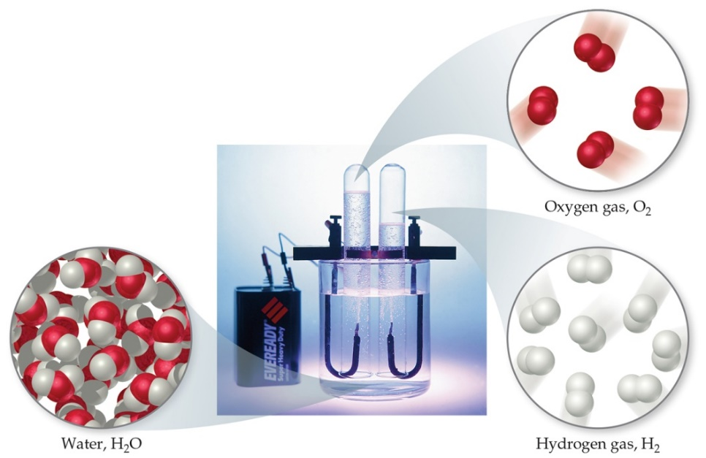
Compounds and Composition
Compounds have a definite composition. That means that the relative number of atoms of each element in the compound is the same in any sample.
This is The Law of Constant Composition (or The Law of Definite Proportions).

Slide 11
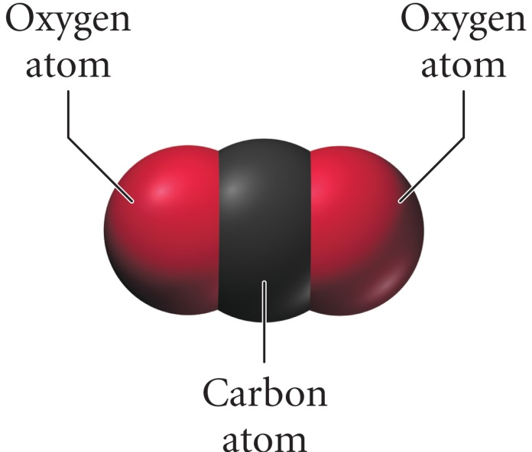
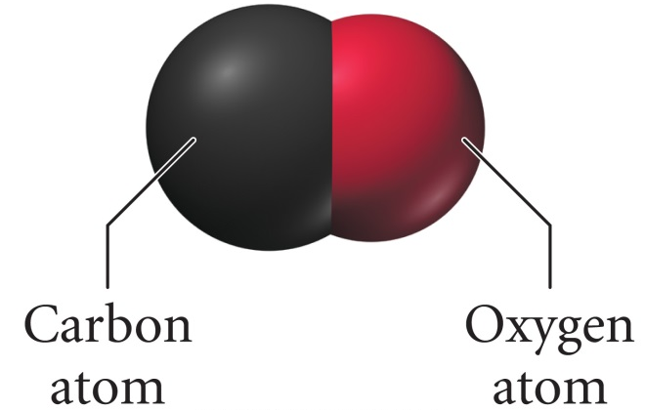
Structure Determines Properties
the properties of matter are determined by the atoms and molecules that compose it
carbon monoxide
carbon dioxide
composed of one carbon atom and one oxygen atom
colorless, odorless gas
burns with a blue flame
binds to hemoglobin
composed of one carbon atom and two oxygen atoms
colorless, odorless gas
incombustible
does not bind to hemoglobin

Slide 12
Types of Properties
Intensive properties are independent of the amount of the substance that is present.
Examples include density, boiling point, or color.
These are important for identifying a substance.
Extensive properties depend upon the amount of the substance present.
Examples include mass, volume, or energy.

Slide 13
Properties of Matter
physical properties are the characteristics of matter that can be changed without changing its composition
characteristics that are directly observable
chemical properties are the characteristics that determine how the composition of matter changes as a result of contact with other matter or the influence of energy
characteristics that describe the behavior of matter

Slide 14
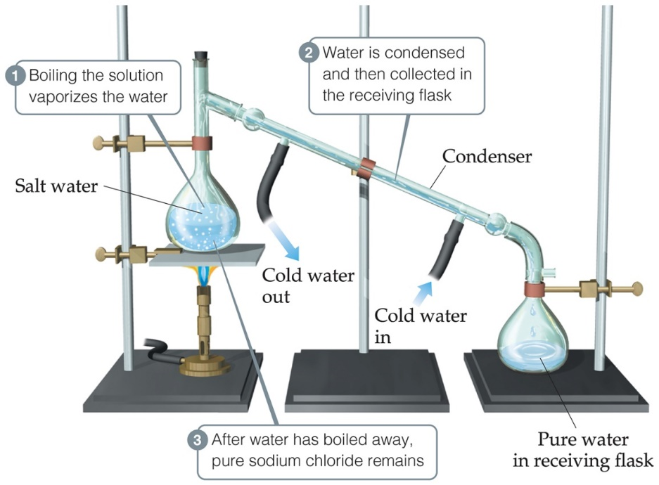
Physical Properties
Physical properties can be observed without changing a substance into another substance.
Some examples include color, odor, density, melting point, boiling point, and hardness.

Slide 15
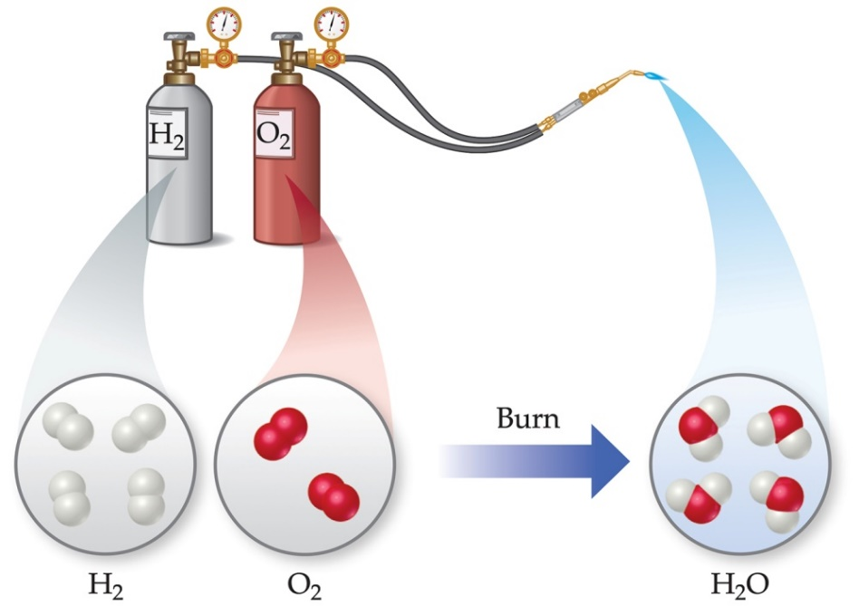
Chemical Properties
Chemical properties can only be observed when a substance is changed into another substance.
One common chemical property is flammability, or the ability to burn in oxygen.

Slide 16
Changes in Matter
changes that alter the state or appearance of the matter without altering the composition are called physical changes
changes that alter the composition of the matter are called chemical changes
during the chemical change, the atoms that are present rearrange into new molecules, but all of the original atoms are still present

Slide 17
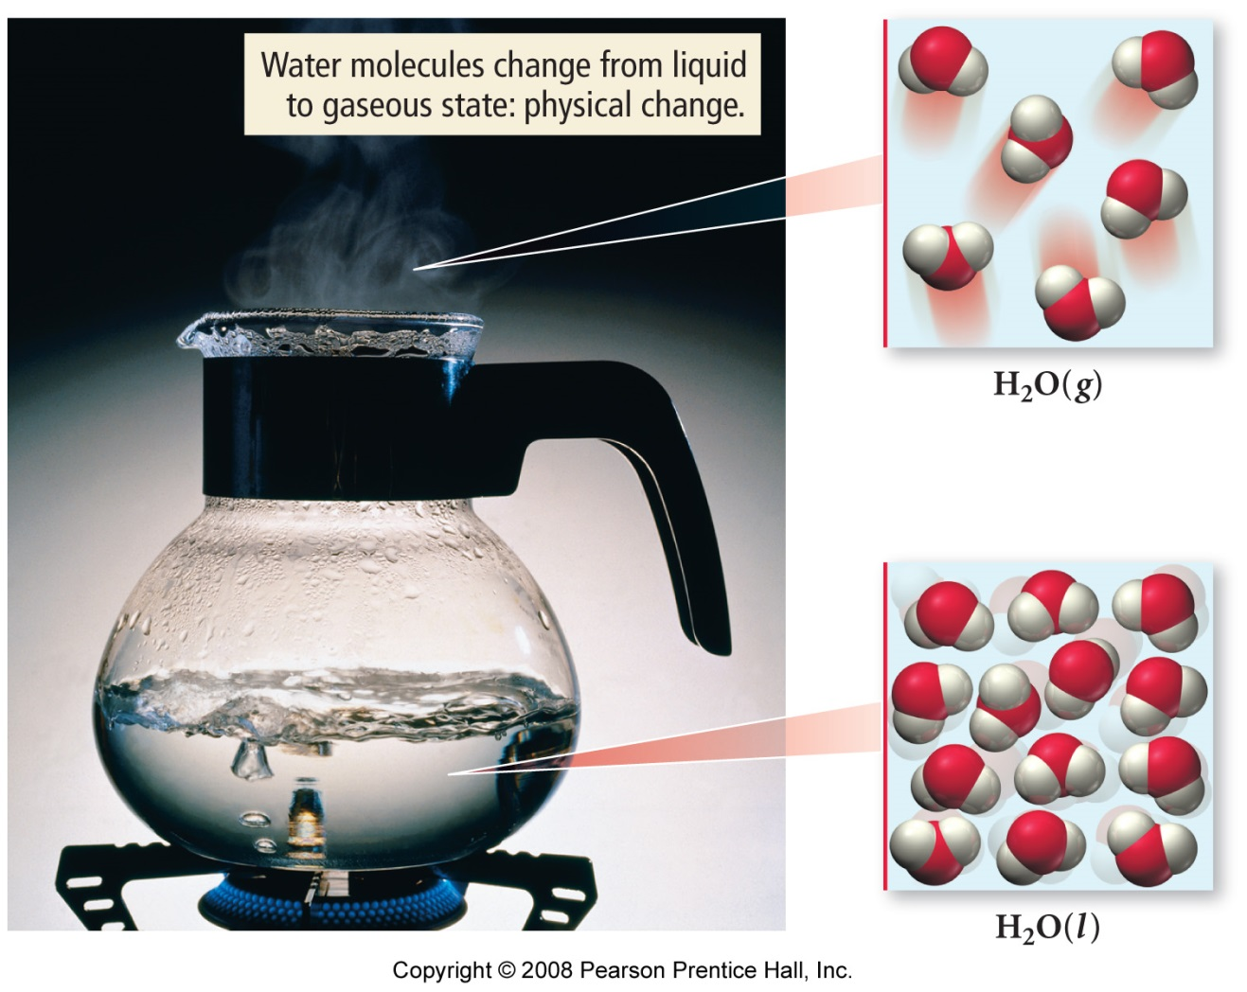
Physical Changes in Matter
The boiling of water is a physical change. The water molecules are separated from each other, but their structure and composition do not change.
H₂O (l) → H₂O (g)

Slide 18
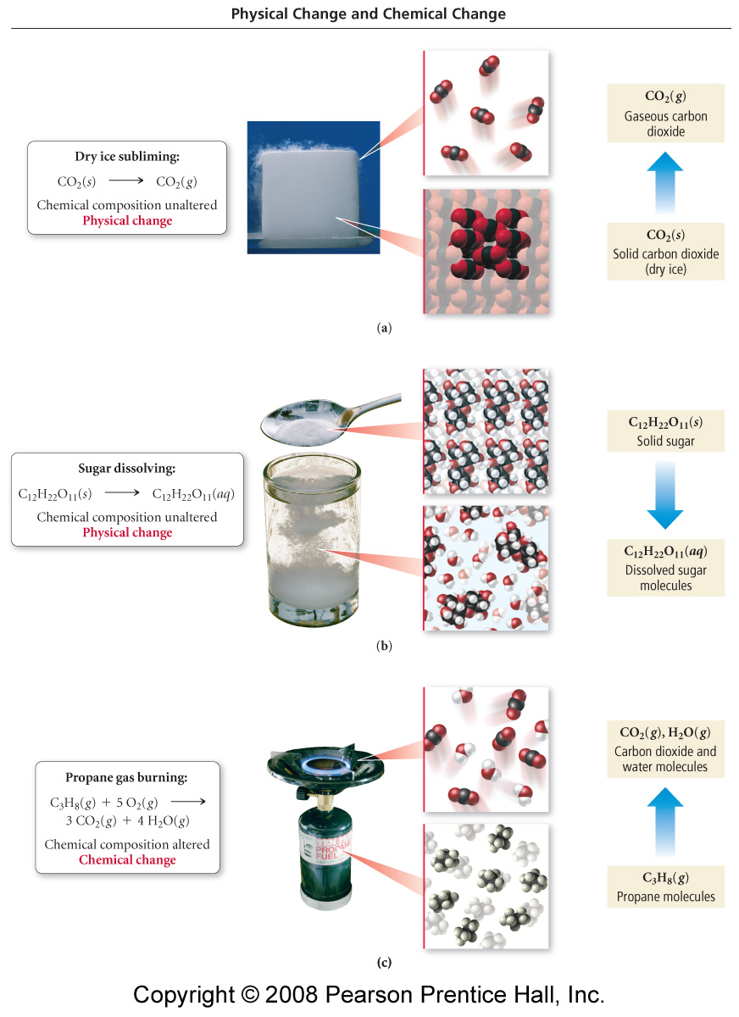
Common Physical Changes
processes that cause changes in the matter that do not change its composition
state changes
boiling / condensing
melting / freezing
subliming
Dissolving of Sugar
C₁₂H₂₂O₁₁(s)
dissolving
C₁₂H₂₂O₁₁(aq)

Slide 19
Common Physical Changes
processes that cause changes in the matter that do not change its composition
state changes
boiling / condensing
melting / freezing
subliming
Subliming of Dry Ice
CO₂(g)
Dry Ice
CO₂(s)
dissolving

Slide 20
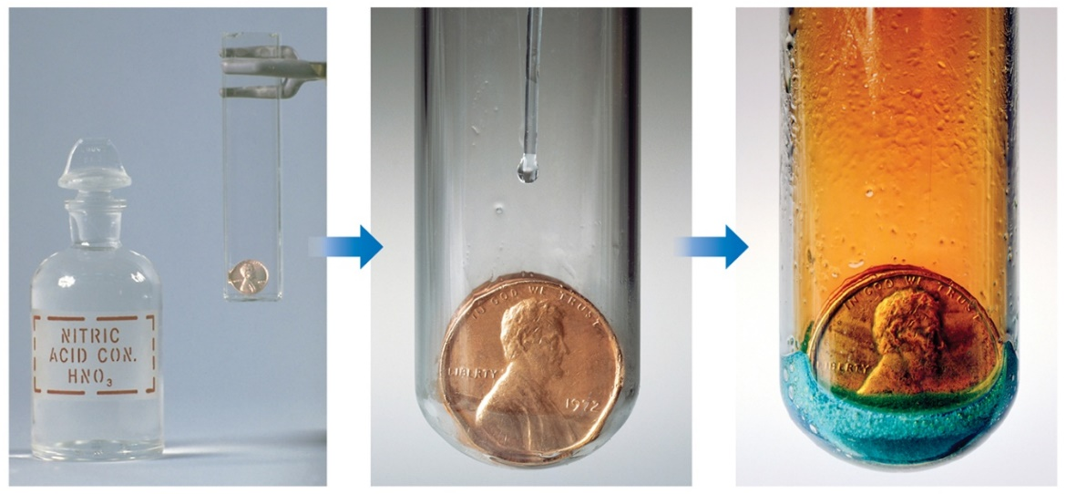
Chemical Reactions (Chemical Change)
In the course of a chemical reaction, the reacting substances are converted to new substances. Here, the copper penny reacts with nitric acid; it gives a blue solution of copper(II) nitrate and a brown gas called nitrogen dioxide (unbalanced equation below).
Cu(s) + HNO₃(aq) → Cu(NO₃)₂(aq) + NO₂(g) + H₂O(l)
Note: Physical properties, like color, often helps us “See” that chemical change has occurred.

Slide 21
Common Chemical Changes
processes that cause changes in the matter that change its composition
rusting
processes that release lots of energy
burning
C₃H₈(g) + 5 O₂(g) → 3 CO₂(g) + 4 H₂O(l)

Slide 22
Separating Mixtures
Mixtures can be separated based on physical properties of the components of the mixture. Some methods used are
Filtration - Evaporation
Distillation - Centrifugation
Chromatography - Decanting

Slide 23
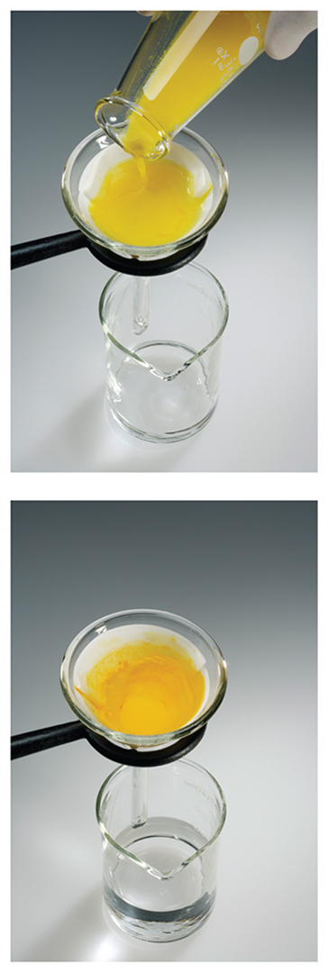
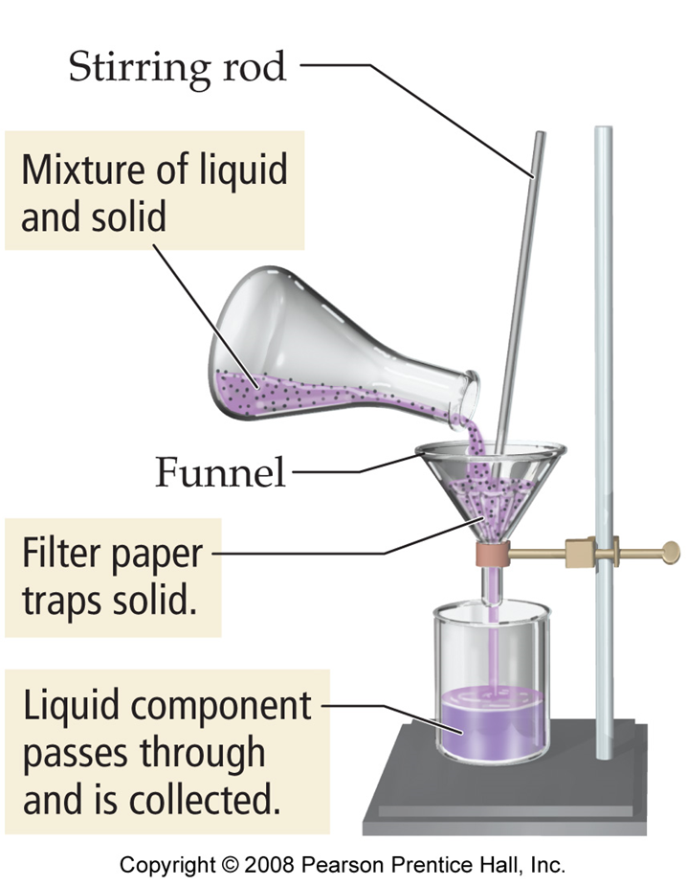
Filtration
In filtration, solid substances are separated from liquids and solutions.

Slide 24

Distillation
Distillation uses differences in the boiling points of substances to separate a homogeneous mixture into its components.

Slide 25
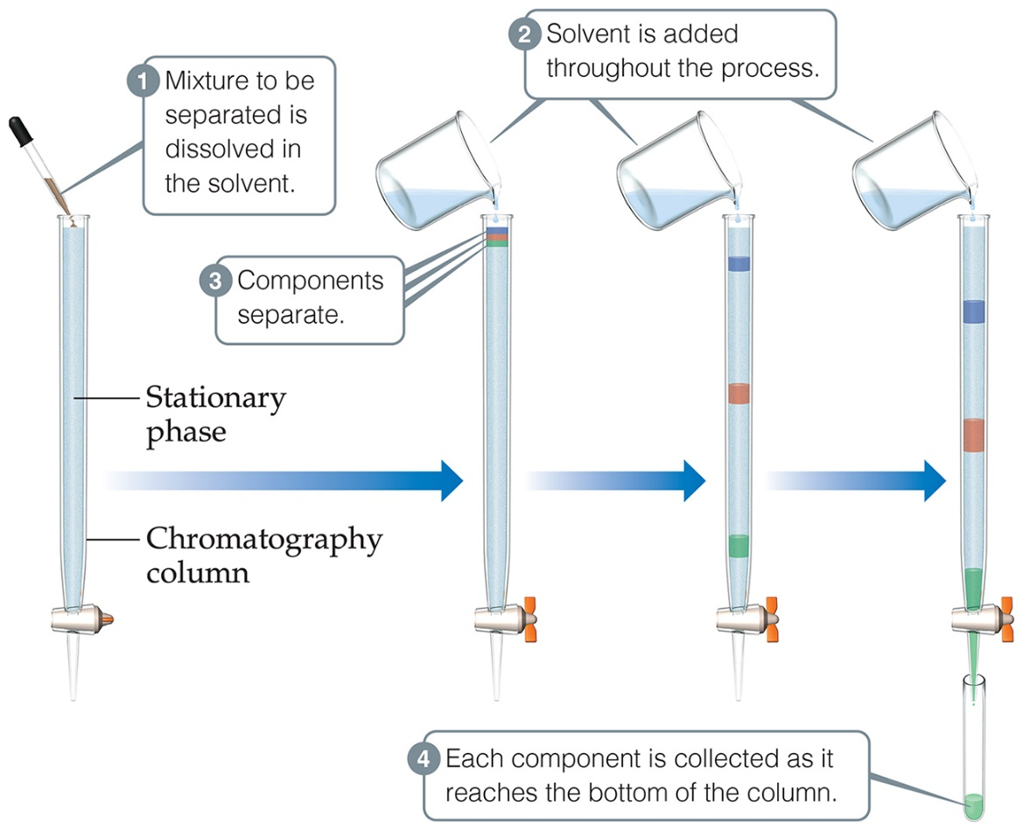
Chromatography
This technique separates substances on the basis of differences in the ability of substances to adhere to the solid surface, in this case, dyes to paper.

Slide 26
Classifying Matter by Physical State
matter can be classified as solid, liquid, or gas based on the characteristics it exhibits
Fixed = keeps shape when placed in a container
Indefinite = takes the shape of the container

Slide 27
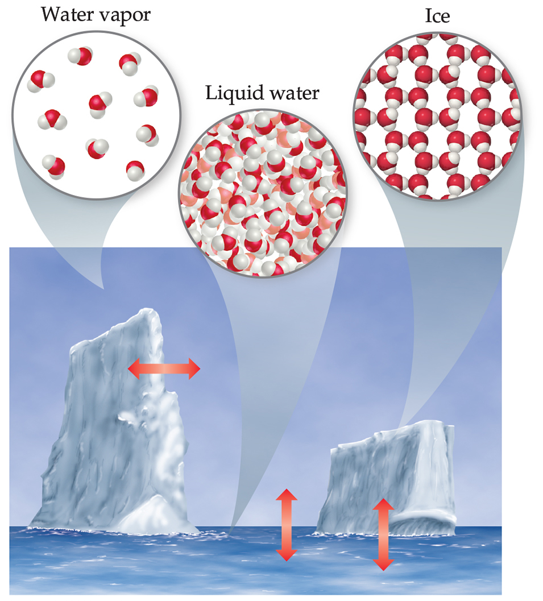
States of Matter
The three states of matter are
solid.
liquid.
gas.
In this figure, those states are ice, liquid water, and water vapor.

Slide 28
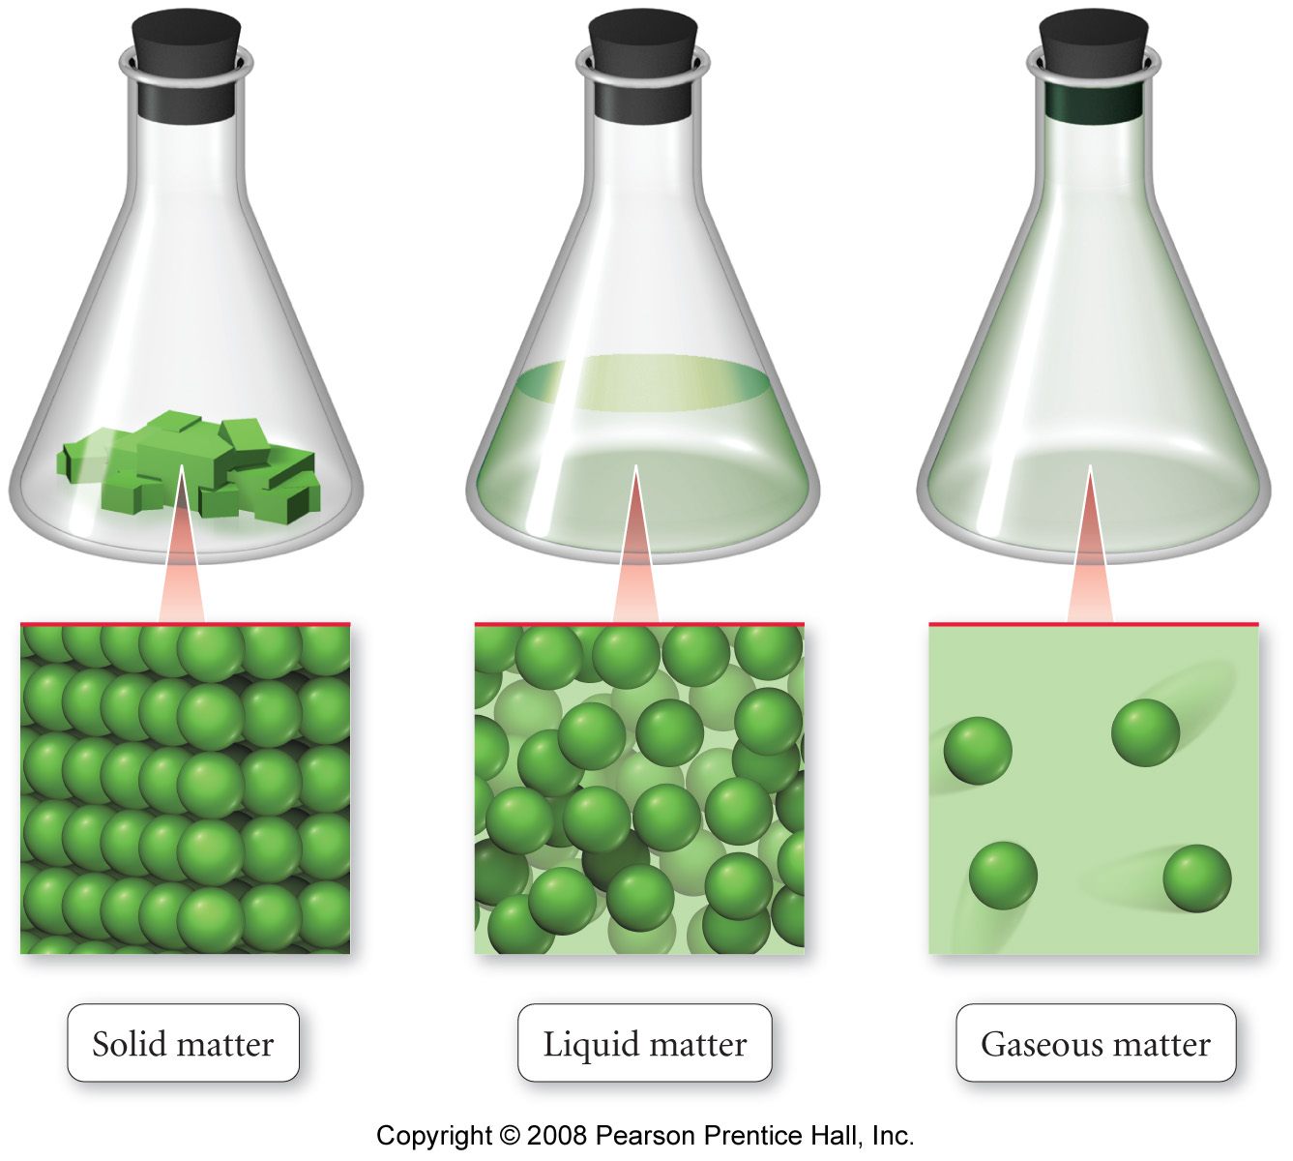
Solids
the particles in a solid are packed close together and are fixed in position
though they may vibrate
the close packing of the particles results in solids being incompressible
the inability of the particles to move around results in solids retaining their shape and volume when placed in a new container, and prevents the particles from flowing

Slide 29
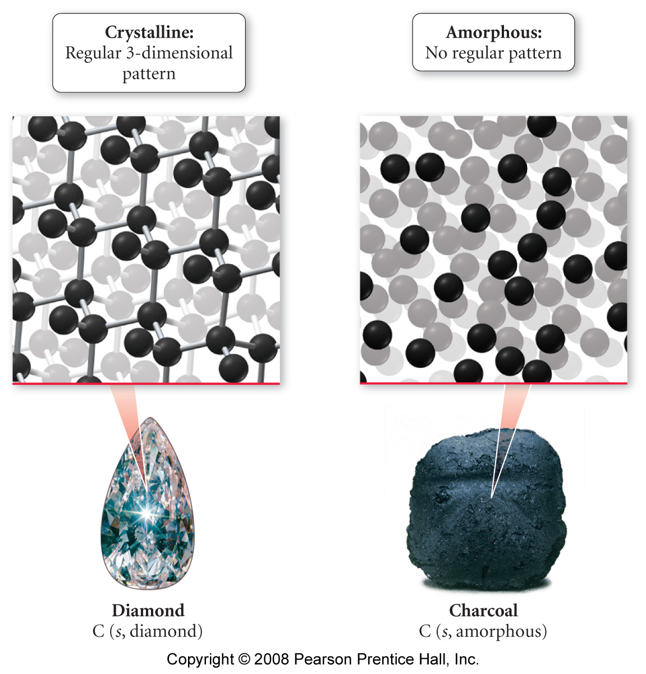
Crystalline Solids
some solids have their particles arranged in an orderly geometric pattern – we call these crystalline solids
salt and diamonds

Slide 30
Amorphous Solids
some solids have their particles randomly distributed without any long-range pattern – we call these amorphous solids
plastic
glass
charcoal

Slide 31
Liquids
the particles in a liquid are closely packed, but they have some ability to move around
the close packing results in liquids being incompressible
but the ability of the particles to move allows liquids to take the shape of their container and to flow – however, they don’t have enough freedom to escape and expand to fill the container

Slide 32
Gases
in the gas state, the particles have complete freedom from each other
the particles are constantly flying around, bumping into each other and the container
in the gas state, there is a lot of empty space between the particles
on average

Slide 33
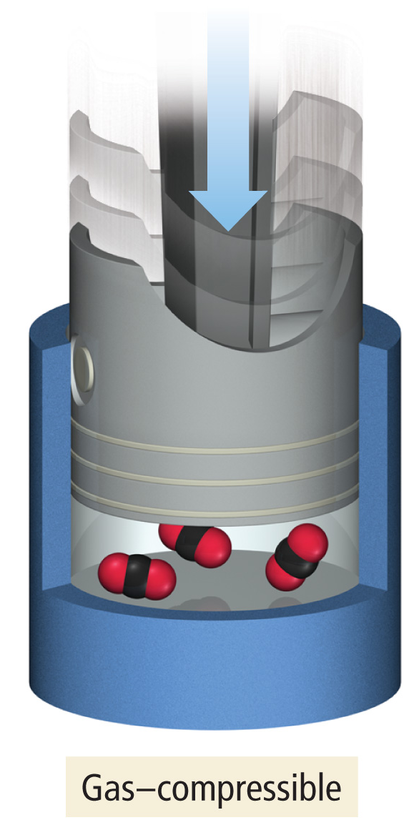
Gases
because there is a lot of empty space, the particles can be squeezed closer together – therefore gases are compressible
because the particles are not held in close contact and are moving freely, gases expand to fill and take the shape of their container, and will flow

Slide 34
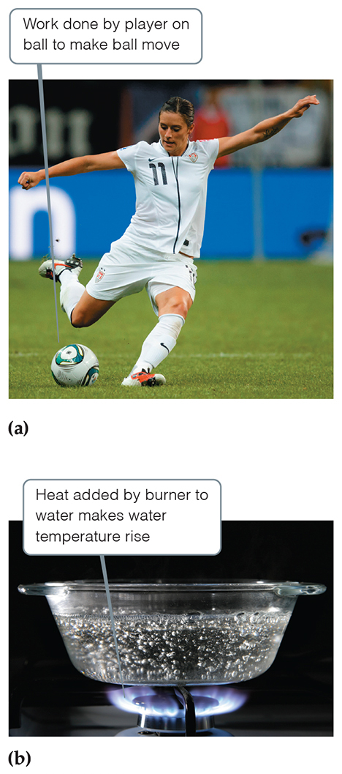
Energy changes in matter, both physical and chemical, result in the matter either gaining or releasing energy
Energy is the capacity to do work or transfer heat.
Work is the energy transferred when a force exerted on an object causes a displacement of that object.
Heat is the energy used to cause the temperature of an object to increase.
Force is any push or pull on an object.

Slide 35
Energy of Matter
all matter possesses energy
energy is classified as either kinetic or potential
energy can be converted from one form to another
when matter undergoes a chemical or physical change, the amount of energy in the matter changes as well
whatever process you do that converts energy from one type or form to another, the total amount of energy remains the same
Law of Conservation of Energy & Matter

Slide 36
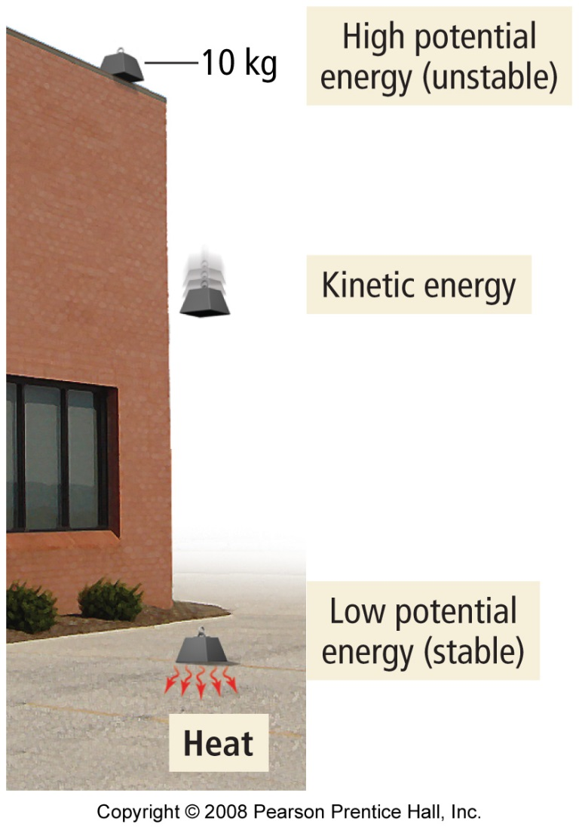
Spontaneous Processes
materials that possess high potential energy are less stable
processes in nature tend to occur on their own when the result is material(s) with lower total potential energy
processes that result in materials with higher total potential energy can occur, but generally will not happen without input of energy from an outside source
when a process results in materials with less potential energy at the end than there was at the beginning, the difference in energy is released into the environment

Slide 37
WORKSHOP - Matter
1. From the thermal decomposition of a pure solid, we obtained a solid and a gas, each of which is a pure substance. From this information, we can conclude with certainty that
a. the original solid is not an element
b. both products are elements
c. at least one of the products is an element
d. the solid is a compound and the gas is an element
2. A solution can be distinguished from a compound by its
a) liquid state
b) heterogeneous nature
c) lack of color
d) variable composition
e) all of the above
3. List the name and symbols for the first 80 elements.
4. Distinguish the chemical properties from the physical properties of copper? Give examples.
5. A clear blue liquid in an open beaker was left in the hood. After 1 week, the beaker contained only blue crystals. The original liquid can be classified as a(n) ______________.
6. Describe the best technique for separating a solid from its liquid. What techniques would you use to separate with liquids?

Slide 38
Standard Units of Measure

Slide 39
MEASUREMENTS Scientific Notation
Many measurements in science involve either very large numbers or very small numbers (#). Scientific notation is one method for communicating these types of numbers with minimal writing.
GENERIC FORMAT: # . # #… x 10#
A negative exponent represents a number less than 1 and a positive exponent represents a number greater than 1.
6.75 x 10⁻³ is the same as 0.00675
6.75 x 10³ is the same as 6750

Slide 40
MEASUREMENTS Scientific Notation Practice
Give the following in scientific notation (or write it out) with the appropriate significant figures.
1. 528900300000 =
2. 0.000000000003400 =
3. 0.23 =
4. 5.678 x 10⁻⁷ =
5. 9.8 x 10⁴ =
5.289003 x 10¹¹
3.400 x 10⁻¹²
2.3 x 10⁻¹
0.0000005678
98000

Slide 41
MEASUREMENTS Significant Figures
I. All nonzero numbers are significant figures.
II. Zero’s follow the rules below.
1. Zero’s between numbers are significant.
30.09 has 4 SF
2. Zero’s that precede are NOT significant.
0.000034 has 2 SF
3. Zero’s at the end of decimals are significant.
0.00900 has 3 SF
4. Zero’s at the end without decimals are either.
4050 has either 4 SF or 3 SF

Slide 42
MEASUREMENTS Significant Figures & Calculations
Significant figures are based on the tools used to make the measurement. An imprecise tool will negate the precision of the other tools used. The following rules are used when measurements are used in calculations.
Adding/subtracting:
The result should be rounded to the same number of decimal places as the measurement with the least decimal places.
Multiplying/dividing:
The result should contain the same number of significant figures as the measurement with the least significant figures.

Slide 43
Multiplication and Division with Significant Figures
when multiplying or dividing measurements with significant figures, the result has the same number of significant figures as the measurement with the fewest number of significant figures
5.02 × 89,665 × 0.10 = 45.0118 = 45
3 sig. figs. 5 sig. figs. 2 sig. figs. 2 sig. figs.
5.892 ÷ 6.10 = 0.96590 = 0.966
4 sig. figs. 3 sig. figs. 3 sig. figs.

Slide 44
Addition and Subtraction with Significant Figures
when adding or subtracting measurements with significant figures, the result has the same number of decimal places as the measurement with the fewest number of decimal places
5.74 + 0.823 + 2.651 = 9.214 = 9.21
2 dec. pl. 3 dec. pl. 3 dec. pl. 2 dec. pl.
4.8 - 3.965 = 0.835 = 0.8
1 dec. pl 3 dec. pl. 1 dec. pl.

Slide 45
MEASUREMENTS Significant Figures & Calculations
2 Answers are Incorrect!!!
Adding & Subtracting
345.678
+ 12.67
0.07283
- 0.0162789
1587
- 120
358.348
0.0565511
1467
358.35
0.05655
If 3 SF: 1470 or 1.47 x 10³
Multiplication & Division
(12.034)(3.98) =
47.89532
47.9 is correct
98.657 ÷ 43 =
2.294348837
2.3 is correct
(13.59)(6.3) =
12
7.13475
7.1 is correct

Slide 46
PRACTICE PROBLEMS
Show your work for the following questions on the back. Always give the correct significant figures.
1. Express each of the following numbers in scientific notation & 3 significant figures.
A) 6545490087 _______ C) 0.0002368 _______
B) 0.000001243 _______ D) 94560 _______
2. 0.00496 - 0.00298 = ________________
3. (3.36-5.6) / (82.98 + 2.4) = ______________________
4. 4.45 x 10⁻ ²³ / 8.345 x 10⁻⁵³ = ________________
5. [(26.7 x 10⁻⁸) (47 x 10¹³)]⁴ / (8.54 x 10¹⁷)^{1/2} = __________

Slide 47
DIMENSIONAL ANALYSIS
Unit Conversions
Common SI Prefixes:
Factor Prefix Abbreviation
10⁶ Mega M
10³ Kilo k
10² Hecto h
10¹ Deka da
10⁻¹ Deci d
10⁻² Centi c
10⁻³ Milli m
10⁻⁶ Micro μ
10⁻⁹ Nano n
10⁻¹² Pico p

Slide 48
Units of Measurements—SI Units
Système International d’Unités (“The International System of Units”)
A different base unit is used for each quantity.
Table 1.3 SI Base Units
Physical Quantity | Name of Unit | Abbreviation
Length | Meter | m
Mass | Kilogram | kg
Temperature | Kelvin | K
Time | Second | s or sec
Amount of substance | Mole | mol
Electric current | Ampere | A or amp
Luminous intensity | Candela | cd

Slide 49
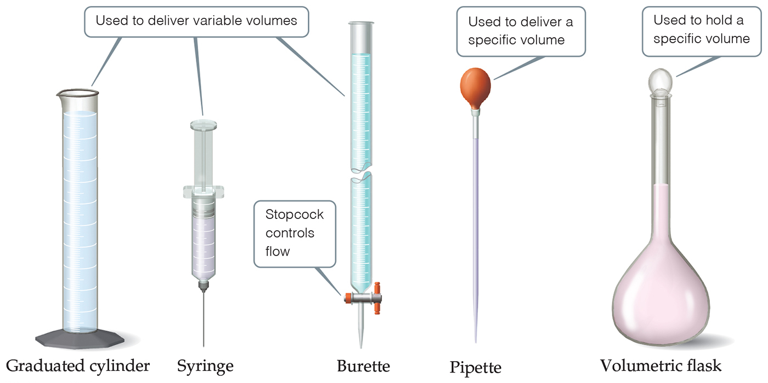
Glassware for Measuring Volume

Slide 50
TEMPERATURE CONVERSIONS
1. Fahrenheit – at standard atmospheric pressure, the melting point of ice is 32 °F, the boiling point of water is 212 °F, and the interval between is divided into 180 equal parts.
2. Celsius – at standard atmospheric pressure, the melting point of ice is 0 °C, the boiling point of water is 100 °C, and the interval between is divided into 100 equal parts.
3. Kelvin – assigns a value of zero to the lowest conceivable temperature; there are NO negative numbers.
T(K) = T(°C) + 273.15
T(°F) = 1.8T(°C) + 32

Slide 51
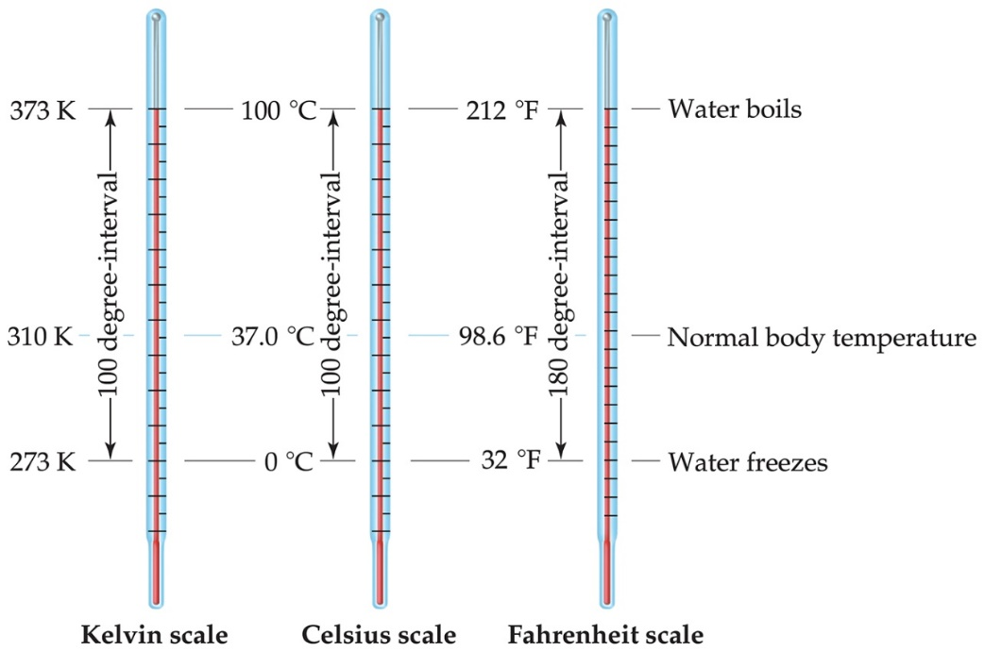
Temperature
In general usage, temperature is considered the “hotness and coldness” of an object that determines the direction of heat flow.
Heat flows spontaneously from an object with a higher temperature to an object with a lower temperature.

Slide 52
Dimensional Analysis
Dimensional Analysis (also call unit analysis) is one method for solving math problems that involve measurements. The basic concept is to use the units associated with the measurement when determining the next step necessary to solve the problem. Always start with the given measurement then immediately follow the measurement with a set of parentheses.
Keep in mind, try to ask yourself the following questions in order to help yourself determine what to do next.
1. Do I want that unit?
If not, get rid of it by dividing by it if the unit is in the numerator, (if the unit is in the denominator, then multiply).
2. What do I want?
Place the unit of interest in the opposite position in the parentheses.
Numerator
Denominator

Slide 53
MEASUREMENTS LECTURE - METRIC
1. How many meters are equal to 75.99 km?
2. How many cubic centimeters are there in 2 cubic meter?
3. How many nm are there in 200. cm? Express your answer in scientific notation.
4. How many μg are there in 0.5 kg?

Slide 54
MEASUREMENTS PRACTICE - METRIC
1. The mass of a young student is found to be 67 kg. How many grams does this mass correspond to?
2. How many liters is equivalent to 38.0 cubic meters?
67 kg (1000g / 1 kg) = 67000 g or 6.7 x 10⁴ g
38.0 m³ (100 cm / 1 m)³ (1 mL/1 cm³) (1 L/1000 mL) = 3.80 x 10⁴ L

Slide 55
MEASUREMENTS
Since two different measuring systems exist, a scientist must be able to convert from one system to the other.
CONVERSIONS
Length: 1 in = 2.54 cm 1 mi = 1.61 km
Mass: 1 lb = 454 g 1 kg = 2.2 lb
Volume: 1 qt = 946 mL 1 L = 1.057 qt
4 qt = 1 gal 1 mL = 1 cm³
Temperature: °F = (1.8 °C) + 32
°C = (°F – 32) K = °C + 273.15 1.8

Slide 56
MEASUREMENTS LECTURE - CONVERSIONS
1. The mass of a student is found to be 75 kg. How many pounds does this mass correspond to?
2. An American visited Europe during the summer, and the speedometer in the taxi read 105 km/hr. How fast was the American driving in miles per hour?
(Note: 1 mile = 1.6093 km)
3. In most countries, meat is sold in the market by the kilogram. Suppose the price of a certain cut of beef is 1600 pesos/kg, and the exchange rate is 124 pesos to the U.S. dollar. What is the cost of the meat in dollars per pound (lb)? (Note: 1 kg = 2.20 lb)

Slide 57
PRACTICE PROBLEMS
0.00359 kcal
Convert 15.0 J to kcal
Convert 15.0 mg to pounds
Convert 15.0 ft³ to cL
How many liters of gasoline will be used to drive 725 miles in a car that averages 27.8 miles per gallon?
Diamonds crystallize directly from rock melts rich in magnesium and saturated carbon dioxide gas that has been subjected to high pressures and temperatures exceeding 1677 K. Calculate this temperature in Fahrenheit.
D.J. promised to bake 25 dozen cookies and deliver them to a bake sale. If each cookie weighs 3.5 ounces, how many kilograms will 25 dozen cookies weigh?
3.30 x 10⁻⁵ lb
4.25 x 10⁴ cL
98.7 L
2559 ºF
30. kg

Slide 58
WORKSHOP 1 Measurements
1. The melting point (freezing point) of mercury is -35ºC. What is the melting point temperature, in degrees Fahrenheit? Normal body temperature is 98.6ºF. What is this in Celsius?
2. Which is the shortest distance?
a) 100,000 millimeters b) 1 x 10⁻³ kilometers
c) 100,000,000 micrometers d) 1,000 centimeters
e) 1 x 10⁻⁴ mega meters f) 100 x 10¹⁰ nm
3a. When a weight of 28.53 grams is added to a weight of 1.792 grams, the result should be expressed as: _________________ (sig fig/sci not/units)
3b. When a weight of 28.5345 grams is divided by 1.792 mL, the result should be expressed as: ____________________ (sig fig/sci not/units)
4. How many liters of gasoline will be used to drive 103 km in a car that averages 25.8 miles per gallon?
Calculate the number of weeks in 672 hours.
6. Fluorite, a mineral of calcium, is a compound of the metal with fluoride. Analysis shows that a 0.01215 lb sample of fluorite contains 2840 mg of calcium. Calculate the mass percent of calcium and fluoride in fluorite.

Slide 59
Density

Slide 60
Introduction to Density
Density is the measurement of the mass of an object per unit volume of that object.
d = m / V
Density is usually measured in g/mL or g/cm³ for solids or liquids.
Volume may be measured in the lab using a graduated cylinder or calculated using:
Volume = length x width x height if a box or V = πr²h if a cylinder.
Remember 1 mL = 1 cm³

Slide 61
Volume vs. Mass of Brass
y = 8.38x
160
140
120
100
Mass, g
80
60
40
20
0
0.0
2.0
4.0
6.0
8.0
10.0
12.0
14.0
16.0
18.0
Volume, cm³

Slide 62
DENSITY DETERMINATION
1. Mercury is the only metal that is a liquid at 25 °C. Given that 1.667 mL of mercury has a mass of 22.60 g at 25 °C, calculate its density.
2. Iridium is a metal with the greatest density, 22.65 g/cm³. What is the volume of 192.2 g of Iridium?
3. What volume of acetone has the same mass as 10.0 mL of mercury? Take the densities of acetone and mercury to be 0.792 g/cm³ and 13.56 g/cm³, respectively.
4. Hematite (iron ore) weighing 70.7 g was placed in a flask whose volume was 53.2 mL. The flask was then carefully filled with water and weighed. Hematite and water combined weighed 109.3 g. The density of water is 0.997 g/cm³. What is the density of hematite?

Slide 63
PRACTICE PROBLEMS
A study of gemstones and dimensional analysis:
The basic unit for gemstones is the carat. One carat is equal to 200 milligrams. A well-cut diamond of one carat measures 0.25 inches exactly in diameter. Right click for answers
_____ 1. The Star of India sapphire (Al₂O₃, corundum) weighs 563 carats. What is the weight of the gemstone in milligrams?
_____ 2. The world’s largest uncut diamond (C, an allotrope of carbon) was the Cullinan Diamond. It was discovered 1/25/1905 in Transvaal, South Africa. It weighed 3,106 carats. Calculate this weight in grams.
_____ 3. The Cullinan Diamond was cut into nine major stones and 96 smaller brilliants. The total weight of the cut stones was 1063 carats, only 35% of the original weight! What weight (in kilograms) of the Cullinan Diamond was not turned into gemstones?
_____ 4. Emerald is a variety of green beryl (Be₃Al₂Si₆O₁₈) that is colored by a trace of chromium, which replaces aluminum in the beryl structure. The largest cut emerald was found in Carnaiba, Brazil Aug. 1974. It weighs 86,136 carats. Assuming the diamond carat to size relationship stands for emeralds, calculate the approximate diameter of this stone in meters.
_____ 5. The largest cut diamond, the Star of Africa, is a pear-shaped diamond weighing 530.2 carats. It is 2.12 in long, 4.4 cm wide, and 250 mm thick at its deepest point. What is the minimum volume (in liters) of a box that could be used to hide this diamond.
1.13 x 10⁵ mg
621.2 g
0.3948 kg
0.54696 m
0.59 L

Slide 64
WORKSHOP 1Density
1. For each of the following cases, state whether the density of the object increases (I), decreases (D), or remains the same (R).
a) ________ A sample of chlorine gas is compressed.
b) ________ A lead weight is carried from sea level to the top of a high mountain.
c) ________ A sample of liquid water is frozen.
2. Calculate the density of a box that is 750 mm long by 55 cm wide by 9 in high and weighs 24.33g. Will it sink or float in water? Justify your answer mathematically.
3. Water, with a density of 1.00 g/ml and ethyl alcohol, with a density of 0.789g/ml, are combined to form a mixture which is 50% by weight of each substance. If 56 grams of water are used, how many milliliters of the alcohol must be used?
4. A sample of metallic element X, weighing 3.177 g, combines completely with 0.6015 L of O₂ gas (at ambient temperature and pressure) to form the metal oxide with the formula XO. If the density of O₂ gas is 1.330 g/L, identify X?

Slide 65
Precision and Accuracy

Slide 66
Uncertainty in Measured Numbers
uncertainty comes from limitations of the instruments used for comparison, the experimental design, the experimenter, and nature’s random behavior
to understand how reliable a measurement is we need to understand the limitations of the measurement
accuracy is an indication of how close a measurement comes to the actual value of the quantity
precision is an indication of how reproducible a measurement is

Slide 67
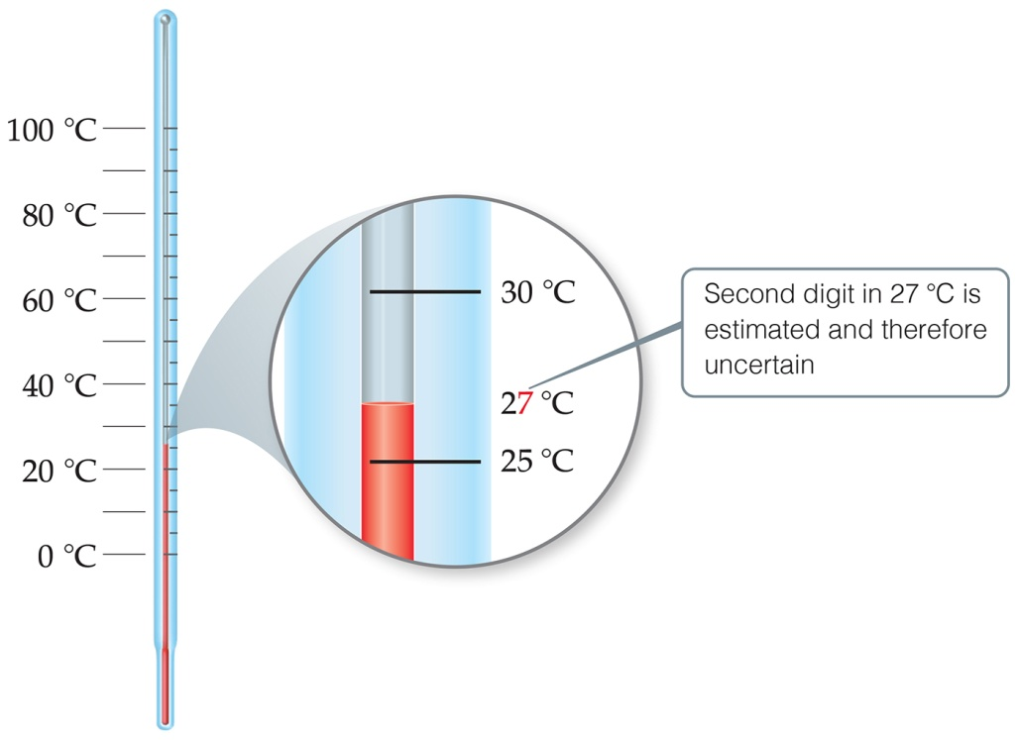
Uncertainty in Measurements
Different measuring devices have different uses and different degrees of accuracy.
All measured numbers have some degree of inaccuracy.
The last digit measured is considered reliable, but Not exact.

Slide 68
Precision
imprecision in measurements is caused by random errors
errors that result from random fluctuations
no specific cause, therefore cannot be corrected
we determine the precision of a set of measurements by evaluating how far they are from the actual value and each other
even though every measurement has some random error, with enough measurements these errors should average out

Slide 69
Accuracy
inaccuracy in measurement caused by systematic errors
errors caused by limitations in the instruments or techniques or experimental design
can be reduced by using more accurate instruments, or better technique or experimental design
we determine the accuracy of a measurement by evaluating how far it is from the actual value
systematic errors do not average out with repeated measurements because they consistently cause the measurement to be either too high or too low

Slide 70
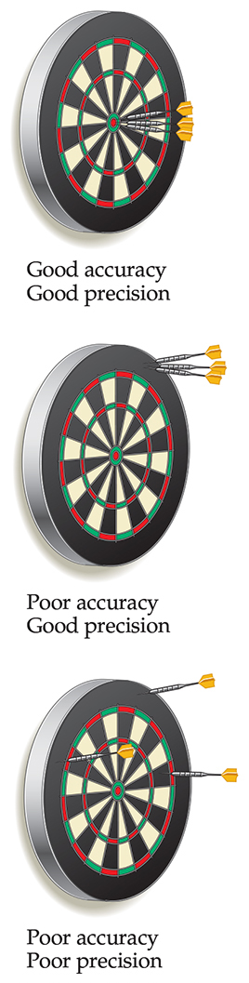
Accuracy versus Precision
Precision is a measure of how closely individual measurements agree with one another.
Accuracy refers to how closely individual measurements agree with the correct, or “true,” value.
Experimentally, we often take several measurements and determine a standard deviation.

Slide 71
PRECISION AND ACCURACY
1. Precision – refers to the degree of reproducibility of a measured quantity.
2. Accuracy – refers to how close a measured value is to the accepted or true value.
Precise (not accurate) Accurate (not precise) Both Precise/Accurate

Slide 72
STANDARD DEVIATION
The standard deviation of a series of measurements which includes at least 6 independent trials may be defined as follows. If we let x_{m} be a measured value, N be the number of measurements, <x> be the average or mean of all the measurements, then d is the deviation of a value from the average:
d = x_{m}-<x>
and the standard deviation, s, is defined by:
where Σd² means “sum of all the values of d².”
The value of the measurement should include some indication of the precision of the measurement. The standard deviation is used for this purpose if a large number of measurements of the same quantity is subject to random errors only. We can understand the meaning of s if we plot on the y-axis the number of times a given value of x_{m} is obtained, against the values, x_{m}, on the x-axis. The “normal distribution curve” is bell-shaped, with the most frequent value being the average value, <x>.

Slide 73
STANDARD DEVIATION
Figure 3: Distribution of Values of a Measurement
Most of the measurements give values near <x>. In fact, 68% of the measurements fall within the standard deviation s of <x> (see graph). 95% of the measured values are found within 2s of <x>. We call the value of 2s the uncertainty of the measurement, u. Then, if we report our value of the measurement as <x>± u, we are saying that <x> is the most probable value and 95% of the measured values fall within this range. The next example shows how the standard deviation can be used to evaluate the data.

Slide 74
STANDARD DEVIATION
Example 1. Weight of a test tube on 10 different balances
or, the test tube weighs between 24.11 and 24.47 g, with 95% certainty.
trial | weight | d =X_{m} - <X> | d²
1 | 24.29 | 0.00 | 0.0000
2 | 24.26 | -0.03 | 0.0009
3 | 24.17 | -0.12 | 0.0144
4 | 24.31 | 0.02 | 0.0004
5 | 24.28 | -0.01 | 0.0001
6 | 24.19 | -0.10 | 0.0100
7 | 24.33 | 0.04 | 0.0016
8 | 24.50 | 0.21 | 0.0441
9 | 24.30 | 0.01 | 0.0001
10 | 24.23 | -0.06 | 0.0036

Slide 75
STANDARD DEVIATION ACTIVITY
Weight of a test tube on 10 different balances
ACTIVITY: If each of the values of x_{m} are checked against the range, note that the weight from balance 8 is outside the range; it should be discarded as unreliable therefore, Using excel, recalculate <x>, d, d² and s. Email your excel file to me.
trial | weight | d =X_{m} - <X> | d²
1 | 24.29 | 0.00 | 0.0000
2 | 24.26 | -0.03 | 0.0009
3 | 24.17 | -0.12 | 0.0144
4 | 24.31 | 0.02 | 0.0004
5 | 24.28 | -0.01 | 0.0001
6 | 24.19 | -0.10 | 0.0100
7 | 24.33 | 0.04 | 0.0016
8 | 24.50 | 0.21 | 0.0441
9 | 24.30 | 0.01 | 0.0001
10 | 24.23 | -0.06 | 0.0036

Slide 76
WORKSHOP 1 precision
1. Bernadette recorded the following data in the lab when determining the percentage of water in an unknown hydrate. What is the percentage water her unknown?
Mass of container: 47.952 g
Mass of container & hydrate: 49.837 g
Mass of container & contents after:
First heating: 49.500 g
Second heating: 48.918 g
Third heating: 48.811 g
2. An instructor gives a sample of powered metal to each of four students (W, X, Y, & Z), and they weigh the samples on different balances. Their results for three trials are as follows. The true value is 8.720 g.
Student Trial 1 Trial 2 Trial 3 Average
W 8.72 g 8.7810 g 8.6 g
X 8.50 g 8.48 g 8.511 g
Y 8.56 g 8.7770 g 8.830 g
Z 8.4100 g 8.720 g 8.550 g
a) Calculate the average mass for each data set with the correct significant figures.
b) Which student was the most accurate in weighing? _______
c) Which student was the most precise? _______
d) Which student had the best combination for accuracy and precision? _______

